Slide 1
Introduction to Face Recognition Project
The goal of this project is to develop a face recognition model using a custom Convolutional Neural Network (CNN) architecture.
Content
Dataset overview
Data manipulation and preprocess
Model architecture
Model training and optimization
Performance
Performance analysis
Future improvements

Slide 2
Dataset Overview and Preparation
The dataset is comprised of images categorized into 'face' and 'non-face' groups. A custom parsing function organizes the data into training and testing sets, ensuring a diverse representation for model training.
Unbalance data
Number of Images Per category
 | Fece | Non-face
Train | 2000 | 4000
Test | 480 | 23300

Slide 3
Data Augmentation Techniques and Up-sampling
To enhance the dataset and improve model robustness, various augmentation techniques are applied. These include random horizontal and vertical flips, random rotation, grayscale conversion, color jittering, and the application of Gaussian blur.
In addition, to address the unbalance between face and non-face up-sampling was applied.

Slide 4
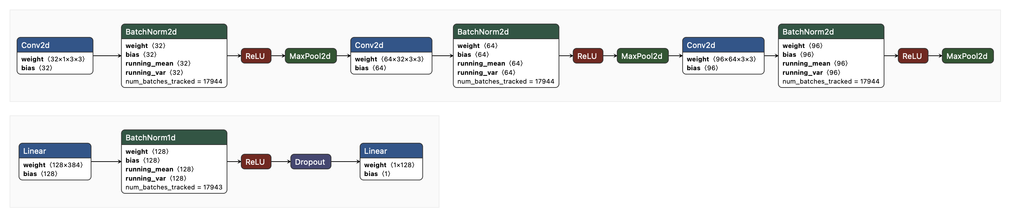
CNN Architecture with Batch Normalization
The model, CNN classifier, features convolutional layers with batch normalization, max pooling, and fully connected layers. Activation functions include ReLU for intermediate layers.

Slide 5
Model Training and Optimization
Model training involves the use of the Adam optimizer with specific learning rate and weight decay settings.
The training process employs batch processing with Data-Loader for efficient data handling,
The BCEWithLogitsLoss function for loss calculation, with weight.

Slide 6
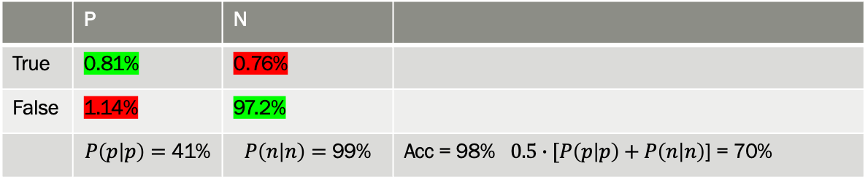
Training and Validation Performance
Throughout the training phases, the model's performance is monitored by tracking the loss and accuracy metrics for both training and validation datasets. This iterative evaluation helps in fine-tuning model parameters for optimal performance.
Naïve attempt yields 98.3% accuracy but since the test data is highly unbalanced, those numbers represent wrong insight.
 | P | N
True | 0.81% | 0.76%
False | 1.14% | 97.2%
 | $$P\left(p | p\right)=\text{41\%}$$ | $$P\left(n | n\right)=\text{99}\text{\%}$$ | Acc = 98% $0.5∙[P\left(p | p\right)+P\left(n | n\right)$] = 70%

Slide 7
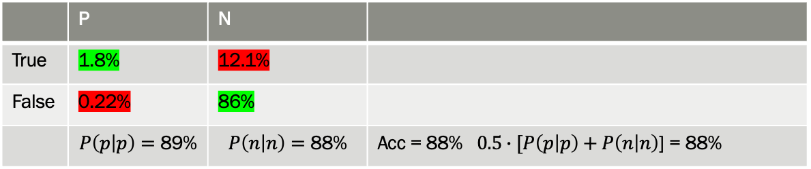
Model Testing and Final Accuracy
Upon completion of training, the model is tested with a separate dataset to evaluate its performance on unseen data. The final accuracy metric provides insight into the model's effectiveness in recognizing faces.
After hyperparameter adjustments such as regularization and up-sampling, the final results are:
 | P | N
True | 1.8% | 12.1%
False | 0.22% | 86%
 | $$P\left(p | p\right)=\text{89}\text{\%}$$ | $$P\left(n | n\right)=\text{88}\text{\%}$$ | Acc = 88% $0.5∙[P\left(p | p\right)+P\left(n | n\right)$] = 88%

Slide 8
Analysis of mis-classifications
False N
Blur
No apparent reason
False P
Face-like shapes

Slide 9
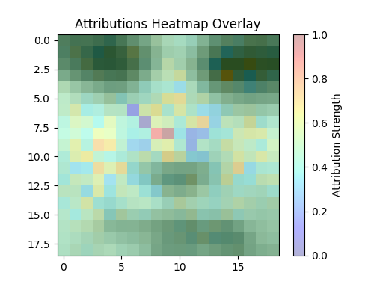
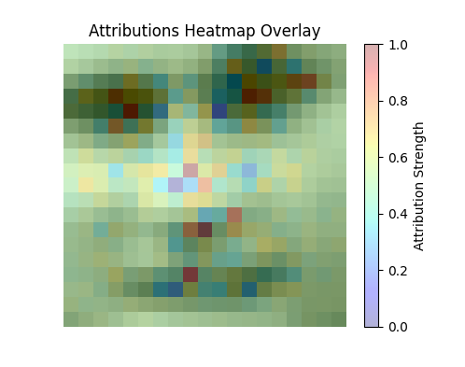
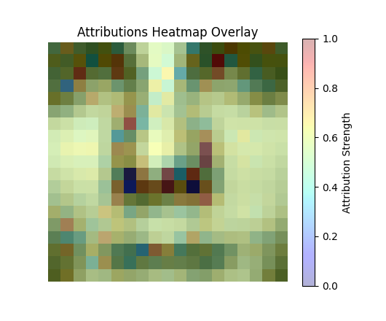
Visualization of the computed features

Slide 10


Challenges Faced and Future Improvements
The project encountered challenges such as handling diverse image data and optimizing the model for better accuracy.
Unbalanced data and a relatively small amount of positive images.
Future improvement can combine two or more models to increase accuracy.
We can take a not-ideal classifier and apply it only if the first model provides negative results
And we can get improvement up to:
P${\left(p | p\right)}^{∗}=P{\left(p | p\right)}_{1}+P{\left(n | p\right)}_{1}∗P{\left(p | p\right)}_{2}$
P${\left(n | n\right)}^{∗}=P{\left(n | n\right)}_{1}∗P{\left(n | n\right)}_{2}$

Slide 11
Conclusion and Directions for Future Work
Future work may explore more complex model architectures and advanced data augmentation techniques for further improvements.
The appropriate need of the model will dictate the balance between FP and TN.
Feature extraction from a pre-trained model can improve the accuracy of the results.

