Slide 1
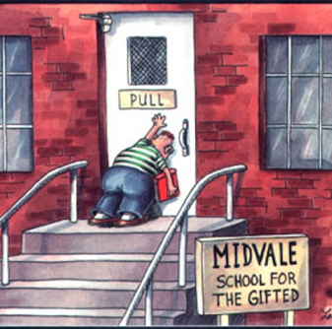
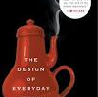
CS3: Mobile Development and Design
User-Centered Design
Melissa Densmore
University of Cape Town

Slide 2
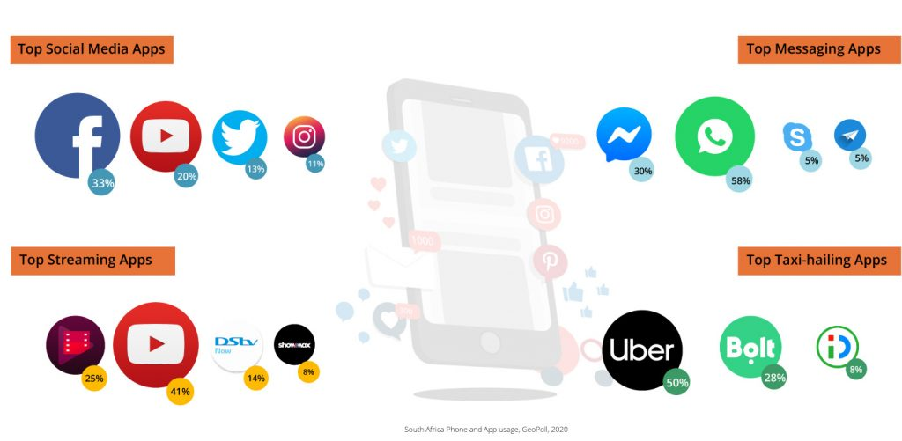
Interaction Design
“The design of spaces for human communication and interaction” (Winograd 1997)
Notes:
Consider all the computing devices you interact with in a day. Even without smartwatches and smartphones, you might interact with headphones, printers, door scanners, payment card scanners, remote controls, coffee machine, and ATMs.
What’s your experience of each of these? Pleasant, potentially invisible or frustrating and unpredictable? Are they usable?
Let’s say you have a smartphone. How many apps do you have? How many do you use? How many have you uninstalled? What makes you choose one app over another? What makes you keep checking social media or playing a particular game?
Interaction design is about understanding the dynamics of how we interact with computing devices, from high level questions around using particular apps, to how people understand specific icons and widgets in the interface, to social dynamics around computing device use.

Slide 3
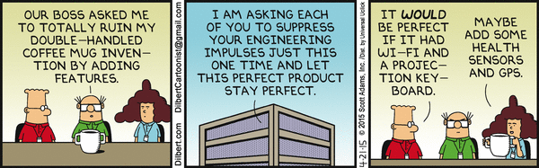
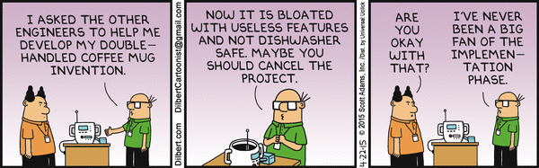
Engineers are Terrible Designers
Notes:
The big problem, however, is that most people that are good at programming tend to have terrible instincts for what users actually want. To get better at this, HCI is interdisciplinary – drawing upon other disciplines – like social science, psychology, to help inform our design principles and approaches.

Slide 4
Goals
High level goals
Key Performance Indicators
Easy to learn
Effective to use
Enjoyable
User retention
More clicks/screen time
More ad views
Persuasion
…
→ making more money!
→ political objectives
Notes:
At a high level – user interaction designers seek to build applications that are learnable, discoverable, effective, and not just usable, but pleasant to use.
At the second order, however, we have lots of different goals, from getting lots of likes and user retention to perhaps social good goals like improving how people use masks or understand their health. Perhaps on the more sinister end, apps and services are designed and manipulated to foster addiction or affect public opinion, as noted in the dramatized documentary “the social dilemma” and fears of foreign governments manipulating elections.

Slide 5
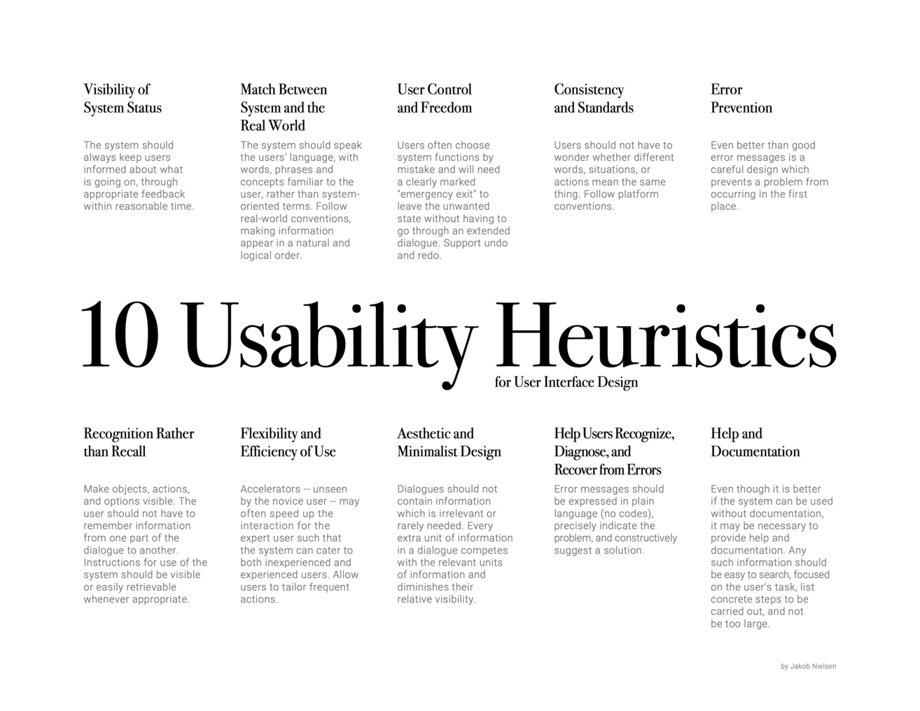
Notes:
So how do we get there? How do we become good designers?
Good designers often follow both written and unwritten design principles – standards and guidelines that help us to predict whether someone will like a particular interface, and will help us to design something people will be able to use. We’ll go over more of these in detail throughout the course.
Poster from
https://uxdesign.cc/the-practicality-of-neilsons-10-91cd4a6fb61c
10 Usability Heuristics by Jakob Nielsen. Layout designed by Jon Daiello.

Slide 6
The Design Cycle
Prototype
Evaluate
Design
User-centred design starts and ends with real users.
observation, surveys, workshops, focus groups, interviews, logs, measurements
Notes:
However, it’s not enough to just follow the principles – every group of users can be quite different, and new interfaces may not have tried-and-true standards for implementation.
Some of the key aspects of good user-centered design overlap with what we’ll cover in advanced software development next semester. Iterative development coupled with customer or user engagement helps us to get to designs that ultimately work better for the actual real users of the systems. It also happens to help us work better together.
The design cycle is core to our approach to doing design in a user-centered way. So while you *might* start with your own intuition and design principles, you continue by engaging with real users and adjusting your designs as you go. You start by evaluating what you know about the users – then based on that, come up with a design. Finally, you actually build something. This then starts the next cycle – an evaluation of what you’ve prototyped, analysis of the findings, resulting in a new design, followed by building the prototype. This continues as long as you have time until everyone is satisfied with the final product.

Slide 7
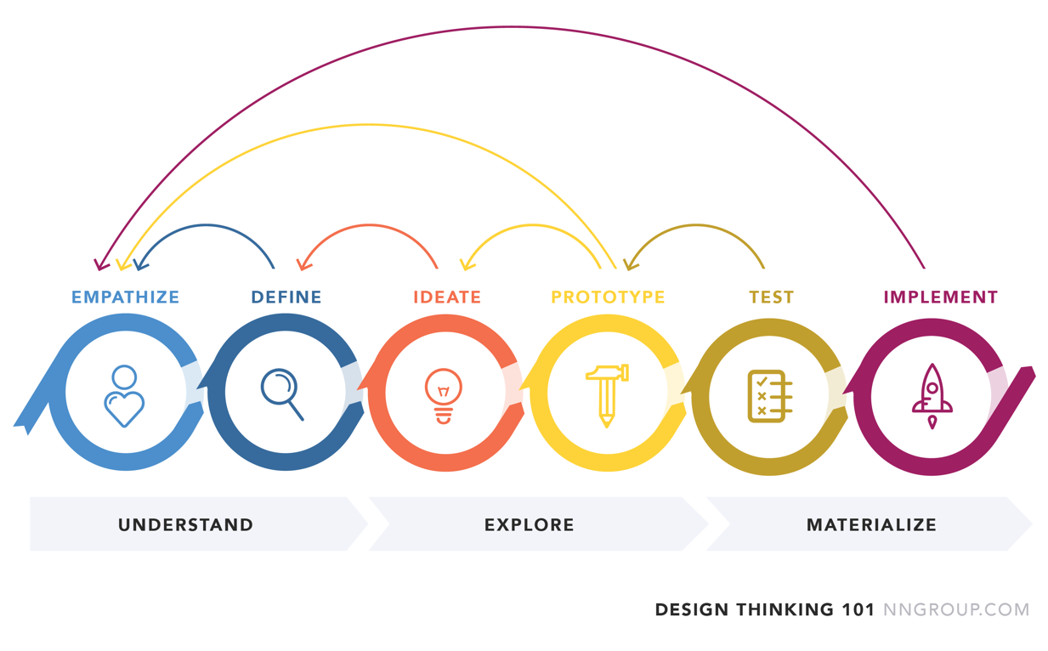
Design Thinking
Notes:
You’ll see some version of the design cycle in most user-centered approaches, including that of the School of Design thinking (at UCT, Stanford and in Potsdam)
Your first assignment is based on a user-centered approach called design thinking, which also takes a cyclical approach. Design thinking is popular in business circles as something that’s easy to learn and implement, and applied both for computing interface design as well as for processes and anything else you can imagine.

Slide 8
Summary
Interaction Design is the design of spaces for human communication and intersection (with computing devices and with one another)
Goals of user-centered design
Easy to learn
Effective to use
Enjoyable
How do we do user-centered design
Following design principles
With real users – the design cycle

