Slide 1
Wentao Zhang
Doctoral degree / institution and country / actual or expected degree date
PhD in Electrical Engineering, Southeast University, Nanjing, China; completed September 2025 (supervisor Prof. Zhongze Wu)
Other degrees (MS, BS, etc.) or relevant experience
M.Eng. (2021) and B.Eng. (2018) in Electrical Engineering, Southeast University, Nanjing, China
Research Assistant, Power Electronics and Machines Centre (PEMC), University of Nottingham, UK, Sep 2025 to present (EPSRC AIMD programme, magnet-free synchronous machines)
PhD-stage technical lead for two high-speed traction-machine prototypes in an industrial programme with Inovance
PhD Dissertation Title: “Multi-physics Analysis and Design of Hairpin Winding PM Traction Machines in Electric Vehicles”
Awards/Honors
2025 1st Prize, IEEE Transactions on Energy Conversion Electric Vehicle Design Competition
2025 2nd Prize Paper Award, IEEE Transactions on Transportation Electrification (for [J5])
2025 MDPI Machines Best PhD Thesis Award
2023 1st Prize, IEEE IAS CMD Thesis Contest; 2023 CIEEC Best Paper Award
Selected Publications or Research Products (Abstracts/patents, etc.)
26 journal papers (20 IEEE Transactions, 11 first-author), 19 conference papers, 9 patents. Selected first-author work:
[J5] Design of n-layer flat wire winding in PM machines for electric vehicles, IEEE Trans. Transport. Electrific., 2025
[J10] High-fidelity lumped-parameter thermal model for oil-cooled hairpin winding PM machines, IEEE Trans. Transport. Electrific., 2026
[J11] Notching and mechanical stress relieving grooves for high-speed PM machines, IEEE Trans. Ind. Appl., early access, 2026
[C1] Deep-learning magnetic field surrogate modelling for IPM machines, ICEM 2026 (accepted)
Potential Notre Dame Mentor(s) and Department
Prof. Nishanth Gadiyar (proposed primary mentor), Department of Electrical Engineering, AMPERE Lab
Desired start date range at Notre Dame
August to October 2027

Slide 2
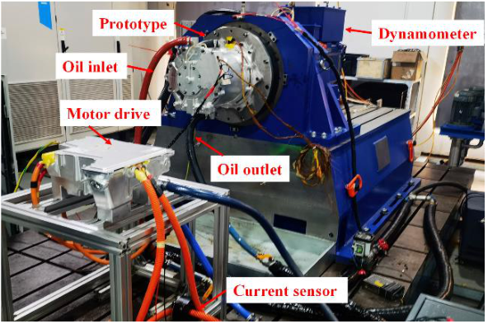
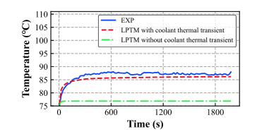
Wentao Zhang Previous research I: multiphysics design and validated hardware
Previous research (include figures and citations as applicable)
Two high-speed oil-cooled PM traction machines taken from specification to dynamometer test in an industrial programme with Inovance (all values measured):
20,000 rpm, 270 kW, 380 Nm, 7.87 kW/kg, 97.4% peak efficiency
18,000 rpm, 113 kW, 138 Nm, 7.78 kW/kg, 95.3% peak efficiency
Models behind the hardware, each checked against test:
Thermal: oil-cooled thermal network validated against thermocouples across the full operating map [J10]; transient thermal model [J12]; thermal-network patent [P4]
Mechanical: rotor stress relieving grooves, confirmed by a 22,500 rpm overspeed test [J11]
Electromagnetic and manufacturing: n-layer flat-wire (hairpin) winding methodology [J5] (2025 IEEE TTE Prize Paper Award, 2nd Prize); PWM excitation effects on loss and temperature [J22]
Research skills / experience
Electromagnetic and structural FE: ANSYS Maxwell 2D/3D, JMAG, FEMM 4.2, ANSYS Mechanical
Thermal networks and Motor-CAD; SolidWorks and AutoCAD drawings with tolerances
Dynamometer, thermal and overspeed testing; C/C++ on TI C2000 and STM32
Highlight your role in project for multidisciplinary work (if applicable)
Technical lead from specification through design, drawing and tolerance release and supplier manufacture to AVL dynamometer test, making electromagnetic, thermal, mechanical and manufacturing decisions in one design loop.
[J11] High-speed flat-wire PM prototype on the dynamometer test rig (oil-cooled)
[J10] Measured (EXP) and thermal-network predicted temperature, oil-cooling Test II (crown section I)

Slide 3
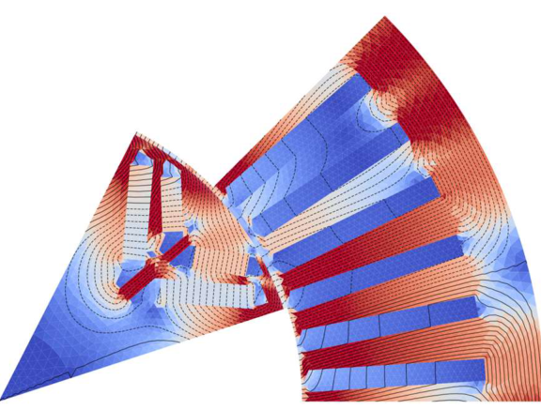
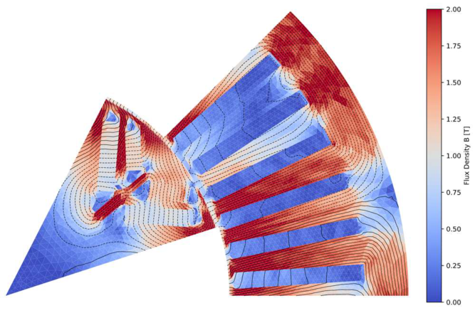
Wentao Zhang Previous research II: physics-informed AI on an in-house FE solver
Previous research (include figures and citations as applicable)
In-house Python FE package (geometry, mesh, electromagnetic, structural-modal and stress solvers), developed at PEMC and used as the reference for learned models
[C1] Physics-informed full-field magnetic surrogate of an IPM machine trained on this solver: R² = 0.9996 (torque) and 0.9730 (iron loss) on unseen designs; more than 94% faster than FEA; 15 design inputs
[J6] Hybrid AI-plus-physics optimisation cut a 67-hour FE optimisation to 2.3 hours; [P3] dual-model database patent
Current project: LLM-agent-assisted design and training of physics-informed surrogates (six months), supported by in-kind API credits from the OpenAI Researcher Access Program
Research skills / experience
Python, PyTorch, MATLAB/Simulink; FE solver development
JMAG, ANSYS Maxwell, Motor-CAD for cross-checking learned models
Dynamometer testing, which supplies measured data to hold models to
Highlight your role in project for multidisciplinary work (if applicable)
First author of [C1] and [J6]; I lead the current LLM-agent project at PEMC. The work joins electrical-machine design and machine learning: I write the FE solver, train the models and check them against FE and, where available, measurement.
[C1] Flux-density field on a design not seen in training
(a) FE analysis (in-house solver)
(b) Deep-learning surrogate with Fourier layer

Slide 4
Wentao Zhang Proposed research
Proposed research (include names of potential Notre Dame mentors)
Physics-consistent learned models for multiphysics design of electric machines beyond rare-earth magnets
FE evaluation of a machine design takes minutes to hours. Learned surrogates are fast, but a small field error can hide a large energy or loss error, and most are tied to one topology.
Aim 1 (months 1 to 8) Physics-consistent field operator: energy-norm and loss-consistent training; calibrated uncertainty so the FE solver is called only where the model is unsure. Milestone: energy-norm and iron-loss errors within a stated band on held-out designs across at least two topology families.
Aim 2 (months 6 to 16) Transfer to new topologies and materials by fine-tuning a frozen checkpoint: rare-earth-lean and magnet-free machines, AMPERE’s additively manufactured SynRel and axial-flux designs. Milestone: transfer with a stated fraction of the FE data a from-scratch model needs.
Aim 3 (months 12 to 24) Coupled loss-thermal prediction: loss maps into the validated thermal network [J10], compared with dynamometer data. Milestone: validated predictions on one AMPERE machine and one Inovance-derived dataset.
Proposed primary mentor: Prof. Nishanth Gadiyar (Electrical Engineering, AMPERE Lab). The work connects to the lab’s AI-Accelerated Design and Integrated Electro-Mechanical Systems thrusts, and its AM SynRel, axial-flux and rare-earth-lean hardware supplies the transfer test cases.
Resources needed for project (if applicable)
GPU compute from the $15,000 allowance; AMPERE Lab machines and test facilities; JMAG alongside the in-house solver.
Include figures and citations as appropriate
Schematic and preliminary results at right; citations [C1], [J10].
In-house FE solver + measurements
fields, losses, temperatures [C1], [J10]
Physics-consistent operator
energy-norm and loss-consistent training, calibrated uncertainty (Aim 1)
Transfer and coupled prediction
new topologies and materials (Aim 2); loss-thermal, checked on hardware (Aim 3)
Preliminary, single-seed results (unpublished)
Coordinate-network / neural-operator model of the vector potential, conditioned on design and rotor position:
• FE energy-norm term: energy-norm error 29.8% → 5.4%
• Rotor-frame coherence term: rotor iron-loss error 50% → 13%
• Transfer to a new magnet grade (remanence 1.165 → 1.42 T) by fine-tuning a frozen checkpoint

Slide 5
Wentao Zhang Teaching, training goals and career plan
Teaching/mentoring/professional service experience
Teaching assistant, Southeast University postgraduate course Integrated Practice of Electrical Machine Systems (2021 to 2025): tutorial preparation and delivery, Q&A and consultation hours, structured written feedback on final-project proposals, mark recommendations to the coordinator
Developed tutorial and assessment materials and two research-derived resources: a coupled electromagnetic-thermal modelling exercise and an embedded motor-drive practical
Day-to-day technical guidance to junior PhD and M.Eng. researchers (FEA, thermal networks, PWM-loss modelling), reflected in jointly authored papers; informal mentoring continues at PEMC
Referee for IEEE Trans. Industry Applications, IEEE Trans. Energy Conversion and IEEE Trans. Transportation Electrification
Co-Organiser, ICEM 2026 Special Session “Next-Generation Electrified Transport: Advances in Electric Drive Systems”, Funchal, Madeira, Portugal (with Dr Lingyun Shao, NUAA)
Goals for postdoctoral training period
Build an independent research programme on physics-consistent learned models with the AMPERE Lab
Formally co-mentor graduate and undergraduate students (my mentoring so far has been informal)
Prepare grant proposals to NSF, DOE and ARPA-E (I have not yet led a funded project)
Take part in the College of Engineering Postdoctoral Training program and its cohort
Build a US research network through Prof. Gadiyar’s WEMPEC, GE Research and Oak Ridge National Laboratory links
Career plans/goals following fellowship
A tenure-track faculty post in electrical machines and physics-informed AI, leading a group that designs, builds and tests machines and holds its learned models to measurement.

