Slide 1

Feature Engineering
Dec 2024 - Materials Science Department
Present by: A. Gharaghani
Some of Slides Related to University of Montreal, and the related Logo is not deleted
Sources :
https://ift6758.github.io/lectures/feature_engineering.pdf
https://towardsdatascience.com/feature-engineering-for-machine-learning-3a5e293a5114

Slide 2
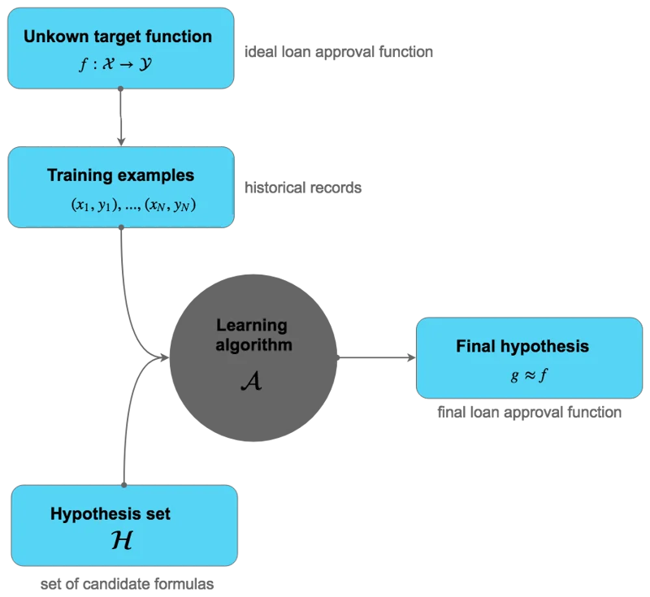
ML Work flow as Review
Good data = Good Model

Slide 3
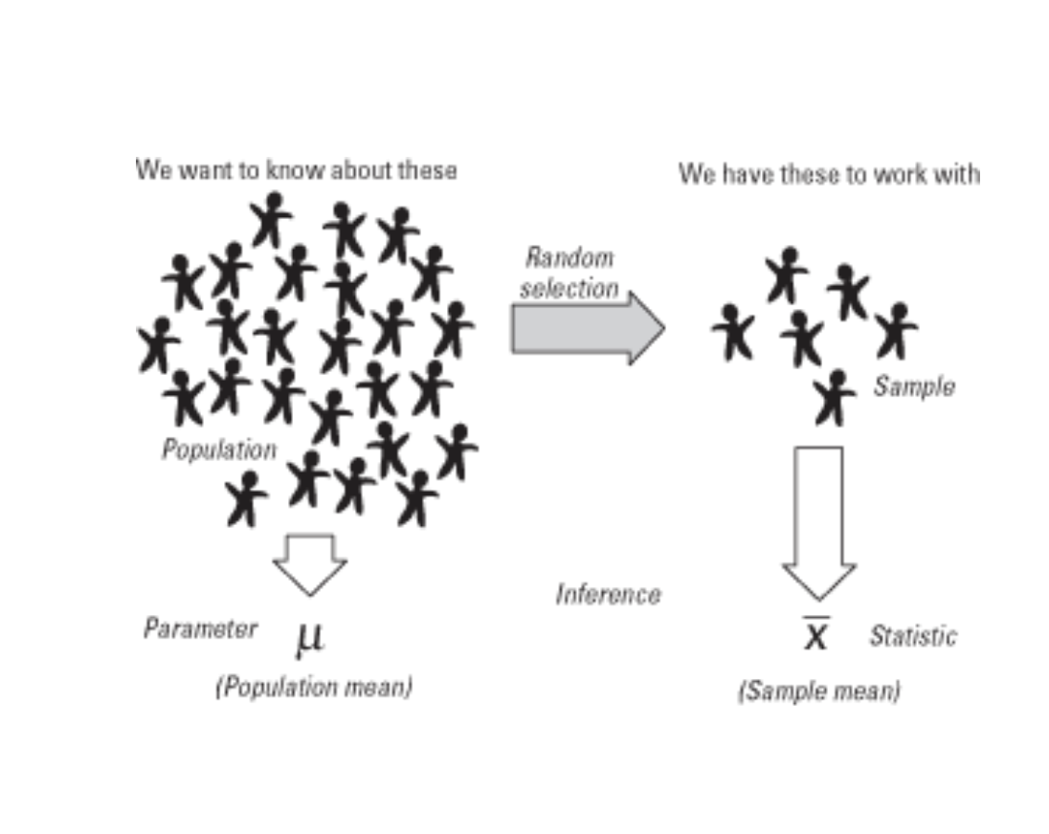
Why need to Feature engineering

Slide 4
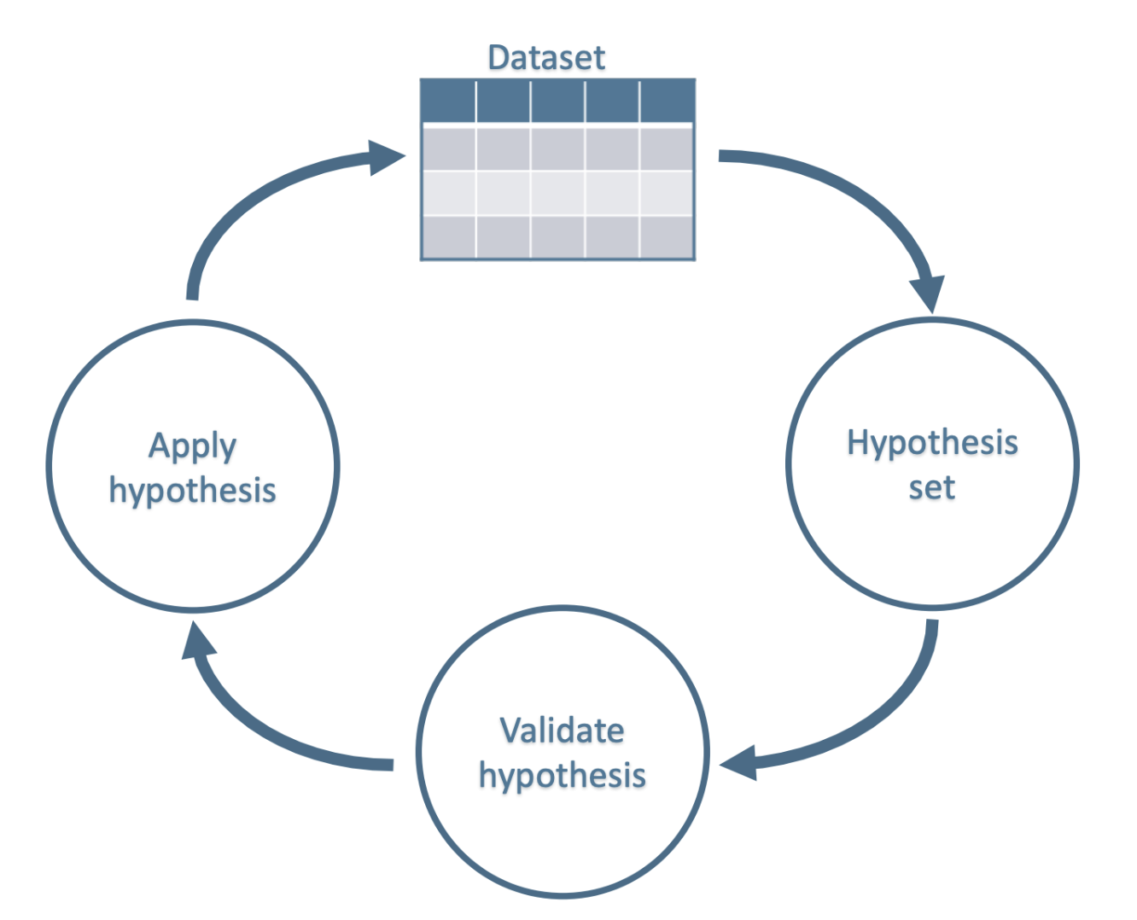
Feature engineering Cycle

Slide 5
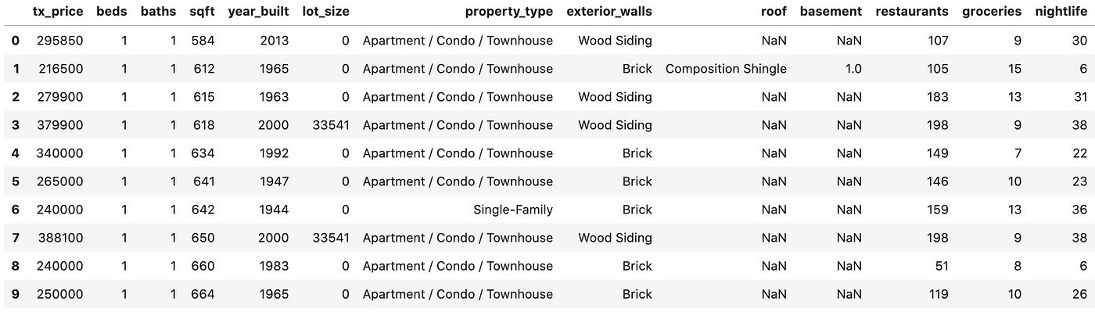
House Price Prediction Sample

Slide 6
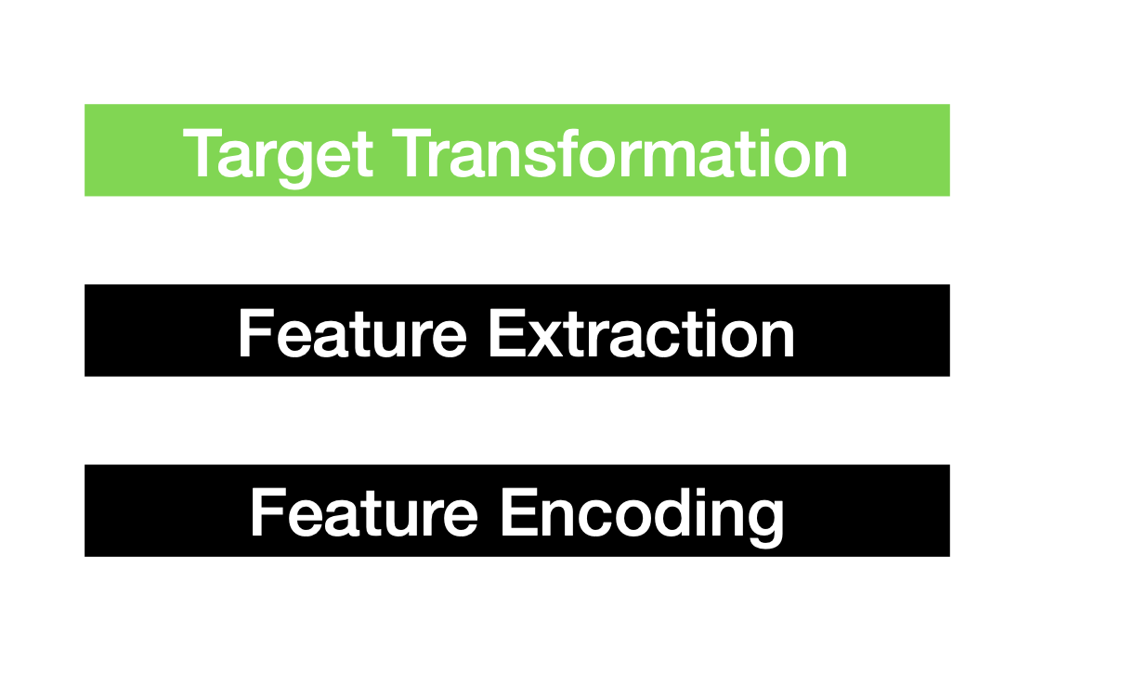
Key Elements of Feature Engineering

Slide 7
Target Transformation
• Predictor/Response Variable Transformation
• Use it when variable shows a skewed distribution make the residuals more
close to “normal distribution” (bell curve)
• Can improve model fit
e.g., log(x), log(x+1), sqrt(x), sqrt(x+1), etc.

Slide 8
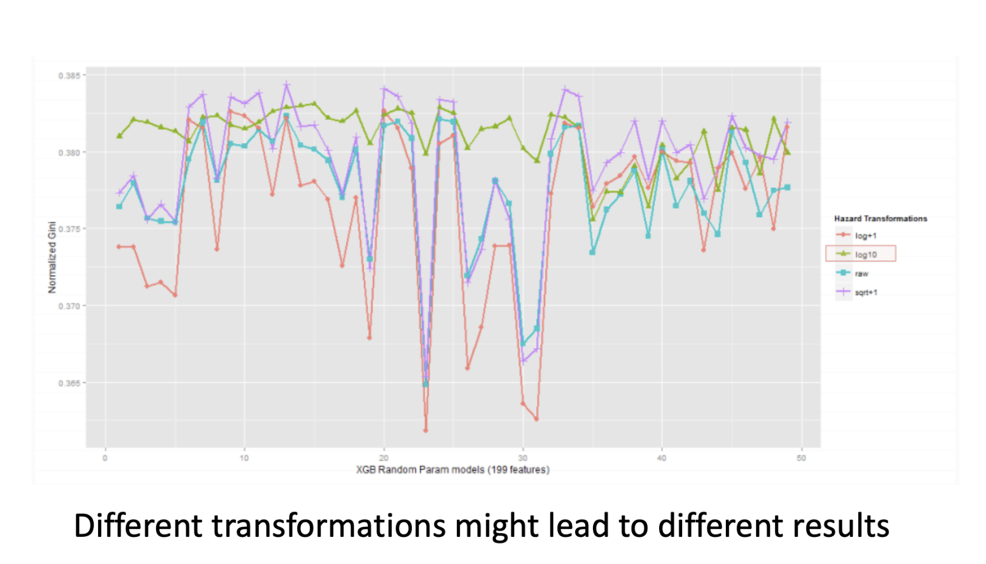
Target Transformation

Slide 9
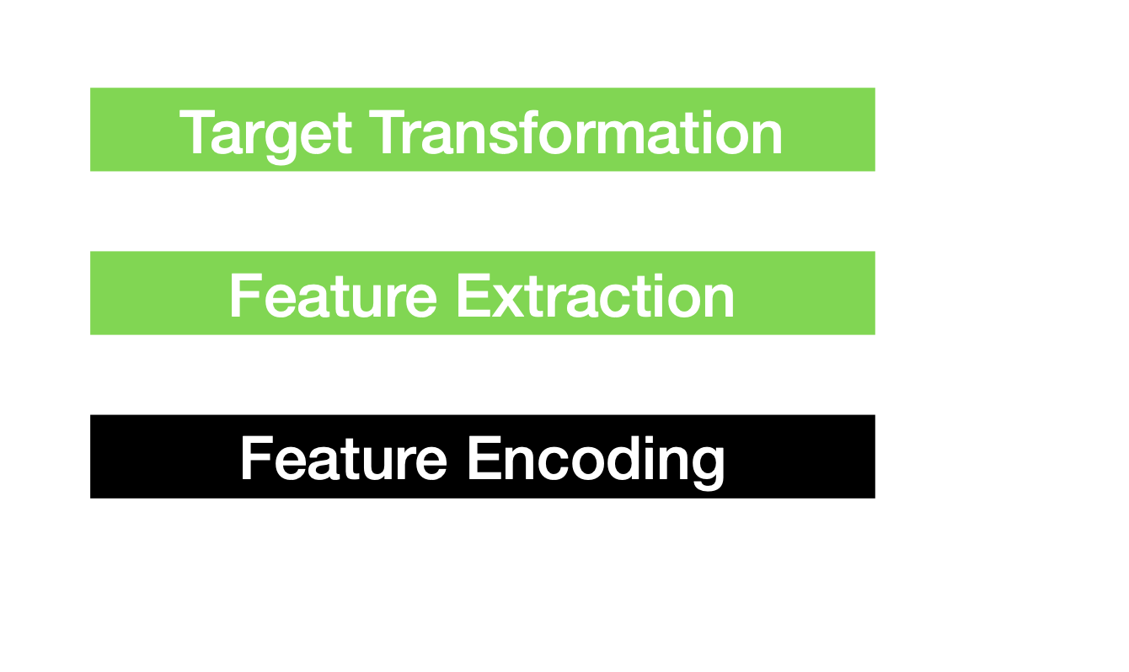
Key Elements of Feature Engineering

Slide 10

Imputation
Common problem in preparing the data: Missing Values
• Why we have missing values?
Human errors
Interruptions in the data flow
Privacy concerns
• What to do?
Simple solution: drop the row/column
Preferable option: Imputation

Slide 11
Imputation
• Numerical Imputation
Assing zero
Assing NA
Default value or medians of the columns (Note that averages are
sensitive to outlier values)
• Categorical Imputation
maximum occurred value
There is not a dominant value, imputing a category like “Other”

Slide 12
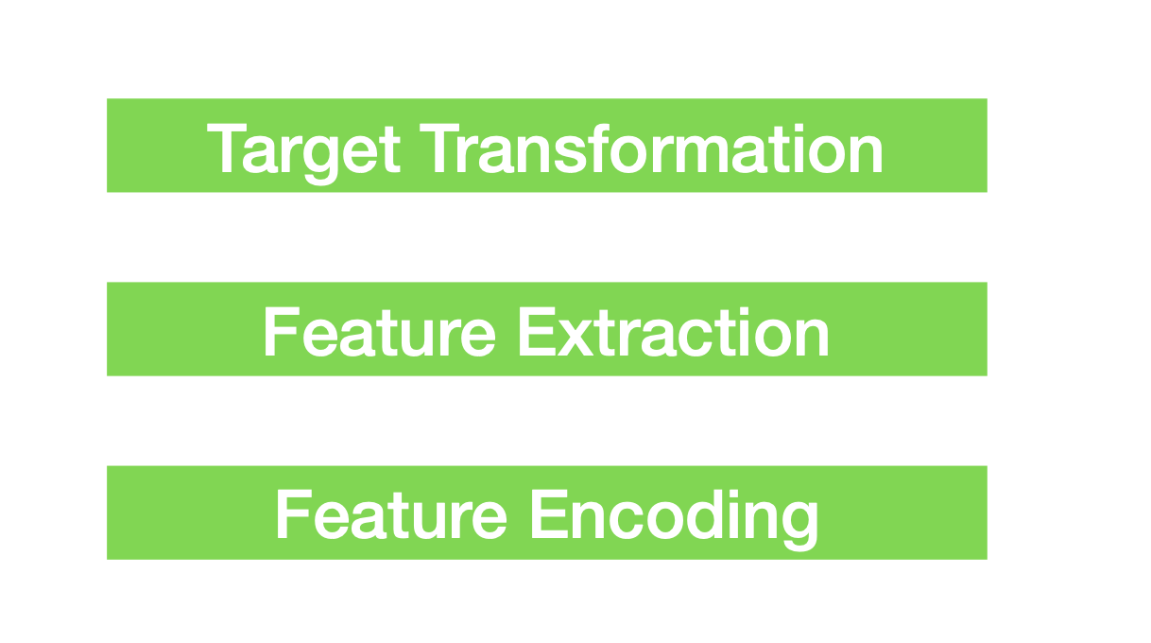
Key Elements of Feature Engineering

Slide 13
Train – Test Data Splitting
Overfitting
Underfitting

