Slide 1
ICE Tea Presentation 5th October 2012
PLCs Security
Author: Filippo Tilaro

Slide 2
Overview
Background
Scope and objectives
Fuzzing
Concepts and Features
Types of Fuzzing
Test-bench Implementation
Fuzzing implementation
DUT monitoring
Vulnerability Reporting System
Reproducibility

Slide 3
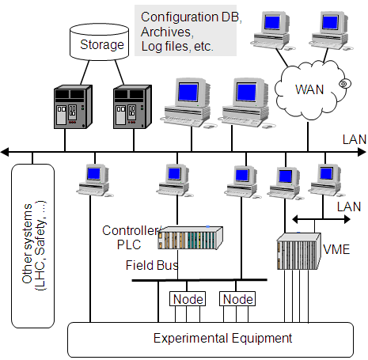

SIEMENS Openlab Security Project
Industrial Control System (ICS) Security
Possible Impacts:
Control process downtimes or failures, catastrophes
All CERN industrial environments: LHC machine, all experiments
Goals and Approach:
Define new security testing techniques
Improve the ICS robustness
Enhancing the previous phase methodologies
Including the Supervision level into analysis
Operation &Supervision: SCADA
Process Control: PLCs
Sensors / Actuators Devices

Slide 4
Scope
Objective
Improve the Process Control System (PCS) security level
More and more discovered vulnerabilities related to PCS
2010: VxWorks and STUXNET
2011: Sunway ForceControl and pNetPower, Beckhoff TwinCAT 'TCATSysSrv.exe' Network DoS, Rockwell RSLogix Overflow, Measuresoft ScadaPro, Cogent DataHub, AzeoTech DAQFactory Stack Overflow, Progea Movicon, ScadaTEC ModbusTagServer and ScadaPhone Remote Buffer Overflow, Scadatec Procyon 'Coreservice.exe' Stack Buffer Overflow, Siemens WinCC Flexible Runtime Heap Overflow, ActiveX in Advantech Broadwin WebAccess, Sunway ForceControl SCADA SHE, Control Microsystems (Schneider Electric) ClearSCADA Remote Authentication Bypass, Inductive Automation Ignition Disclosure, Siemens SIMATIC S7-300 Hardcoded Credentials, Password Protection Vulnerability in Siemens SIMATIC Controllers (S7-200,300,400,1200), Siemens SIMATIC S7-1200 PLC, Honeywell ScanServer ActiveX Control Use-After-Free, DUQU as successor of STUXNET
Result: loss of process control, damage propagation to critical PCSs
Strategy
Design of a test-bench to evaluate the PCSs network robustness
Determine key cyber security aspects relevant to CERN
Notes:
4

Slide 5
Analysis of the security standards
Study and comparison of the ISA-99, NERC-CIP, IEC-62351, ISA-95
Understand the scope and the level of convergence of these different standards
Extract some security patterns and possible specific procedures in order to improve the system security level
Analyze the reliability and effectiveness of these standards’ guidelines

Slide 6
ISA-99 Review
Benefits and Drawbacks of the general approach
Definition of common language
Process Control Systems and IT Systems
Improvements in the authentication process
Importance of the testing phase
Auditing in Process Control Devices
How to apply the risk analysis
Do not use “obscure network protocol”
Integration
A dynamic standard
An incomplete Defense-in-depth strategy
Notes:
The general approach

Slide 7
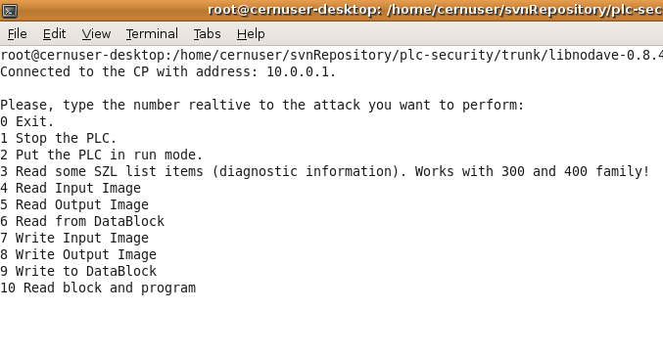
Use of an open-source library: Libnodave
Possible Actions:
Stop
Run
Read not-codified diagnostic information
Read / Write Input Process Image
Read / Write Output Process Image
Read from / Write to Data-Block
Read blocks and programs

Slide 8
Protocol Robustness Testing
IEEE defines robustness “in the degree to which a system or component can function correctly in the presence of invalid inputs or stressful environmental conditions.“
What is a robustness failure?
Failure to return the expected packet
Inability to progress to next protocol state
Dropped connections
Lost or modified data
MORE IMPORTANT: Any unexpected effect in the process control!

Slide 9
Why Fuzzing?
Brute Force Testing:
Simple but inefficient
Input space infinite
Not all the combinations are interesting
Fuzzing & Grammar Testing:
Not random: essential for debugging!
Not exhaustive but we can cover specific “meaningful” sequences
Context free grammar driven
Integration of the security specialists’ knowledge

Slide 10
Fuzzing techniques

Slide 11
What is fuzzing?
A testing technique which generates random or pseudo
random data structures as input of the system under test
You can fuzz:
Network protocols and stack implementations
Software applications, libraries and APIs
System I/O modules
File systems
… anything which takes arguments as input (surface of attack)
How to fuzz:
Black box model and White box model
Generation vs. mutation
Dumb or intelligent fuzzers
Easiness vs. performances and results
Short vs. long development time
Pattern matching, boundary

Slide 12
3 types of fuzzing approach
Manual: iterative approach to run at each iteration a new test sequence
Semi-automatic:
Tiny scripts or programs to run singularly
Related to a specific context/application/protocol
Automatic:
Frameworks for the tests generation
Generic enough to be multi-context/application/protocol
Use of standard and reliable components
Easier to maintain in terms of growing number of tests
Need for a learning curve

Slide 13
Why Peach?
Automatic Framework for the tests generation
Generic enough to be multi-context/application/protocols not like:
SNMP fuzzer, Protocol Independent Fuzzer (PIF)…
Use of standard and reliable software components
Scalable in terms of growing number of tests:
‘xml’ files which can be classified
Make use of a script language:
Entirely written in Python
More dynamic than ‘C’ (Spike, sfuzz…) overall with string and generic datatypes management
More robust than trivial scripts (ethereal’s fuzz)
Need for a learning curve, but really customizable!

Slide 14
Common fuzzing operations
Size field altering:
Invalid or unexpected values
Limit (0x0000,0xFFFF) or negative values (-1, -9999)
Smaller or bigger than the real values (buffer overflows against static arrays)
Large positive or unsigned numbers (playing with the sign bit)
Value field altering:
Invalid or unexpected values
Long or empty strings
Wrong Coding (binary, hex, text)
Marks for starting or ending of a field
Cross mutation and generation of fields:
Relationships among data fields
Checksums, encryption, hash, compression
Exploratory test of the system state machine:
Forcing state changes
Introducing Invalid states

Slide 15
ISCI CRT Testing Phases
5 security testing phases:
Discover Protocol Functionalities and Attack Surface
Storms and Maximum Load Tests
Single Field Injection
Combinatorial Fields Injection
Cross State Fuzzing (for stateful protocols)
Fulfilling the ISCI CRT requirements:
Integration of the CRT test cases into the TRoIE
Notes:
CRT specifications provide requirements for testing the robustness of embedded device implementation of the most common protocols: Ethernet,ARP,ICMP,IP,UDP,TCP… It specifies the malformed single messages or sequence of them which must be generated to validate a device.
We are at the end of this activity but it is not totally finished with an extension for not covered and emerging protocols!

Slide 16
Test-Bench Implementation

Slide 17

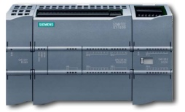


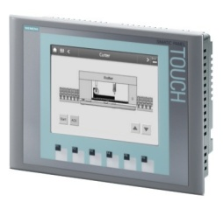








Test-bench diagram
System Testing
Target
Extended Peach Fuzzing
Panel
Partner
Attacker
System Monitoring
Reporting System
Vulnerabilities DB
Configurator
Traffic Analyzer
Signals Monint.
Web front-end

Slide 18
Fuzzing Testing Requirements
A Common Framework:
No standalone scripts
Scalability
Handle and organize the growing amount of tests (almost infinite combinations)
Tests Customization
Protocol header format
Protocol field values
Protocol state machine
Reproducibility
Essential for any debugging activity

Slide 19



Extended Fuzzing Framework
Configuration
Data Model and States sequence
Initialization
Context and State Machine
Components initialization
Running
Injection
Publishers and Mutators
Mutation Strategy
Packets generation
Testing
Monitoring and Packets transmission
Packet
Target
19

Slide 20
Custom Fuzzing with Extended Peach
Data Model:
Definition of the protocol header
Specify the protocol field values
Indicate protocol field to mutate or to calculate (checksum)
Specify field format (string or number) and codification (hex)
Mutation Strategy
How to change the protocol fields values
State Machine
In case of Stateful protocol
Publisher
Send the specific protocol packet

Slide 21
DUT Monitoring

Slide 22
PLC I/O Monitoring
Objective:
Detect any delay or anomaly in the device’s process control I/O during the phase of testing
Precedent solution with the use of another PLC:
The analysis was affected by synchronization issues between the PLC under test and the monitoring one
Low Analysis Time Resolution, not enough to fulfill the ISCI requirements
Current solution with a Digital Acquisition Card (DAC):
No synchronization issues and quite better time resolution than the previous one
First version has been released, but further tuning is required

Slide 23

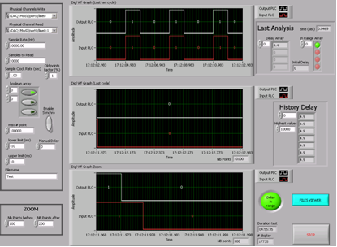
PLC I/O Monitoring
Waveforms Comparison
Feedback Control System:
No synchronization issues
Reduced PLC Scan Cycle for a best timing resolution
Target
Requirements:
3 sec period:1 sec High, 2 sec Low
PLC waveform generation
20 msec resolution
Parametric threshold jitter

Slide 24
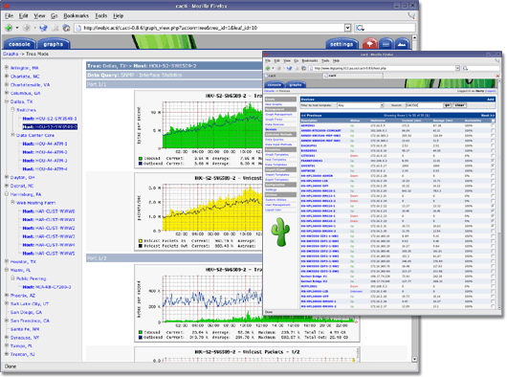
Cacti Server
Network graphing solution for monitoring
SNMP protocol
Fast poller
Multiple data acquisition methods
Could manage hundreds of devices
A common solution:
every device has its own MIBs and OIDs
the SNMP protocol was not defined to this purpose (not efficient, not suitable for real-time)
Not all resources cannot be checked using this network protocol

Slide 25
PLC Status Monitoring
Internal resources of the device under test:
Scan-cycle & execution time
Memory usage
CPU status
I/O signals memory & communication modules conditions.
No common way to query the device
Open-source library (libnodave)
Proprietary libraries (Siemens Softnet Linux lib)
Supported by the Siemens
Compatible with different versions of the same device model
Specific API to gather diagnostic information (New version tested and working!)

Slide 26
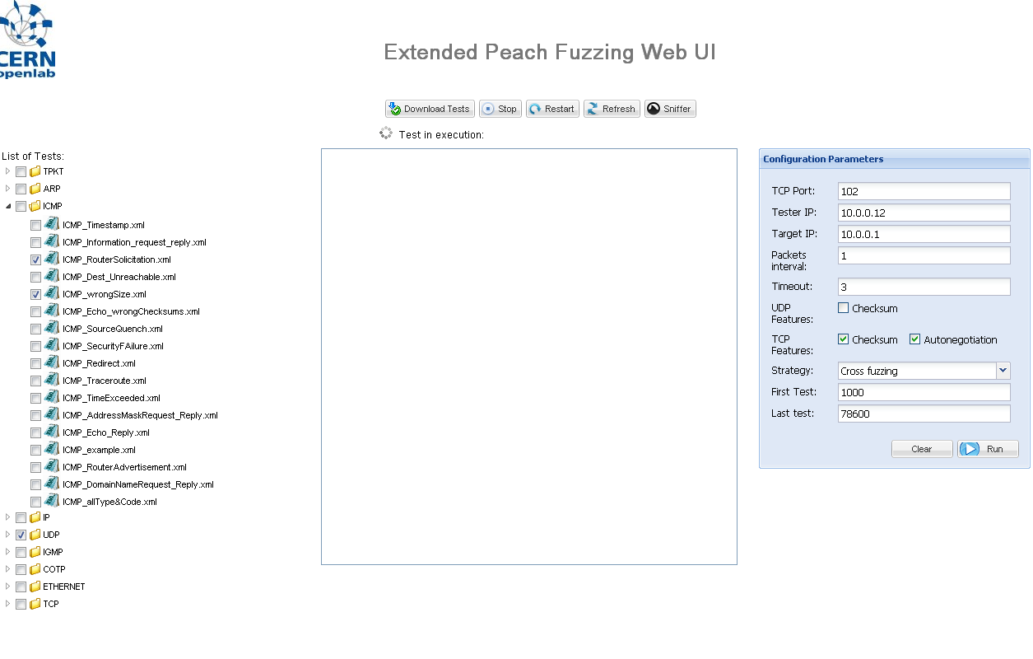
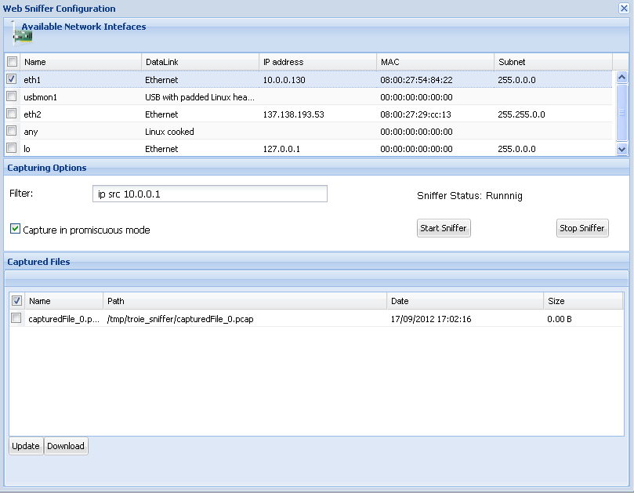
Communication Monitoring System
Development of a web driven sniffer
Internal module of the TRoIE test-bench and communicating with other internal modules

Slide 27
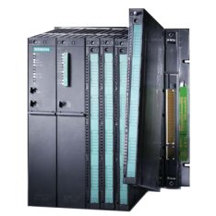
PLC Status monitoring
Previous existing CERN system:
PLC DIAMON with ‘libnodave’ (open-source library)
Siemens Softnet library
Development of a server-side monitoring system able to question the Siemens PLCs
Integration with the GWT client application within the TRoIE test-bench
NOT Finished yet!
Publishers: DIP/DIM, CMW, WinCC OA, WebService
PLC Agent
DLL based on Softnet
Communication
Softnet Server

Slide 28
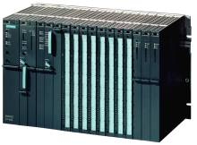


Traffic analyzer with Libnodave
Establishment of a Communication load
Traffic Analyzer
(Average T, standard deviation)
Graphic representation of the results through QtOctave
Cyclic communication with a deterministic period
Definition of the communication scan cycle(T)
Monitoring of the average value of T and its standard deviation:

Slide 29
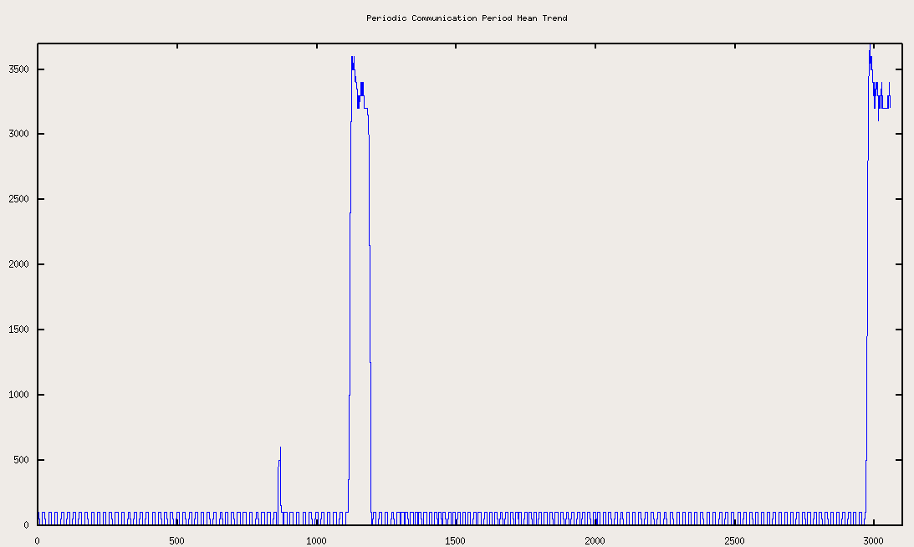
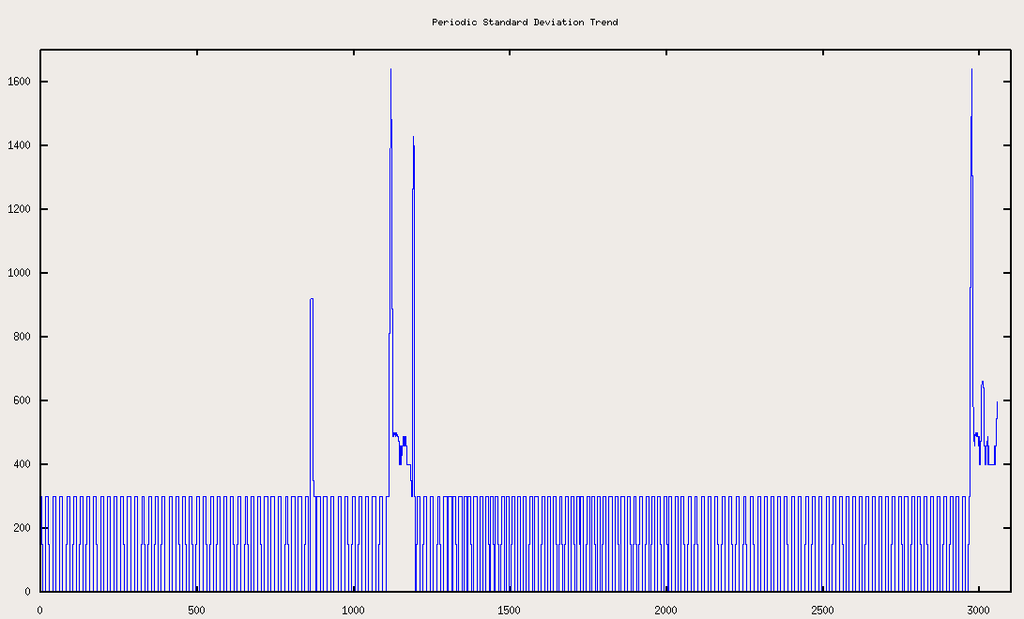
Non-deterministic timeline and random delays in the communication
Communication Mean Period
Configuration:
Device Name: S7-400
Module: CPU 412-2XG04-0AB0
Serial Number: SVPS6372088
Firmware Version: 4.0.2
Device Name: CP 443-1Advan.
Module: 443-1EX40-0xE0
Firmware Version: 1.0
Device Name: DO422
Model: 422-1BL00-0AA0
Standard Deviation Communication Period

Slide 30
Reporting system

Slide 31
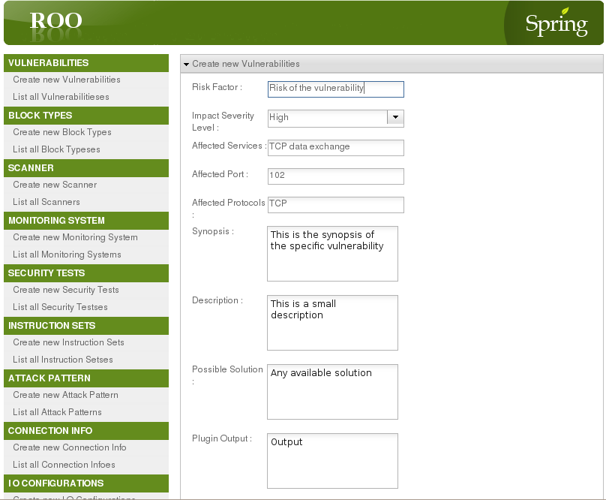
Testing Reporting System
No standard common format to store vulnerabilities
Vulnerability classification & query support:
Improve data analysis
Track progresses
Redeploy attacks
Check device version status

Slide 32
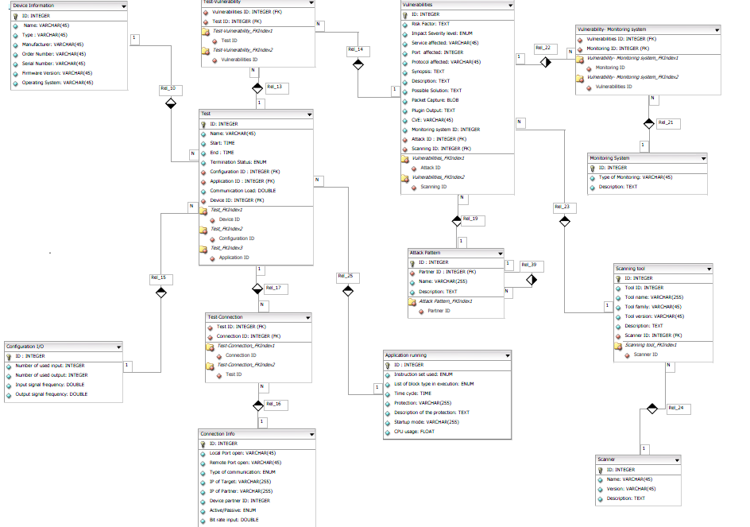
E-R DB diagram

Slide 33
Reproducibility

Slide 34


Fuzzing Test Generator
Grammars
INPUT
Customized Peach
Fuzzing Framework
GEN.
Target
Generation and forging of any kind of communication load
Translate experts’ knowledge into grammar rules
Definition of proprietary and even not-existing protocols
Scalable in terms of:
Testing files
Protocol testing behavior (state-machine, mutation strategies)

Slide 35
Test-bench User Interface
Main objectives:
Ability to run the tests against specific targets but not to change test definitions
Built-in or produced as a part of the TRoIE framework
No specific security knowledge is necessary
No client-side installation required
Client Compatibility with both Windows and Linux
Automated Start/Stop of tests
Authentication to run a test
Achievement:
First implementation has been released to Siemens, but further developments are required
Notes:
Not all the users have a deep security knowledge, but they only want to reproduce the tests. The security testers will not be able to change the tests but only to run it against specific targets.

Slide 36












Test-bench Reproducibility
3-Layers Architecture
Reverse Proxy & Access Control
REST Web Service
Extended Peach Framework
JSON
Authentication to run a test
Built-in invariant test definitions
No specific security knowledge
OS Compatibility
Client
Notes:
Not all the users have a deep security knowledge, but they only want to reproduce the tests. The security testers will not be able to change the tests but only to run it against specific targets.

Slide 37
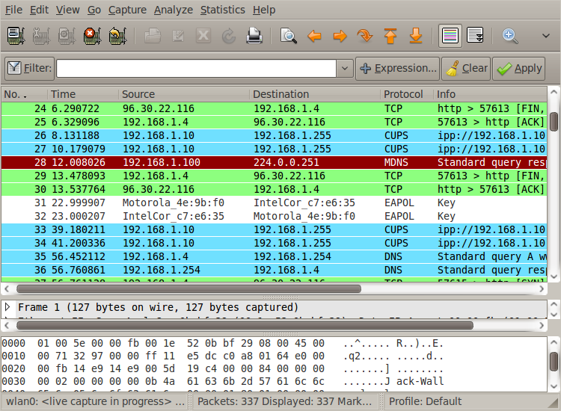
Reproduce Attack Sequences
TCPReplay (Unix suite)
tcpreplay: replays pcap files at arbitrary speeds onto the network
Tcprewrite: pcap file editor (Network Layer 2, 3 and 4 headers)
Tcpprep: pcap file pre-processor
TCPDump: command line packet analyzer
JTCPReplay
OpenLab developed tool
Reproduce the packets sequence handling TCP connections (sequence and ack numbers)
It is only a “prototype” which could be useful to share and reproduce vulnerabilities
Packets Sequence
JTCPReplay
Packets Handler
Sniffer
Sender

Slide 38
Run Peach Test cases

Slide 39
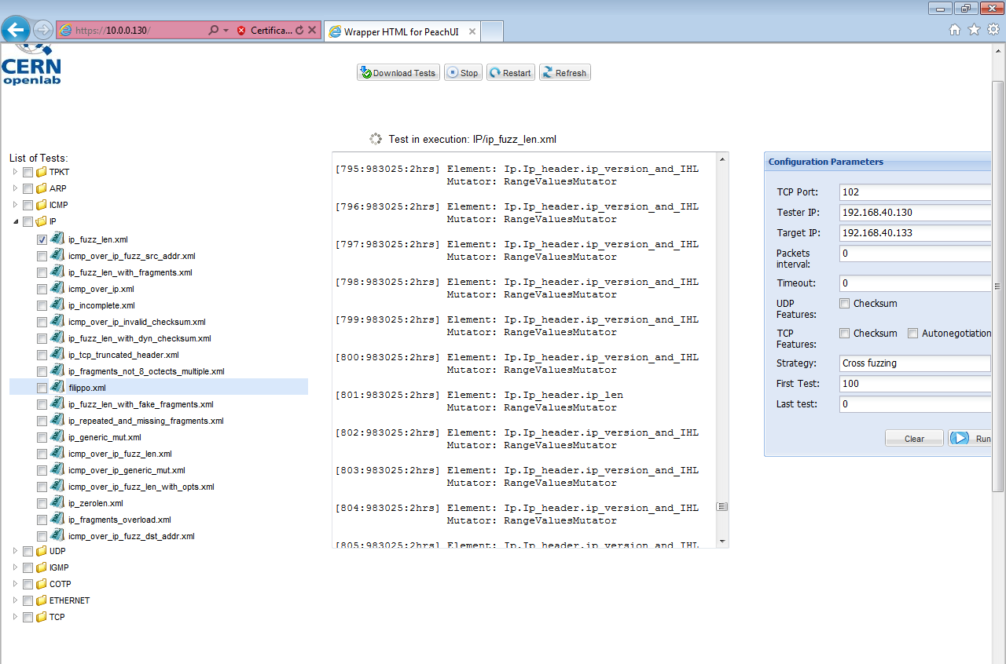
How to run a test
From the console:
Running the agent: ‘python peach –a‘
Running Peach: ‘python peach.py –strategy=Strategy testFile.xml’
From the Web:
Peach host
Parameters to run Peach
Select the list of Tests

Slide 40


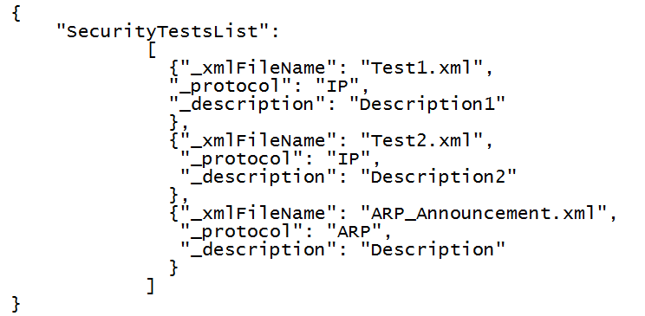

Security Tests Download
REST Web Service
Security Tests
IP
Test1.xml
Test2.xml
ICMP
Test1.xml
TCP
Test1.xml

Slide 41

Any Questions
Thank you for attending!

