Slide 1
Database Normalization
The power of Normalization

Slide 2
TABLE OF CONTENTS
1.
2.
3.
Database Normalization
Revision
Database relations.
Primary Key Vs Foreign Key
What and why?
Normal Forms
First normal form
Second normal form
Third normal form
Fourth normal form

Slide 3
1
Revision

Slide 4
Difference between Primary Key and Foreign Key

Slide 5
Primary Key VS Foreign Key
Primary Key : is used to ensure that data in the specific column is unique. A column cannot have NULL values. It is either an existing table column or a column that is specifically generated by the database according to a defined sequence.

Slide 6
Primary Key VS Foreign Key
Foreign Key: is a column or group of columns in a relational database table that provides a link between data in two tables. It is a column (or columns) that references a column (most often the primary key) of another table.

Slide 7
Database Relations Type

Slide 8
Database Relations type
There are 3 types of relationships in relational database design. They are:
One-to-One
One-to-Many (or Many-to-One)
Many-to-Many

Slide 9
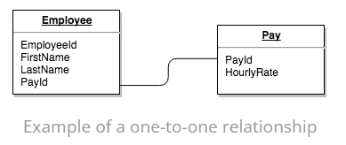
One-to-One Relationship
A row in table A can have only one matching row in table B, and vice versa. (This is not a common relationship type)

Slide 10
One-to-One Relationship
In the previous example, we could just as easily have put an HourlyRate field straight into the Employee table and not bothered with the Pay table. However, hourly rate could be sensitive data that only certain database users should see. So, by putting the hourly rate into a separate table, we can provide extra security around the Pay table so that only certain users can access the data in that table.

Slide 11
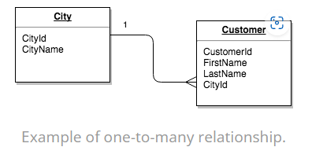
One-to-Many Relationship
In this type of relationship, a row in table A can have many matching rows in table B, but a row in table B can have only one matching row in table A.(This is the most common relationship type)

Slide 12
One-to-Many Relationship
In the previous example, the Customer table is the “many” and the City table is the “one”. Each customer can only be assigned one city,. One city can be assigned to many customers.

Slide 13
Many-to-Many Relationship
In a many-to-many relationship, a row in table A can have many matching rows in table B, and vice versa.

Slide 14
Many-to-Many Relationship
A many-to-many relationship could be thought of as two one-to-many relationships, linked by an intermediary table.
The intermediary table is typically referred to as a “junction table” (also as a “cross-reference table”). This table is used to link the other two tables together. It does this by having two fields that reference the primary key of each of the other two tables.

Slide 15
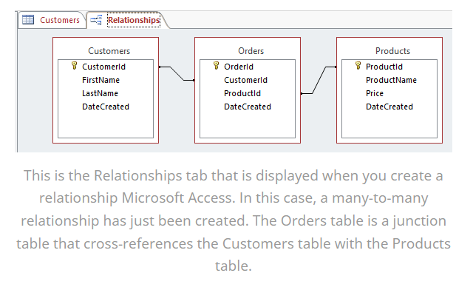
Many-to-Many Relationship
The following is an example of a many-to-many relationship:

Slide 16
Many-to-Many Relationship
So, in order to create a many-to-many relationship between the Customers table and the Products table, we created a new table called Orders.

Slide 17
2
Database Normalization

Slide 18
What Is Database Normalization

Slide 19
What Is Database Normalization?
DBMS Normalization is a systematic approach to decompose (break down) tables that allow users to (insert, update, delete) tuples:
Without introducing database inconsistency
Eliminate data redundancy(repetition)
Eliminate undesirable characteristics:
Insertion anomaly in DBMS
Update anomaly in DBMS
Delete anomaly in DBMS.

Slide 20
What Is Database Normalization?
Normalization in DBMS is a technique using which you can organize the data in the database tables so that:
There is less repetition of data.
A large set of data is structured into a bunch of smaller tables.
and the tables have a proper relationship between them .

Slide 21
Database Anomaly

Slide 22
Database Anomaly
Anomalies in the relational model refer to inconsistencies or errors that can arise when working with relational databases, specifically in the context of data insertion, deletion, and modification. There are different types of anomalies that can occur in referencing and referenced relations

Slide 23
Database Anomaly
These anomalies can be categorized into three types:
Insertion Anomalies
Deletion Anomalies
Update Anomalies.

Slide 24
Insert Anomaly
These anomalies occur when it is not possible to insert data into a database because the required fields are missing or because the data is incomplete.

Slide 25
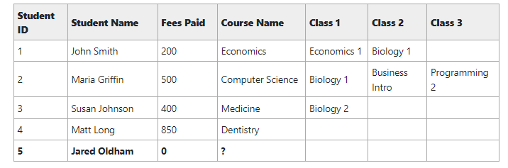
Insert Anomaly
Example:
Can not insert student unless course name is assigned to it.

Slide 26
Update Anomaly
These anomalies occur when modifying data in a database and can result in inconsistencies or errors.

Slide 27
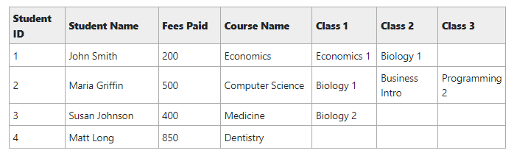
Update Anomaly
Example:
There’s a risk that we miss out on a value, which would cause issues.

Slide 28
Delete Anomaly
These anomalies occur when deleting a record from a database and can result in the unintentional loss of data.

Slide 29
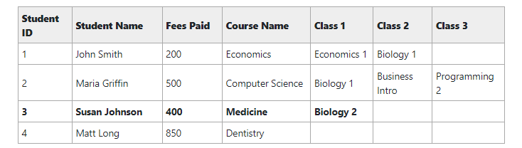
Delete Anomaly
Example:
We should be able to delete one type of data or one record without having impacts on other records we don’t want to delete.

Slide 30
How Are Anomalies Caused in DBMS?

Slide 31
How Are Anomalies Caused in DBMS?
Database anomalies are the faults in the database caused due to poor management of storing everything in the flat database.

Slide 32
Why Is Database Normalization

Slide 33
Why Is Database Normalization?
Eliminating redundant(useless) data, therefore handling data integrity, because if data is repeated it increases the chances of inconsistent data.
Normalization helps in keeping data consistent by storing the data in one table and referencing it everywhere else.

Slide 34
Why Is Database Normalization?
Breaking down large tables into smaller tables with relationships, so it makes the database structure more scalable and adaptable.
Ensuring data dependencies make sense i.e., data is logically stored.

Slide 35
Advantages Of Relational Database

Slide 36
Advantages Of Relational Database
Data Integrity: Relational databases enforce data integrity through various constraints such as primary keys, foreign keys, and referential integrity rules, ensuring that the data is accurate and consistent.

Slide 37
Advantages Of Relational Database
Scalability: Relational databases are highly scalable and can handle large amounts of data without sacrificing performance.

Slide 38
Advantages Of Relational Database
Flexibility: The relational model allows for flexible querying of data, making it easier to retrieve specific information and generate reports.

Slide 39
Advantages Of Relational Database
Security: Relational databases provide robust security features to protect data from unauthorized access.

Slide 40
3
Normal Forms

Slide 41
What Are The Normal Forms?

Slide 42
What Are The Normal Forms?
The process of normalization involves applying rules to a set of data. Each of these rules transforms the data to a certain structure, called a normal form.

Slide 43
Types Of Normal Forms

Slide 44
Types Of Normal Forms
There are three main normal forms that you should consider (Actually, there are six normal forms in total, but the first three are the most common):
First Normal Form
Second Normal Form
Third Normal Form

Slide 45
First Normal Form(1NF)

Slide 46
First Normal Form (1NF)
For a table to be in the First Normal Form, it should follow the following 4 rules:
Primary Key
Should only have single(atomic) valued attributes/columns.
Values stored in a column should be of the same domain.
All the columns in a table should have unique names

Slide 47
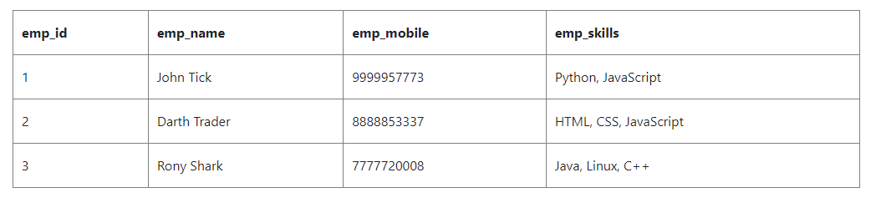
First Normal Form (1NF)
Example
In this example, the “emp_skills" column violates 1NF
because it contains multiple values separated by commas. To bring this table to 1NF

Slide 48
First Normal Form (1NF)
Can We Separate This Column into Multiple Columns ??
That will introduce null in many row in this table.
So, Can we do better??

Slide 49
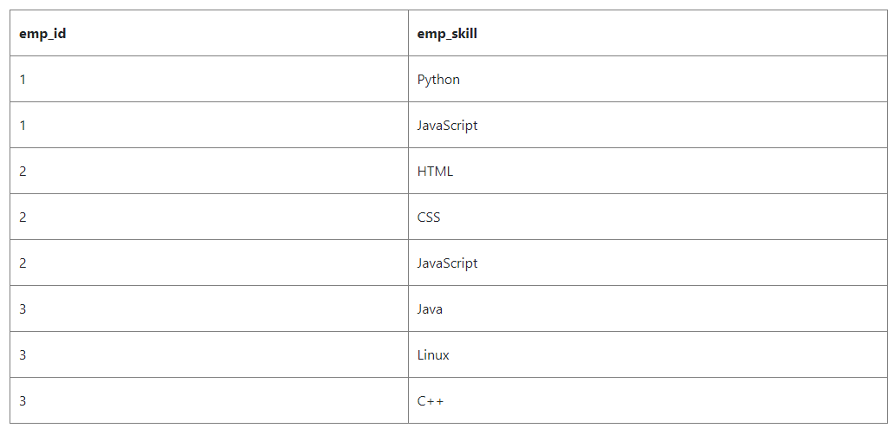
First Normal Form (1NF)
we can split the “emp_skills” into a separate table and give each Skill its own row, using a unique identifier

Slide 50
Second Normal Form(2NF)

Slide 51
Second Normal Form (2NF)
For a table to be in the First Normal Form, it should follow the following rules:
It should be in The 1NF.
It should not have Partial Dependency.
Vertical Redundancy.

Slide 52
Second Normal Form (2NF)
Partial Dependency:
When a table has a primary key that is made up of two or more columns, then all the columns(not included in the primary key) in that table should depend on the entire primary key and not on a part of it. If any column(which is not in the primary key) depends on a part of the primary key, then we say we have Partial dependency in the table
توهت؟!
Let's take an example.

Slide 53
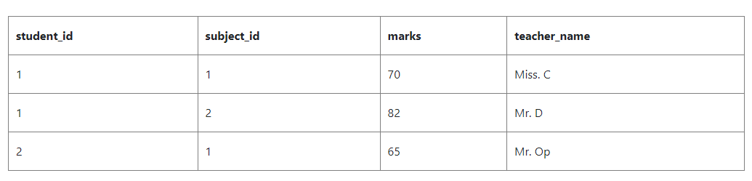
Second Normal Form (2NF)
Partial Dependency:

Slide 54
Second Normal Form (2NF)
the primary key is student_id + subject_id, because both these information are required to select any row of data.
we have a column teacher_name, which depends on the subject information or just the subject_id, so, we should not keep that information in this table.

Slide 55
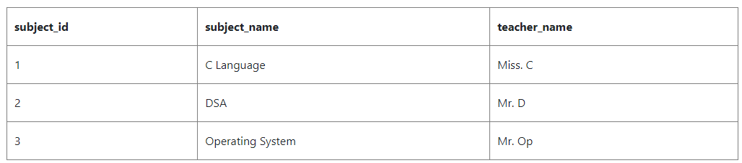
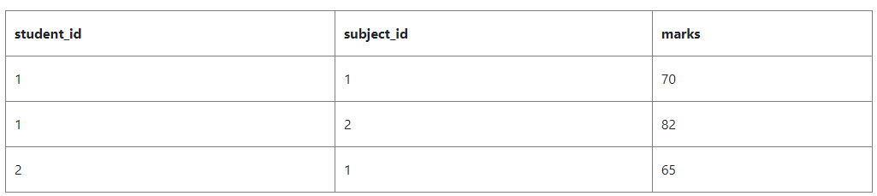
Second Normal Form (2NF)

Slide 56
Third Normal Form(3NF)

Slide 57
Third Normal Form (3NF)
For a table to be in the First Normal Form, it should follow the following rules:
It should satisfy 1NF and 2NF .
it doesn't have Transitive Dependency.

Slide 58
Third Normal Form (3NF)
Transitive Dependency:
In a table we have some column that acts as the primary key and other columns depends on this column. But what if a column that is not the primary key depends on another column that is also not a primary key or part of it? Then we have Transitive dependency in our table.(Non-Prim Attribute depends on Non-prim Attribute)
توهت تاني؟!

Slide 59
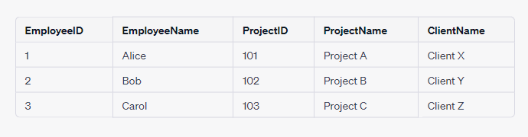
Third Normal Form (3NF)
ProjectName -> ProjectID
ProjectID -> EmployeeID

Slide 60
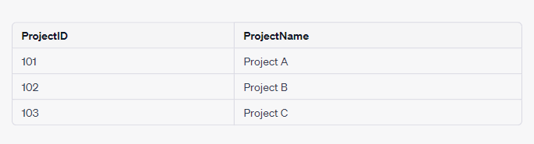
Third Normal Form (3NF)

Slide 61
Boyce-Codd Normal Form(NF)

Slide 62
Boyce-Codd Normal Form(BCNF)
Every non-prime attribute (an attribute that is not part of any candidate key) is functionally dependent on the super-key (a set of attributes that uniquely identifies a tuple in a relation). In other words, there should be no partial dependencies, where a non-prime attribute depends on only part of a candidate key.

Slide 63
Boyce-Codd Normal Form(BCNF)
There should be no transitive dependencies, where a non-prime attribute depends on another non-prime attribute through a candidate key.

Slide 64
Recap Example

Slide 65
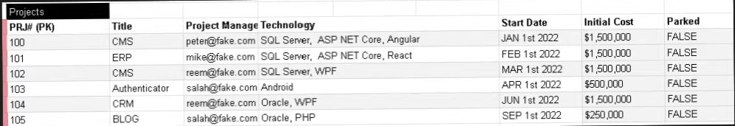
Recap Example

Slide 66
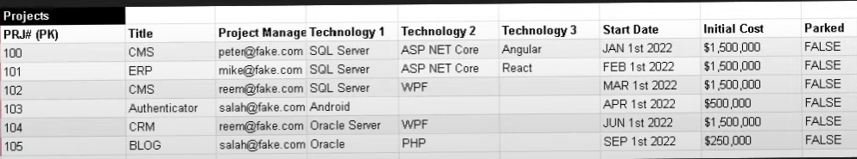
Recap Example
First Normal Form
Separate Column “Technology ” but that will produce many Nulls + bad performance.
Any Ideas??
Notes:
Primary Key
Should only have single(atomic) valued attributes/columns.
Values stored in a column should be of the same domain.
All the columns in a table should have unique names

Slide 67

Recap Example
First Normal Form
Create new table for technology.

Slide 68

Recap Example
Second Normal Form
There is vertical redundancy in
“project manager” and "Technology”.
Notes:
It should be in The 1NF.
It should not have Partial Dependency.
Vertical Redundancy.

Slide 69
Recap Example
Second Normal Form
look at the Relations between the Column
One-to-one (Project /Title).
One-to-many (Project Manager/Project).
Many-to-many (Project/Technology).
Notes:
It should be in The 1NF.
It should not have Partial Dependency.
Vertical Redundancy.

Slide 70
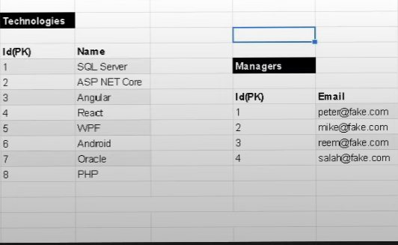
Recap Example
Second Normal Form
Decompose This relations
Into new Tables.
Notes:
It should be in The 1NF.
It should not have Partial Dependency.
Vertical Redundancy.

Slide 71
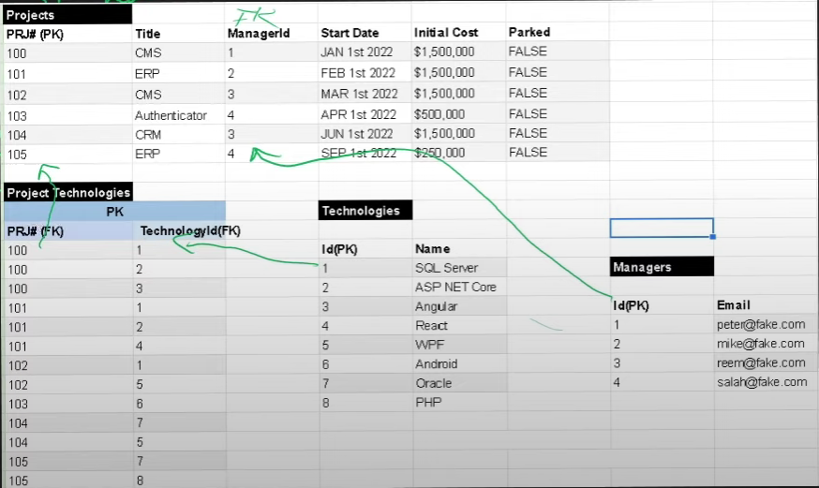
Recap Example
Second Normal Form
Notes:
It should be in The 1NF.
It should not have Partial Dependency.
Vertical Redundancy.

Slide 72
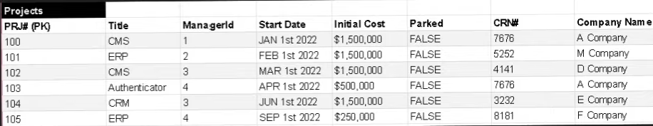
Recap Example
Third Normal Form
Notes:
It should satisfy 1NF and 2NF .
it doesn't have Transitive Dependency.

Slide 73
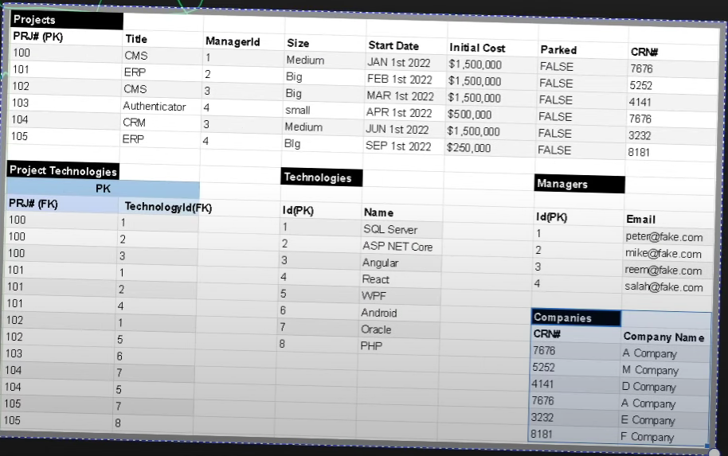
Recap Example
Third Normal Form
Notes:
It should satisfy 1NF and 2NF .
it doesn't have Transitive Dependency.

Slide 74
Task

Slide 75
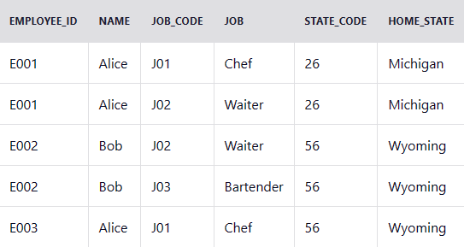
Task Description
Imagine we're building a restaurant management application.
That application needs to store data about the company's employees,
and it starts out by creating the following table of employees:
Apply 1NF,2NF and 3NF,
(describe each step)

Slide 76
Task Solution

