Slide 1

Alzheimer's Disease Detection
Fleur LAURENS, Laura SAYAPHOMMY, Zyad TAOUIL
M2 IKSEM

Slide 2
Problem Explanation and Task Identification
Classification for Alzheimer Disease (AD)
Random Forest for AD
In our dataset the patients are classified into different stages of dementia (CDR attribute).
Clinical Dementia Rating (0 = no dementia, 1 = mild AD, 2 = moderate AD, 3 = severe AD)
Random Forests algorithm has high accuracy and robustness in classification tasks.
Aggregate the results of multiple decision trees, reducing the risk of overfitting and improving generalization to new data.

Slide 3
Used Dataset
Clinical Info :
MMSE - Mini-Mental State Examination score commonly used in medicine to measure cognitive impairment (range is from 0 = worst to 30 = best)
CDR - Clinical Dementia Rating (0 = no dementia, 0.5 = very mild AD, 1 = mild AD, 2 = moderate AD, 3 = severe AD)
Derived anatomic volumes
eTIV (Estimated Total Intracranial Volume) - Estimated total intracranial volume, mm3.
Range: 1106 to 2084.
nWBV (Normalized Whole Brain Volume) - Normalized whole-brain volume, expressed as a percent of all voxels in the atlas-masked image that are labeled as gray or white matter by the automated tissue segmentation process.
Range: 0.644 to 0.893 (it is a ratio, so no unit).
ASF (Atlas Scaling Factor) - Computed scaling factor that transforms native-space brain and skull to the atlas target (i.e., the determinant of the transform matrix)
Range: 0.876 to 1.587 (unitless ratio).
We used two datasets from OASIS DATASET : 'oasis_cross-sectional' merged with 'oasis_longitudinal' dataset and we dropped and renamed columns as well as handled null values.
Demographics Info :
M.F - Gender
Hand - Handedness (actually all subjects were right-handed so I will drop this column)
Age - in years
EDUC - Years of education
Range: 1 to 23.
SES - Socioeconomic status as assessed by the Hollingshead Index of Social Position and classified into categories from 1 (highest status) to 5 (lowest status)

Slide 4
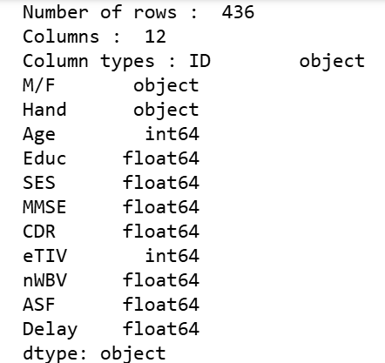
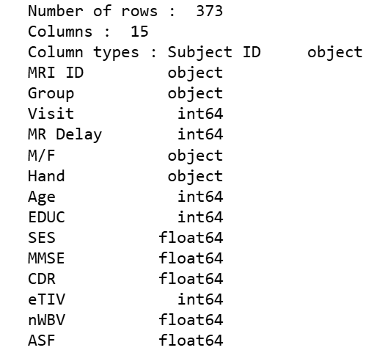
Data preparation
Data exploration on the two datasets: 'oasis_cross-sectional' and 'oasis_longitudinal'
'oasis_cross-sectional' has 436 rows and 12 columns
'oasis_longitudinal' has 373 rows and 15 columns
There were some extra attributes in oasis_longitudinal

Slide 5
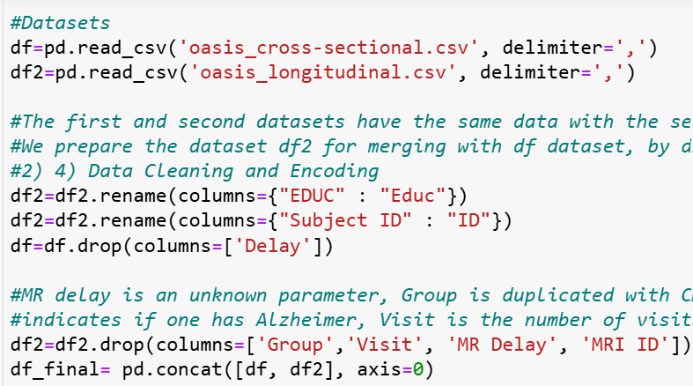

Data preparation
The oasis_longitudinal had 3 more columns (MRI ID, Group and Visit) but they were not relevant to the problem so we dropped them and also renamed EDUC to Educ to merge with oasis_cross-sectional. Dropped MR delay (lots of null values and unknown feature)
Dropped rows where CDR is null, dropped hand because there were only Right handed people, dropped na on SES because discrete values and only a few rows affected
One-hot Encoded M/F Data, Label encoded CDR and Label encoded SES
After all the cleaning we ended up with 570 rows and 10 columns

Slide 6
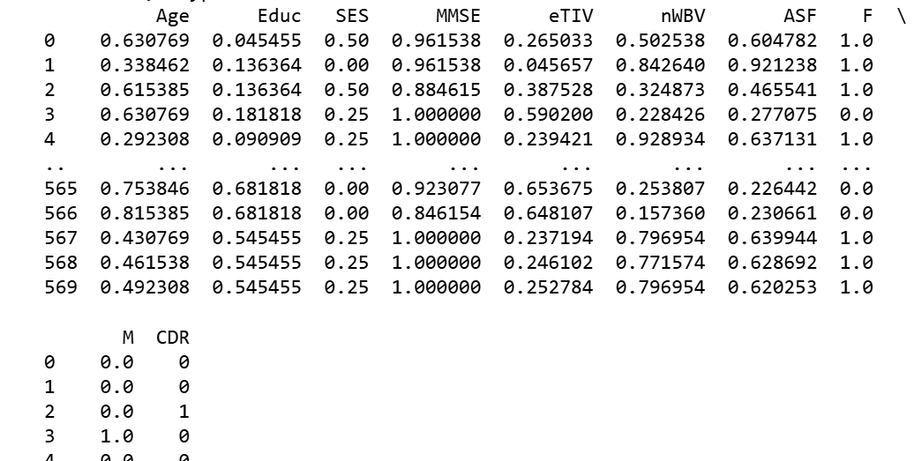
Data preparation
Excluded CDR from the algorithm
We used Normalization to standardize the data because of there were big intervals between the values

Slide 7
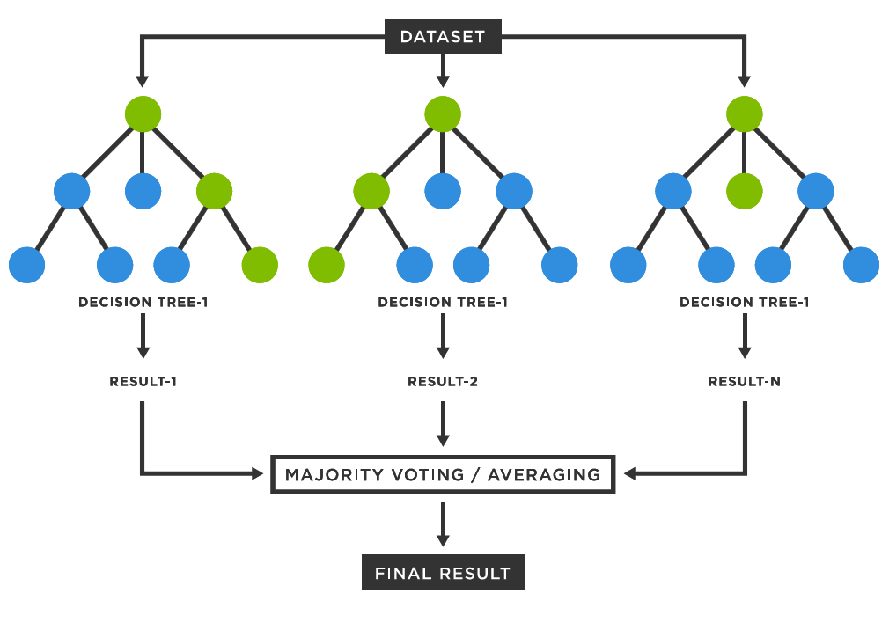
Random Forest
Random Forests can be regarded as ensemble learning with decision trees
X Building a single decision tree and use it to make predictions → Build many slightly different trees
Combine their predictions using majority voting

Slide 8
Random Forest
Accurate predictions
Standard decision trees often have high variance and low bias
High chance of overfitting (with ‘deep trees’, many nodes)
With a Random Forest, the bias remains low and the variance is reduced thus we decrease the chances of overfitting
Flexible
Disadvantages:
When the number of variables is large, but the fraction of relevant variables is small, random forests are likely to perform poorly

Slide 9
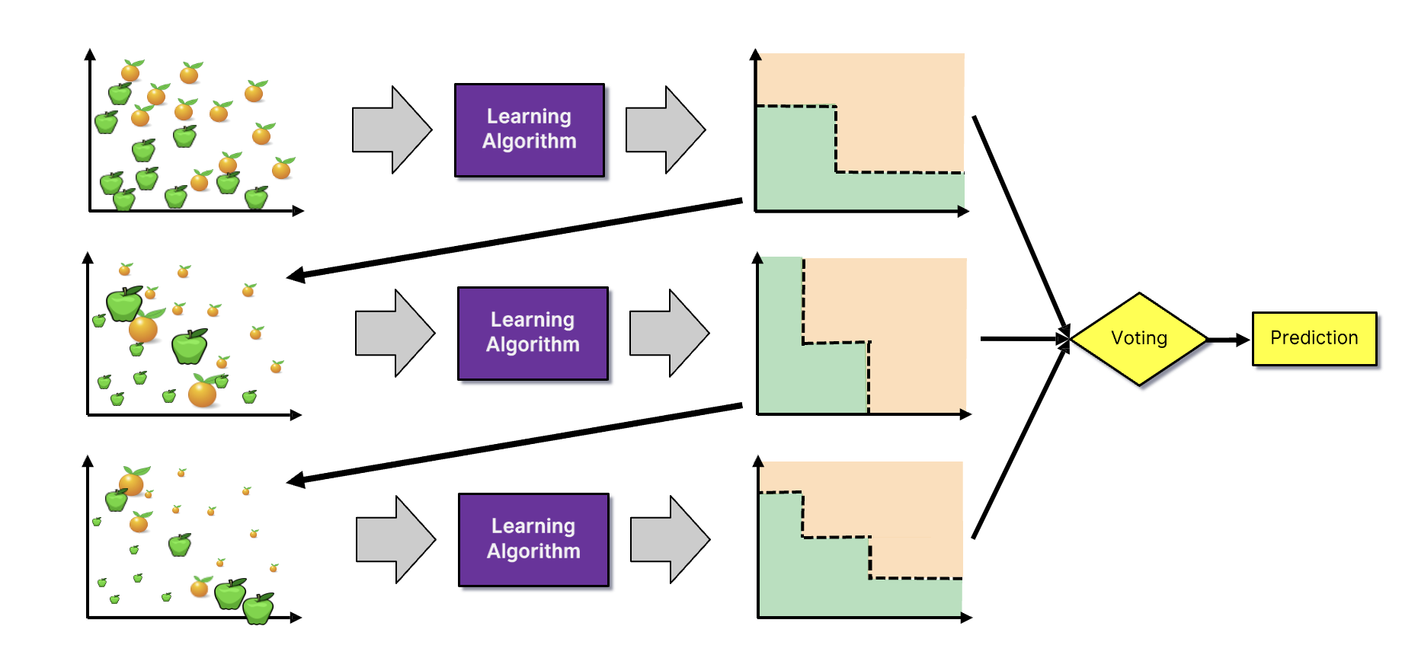
Random Forest - Boosting

Slide 10
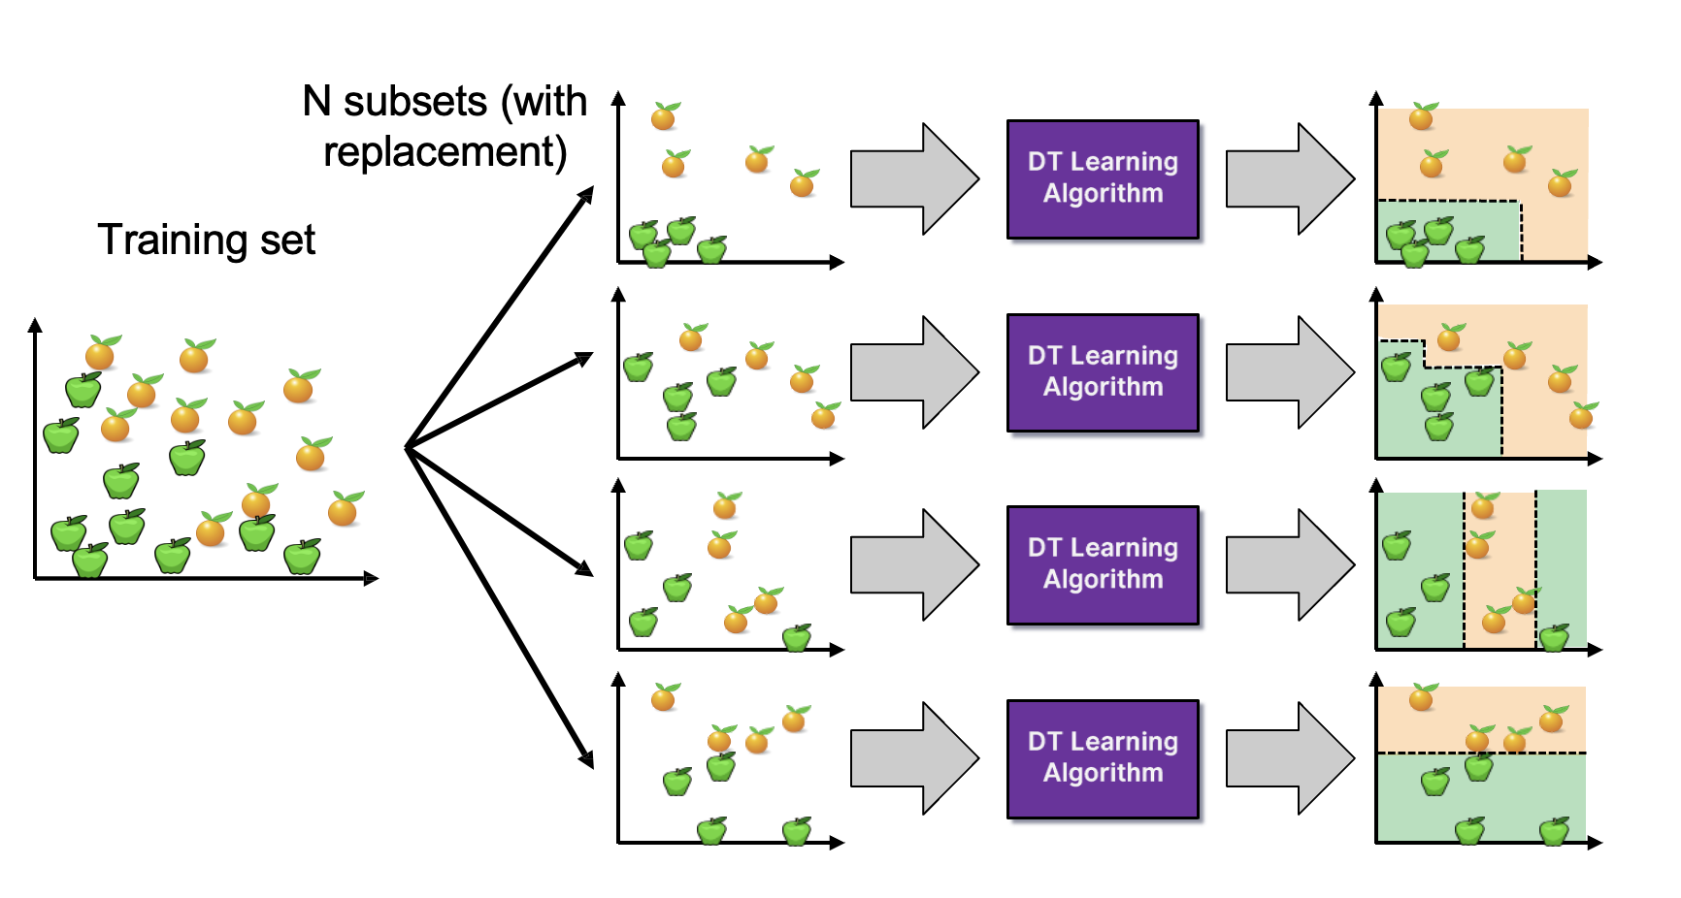
Random Forest – Bagging (Bootstrap Aggregating)

Slide 11
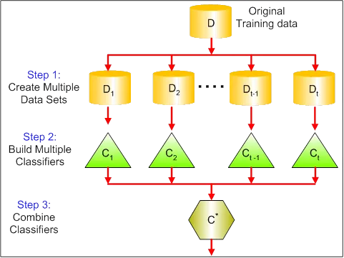
Explanation of Ensemble Method for Classification
Techniques that aim at improving the accuracy of results in models by combining multiple models instead of using a single model.
Reduce bias and variance

Slide 12
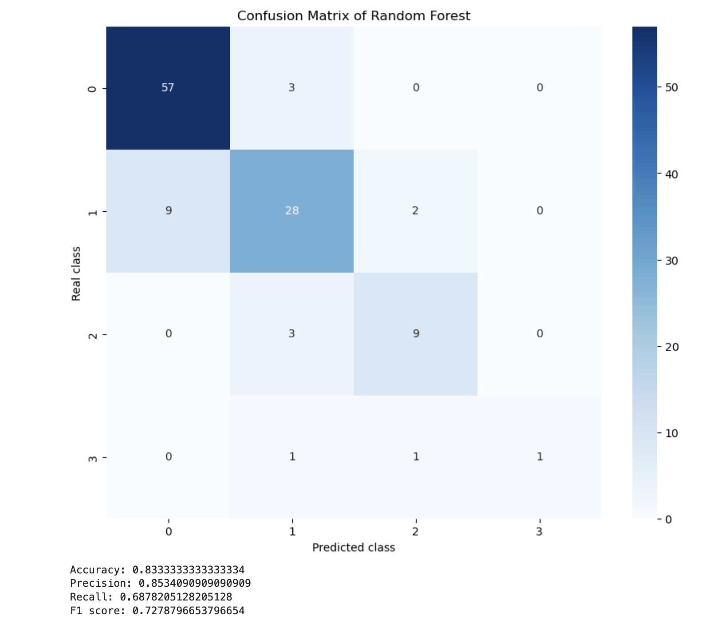
Random Forest – OASIS
Analysis
Legend :
0 = no dementia
1 = mild AD
2 = moderate AD
3 = severe AD

Slide 13
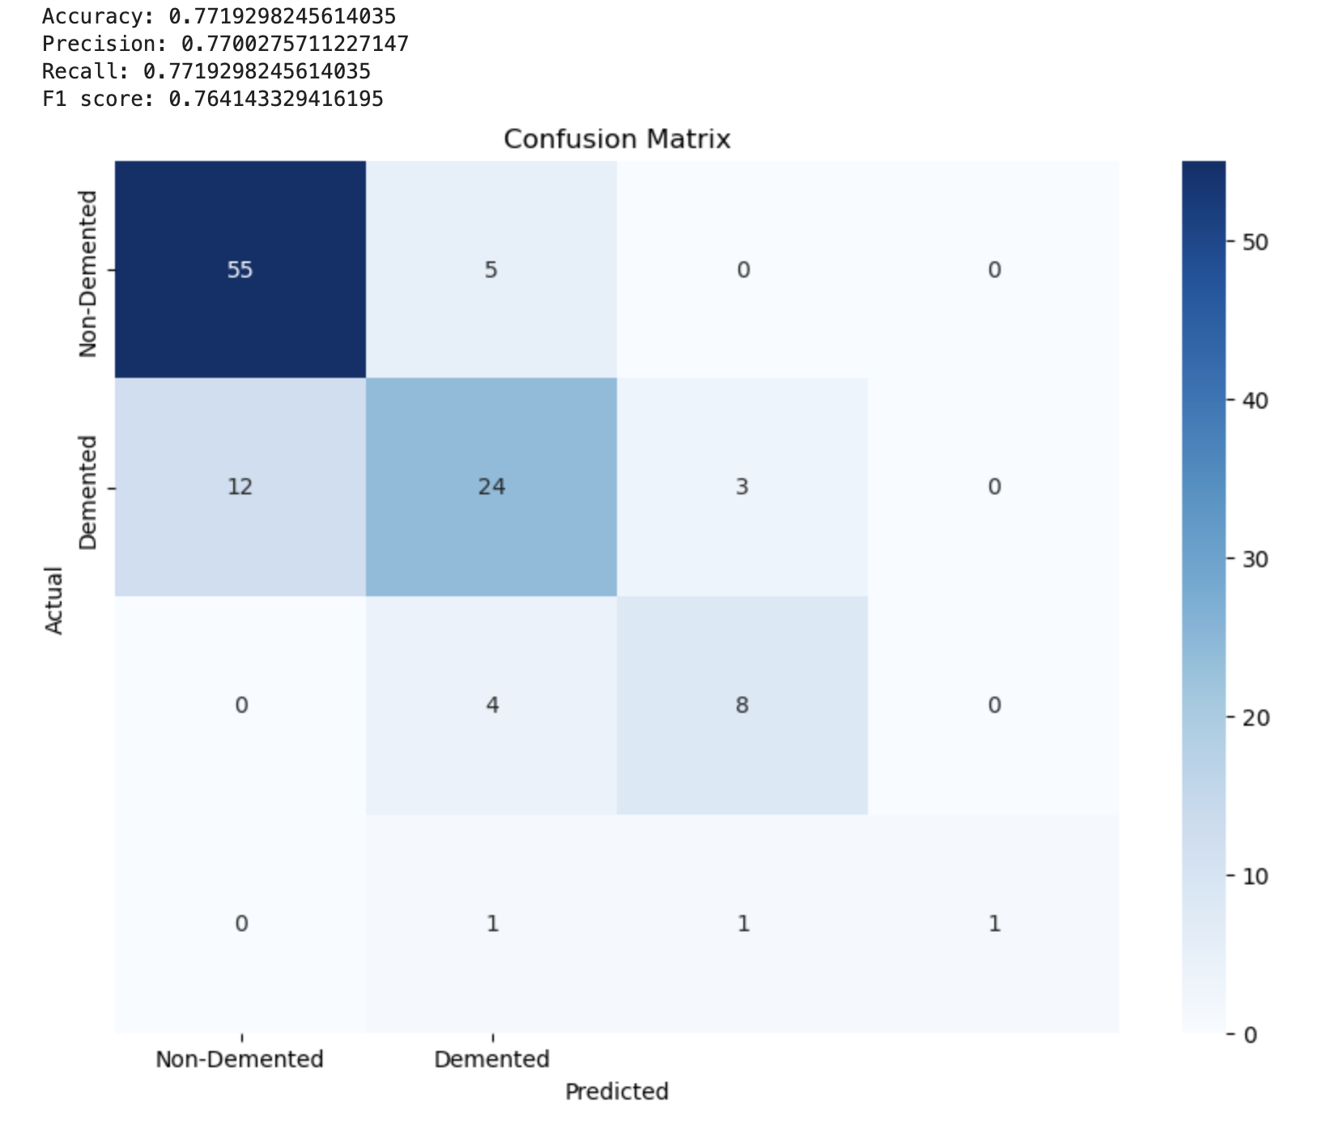
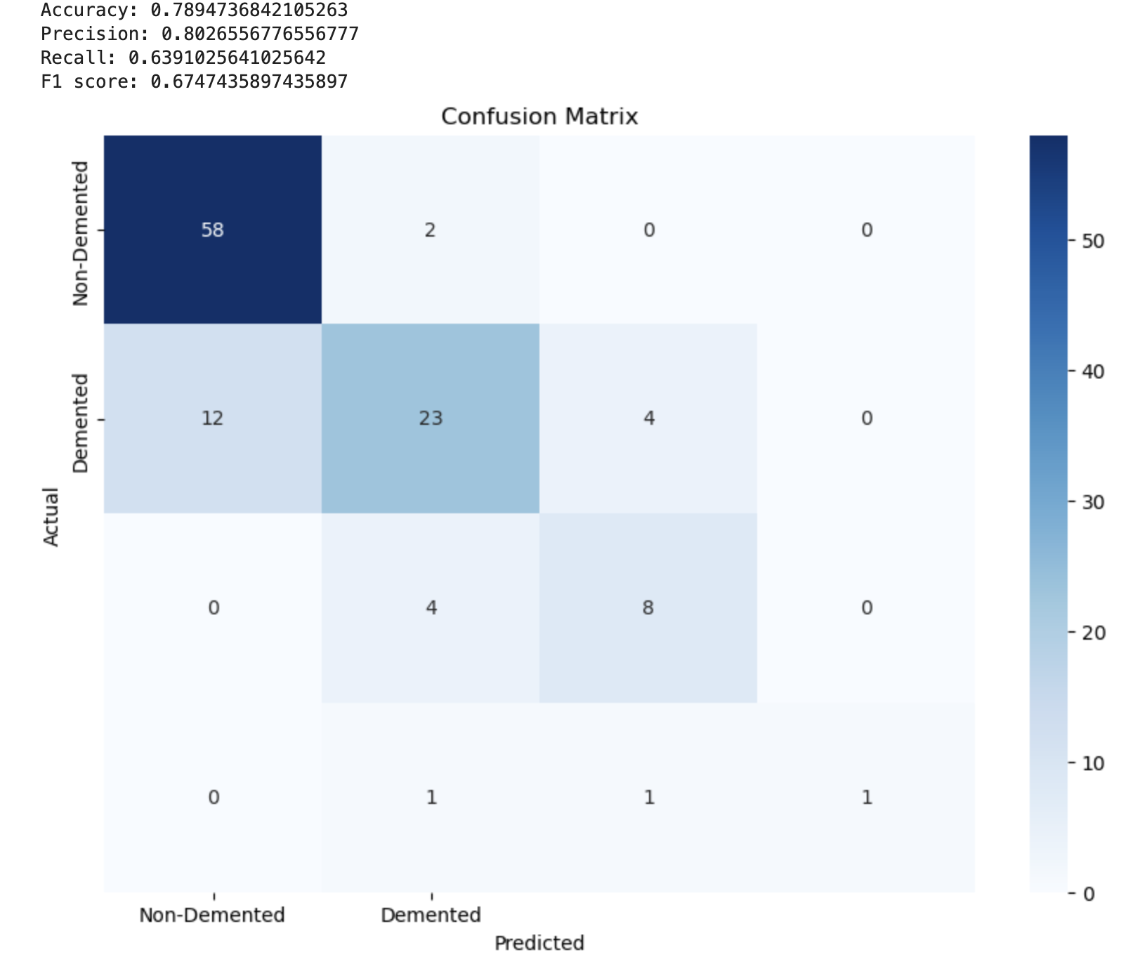
Explanation of Ensemble Method for Classification
Usage of VotingClassifier combining : Random Forest, Gradient Boosting, KNeighbors and SVC
Usage of VotingClassifier combining : Random Forest, Gradient Boosting and Kneighbors (without SVC)
Better results without SVC
13

Slide 14
Conclusion
Comparison between Random Forest and other Machine Learning algorithm
Comparison between performances with other Ensemble Methods
Lack of data might have affected algorithm performances

