Slide 1
Analyze the stocks in S&P 500 Index by PCA
669 Final Project
Ying Zhang

Slide 2

Download Data
pandas_datareader library
pdr.get_data_yahoo(stock_name, start="2009-03-30", end="2019-04-15")
Benefit:
read data directly from
Yahoo Finance API
FAST!!!

Slide 3
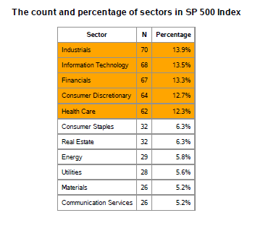
2. S&P 500 Index
Percentage of Industrials, Information Technology, Financials, Consumer Discretionary and Health Care >10%
Total 504 stocks

Slide 4
PCA part

Slide 5
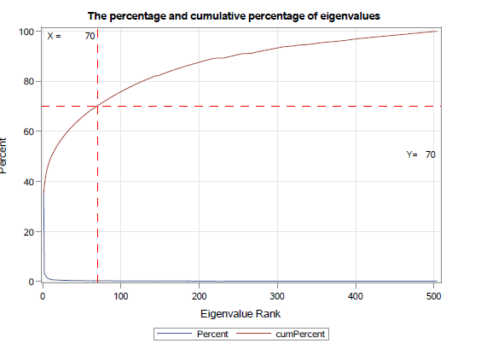
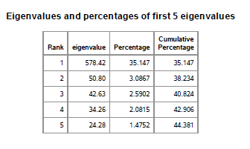
Eigenvalues
The first eigenvalue really explains most variation.
Notes:
The first eigenvalue accounts for the market variation, which influences all stocks in the market.
The total 70 stocks could explain 70% of the variation, thus we reduce the variable number from 504 to 70 and keep 70% information .

Slide 6
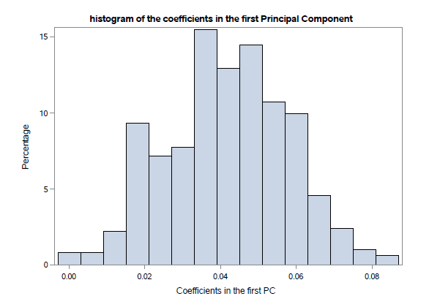
1st Principal Component
All positive coefficients
Symmetric distribution
Stands for the market effect
96.6% correlation with S&p 500 Index

Slide 7
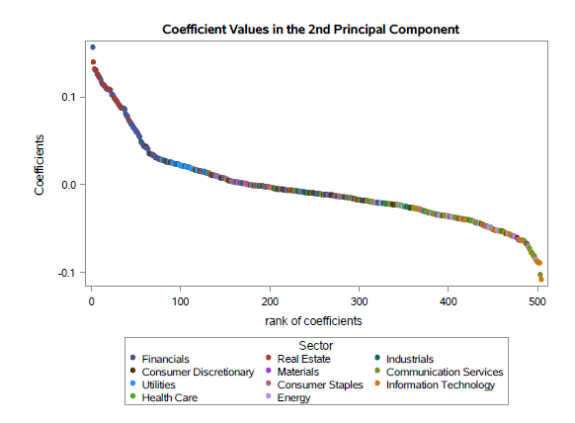
2nd Principal Component
Left upper corner:
real estate
finance
right lower corner:
information technology communication services

Slide 8
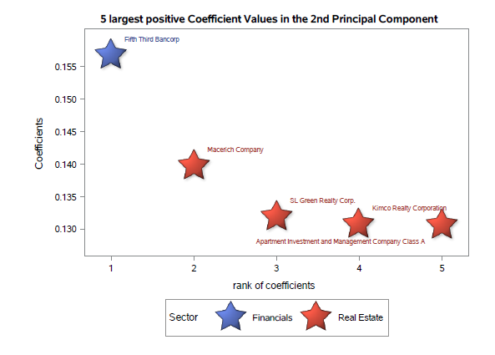
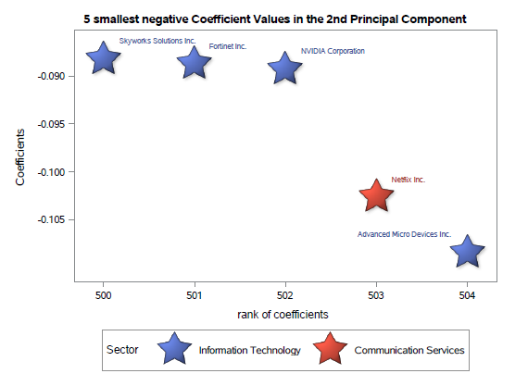
2nd Principal Component

Slide 9
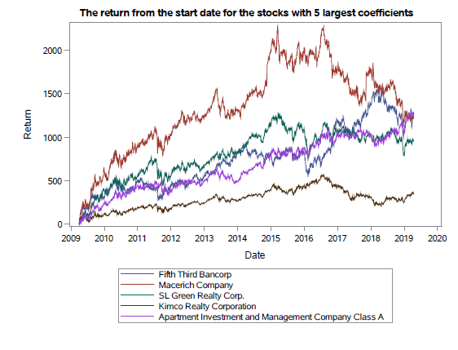
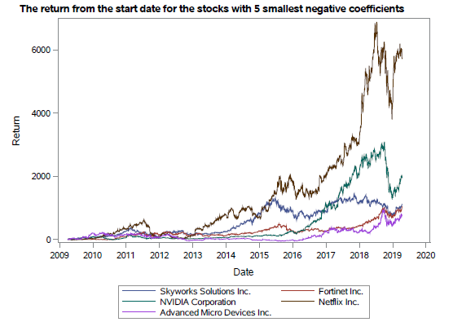
2rd Principal Component
Range is different
Trend of right side is higher
Buying Netflix is a good deal
😉
Notes:
The left side is more stable and the right side soared from 2017 to 2018 and fluctuates a lot recently
Thus， but real esate to lower risk and get less return。 With information technology and communication services to get higher return but with ｈｉｇｈ risk

Slide 10
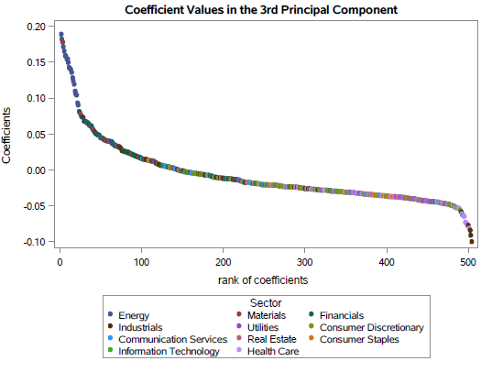
３rd Principal Component
Left upper corner:
energy
materials
right lower corner:
Health and Airlines

Slide 11
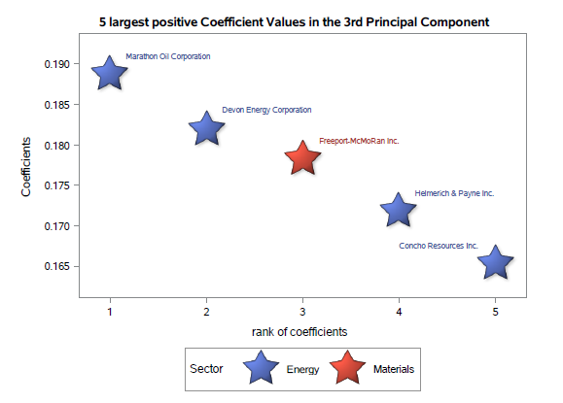
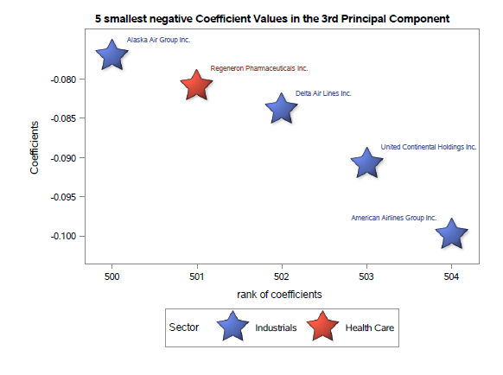
３rd Principal Component

Slide 12
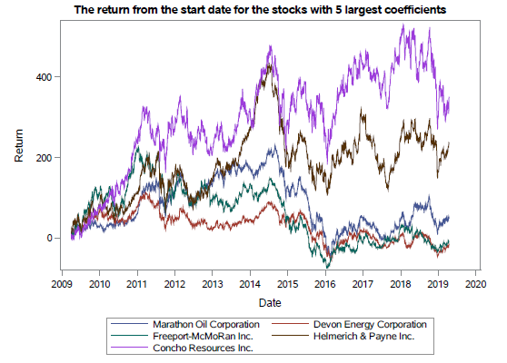
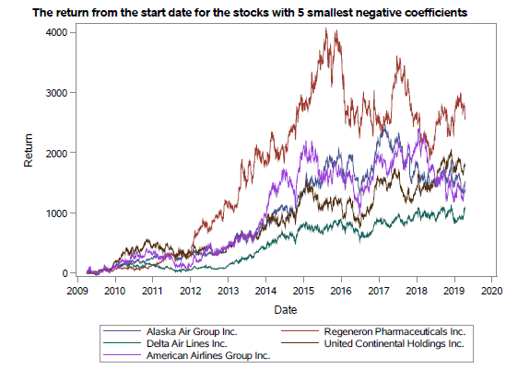
３rd Principal Component
The Airlines and pharmaceutical companies increased more
Change in opposite direction

Slide 13
Summary and Limitation
PCA could separate stocks by similarity variation between sectors
Lack of knowledge in finance to fully explain results
👍
📖

Slide 14
Thanks!
Any questions?

