Slide 1
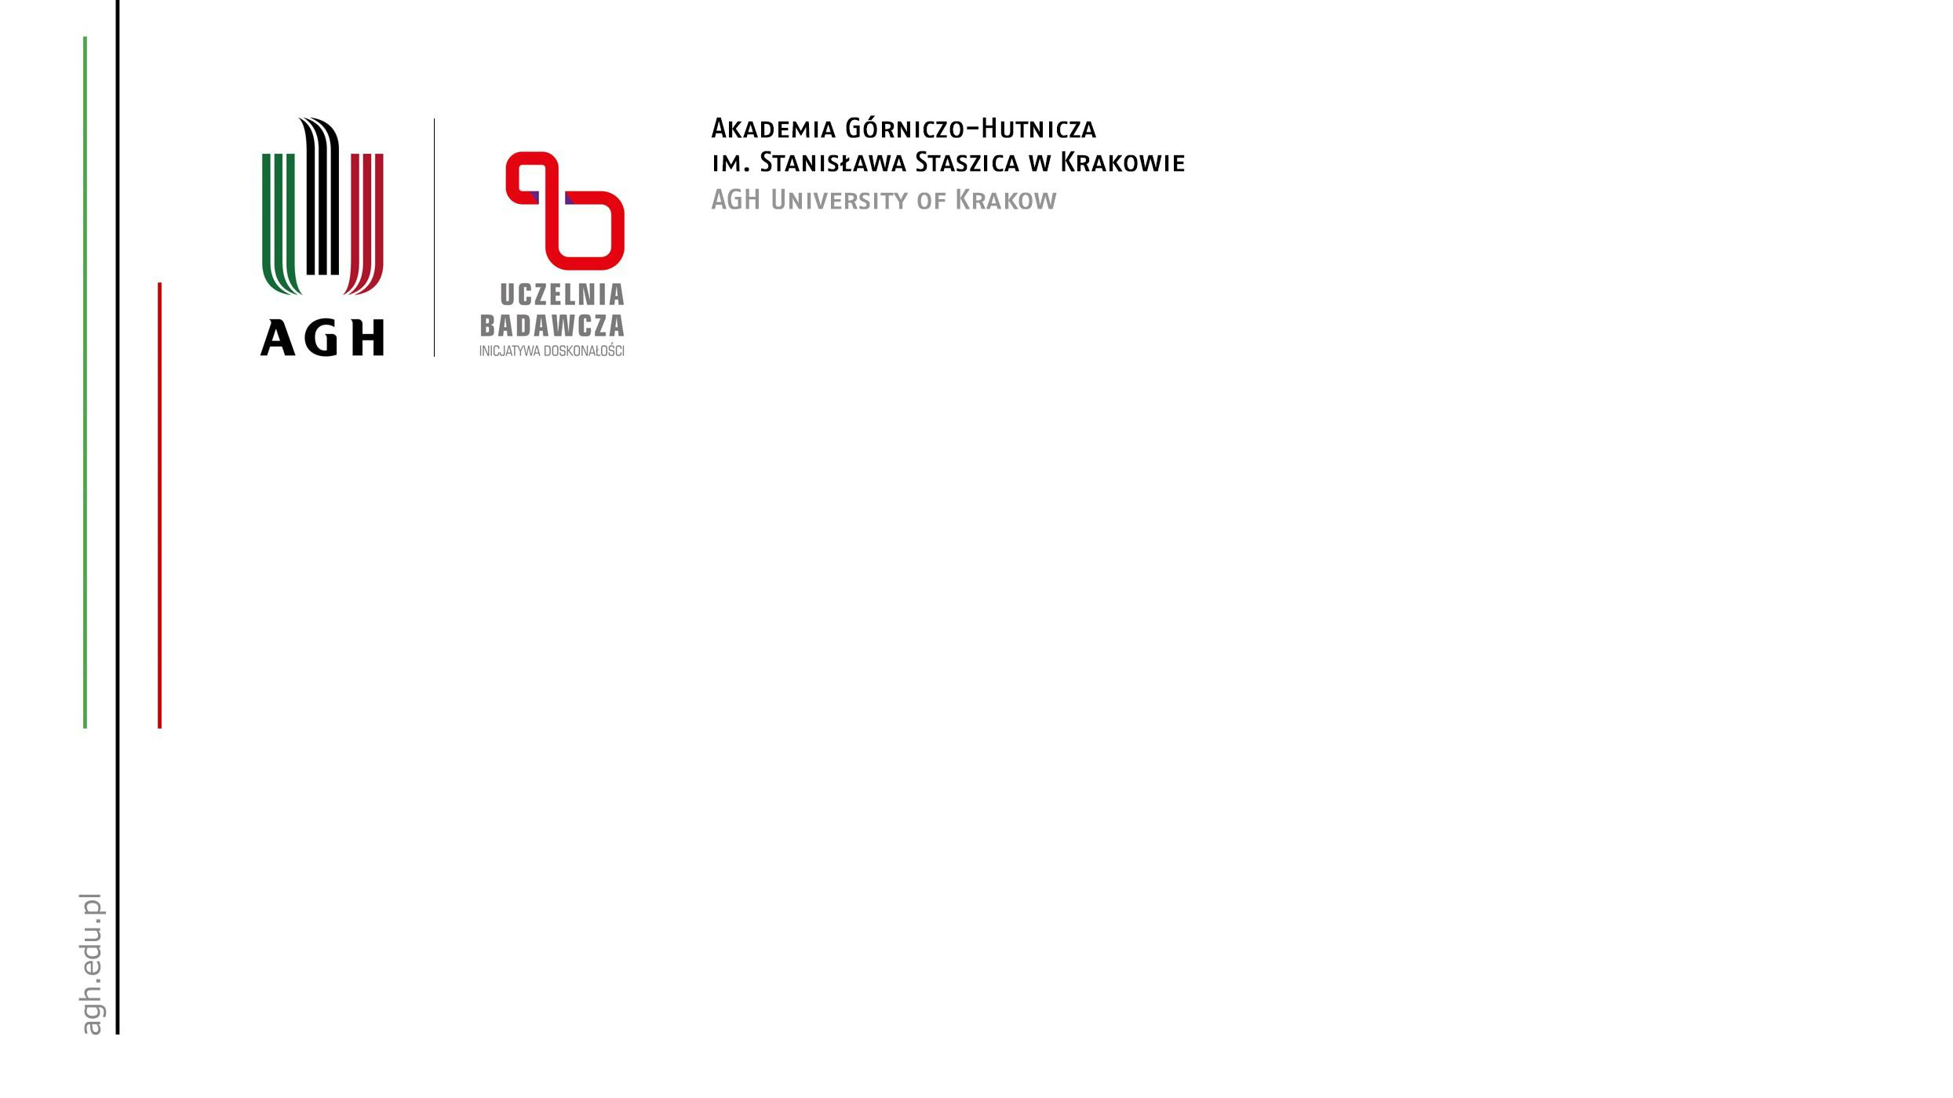
Best state-of-the-art models for semantic segmentation problems and their abilities and limitations
Author: Angelika Żyła
08.05.2024r.

Slide 2
Semantic Segmentation
The semantic image segmentation task consists of classifying each pixel of an image into an instance, where each instance corresponds to a class. This task is a part of the concept of scene understanding or better explaining the global context of an image. In the medical image analysis domain, image segmentation can be used for image-guided interventions, radiotherapy, or improved radiological diagnostics.

Slide 3
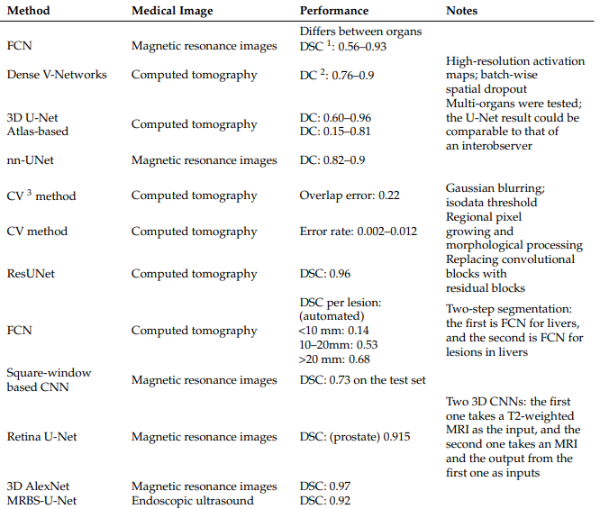
Models

Slide 4
Fully Convolutional Network (FCN)
One of the most-selected models for segmentation tasks is FCN. The difference between FCNs and traditional convolutional neural networks is that the last layer is not a fully connected layer that enables the model to integrate information. Instead, the final number of output channels is modified through convolutional networks. The main benefit of this approach is that the model has no restrictions from the full connection layer, so the size of the input can be flexible.

Slide 5
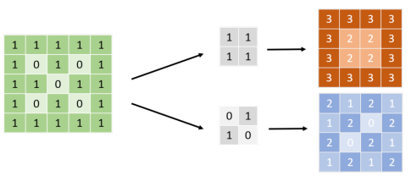
Convolutional Neural Network (CNN)
Figure 1. CNN kernel. Before input, the figure will be transformed into a signal, as shown on the left; 0/1, for example. The arrays in the middle are called the convolutional kernel. The size of the kernel must not be larger than the input. The neural network applies several kernels with different weight compositions to the input to obtain feature maps, which are usually dot products, as shown on the right. The neural network extracts a feature that can make them accomplish the tasks from those kernels [1].

Slide 6
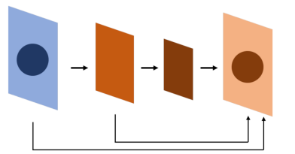
Fully Convolutional Network (FCN)
Figure 2. FCN. The whole neural network is composed of a convolutional neural network, which is different from a conventional neural network, especially on the bottom 1~2 layers. The result is at a pixel level, so the network can afford a segmentation task. FCN uses a convolutional neural network to extract features and uses skip connections to find out the location of the feature at the whole-map level [1].

Slide 7
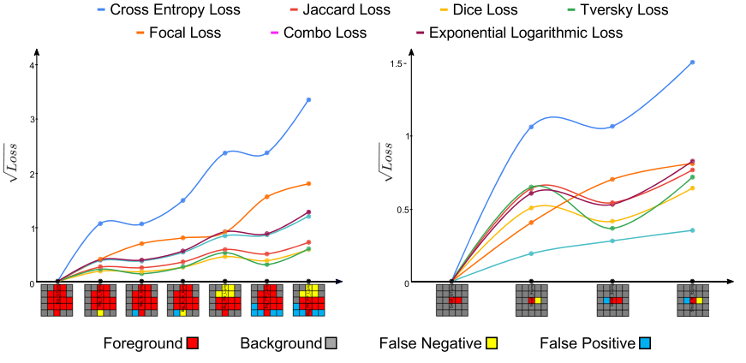
Loss functions
Rysunek 1. A comparison of seven loss functions for diferent extends of overlaps for a large (left) and a small (right) object [1].

Slide 8
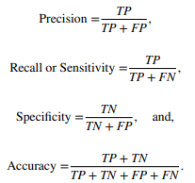
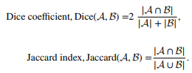

Evaluation metrics

Slide 9
Medical Imaging
Diagnostics - Segmenting organs, tumors, and other anatomical structures from medical images such as MRI, CT scans, and X-rays to assist in diagnosis.
Radiotherapy - Identifying target regions and critical structures to plan and deliver precise radiation treatment.
Surgical Planning - Providing detailed maps of anatomy to assist surgeons in planning and performing procedures.

Slide 10
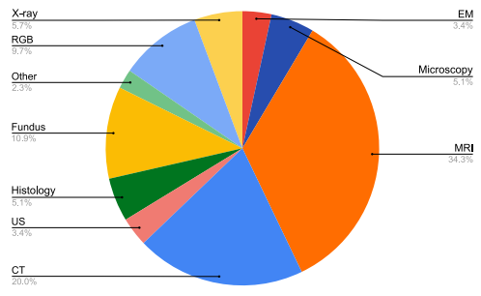
Semantic Segmentation
Figure 4. Analyzing the attributes of the medical image segmentation papers discussed in this review. The large number of medical imaging modalities. As well as the smaller average dataset sizes for medical image segmentation datasets [2].

Slide 11
Semantic segmentation is used…
Autonomous Driving - Scene Understanding, Obstacle Detection.
Aerial and Satellite Imagery - Land Use and Land Cover Mapping, Disaster Response.
Robotics – Navigation, Manipulation.
Agriculture - Crop Monitoring, Weed Detection.

Slide 12
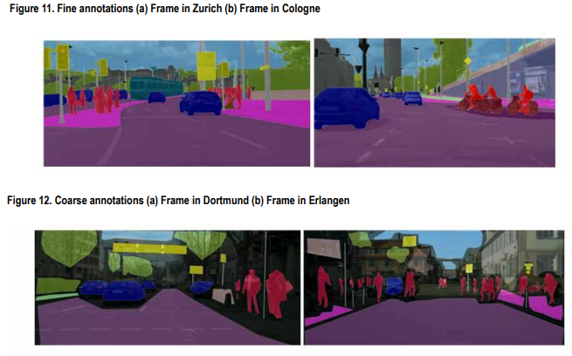
Semantic Segmentation

Slide 13
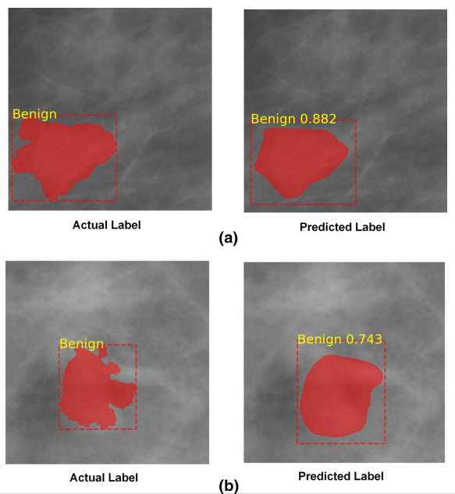
Semantic Segmentation
Figure 6. Actual vs predicted label of the benign class

Slide 14
Literature
[1] A review of semantic segmentation using deep neural networks Yanming Guo1, Yu Liu1, Theodoros Georgiou1, Michael S. Lew1 Received: 9 October 2017 / Revised: 2 November 2017 / Accepted: 14 November 2017 / Published online: 24 November 2017
[2] Semantic Segmentation: A Systematic Analysis From State-of-the-Art Techniques to Advance Deep Networks Aakanksha, Amity University, Noida, India Arushi Seth, Amity University, Noida, India Shanu Sharma, ABES Engineering College, India, https://orcid.org/0000-0003-0384-7832
[3] How deep learning is empowering semantic segmentation Traditional and deep learning techniques for semantic segmentation: A comparison Uroosa Sehar1, Muhammad Luqman Naseem2 Received: 3 June 2021 / Revised: 28 January 2022 / Accepted: 9 March 2022, LLC, part of Springer Nature 2022
[4] Deep semantic segmentation of natural and medical images: a review Saeid Asgari Taghanaki1 · Kumar Abhishek1 · Joseph Paul Cohen2 · Julien Cohen‑Adad3 · Ghassan Hamarneh1 Published online: 13 June 2020, Springer Nature B.V. 2020
[4] Abdulla W (2017) Mask R-CNN for object detection and instance segmentation on Keras and TensorFlow. https://github.com/matterport/Mask_RCNN
[5] Abhishek K, Hamarneh G (2019) Mask2Lesion: mask-constrained adversarial skin lesion image synthesis. In: Medical image computing and computer-assisted intervention workshop on simulation and synthesis in medical imaging, pp 71–80
[6] Abhishek K, Hamarneh G, Drew MS (2020) Illumination-based transformations improve skin lesion segmentation in dermoscopic images. arXiv:200310111
[7] Images data practices for Semantic Segmentation of Breast Cancer using Deep Neural Network Luqman Ahmed1 · Muhammad Munwar Iqbal1 · Hamza Aldabbas2 · Shehzad Khalid3 · Yasir Saleem4 · Saqib Saeed5 Received: 30 September 2019 / Accepted: 3 January 2020 Published online: 13 January 2020, Springer-Verlag GmbH Germany, part of Springer Nature 2020

Slide 15
Thank you for your attention!

