Slide 1
RAPIDS: end-to-end data science on GPU
Michael Poli

Slide 2
RAPIDS in a nutshell:
RAPIDS is a suite of open source software libraries developed with the aim of enabling execution of end-to-end data science and analytics pipelines entirely on GPUs.
These libraries rely on NVIDIA® CUDA® primitives for low-level compute optimization, while concurrently exposing GPU parallelism and high-bandwidth memory speed through user-friendly Python interfaces.
https://rapids.ai/index.html

Slide 3
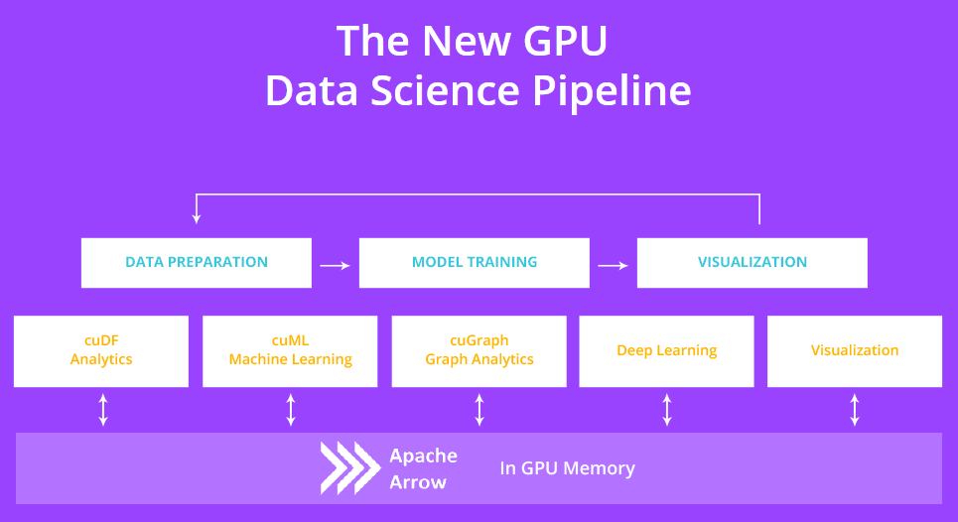
https://rapids.ai/index.html

Slide 4
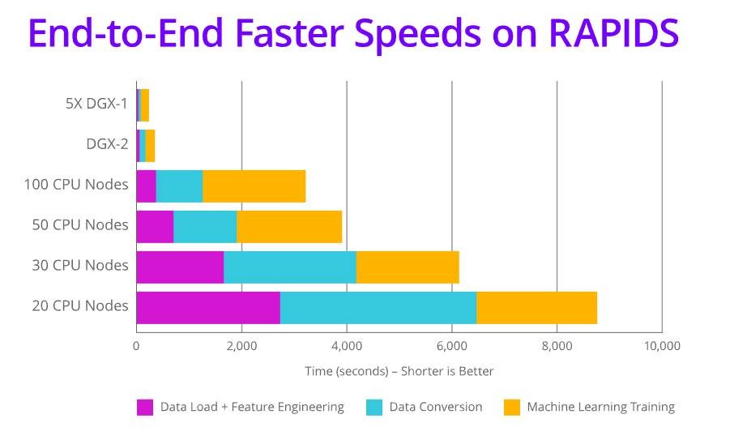
https://rapids.ai/index.html

Slide 5
KEY FEATURES:
cuDF:
DataFrame manipulation for data preparation
cuDF currently has 2 APIs: C++ and a Python API that mimics Pandas
cuML:
GPU-accelerated machine learning libraries.
Apache Arrow:
Columnar in-memory data structure that delivers efficient and fast data interchange with flexibility to support complex data models.
https://rapids.ai/index.html

Slide 6
Apache Arrow
Apache Arrow is a cross-language development platform for in-memory data.
Standard language-independent columnar memory format for flat and hierarchical data, organized for efficient analytic operations on modern hardware.
https://arrow.apache.org/

Slide 7
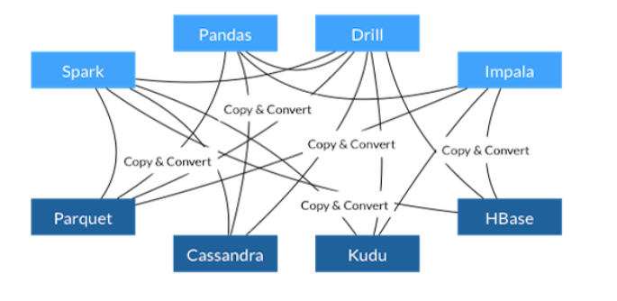
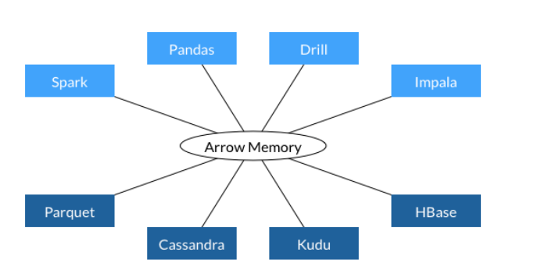
Apache Arrow is an open standard for DataFrame-like data manipulation
Main draw: zero-copy reads between interfaces
https://arrow.apache.org/

Slide 8
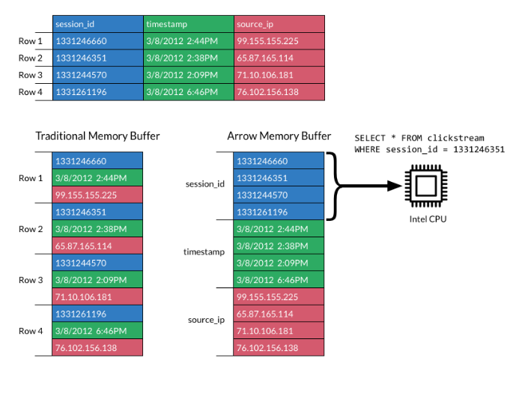
Additional advantages:
Execution engines can take advantage of SIMD while processing DataFrames
Cache misses minimized
Leverages columnar compression techniques
Allows for the deconstruction of traditionally vertically integrated analytic database architectures
Apache Arrow: A Cross-Language Development Platform for in Memory Data | SciPy 2018 | Wes McKinney

Slide 9
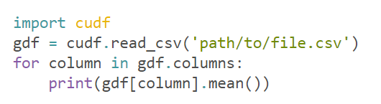
Example 1:
https://rapids.ai/start.html

Slide 10
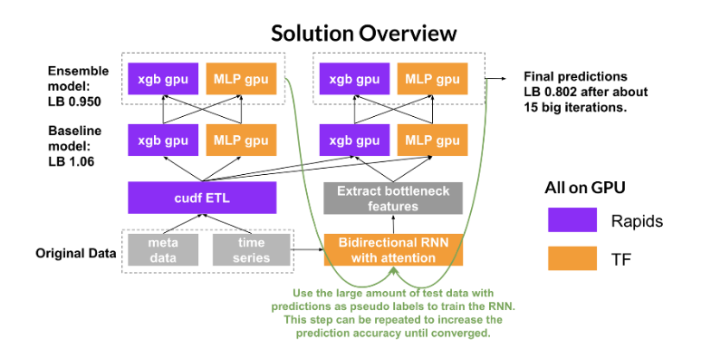
Example 2: Kaggle competition

