Slide 1
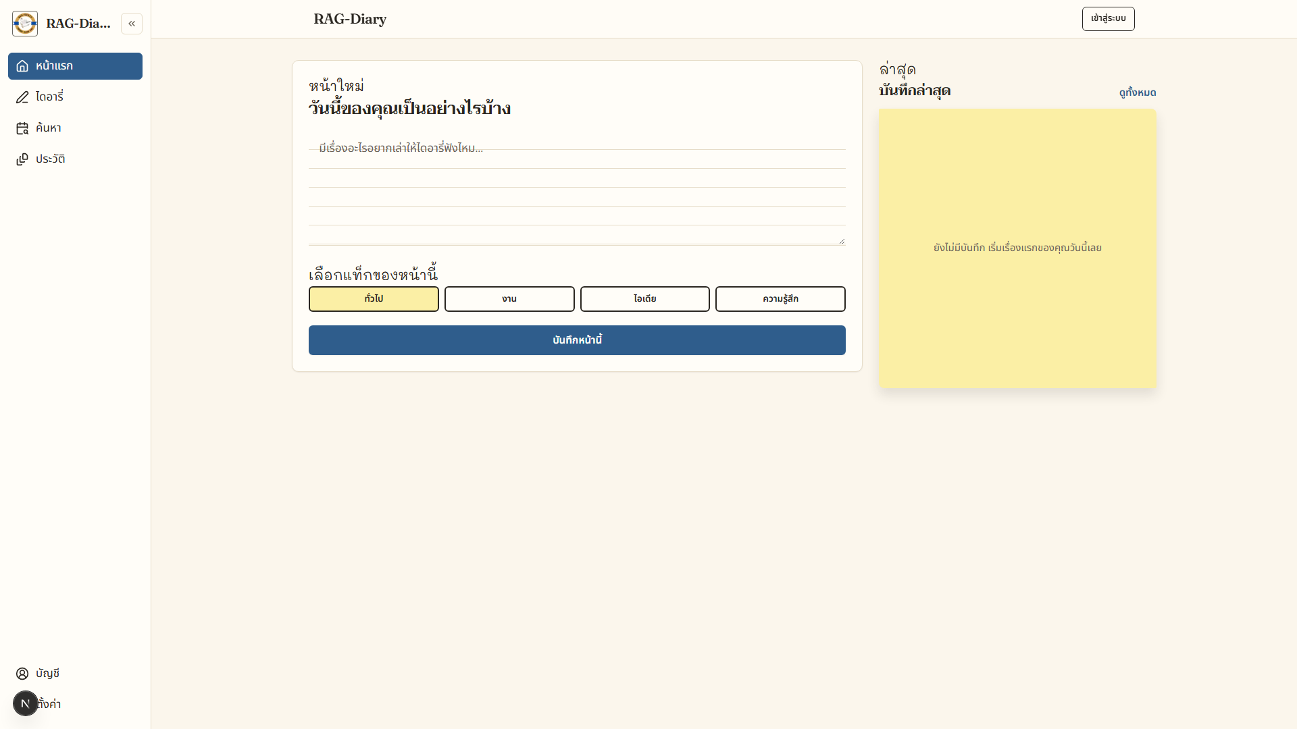
BA / SA Portfolio | Self-initiated project
RAG-Diary
A private diary you can search and talk to with AI
A working system • 25 documents • AI through Google Gemini
25
15 + 8
24
documents
FR / NFR
test cases
RAG-Diary | BA/SA project overview | v1.0
1 / 22
Notes:
Open with the short version: a project that was actually built, with a complete document set.

Slide 2
At a glance
The size of what was delivered
Every figure comes from the D-00 to D-24 set and the code that is deployed
25
23
16
documents
requirements
use cases + stories
D-00 to D-24, every stage from discovery to delivery
15 functional and 8 non-functional, each measurable
6 use cases and 10 user stories with acceptance criteria
30
15
22
test cases
API endpoints
automated tests
24 test cases and 7 UAT scenarios, traced in the RTM
auth 5, notes 4, search/chat 2, AI 2, export/delete 2
13 server and 9 frontend, with GitHub Actions on every push
Every figure traces back in the TRACEABILITY-MATRIX (D-09)
RAG-Diary | BA/SA project overview | v1.0
2 / 22
Notes:
Point out that every number can be traced in the documents and matches the deployed code.

Slide 3
01
Problem and users
6 pain points from the AS-IS
Why this system exists, and who benefits
9 stakeholders · 2 personas
v1.0 scope by MoSCoW
ส่วนที่ 01 จาก 3
RAG-Diary | BA/SA project overview | v1.0
3 / 22
Notes:
Three parts: the problem, the users, the scope.

Slide 4
Discovery
The problem with paper and note apps
6 pain points lead to 7 gaps, each tied to a requirement
PP-01 Entries are scattered across apps and exact-word search misses them
7 gaps
PP-02 The original words are forgotten, so nobody goes back to read
GAP-01 to GAP-07, traced to every FR and closed in v1.0
PP-03 There is no view of mood over time
PP-04 Important memories are never kept as an image
Result: 7 gaps tied to every FR in the RTM
RAG-Diary | BA/SA project overview | v1.0
4 / 22
Notes:
Use PP-01 and PP-02 as the examples most diary writers recognise.

Slide 5
Users and stakeholders
Two main personas, nine stakeholder groups
Casual
Reflective
SH-01 to SH-09
Occasional diarist
Long-term diarist
Nine groups
• Writes in short bursts
• The form never blocks writing
• Finds entries with words they remember
• Reviews by period
• Searches and chats with entries
• Mood summary and illustration
• Users, admins and the DPO
• Development and test teams
• RACI across 6 decisions
D-03 · SH-01
D-03 · SH-02
D-03 · SH-09
The anchor requirement: FR-15 isolates data on every path
RAG-Diary | BA/SA project overview | v1.0
5 / 22
Notes:
Personas come from the stakeholder matrix and its communication plan.

Slide 6
v1.0 scope
Priority by MoSCoW
Level | Count | Items | Reason
Must | 11 | FR-01 to FR-06, 08, 09, 13, 14, 15 | Without it the product cannot run, or it breaks a privacy requirement
Should | 3 | FR-07 edit, FR-10 chat, FR-11 mood summary | Clearly better with it, but the product still works without
Could | 1 | FR-12 illustration | Adds value, but depends on the AI provider's quota
Won't | — | Separate mobile app, team sharing, multiple tags | Beyond v1.0 and it would complicate the data model
15 FRs in total: Must 11 · Should 3 · Could 1, matching the SRS and ROADMAP
RAG-Diary | BA/SA project overview | v1.0
6 / 22
Notes:
This table matches the SRS and ROADMAP after the consistency check.

Slide 7
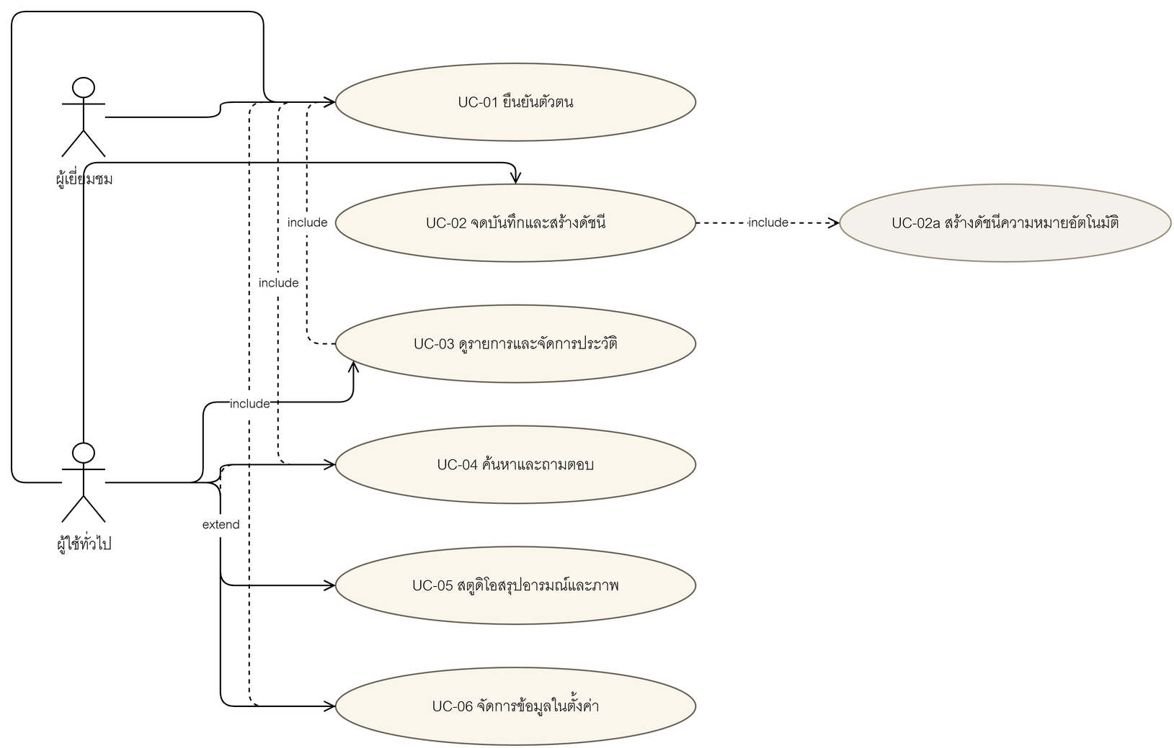
Use case
The scope in one picture
6 main use cases, tied to the FRs and to UAT
UC-01 to UC-06 · users and external systems
RAG-Diary | BA/SA project overview | v1.0
7 / 22
Notes:
UC-04 and UC-05 are the points where consent is required before data leaves.

Slide 8
02
Architecture and data
C4 · ERD · DFD
What the system is made of, and how the data stays safe
pgvector + RLS, 4 policies
Gemini embeddings and chat
ส่วนที่ 02 จาก 3
RAG-Diary | BA/SA project overview | v1.0
8 / 22
Notes:
This part uses the real diagrams from the document set.

Slide 9
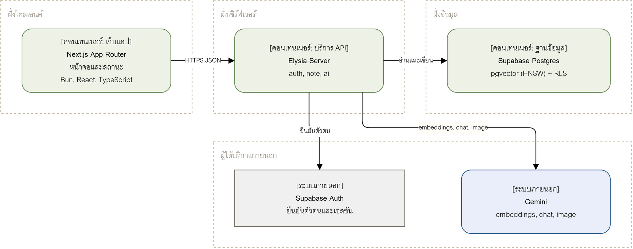
C4 Level 2
Containers and the stack in use
Next.js, Elysia, Supabase + pgvector, Google Gemini
C4 Level 2
RAG-Diary | BA/SA project overview | v1.0
9 / 22
Notes:
Frontend and backend are clearly separated, and every request carries the session cookie.

Slide 10
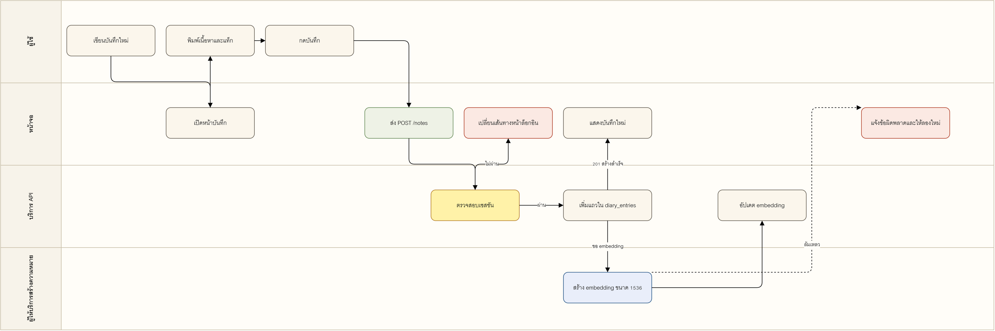
Process flow
PF-01 Write an entry and build the index
User → screen → API → Gemini, and where it can fail
PF-01
RAG-Diary | BA/SA project overview | v1.0
10 / 22
Notes:
Tell the main path, and the point where embedding fails while the entry is still saved.

Slide 11
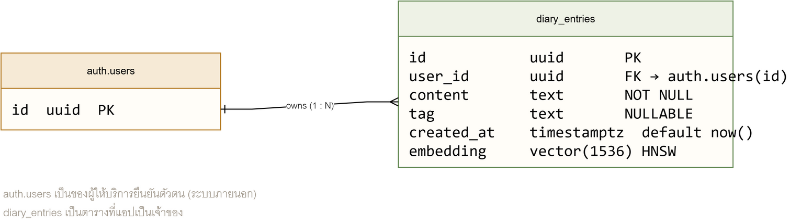
Data model
Data and safety at the database level
diary_entries + HNSW (cosine) + 4 RLS policies keyed on auth.uid()
diary_entries · match_diary_entries · search_diary_entries
RAG-Diary | BA/SA project overview | v1.0
11 / 22
Notes:
RLS means isolation does not depend on application code alone.

Slide 12
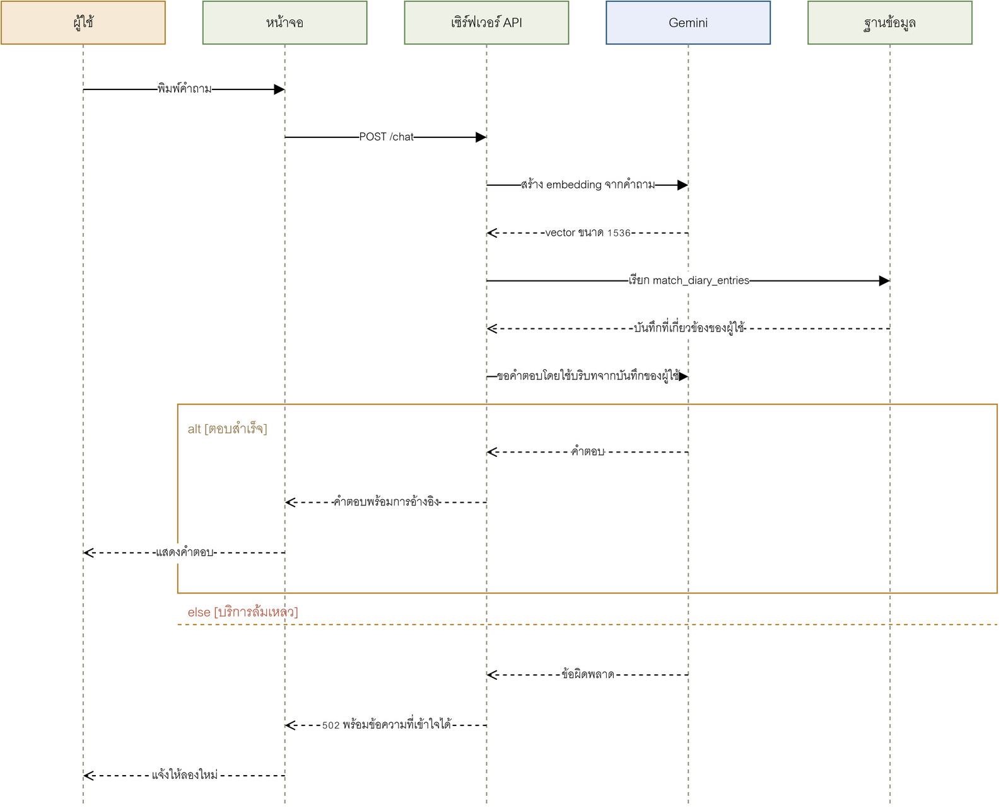
Message sequence
RAG: retrieve first, then answer
SEQ-04 searches only the signed-in user's index
SEQ-04
RAG-Diary | BA/SA project overview | v1.0
12 / 22
Notes:
The question embedding retrieves five contexts before the model answers.

Slide 13
AI
The AI provider and its limits
Moved from OpenAI to Google Gemini (free tier), per ADR-08
Embeddings gemini-embedding-001 at 1,536 dimensions, matching the existing column
Chat and summary gemini-3.5-flash through the OpenAI-compatible chat completions endpoint
Images gemini-3.1-flash-image, subject to plan quota; may answer 429
Limits Model names change often, so they are read from the environment
Effect: AI cost is lower, but quota and model availability need watching
RAG-Diary | BA/SA project overview | v1.0
13 / 22
Notes:
Say plainly that the free tier has quota, and that the system reports when images are unavailable.

Slide 14
Privacy
PDPA: when data leaves the system
From DFD Level 0/1 and the PII inventory in D-14
7 PII items Email, password, content, tag, time, embedding and the session cookie
Verification
Boundary crossings Text and questions go to Google Gemini when indexing, answering or drawing
TC-18 and UAT-07 tie to NFR-03 and BR-06
Controls RLS on every row, a consent gate before AI, self-service export and delete
Status Enforced on the client, withdrawable in settings
The consent gate has been live since CR-06
RAG-Diary | BA/SA project overview | v1.0
14 / 22
Notes:
This point used to be only a proposal and was closed by CR-06.

Slide 15
03
Quality, testing and plan
8 measurable NFRs
How we know the system is good enough
24 test cases · 7 UAT
Plan from v1.0 to v1.2
ส่วนที่ 03 จาก 3
RAG-Diary | BA/SA project overview | v1.0
15 / 22
Notes:
The last part is about evidence of quality and the plan ahead.

Slide 16
UX
The language and look users see
Paper and ink
Latin first, Thai after
/login to /setting
Marginalia
Type
7 screens
• Paper #FFFDF8
• Ink #3B2A1E
• Accents #2F5D8C and #C8553D
• Headings in Cordia New bold
• Body in Cordia New 16 pt
• Line height 1.2–1.5
• Mood and image studio
• Search and chat
• Settings and data control
D-15 · tokens
D-15 · fonts
D-15 · screens
Checked at 390px: no content overflow (overflow = 0)
RAG-Diary | BA/SA project overview | v1.0
16 / 22
Notes:
Thai fonts were added later so the app matches the document set.

Slide 17
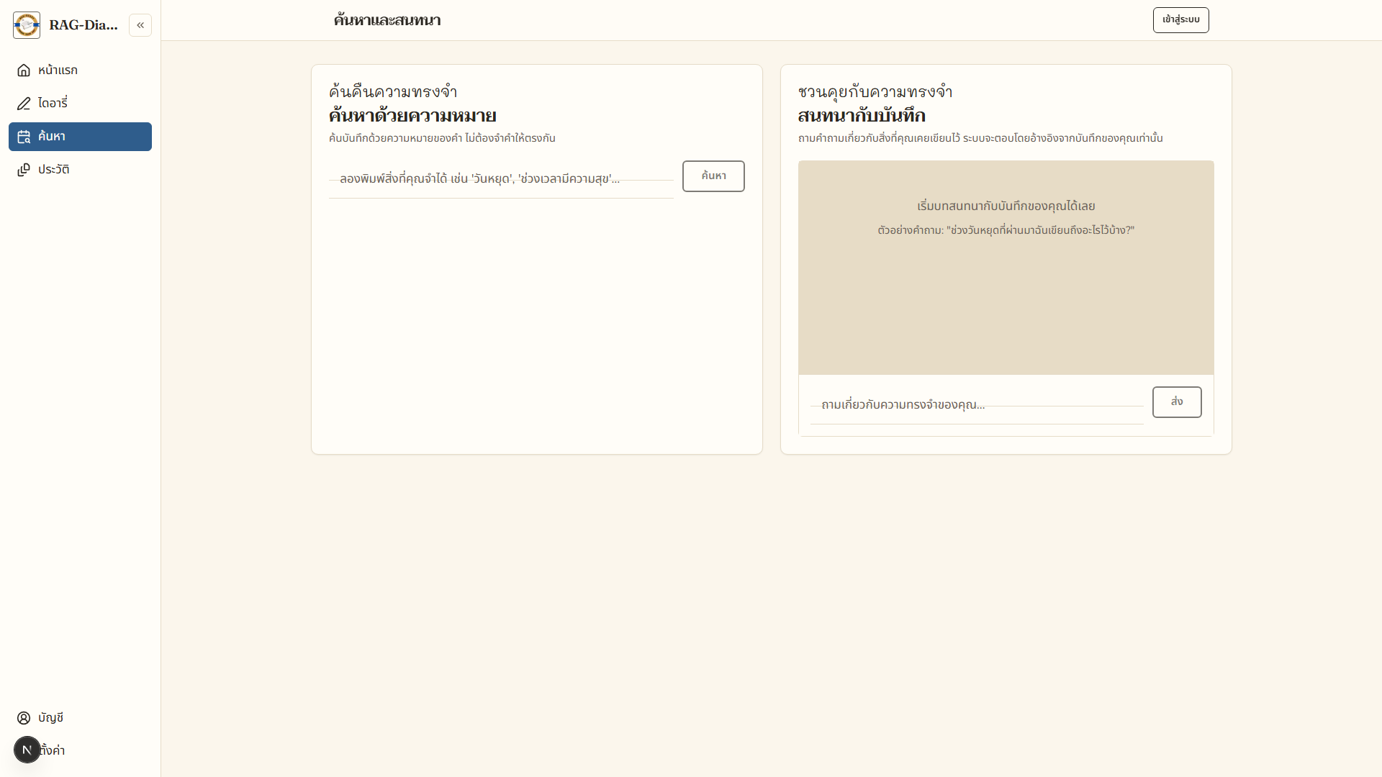
Real screens
A working product, not a mock-up
Deployed on Vercel: frontend, API and Supabase
Home: write and tag an entry
Search by meaning, not exact words
Checked at 390px with no content overflow (NFR-08)
RAG-Diary | BA/SA project overview | v1.0
17 / 22
Notes:
Show the real screens, to make the point that this is a product, not a slide deck.

Slide 18
NFR
Eight quality requirements that can be measured
ID | Area | Measure | Latest result
NFR-01 | Performance | Search p95 within 3.5 s at 5,000 entries | p95 3.16 s (pass)
NFR-02 | Security | Zero cross-user access; every endpoint requires auth | 401 on every path without a session
NFR-03 | PDPA | Notice and consent complete; export and delete work | consent gate + export/delete
NFR-04 | Accessibility | Every flow works by keyboard; messages are readable | aria-label and focus ring in place
NFR-05 | Errors | The screen stays usable when a provider fails | 503 with a plain-language message
NFR-06 | Scalability | Ten times the data does not blow up response time | HNSW plus an index on user_id
NFR-07 | Maintainability | Type checking passes; no duplicated data access | tsc 0 errors · 22 tests
NFR-08 | Compatibility | Phone to large screen, no overflow or overlap | 390–1440 px, no overflow
Verified by TC-16 to TC-24 in the TEST-PLAN
RAG-Diary | BA/SA project overview | v1.0
18 / 22
Notes:
Point at NFR-01, measured at 3.16 s, and NFR-02, verified with 401 responses.

Slide 19
Risk
Risks worth watching, and what was closed
ID | Risk | Score | Status | Mitigation
R-01 | Token stolen through a script | 20 | Reduced | httpOnly cookie (ADR-10)
R-04 | Data sent out without clear consent | 20 | Reduced | consent gate + UAT-07
R-02 | Too many calls, cost runs away | 16 | Reduced | rate limit in code (awaiting migration)
R-05 | Dependence on one AI provider | 12 | Open | an adapter that can switch providers
R-09 | No automated test suite | 12 | Reduced | 22 tests + GitHub Actions
R-11 | Vector search slows as data grows | 8 | Open | load testing and HNSW tuning
RAG-Diary | BA/SA project overview | v1.0
19 / 22
Notes:
R-01, R-02, R-04 and R-09 are closed or reduced; R-05 and R-11 still need watching.

Slide 20
Testing
Evidence, and what is still open
Reported honestly, including what could not run
TC-01 to TC-24 Tied to all 15 FRs and 8 NFRs through the RTM
22 automated tests 13 server and 9 frontend, all passing in CI on every push
22 QA checks Verify the 25 documents, the PDF count and type checking
p95 3.16 s Measured with 30 entries and 20 queries, against a 3.5 s target
Still open: UAT has not run with real users, and /ai/imagine is blocked by provider quota
RAG-Diary | BA/SA project overview | v1.0
20 / 22
Notes:
Say plainly that some AI paths were skipped for quota, not hidden.

Slide 21
Delivery plan
From v1.0 to the next releases
Done
Done (rate limit awaits migration)
Not started
v1.0 MVP
v1.1 Hardening
v1.2 Experience
• FR-01 to FR-15 complete
• Documents D-00 to D-24
• Deployed on Vercel
• Per-user rate limiting
• httpOnly cookies (ADR-10)
• CI and export/delete
• Several tags per entry
• Favourites screen
• Timeline and mood trends
M1–M5 in the ROADMAP
Closes R-01, R-02, R-09
From the RTM and DATA-MODEL
Milestones M1 to M5 are in the ROADMAP
RAG-Diary | BA/SA project overview | v1.0
21 / 22
Notes:
The plan references the risks and the observations in the RTM.

Slide 22
Lessons
What building it for real taught me
Build it The system runs, and the documents were written from the real thing
Check both ways Documents and code must agree: consent, fonts, NFR numbers
Quality discipline Automated QA, 100 percent RTM coverage, gaps closed by CR
Next UAT with real users, Playwright end-to-end tests, turn on rate limiting
Accepted limit: the team is simulated, and there are no real users yet
RAG-Diary | BA/SA project overview | v1.0
22 / 22
Notes:
Close on the honest limitation.

