Slide 1

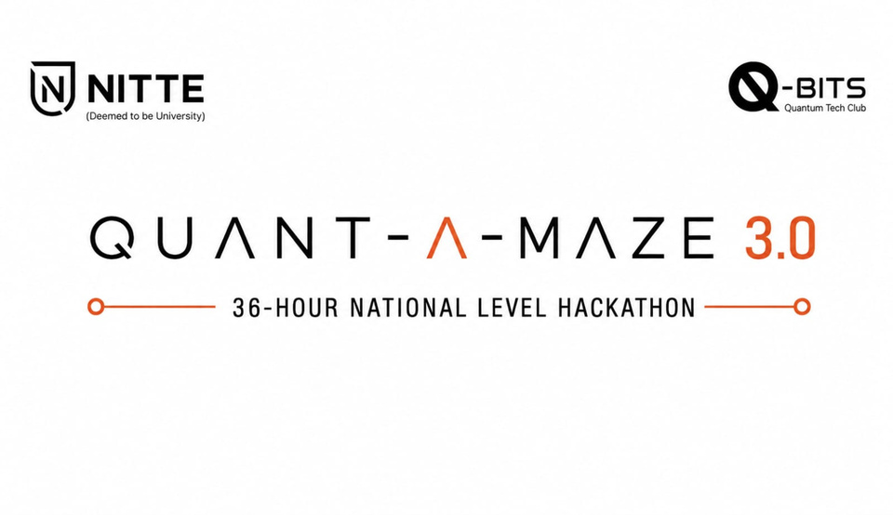

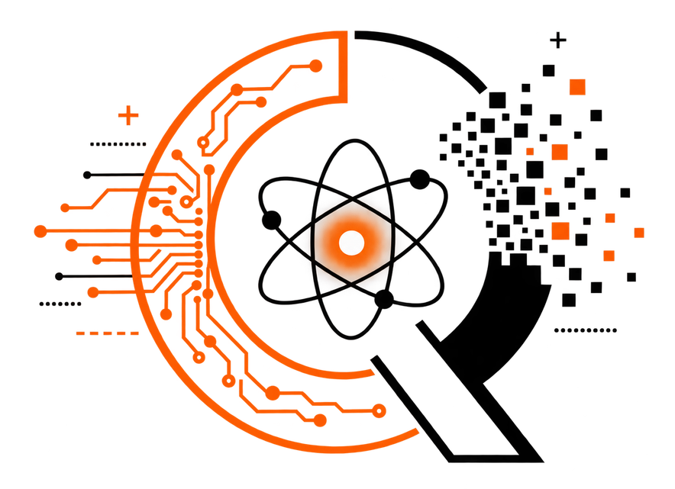

1. Participant Information & Topic Name
Q-SHIELD
Continuous trust, not one-time trust.
  Team Name –
  Team Lead Name –
  Team Lead Contact No –
  Selected Track:
    Post-Quantum Cryptography (PQC)

Slide 2
AUTHENTICATE ONCE
Q-SHIELD
2. Problem Definition
THE PROBLEM
Authentication answers:
“Who are you?”
AIoT security must keep asking:
“Can you still be trusted?”
DEVICE
AUTHENTICATE
OBSERVE
AUTHENTICATED
CORRELATE
TRUSTED FOREVER
TRUST
← the gap
RESPOND

Slide 3
3. Proposed Solution & Execution Plan
CONTINUOUS TRUST,
NOT ONE-TIME TRUST.
Every device message and every AI observation is authenticated,
then fused into one deterministic, explainable trust score.
A valid signature never raises trust by itself —
trust is earned only by what the evidence actually says.
ESP32
Camera
Telemetry / Sensors
YOLO11n → Signed Obs.
PQC SECURITY LAYER
ML-KEM-768 · ML-DSA-65
DYNAMIC TRUST ENGINE
TRUST STATE
TRUSTED
SUSPICIOUS
QUARANTINED
RECOVERING
VERIFIED
RECOVERED

Slide 4
4. Technical Design
Five layers. Trust computation never touches the detector,
the camera, the firmware or the crypto code.
  Orange hexagon = implemented, tested
  Gray hexagon = designed, not yet built
AIoT DEVICE
IMPLEMENTED
ESP32 · HMAC
VISION
IMPLEMENTED
YOLO11n
SECURITY
IMPLEMENTED
ML-DSA · ML-KEM
TRUST ENGINE
IMPLEMENTED
scoring · fusion
RESPONSE
DESIGNED
quarantine

Slide 5
5. Feasibility & Innovation
Real gateway. Real webcam. Real forged attack,
rejected — and the score fell because of it.
USP
Continuous trust across cyber, physical and
visual signals — secured by post-quantum crypto.
544
TESTS PASSING
53 µs
MEAN TRUST APPLY
73 µs
P99 LATENCY
ML-KEM-768
ML-DSA-65
OBSERVE
VERIFY
TRUST
RE-TRUST
RECOVER
RESPOND

Slide 6
6. Expected Outcome
Demonstrated
Live gateway, real detection, real rejected attack,
real score drop — not simulated.
Honest gap
Quarantine and recovery are validated states —
not yet enforced. That is next.
Future scope
Enforcement, recovery orchestration, evidence chain,
digital twin, dashboard (Phases 5–10).
NOTE : export and upload as pdf

