Slide 1

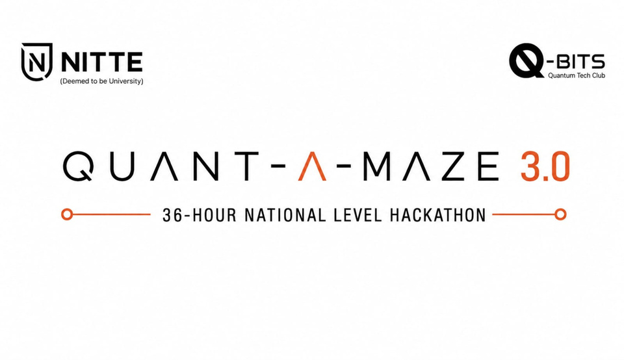

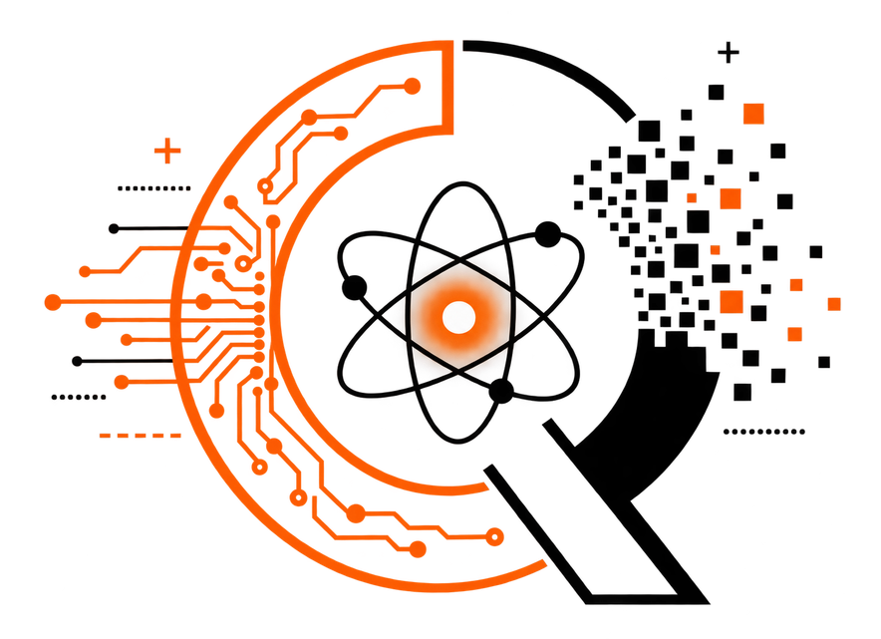

1. Participant Information & Topic Name
Q-SHIELD
Quantum-Resilient Self-Healing AIoT Security Architecture
  Team Name –
  Team Lead Name –
  Team Lead Contact No –
  Selected Track:
    Post-Quantum Cryptography (PQC)

Slide 2
AUTHENTICATE ONCE
Q-SHIELD
2. Problem Definition
THE PROBLEM
Static IoT authentication answers one question:
“Who are you?”
But AIoT security also has to keep asking:
“Can you still be trusted?”
A device can authenticate perfectly and still be compromised
the moment after. Authentication is a snapshot; trust has to be continuous.
DEVICE
AUTHENTICATE
OBSERVE
AUTHENTICATED
CORRELATE
TRUSTED FOREVER
TRUST
← the gap
RESPOND

Slide 3
3. Proposed Solution & Execution Plan
Solution Overview
A continuous trust pipeline layered on top of authentication:
every sensor reading and every observation is turned into a
signed, explainable trust decision.
Working Principle
Device and vision evidence is authenticated first, fused into a
deterministic 0–100 score, then mapped to a device state.
Core Functionality
Signed telemetry • signed visual observations • replay
rejection • deterministic scoring • explainable events.
ESP32
Camera
Telemetry / Sensors
YOLO11n → Signed Obs.
PQC SECURITY LAYER
ML-KEM-768 · ML-DSA-65
DYNAMIC TRUST ENGINE
TRUST STATE
TRUSTED
SUSPICIOUS
QUARANTINED
RECOVERING
VERIFIED
RECOVERED

Slide 4
4. Technical Design
Five layers, cleanly separated. Trust computation stays out of
the detector, the camera, the firmware and the crypto code.
AIoT DEVICE LAYER
ESP32 · Sensors · Telemetry (HMAC-SHA256)
IMPLEMENTED
VISION LAYER
Camera · YOLO11n · Visual Rule Signals
IMPLEMENTED
SECURITY LAYER
ML-DSA-65 · ML-KEM-768 · AES-256-GCM · Replay Protection
IMPLEMENTED
TRUST LAYER
Dynamic Trust · Signal Fusion · Temporal Decay · Caps/Gates · Explainable Events
IMPLEMENTED
RESPONSE LAYER
Quarantine · Recovery · Re-authentication · Trust Restoration
DESIGNED / NEXT

Slide 5
5. Feasibility & Innovation
Technical Feasibility
Phases 0–4.1 run end to end today on real hardware and a
real webcam — not a slide-only concept.
Scalability / Performance
Trust-engine cost is measured, not assumed (right).
Innovation / USP
Continuous dynamic trust across cyber, physical and visual
signals, secured by post-quantum cryptography.
544
TESTS PASSING
53 µs
MEAN TRUST APPLY
73 µs
P99 LATENCY
ML-KEM-768
ML-DSA-65
OBSERVE
VERIFY
TRUST
RE-TRUST
RECOVER
RESPOND

Slide 6
6. Expected Outcome
Expected Results / Prototype
A working gateway, real webcam + YOLO11n pipeline, ML-KEM
session and a live dynamic-trust run — demonstrated, not simulated.
Real-World Impact
A pattern for AIoT deployments that must keep working after
cryptographically-relevant quantum computers arrive.
Future Scope
Quarantine enforcement, recovery orchestration, self-healing
response and a live operator dashboard (Phases 5–10).
NOTE : export and upload as pdf

