Slide 1

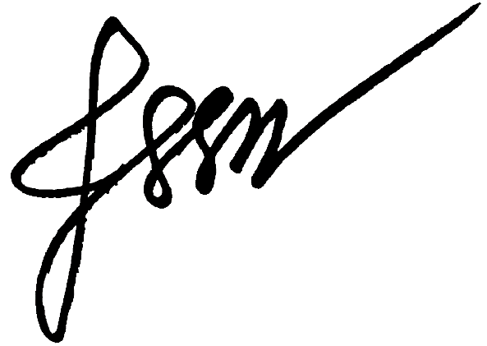
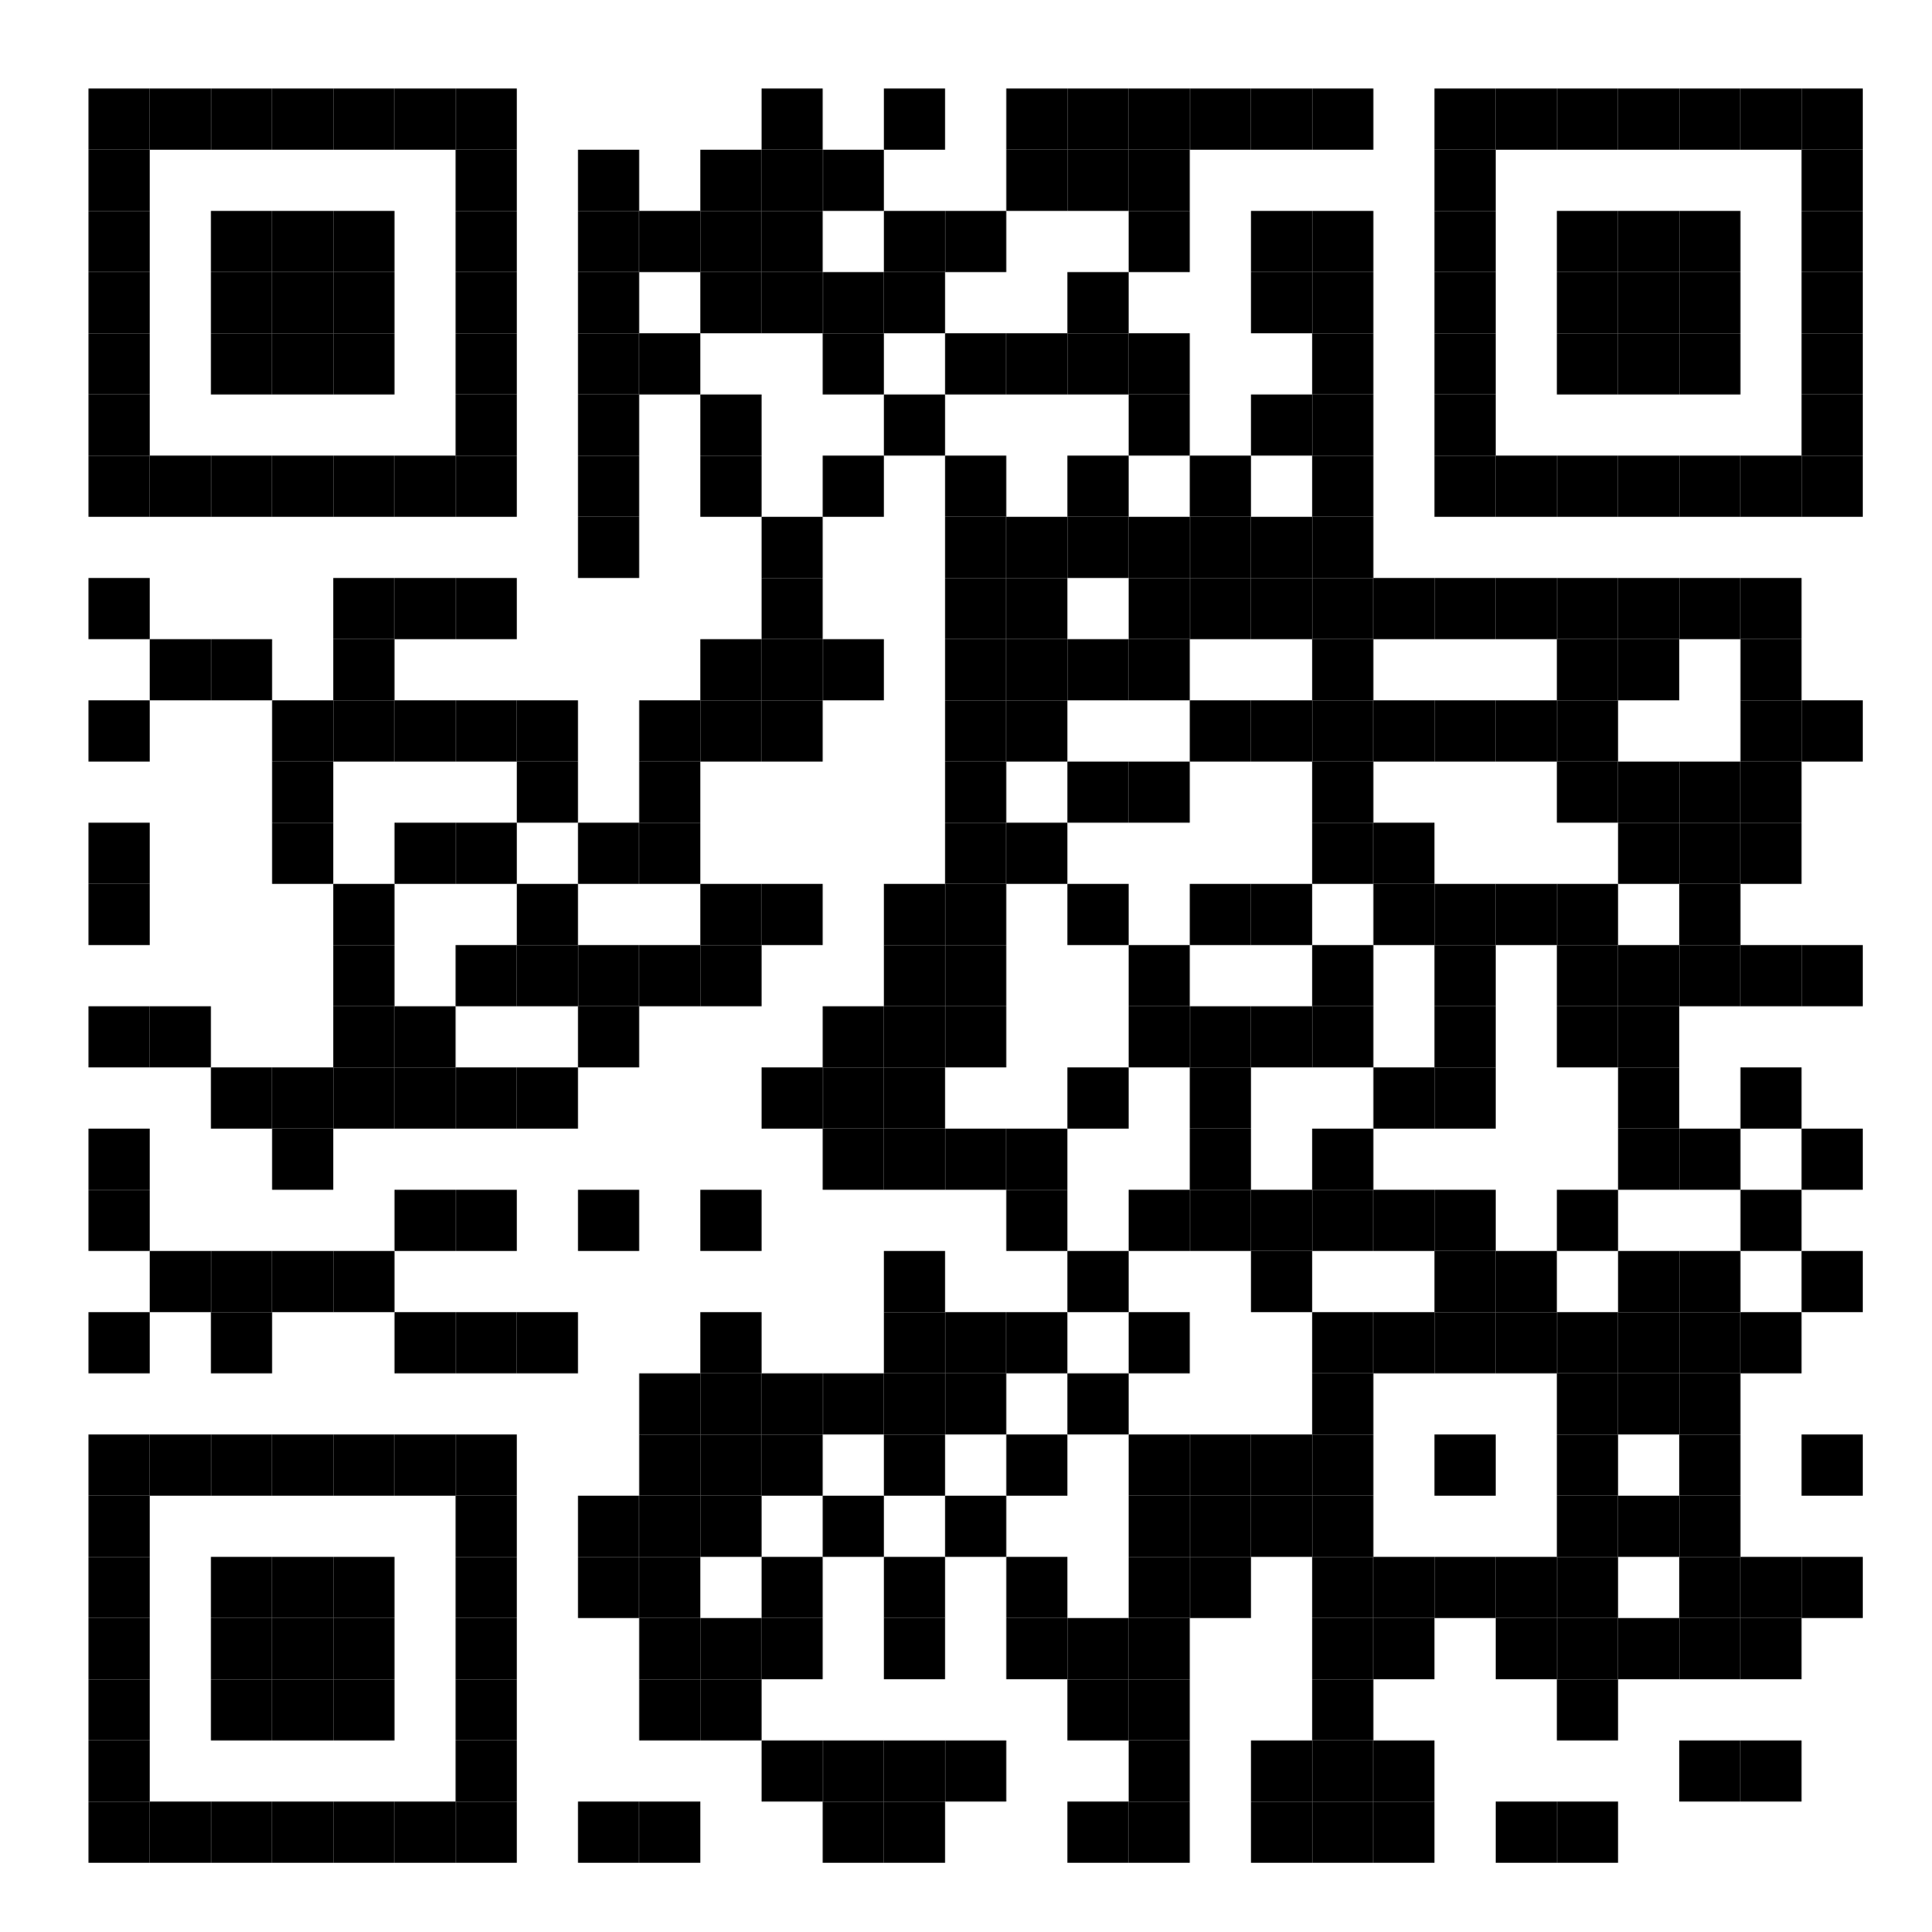
CERTIFICATE OF
PARTICIPATION
is awarded to
<<Name>>
for successfully completing the 1-hour webinar on 'Effective Time Management for Professionals' organized by ABC Company on May 15, 2023. Program of the Department of Information and Communications Technology - Region IVB held on April 25, 2023 at Occidental Mindoro State College - San Jose Campus.
JAKE DENVER ALBERIO
OJT Programmer
DICT - Occidental Mindoro
<<Webinar Code>>
<<Control No>>
This certificate is valid as evidenced by the attached QR Code.

