Slide 1
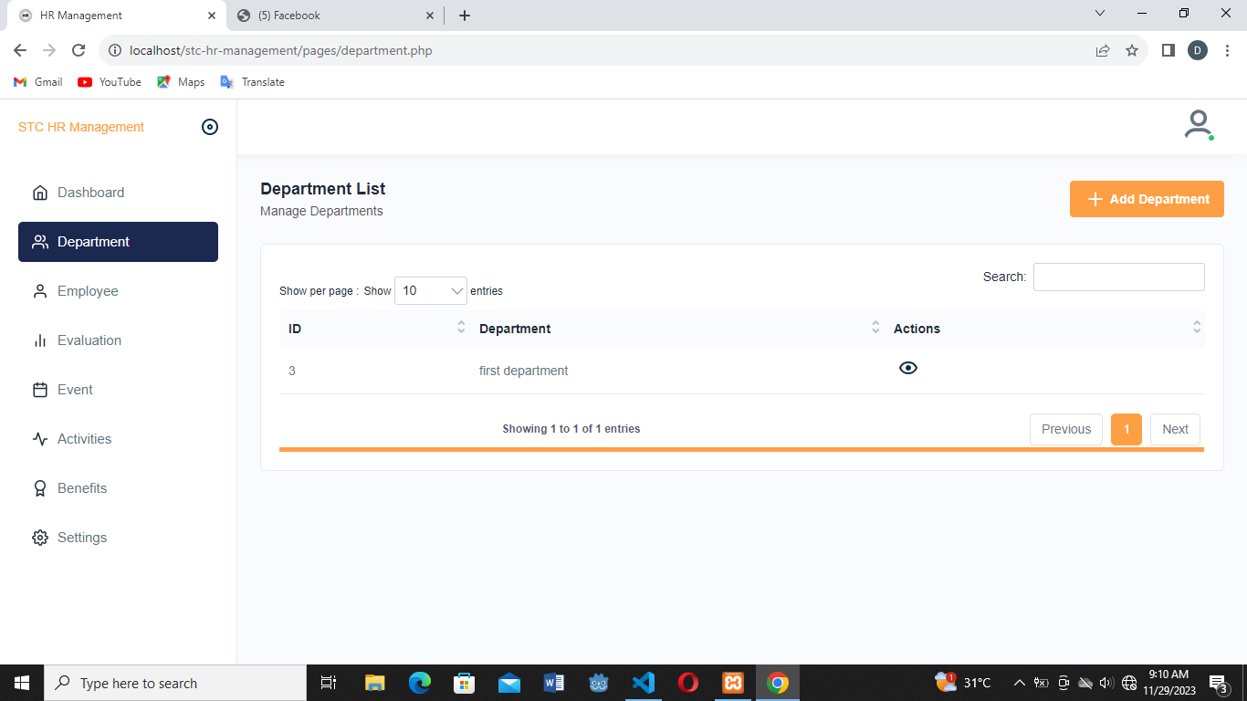
Pag click ng view lalabas yung mga employees under Mayor’s Office same po sa lahat ng kada offices
Offices List
Manage Offices
Offices
Dito po under po ng employee is Permanent, Job Order, then File po
Offices
Mayor’s Office
Report
Vice-Mayor and SB Office
Yung Promotion at benefits po is under ng Report
Human Resource Office
Promotion
MPDO
Offices

Slide 2
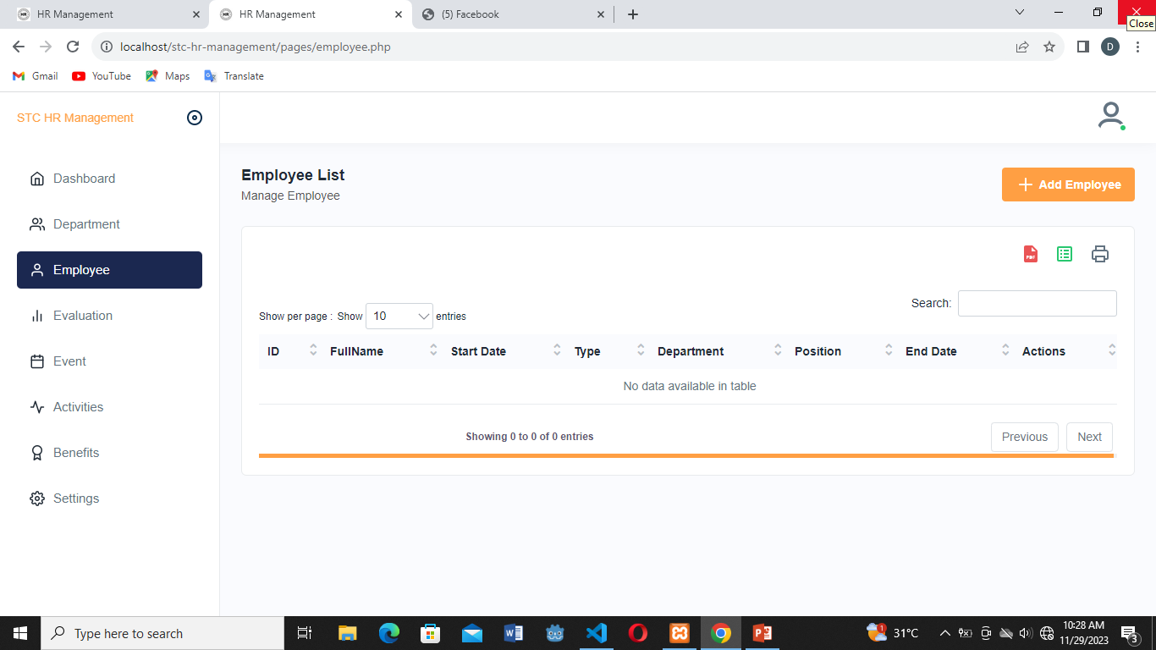
Meron din po ditto na parang view then pwede din po iprint
Mayor’s Office
Manage Employees
Offices
Filter
Item No.
Offices
Fullname
Type of Employment
Offices
Start Date
Position Title
 | 3-01-001-01 | Municipal Mayor | Ernesto P. Torreliza | Elective
 | 3-01-001-02 | Municipal Administrator | Atty. Leonardo F. Abeleda Jr. | Coterminous
 | 3-01-001-01 | Local Disaster Risk Reduction and Management Office III | (Vacant) | -
- | Mayor’s Office
- | Mayor’s Office
- | Mayor’s Office

Slide 3
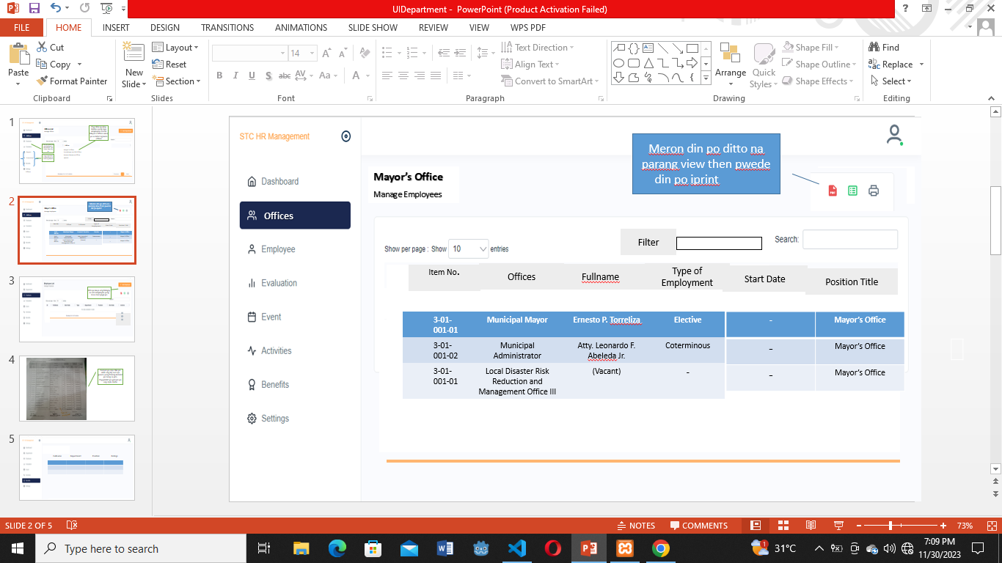

Dito po kuya ang ilalagay sa add employee yung nasa next page po

Slide 4
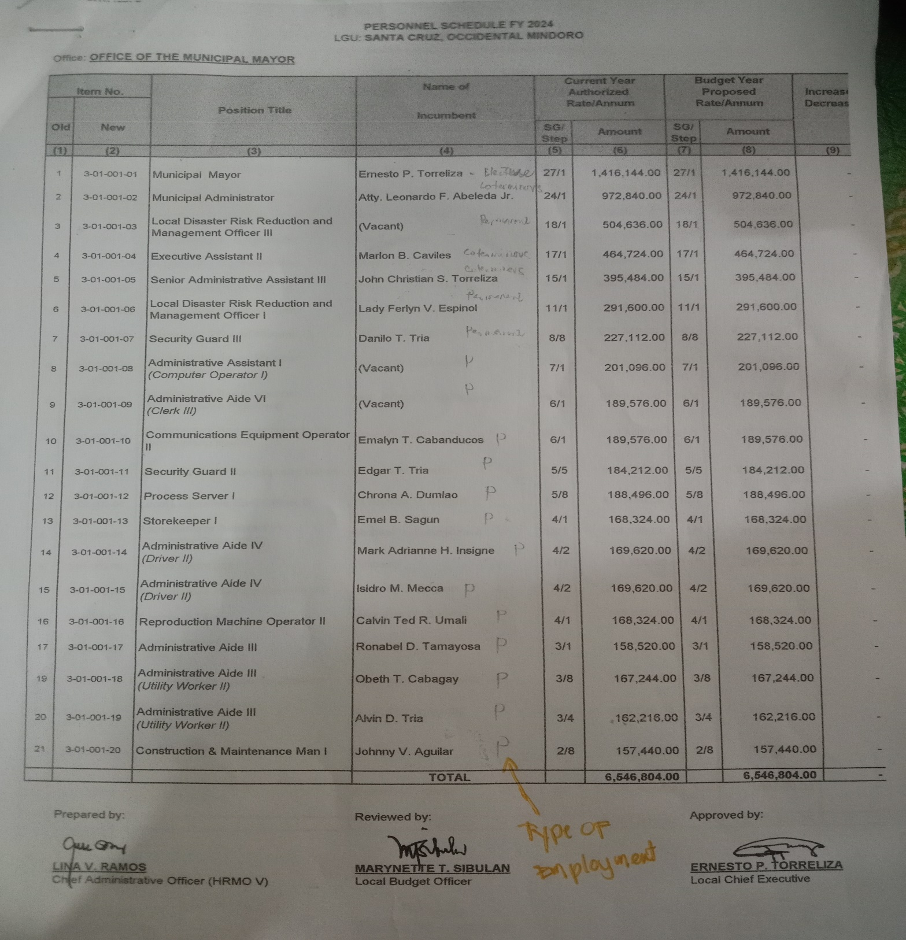
Ganyan po siya diko po alam ang lay out nya paano yung Parang katulad po nung sa pds.
Pag pnirint po ganyan po ang style. Hehe

Slide 5
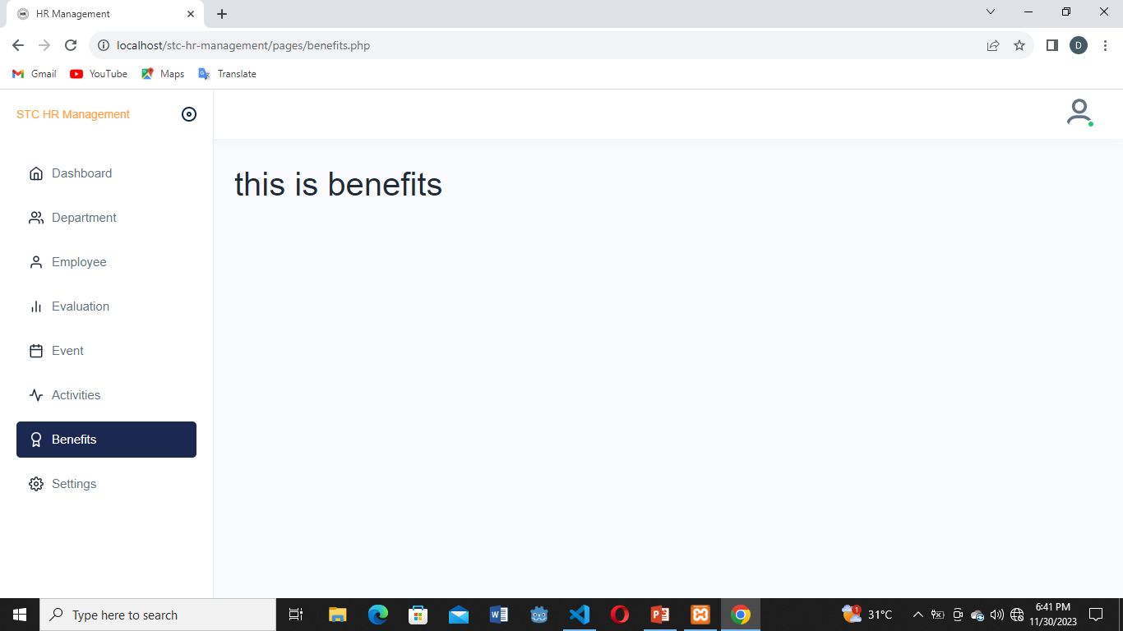
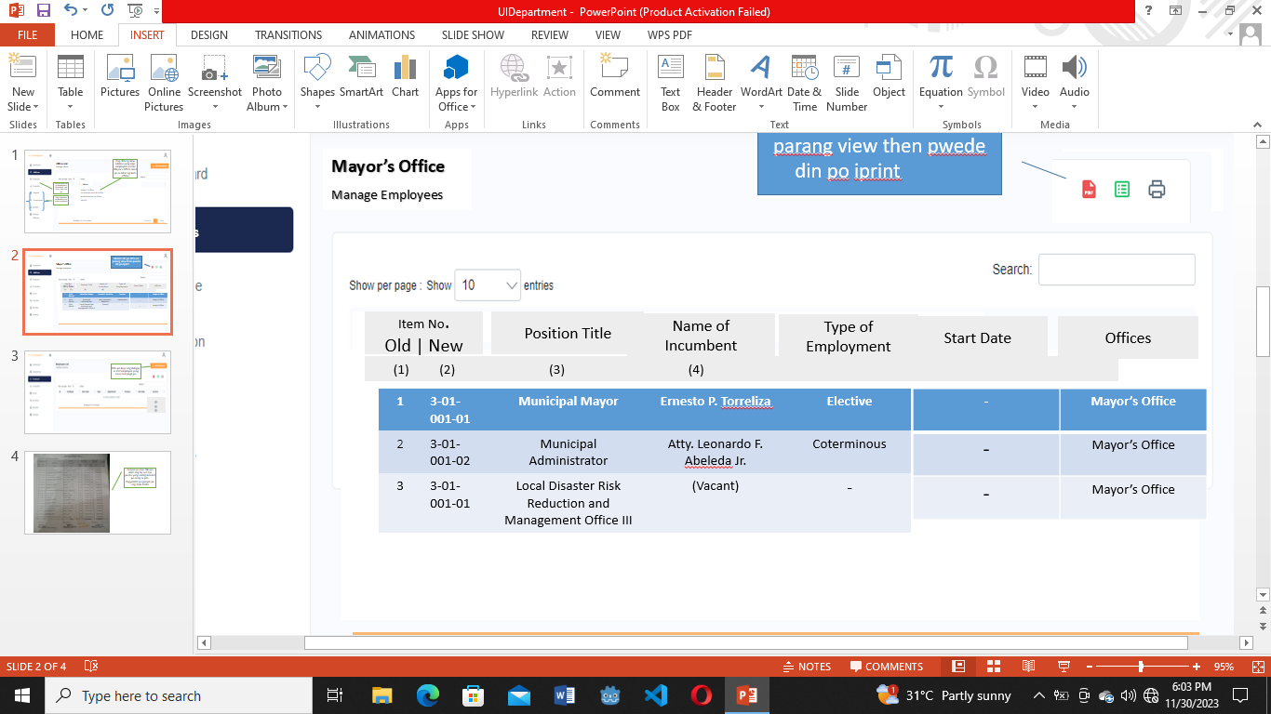
Benefits
Manage Employee’s Benefits
Dito once na inopen mapupunta po sa list of awardees then connected po sya sa kung gaano katagal na po yung employee, 10 yrs po para sa loyalty awardee
Benefits
Loyalty Awardees
13th Month Pay
Anniversary Bonus
Retirement Benefits

Slide 6
Loyalty Awardees List
Fullname
Department
Position
Ratings
Ernesto Torreliza | Mayor’s Office | Mayor | Very Satisfactory
Lina V. Ramos | HRMO Head | HR | Very Satisfactory

Slide 7
Promotion List
Fullname
Department
Position
Ratings
Ernesto Torreliza | Mayor’s Office | Mayor | Very Satisfactory
Lina V. Ramos | HRMO Head | HR | Very Satisfactory
Promotion
Dito sa promotion Connected po sa evaluation if very satisfactory po yung employee sa ratings ditto mapupunta sa list ditto po.

