Slide 1
DPR400210 — FINAL CAPSTONE EXAMINATION
Football Club Performance
& Transfer Management System
An Oracle Database & PL/SQL system for tracking club performance,
player contracts, and transfer activity — with automated business rules,
auditing, and Power BI analytics.
Eugene | Student ID 32327/2025
University of Lay Adventists of Kigali — Faculty of Computing and Information Sciences
Instructor: Eric Maniraguha

Slide 2
Introduction
What this presentation covers
01
Problem
05
PL/SQL Programming
The real-world gap this system addresses
Functions, procedures, packages, cursors
02
Methodology
06
Advanced Programming
Design approach and project phases
Triggers, auditing, and security rules
03
Database Design
07
Innovation
Entities, relationships, and normalization
Power BI analytics dashboard
04
Implementation
08
Results & Conclusion
Tables, constraints, and sample data
What the system achieves
DPR400210 — Football Club Performance & Transfer Management System
2

Slide 3
Problem Statement
Football clubs generate large volumes of data — player performance, contracts, transfers, injuries, and match results — but this information is often scattered across spreadsheets with no centralized structure.
TARGET USERS
Club administrators, coaches, and league analysts who need a single reliable source of truth for squad and transfer data.
No reliable way to track contract expiry or transfer eligibility
PROJECT OBJECTIVE
No audit trail for who changed critical records, or when
Build a normalized Oracle database with PL/SQL logic, enforced business rules, auditing, and analytics for football club management.
No enforced business rules around when transfers may be processed
No centralized analytics on player and club performance
EXPECTED BENEFIT
Accurate, auditable records; enforced transfer eligibility; and live analytics that support squad decisions.
DPR400210 — Football Club Performance & Transfer Management System
3

Slide 4
Methodology
Methodology
An 8-phase build, moving from problem analysis to a fully auditable, analytics-ready system.
1
2
3
4
5
6
7
8
Problem Statement
Business Process Modeling
Logical Design (ERD, 3NF)
Database Creation
Tables & Constraints
PL/SQL Programming
Triggers & Auditing
Docs & Presentation
DPR400210 — Football Club Performance & Transfer Management System
4

Slide 5
Database Design
12 entities, normalized to 3NF — non-key columns depend on the key, the whole key, and nothing but the key.
COACHES
REFEREES
PUBLIC_
HOLIDAYS
STADIUMS
CLUBS
PLAYERS
MATCHES
MATCH_
PERFORMANCE
CONTRACTS
TRANSFERS
INJURIES
AUDIT_LOG
DPR400210 — Football Club Performance & Transfer Management System
5

Slide 6
Implementation
Tables, constraints, and sample data — realistic European club data across 12 tables.
12
5
15
4
Tables
Clubs
Players
Constraint Types
CONSTRAINTS ENFORCED
PRIMARY KEY
Surrogate identity keys on every table (e.g. player_id)
FOREIGN KEY
Enforces relationships — e.g. players.club_id → clubs.club_id
CHECK
Business validity — e.g. home_club_id <> away_club_id
UNIQUE / NOT NULL
Data integrity — e.g. one performance row per match+player
DPR400210 — Football Club Performance & Transfer Management System
6

Slide 7
PL/SQL Programming
Four required PL/SQL elements, each solving a real business need.
FUNCTION
PROCEDURE
PACKAGE
CURSOR
fn_is_transfer_eligible
proc_execute_transfer
pkg_player_performance
Fitness / rotation risk report
Checks whether a player's contract has expired or is within 30 days of expiry.
Validates eligibility, records the transfer, updates the player's club — with custom exception handling.
Bundles average rating, total goals, and top-scorer analytics into one reusable unit.
Loops through every player, flagging missing match appearances and open injuries.
DPR400210 — Football Club Performance & Transfer Management System
7

Slide 8
Advanced Programming
Business Rule: block INSERT / UPDATE / DELETE on weekdays and public holidays.
trg_transfers_audit_security
trg_contracts_audit_security
pkg_demo_control
Compound trigger — TRANSFERS table
Compound trigger — CONTRACTS table
Session-level bypass for live demo — OFF by default, and every toggle is itself logged to audit_log.
BEFORE STATEMENT: enforce rule | AFTER EACH ROW: log to audit_log
BEFORE STATEMENT: enforce rule | AFTER EACH ROW: log to audit_log
LIVE DEMO FLOW
Insert on a weekday
→
ORA-20001 raised — blocked
→
Enable demo bypass
→
Insert succeeds
→
Audit log confirms both events
Every INSERT / UPDATE / DELETE on TRANSFERS and CONTRACTS is logged with the operation type, old and new values, the user, and the timestamp — a full audit trail regardless of demo mode.
DPR400210 — Football Club Performance & Transfer Management System
8

Slide 9
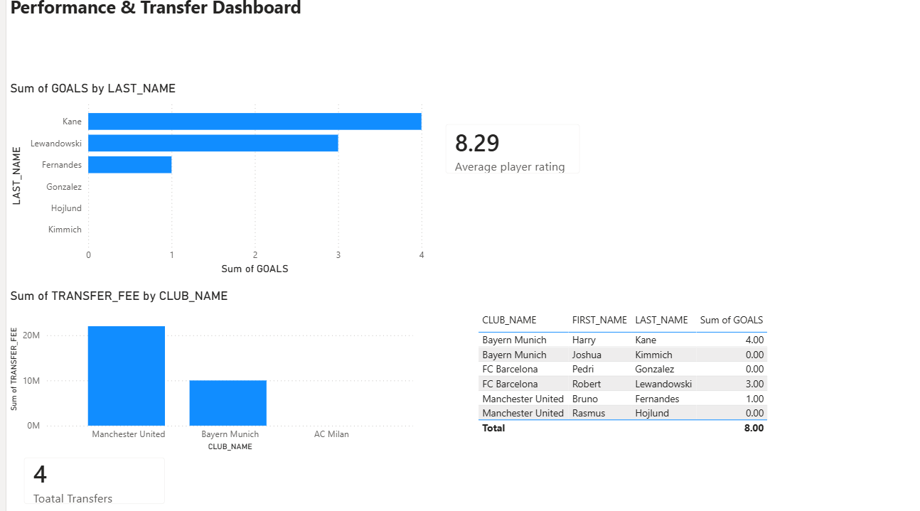
Innovation — Power BI Dashboard
Live analytics connected directly to the Oracle database via the Oracle client connector.
Top Scorers
Goals by player, drawn from match_performance.
Transfer Fees by Club
Aggregated spend, sourced from the transfers table.
Average Player Rating
Live KPI card across all recorded matches.
Top Scorer by Club
Table mirroring the logic in pkg_player_performance.
DPR400210 — Football Club Performance & Transfer Management System
9

Slide 10
Results & Conclusion
A fully normalized (3NF) Oracle schema across 12 tables with enforced PK/FK/CHECK/UNIQUE constraints
This project demonstrates full-cycle Oracle database engineering — from 3NF design through PL/SQL business logic, enforced security rules, complete auditing, and live analytics — built and defended end-to-end.
Working PL/SQL: an eligibility function, a transfer procedure, a performance package, and a fitness-risk cursor
Compound triggers blocking transfer/contract activity on weekdays and holidays, with an auditable demo bypass
A complete audit trail of every INSERT, UPDATE, and DELETE on critical tables
Thank you.
Eugene — 32327/2025
A live Power BI dashboard connected directly to the database for performance and transfer analytics
DPR400210 — Football Club Performance & Transfer Management System
10

