Slide 1
2026 FIFA World Cup Prediction
Bracket visualization and things to watch
Champion Pick
Argentina
Runner-up
France
Third Place
Spain
Live model through M100: direct SofaScore form and match stats, human tactical reads, plus July 12 Polymarket/Kalshi priors at 0.10 weight.
Generated 2026-07-12

Slide 2
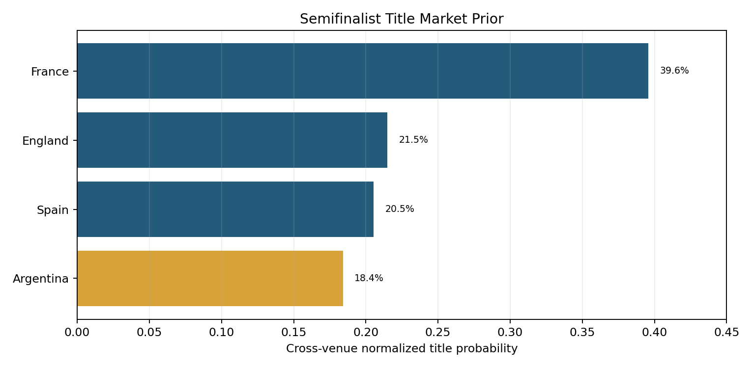
Model Snapshot
Live rating stack
FIFA-rank base
+ squad depth
+ direct SofaScore form
+ result signal
+ human tactical delta
+ 0.10 market prior
Semifinal probabilities also blend complete match-advance markets at 0.10 on the log-odds scale.
Semifinals: France over Spain (52.8%); Argentina over England (55.6%).

Slide 3
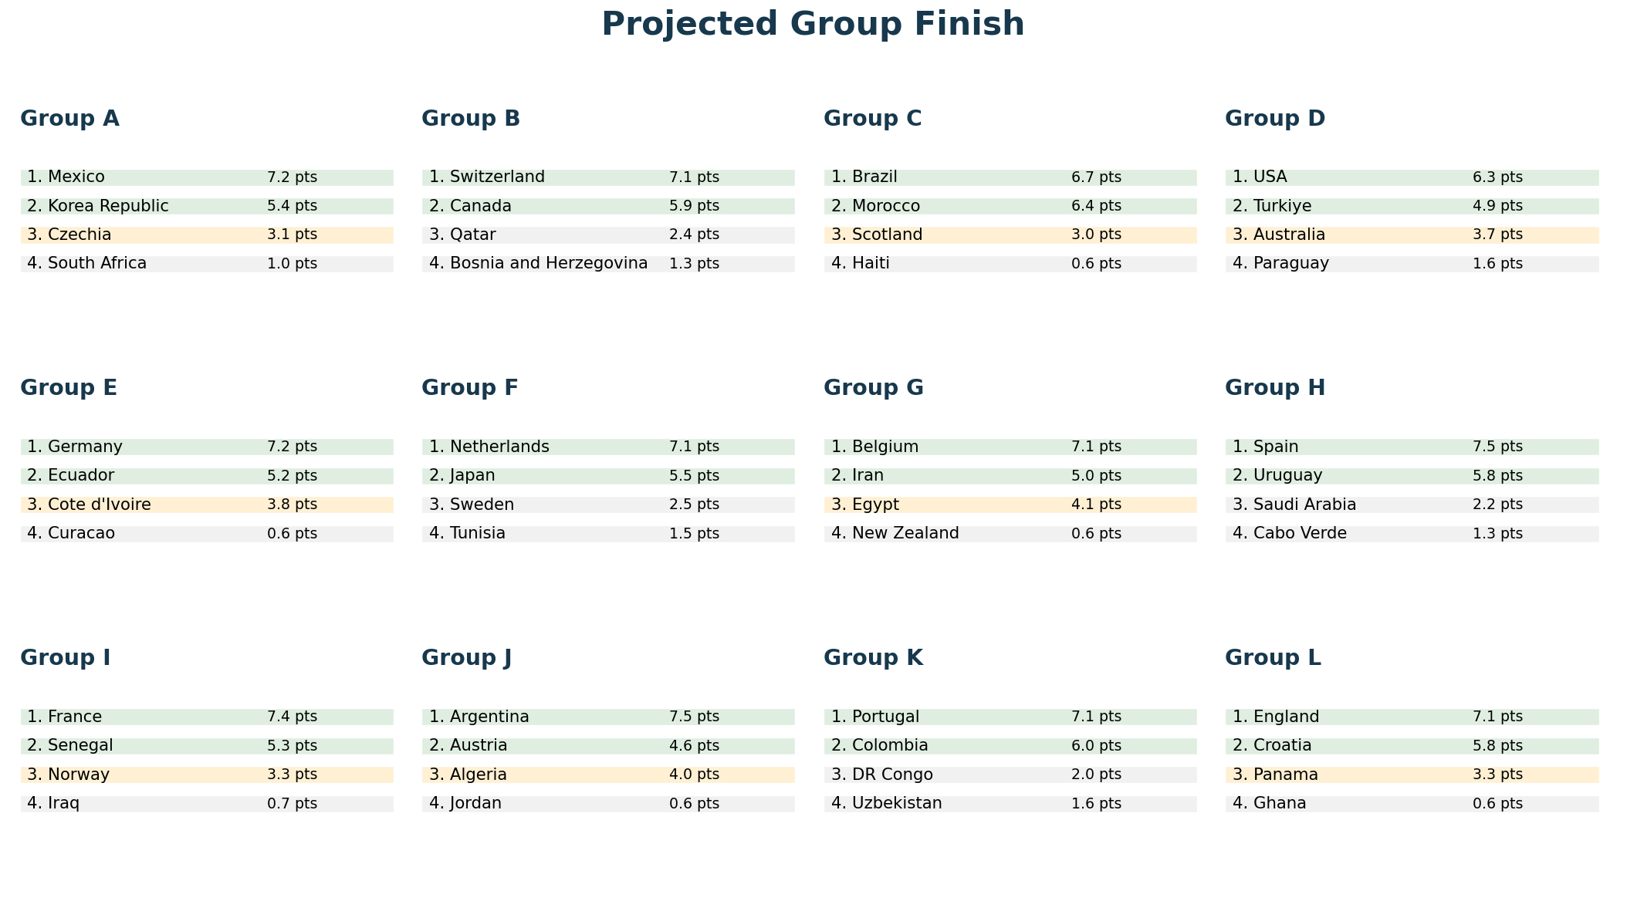
Original Group Projection (Historical)

Slide 4
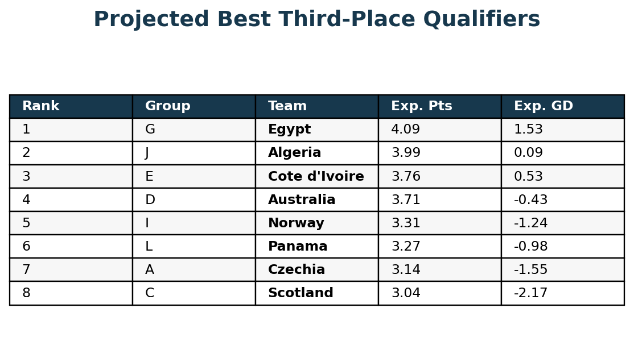
Original Best Third Projection (Historical)
Why this matters
- Eight of twelve third-place teams advance.
- The exact groups that advance change the official Annex C bracket mapping.
- This model's third-place set is A, C, D, E, G, I, J, L.
- Egypt, Algeria, Cote d'Ivoire, Australia, Norway, and Panama are the hinge teams.
The third-place pool is the biggest bracket uncertainty: one extra group-stage goal can redraw an entire route.

Slide 5
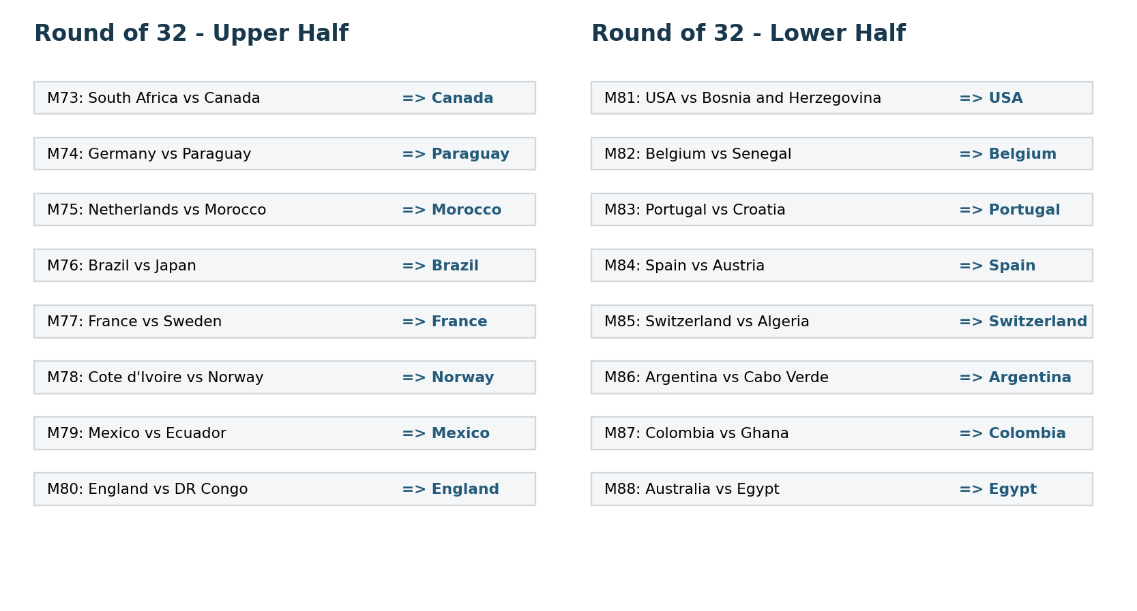
Round Of 32 Matchups

Slide 6
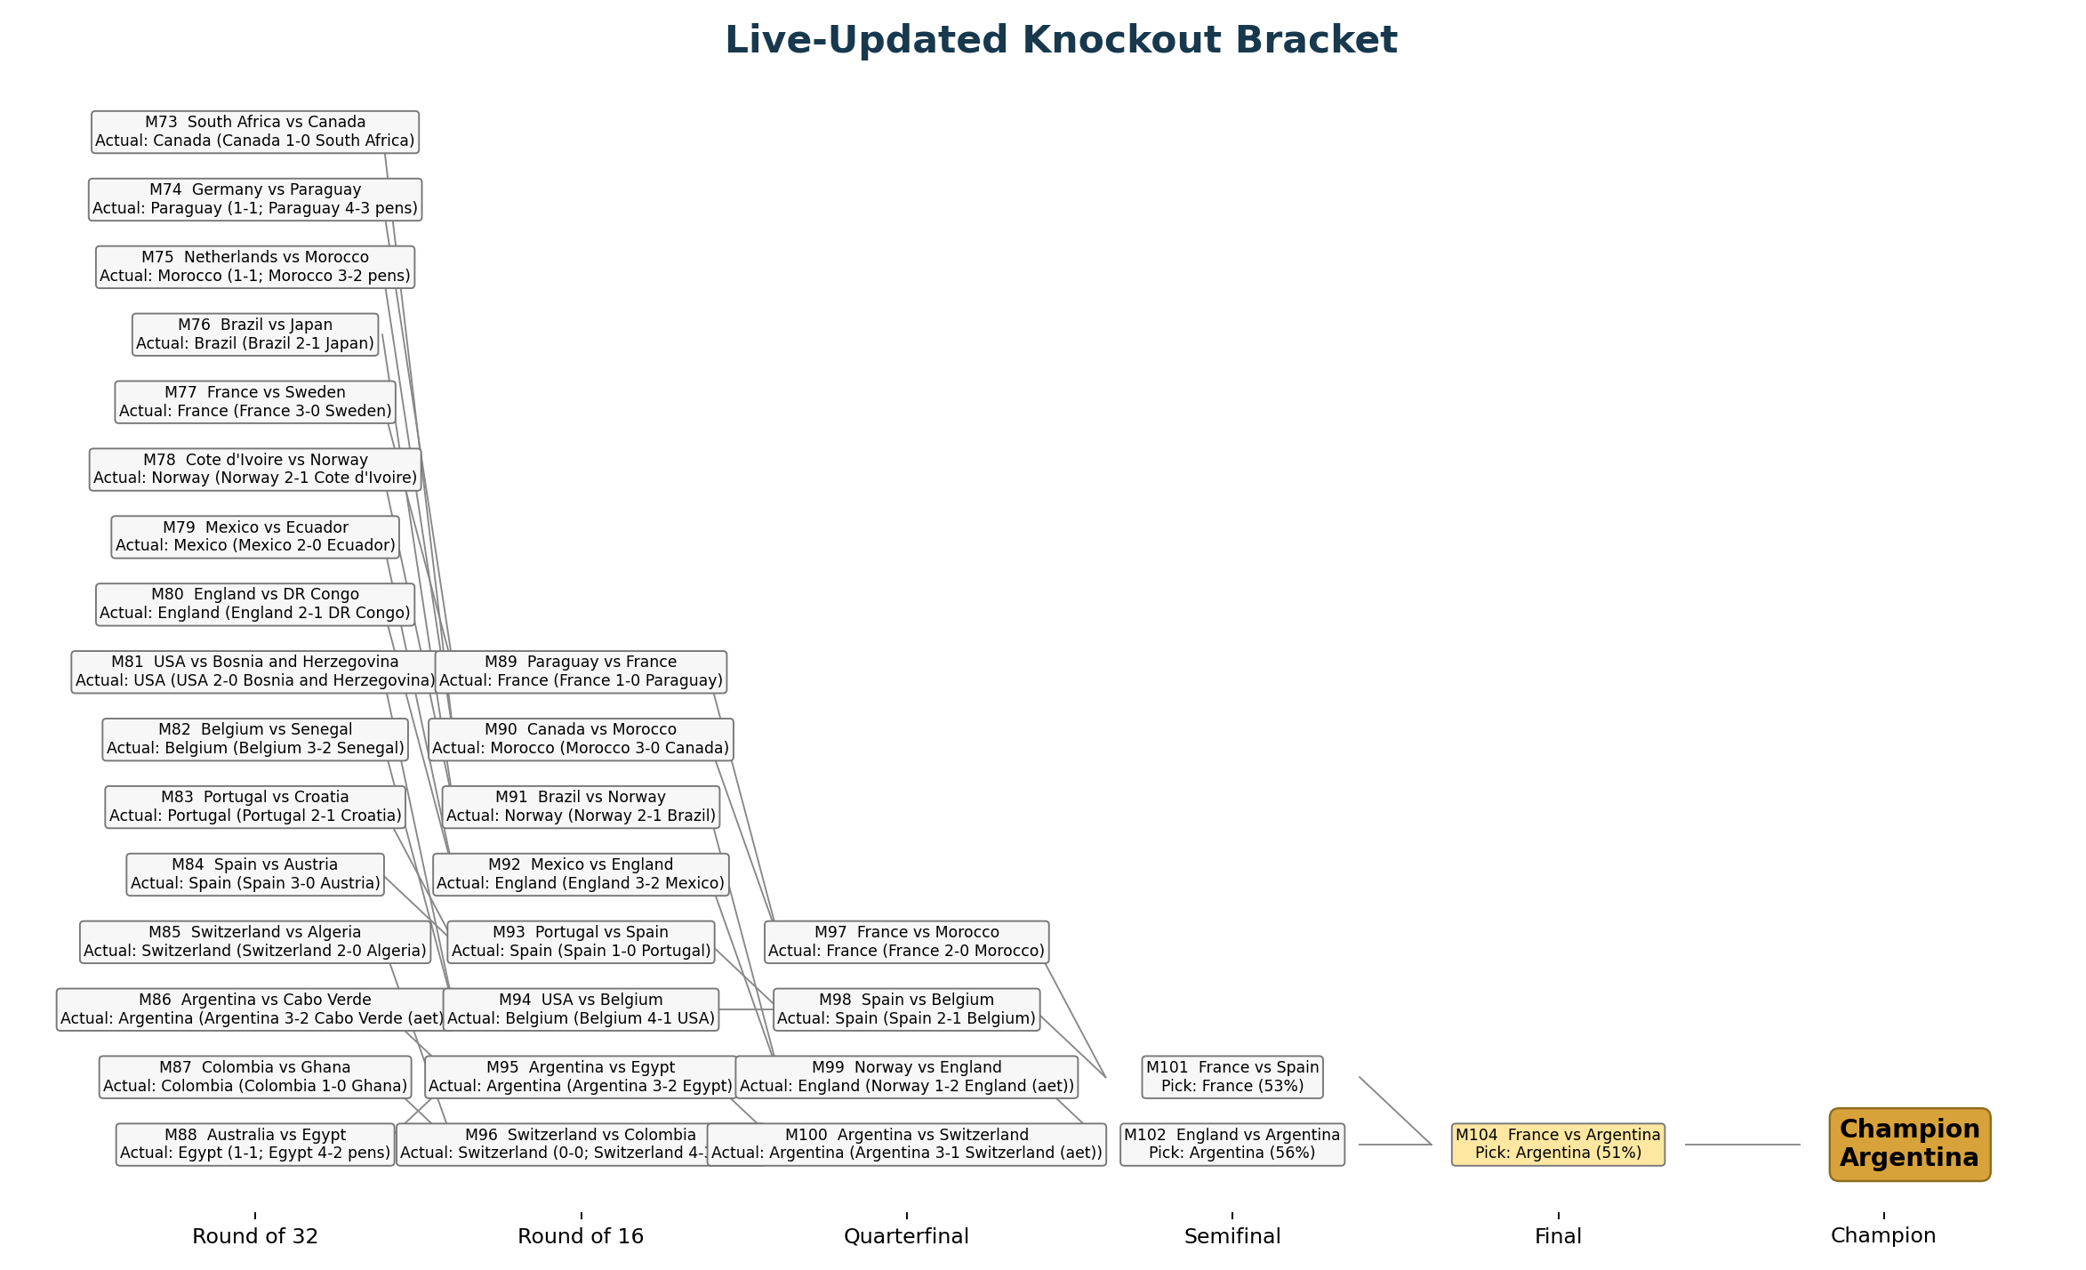

Slide 7
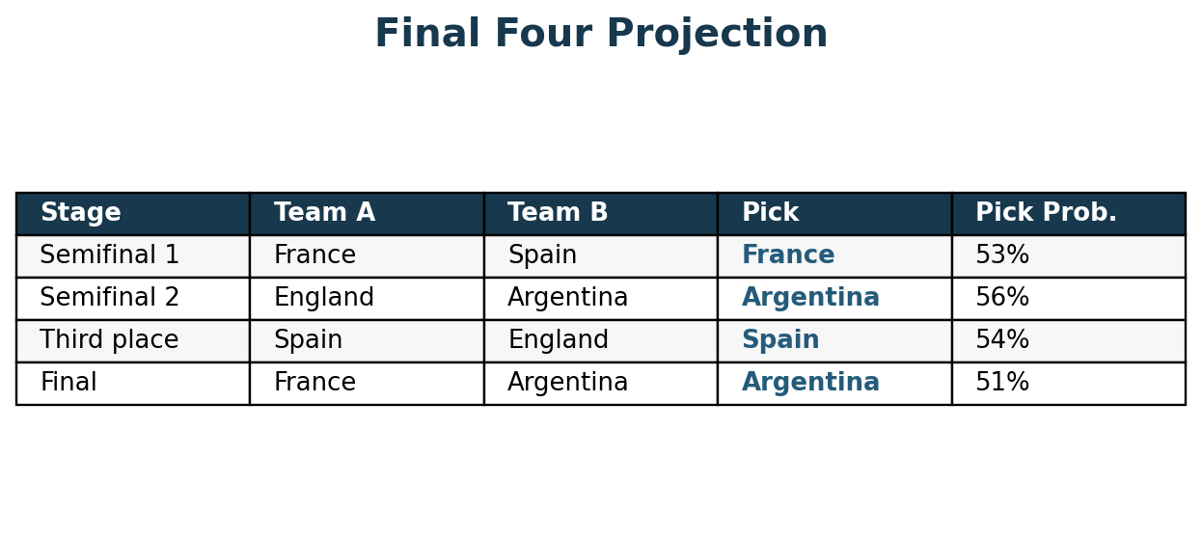
Final Four
Projected route: France beats Spain, Argentina beats England, then Argentina beats France in the final. Spain takes third place.

Slide 8
Things To Watch
Semifinal variables
- France pace versus Spain control
- Spain finishing without a classic No. 9
- England's adversity management
- Argentina's defensive vulnerability
- Extra-time fatigue and recovery
- Penalty and refereeing variance
Player-form variables
- Messi workload after long matches
- Mbappe/Dembele chance creation
- Bellingham's four knockout goals
- Kane's clutch finishing
- Almada and Lopez bench options
- Goalkeeper form under pressure

Slide 9
How To Refresh The Scenario
1. Lock newly completed matches in the model source.
2. Run the SofaScore and prediction-market collectors.
3. Regenerate and execute the notebook.
4. Rebuild tables, site, README assets, and this deck from the executed outputs.
Current coverage: 100 completed matches with direct player ratings, minutes, team statistics, and shot maps.

Slide 10
Sources And Caveats
Sources used in the notebook
- FIFA schedule and bracket structure
- AP, FIFA, Guardian, and Opta match reporting
- Direct SofaScore lineups, ratings, team stats, and shot maps
- July 12 Polymarket and Kalshi public APIs
- Transfermarkt value snapshot
Caveats
- Human tactical reads are explicit and lightly weighted.
- Market prices are snapshots, not truth.
- Transfer values and ticket prices can move.
- Semifinal calls remain close and sensitive to availability.

