Slide 1
2026 FIFA World Cup Prediction
Bracket visualization and things to watch
Champion Pick
France
Runner-up
Argentina
Third Place
Spain
Built from the current notebook model: FIFA rank, host bonus, squad-depth bucket, and player-form modifier. No new API fetches were used.
Generated 2026-04-30

Slide 2
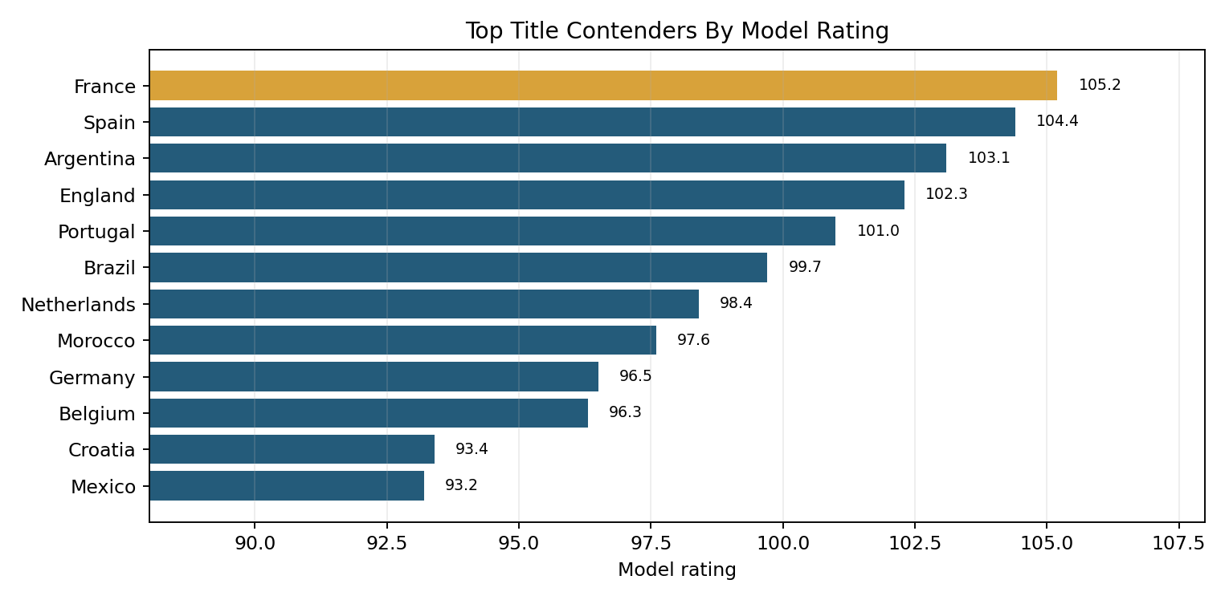
Model Snapshot
Rating formula
100 - 0.8 x FIFA rank
+ host bonus
+ player-form modifier
+ squad-depth modifier
Knockout probability
logistic((rating A - rating B) / 8)
Transparent scenario model, not a betting market.
Top-tier calls are close: France over Spain and Argentina over England are both narrow semifinal picks.

Slide 3
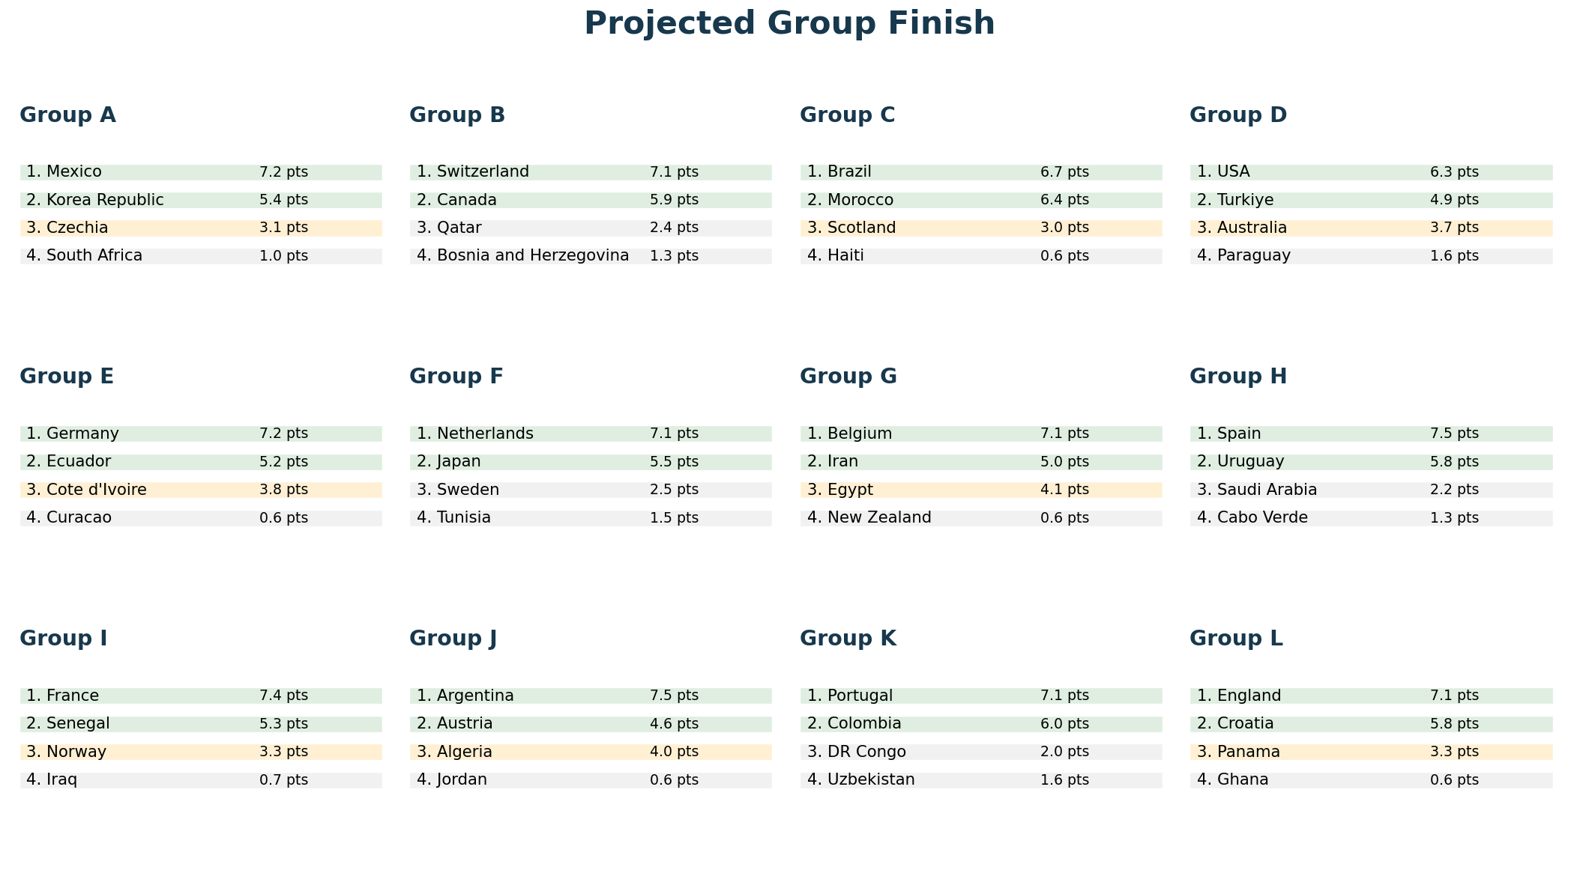
Group Stage Projection

Slide 4
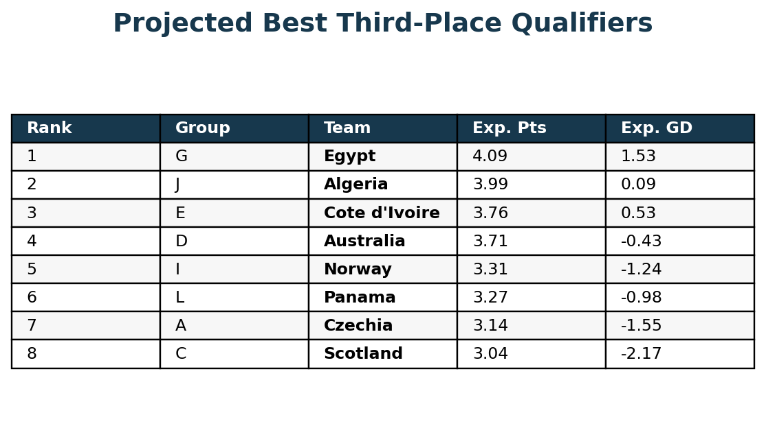
Best Third-Place Qualifiers
Why this matters
- Eight of twelve third-place teams advance.
- The exact groups that advance change the official Annex C bracket mapping.
- This model's third-place set is A, C, D, E, G, I, J, L.
- Egypt, Algeria, Cote d'Ivoire, Australia, Norway, and Panama are the hinge teams.
The third-place pool is the biggest bracket uncertainty: one extra group-stage goal can redraw an entire route.

Slide 5
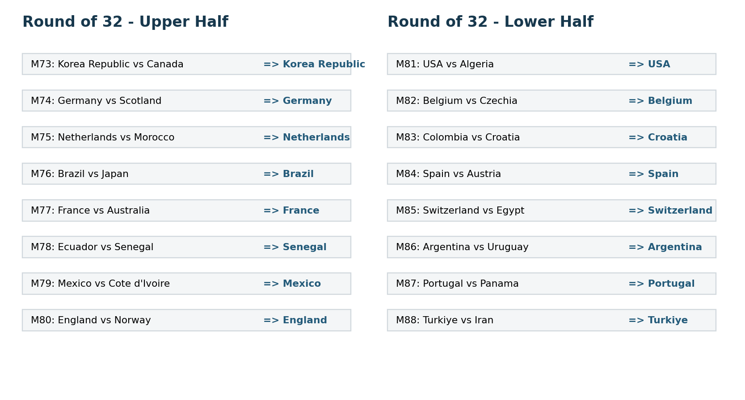
Round Of 32 Matchups

Slide 6
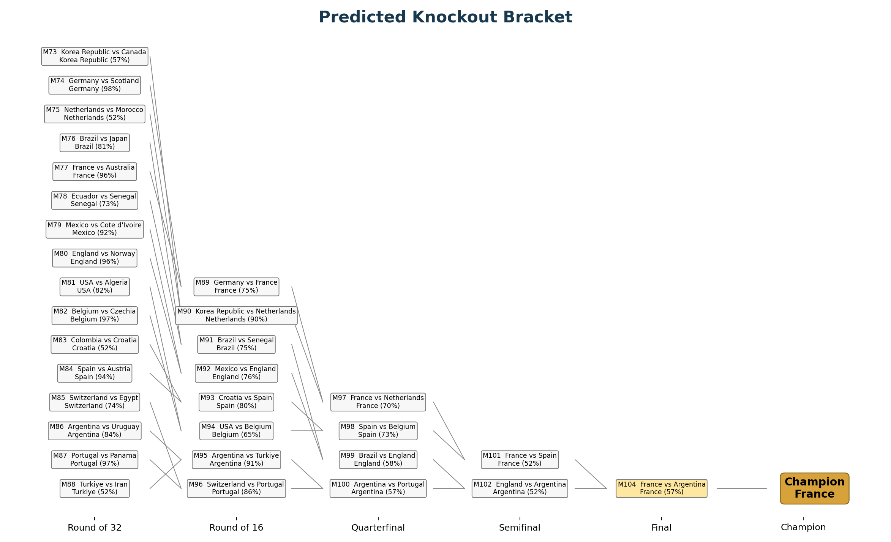

Slide 7
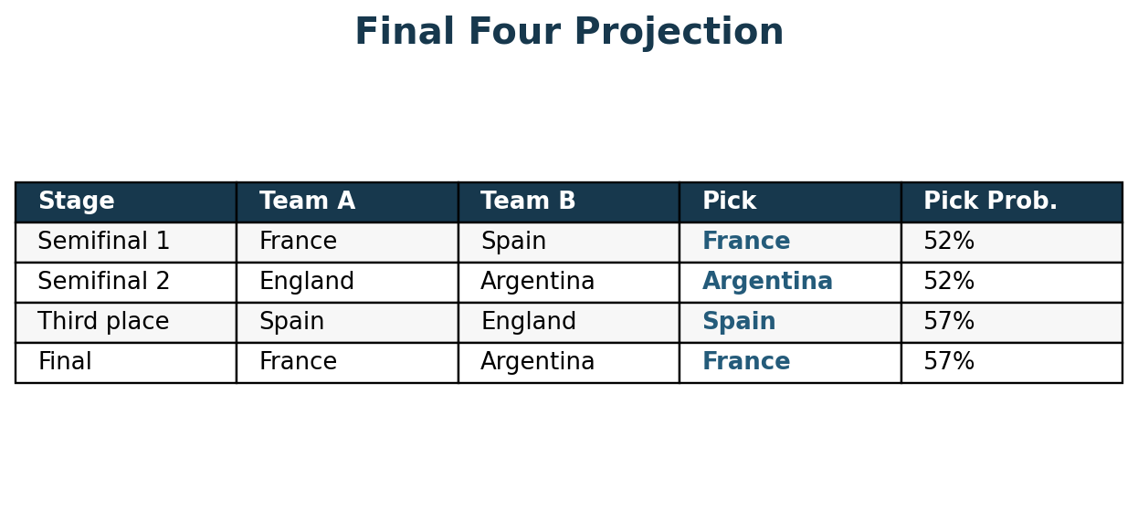
Final Four
Projected route: France beats Spain, Argentina beats England, then France beats Argentina in the final. Spain edges England for third place.

Slide 8
Things To Watch
Tournament variables
- Final squads and injuries
- June 10 FIFA ranking update
- Host-continent travel and climate
- Third-place mapping volatility
- Penalty shootout variance
- Refereeing and game-state effects
Player-form variables
- Rodri/Spain availability and minutes
- Messi/Argentina workload
- Mbappe and France attacking form
- Kane/Bellingham/Saka finishing output
- Haaland/Odegaard effect on Norway's upset risk
- Goalkeeper form in knockout games

Slide 9
How To Refresh The Scenario
1. Update FIFA rankings when the June 2026 list is published.
2. Refresh the player-form modifier after final squads, injuries, and late club matches.
3. Re-run the notebook cells from top to bottom.
4. Rebuild this deck from the current notebook outputs if the bracket path changes.
Best next enhancement: add a player-form input table for recent ratings, minutes, goals/assists, defensive actions, goalkeeper saves, and injury status.

Slide 10
Sources And Caveats
Sources used in the notebook
- FIFA men's ranking page, April 2026 update
- ESPN April 2026 FIFA ranking table
- FIFA qualified-teams article and official schedule article
- Official bracket template summarized via the 2026 knockout-stage reference
- DR Congo playoff placement reporting
Caveats
- Player-form modifiers are transparent subjective inputs.
- Exact FIFA points were not used for every team.
- Third-place qualification and mapping are highly sensitive.
- Final squads and injuries may materially change the bracket.

