Slide 1

Pong?
Zachary Job
How it Works…

Slide 2
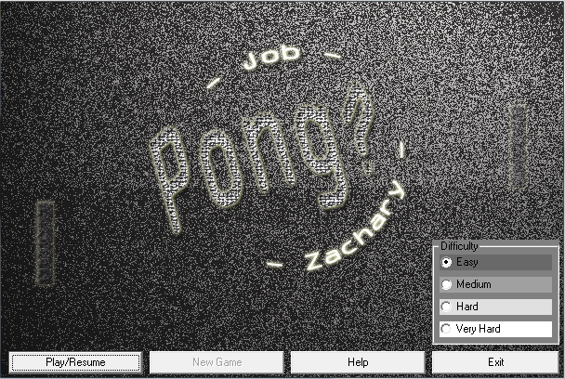
How It Begins
The games main screen

Slide 3
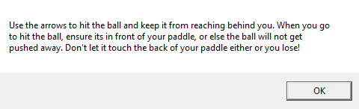
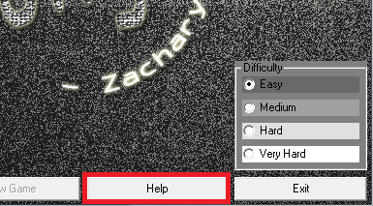
Help Buttons
Located at the bottom of the main screen, this button opens help information

Slide 4
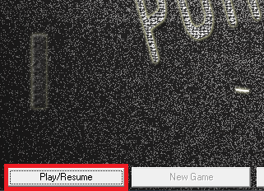
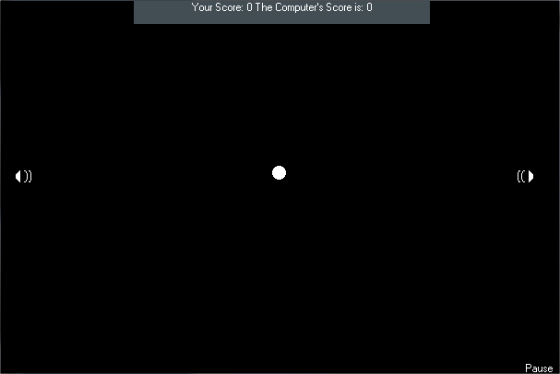
In Game
The actual pong game begins and after a pause begins, and each time someone scores, the game resets the paddles and ball then pauses. The user may also go to the main menu via the pause button.

Slide 5
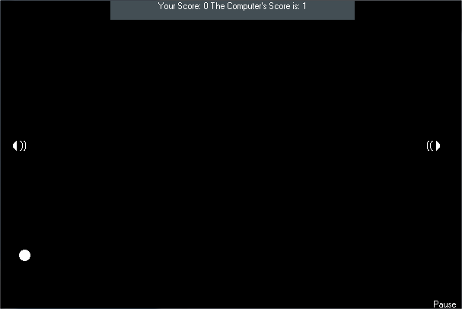
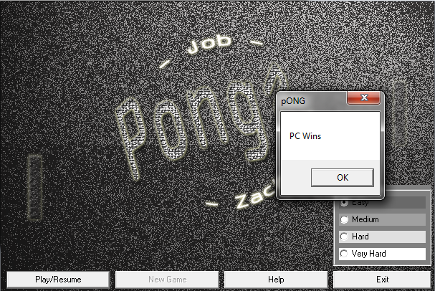
Scoring
Once the user or the computer reaches 25, then they win and a message appears.

Slide 6
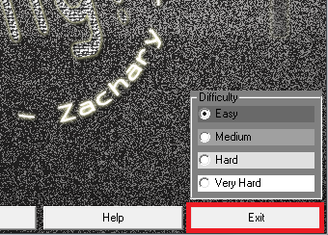
Exiting
Once clicked, the exit button unloads the form

