Slide 1
Galaxy Classification Using Deep Learning
- Evan Chow, Dvir Zagury, Pierson Tomietto, Patrick Thompson

Slide 2
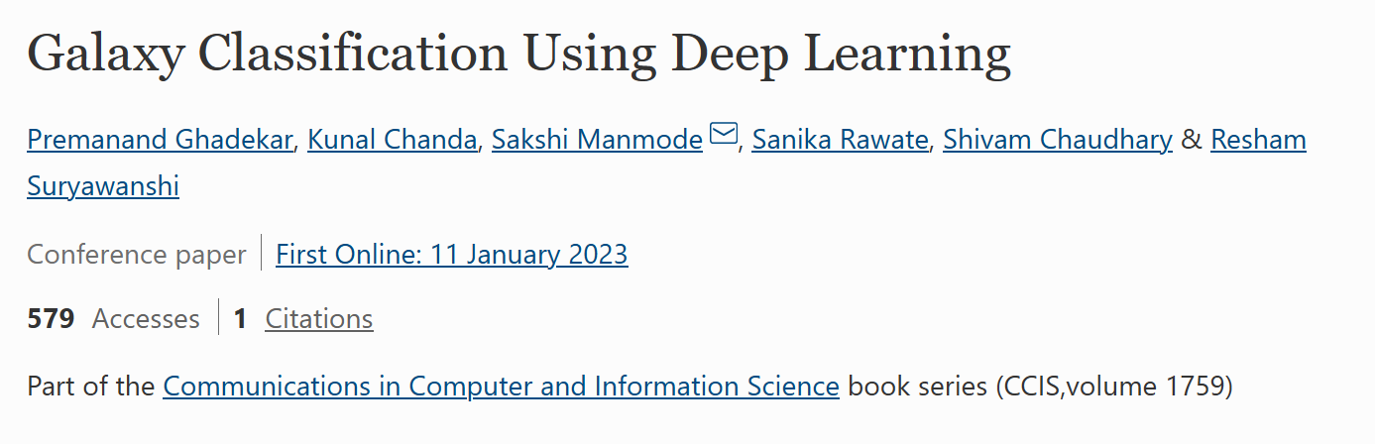
The Paper
Proposes a way of classifying galaxies in scale via ML

Slide 3
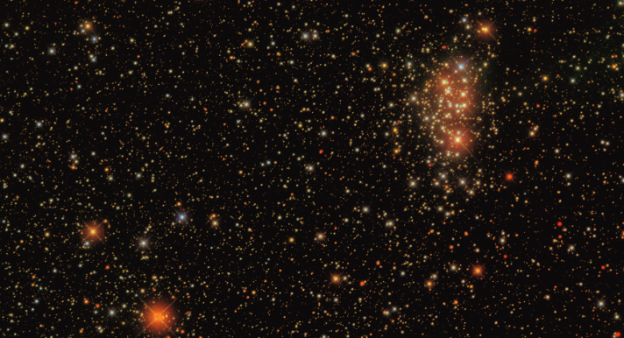
Problem Statement
Sky Surveys:
Hundreds of thousands of galaxies.
Manually classified by votes.
Wasted time and resources
10 Classes (not Hubble tuning fork)
Use Convolution Neural Net Instead
From Sloan Digital Sky Survey (SDSS)

Slide 4
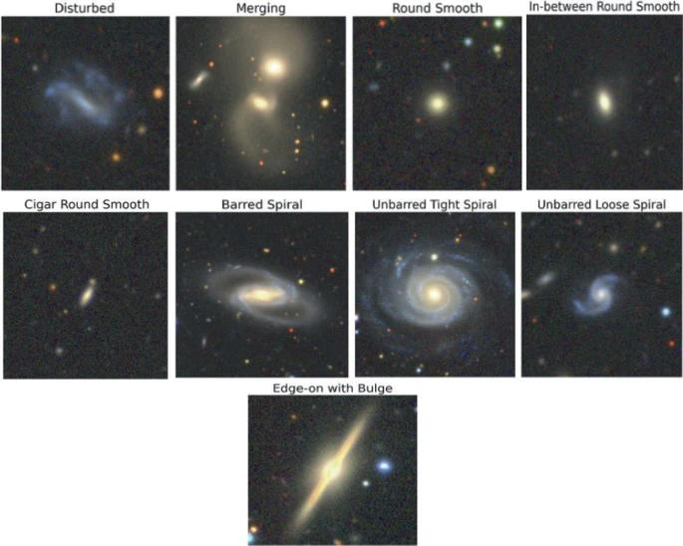
Data Collection and Pre-Processing
Galaxy10 DECals Dataset
~18,000 galaxies
10 Classifications
256x256 pixel colour images
Input Layer includes 16 filters

Slide 5
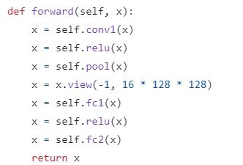
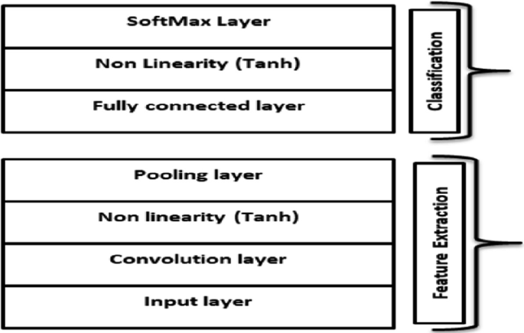
Models
Us
Paper

Slide 6
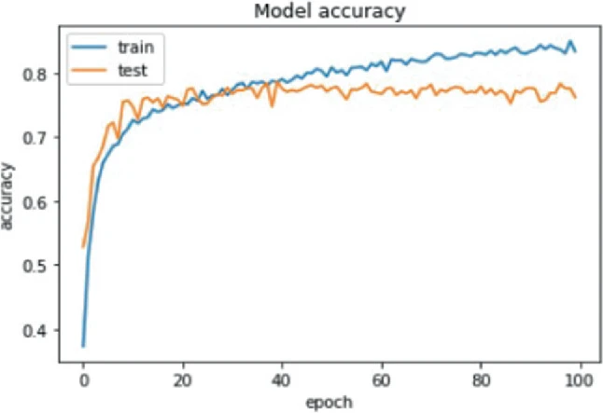
Results
Us
Paper

Slide 7
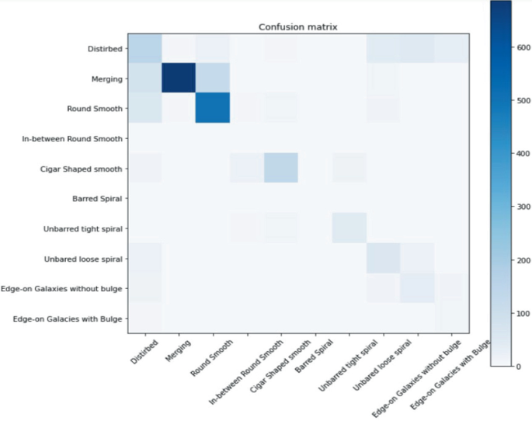
Results
Us
Paper

Slide 8
R&D

Slide 9
Results

Slide 10
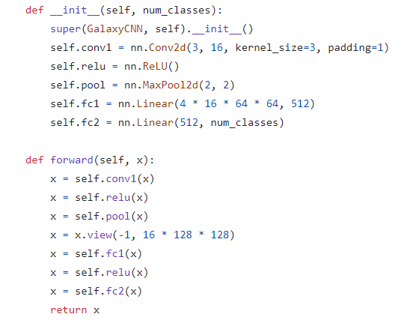
Code Review

Slide 11
Code Review cont.

Slide 12
Code Review cont.

