Slide 1
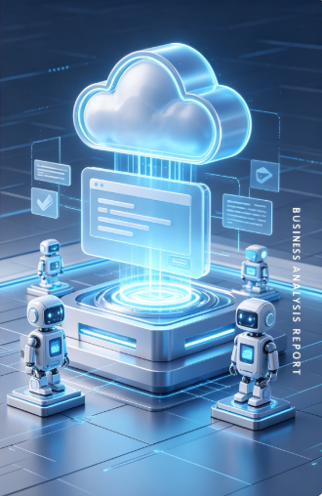
COMP7940 Cloud Computing
Project: Telegram LLM Chatbot
BUSINESS ANALYSIS REPORT
Tian Qinan -25456431
Xie Youxin -25450875
Zhang Ziye -25409271

Slide 2
Catalogue
01
Project Overview
02
System Architecture
03
Technical Stack
04
Core Implementation
05
Deployment
06
Summary

Slide 3



01 Project Overview
Project Goals
Tech
stack
Core Features
Primary Objective
Technology
Successfully fulfill all 7 mandatory technical requirements specified in the course rubric.
Natural Language Q&A
Telegram Bot API
Azure OpenAI / HKBU LLM API
AWS EC2
Docker
MongoDB Atlas
GitHub
Multi-turn Contextual Chat
Secondary Objective
Build a production-ready, low-cost, and fully functional LLM-powered chatbot with high uptime.
Rate Limiting & Error Handling
Notes:
Hello everyone. Today, we'll present our project for the COMP7940 Cloud Computing course. Our task was to transform a simple lab chatbot into a robust, cloud-native Telegram bot. Our main goal was to meet all seven mandatory technical requirements set by the course, while building a stable, low-cost, and intelligent chatbot with core features like natural language Q&A, multi-turn conversations, and essential system safeguards like rate limiting and error handling.

Slide 4
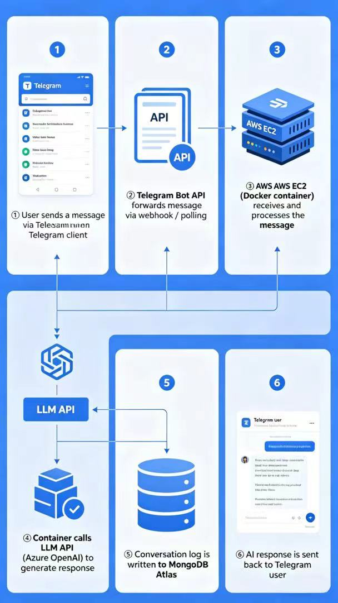



02 System Architecture
Work
flow Process
Core Architecture Stack
Infrastructure Layer
AWS EC2 for scalable cloud hosting. Docker containerization ensures consistent runtime environments.
AI Processing Engine
Seamless integration with a Large Language Model (LLM) API for context-aware response generation.
Data Persistence
MongoDB Atlas stores all chat logs for auditing and analysis.
Notes:
Here's an overview of our system architecture. When a user sends a message through Telegram, the request is forwarded to our bot service, which is containerized with Docker and hosted on an AWS EC2 instance. The bot then interacts with a Large Language Model API to generate a response, which is sent back to the user. Importantly, all conversation logs are securely stored in a MongoDB Atlas cloud database for persistence and monitoring. This architecture ensures scalability, maintainability, and cost-effectiveness.

Slide 5


03 Technical Stack
Development
Cloud & Deployment
AI & Version Control
CONTAINERIZATION
CORE LANGUAGE
Docker - Ensures consistent runtime environment.
INTELLIGENCE CORE
Python 3.10+ - Chosen for its rich ecosystem and readability.
Integrated with external LLM APIs (HKBU / OpenAI) for NLP capabilities.
CLOUD HOSTING
AWS EC2 (t2.micro) - Stable & free-tier eligible.
BOT FRAMEWORK
DATABASE
CODE MANAGEMENT
python-telegram-bot v13.x for seamless Telegram API interaction.
MongoDB Atlas (M0) - Cloud-based log storage.
Git & GitHub - Full lifecycle tracking and team collaboration.
Notes:
To build this project, we utilized a modern and efficient tech stack. We chose Python as our primary language, using the `python-telegram-bot` framework for seamless interaction with the Telegram API. For deployment, we containerized the application with Docker and hosted it on an AWS EC2 free-tier instance. MongoDB Atlas's free tier was used for our cloud database needs. The bot's intelligence comes from integrating with an external LLM API, and we maintained strict version control throughout the project using Git and GitHub.

Slide 6




04 Core Implementation
Cost Control
Leveraged free-tier cloud resources to achieve minimal operational cost, with total monthly expense below $1.
7 Mandatory Technical Requirements
Telegram Bot Integration
LLM API Integration
Successfully implemented with core commands and conversation handling logic.
Seamless integration with external LLM APIs for generating intelligent and context-aware responses.
Cloud Database for Log Storage
Git Version Control
MongoDB Atlas deployed for persistent logging of all user interactions and system states.
Full code lifecycle management with detailed commit history and team collaboration workflow.
Cloud Platform Hosting (AWS EC2)
Container Technology (Docker)
Hosted on a stable EC2 instance ensuring 24/7 service availability and reliability.
Application fully packaged in Docker containers for consistent deployment across different environments.
Notes:
This slide demonstrates our fulfillment of all seven mandatory technical requirements for the course. We successfully integrated the Telegram bot, set up cloud logging with MongoDB, hosted the service on AWS EC2, integrated the LLM API, managed our code with Git, containerized the application with Docker, and strictly controlled costs by utilizing free-tier resources. Each requirement was carefully implemented to ensure the project's success and compliance with the course objectives.

Slide 7
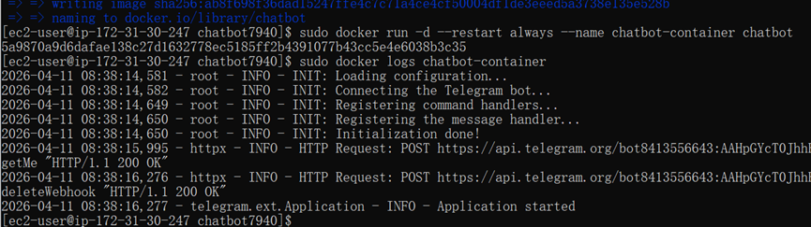


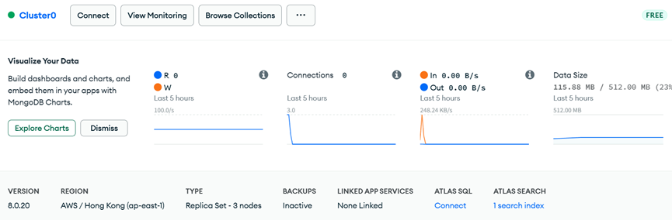


05 Deployment
Deployment Process
The deployment and startup of the Telegram chatbot container via Docker on an AWS EC2 instance. The logs verify that the bot completed initialization, established a connection with the Telegram API, and is running stably in the background. The relevant command maintains 24/7 uptime.
01.Local Development
Code written and tested locally in a dev environment.
02.Dockerization
Application packaged into a lightweight Docker image.
03.AWS Infrastructure Setup
EC2 instance configured with security groups & VPC.
04.Production Deployment
The robot service is currently running stably under low load; at the same time, the interface supports operations such as data visualization, chart building and index management, proving that the project has successfully persisted chat logs and other data to the MongoDB cloud database, meeting the requirements of the project for log recording and cloud data management.
Container pulled & run on EC2 for 24/7 uptime.
Notes:
Our deployment process followed a streamlined DevOps approach. After local development and testing, we containerized the application using Docker. We then configured an AWS EC2 instance and deployed the Docker container, ensuring the bot runs continuously.
As shown in the cost summary, we effectively utilized free-tier services for our infrastructure, resulting in a very low operational cost, primarily limited to minimal LLM API usage. This demonstrates our ability to build cost-effective cloud solutions.

Slide 8



06 Summary
Key Achievements
Challenges & Lessons
Future Improvements
• Delivered a fully functional cloud-native chatbot.
• Mastered Docker, AWS, MongoDB & API integration.
• Implemented a complete DevOps workflow.
Challenges:Resolved Docker inconsistencies & LLM API rate limits.
Learned:Critical importance of version control, cost control & robust error handling.
• Optimize response speed with caching strategies.
• Add multi-language support & conversation history.
• Explore serverless architectures for scalability.
Notes:
In summary, our project successfully delivered a fully functional cloud-native chatbot, meeting all course requirements. We gained valuable hands-on experience with core cloud technologies and DevOps practices. We overcame challenges like Docker deployment issues and API rate limiting, learning crucial lessons about version control, cost management, and system stability. For the future, we plan to optimize the bot's performance, add new features, and explore more advanced cloud architectures to further enhance the system. Thank you.

Slide 9
THANKS.
BUSINESS ANALYSIS REPORT

