Slide 1
综合英语
2026-11-11第8-9节
2026-11-11 · 共 58 页幻灯片（iCourse 自动截图）

Slide 2
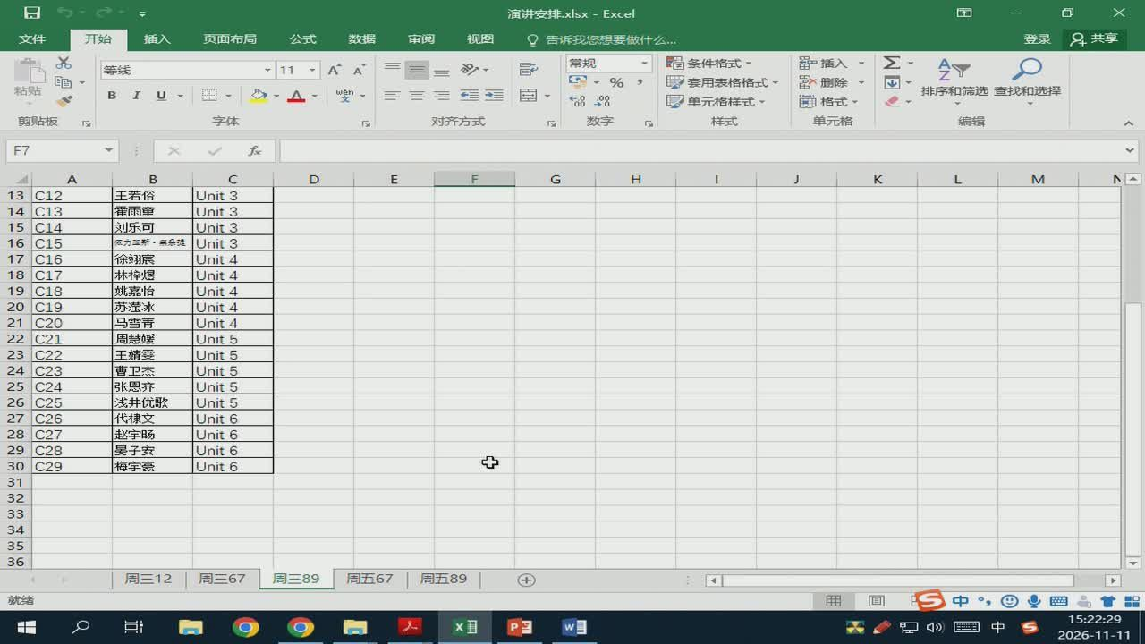
1/58 · 00:00
Notes:
演讲安排.xlsx-Excel
页面布局
数据
常规
留插入
等线
同%
套用表格格式
删除
排序和筛选查找和选择
单元格样式
对齐方式
数字
单元格
F7
C12
王若俗
Unit3
C13
霍雨童
Unit3
C14
刘乐可
Unit3
C15
依力监新·余捷
Unit3
C16
徐翊宸
Unit4
C17
林梓煜
Unit4
C18
姚嘉怡
Unit4
C19
苏莹冰
Unit4
C20
马雪青
Unit4
C21
周慧媛
Unit5
C22
王婧雯
Unit5
C23
曹卫杰
Unit5
C24
张恩齐
Unit5
C25
浅井优歌
Unit5
C26
代棣文
Unit6
C27
赵宇肠
Unit6
C28
晏子安
Unit6
C29
梅宇豪
Unit6
周三12
周三67
周三89
周五67
周五89
就绪
分中

Slide 3
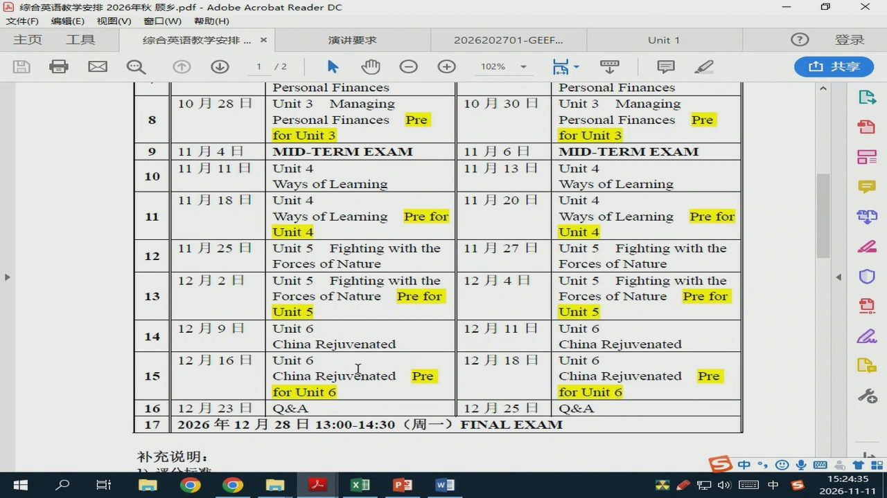
2/58 · 01:24
Notes:
综合英语教学安排2026年秋顾乡.pdf-AdobeAcrobatReaderDC
文件（F)
编辑（E）视图（V)窗口（W）帮助（H）
主页
综合英语教学安排..
演讲要求
2026202701-GEEF...
Unit1
PersonalFinances
Personal Finances
10月28日
Unit3
Managing
10月30日
Unit3
Managing
PersonalFinances
Pre
PersonalFinances
Pre
forUnit3
forUnit3
11月4日
MID-TERMEXAM
11月6日
MID-TERMEXAM
11月11日
Unit4
11月13日
Unit4
Waysof Leaining
Ways of Learning
11月18日
Unit4
11月20日
Unit4
Waysof Leaining
Prefor
Ways of Learning
Prefor
Unit4
Unit4
11月25日
Unit5
Fightingwith the
11月27日
Unit5
Fightingwith the
ForcesofNature
ForcesofNature
12月2日
Unit5
Fightingwith the
12月4日
Unit5 Fightingwith the
Forces ofNature
Prefor
ForcesofNature
Prefor
Unit5
Unit5
12月9日
Unit6
12月11日
Unit6
ChinaRejuvenated
ChinaRejuvenated
12月16日
Unit6
12月18日
Unit6
ChinaRejuvenated
Pre
ChinaRejuvenated
Pre
forUnit6
forUnit6
12月23日
Q&A
12月25日
Q&A
2026年12月28日13:00-14:30（周
一)FINALEXAM
补充说明：
会中

Slide 4
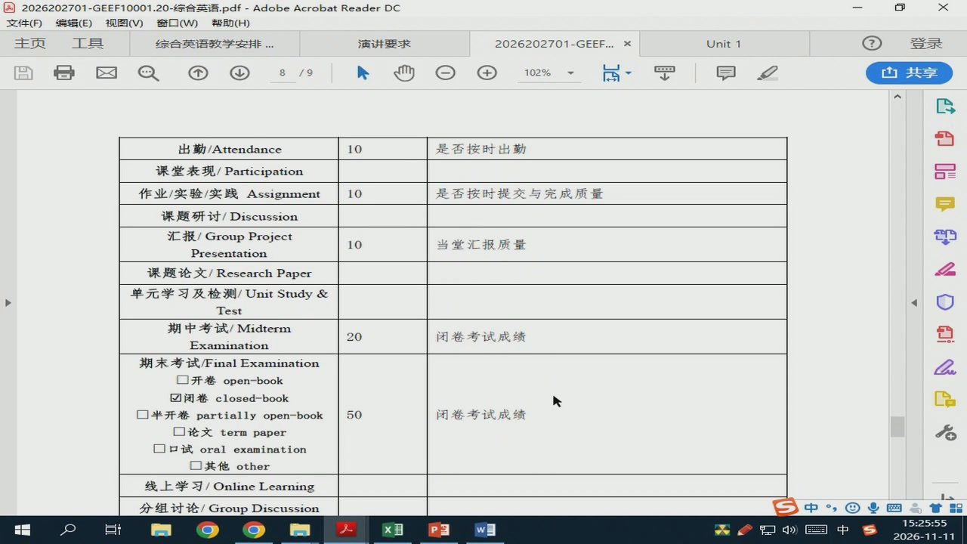
3/58 · 02:45
Notes:
2026202701-GEEF10001.20-综合英语.pdf-AdobeAcrobatReaderDC
文件（F)
编辑（E）视图（V)窗口（W）帮助（H）
主页
综合英语教学安排
演讲要求
2026202701-GEEF...
Unit1
出勤/Attendance
是否按时出勤
课堂表现/Participation
作业/实验/实践Assignment
是否按时提交与完成质量
课题研讨/Discussion
汇报/GroupProject
当堂汇报质量
Presentation
课题论文/ResearchPaper
单元学习及检测/UnitStudy&
Test
期中考试/Midterm
闭卷考试成绩
Examination
期末考试/FinalExamination
开卷open-book
闭卷closed-book
半开卷partiallyopen-book
闭卷考试成绩
论文termpaper
口试oralexamination
其他other
线上学习/OnlineLearning
分组讨论/GroupDiscussion

Slide 5
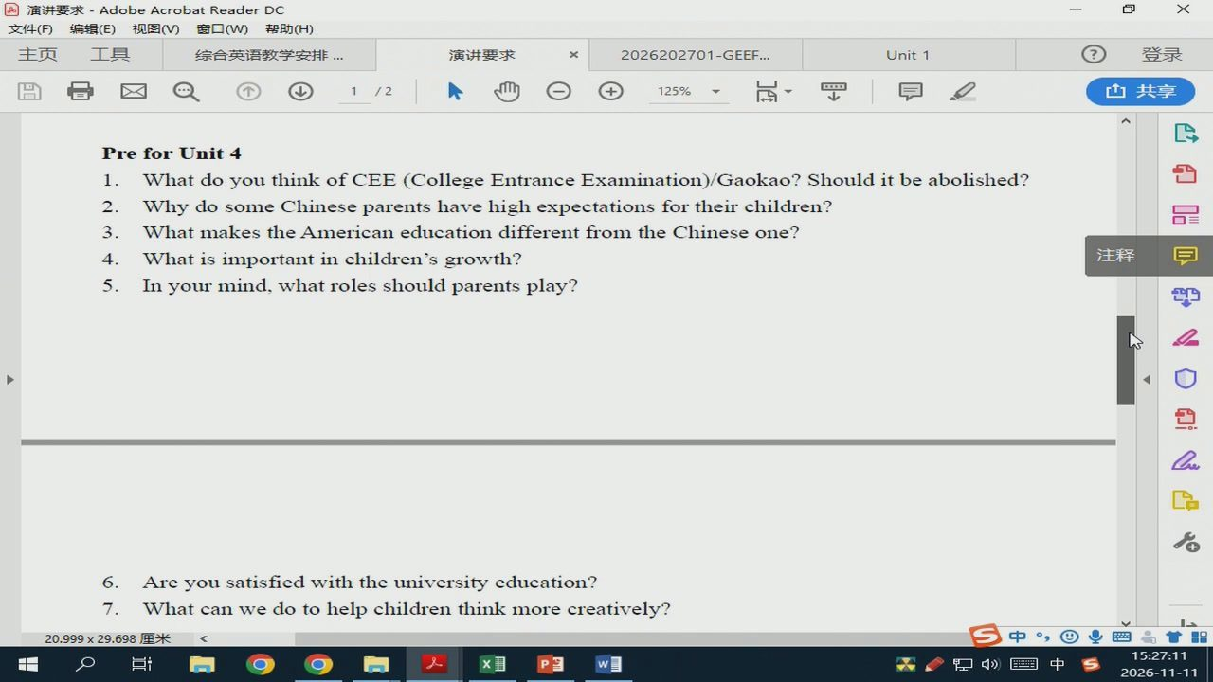
4/58 · 04:00
Notes:
演讲要求-AdobeAcrobatReaderDC
文件(F)
编辑（E）视图（V)窗口（W)帮助（H)
主页
综合英语教学安排
演讲要求
2026202701-GEEF..
Unit1
Pre forUnit4
1.
Whatdoyou thinkofCEE(CollegeEntranceExamination)/Gaokao?Shoulditbeabolished?
2.
3.
WhatmakestheAmericaneducationdifferentfromtheChineseone?
4.
Whatisimportantin children'sgrowth?
注释
5.
Inyourmind,whatrolesshouldparentsplay?
6.
Areyousatisfiedwith theuniversityeducation?
7.
Whatcanwedotohelpchildrenthinkmorecreatively?
20.999×29.698厘米
中四
分中

Slide 6
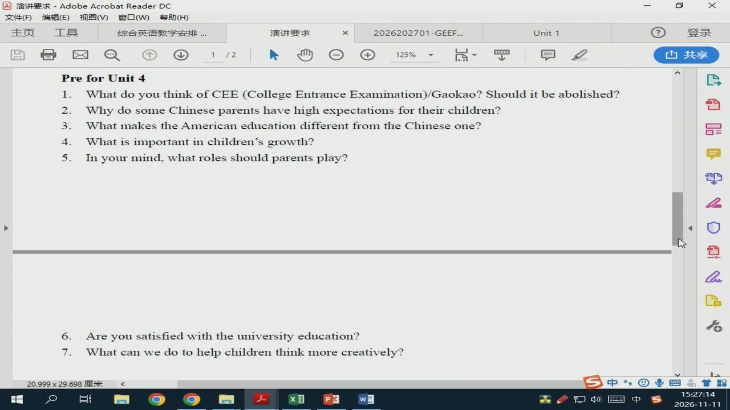
5/58 · 04:03
Notes:
演讲要求-AdobeAcrobatReaderDC
文件(F)
编辑（E）视图（V)窗口（W)帮助（H)
主页
综合英语教学安排
演讲要求
2026202701-GEEF..
Unit1
PreforUnit 4
1.
WhatdoyouthinkofCEE(CollegeEntranceExamination)/Gaokao?Shoulditbeabolished?
2.
WhydosomeChineseparentshavehighexpectationsfortheirchildren?
3.
WhatmakestheAmericaneducationdifferentfromtheChineseone?
4.
Whatisimportantinchildren'sgrowth?
5.
Inyourmind,whatrolesshouldparentsplay?
6.
Areyousatisfiedwiththeuniversityeducation?
7.
Whatcanwedotohelpchildren thinkmorecreatively?
20.999×29.698厘米
Ed
分中

Slide 7
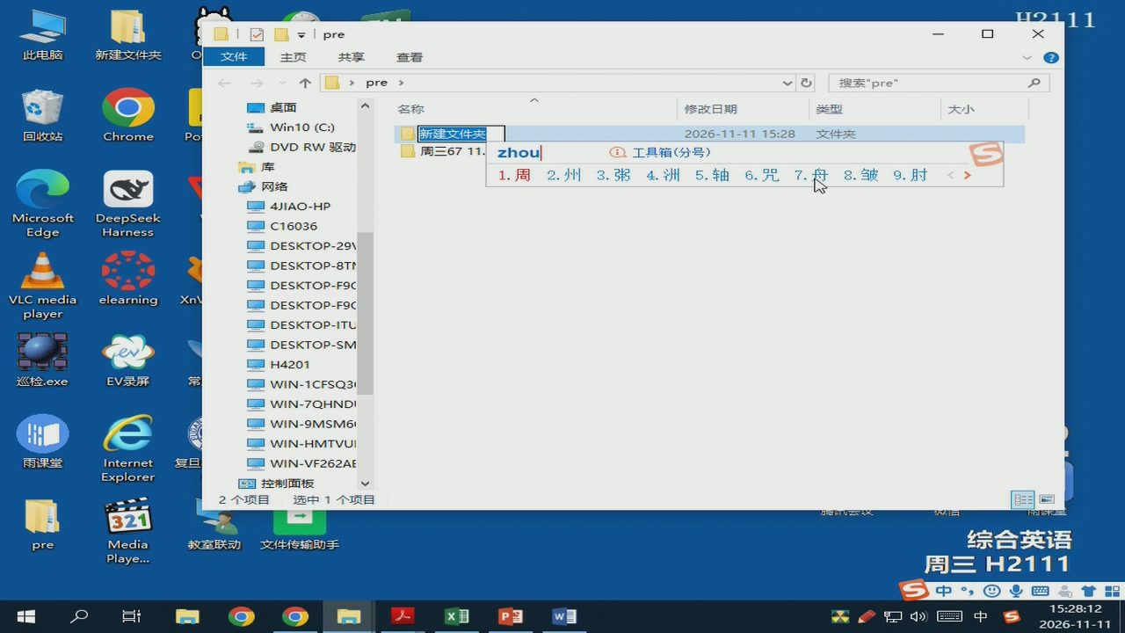
6/58 · 05:01
Notes:
LGH
pre
此电脑
新建文件夹
主页
查看
pre
搜索”pre”
桌面
名称
修改日期
类型
大小
Win10(C:)
回收站
Chrome
Po
新建文件夹
2026-11-11 15:28
文件夹
DVDRW驱动
周三6711.
zhou
工具箱（分号）
1.周
2.州3.粥4.洲5.轴
6.咒
8.皱
9.肘
网络
4JIAO-HP
Microsoft
DeepSeek
Edge
Harness
C16036
DESKTOP-29V
DESKTOP-8T
DESKTOP-F9C
VLCmedia
elearning
Xn\
DESKTOP-F9C
player
DESKTOP-ITU
DESKTOP-SM
H4201
巡检.exe
EV录屏
WIN-1CFSQ3I
WIN-7QHNDI
WIN-9MSM6
WIN-HMTVUI
雨课堂
Internet
复旦
WIN-VF262AE
Explorer
控制面板
选中1个项目
综合英语
pre
Media
教室联动
文件传输助手
Playe...
周三H2111
中国
Ed

Slide 8

7/58 · 05:19
Notes:
pre
此电脑
新建文件夹
主页
查看
pre
搜索”pre”
桌面
名称
修改日期
类型
大小
Win10(C:)
回收站
Chrome
Po
周三8911.11
2026-11-1115:28
文件夹
DVDRW驱动
周三6711.11
2026-11-11 13:35
文件夹
网络
4JIAO-HP
Microsoft
DeepSeek
Edge
Harness
C16036
DESKTOP-29V
DESKTOP-8T1
DESKTOP-F9C
VLCmedia
elearning
Xn\
DESKTOP-F9C
player
DESKTOP-ITU
DESKTOP-SM
H4201
巡检.exe
EV录屏
WIN-1CFSQ3
WIN-7QHNDI
WIN-9MSM6
WIN-HMTVUI
雨课堂
Internet
复旦
WIN-VF262AE
Explorer
控制面板
综合英语
pre
Media
教室联动
文件传输助手
Playe...
周三H2111
英四品

Slide 9
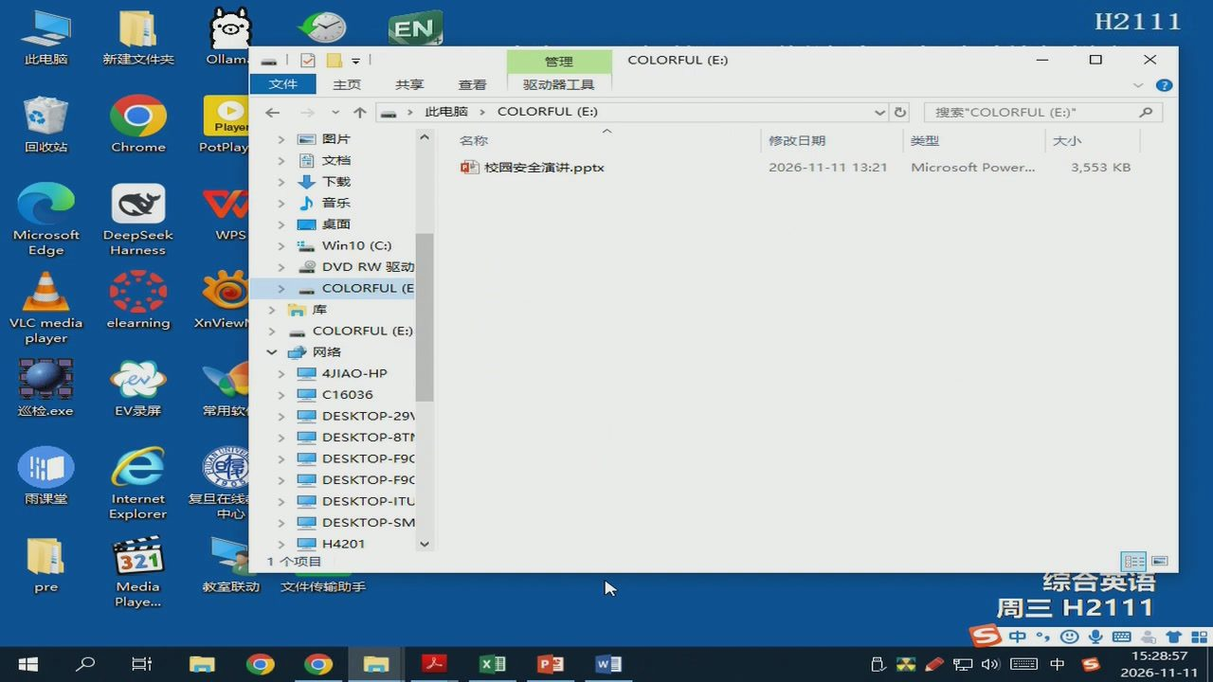
8/58 · 05:47
Notes:
EN
H2111
此电脑
新建文件夹
Ollam
管理
主页
查看
驱动器工具
此电脑
搜索COLORFUL（E:)”
Player
回收站
Chrome
PotPlay
名称
修改日期
类型
大小
文档
校园安全演讲.pptx
2026-11-1113:21
MicrosoftPower...
3,553KB
下载
音乐
桌面
Microsoft
DeepSeek
WPS
Edge
Harness
Win10（C:)
DVDRW驱动
COLORFUL(E
VLCmedia
elearning
XnViewi
player
网络
4JIAO-HP
C16036
巡检.exe
EV录屏
常用软
DESKTOP-29V
DESKTOP-8T
DESKTOP-F9C
DESKTOP-F9C
雨课堂
Internet
复旦在线
DESKTOP-ITU
Explorer
中心
DESKTOP-SM
H4201
教室联动
文件传输助手
综合英语
pre
Media
Playe...
周三H2111
中国

Slide 10
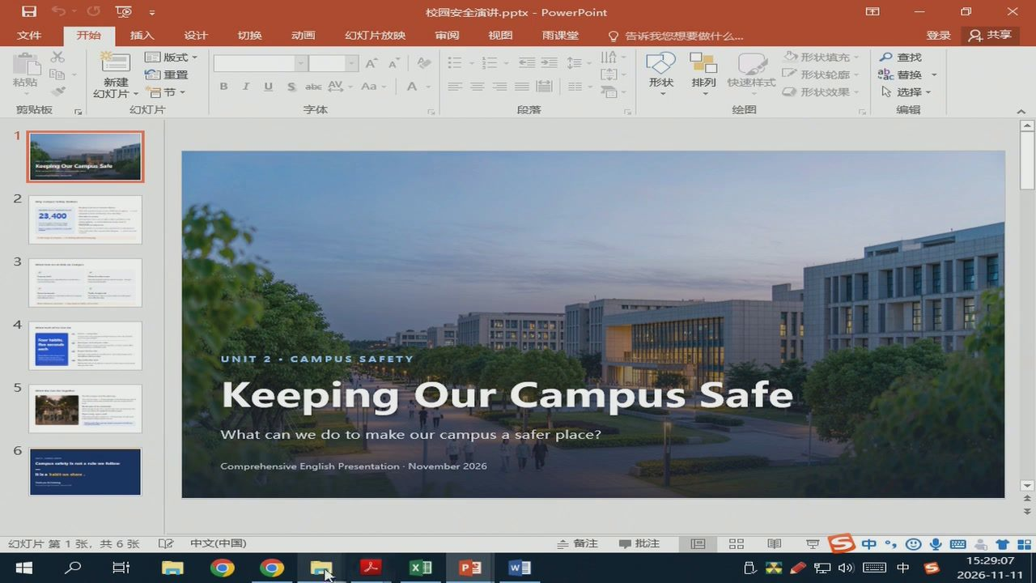
9/58 · 05:57
Notes:
雨课堂
排列快速样式
冒节
23,400
UNIT
Keeping Our Campus Safe
Whatcanwedo to makeourcampusa saferplace?
Comprehensive English Presentation·November2026
台1中

Slide 11
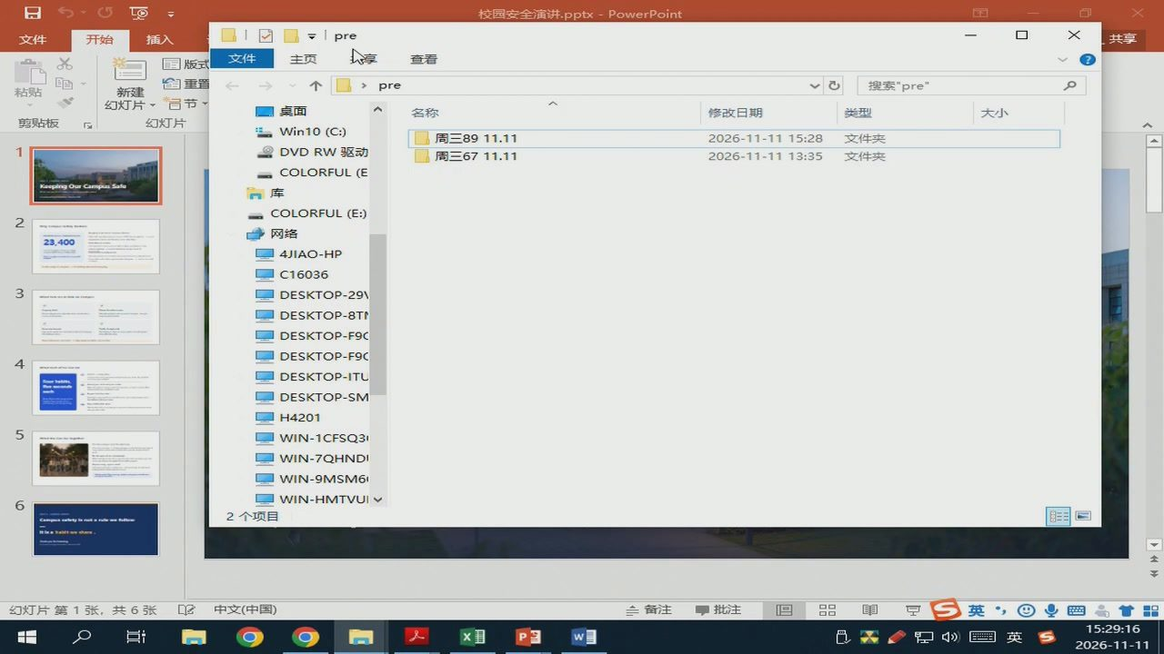
10/58 · 06:05
Notes:
pre
主页
查看
pre
搜索”pre”
桌面
名称
修改日期
类型
大小
Win10（C:)
周三8911.11
2026-11-1115:28
文件夹
DVDRW驱动
周三6711.11
2026-11-11 13:35
文件夹
COLORFUL(E
网络
23,400
4JIAO-HP
C16036
DESKTOP-291
DESKTOP-8T
DESKTOP-F9C
DESKTOP-F9C
DESKTOP-ITU
DESKTOP-SM
H4201
WIN-1CFSQ3
WIN-7QHNDI
WIN-9MSM6
WIN-HMTVUI
幻灯片第1张，
共6张
英四
分英

Slide 12
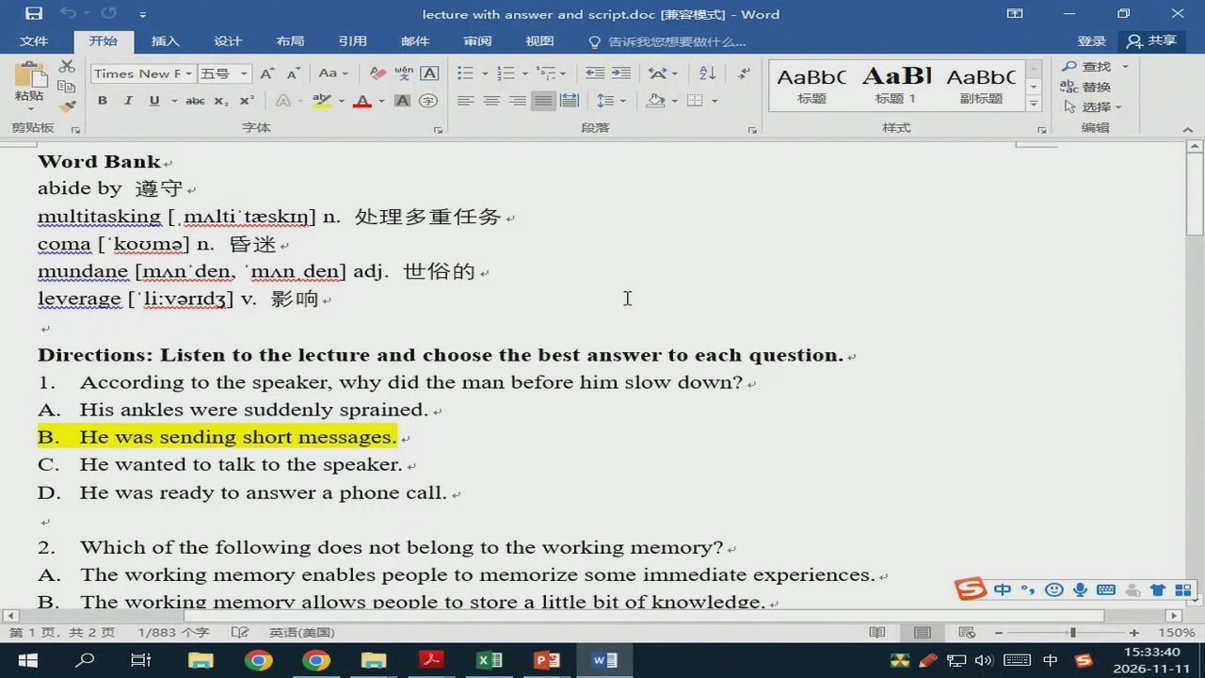
11/58 · 10:29
Notes:
lecturewith answerandscript.doc[兼容模式t]-Word
布局
引用
TimesNewF
AaBbC
AaBl
AaBbC
x3ee
标题
WordBank
abideby遵守
multitasking[.mAlti'taeskim]n.处理多重任务
coma[kooma]n.昏迷
mundane[mAnden，‘mAnden]adj.世俗的
leverage['li:varid3]v.影响
Directions:Listentothelectureandchoosethebestanswertoeachquestion.
1.
Accordingtothespeaker,whydidthemanbeforehimslowdown?
His anklesweresuddenly sprained.
Hewassendingshortmessages.
Hewanted to talkto thespeaker.
Hewasreadytoansweraphonecall.
2.
Whichofthefollowingdoesnotbelongtotheworkingmemory?
Theworkingmemoryenablespeopletomemorizesomeimmediateexperiences.
Theworkingmemorvallowspeopletostorealittlebitofknowledge.
第1页，
共2页
1/883个字
英语（美国）
台1中

Slide 13
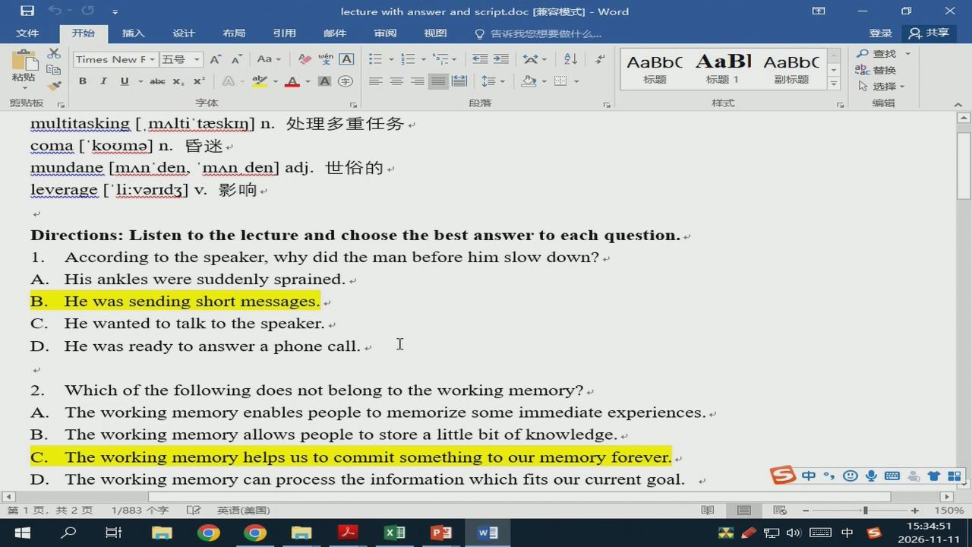
12/58 · 11:41
Notes:
lecturewith answer andscript.doc[兼容模式]-Word
布局
引用
AaBbC
AaBl
AaBbC
TimesNewF
标题
multitasking[.mAlti'taeskin]n.处理多重任务
coma[kooma]n.昏迷
mundane[mAn'den，‘mAnden]adj.世俗的
leverage['li:varid3]v.影响
Directions:Listen tothelectureandchoose thebestanswer toeachquestion.
1.
Accordingtothespeaker,whydidthemanbeforehimslowdown?
Hisanklesweresuddenlysprained.
Hewassendingshortmessages.
Hewantedtotalktothespeaker.
He wasready to answer a phone call.
2.
Whichofthefollowingdoesnotbelongtotheworkingmemory?
Theworkingmemoryenablespeopletomemorizesomeimmediateexperiences.
Theworkingmemoryallowspeopletostorealittlebitofknowledge.t
Theworkingmemoryhelpsustocommitsomethingtoourmemoryforever.
Theworkingmemorycanprocesstheinformationwhichfitsourcurrentgoal.
中业四高
第1页，
共2页
1/883个字
英语（美国）
X1
台中

Slide 14
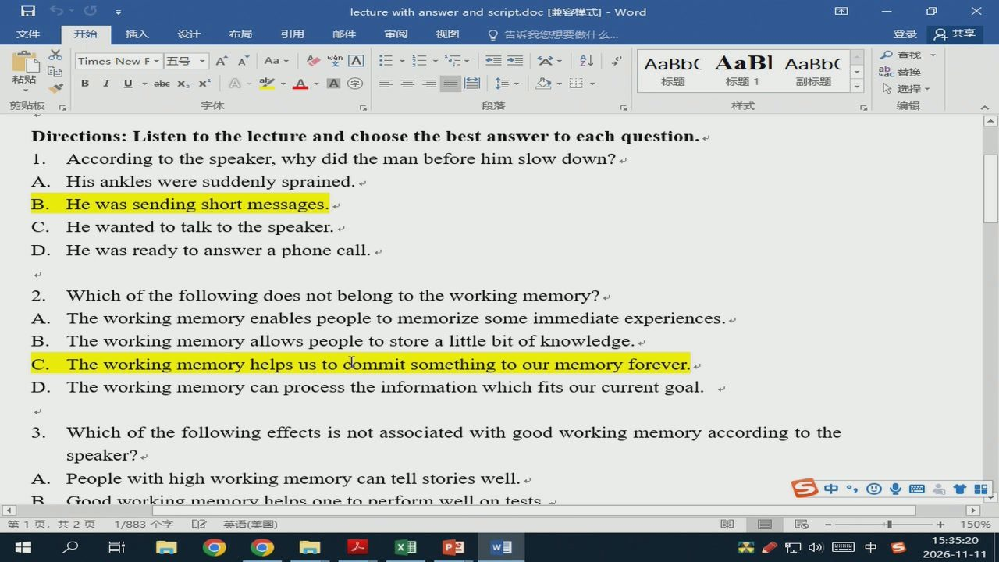
13/58 · 12:10
Notes:
lecturewith answerand script.doc[兼容模式]-Word
布局
引用
AaBbC
AaBl
AaBbC
Times NewF
abe
标题
Directions:Listen tothelectureandchoosethebestanswer toeachquestion.
1.Accordingtothespeaker,whydidthemanbeforehimslowdown?
Hisanklesweresuddenlysprained.
Hewassendingshortmessages.
Hewantedtotalktothespeaker.
Hewasreadytoansweraphonecall.
2.
Whichofthefollowingdoesnotbelongtotheworkingmemory?
Theworkingmemoryenablespeopletomemorizesomeimmediateexperiences.
Theworkingmemoryallowspeopletostorealittlebitofknowledge.t
Theworkingmemoryhelpsustodommitsomethingtoourmemoryforever.
Theworkingmemorycanprocesstheinformationwhichfitsourcurrentgoal.
3.
Whichofthefollowingeffectsisnotassociatedwithgoodworkingmemoryaccordingtothe
speaker?
Peoplewithhighworkingmemorycantellstorieswell.
中四
Goodworkinamemorvhelnsonetonerformwellontests
第1页，
共2页
1/883个字
英语（美国）
X1

Slide 15
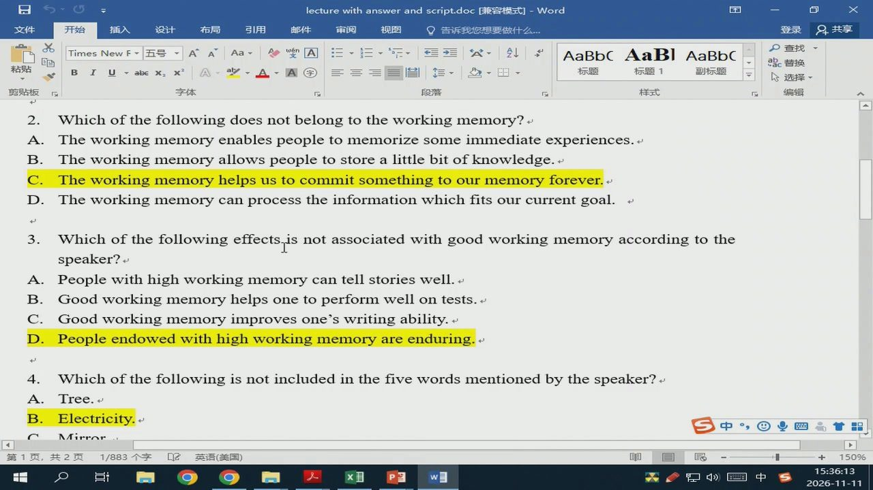
14/58 · 13:03
Notes:
lecturewithanswerandscript.doc[兼容模式t]-Word
布局
引用
告诉我您想要做什公
AaBbC
AaBl
AaBbC
TimesNewF
田、
标题
2.
Whichof thefollowingdoesnotbelongtotheworkingmemory?
Theworkingmemoryenablespeopletomemorizesomeimmediateexperiences.
Theworkingmemoryallowspeopletostorealittlebitofknowledge.t
Theworkingmemoryhelpsustocommitsomethingtoourmemoryforever.
Theworkingmemorycanprocesstheinformationwhichfitsourcurrentgoal.
3.
Whichofthefollowingeffectsisnotassociatedwithgoodworkingmemoryaccordingtothe
speaker?
Peoplewithhighworkingmemorycantellstorieswell.
Goodworkingmemoryhelpsonetoperformwell ontests.
Goodworkingmemoryimprovesone'swritingability.
Peopleendowedwithhighworkingmemoryareenduring.
4.
Whichofthefollowingisnotincludedinthefivewordsmentionedbythespeaker?
Tree.
Electricity.
AAirr
第1页，
共2页
1/883个字
英语（美国）
X1
会1中

Slide 16
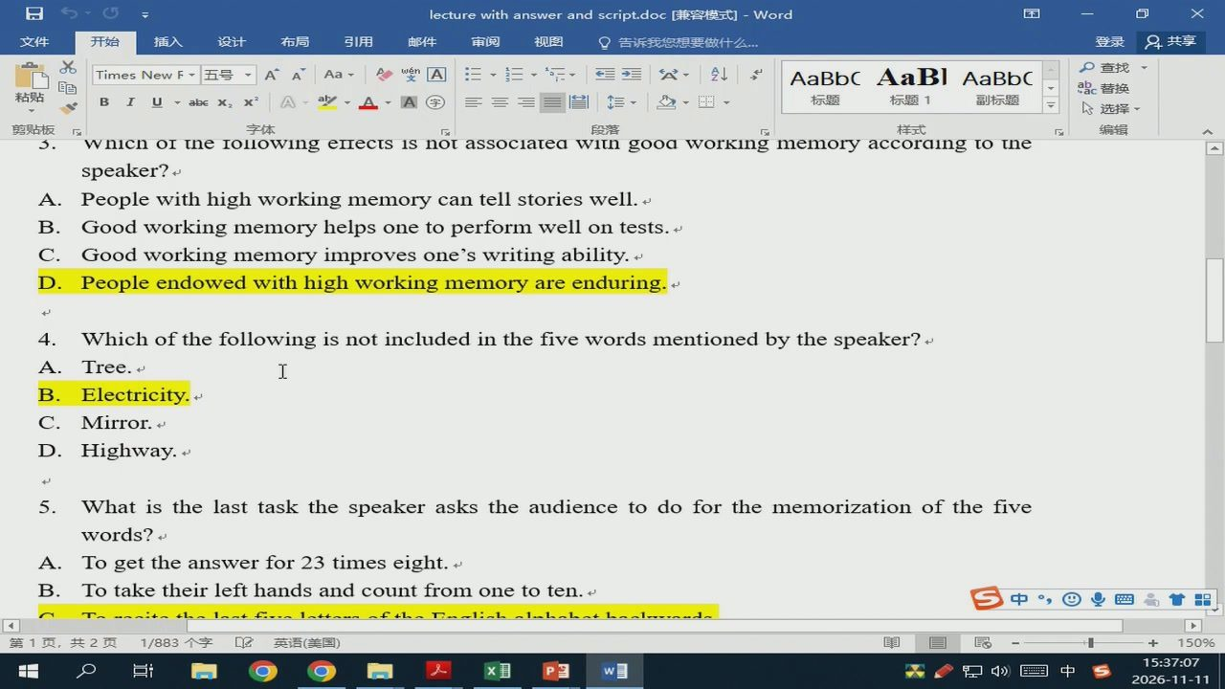
15/58 · 13:56
Notes:
lecturewithanswerandscript.doc[兼容模式t]-Word
布局
引用
告诉我您想要做什公
AaBbC
AaBl
AaBbC
P查找
→三
标题
abc
3.
speaker?
Peoplewithhighworkingmemorycantellstorieswell.
Goodworkingmemoryhelpsonetoperformwellontests.
Goodworkingmemory improvesone'swriting ability.t
Peopleendowedwithhighworkingmemoryareenduring.
4.
Whichofthefollowingisnotincludedinthefivewordsmentionedbythespeaker?
Tree.t
Electricity.
Mirror.
Highway.
5.
Whatisthelasttaskthespeakeraskstheaudiencetodoforthememorizationofthefive
words?
Togettheanswerfor23timeseight.
Totaketheirlefthandsandcountfromonetoten.
中四
第1页，
共2页
1/883个字
英语（美国）
X1
台1中

Slide 17
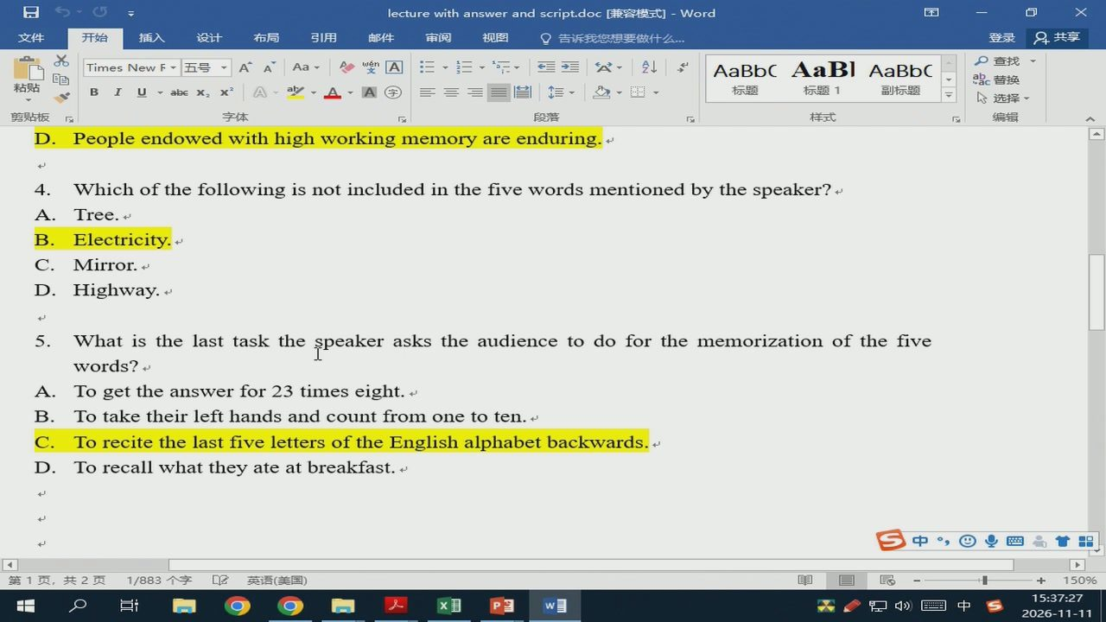
16/58 · 14:17
Notes:
lecturewithanswerandscript.doc[兼容模式t]-Word
布局
引用
TimesNewF
AaBbC AaBl
AaBbC
标题
Peopleendowedwithhighworkingmemoryareenduring.
4.
Whichofthefollowingisnotincludedinthefivewordsmentionedby thespeaker?
Tree.
Electricity.
Mirror.
Highway.
5.
Whatisthelasttaskthespeakeraskstheaudiencetodoforthememorizationofthefive
words?
Togettheanswerfor23timeseight.
Totaketheirlefthandsandcountfromonetoten.
TorecitethelastfivelettersoftheEnglishalphabetbackwards
Torecallwhattheyateatbreakfast.
中@四心
第1页，
共2页
1/883个字
英语（美国）

Slide 18
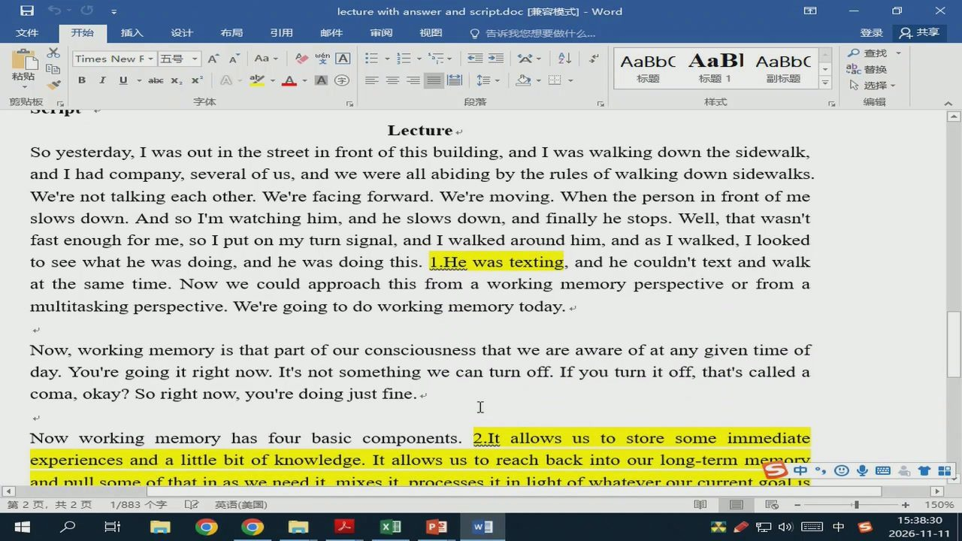
17/58 · 15:19
Notes:
lecturewithanswerandscript.doc[兼容模式t]-Word
布局
引用
AaBbC
AaBl
AaBbC
TimesNewF
标题
Lectures
Soyesterday,Iwasoutinthestreetinfrontofthisbuilding,andIwaswalkingdownthesidewalk,
andIhadcompany,severalofus,andwewereallabidingbytherulesofwalkingdownsidewalks.
We'renottalkingeachother.We'refacingforward.We'removing.Whenthepersoninfrontofme
slowsdown.AndsoI'mwatchinghim,andheslowsdown,andfinallyhestops.Well,thatwasn't
fastenoughforme,soIputonmyturnsignal,andIwalked aroundhim,and asIwalked,I looked
toseewhathewasdoing,andhewasdoingthis.
1.Hewastexting,andhe couldn't textandwalk
atthesametime.Nowwecouldapproachthisfromaworkingmemoryperspectiveorfroma
multitaskingperspective.We'regoingtodoworkingmemorytoday.
Now,workingmemoryisthatpartofourconsciousnessthatweareawareofatanygiventimeof
day.You'regoingitrightnow.It'snotsomethingwecanturnoff.Ifyouturnitoff,that'scalleda
coma,okay?Sorightnow,you'redoingjustfine.
Now workingmemoryhas four basic components.
2.Itallowsustostoresomeimmediate
experiencesandalittlebitofknowledge.Itallowsustoreachbackintoourlong-termme
andnullsomeofthatinasweneeditmixesitnrocessesitinliahtofwhateverourcurrent
onal1s
1/883个字
英语（美国）
会中

Slide 19
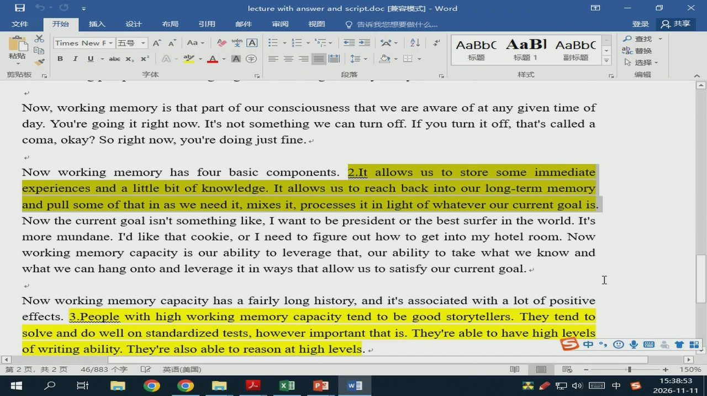
18/58 · 15:42
Notes:
lecturewithanswerandscript.doc[兼容模式t]-Word
布局
引用
Times
AaBbC
AaBl
AaBbC
标题
Now,workingmemoryisthatpartofourconsciousnessthatweareawareofatanygiventimeof
day.You'regoingitrightnow.It'snotsomethingwecanturnoff.Ifyouturnitoff,that'scalled a
coma,okay?Sorightnow,you'redoingjustfine.
Nowworkingmemory has fourbasiccomponents.
2.Itallowsustostoresomeimmediate
experiencesandalittlebitofknowledge.Itallowsustoreachbackintoourlong-termmemory
andpullsomeofthatinasweneedit,mixesit,processesitinlightofwhateverourcurrentgoalis
Nowthecurrentgoalisn'tsomethinglike,Iwanttobepresidentorthebestsurferintheworld.It's
moremundane.I'dlikethatcookie,orIneedtofigureouthowtogetintomyhotelroom.Now
workingmemorycapacityis ourabilitytoleveragethat,ourabilitytotakewhatweknowand
whatwecanhangontoandleverageitinwaysthatallowustosatisfyourcurrentgoal.
Nowworkingmemorycapacityhasafairlylonghistory,and it'sassociatedwithalotofpositive
effects.
3.Peoplewithhighworkingmemorycapacitytendtobegoodstorytellers.Theytendto
solveanddowellonstandardizedtests,howeverimportantthatis.They'reabletohavehighlevels
ofwritingability.They'realsoabletoreasonathighlevels.
46/883个字
英语（美国）

Slide 20
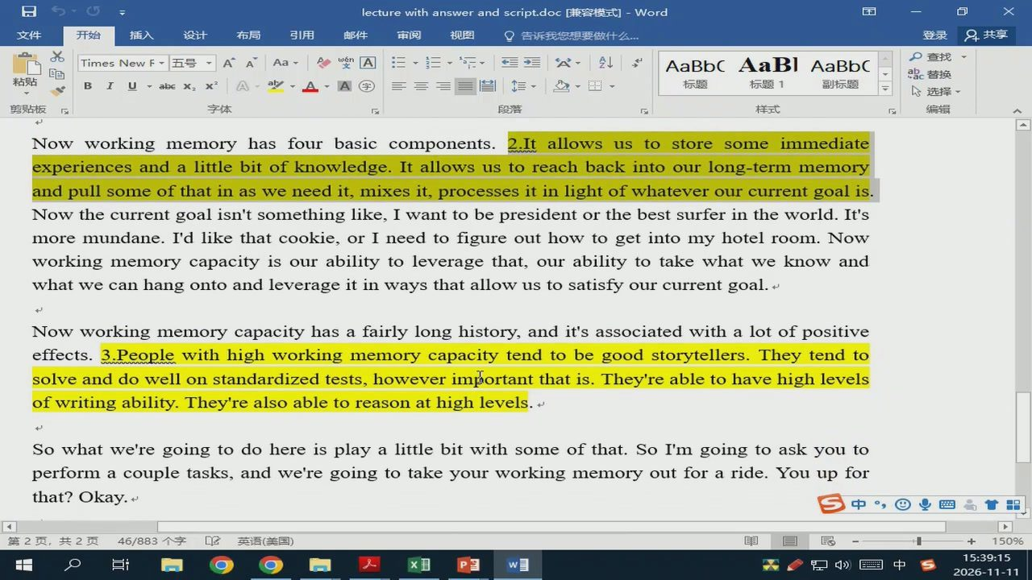
19/58 · 16:04
Notes:
lecturewithanswerandscript.doc[兼容模式t]-Word
布局
引用
Q告诉我您想要做什么
8共享
AaBbC
AaBl
AaBbC
TimesNewF
标题
Nowworkingmemory
hasfourbasiccomponents.
2.Itallowsustostoresomeimmediate
experiencesandalittlebitofknowledge.Itallowsustoreachbackintoourlong-termmemory
andpullsomeofthatinasweneedit,mixesit,processesitinlightofwhateverourcurrentgoalis.
Nowthecurrentgoalisn'tsomethinglike,Iwanttobepresidentorthebestsurferintheworld.It's
moremundane.I'dlikethatcookie,orIneed tofigureouthowtogetintomyhotelroom.Now
workingmemorycapacityisourabilitytoleveragethat,ourabilitytotakewhatweknowand
whatwecanhangontoandleverageitinwaysthatallowustosatisfyourcurrentgoal.
Nowworkingmemorycapacityhasafairlylonghistory,andit'sassociatedwithalotofpositive
effects.
3.Peoplewithhighworkingmemorycapacitytendtobegoodstorytellers.Theytendto
solveanddowellonstandardizedtests,howeverimportantthatis.They'reabletohavehighlevels
ofwritingability.They'realsoabletoreasonathighlevels.
Sowhatwe'regoingtodohereisplayalittlebitwithsomeofthat.SoI'mgoingtoaskyouto
that?Okay.
中四
46/883个字
英语（美国）
会1中

Slide 21
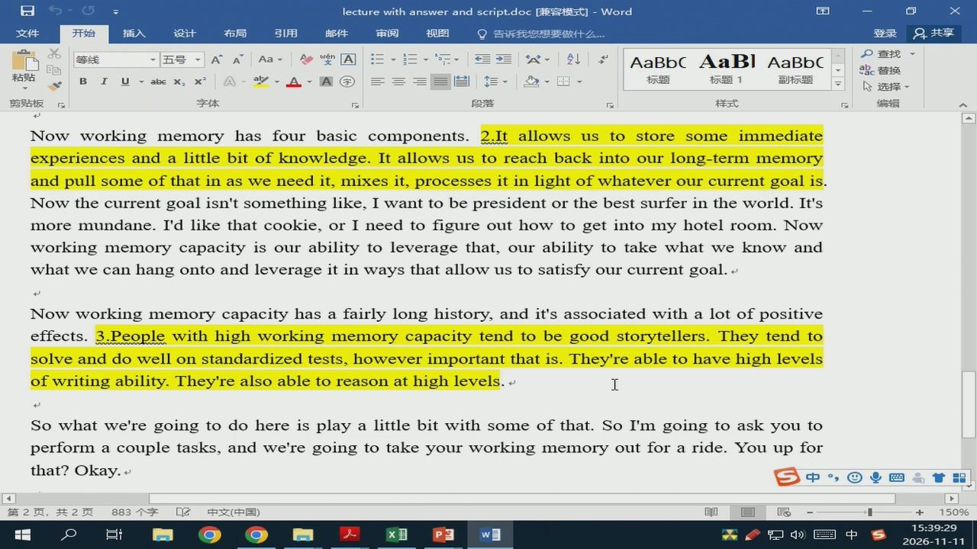
20/58 · 16:19
Notes:
lecturewithanswerandscript.doc[兼容模式t]-Word
布局
引用
等线
AaBbC
AaBl
AaBbC
标题
Nowworkingmemory
hasfourbasiccomponents.
2.Itallowsustostoresome
immediate
experiencesandalittlebitofknowledge.Itallowsustoreachbackintoourlong-termmemory
andpullsomeofthatinasweneedit,mixesit,processesitinlightofwhateverourcurrentgoalis.
Nowthecurrentgoalisn'tsomethinglike,Iwanttobepresidentorthebestsurferintheworld.It's
moremundane.I'dlikethatcookie,orIneedtofigureouthowtogetintomyhotelroom.Now
workingmemorycapacityisourabilitytoleveragethat,ourabilitytotakewhatweknowand
whatwecanhangontoandleverageitinwaysthatallowustosatisfyourcurrentgoal.
Nowworkingmemorycapacityhasafairlylonghistory,andit'sassociatedwithalotofpositive
effects.
3.Peoplewithhighworkingmemorycapacitytendtobegoodstorytellers.Theytendto
solveanddowellonstandardizedtests,howeverimportantthatis.They'reabletohavehighlevels
ofwritingability.They'realsoabletoreasonathighlevels.
Sowhatwe'regoingtodohereisplayalittlebitwithsomeofthat.SoI'mgoingtoaskyouto
performacoupletasks,andwe'regoingtotakeyourworkingmemoryoutforaride.Youupfor
that? Okay.
中国国
門台中

Slide 22
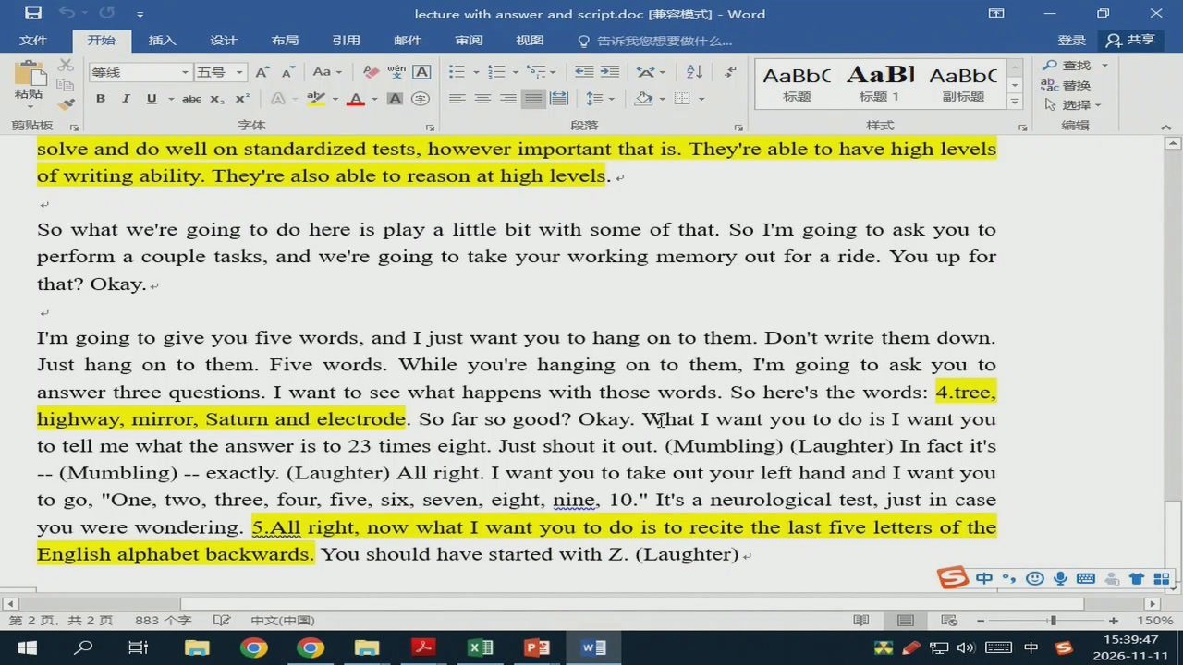
21/58 · 16:37
Notes:
lecturewithanswerandscript.doc[兼容模式t]-Word
布局
引用
等线
AaBbCAaBl
AaBbC
标题
solveanddowellonstandardizedtests,howeverimportantthatis.They'reabletohavehighlevels
ofwritingability.They'realsoabletoreasonathighlevels.
Sowhatwe'regoingtodohereisplayalittlebitwithsomeofthat.SoI'mgoingtoaskyouto
that? Okay.
I'mgoingtogiveyoufivewords,andIjustwantyoutohangontothem.Don'twritethemdown.
Just hang on to them.Fivewords.Whileyou're hanging on to them,I'm going to askyou to
answerthreequestions.Iwanttoseewhathappenswiththosewords.Sohere'sthewords:
4.tree,
highway,mirror,Saturn andelectrode.Sofarsogood?Okay.WhatIwantyou todoisIwantyou
totellmewhattheansweristo23timeseight.Justshoutitout.(Mumbling)(Laughter)Infactit's
--(Mumbling)--exactly.(Laughter)Allright.IwantyoutotakeoutyourlefthandandIwantyou
togo,"One,two,three,four,five,six,seven,eight,nine,1o."It'saneurologicaltest,justincase
youwerewondering.
5.Allright,nowwhatIwantyoutodoistorecitethelastfivelettersofthe
Englishalphabetbackwards.
YoushouldhavestartedwithZ.(Laughter)
会中

Slide 23
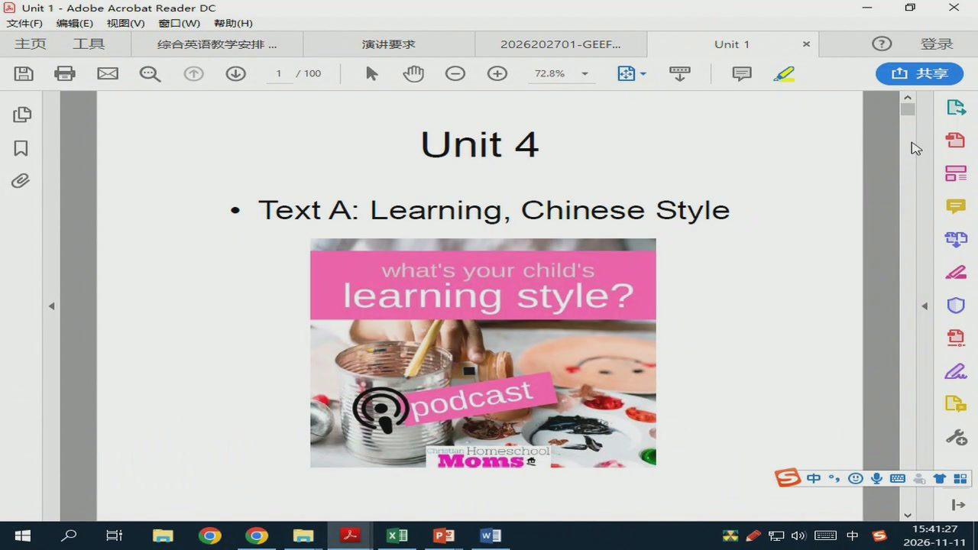
22/58 · 18:17
Notes:
Unit 1-AdobeAcrobatReaderDC
文件（F)
编辑（E）视图（V)窗口（W）帮助（H）
主页
综合英语教学安排
演讲要求
2026202701-GEEF.
Unit1
100
72.8%
Unit 4
白品G
· Text A: Learning, Chinese Style
what'syour child's
learning style?
podcast
Moms
中国
Ed
1中

Slide 24
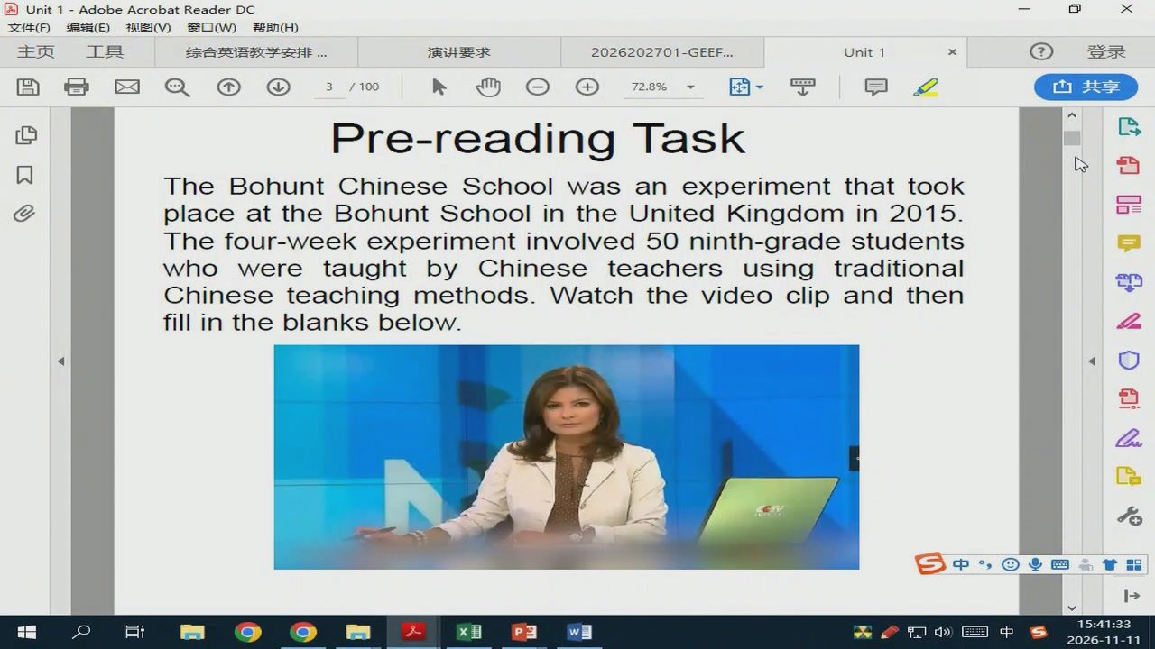
23/58 · 18:22
Notes:
Unit 1-AdobeAcrobatReaderDC
文件（F)
编辑（E）视图（V)窗口（W)帮助（H)
主页
综合英语教学安排
演讲要求
2026202701-GEEF..
Unit1
72.8%
Pre-reading Task
The BohuntChineseSchool was an experiment that took
placeattheBohuntSchoolintheUnitedKingdomin2015
Thefour-weekexperimentinvolved50ninth-gradestudents
whoweretaughtbyChineseteachersusingtraditional
Chineseteachingmethods.Watchthevideoclipand then
fillintheblanksbelow.
中四
甘品
Ed
台1中

Slide 25
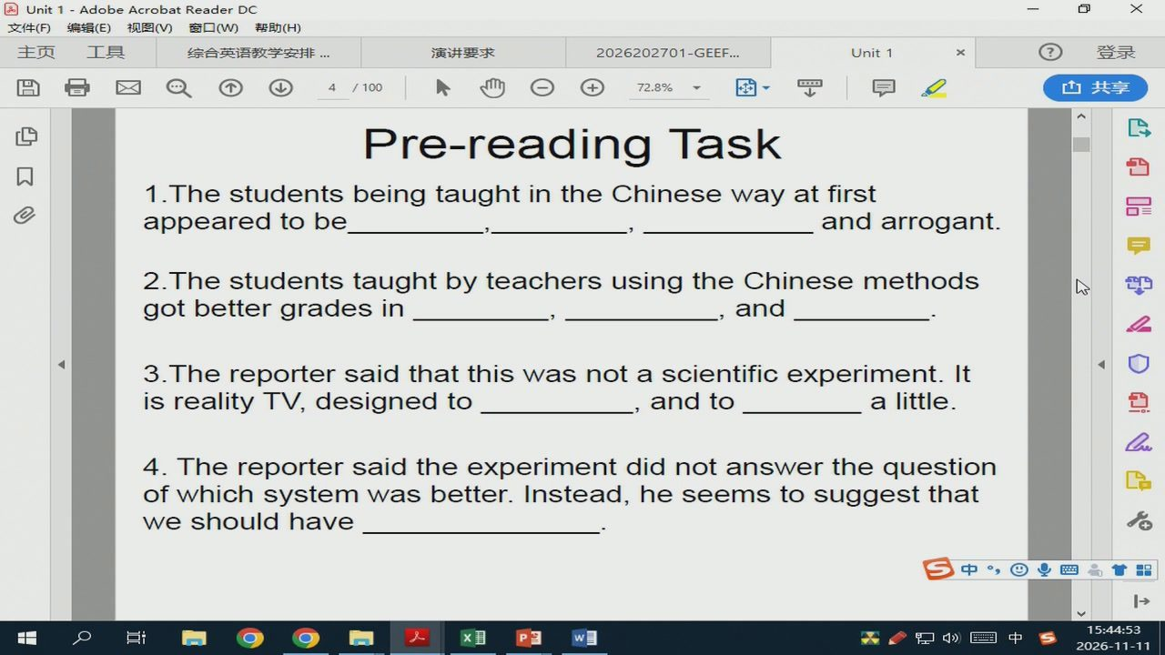
24/58 · 21:42
Notes:
Unit1-AdobeAcrobatReaderDC
文件（F)
编辑（E）视图（V)窗口(W)帮助（H)
主页
综合英语教学安排
演讲要求
2026202701-GEEF...
Unit1
72.8%
Pre-reading Task
1.ThestudentsbeingtaughtintheChinesewayatfirst
appearedtobe
andarrogant.
2.Thestudentstaughtby teachersusing theChinesemethods
gotbettergrades in
and
3.The reporter said that this was not a scientific experiment. It
is reality TV, designed to
and to
a little.
4.Thereportersaidtheexperimentdidnotanswerthequestion
ofwhichsystemwasbetter.Instead,heseemstosuggestthat
weshouldhave
中四
分中

Slide 26
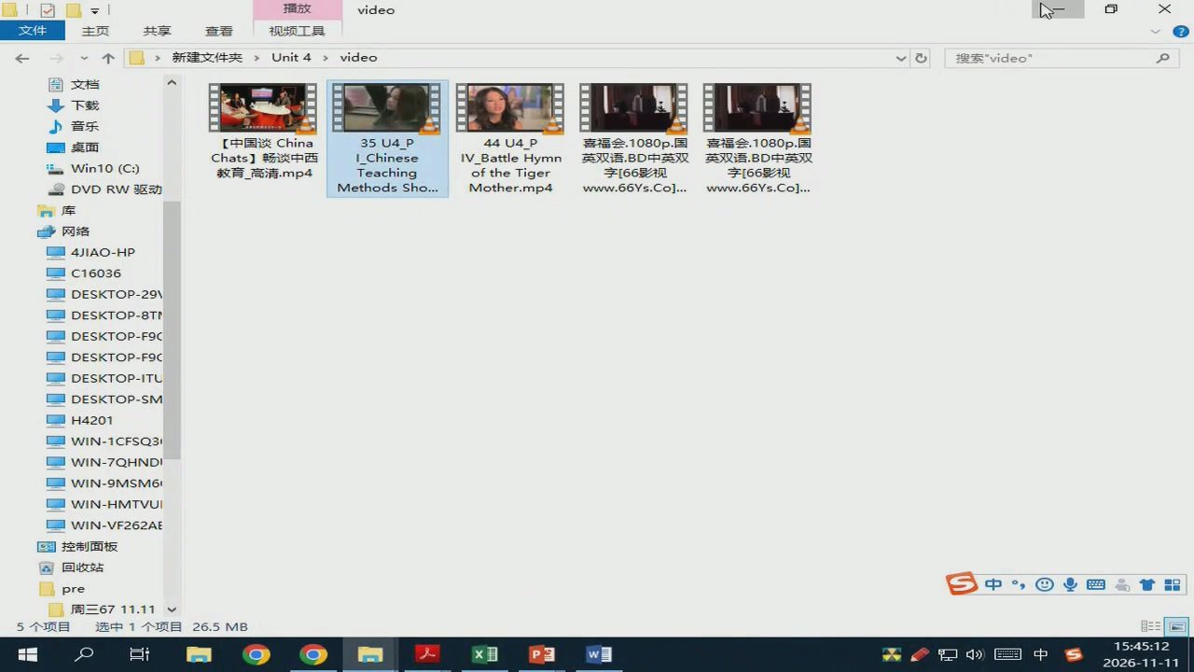
25/58 · 22:02
Notes:
播放
video
主页
查看
视频工具
新建文件夹>Unit4>
video
搜索”video”
文档
下载
音乐
桌面
【中国谈China
35U4_P
44U4_P
喜福会.1080p.国
喜福会.1080p.国
Chats】畅谈中西
IChinese
IV_BattleHymn
英双语.BD中英双
英双语.BD中英双
Win10(C:)
教育_高清.mp4
Teaching
of theTiger
字[66影视
字[66影视
DVDRW驱动
Methods Sho...
Mother.mp4
www.66Ys.Co...
www.66Ys.Co]...
网络
4IAO-HP
C16036
DESKTOP-29
DESKTOP-8TN
DESKTOP-F9C
DESKTOP-F9C
DESKTOP-ITU
DESKTOP-SM
H4201
WIN-1CFSQ3
WIN-7QHNDI
WIN-9MSM6
WIN-HMTVUI
WIN-VF262AE
控制面板
回收站
pre
中四
周三6711.11
选中1个项目
26.5MB
Ed
会1中

Slide 27
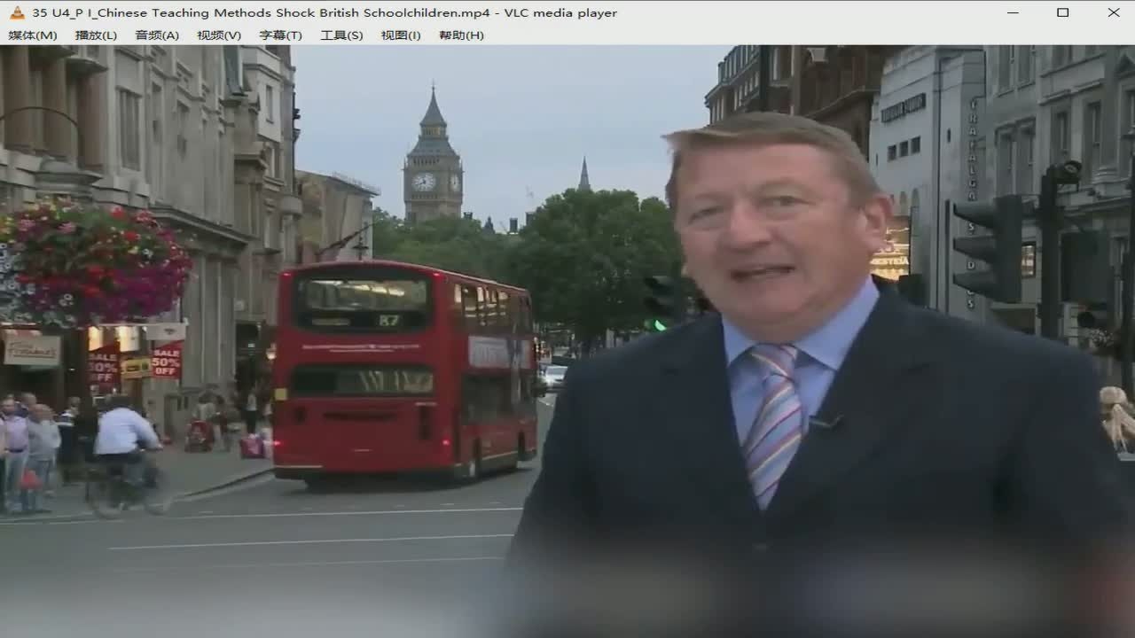
26/58 · 25:44
Notes:
35U4_PI_ChineseTeachingMethodsShockBritishSchoolchildren.mp4-VLCmediaplayer
媒体(M)
放（L）
音频(A)
视频(M)
山章专
工具（S）
视图（)
帮助（H）

Slide 28
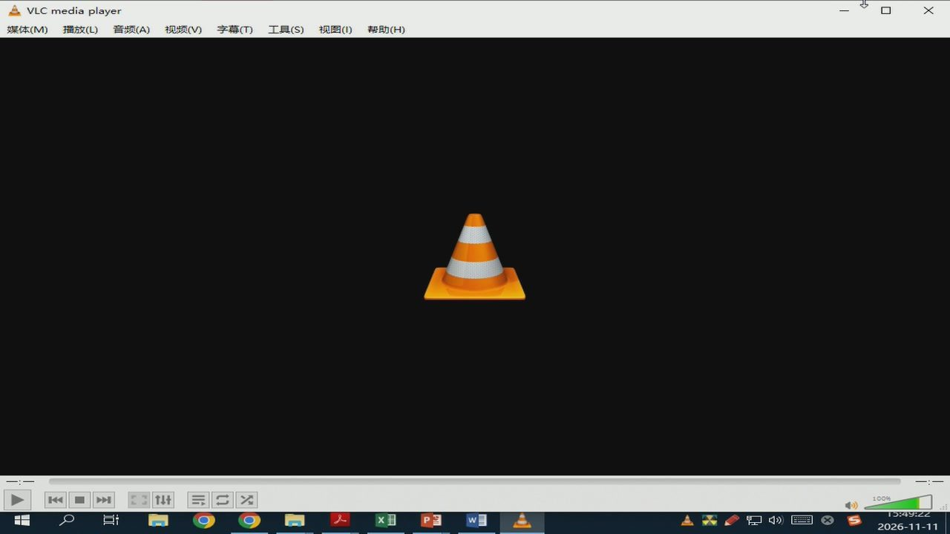
27/58 · 26:11
Notes:
VLCmediaplayer
媒体（M）
摧放（L）
音频（A)
视频（V)
）章
工具（S)
视图（）
帮助（H）
27:6:0

Slide 29
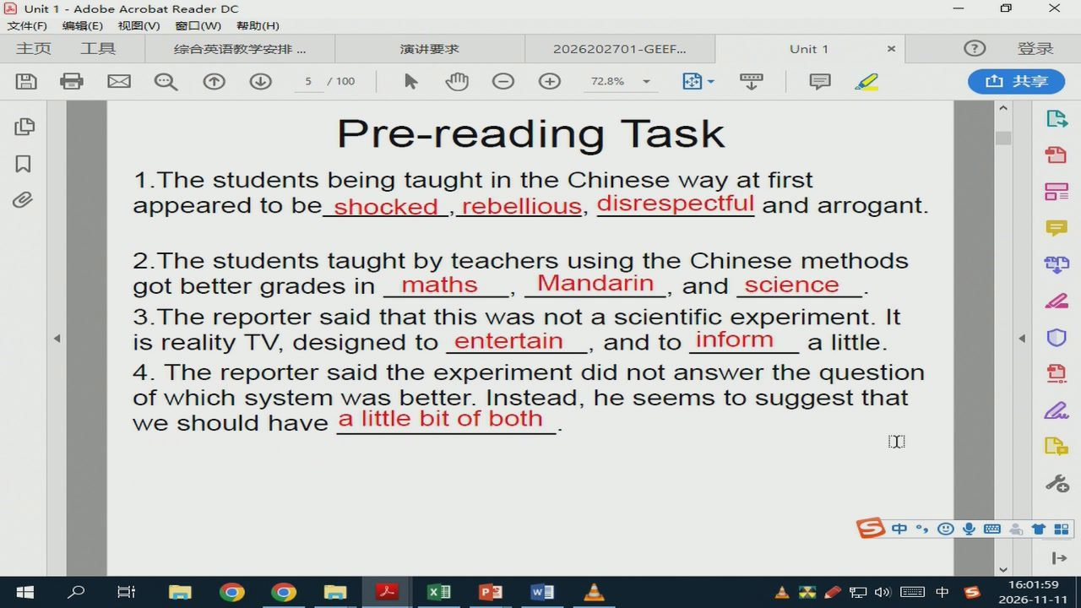
28/58 · 38:48
Notes:
Unit1-AdobeAcrobatReaderDC
文件（F)
编辑（E）视图（V)窗口（W)帮助（H)
主页
综合英语教学安排
演讲要求
2026202701-GEEF...
Unit1
72.8%
Pre-reading Task
1.ThestudentsbeingtaughtintheChinesewayatfirst
appeared tobe_shocked,rebellious,disrespectful and arrogant.
2.ThestudentstaughtbyteachersusingtheChinesemethods
gotbettergradesin
maths
Mandarin，andscience
3.Thereportersaidthatthiswasnotascientificexperiment.It
isrealityTV,designedtoentertain
_,and to inform
a little.
4.Thereportersaidtheexperimentdidnotanswerthequestion
ofwhichsystemwasbetter.Instead,heseemstosuggestthat
we should havea littlebitof both
[X]
中国业国品
分中

Slide 30
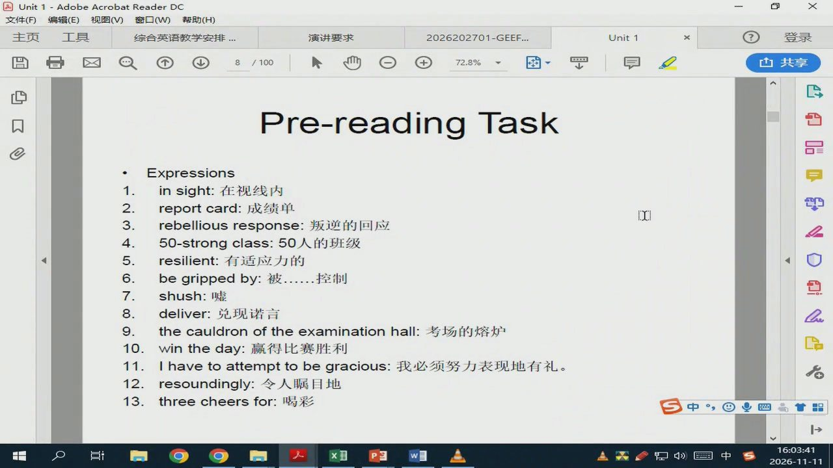
29/58 · 40:31
Notes:
Unit1-AdobeAcrobatReaderDC
文件（F）
编辑（E）视图（V)窗口（W）帮助（H）
主页
综合英语教学安排
演讲要求
2026202701-GEEF...
Unit1
72.8%
Pre-reading Task
Expressions
1.
insight:在视线内
2.
reportcard:成绩单
[X]
3.
rebelliousresponse：叛逆的回应
4.
50-strongclass:50人的班级
5.
resilient:有适应力的
6.
begrippedby:被......控制
7.
shush:嘘
8.
deliver:兑现诺言
9.
thecauldronoftheexaminationhall:考场的熔炉
10.
wintheday:赢得比赛胜利
11.
Ihavetoattempttobegracious：我必须努力表现地有礼。
12.
resoundingly：令人瞩目地
13.
threecheersfor:喝彩
中四
会1中

Slide 31
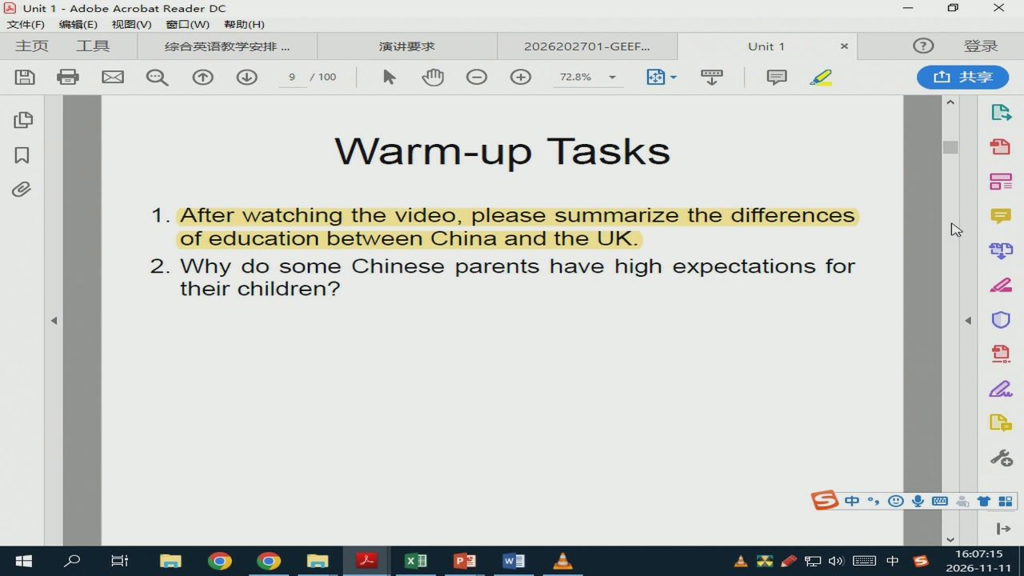
30/58 · 44:05
Notes:
Unit 1-AdobeAcrobatReaderDC
文件（F)
编辑（E）视图（V)窗口（W)帮助（H)
主页
综合英语教学安排
演讲要求
2026202701-GEEF..
Unit1
72.8%
Warm-upTasks
1.Afterwatchingthevideo,pleasesummarizethedifferences
ofeducationbetweenChinaandtheUK.
2.WhydosomeChineseparentshavehighexpectationsfor
their children?
中四
Ed
台1中

Slide 32
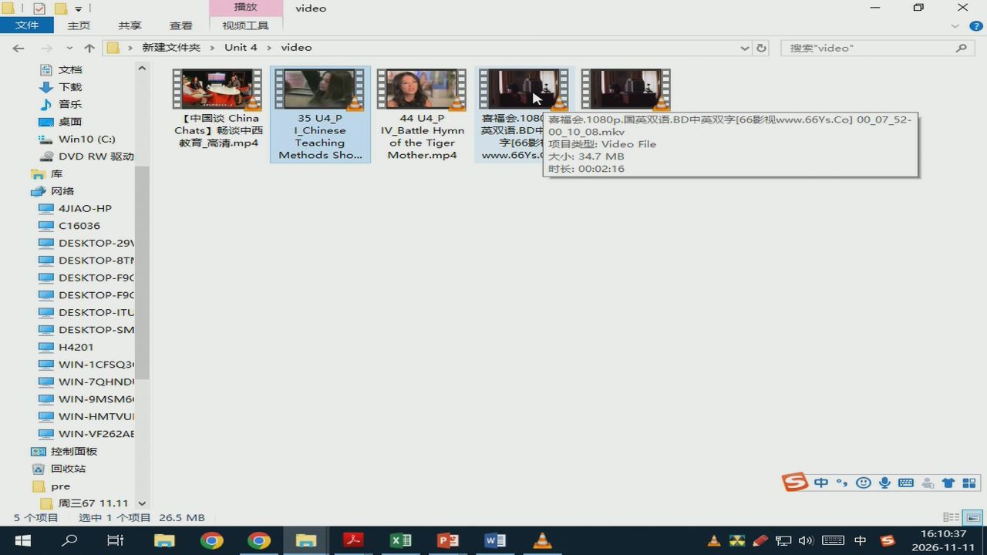
31/58 · 47:27
Notes:
播放
video
主页
查看
视频工具
新建文件夹>Unit4>
video
搜索”video”
文档
下载
音乐
桌面
【中国谈China
35U4_P
44U4_P
喜福会.1080
喜福会.1080p.国英双语.BD中英双字[66影视www.66Ys.Co]00_07_52-
Chats】畅谈中西
IChinese
IV_BattleHymn
英双语.BD中
Win10(C:)
00_10_08.mkv
教育_高清.mp4
Teaching
of theTiger
991
项目类型：VideoFile
DVDRW驱动
Methods Sho...
Mother.mp4
www.66Ys.
大小：34.7MB
向库
时长：00:02:16
网络
4JIAO-HP
C16036
DESKTOP-29V
DESKTOP-8TN
DESKTOP-F9C
DESKTOP-F9C
DESKTOP-ITU
DESKTOP-SM
H4201
WIN-1CFSQ3
WIN-7QHNDI
WIN-9MSM6
WIN-HMTVUI
WIN-VF262AE
控制面板
回收站
pre
中四↑品
周三6711.11
选中1个项目
26.5MB
Ed
1中

Slide 33
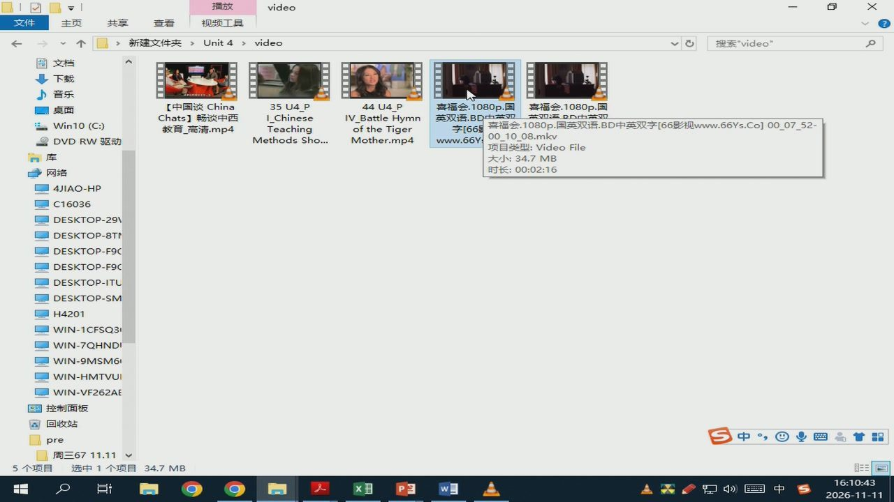
32/58 · 47:32
Notes:
播放
video
主页
查看
视频工具
新建文件夹>Unit4>
video
搜索”video”
文档
下载
音乐
桌面
【中国谈China
35U4_P
44U4_P
喜福会.1080p.国
喜福会.1080p.国
Chats】畅谈中西
I_Chinese
IV_BattleHymn
英双语.BD中茶双
英运D中英观
Win10(C:)
教育_高清.mp4
Teaching
of theTiger
字[66号
喜福会.1080p.国英双语.BD中英双字[66影视www.66Ys.Co]00_07_52-
DVDRW驱动
Methods Sho...
Mother.mp4
www.66Y
00_10_08.mkv
项目类型：VideoFile
大小：34.7MB
网络
时长：00:02:16
4JIAO-HP
C16036
DESKTOP-29V
DESKTOP-8TN
DESKTOP-F9C
DESKTOP-F9C
DESKTOP-ITU
DESKTOP-SM
H4201
WIN-1CFSQ3
WIN-7QHNDI
WIN-9MSM6
WIN-HMTVUI
WIN-VF262AE
控制面板
回收站
pre
中国品
周三6711.11
选中1个项目
34.7MB
分1中

Slide 34
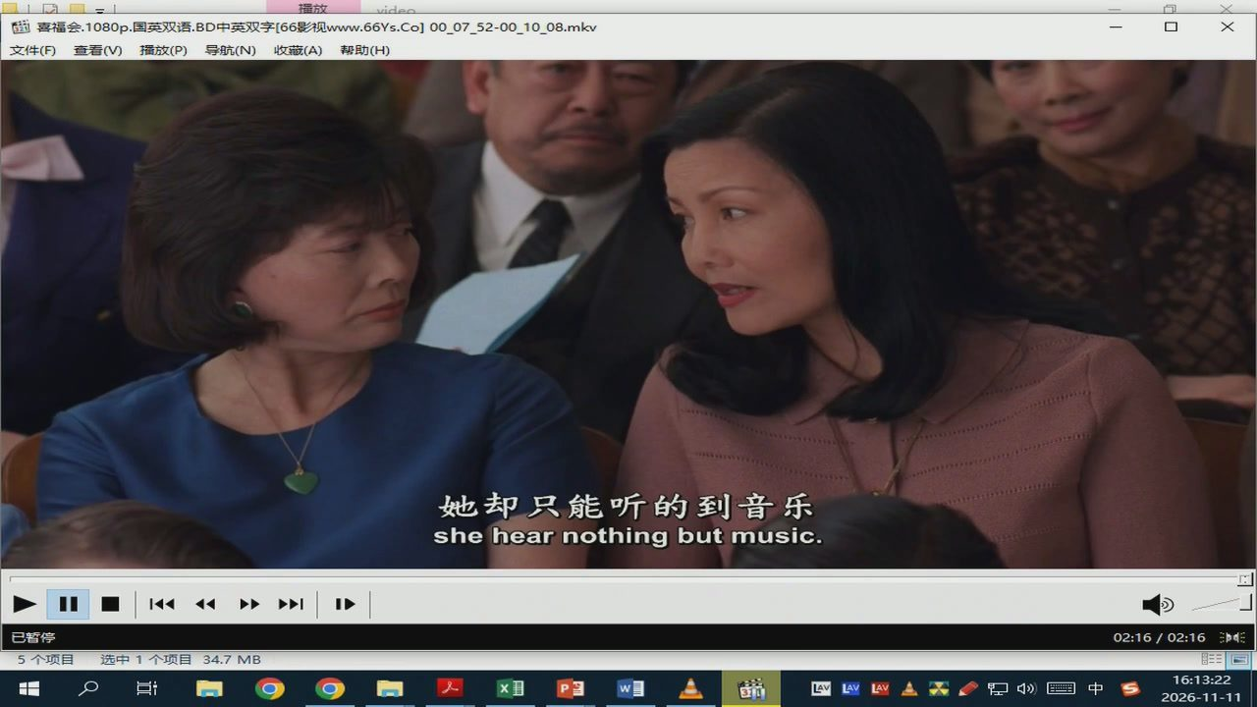
33/58 · 50:11
Notes:
播放
喜福会.1080p.国英双语.BD中英双字[66影视www.66Ys.Co]00_07_52-00_10_08.mkv
文件（F)查看（V)播放（P)
导航（N）收藏（A)
帮助（H)
她却只能听的到音乐
she hear nothing but music.
会会习立
已暂停
02:16/02:16
选中1个项目34.7MB
Ed
LAV
LAVLAVA
分中

Slide 35
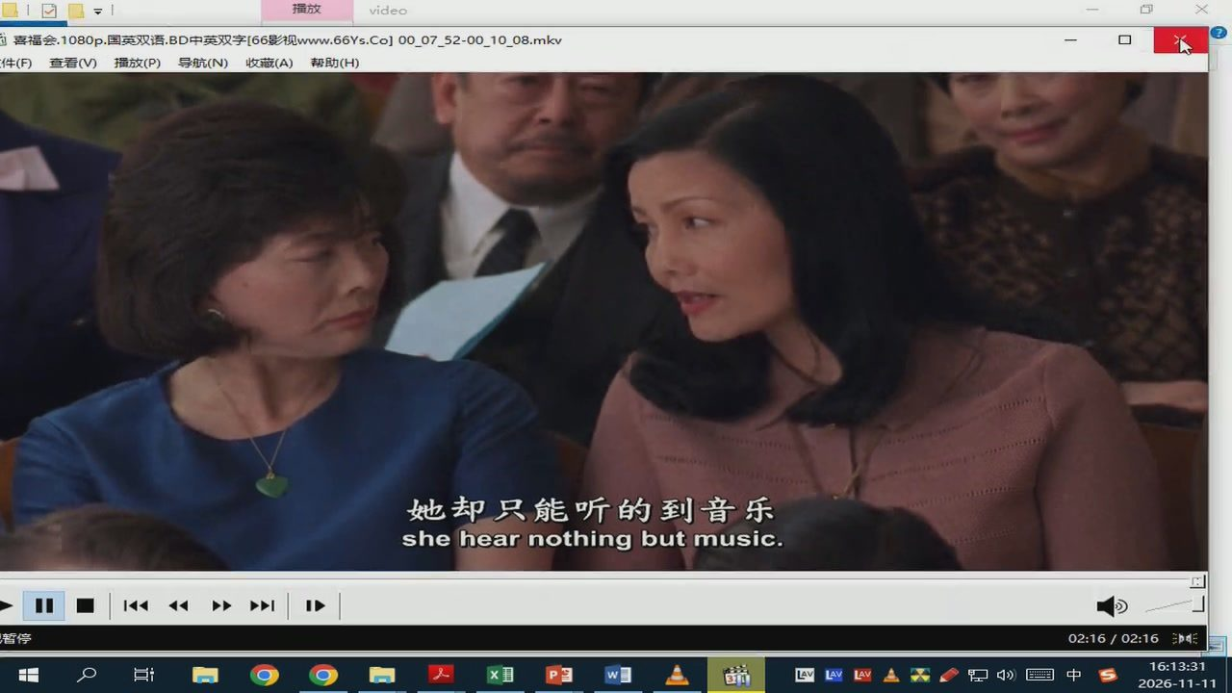
34/58 · 50:20
Notes:
播放
video
喜福会.1080p.国英双语.BD中英双字[66影视www.66Ys.Co]00_07_52-00_10_08.mkv
件（F）
查看（V）播放（P）
导航（N）
收藏（A）
帮助（H）
她却只能听的到音乐
she hearnothing butmusic.
暂停
02:16/02:16
LAV
1中

Slide 36
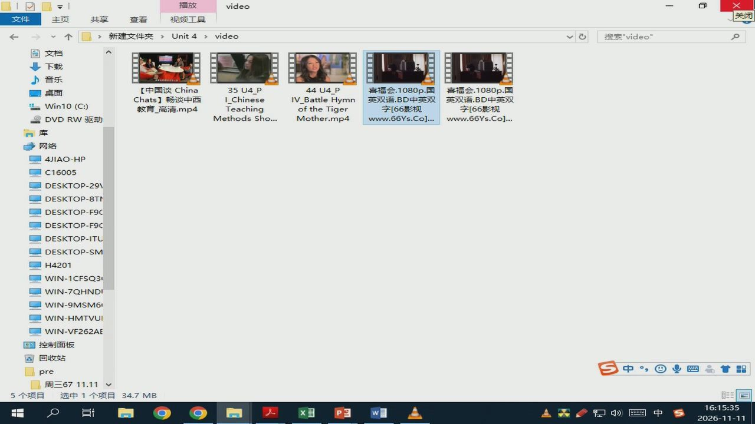
35/58 · 52:25
Notes:
播放
video
主页
查看
视频工具
关闭
新建文件夹>Unit4>
video
搜索”video
文档
下载
音乐
桌面
【中国谈China
35U4_P
44U4_P
喜福会.1080p.国
喜福会.1080p.国
Chats】畅谈中西
IChinese
IV_BattleHymn
英双语.BD中英双
英双语.BD中英双
Win10(C:)
教育_高清.mp4
Teaching
of theTiger
字[66影视
字[66影视
DVDRW驱动
Methods Sho...
Mother.mp4
www.66Ys.Co...
www.66Ys.Co]...
网络
4JIAO-HP
C16005
DESKTOP-29V
DESKTOP-8TN
DESKTOP-F9C
DESKTOP-F9C
DESKTOP-ITU
DESKTOP-SM
H4201
WIN-1CFSQ3
WIN-7QHNDI
WIN-9MSM6
WIN-HMTVUI
WIN-VF262AE
控制面板
回收站
pre
中四
周三6711.11
选中1个项目
34.7MB
台1中

Slide 37
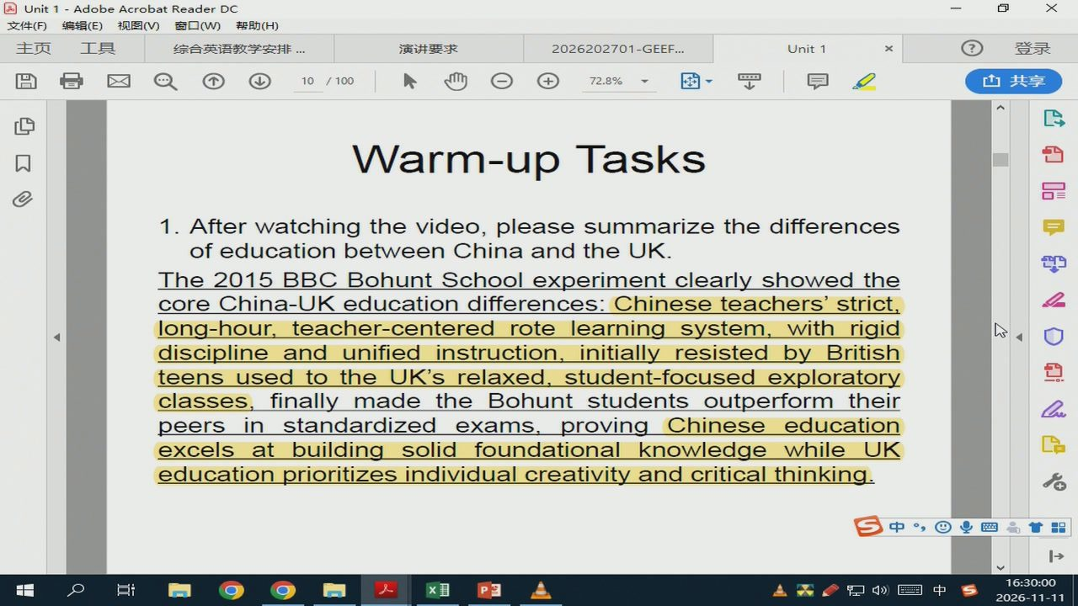
36/58 · 66:49
Notes:
Unit 1-Adobe Acrobat Reader DC
文件（F)
编辑（E）视图（V)窗口（W)帮助（H）
主页
综合英语教学安排
演讲要求
2026202701-GEEF..
Unit1
72.8%
Warm-up Tasks
1. After watching the video, please summarize the differences
ofeducationbetweenChinaandtheUK.
The2015BBCBohuntSchoolexperimentclearlyshowedthe
coreChina-UKeducationdifferences:Chinese teachers'strict,
long-hour,teacher-centeredrotelearningsystem,withrigid
disciplineandunifiedinstruction,initiallyresistedbyBritish
teensusedtotheUk'srelaxed,student-focusedexploratory
classes,
finallymadetheBohuntstudentsoutperformtheir
peersinstandardizedexams,provingChineseeducation
excelsatbuildingsolidfoundationalknowledgewhileUK
educationprioritizesindividualcreativityandcritical thinking.
中国四
Ed

Slide 38
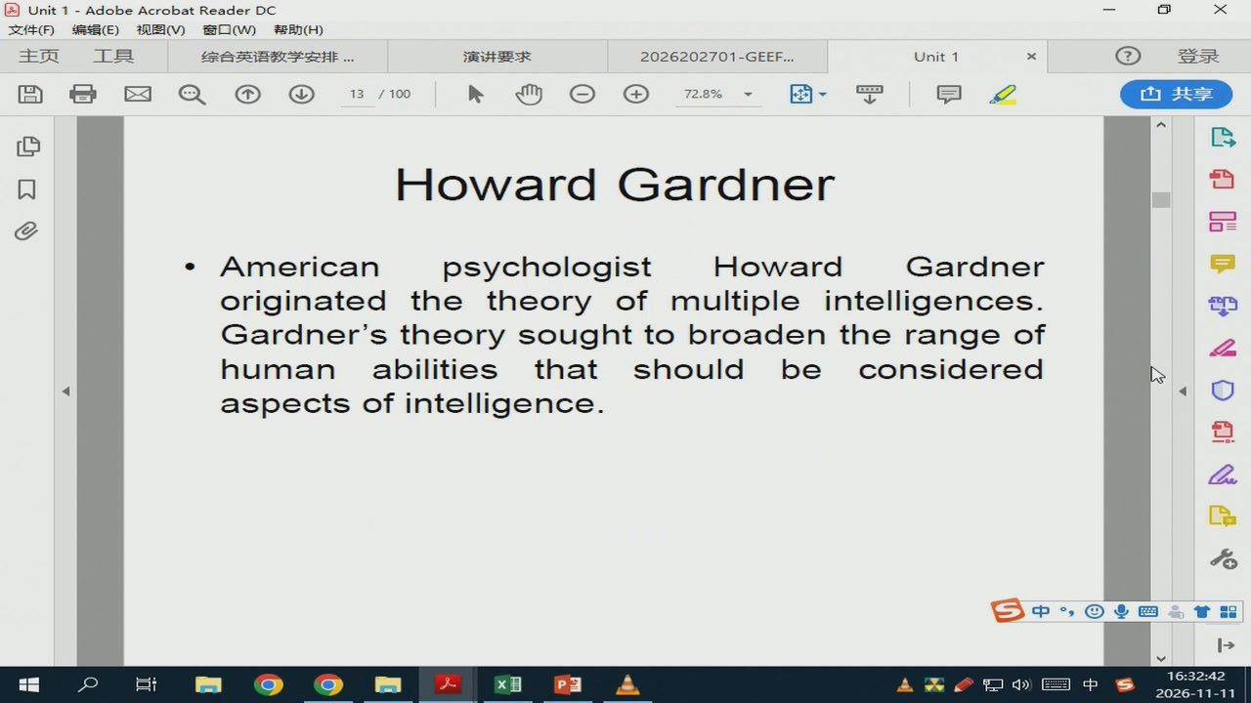
37/58 · 69:31
Notes:
Unit 1-AdobeAcrobat Reader DC
文件（F)
编辑（E）视图(V)
窗口（W）帮助（H)
主页
综合英语教学安排
演讲要求
2026202701-GEEF...
Unit1
72.8%
Howard Gardner
American
psychologist
Howard
Gardner
originatedthetheoryofmultipleintelligences.
Gardner's theory sought tobroaden the range of
human
abilities
that
shouldbe
considered
aspects ofintelligence.
中国四
分中

Slide 39
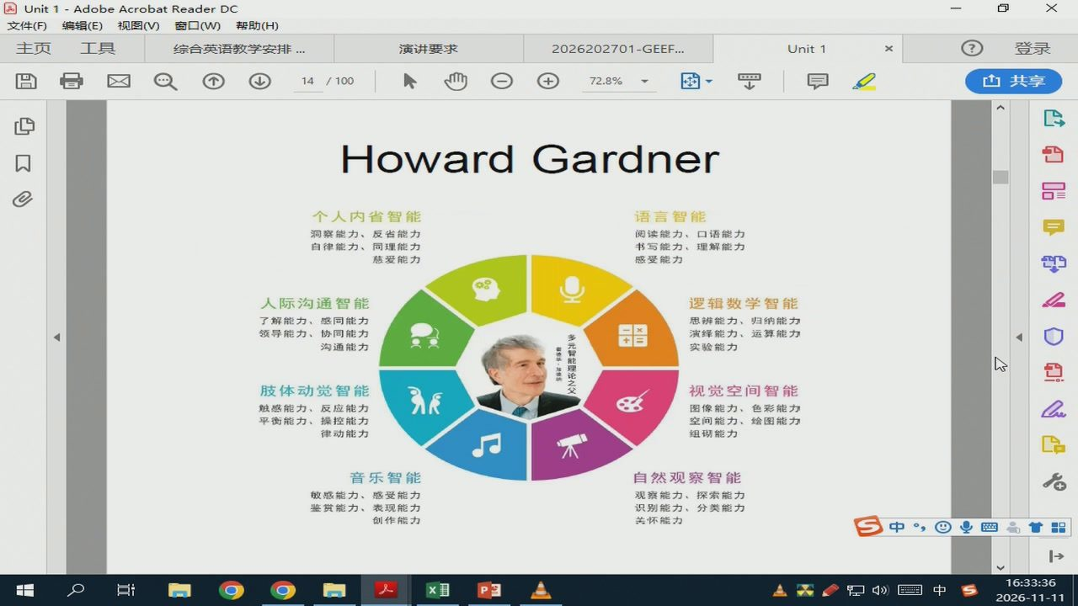
38/58 · 70:26
Notes:
Unit 1-AdobeAcrobat Reader DC
文件（F)
编辑（E）视图（V)窗口（W）帮助（H）
主页
综合英语教学安排
演讲要求
2026202701-GEEF...
Unit 1
72.8%
Howard Gardner
个人内省智能
语言智能
洞察能力、反省能力
阅读能力、口语能力
自律能力、同理能力
书写能力、理解能力
慈爱能力
感受能力
人际沟通智能
逻辑数学智能
了解能力、感同能力
思辨能力、归纳能力
领导能力、协同能力
多元智能理论之父
演绎能力、运算能力
沟通能力
实验能力
肢体动觉智能
视觉空间智能
感能力、反应能力
图像能力、色彩能力
平衡能力、操控能力
空间能力、绘图能力
律动能力
组砌能力
音乐智能
自然观察智能
敏感能力、感受能力
观察能力、探索能力
鉴赏能力、表现能力
识别能力、分类能力
创作能力
关怀能力
中四
Ed
1中

Slide 40
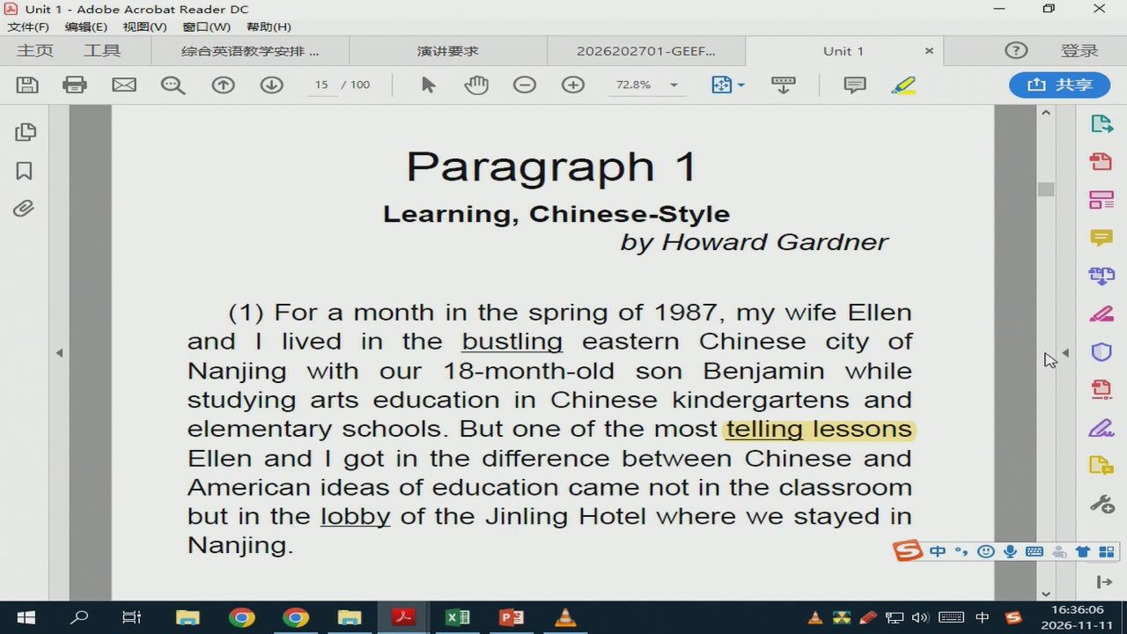
39/58 · 72:56
Notes:
Unit1-AdobeAcrobatReaderDC
文件（F)
编辑（E）视图（V)窗口（W)帮助（H)
主页
综合英语教学安排
演讲要求
2026202701-GEEF.
Unit1
72.8%
Paragraph 1
Learning,Chinese-Style
byHowardGardner
（1)Foramonth inthespringof 1987,mywifeEllen
andIlivedinthebustlingeasternChinesecityof
Nanjingwithour18-month-oldsonBenjaminwhile
studying arts education in Chinese kindergartens and
elementaryschools.Butoneofthemosttellinglessons
EllenandIgotinthedifferencebetweenChineseand
Americanideasofeducationcamenotintheclassroom
but inthelobbyoftheJinlingHotelwherewestayed in
Nanjing.
中国
Ed
会1中

Slide 41
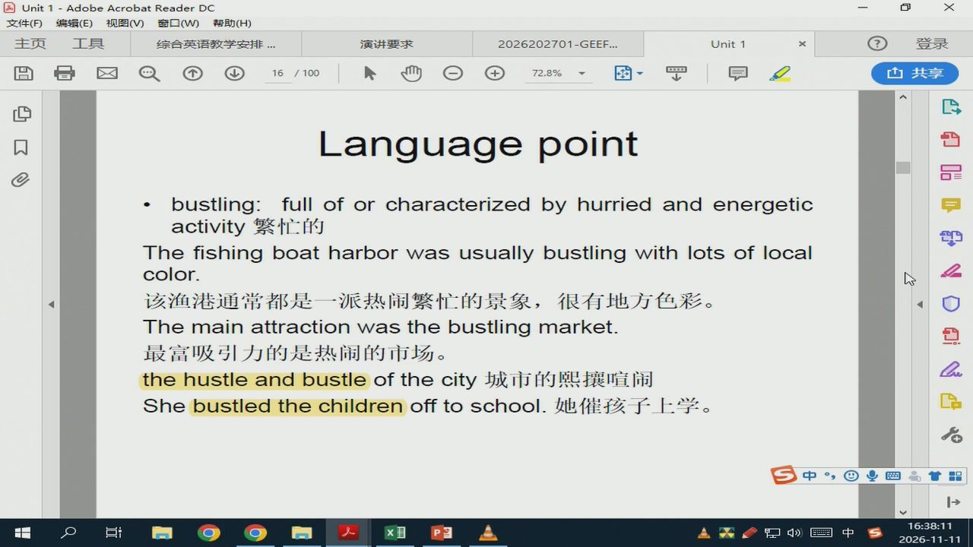
40/58 · 75:01
Notes:
Unit 1-Adobe Acrobat Reader DC
文件（F)
编辑（E）视图（V)窗口（W)帮助（H)
主页
综合英语教学安排
演讲要求
2026202701-GEEF...
Unit1
72.8%
Language point
bustling:fullof or characterized byhurried and energetic
activity繁忙的
Thefishingboatharborwasusuallybustlingwithlotsof local
color.
该渔港通常都是一派热闹繁忙的景象，很有地方色彩。
Themainattractionwasthebustlingmarket.
最富吸引力的是热闹的市场。
thehustleandbustleofthecity城市的熙攘喧闹
Shebustledthechildrenofftoschool.她催孩子上学。
中四
Ed
会1中

Slide 42
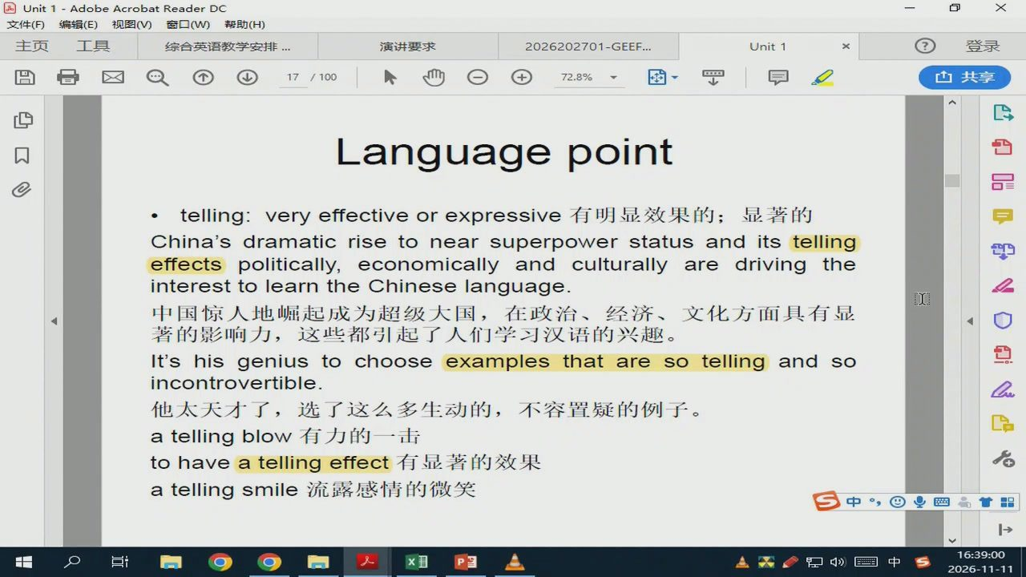
41/58 · 75:50
Notes:
Unit1-AdobeAcrobatReaderDC
文件（F)
编辑（E）视图（V)窗口（W)帮助（H)
主页
综合英语教学安排
演讲要求
2026202701-GEEF..
Unit1
72.8%
Language point
telling：veryeffectiveorexpressive有明显效果的；显著的
China's dramaticrise tonear superpowerstatus and its telling
effectspolitically,economicallyandculturallyaredrivingthe
interesttolearntheChineselanguage.
中国惊人地崛起成为超级大国，在政治、经济、文化方面具有显
著的影响力，这些都引起了人们学习汉语的兴趣。
It'shisgeniustochooseexamples that areso tellingandso
incontrovertible.
他太天才了，选了这么多生动的，不容置疑的例子。
atellingblow有力的一击
tohaveatellingeffect有显著的效果
atellingsmile流露感情的微笑
中四
Ed
分中

Slide 43
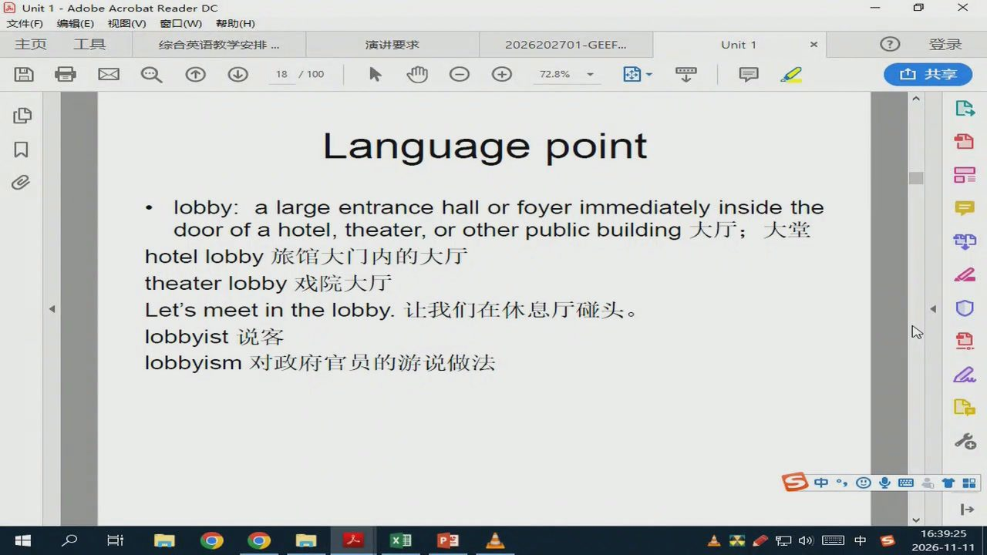
42/58 · 76:14
Notes:
Unit 1-Adobe AcrobatReaderDC
文件（F）
编辑（E）视图（V)窗口（W)帮助（H)
主页
综合英语教学安排
演讲要求
2026202701-GEEF...
Unit1
72.8%
Language point
lobby:a large entrance hall or foyerimmediately inside the
doorofahotel,theater，orotherpublicbuilding大厅；大堂
hotel lobby旅馆大门内的大厅
theaterlobby戏院大厅
Let'smeetinthelobby.让我们在休息厅碰头。
lobbyist说客
lobbyism对政府官员的游说做法
中四
甘品
Ed
会1中

Slide 44
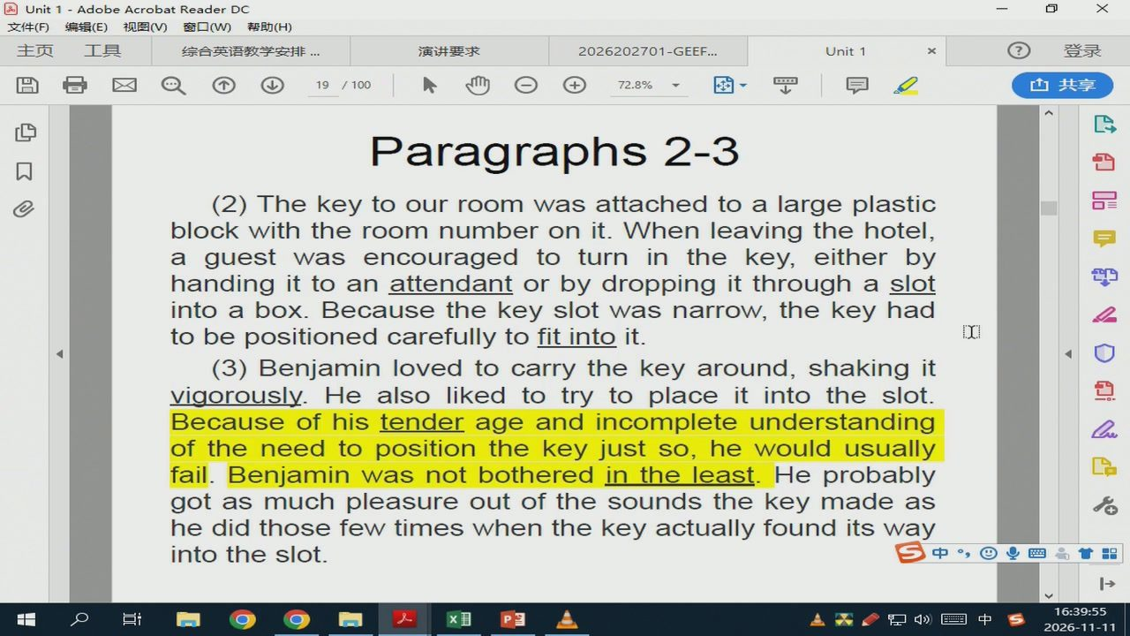
43/58 · 76:45
Notes:
Unit 1-Adobe Acrobat Reader DC
文件（F)
编辑（E）视图（V)窗口（W)帮助（H)
主页
综合英语教学安排
演讲要求
2026202701-GEEF..
Unit1
72.8%
Paragraphs 2-3
(2)Thekeytoourroomwasattachedtoalargeplastic
blockwiththeroomnumberonit.Whenleavingthehotel,
handingittoanattendantorbydroppingitthroughaslot
intoabox.Becausethekeyslotwasnarrow,thekeyhad
tobepositionedcarefullytofitintoit.
(3)Benjaminlovedtocarrythekeyaround,shakingit
vigorously.Healsolikedtotrytoplaceitintotheslot.
Becauseofhistenderageandincompleteunderstanding
oftheneedtopositionthekeyjustso,hewouldusually
fail.Benjaminwasnotbotheredintheleast.Heprobably
gotasmuchpleasureoutofthesoundsthekeymadeas
hedidthosefewtimeswhenthekeyactuallyfounditsway
intotheslot.
中四高
分中

Slide 45
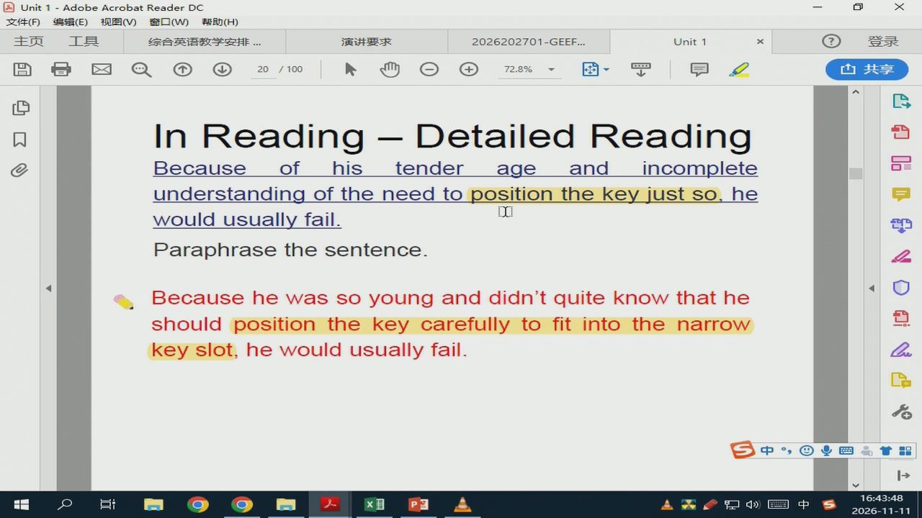
44/58 · 80:37
Notes:
Unit 1-AdobeAcrobatReaderDC
文件（F)
编辑（E）视图（V)窗口（W)帮助（H）
主页
综合英语教学安排
演讲要求
2026202701-GEEF.
Unit1
72.8%
In Reading - Detailed Reading
Because
of
his
tender
age
and
incomplete
understandingoftheneedtopositionthekeyjustso,he
wouldusuallyfail.
Paraphrasethesentence.
Becausehewassoyounganddidn'tquiteknowthathe
shouldpositionthekeycarefullytofitintothenarrow
keyslot,hewouldusuallyfail.
中国

Slide 46
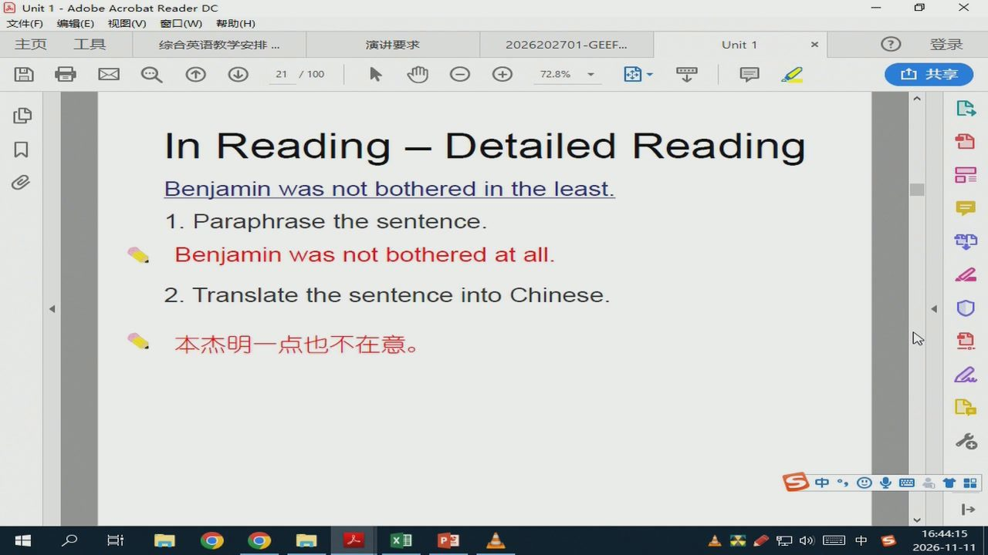
45/58 · 81:04
Notes:
Unit 1-AdobeAcrobatReader DC
文件（F)
编辑（E）视图（V)窗口（W)帮助（H)
主页
综合英语教学安排
演讲要求
2026202701-GEEF..
Unit 1
72.8%
In Reading - Detailed Reading
Benjaminwasnotbotheredintheleast.
1.Paraphrasethesentence.
Benjaminwasnotbotheredatall.
2.TranslatethesentenceintoChinese.
本杰明一点也不在意。
Ed
台1中

Slide 47
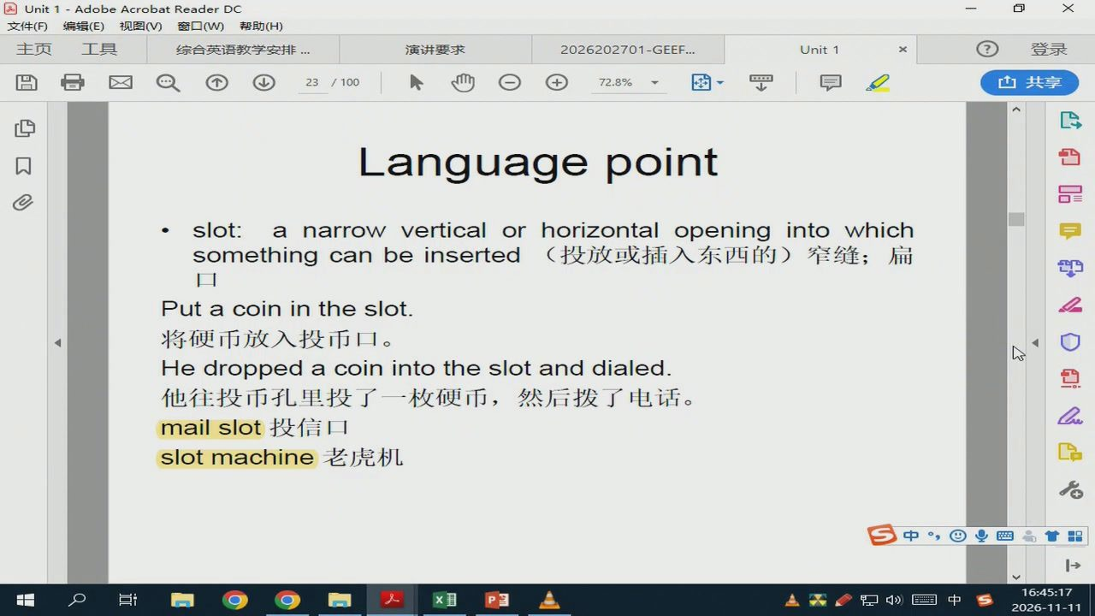
46/58 · 82:07
Notes:
Unit1-AdobeAcrobatReaderDC
文件（F）
编辑（E）视图（V)窗口（W)帮助（H)
主页
综合英语教学安排
演讲要求
2026202701-GEEF...
Unit1
72.8%
Language point
slot:a narrow vertical or horizontal opening into which
somethingcanbeinserted（投放或插入东西的）窄缝；扁
Putacoin in the slot.
将硬币放入投币口。
Hedroppedacoinintotheslotanddialed
他往投币孔里投了一枚硬币，然后拨了电话。
mailslot投信口
slotmachine老虎机
中国
Ed
分中

Slide 48
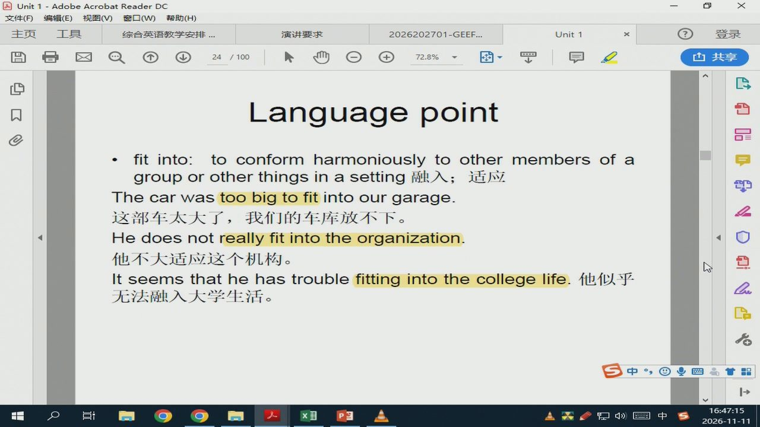
47/58 · 84:04
Notes:
Unit1-AdobeAcrobatReaderDC
文件（F)
编辑（E）视图（V)窗口（W)帮助（H)
主页
综合英语教学安排
演讲要求
2026202701-GEEF...
Unit1
72.8%
Language point
fit into:toconformharmoniouslytoothermembersofa
grouporotherthingsinasetting融入；适应
Thecarwastoobigtofitintoourgarage.
这部车太大了，我们的车库放不下。
Hedoesnotreallyfitintotheorganization
他不大适应这个机构。
Itseemsthathehastroublefittingintothecollegelife.他似乎
无法融入大学生活。
中四品
台1中

Slide 49
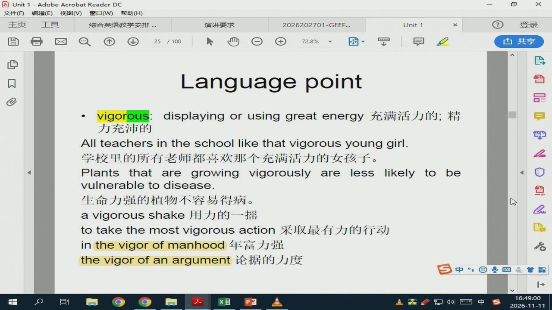
48/58 · 85:50
Notes:
Unit1-AdobeAcrobatReaderDC
文件（F)
编辑（E）视图（V)窗口（W)帮助（H)
主页
综合英语教学安排
演讲要求
2026202701-GEEF...
Unit1
72.8%
Language point
vigorous:
displayingorusinggreatenergy充满活力的；精
力充沛的
All teachers in the school like that vigorous young girl.
学校里的所有老师都喜欢那个充满活力的女孩子。
Plantsthat aregrowingvigorouslyarelesslikelytobe
vulnerabletodisease.
生命力强的植物不容易得病。
avigorousshake用力的一摇
totakethemostvigorousaction采取最有力的行动
inthevigorofmanhood年富力强
thevigorofanargument论据的力度
中四品
台1中

Slide 50
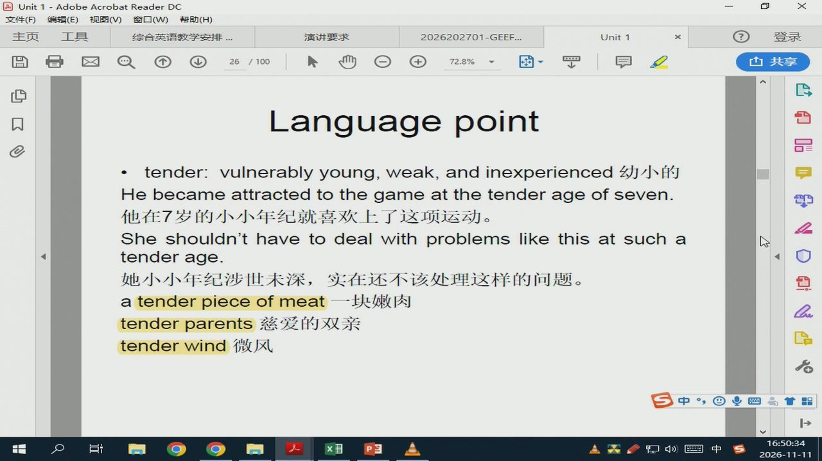
49/58 · 87:23
Notes:
Unit1-AdobeAcrobatReaderDC
文件（F)
编辑（E）视图（V)窗口（W)帮助（H)
主页
综合英语教学安排
演讲要求
2026202701-GEEF...
Unit1
72.8%
Language point
：tender:vulnerablyyoung,weak,and inexperienced 幼j小的
Hebecameattractedtothegameatthetenderageofseven.
他在7岁的小小年纪就喜欢上了这项运动。
Sheshouldn'thavetodealwithproblemslikethisatsucha
tenderage.
她小小年纪涉世未深，实在还不该处理这样的问题。
atenderpieceofmeat一块嫩肉
tenderparents慈爱的双亲
tenderwind微风l
Ed
AXO
分1中

Slide 51
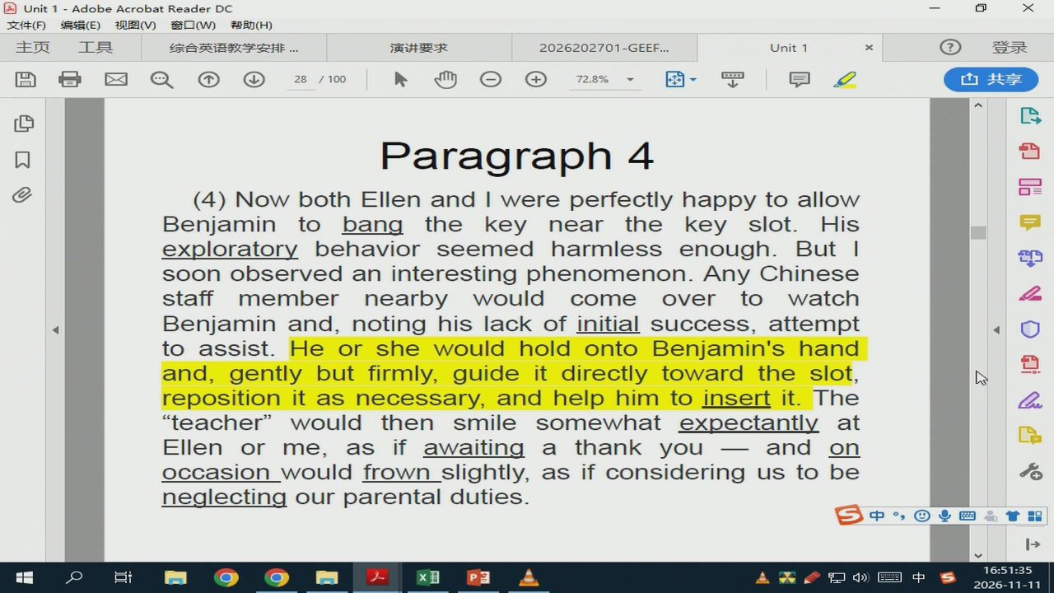
50/58 · 88:24
Notes:
Unit1-AdobeAcrobatReaderDC
文件（F)
编辑（E）视图（V)窗口（W)帮助（H）
主页
综合英语教学安排
演讲要求
2026202701-GEEF.
Unit1
72.8%
Paragraph 4
(4)NowbothEllenandIwereperfectlyhappytoallow
Benjamintobangthekeynearthekeyslot.His
exploratorybehaviorseemedharmlessenough.But1
soonobservedaninterestingphenomenon.AnyChinese
staffmembernearbywouldcome
overtowatch
Benjamin and,noting his lackofinitial success,attempt
toassist.HeorshewouldholdontoBenjamin'shand
and,gentlybutfirmly,guideitdirectlytoward theslot,
reposition itasnecessary,and helphim toinsertit.The
"teacher"wouldthensmilesomewhatexpectantlyat
Ellen or me, as if awaiting a thank you
I—andon
occasion_wouldfrown_slightly,asifconsideringustobe
neglectingourparentalduties.
中四
分中

Slide 52
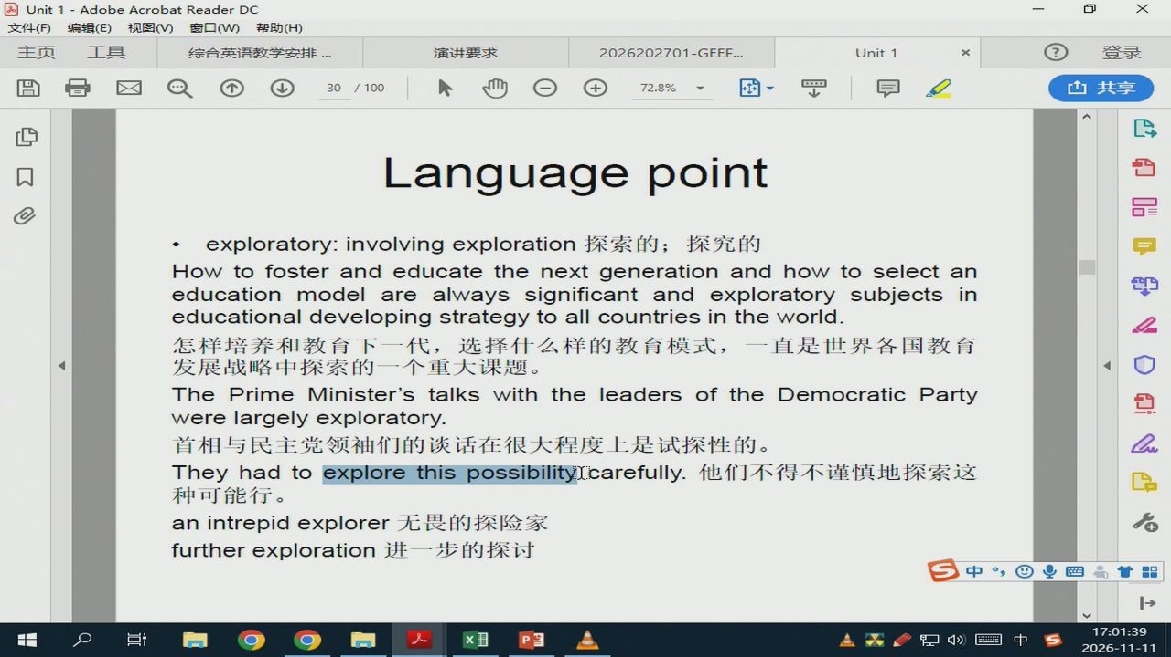
51/58 · 98:28
Notes:
Unit1-Adobe AcrobatReaderDC
文件（F)
编辑（E）视图（V)窗口（W)帮助（H）
主页
综合英语教学安排
演讲要求
2026202701-GEEF.
Unit1
72.8%
Language point
exploratory：involvingexploration探索的；探究的
Howtofosterandeducatethenextgenerationandhowtoselectan
educationmodelarealwayssignificantandexploratorysubjectsin
educationaldevelopingstrategytoallcountriesintheworld.
怎样培养和教育下一代，选择什么样的教育模式，一直是世界各国教育
发展战略中探索的一个重大课题。
ThePrimeMinister'stalkswiththeleadersoftheDemocraticParty
werelargelyexploratory.
首相与民主党领袖们的谈话在很大程度上是试探性的。
TheyhadtoexplorethispossibilityIcarefully.他们不得不谨慎地探索这
种可能行。
anintrepidexplorer无畏的探险家
furtherexploration进一步的探讨
中四
Ed
分中

Slide 53

52/58 · 98:38
Notes:
Unit1-AdobeAcrobatReaderDC
文件（F)
编辑（E）视图（V)窗口（W)帮助（H)
主页
综合英语教学安排
演讲要求
2026202701-GEEF...
Unit1
72.8%
Language point
initial:comingfirst,orpresentatthebeginningofaneventor
process最初的；开始的
Myinitialreactionwastodeclinetheoffer.
我最初的反应是要婉言谢绝这个提议。
Afteraninitialsurgeofinterest,therehasbeenlittlecallforour
services.
过了开始的一阵新鲜劲后，对我们服务的需求就变得很小。
La
toinitiatestudentsintothemysteriesoflinguistics把语言学的奥
妙之处传授给学生
totaketheinitiative采取主动
Doesshehaveenoughinitiativetogetthisjobdone？她确有干好
这个工作的进取心吗？
中国业国品
Ed
会1中

Slide 54

53/58 · 100:45
Notes:
Unit1-AdobeAcrobatReaderDC
文件（F)
编辑（E）视图（V)窗口（W)帮助（H)
主页
综合英语教学安排
演讲要求
2026202701-GEEF...
Unit1
72.8%
Language point
expectantly:in the expectation that something interesting,exciting,
orpleasurablewillhappen期待地；期望地
Shesteppedbackfromthedoorexpectantly.
她满怀期待地从门口退了回来。
upthepen,turnedoverthepaperhe'dwrittenon.
小男孩满怀期待地站在那儿，他妈妈瞧了瞧他，拿起笔，把那张纸翻过
来。
Weexpectmorefromhim.我们对他有更大的期待。
lifeexpectancy预期寿命
Shemovedeverythingindoorsinexpectationofrain.她把所有东西搬进
屋里，因为预计有雨。
中四品
食品

Slide 55

54/58 · 101:05
Notes:
Unit1-AdobeAcrobatReaderDC
文件（F)
编辑（E）视图（V)窗口（W)帮助（H)
主页
综合英语教学安排
演讲要求
2026202701-GEEF...
Unit1
72.8%
Language point
await: to wait for, expect, or look for somebody or
something等待
Weawaitthenextvolumeofthissuperbeditionwithkeen
anticipation.
我们殷切期盼着这本精装版下一卷的面世。
Sheisawaitingtrialoncorruptioncharges.
她因被控贪污正等候审判。
Deathawaitsallmen.人皆会死。
中四高
分1中

Slide 56

55/58 · 103:13
Notes:
演讲安排.xlsx-Excel
页面布局
数据
常规
等线
套用表格格式
删除
排序和筛选查找和选择
单元格样式
对齐方式
数字
单元格
126
fx
D9
康珠燕
Unit2
D10
徐丽瑶
Unit2
D11
李鑫能
Unit3
D12
李凯恩
Unit3
D13
乔风华
Unit3
D14
陈艳
Unit3
D15
赵紫涵
Unit3
D16
赵容慧
Unit4
D17
曹静逸
Unit4
D18
杨皓
Unit4
D19
房蓉
Unit 4
D20
董文贤
Unit4
D21
郑明钰
Unit5
D22
王一帆
Unit5
D23
陈一睿
Unit5
D24
李睿祺
Unit5
D25
杨仕滔
Unit5
D26
辛明遥
Unit6
D27
毛泽彬
Unit6
D28
戴瑜铭
Unit6
D29
魏子宸
Unit6
周三12
周三67
周三89
周五67
周五89
就绪
分中

Slide 57

56/58 · 103:27
Notes:
安xf-Excel
交件
共厚
常观
唱要件格式·
假入
察用表格格式
非序和精选重找和选择
单元格样式
数字
单元格
F25
E9
何恺文
Unit'2
11E10
邱柳婷
Unit2
12E11
王可
Unit.3
13E12
廖常胜
Unita
14E13
黄建山
Unit3
15E14
于子通
Unita
16E15
王士旭
Unit3
E16
李旺
Unit4
18E17
王冠豪
Unit4
19E18
下E
Unit4
20E19
魏小飞
Unit4
21E20
张嘉瑜
Unit 4
E21
雷轶通
Unit5
E22
何宇宸
Unit5
E22
椰琴
Unit5
E24
李香源
Unit5
26E25
王一鸣
Unit5
27E26
Unit6
28E27
马琳栋
Unit6
29E28
Unit.6
三67
周二89
周五67
击89
AKO
分中

Slide 58

57/58 · 103:31
Notes:
演讲安排.xlsx-Excel
页面布局
数据
8共享
常规
等线
套用表格格式
删除
排序和筛选查找和选择
单元格样式
对齐方式
数字
单元格
F25
fx
E9
何恺文
Unit2
E10
邱柳婷
Unit2
E11
王可
Unit3
E12
廖常胜
Unit3
E13
黄建峰
Unit3
E14
于子涵
Unit3
E15
王士旭
Unit3
E16
李旺
Unit 4
E17
王冠豪
Unit4
E18
夏伊代·阿卜社拉
Unit4
E19
魏小飞
Unit4
E20
张嘉瑜
Unit4
E21
雷轶涵
Unit5
E22
何宇宸
Unit5
E23
娜琴
Unit5
E24
李睿源
Unit5
E25
王一鸣
Unit5
E26
耿浚哲
Unit6
E27
马琳栋
Unit6
E28
张可颖
Unit6
周三12
周三67
周三89
周五67
周五89
就绪

Slide 59

58/58 · 104:12
Notes:
录像指南
复旦大学
欢迎使用e
央视网_世
微信文件位
录像指南
filehelpe
提交作业1
主页
查看
新建文件夹>提交作业1
搜索“提交作业1”
桌面
名称
修改日期
类型
大小
Win10（C:)
周三12
2026-11-117:42
文件夹
DVDRW驱动
周三67
2026-11-117:42
文件夹
周三89
2026-11-117:42
文件夹
网络
周五67
2026-11-117:42
文件夹
4JIAO-HP
周五89
2026-11-117:42
文件夹
C16005
lecturewith answer andscript.doc
2026-11-119:42
Microsoft Word
lecture.mp3
2024-11-2118:55
Video File
1,235KB
DESKTOP-29V
书面作业1.docx
2026-10-1313:42
Microsoft Word
DESKTOP-8T1
书面作业1要求.docx
2026-10-1313:58
MicrosoftWord...
DESKTOP-F9C
DESKTOP-F9C
DESKTOP-ITU
DESKTOP-SM
H4201
WIN-1CFSQ3
WIN-7QHNDI
WIN-9MSM6
WIN-HMTVUI
WIN-VF262AE
控制面板
选中1个项目39.0KB
中四品
分中

