Slide 1
计算机系统基础
2026-11-13第6-8节
2026-11-13 · 共 142 页幻灯片（iCourse 自动截图）

Slide 2
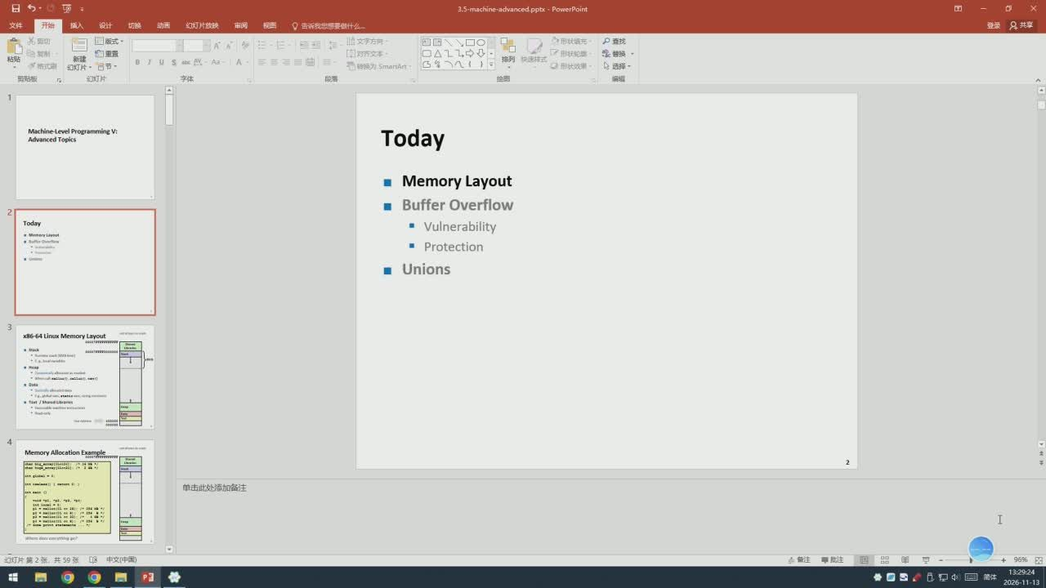
1/142 · 01:18
Notes:
红灯片放映
审网
告诉
登只共享
文字方间
口O
P直找
联轮票
US
快速排式
形状欢
贴板
灯片
Machine-LevelPrograr
ngV:
Today
Advanced Topics
Memory Layout
Buffer Overflow
Today
Vulnerability
Protection
Unions
x86-64 Linsx Memory Layout
幻灯片第2张
共59张
国中中动
草批注

Slide 3
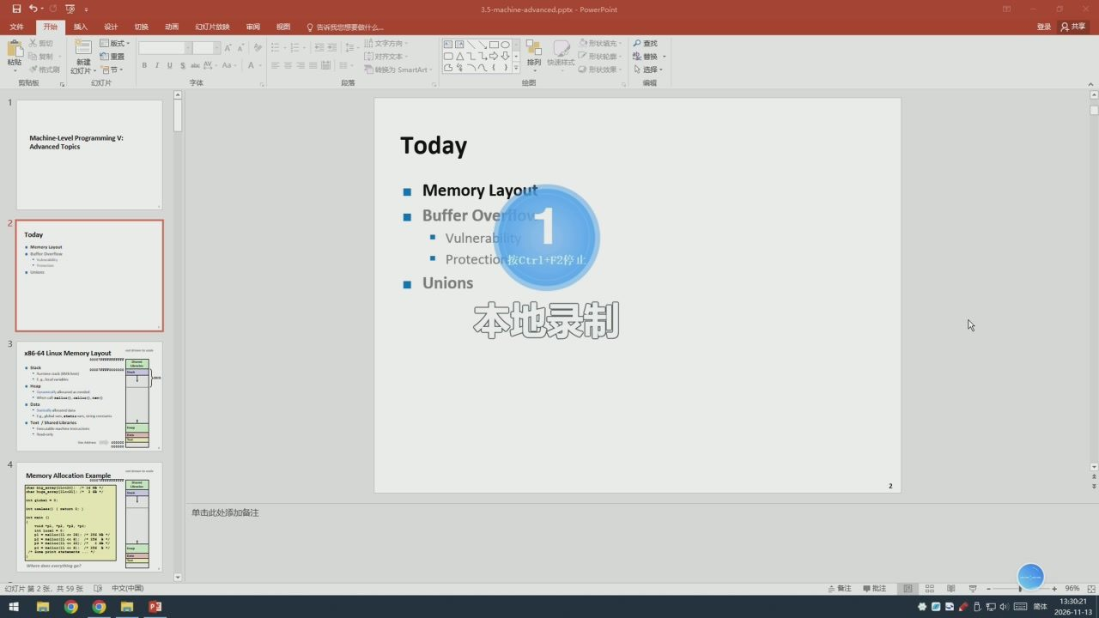
2/142 · 02:11
Notes:
红灯片放映
登录只共享
口0
自重置
形状轮
普换
红灯片·节
US
给图
Machine-Level Program
Today
Advanced Topics
MemoryLayout
BufferOve
Today
Vulnerab
Protectio按Ctr1+F2停l
Unions
本地录制
x86-64 Linux Mem
ory Layout
幻灯片簧2张，共59张中文（中国）
+96%

Slide 4
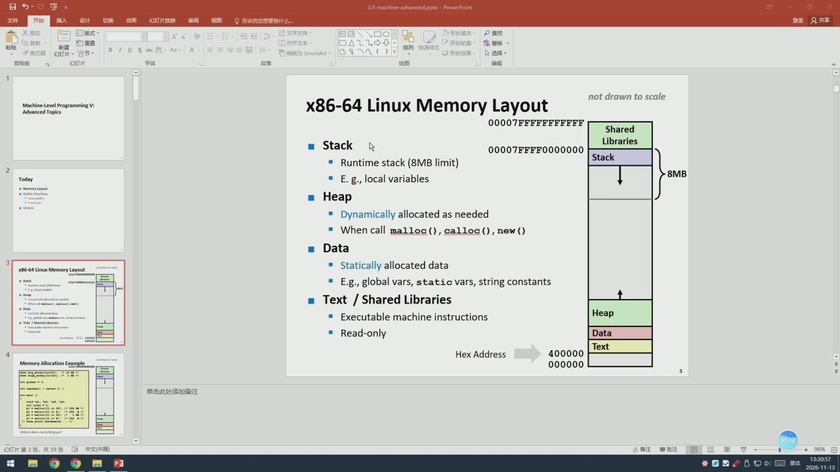
3/142 · 02:47
Notes:
3.5-machine
红灯片放映
告诉我
想要做什么
AA
自重置
形状轮
普换
红灯片·节
红灯片
给图
x86-64LinuxMemoryLayout
notdrawntoscale
Machine-Level Prograr
Advanced Topics
00007FFFFFFFFFFF
Shared
Stack
Libraries
00007FFFFO000000
Stack
Runtimestack(8MBlimit）
E.g.,local variables
Today
Heap
Dynamicallyallocatedasneeded
Whencallmalloc(）,calloc(）,new()
Data
Statically allocateddata
x86-64 Linux Memory Layout
E.gglobalvars,staticvars,stringconstants
Text/SharedLibraries
Executablemachineinstructions
Heap
Read-only
Data
Text
HexAddress
400000
000000

Slide 5
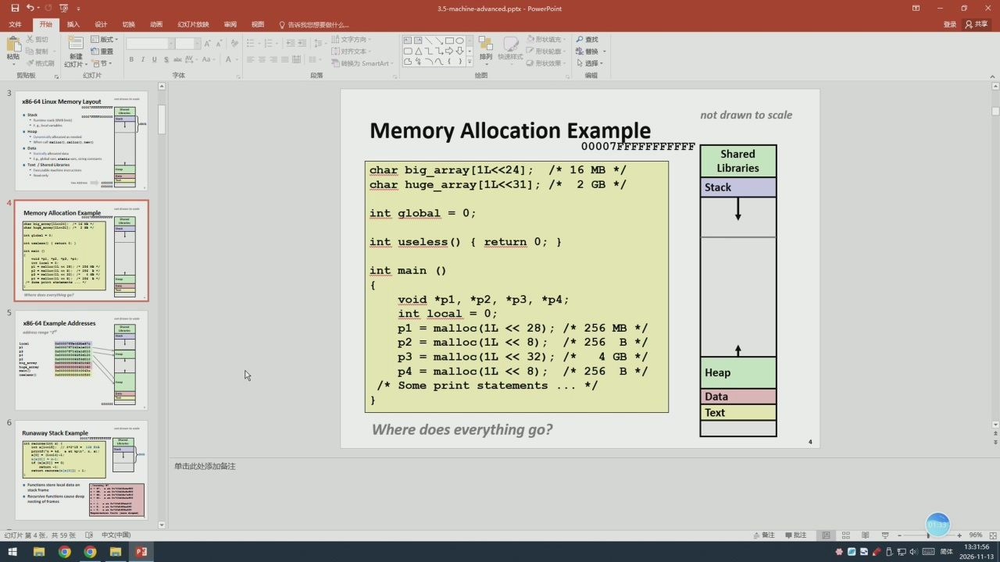
4/142 · 03:46
Notes:
红灯片放映
登录只共享
AA
四国
自重置
形状轮
普换
红灯片·节
US
给图
x86-64 Linux Mem
noeAo
notdrawnto scale
MemoryAllocationExample
meap
00007FFFFFFFFFFF
Shared
char big_array[1L<<24];/* 16MB*/
Libraries
charhuge_array[1L<<31];/*2GB*/
Stack
int global=0;
int useless() ( return 0;}
int main ()
void*p1，*p2，*p3，*p4;
int local=0;
x86-64 Exar
p1=mal1oc（1L<<28）;
/*256MB*/
p2
=ma11oc（1L<<8);
/*
256
B*/
p3=mal1oc（1L<<32）;
/*
GB
*/
p4=mal1oc（1L<<8）;
/*256
B*/
Heap
/* Some print statements
*/
Data
Text
Where does everything go?
幻灯片簧4张，共59张中文（中国）
Ed

Slide 6
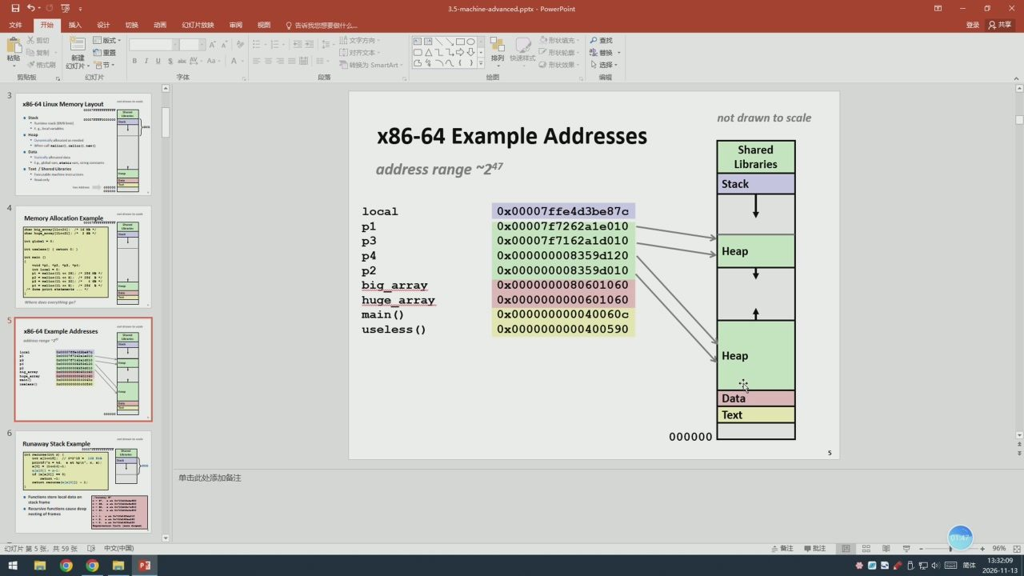
5/142 · 04:00
Notes:
红灯片放映
告诉我您
想要做什么
登录只共享
自重置
形状轮
普换
红灯片·节
US
给图
x86-64 Linux Mem
ory Layout
notdrawntoscale
meap
x86-64ExampleAddresses
Shared
addressrange~247
Libraries
Stack
local
0x00007ffe4d3be87c
p1
0x00007f7262a1e010
ed
0x00007f7162a1d010
P4
0x000000008359d120
Heap
p2
0x000000008359d010
big_array
0x0000000080601060
huge_array
0x0000000000601060
main()
0x000000000040060c
x86-64 Exar
useless()
0x0000000000400590
Heap
Data
Text
000000
幻灯片第5张，共59张中文（中国）
Ed

Slide 7
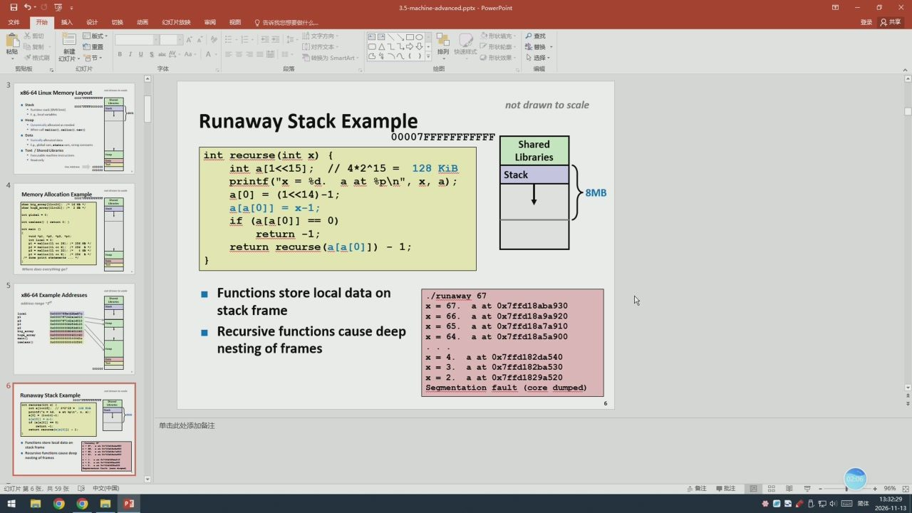
6/142 · 04:19
Notes:
红灯片放映
登录只共享
自重置
形状轮
普换
红灯片·节
US
给图
x86-64 Linux Mem
ory Layout
notdrawntoscale
meap
Runaway Stack Example
00007FFFFFFFFFFF
Shared
int recurse(int x){
Libraries
inta[1<<15];//4*2^15=128KiB
Stack
printf（"x=&d.aat &p\n",x，a）;
a[0]=（1<<14）-1;
a[a[0]] =x-1;
if（a[a[0]]==0)
return -1;
return recurse(a[a[0]])-1;
x86-64 Exa
Functionsstorelocaldataon
/runaway67
stackframe
x=67.
aat0x7ffd18aba930
66.
a at 0x7ffd18a9a920
Recursivefunctionscausedeep
65.
a at0x7ffd18a7a910
aat0x7ffd18a5a900
nestingofframes
at 0x7ffd182da540
3.
at0x7ffd182ba530
2.
aat 0x7ffd1829a520
Segmentation fault (core dumped）
幻灯片第6张，共59张中文（中国）
Ed

Slide 8
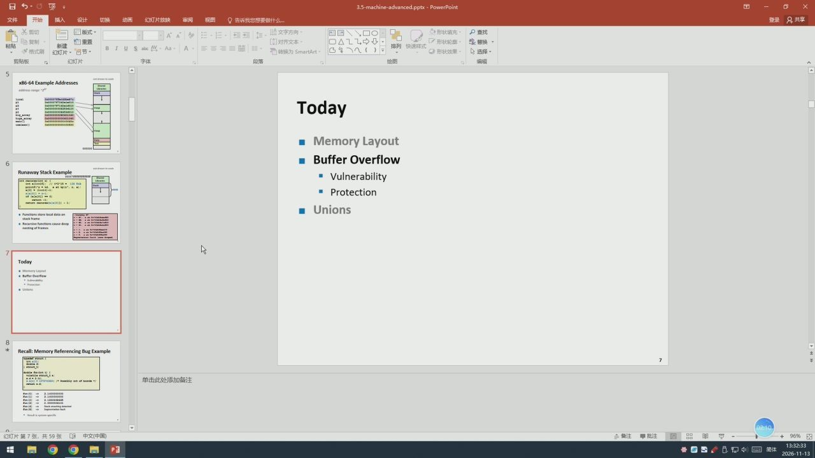
7/142 · 04:23
Notes:
登录只共享
自重置
形状轮
普换
红灯片·节
给图
x86-64 Exar
mple Addresses
Today
Memory Layout
BufferOverflow
StackE
Vulnerability
Protection
Unions
Today
Recall: Mer
幻灯片第7张
共59张
Ed

Slide 9
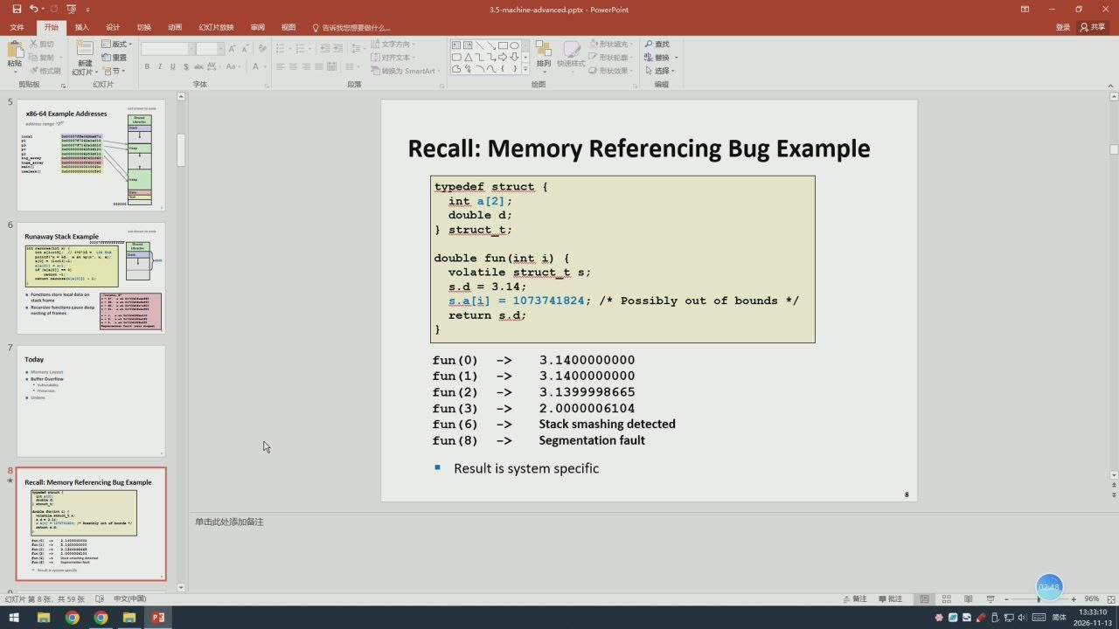
8/142 · 05:00
Notes:
想要做什么
登录只共享
自重置
形状轮
普换
红灯片·节
给图
x86-64 Exar
Recall:Memory ReferencingBug Example
typedef struct(
inta[2];
doubled;
}struct_t;
StackE
double fun(int i）{
volatile struct_ts;
s.d=3.14;
s.a[i] =1073741824;/*Possibly out ofbounds */
return s.d;
Today
fun(0)
->
3.1400000000
fun(1)
->
3.1400000000
fun(2)
->
3.1399998665
fun(3)
->
2.0000006104
fun(6)
->
Stack smashingdetected
fun(8)
->
Segmentation fault
Resultissystemspecific
Recall: Men
Ed

Slide 10
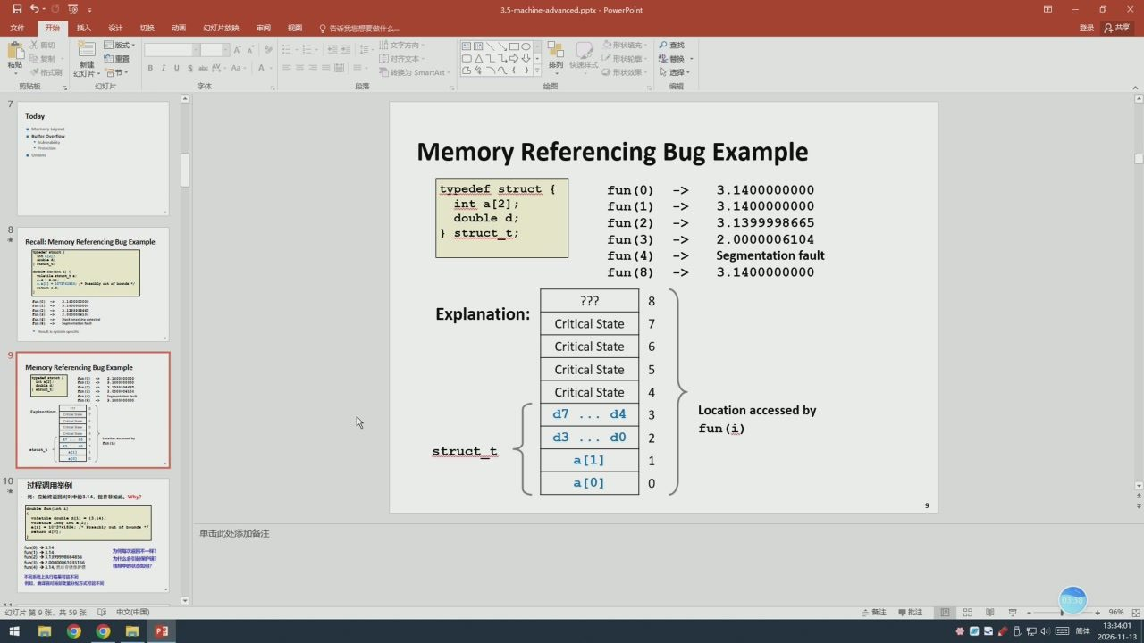
9/142 · 05:51
Notes:
登录只共享
四目
自重置
形状轮
普换
红灯片·节
红灯片
给图
Today
Memory Referencing Bug
typedef struct{
fun(0)
->
3.1400000000
inta[2];
fun(1)
->
3.1400000000
doubled;
fun(2)
->
3.1399998665
}struct_t;
Recall: Men
fun(3)
->
2.0000006104
fun(4)
->
Segmentationfault
fun(8)
->
3.1400000000
???
Explanation:
CriticalState
Critical State
CriticalState
CriticalState
d7
d4
Locationaccessedby
fun(i)
d3
do
struct_t
a[1]
过程调用举例
a[0]
：应地统d可中的1.14，但并非加此，Why？
3.541:
原虎上执门结基可站不用
幻灯片簧9张，共59张
Ed

Slide 11
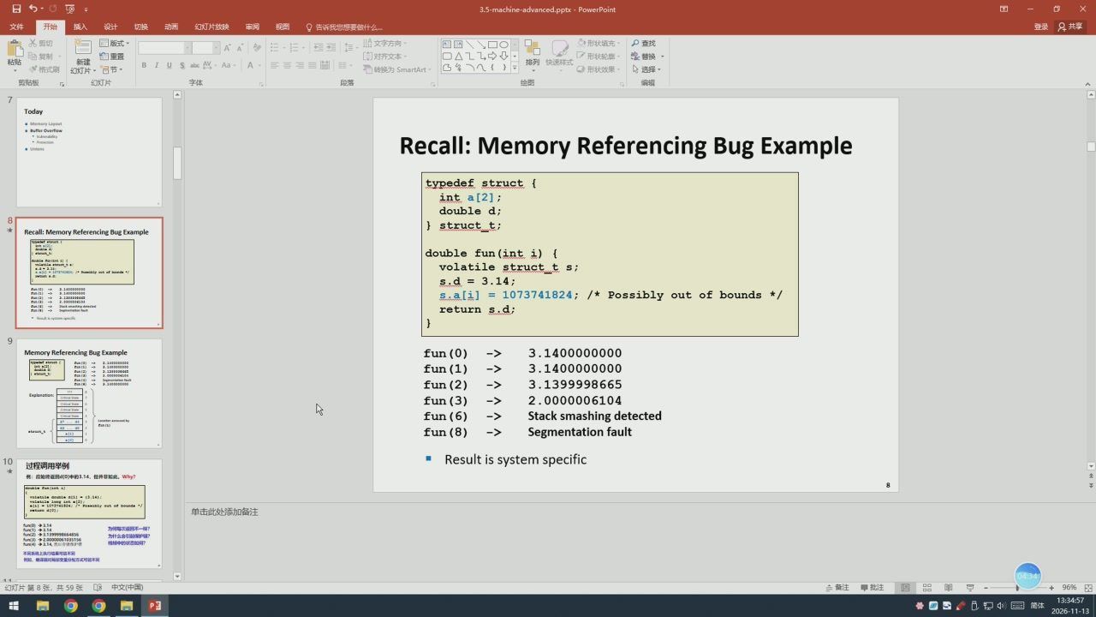
10/142 · 06:47
Notes:
红灯片放映
登录只共享
四目
自重置
形状轮
普换
红灯片·节
红灯片
给图
Today
Recall:Memory ReferencingBugExample
typedef struct(
inta[2];
doubled;
}struct_t;
Recall: Men
double fun（int i）（
volatile struct_t s;
s.d=3.14;
s.a[i] =1073741824;/*Possibly out ofbounds */
return s.d;
fun(0)
->
3.1400000000
fun(1)
->
3.1400000000
fun(2)
->
3.1399998665
fun(3)
->
2.0000006104
fun(6)
->
Stack smashingdetected
fun(8)
->
Segmentationfault
过程调用举例
Result issystem specific
：应地统证d0申的3.14，但并非加此，why？
3.141:
原虎上执门结某可站不用
幻灯片簧8张，共59张
Ed

Slide 12
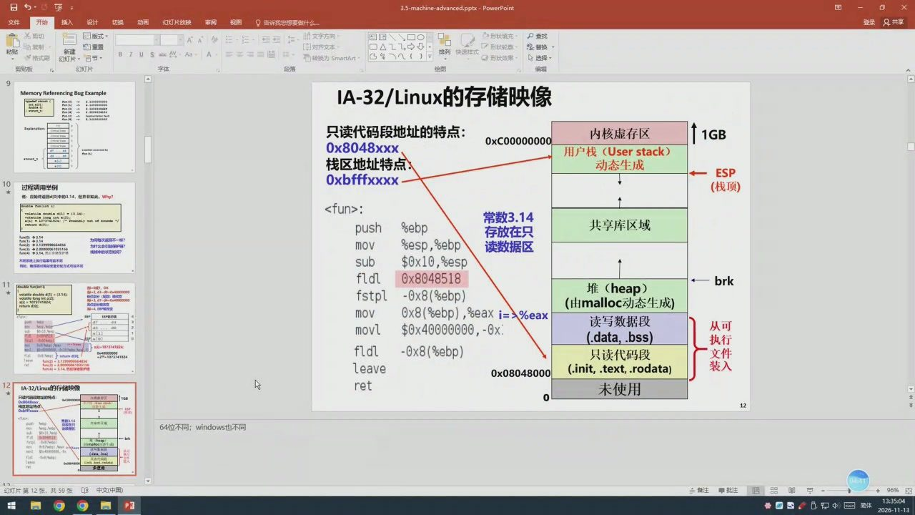
11/142 · 06:54
Notes:
红灯片放快
登录只共享
四目
P查找
白重置
形状轮
US
红灯片
给图
Mer
IA-32/Linux的存储映像
只读代码段地址的特点：
内核虚存区
0x8048xxx
000000000X0
用户栈（Userstack）
栈区地址特点：
动态生成
Oxbfffxxxx
ESP
过程调用举例
（栈顶）
：应始返d中的3.14，世并加此，Why？
<fun>:
13.14):
常数3.14
push
Ssebp
共享库区域
存放在只
为间每次通不一样？
mov
esp,ebp
读数据区
不闭成上执行站果可款不用
sub
$0x10,%esp
fldl
0x8048518
堆（heap）
brk
fstpl
-0x8(ebp)
0x8（%ebp）,eaxi=>%eax
（由malloc动态生成）
mov
读写数据段
movl
$0x40000000,-0x.
从可
(.data,.bss)
执行
fldl
-0x8(sebp)
只读代码段
leave
(.init,.text,.rodata)
装入
0x08048000
IA-32/Linux的存储映像
ret
未使用
64位不同：windows也不同
幻灯片第12张，共59张8中文（中国）
注批注
Ed

Slide 13
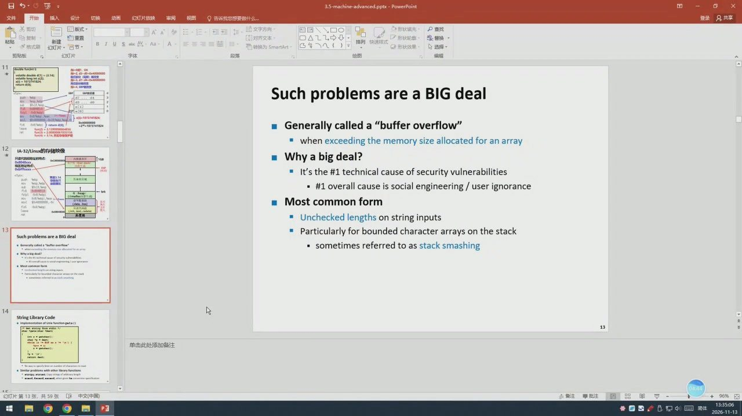
12/142 · 06:57
Notes:
红灯片放映
想要做什么
文字方内
自重置
形状轮
普换
幻灯片·节
红灯片
给图
Suchproblemsare a BlGdeal
Generally called a"buffer overflow"
whenexceedingthememory size allocatedforanarray
1A-32/Linu
ux的存储映像
Why a big deal?
It'sthe#1technicalcauseofsecurityvulnerabilities
·#1overallcauseis socialengineering/user ignorance
Mostcommonform
Unchecked lengthson stringinputs
Particularlyforboundedcharacterarraysonthestack
are a BIG deal
sometimesreferredtoasstacksmashing
String Library Code
幻灯片簧13张，共59张

Slide 14
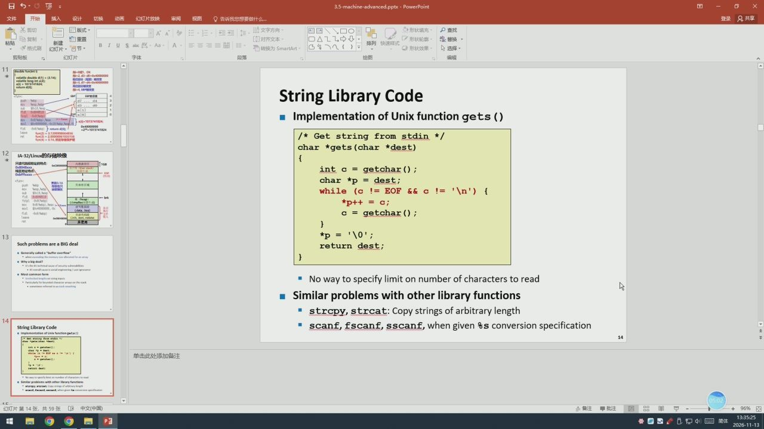
13/142 · 07:15
Notes:
红灯片放映
自重置
形状轮
普换
红灯片·节
红灯片
给图
-2.d
String Library Code
ImplementationofUnixfunctiongets()
/*Get string from stdin */
char *gets（char *dest)
IA-32/Linux的存储映像
intc=getchar（）;
char *p = dest;
while（c!=EOF
&&c!='\n'）{
*p++=c;
c=getchar（）;
*p='10';
are a BIG deal
return dest;
Nowaytospecifylimitonnumberofcharacterstoread
Similarproblemswithotherlibraryfunctions
strcpy,strcat:Copy strings of arbitrarylength
String Library Code
scanf,scanf,sscanf,whengiven&sconversionspecification
幻灯片第14张，共59张8中文（中国）
Ed

Slide 15
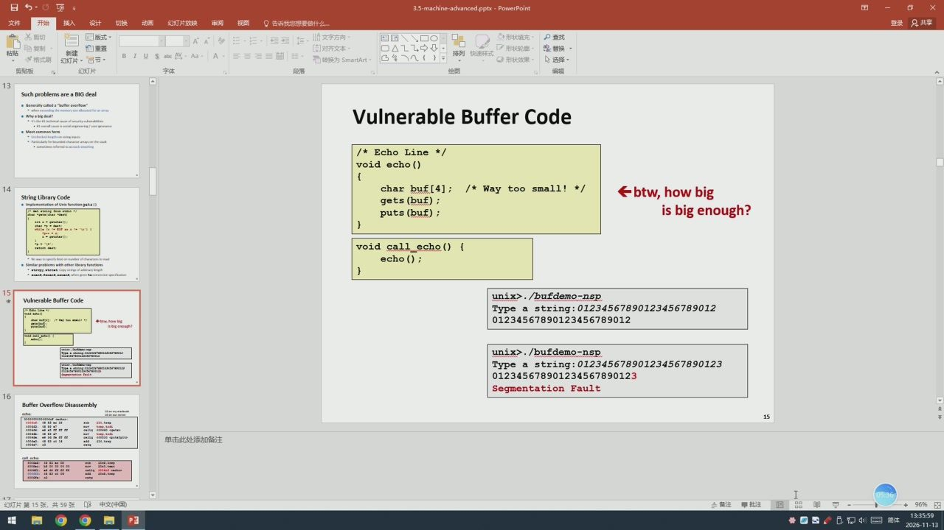
14/142 · 07:49
Notes:
红灯片放映
AA
自重置
形状轮
普换
格式别
红灯片·节
给图
Such problems areaBIG deal
VulnerableBufferCode
Wyegdel
/*Echo Line */
void echo()
char buf[4];/*Way too small！*/
btw,howbig
String Library Code
gets(buf);
puts(buf);
isbigenough?
void call_echo(）(
echo();
Vulnerable Buffer Code
unix>./bufdemo-nsp
Type a string:01234567890123456789012
01234567890123456789012
unix>./bufdemo-nsp
Typea string:012345678901234567890123
012345678901234567890123
Segmentation Fault
Buffer Overflow Disassembly
共59张

Slide 16
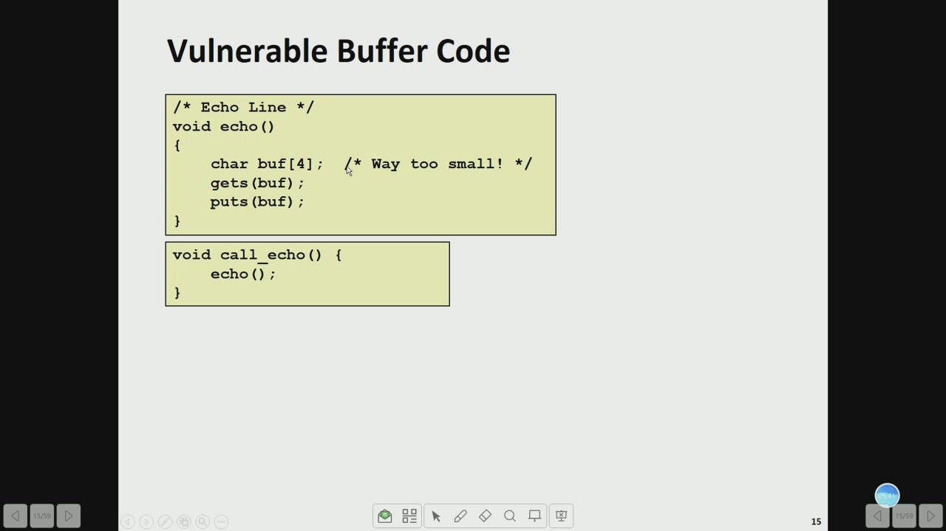
15/142 · 07:54
Notes:
VulnerableBufferCode
/*Echo Line
void echo()
char buf[4];
*Way too small！ */
gets(buf);
puts(buf);
void call_echo(){
echo();

Slide 17
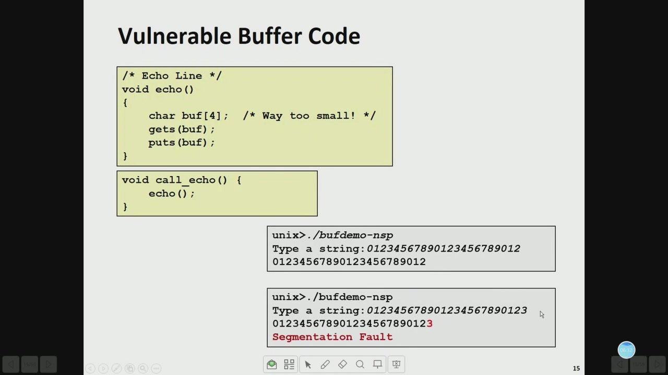
16/142 · 08:45
Notes:
VulnerableBufferCode
/*Echo Line */
void echo()
char buf[4];/*Way too small! */
gets(buf);
puts(buf);
void call_echo(){
echo();
unix>./bufdemo-nsp
Type a string:01234567890123456789012
01234567890123456789012
unix>./bufdemo-nsp
Type a string:012345678901234567890123
012345678901234567890123
Segmentation Fault

Slide 18
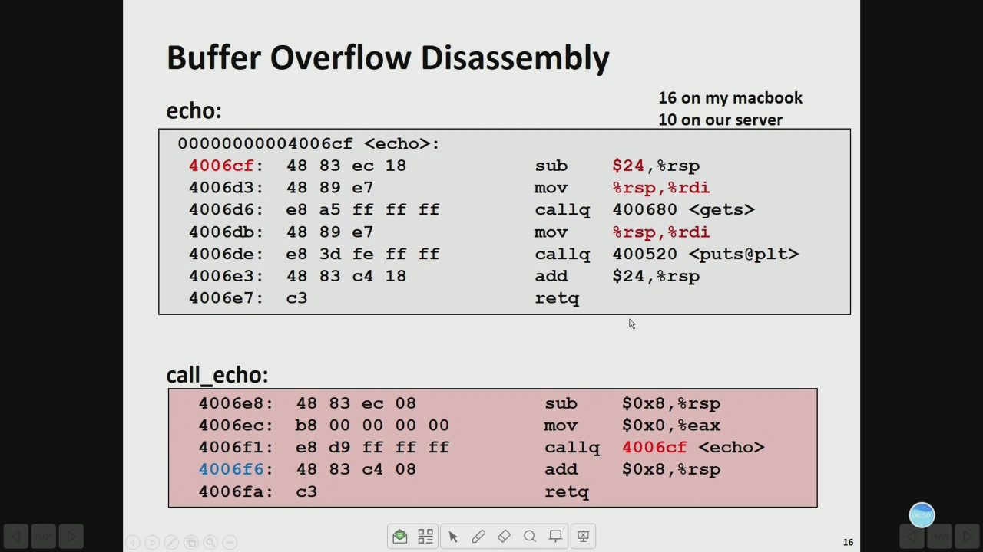
17/142 · 09:02
Notes:
Buffer OverflowDisassembly
16 onmymacbook
echo:
10onourserver
00000000004006cf<echo>:
4006cf:
488
83ec18
sub
$24,%rsp
4006d3:
e7
Aou
&rsp,&rdi
4006d6:
e8
a5
ff
ff ff
callq
400680 <gets>
4006db:
e7
Aou
&rsp,&rdi
4006de:
e8
3d
fe
ff
ff
callq
400520<puts@plt>
4006e3:
C4
add
$24,&rsp
4006e7:
c3
retq
call_echo:
4006e8:
ec
sub
$0x8,%rsp
4006ec:
b8
Aou
$0x0,%eax
4006f1:
e8
d9
ff
ff
ff
callg
4006cf<echo>
4006f6:
C4
add
$0x8,8rsp
4006fa:
c3
retq
Q口

Slide 19
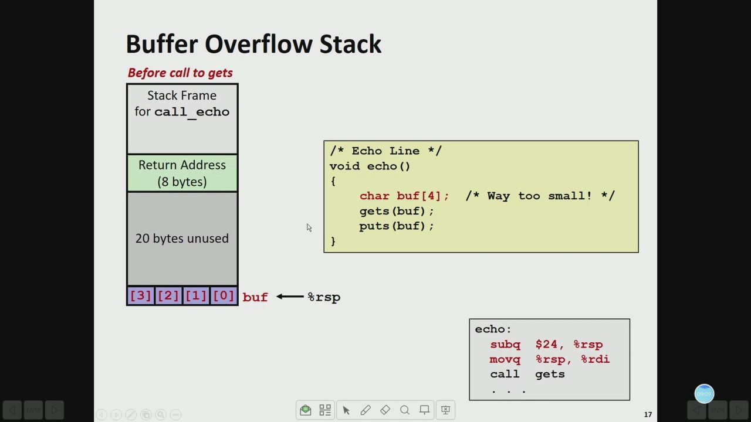
18/142 · 11:21
Notes:
Buffer OverflowStack
Beforecalltogets
StackFrame
forcall echo
Echo Line
Return Address
void echo()
(8bytes)
char buf[4];
/* Way too small！ */
gets(buf);
puts(buf);
20bytes unused
[③]2][1][0]
buf—%rsp
echo:
subq
$24,%rsp
movq
&rsp,&rdi
call
gets

Slide 20
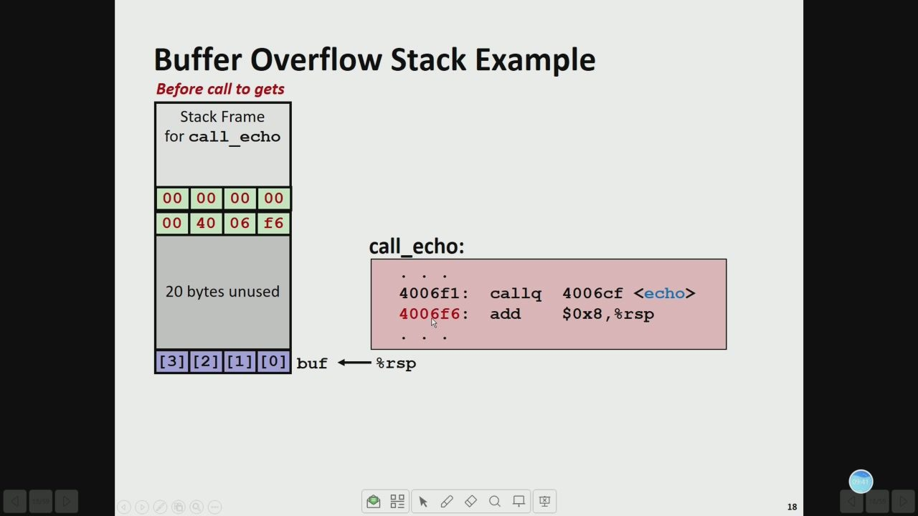
19/142 · 11:54
Notes:
Buffer Overflow Stack Example
Beforecall togets
StackFrame
forcall_echo
f6
call_echo:
20bytes unused
4006f1:
callq
4006cf<echo>
4006f6:
add
$0x8,&rsp
[3][2][1][0]
buf —&rsp

Slide 21
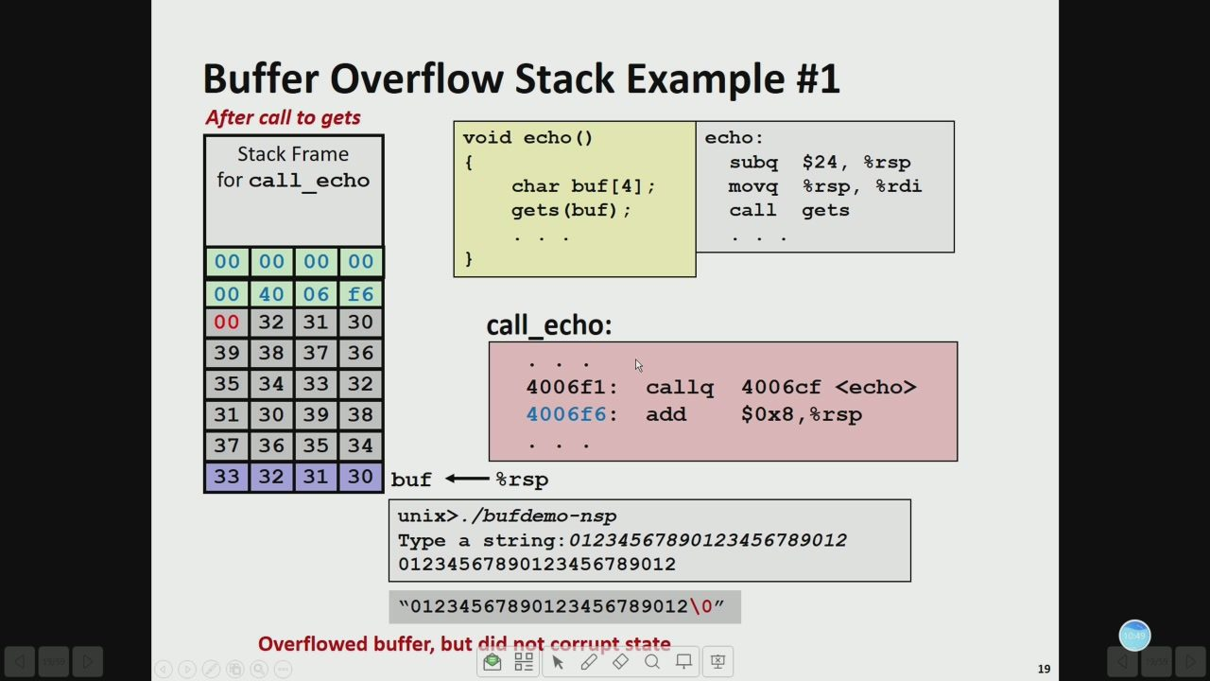
20/142 · 13:01
Notes:
Buffer Overflow Stack Example #1
Aftercalltogets
void echo()
echo:
StackFrame
subq
$24,%rsp
forcall echo
charbuf[4];
bAou
%rsp,&rdi
gets(buf);
call
gets
call_echo:
4006f1:
callq
4006cf<echo>
4006f6:
add
$0x8,&rsp
buf←rsp
unix>./bufdemo-nsp
Typeastring:01234567890123456789012
01234567890123456789012
"01234567890123456789012\0"
Overflowedbuffer,butdidnotcorruptstate

Slide 22
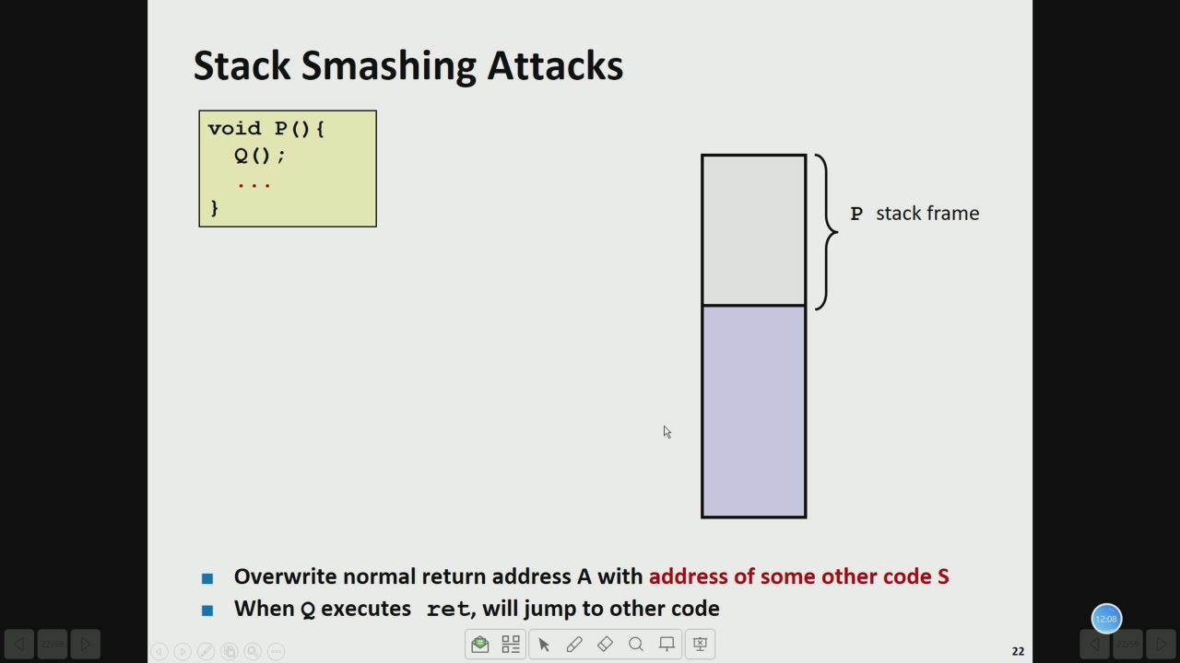
21/142 · 14:21
Notes:
Stack Smashing Attacks
void P(){
Q（）;
Pstackframe
OverwritenormalreturnaddressAwithaddressofsomeothercodeS
WhenQexecutesret,will jumptoothercode

Slide 23
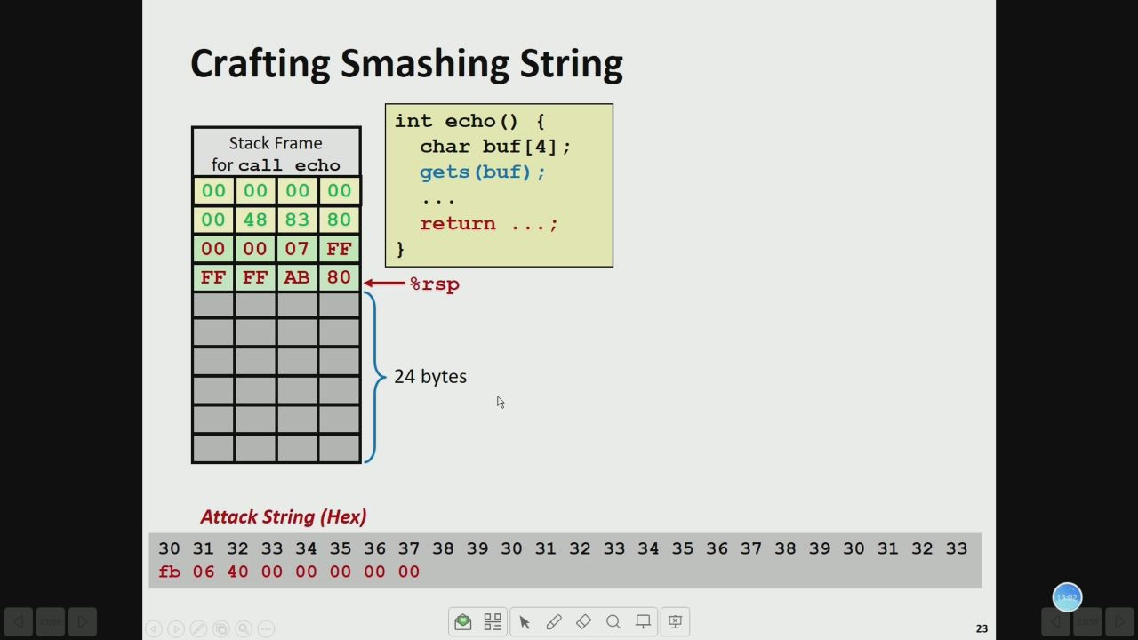
22/142 · 15:15
Notes:
Crafting Smashing String
intecho(){
StackFrame
char buf[4];
forcall echo
gets(buf);
return
FF
FF
FF
AB
&rsp
24bytes
b06400000000000

Slide 24
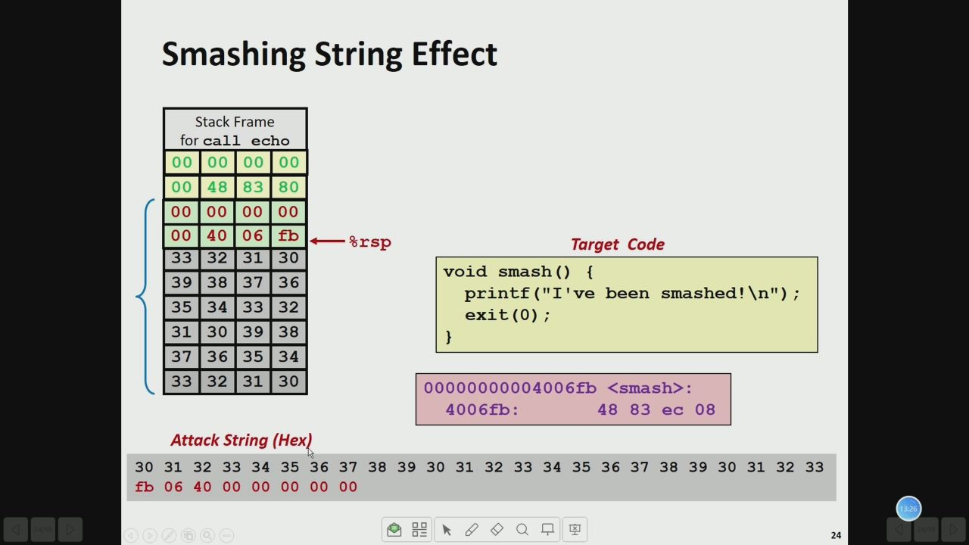
23/142 · 15:39
Notes:
Smashing String Effect
StackFrame
forcall echo
fb
%rsp
TargetCode
void smash(){
printf("I'vebeen smashed!\n");
exit(0);
00000000004006fb<smash>:
4006fb:
4883ec08
b06400000000000

Slide 25
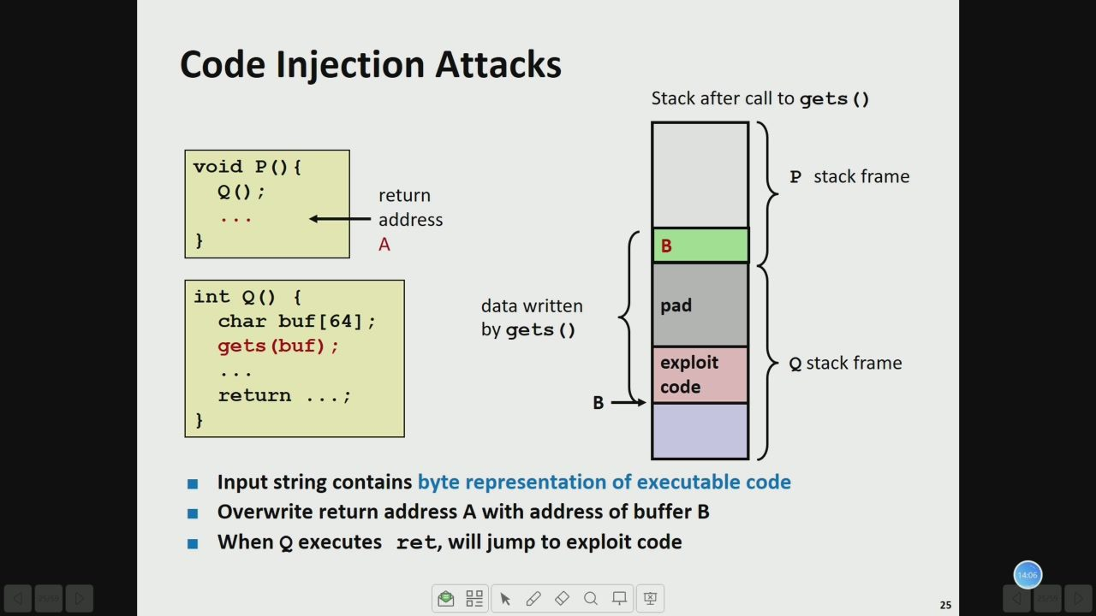
24/142 · 16:19
Notes:
Code Injection Attacks
Stackaftercalltogets()
void P(){
Pstackframe
Q();
return
address
intQ（）{
datawritten
pad
charbuf[64];
by gets ()
gets(buf);
exploit
Qstackframe
code
return
Input string contains byte representation of executable code
OverwritereturnaddressAwithaddressofbufferB
WhenQ executes ret,willjump toexploitcode

Slide 26
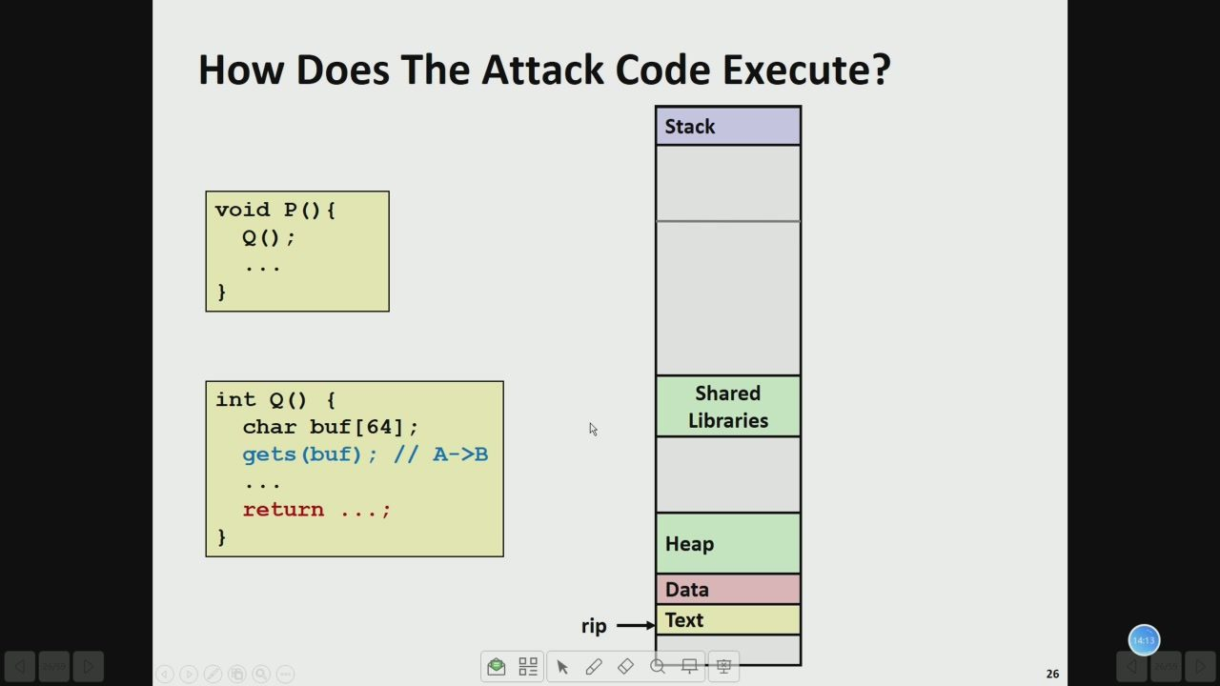
25/142 · 16:26
Notes:
How Does The Attack CodeExecute?
Stack
void P(){
Q（);
intQ(）{
Shared
charbuf[64];
Libraries
gets(buf);// A->B
return
Heap
Data
rip
Text

Slide 27
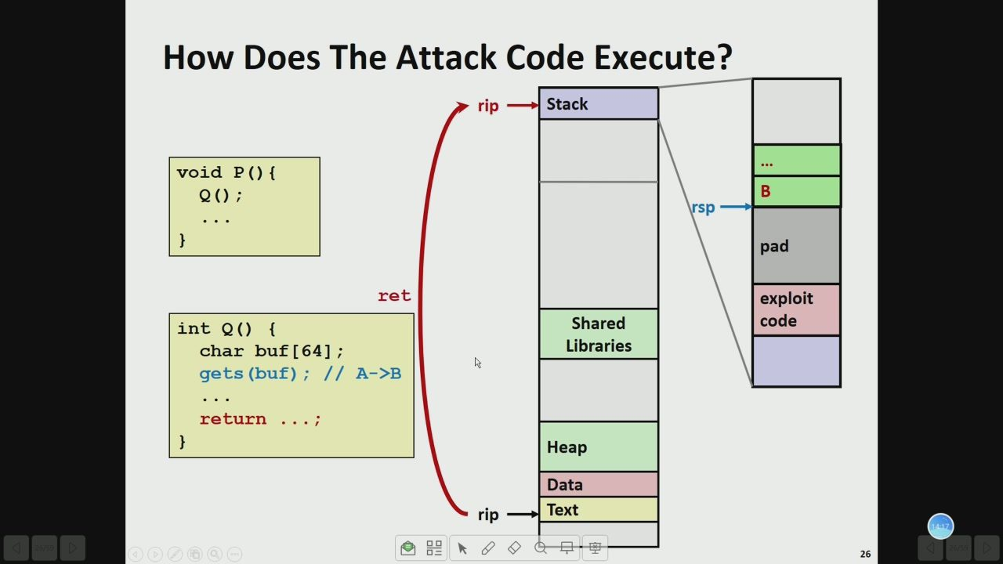
26/142 · 16:30
Notes:
How Does The Attack CodeExecute?
←=
Stack
void P(){
...
Q（);
pad
ret
exploit
intQ(）{
Shared
code
char buf[64];
Libraries
gets(buf);// A->B
return
Heap
Data
rip
Text

Slide 28
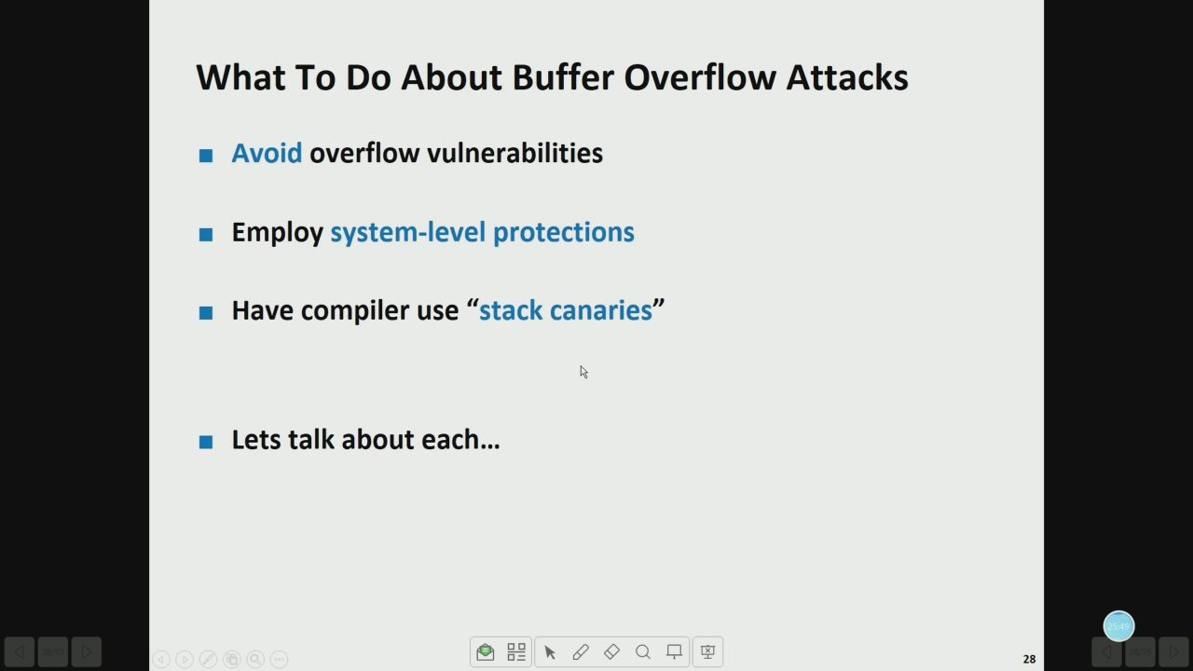
27/142 · 28:02
Notes:
What ToDoAboutBuffer OverflowAttacks
Avoidoverflowvulnerabilities
Employsystem-level protections
Havecompileruse“stackcanaries"
Letstalkabouteach...
品Q口

Slide 29
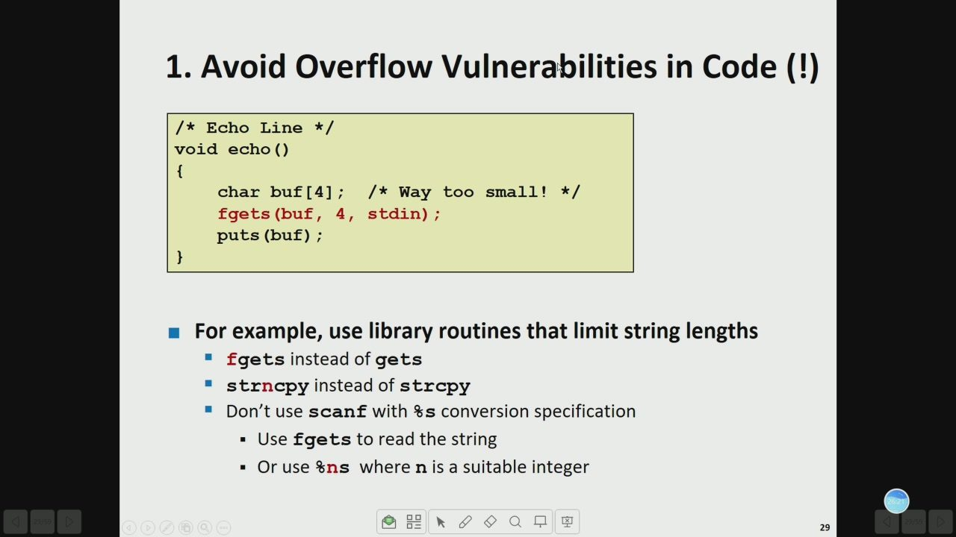
28/142 · 28:34
Notes:
1. Avoid Overflow Vulnerabilities in Code (!)
/* Echo Line */
void echo()
char buf[4];/* Way too small！ */
fgets(buf，4，stdin);
puts(buf);
Forexample,uselibraryroutinesthatlimitstringlengths
fgetsinsteadofgets
strncpy instead of strcpy
Don'tusescanfwith&sconversionspecification
·Usefgets toread the string
·Or use &ns where n isa suitable integer

Slide 30
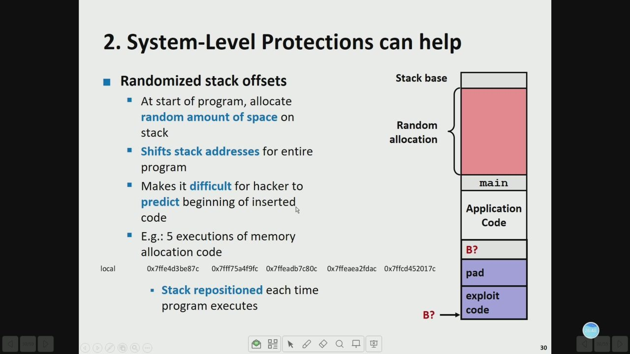
29/142 · 29:01
Notes:
2. System-Level Protections can help
Randomized stackoffsets
Stackbase
Atstartofprogram,allocate
random amountofspaceon
Random
stack
allocation
Shiftsstack addressesforentire
program
Makesitdifficultforhackerto
main
predict beginning of inserted
Application
code
Code
E.g.:5executionsofmemory
allocationcode
B?
local
0x7ffe4d3be87c
Ox7ff75a4f9fc0x7ffeadb7c80c0x7ffeaea2fdac0x7ffcd452017c
ped
Stackrepositionedeach time
exploit
programexecutes
code
B?

Slide 31
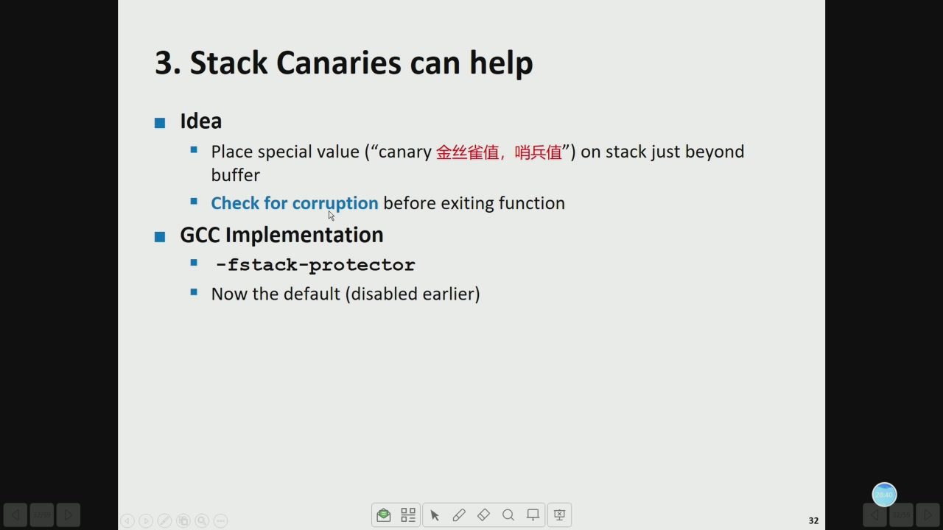
30/142 · 30:52
Notes:
3. Stack Canaries can help
Idea
Place specialvalue（"canary金丝雀值，哨兵值"）on stackjustbeyond
buffer
Checkforcorruptionbeforeexitingfunction
GcCImplementation
-fstack-protector
Nowthedefault(disabledearlier)

Slide 32
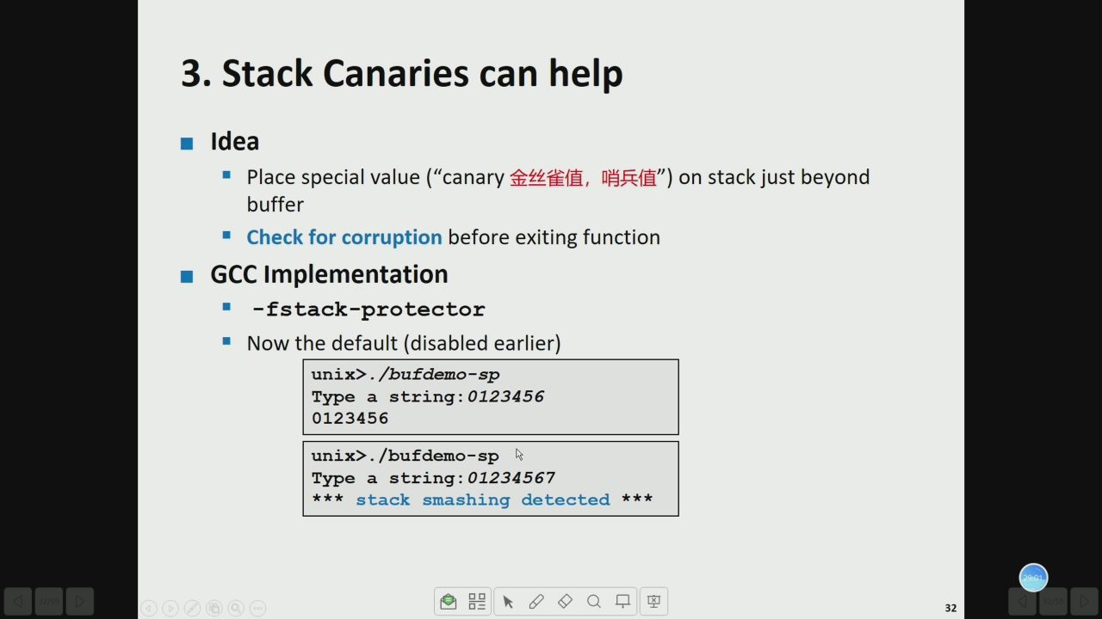
31/142 · 31:14
Notes:
3. Stack Canaries can help
Idea
Place specialvalue（"canary金丝雀值，哨兵值"）on stackjustbeyond
buffer
Checkforcorruptionbeforeexitingfunction
GCCImplementation
-fstack-protector
Nowthe default(disabled earlier)
unix>./bufdemo-sp
Type a string:0123456
0123456
unix>./bufdemo-sp
Type a string:01234567
***
stack smashing detected

Slide 33
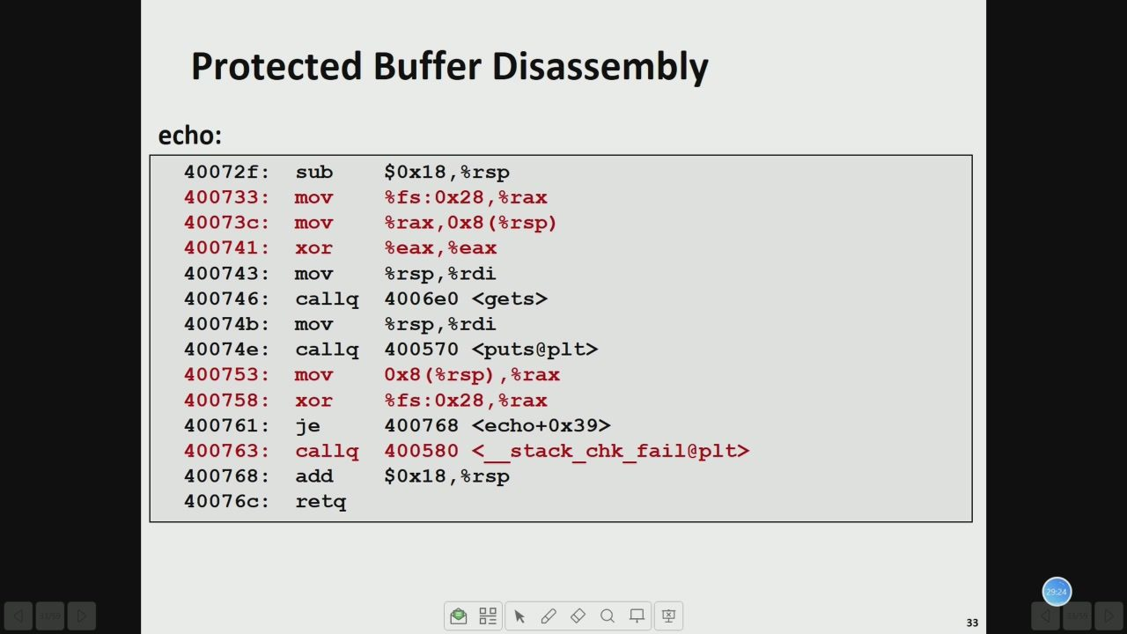
32/142 · 31:36
Notes:
Protected Buffer Disassembly
echo:
40072f:
sub
$0x18,%rsp
400733:
Aou
&fs:0x28,&rax
40073c:
Aou
%rax,0x8(%rsp)
400741:
xor
beax,&eax
400743:
Aou
&rsp,&rdi
400746:
callq
4006e0 <gets>
40074b:
Aou
&rsp,&rdi
40074e:
callq
400570<puts@plt>
400753:
Aou
0x8（%rsp),&rax
400758:
xor
8fs:0x28,8rax
400761:
je
400768<echo+0x39>
400763:
callq
400580<stack_chkfail@plt>
400768:
add
$0x18,%rsp
40076c:
retq

Slide 34
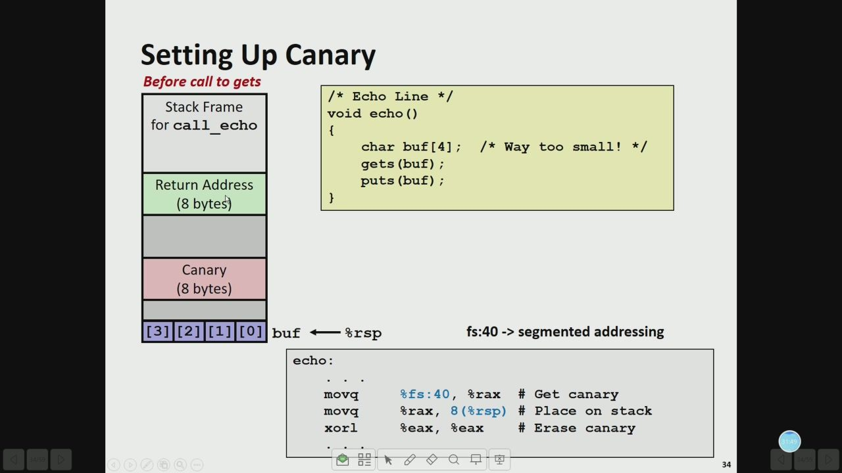
33/142 · 34:02
Notes:
Setting Up Canary
Beforecalltogets
/*Echo Line */
StackFrame
void echo()
forcall echo
char buf[4];/*Way too small! */
gets(buf);
Return Address
puts(buf);
(8bytes)
Canary
(8bytes)
[3][2][1][0]
buf←rsp
fs:40->segmented addressing
echo:
bAou
&fs:40,8rax
#Get canary
mova
%rax,8(%rsp)
#Place on stack
xorl
beax,
%eax
#Erase canary

Slide 35
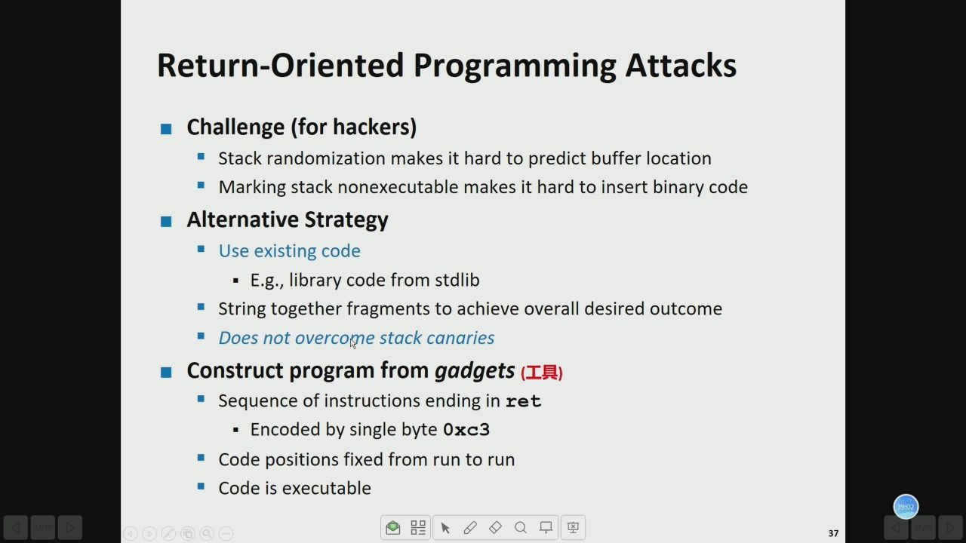
34/142 · 41:15
Notes:
Return-Oriented ProgrammingAttacks
Challenge(forhackers)
Stackrandomizationmakesithardtopredictbufferlocation
Markingstacknonexecutablemakesithard toinsertbinarycode
AlternativeStrategy
Use existingcode
·E.g.,library code from stdlib
Stringtogetherfragmentstoachieveoveralldesiredoutcome
Doesnotovercomestackcanaries
Sequence of instructions ending inret
·Encoded by singlebyte0xc3
Codepositionsfixedfromruntorun
Codeisexecutable

Slide 36
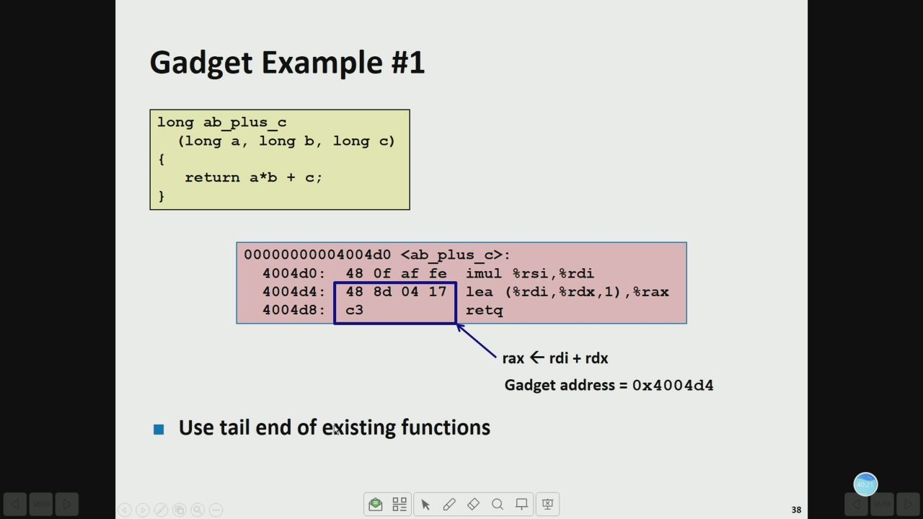
35/142 · 42:33
Notes:
Gadget Example #1
long ab_plus_c
(long a，long b，long c)
return a*b +c;
00000000004004d0<ab_plus_c>:
4004d0:
480faffe
imul %rsi,%rdi
4004d4:
488d0417
lea （%rdi,8rdx,1),8rax
4004d8:
c3
retq
rax←rdi+rdx
Gadgetaddress=0x4004d4
Use tail endofexistingfunctions

Slide 37
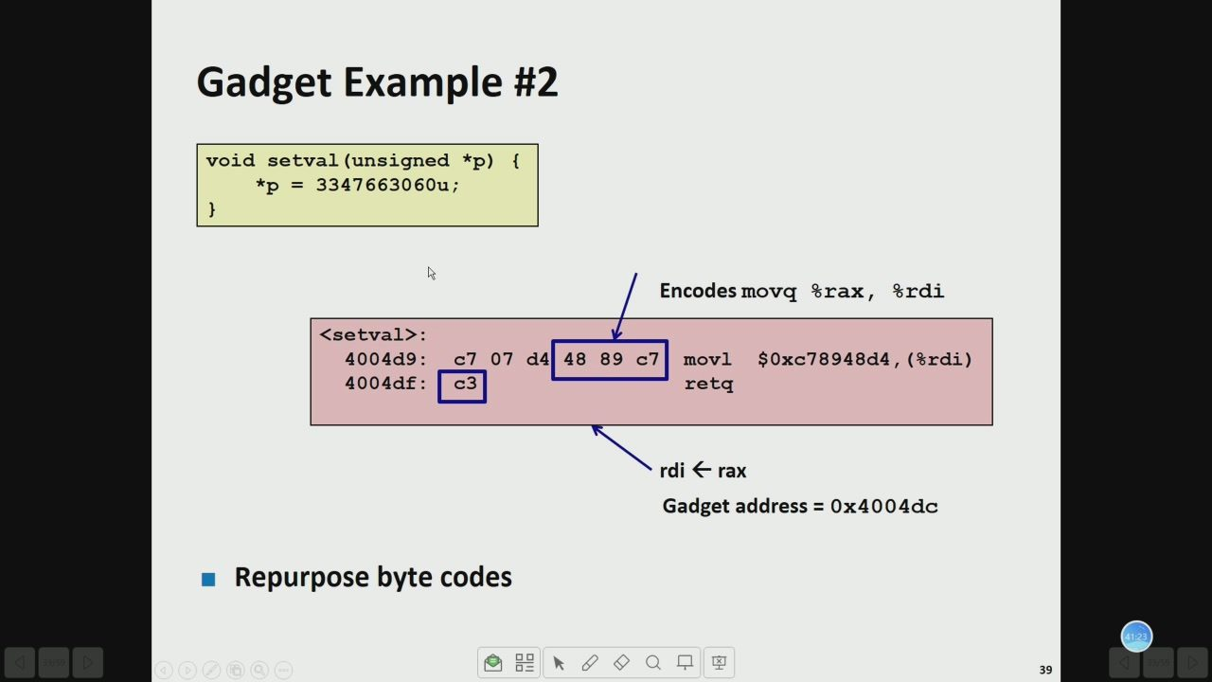
36/142 · 43:35
Notes:
Gadget Example #2
void setval(unsigned *p)
*p=3347663060u;
Encodesmovq rax,&rdi
<setval>:
4004d9:
c707
d4
4889
movl
$0xc78948d4,（8rdi)
4004df:
c3
retg
rdi←rax
Gadgetaddress=0x4004dc
Repurposebyte codes

Slide 38
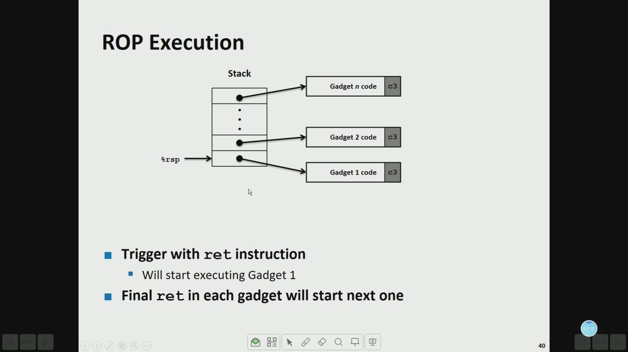
37/142 · 44:23
Notes:
ROP Execution
Stack
Gadgetncode
c3
Gadget2code
c3
Gadget1code
c3
Triggerwith ret instruction
Will startexecutingGadget1
Finalretineachgadgetwillstartnextone

Slide 39
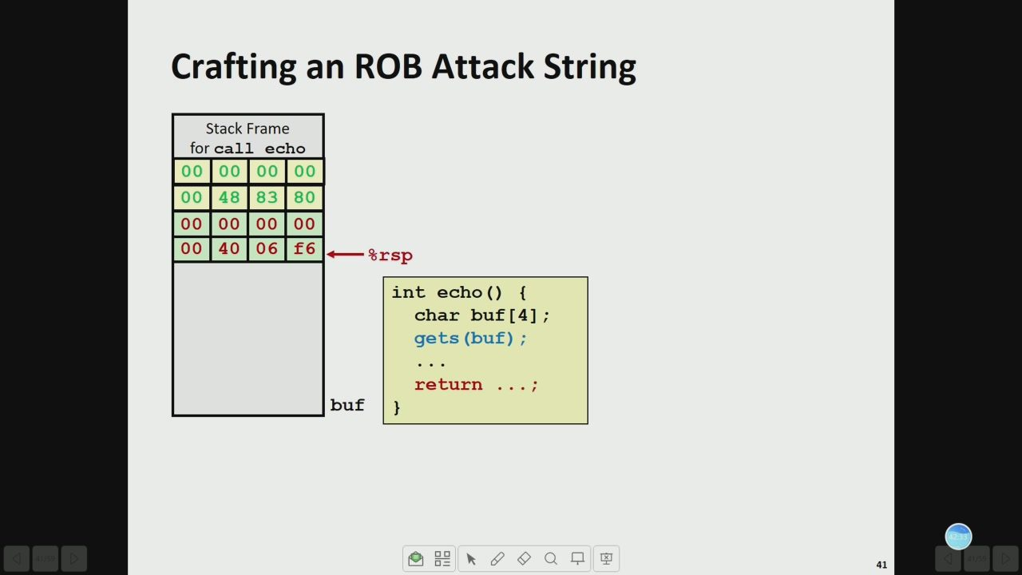
38/142 · 44:46
Notes:
Crafting an ROB Attack String
StackFrame
forcall echo
int echo(){
char buf[4];
gets(buf);
return
buf

Slide 40
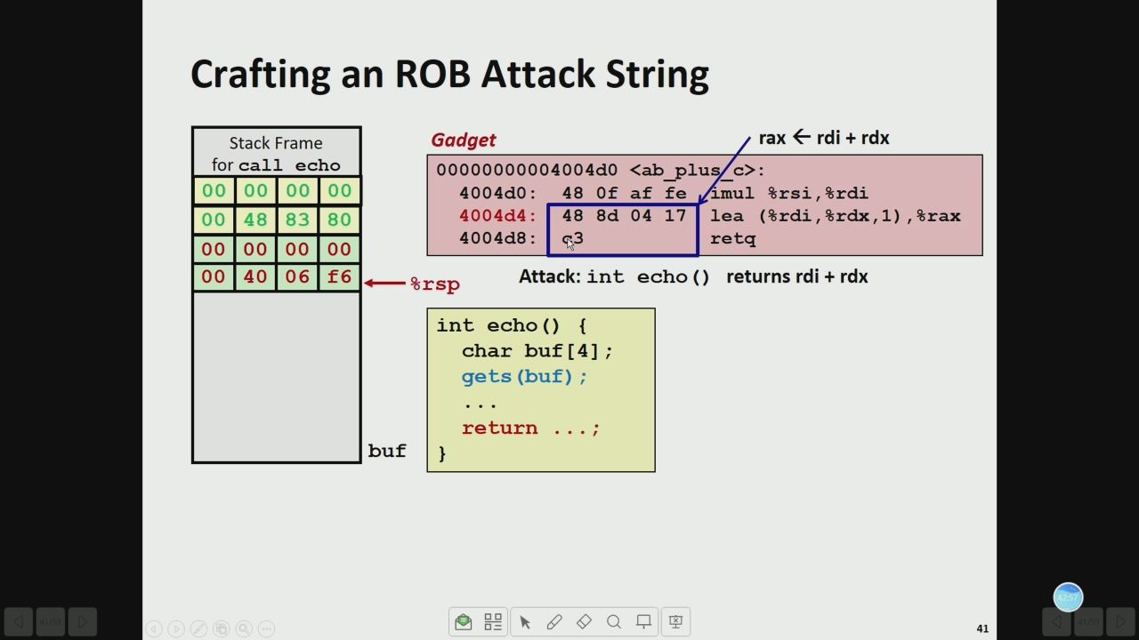
39/142 · 45:10
Notes:
Crafting an ROB Attack String
StackFrame
Gadget
rax←rdi+rdx
forcall echo
00000000004004d0 <ab_plus/c>:
4004d0:
480faffe
imul8rsi,&rdi
4004d4:
488d0417
lea（%rdi,8rdx,1),8rax
4004d8:
retg
%rsp
Attack:int echo()returnsrdi+rdx
int echo(){
char buf[4];
gets(buf);
return
buf

Slide 41
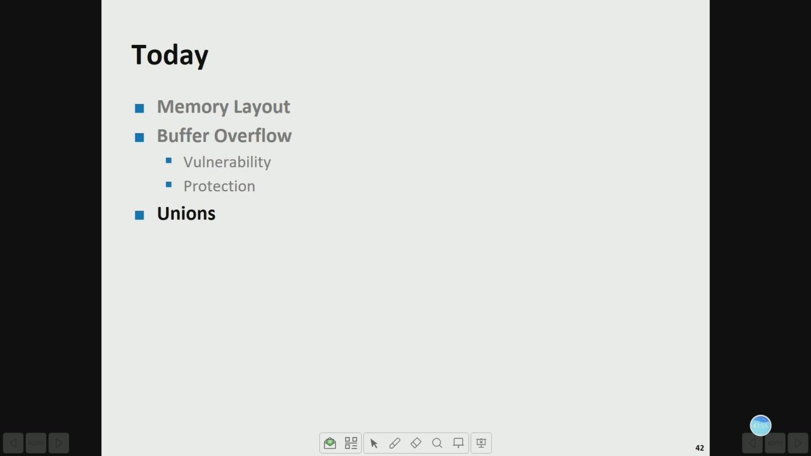
40/142 · 46:08
Notes:
Today
Memory Layout
Buffer Overflow
·Vulnerability
Protection
Unions

Slide 42
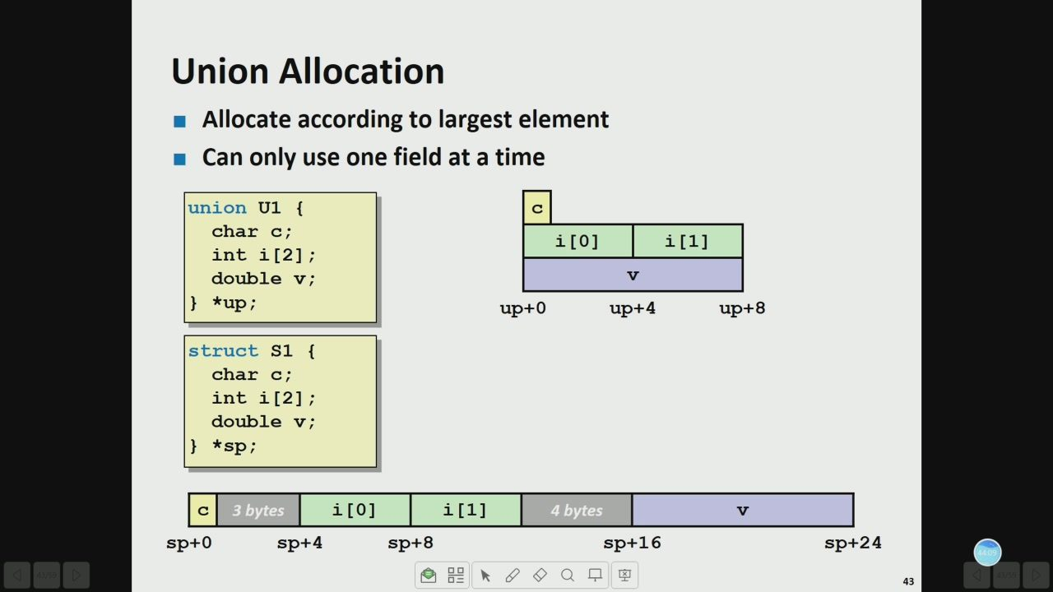
41/142 · 46:22
Notes:
Union Allocation
Allocateaccordingtolargestelement
Canonlyuseonefield atatime
union Ul{
char c;
i[0]
i[1]
inti[2];
doublev;
*up;
up+o
up+4
up+8
struct s1 {
char c;
inti[2];
doublev;
!ds*
3bytes
i[0]
i[1]
4bytes
sp+o
sp+4
sp+8
sp+16
sp+24

Slide 43
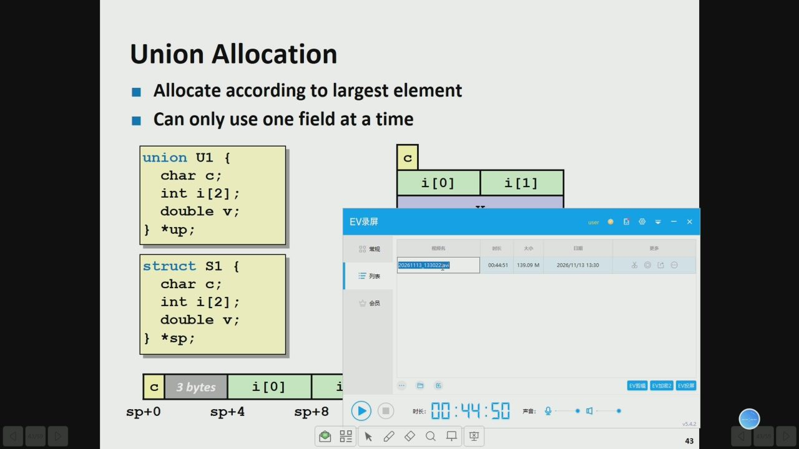
42/142 · 47:05
Notes:
Union Allocation
Allocateaccordingtolargestelement
Canonlyuseonefield ata time
union Ul{
char c;
i[0]
i[1]
inti[2];
doublev;
EV录屏
*up;
0常规
视频名
时长
大小
更多
struct s1
2026111313302
W60661
2026/11/13 13:30
char c;
三列
inti[2];
会员
doublev;
!ds*
3bytes
i[0]
sp+o
sp+4
sp+8
时长：
05:hh:00
产音：
品Q口

Slide 44
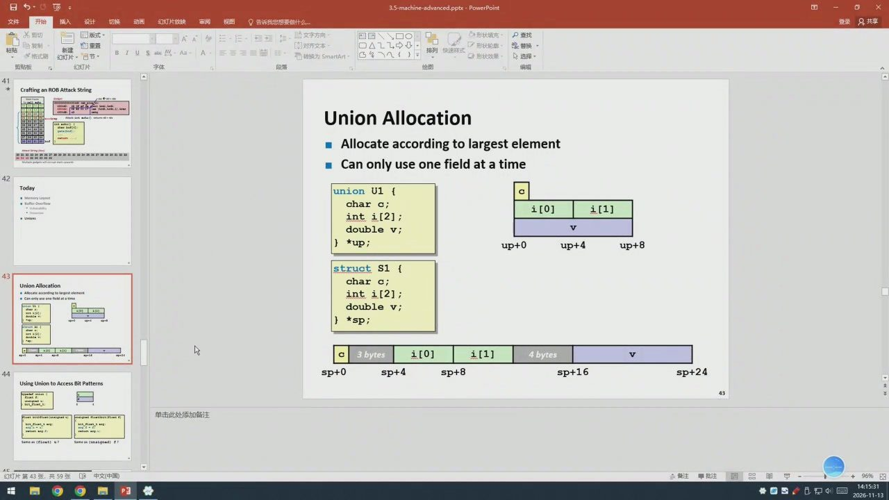
43/142 · 47:21
Notes:
红灯片放映
登录只共享
药切
P查找
白重置
形状轮
红灯片·节
给图
Crafting an ROB Attack String
Union Allocation
Allocateaccordingtolargestelement
Canonlyuseonefieldatatime
Today
union U1{
charc;
i[0]
i[1]
inti[2];
doublev;
*up;
o+dn
up+4
up+8
struct S1{
char c;
Union Allocation
inti[2];
doublev;
*sp;
3bytes
i[0]
i[1]
4bytes
sp+0
sp+4
sp+8
sp+16
sp+24
Using Union to Access Bit Patterns
灯片第43张，共59张

Slide 45
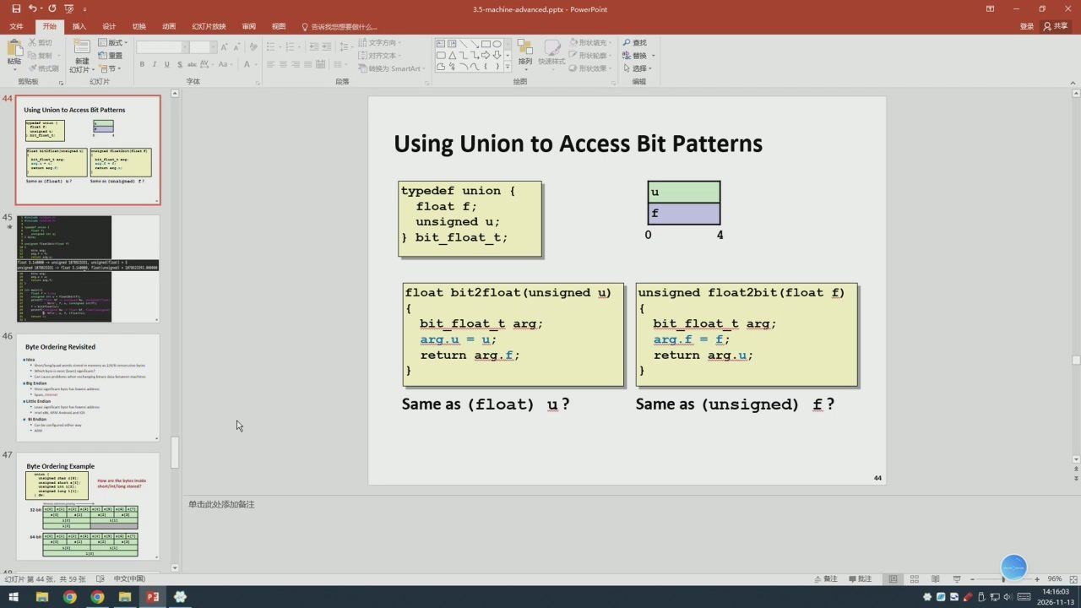
44/142 · 47:53
Notes:
日.
AA
P查找
自重置
形状轮
普换
红灯片·节
给图
Using Union toAccess BitPattes
UsingUnion toAccessBitPatterns
typedefunion{
floatf;
unsigned u;
bit_float_t;
float bit2float(unsignedu)
unsigned float2bit(float f)
bit_float_t arg;
bit_float_targ;
arg.u=u;
arg.f=f;
Byte Ordering Revisited
return arg.f;
return arg.u;
Sameas(float)u?
Sameas(unsigned) f?
Byte Orderin

Slide 46
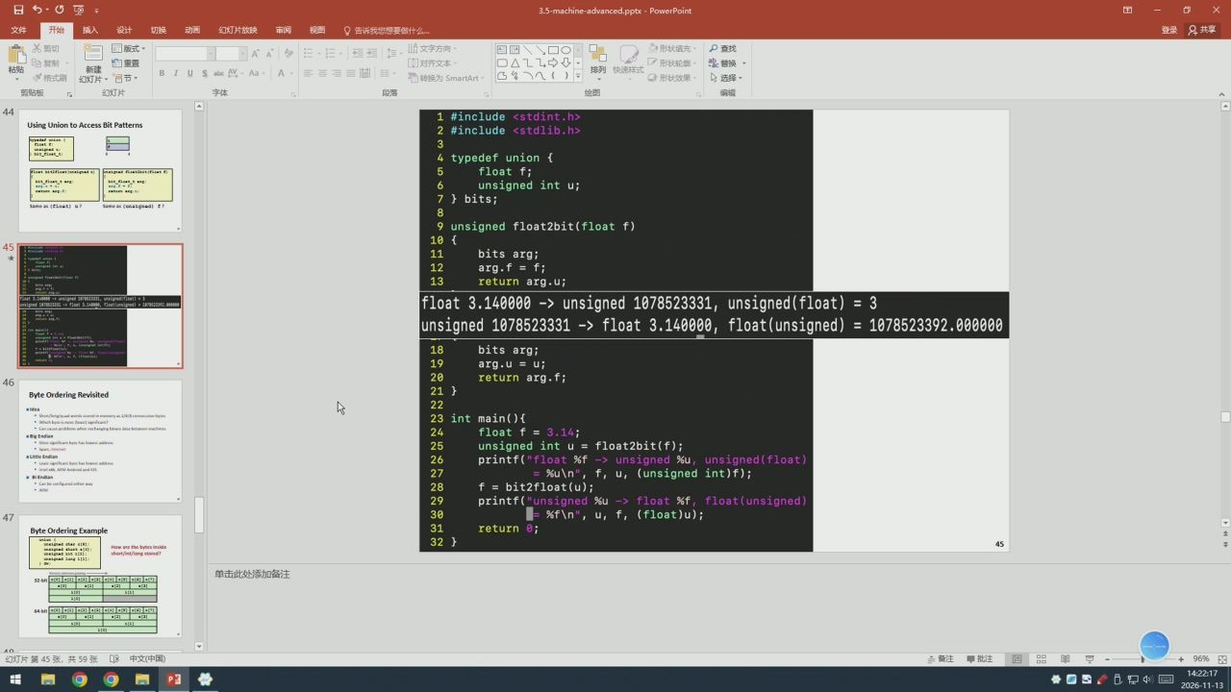
45/142 · 54:07
Notes:
AA
形状墙充
自重置
形状轮
红灯片·节
转接为SmartArt
1#include
Using Union to Access Bit Patterns
<stdint.h>
2#include <stdlib.h>
4typedef union{
float f;
unsigned int u;
7}bits;
unsigned float2bit（floatf)
bits arg;
arg.f=f;
return arg.u;
float 3.140000->unsigned 1078523331,unsigned（float)=3
unsigned 1078523331->float 3.140000,float（unsigned)=1078523392.000000
bits arg;
arg.u=u;
return arg.f;
Byte Ordering Revisited
ldea
int main（）
floatf=3.14;
unsignedintu=float2bit（f);
printf("float %f ->unsigned %u,unsigned（float)
=%u\n",f，u，（unsignedint）f);
f=bit2float（u);
printf("unsigned %u
float %f,
float(unsigned)
=%f\n²，u，f，（float)u）;
Byte Ordering Ex
return0;
+96%

Slide 47
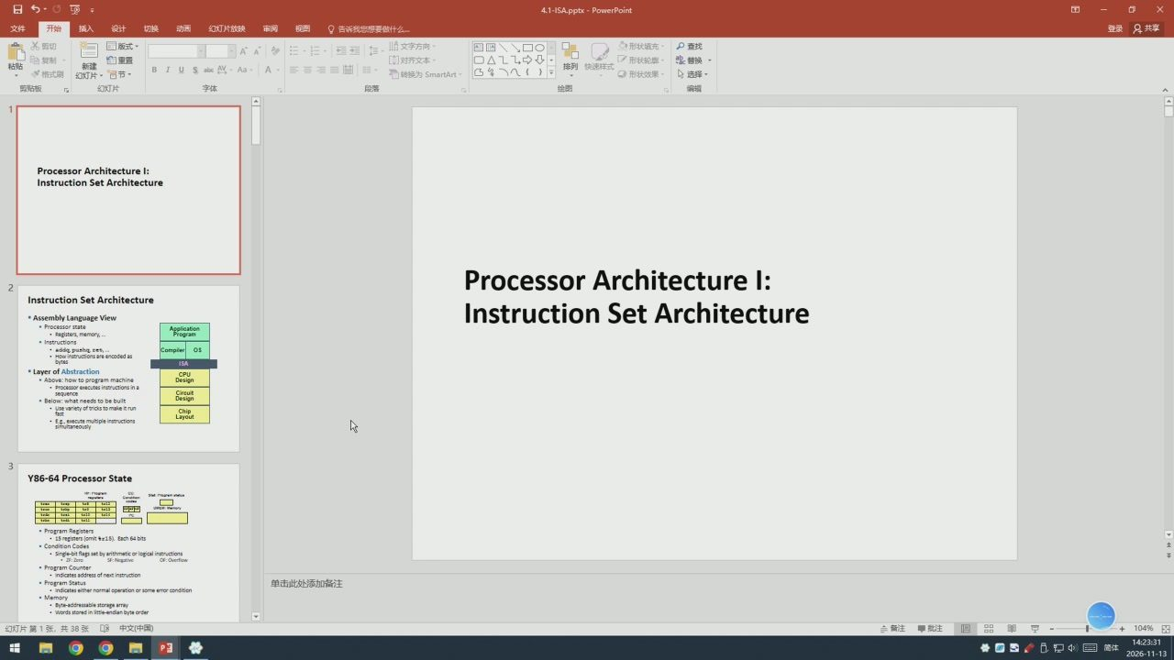
46/142 · 55:21
Notes:
想要做什么
登录只共享
四国
自重置
形状轮
普换
红灯片·节
IUSa
转接为SmartArt
红灯片
给图
ProcessorArchitecturel:
InstructionSetArchitecture
Processor Architecturel:
InstructionSetArchitecture
Assembly Language View
InstructionSetArchitecture
Processor state
ed as
Layer of Abstraction
ve:how to program n
eedstobe bult
Bel
Y86-64ProcessorState
ProgramRegisters
ht +z1.5) Each 64 bits
dition Codes
Ed

Slide 48
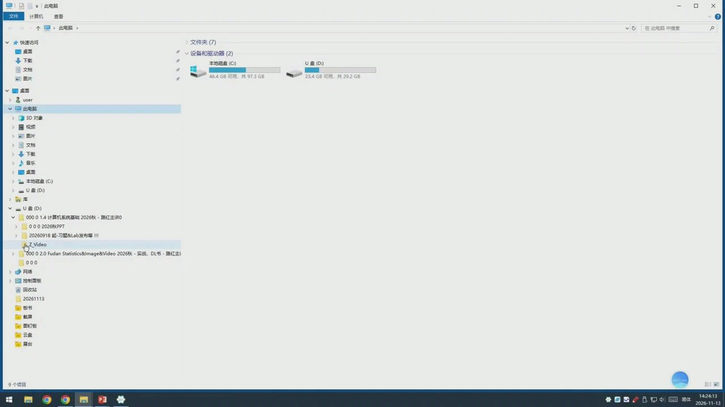
47/142 · 56:03
Notes:
此电脑
计算机
查看
个，此电脑
在此电脑中搜索
快速访问
文件夹（7）
设备和驱动器（2）
本地磁盘（C:)
U盘（D:)
文档
46.4GB可用，共97.3GB
23.4GB可用，共29.2GB
点面
此电脑
30对象
规损
>图片
国文档
音乐
点面
本地磁盘（C）
(q）n<
U（D)
000
20260918起-习题&Lab发布等!
Z.Video
o002.0Fudan Statistics&lmage&Video 2026秋-实战，DL书-路红主
000
网络
控制面板
回收站
20261113
板书
图钉板
展台

Slide 49
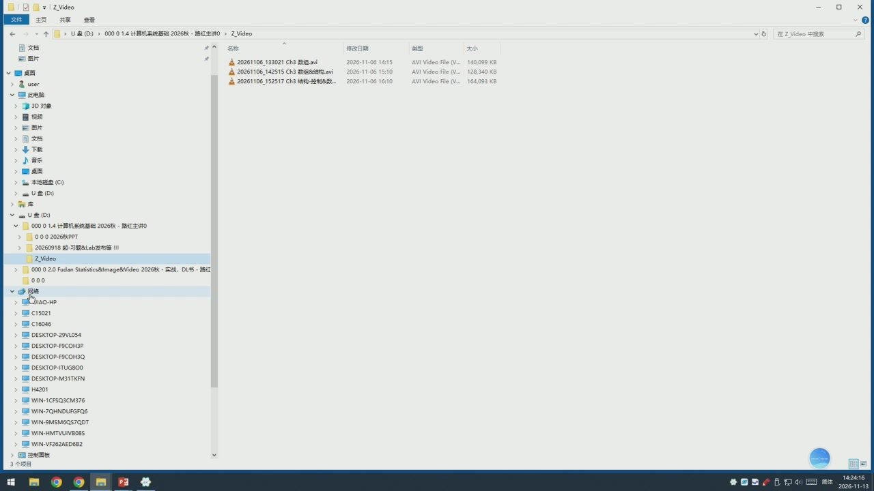
48/142 · 56:06
Notes:
主页
查看
在Z_Video中搜索
文档
名称
修改日期
类型
大小
20261106_133021Ch3数组.avi
2026-11-06 14:15
AVI Video Fle (V...
140,099 KB
点面
20261106_142515 Ch3数8结构.avi
2026-11-06 15:10
AVI Video File (V.
128,340KB
&user
20261106_152517Ch3结构-控制&数
2026-11-06 16:10
AVI Video Fle (V164,093 KB
此电脑
3D对象
规绩
文档
音乐
点面
本地磁盘（C)
(a）n<
U典(D)
00001.4计算机系统基础2026秋-路红主讲0
000
20260918起-习题&Lab发布等
z.Video
>000 02.0Fudan Statistics&lmage&Video 2026秋·实战.DL书-路红
000
网络
IAO-HP
C15021
C16046
DESKTOP-29VL054
DESKTOP-F9COH3P
DESKTOP-ITUG800
H4201
>控制面板

Slide 50

49/142 · 56:14
Notes:
日.
告诉我您
想要做什么
登录只共享
雨切
自重置
形状轮
幻灯片·节
给图
Crafting anROBAttack Strig
Union Allocation
Allocateaccordingtolargestelement
Canonlyuseonefield atatime
Today
union U1{
charc;
i[0]
i[1]
inti[2];
doublev;
*up;
up+o
up+4
up+8
struct S1
char c;
Union Allocation
int i[2];
doublev;
*sp;
3bytes
i[0]
i[1]
4bytes
o+ds
sp+4
sp+8
sp+16
sp+24
Using Union to Access Bit Patterns
灯片第43张，共59张
备注批注
品单
+96%

Slide 51
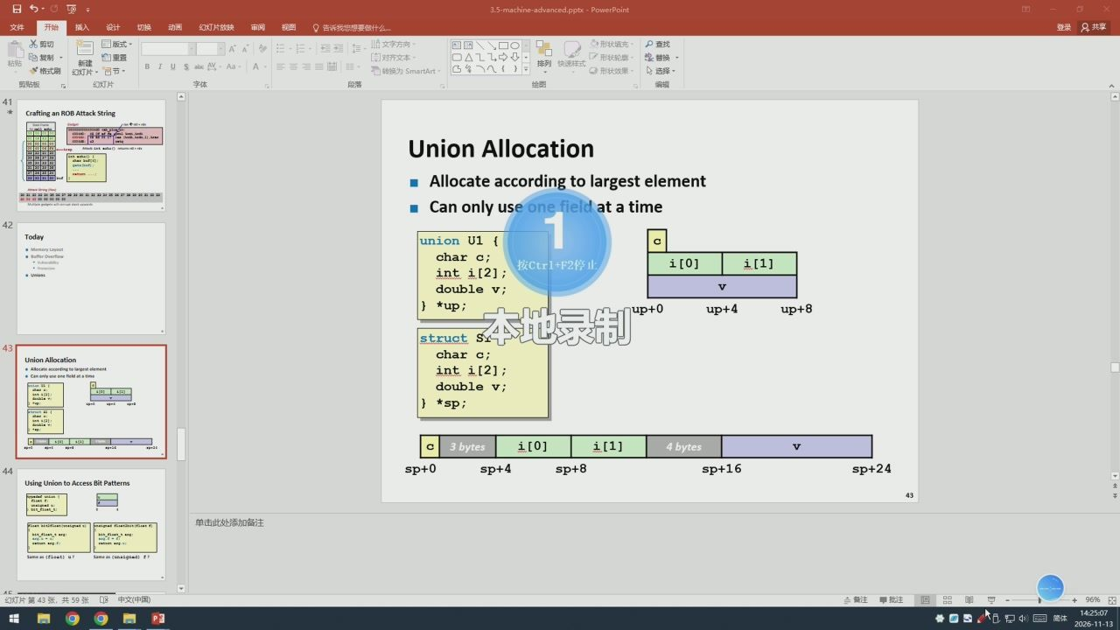
50/142 · 56:57
Notes:
想要做什
登录只共享
自重置
形状轮
普换
红灯片·节
US
给图
Crafting an ROB Attack String
Union Allocation
Allocateaccordingtolargestelement
Canonlyuse
ldatatime
Today
union U1{
charc;
按Ctr1+F2停止
i[0]
i[1]
inti[2];
doublev;
*up;
本地录制
up+o
up+4
up+8
struct
char c;
Union Allocation
inti[2];
doublev;
*sp;
3bytes
i[0]
i[1]
4bytes
0+ds
sp+4
8+ds
sp+16
sp+24
Using Union to Access Bit Patterns
as(float) u
幻灯片簧43张，共59张

Slide 52
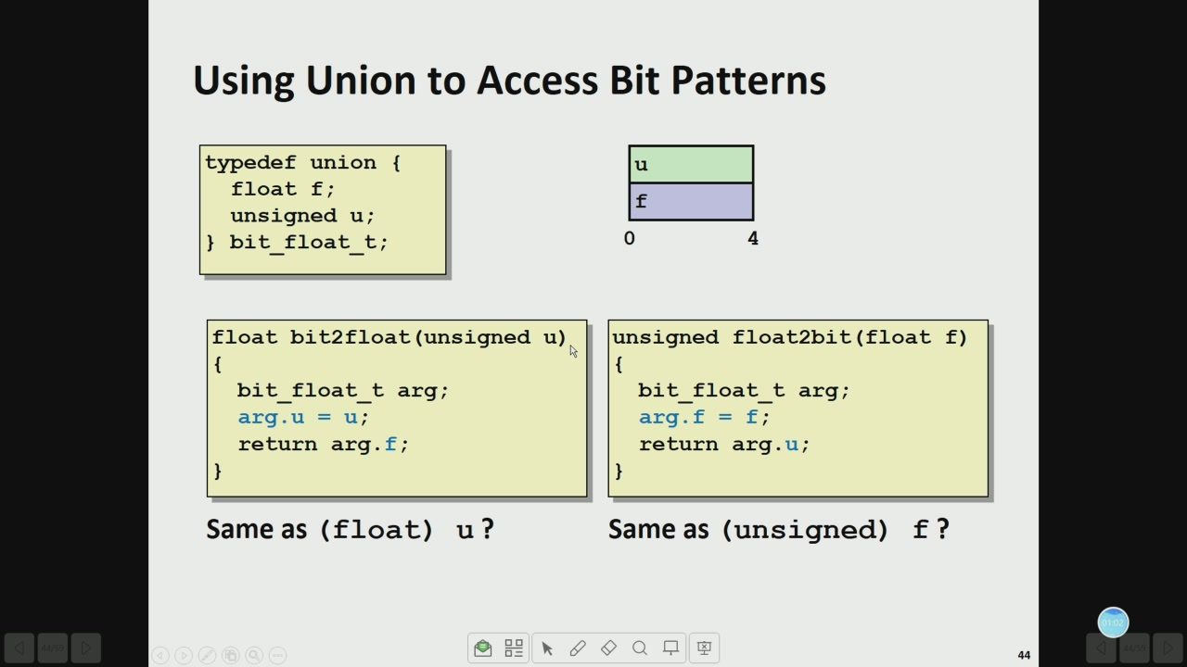
51/142 · 58:00
Notes:
Using Union to Access Bit Patterns
typedef union {
float f;
unsigned u;
bit float_t;
float bit2float(unsigned u)
unsigned float2bit(float f)
bit float_t arg;
bit float_t arg;
arg.u = u;
arg.f =f;
return arg.f;
return arg.u;
Same as (float) u?
Sameas(unsigned) f?

Slide 53

52/142 · 59:18
Notes:
1 #include <stdint.h>
2#include <stdlib.h>
4typedefunion{
float f;
unsigned int u;
}bits;
unsigned float2bit（float f)
bits arg;
arg.f=f;
return arg.u;
float bit2float(unsigned u)
bits arg;
arg.u=u;
return arg.f;
int
main(）{
float f=3.14;
unsigned intu=float2bit（f);
printf("float %f -> unsigned %u,unsigned（float)
=%u\n"，f，u,（unsigned int)f);
f=bit2float（u);
printf("unsigned %u -> float %f,float（unsigned)
=%f\n"，u，f，（float）u）;
return 0;

Slide 54

53/142 · 61:01
Notes:
Byte Ordering Revisited
Idea
Short/long/quadwordsstoredinmemoryas2/4/8consecutivebytes
Whichbyteismost(least)significant?
Cancauseproblemswhenexchangingbinarydatabetweenmachines
BigEndian
Mostsignificantbytehaslowestaddress
Sparc,Internet
LittleEndian
Leastsignificantbytehaslowestaddress
Intelx86,ARMAndroidand1os
Bi Endian
Canbe configured eitherway
ARM

Slide 55

54/142 · 61:40
Notes:
Byte Ordering Example
union
unsigned char c[8];
Howarethebytes inside
unsigned short s[4];
unsigned int i[2];
short/int/long stored?
unsigned long l[1];
dw;
Memory addressesgrowing
32-bit
c[0]
c[1]
c[2]
c[3]
c[4]
c[5]
c[6]
c[7]
s[0]
s[1]
s[2]
s[3]
i[0]
i[1]
1[0]
64-bit
c[0]
c[1]
c[2]
c[3]
c[4]
c[5]
c[6]
c[7]
s[0]
s[1]
s[2]
s[3]
i[0]
i[1]
1[0]

Slide 56

55/142 · 62:10
Notes:
Byte Ordering Example (Cont).
int j;
for（j=0;j<8;j++)
dw.c[j]=0xf0+j;
printf("characters 0-7=
[0x%x,0x%x,0x%x,0x8x,0x%x,0x8x,0x%x,0x8x]1n",
dw.c[0]，dw.c[1],dw.c[2]，dw.c[3],
dw.c[4]，dw.c[5],dw.c[6]，dw.c[7]);
printf("Shorts 0-3 ==[0x%x,0x%x,0xx,0x%x]\n",
dw.s[0], dw.s[1], dw.s[2], dw.s[3]);
printf("Ints 0-1 ==[0xx,0xx]\n",
dw.i[0],dw.i[1]);
printf（"Long 0==[0x%lx]\n",
dw.1[0]);

Slide 57

56/142 · 63:10
Notes:
Byte Ordering on lA32
Little Endian
fo
f1
c[0]
c[1]
c[2]
c[3]
c[4]
c[5]
c[6]
c[7]
s[0]
s[1]
s[2]
s[3]
i[0]
i[1]
1[0]
LSB
MSBLSB
MSB
Print
Output:
Characters0-7
==
[0xf0,0xf1,0xf2,0xf3,0xf4,0xf5,0xf6,0xf7]
Shorts
0-3
==
[0xf1f0,0xf3f2,0xf5f4,0xf7f6]
Ints
0-1
==
[0xf3f2f1f0,0xf7f6f5f4]
Long
[0xf3f2f1f0]
。口

Slide 58

57/142 · 64:22
Notes:
Byte Ordering on x86-64
Little Endian
fo
f1
f7
c[0]
c[1]
c[2]
c[3]
c[4]
c[5]
c[6]
c[7]
s[0]
s[1]
s[2]
s[3]
i[0]
i[1]
1[0]
LSB
MSB
Print
Output on x86-64:
Characters0-7
==
[0xf0,0xf10xf2,0xf3,0xf4,0xf5,0xf6,0xf7]
Shorts
0-3
==
[0xf1f0,0xf3f2,0xf5f4,0xf7f6]
Ints
0-1
==
[0xf3f2f1f0,0xf7f6f5f4]
Long
[0xf7f6f5f4f3f2f1f0]

Slide 59

58/142 · 64:24
Notes:
Summary of Compound Types in C
Arrays
Contiguous allocation of memory
Aligned to satisfy every element's alignment requirement
Pointertofirstelement
No bounds checking
Structures
Allocatebytesinorderdeclared
Padinmiddleand atendtosatisfyalignment
Unions
Overlaydeclarations
Waytocircumventtypesystem

Slide 60

59/142 · 65:00
Notes:
Summary
MemoryLayout
BufferOverflow
Vulnerability
Protection
CodeInjectionAttack
Return Oriented Programming
Unions

Slide 61

60/142 · 65:02
Notes:
Exploits Based on Buffer Overflows
Bufferoverflowbugscanallowremotemachinestoexecute
arbitrarycodeonvictim（受害者）machines
Distressinglycommoninrealprograms
Programmerskeepmakingthesamemistakes
Recentmeasuresmaketheseattacksmuchmoredifficul
Examplesacrossthedecades
Original"Internetworm"（1988)
“IMwars"(1999)
...and many,many more
Youwilllearnsomeofthetricksinattacklab
Hopefully to convince you to never leave such holes in your programs!!

Slide 62

61/142 · 65:20
Notes:
告诉我
P查找
自重置
形状轮
普换
US
给图
Example 2: IM War
1999
Example: the original Internet worm(1988)
Exploitedafewvulnerabilitiestospread
Earlyversionsof thefingerserver(fingerd)usedgets()toread the
argumentsentbytheclient:
.fingerdroh@cs.cmu.edu
Wormattackedfingerdserverbysendingphonyargument:
.finger
"exploit-code
padding
new-return-
address"
exploitcode:executedarootshellon thevictimmachinewitha
directTCPconnectionto theattacker.
Onceonamachine,scannedforothermachinestoattack
invaded~6000computersinhours(10%oftheInternet)
seeJune1989articleinComm.oftheACM
theyoungauthorof thewormwasprosecuted..
andCERTwasformed..stillhomedatCMU
Aside:Wor
and Virus
Phony：假的
Prosecute:prosecute

Slide 63

62/142 · 65:24
Notes:
红灯片放映
告诉我
自重置
形状轮
普换
幻灯片·节
IUS
红灯片
给图
Example: the original Internet worm (1988)
Example:the original Internetworm(1988)
Exploitedafewvulnerabilitiestospread
Earlyversionsof thefingerserver(fingerd)usedgets()toread the
Example 2: IM War
argumentsentbytheclient:
.fingerdroh@cs.cmu.edu
Wormattackedfingerdserverbysendingphonyargument:
.finger"exploit-code
padding
new-return-
address"
exploitcode:executedaroot shellon thevictimmachine with a
directTCPconnectiontotheattacker.
Onceonamachine,scannedforothermachinestoattack
invaded~6000computersinhours(10%oftheInternet)
seeJune1989articleinComm.oftheACM
theyoungauthorof thewormwasprosecuted..
andCERTwasformed..stillhomedatCMU
Phony:假的
Prosecute:prosecute

Slide 64

63/142 · 66:09
Notes:
Instruction Set Architecture
Assembly LanguageView
Processorstate
Application
·Registers,memory,...
Program
Instructions
addg, pushg, ret,...
Compiler
OS
Howinstructions areencoded as
bytes
ISA
LayerofAbstraction
CPU
Above:how toprogram machine
Design
·Processor executes instructions ina
sequence
Circuit
Design
Below:whatneedstobebuilt
Usevarietyoftrickstomakeitrun
Chip
fast
Layout
E.g.,execute multiple instructions
simultaneously

Slide 65

64/142 · 69:23
Notes:
Y86-64ProcessorState
RF:Program
CC:
Condition
Stat:Program status
registers
&rsp
codes
&rax
8r8
8r12
&rcx
8r13
ZFSFOF
DMEM:Memory
8rdx
&rsi
8r10
8r14
PC
&rbx
&rdi
8r11
ProgramRegisters
·15registers（omit%r15).Each64bits
ConditionCodes
·Single-bit flags set by arithmeticor logical instructions
·ZF:Zero
SF:Negative
OF:Overflow
ProgramCounter
Indicatesaddressofnextinstruction
ProgramStatus
Indicateseithernormaloperationorsomeerrorcondition
Memory
Byte-addressablestoragearray
Wordsstoredinlittle-endianbyteorder

Slide 66

65/142 · 70:37
Notes:
How to Encode the Instructions?
mov, add, mul, call, ret, push, pop ...
How many bytes to represent instructions?
What is it like for mov %rax, %rbx?
What is it like for mov %rax, 8(%rbx)?
Whatisit likeforjne$0x32731323?
Q口

Slide 67

66/142 · 74:38
Notes:
Encoding Registers
Eachregisterhas4-bitID
&rax
8r8
&rcx
8r9
&rdx
8r10
&rbx
8r11
&rsp
8r12
&rbp
&r13
&rsi
8r14
&rdi
NoRegister
■Same encoding as in x86-64
Register ID 15(0xF) indicates“no register"
·Will use this in our hardware design in multiple places

Slide 68

67/142 · 76:11
Notes:
Arithmetic and Logical Operations
InstructionCode
FunctionCode
Add
Refer to generically as
addq rA，rB
rArB
"OPq"
Encodings differ only by
Subtract(rAfrom rB)
"function code"
subq rA，rB
1rArB
·Low-order4bitsinfirst
instructionword
And
Set condition codes as side
effect
andq rA,rB
rArB
Exclusive-Or
xorq rA，rB
rArB

Slide 69

68/142 · 76:34
Notes:
MoveOperations
Register→Register
rrmovqrA,rB
rArB
Immediate>Register
irmovqV,rB
Register→Memory
rmmovqrA,D(rB)
rArB
Memory>Register
mrmovqD(rB),rA
rArB
· Like the x86-64 movq instruction
■ Simpler format for memory addresses
·Give different names tokeep them distinct
Q口

Slide 70

69/142 · 77:49
Notes:
Move Instruction Examples
X86-64
Y86-64
movq $0xabcd,8rdx
irmovq $0xabcd，
ordx
Encoding:
30f2cdab000000000000
movq &rsp,
&rbx
rrmovq
Encoding:20 43
movg -12（%rbp）,8rcx
mrmovg -12（8rbp）,8rcx
Encoding:5015f4ff ffffffff ffff
movg 8rsi,0x41c(8rsp)
rmmovq &rsi,0x41c（8rsp)
Encoding:40641c04000000000000

Slide 71

70/142 · 78:47
Notes:
Jump Instructions
Jump(Conditionally)
jxxDest
7fn
Dest
Refer to generically as "j xx"
Encodings differ only by "function code" fn
Basedonvaluesofconditioncodes
Sameasx86-64counterparts
Encodefulldestinationaddress
·UnlikePC-relative addressingseen inx86-64

Slide 72

71/142 · 79:38
Notes:
Y86-64 Program Stack
Stack
Region of memory holding
"Bottom"
program data
Used inY86-64 (and x86-64) for
supporting procedure calls
· Stack top indicated by %rsp
·Address of topstackelement
Increasing
Addresses
Stackgrowstowardlower
addresses
·Top element is at highest address
in the stack
Whenpushing,mustfirst
decrementstackpointer
·After popping, increment stack
Stack"Top"
pointer

Slide 73

72/142 · 80:17
Notes:
StackOperations
pushqrA
rA
Decrement%rspby8
· Store word from rA to memory at %rsp
■Like x86-64
popqrA
· Read word from memory at %rsp
■Save in rA
■ Increment %rsp by 8
■Like x86-64

Slide 74

73/142 · 82:25
Notes:
How to Test the Push/Pop Order
Decrease %rsp -> store word?
Storeword ->Decrease%rsp?
Exercise 4.7
P255

Slide 75

74/142 · 86:52
Notes:
Status Conditions
Mnemonic
Code
·Normal operation
AOK
Haltinstructionencountered
Mnemonic
Code
HLT
Bad address(eitherinstruction or data)
Mnemonic
Code
encountered
ADR
Invalidinstructionencountered
Mnemonic
Code
INS
Desired Behavior
· If AOK, keep going
· Otherwise, stop program execution

Slide 76

75/142 · 89:00
Notes:
Y86-64 Code Generation Example
-First Try
-Problem
Write typical array code
Hardtodoarrayindexingon
Y86-64
·Since don't have scaled
Find number of elements in
addressingmodes
null-terminated list */
long len(long a[])
L3:
long len;
addg $1,8rax
for（len=0;a[len];len++)
bduo
$0，(8rdi，&rax,8)
jne L3
return len;
Compilewithgcc-og -s

Slide 77

76/142 · 90:51
Notes:
Y86-64 Code Generation Example #2
"Second Try
"Result
WriteCcodethatmimics
Compilergeneratescode
expectedY86-64code
withlesscomplexaddress
computationinstructions
1ong len2（long *a)
CanhelpwriteY86code
longip=
(long)a;
long
val =*（long *) ip;
L3:
long len=0;
leaq
8（%rdi)，&rdx
while(val){
bAou
%rdx，%rdi
ip += sizeof(long);
addq
$1,%rax
len++;
bAou
(%rdx），&rdx
val =*(long *)ip;
return len;

Slide 78

77/142 · 92:22
Notes:
Y86-64 Code Generation Example #3
len:
irmovq $1，%r8
Constant 1
irmovq $8, &r9
Constant 8
irmovq $0,%rax
len=0
mrmovq（%rdi)，&rdx
val=*a
Register
Use
andg &rdx，&rdx
#Test val
#If zero， goto Done
ordi
je Done
Loop:
&rax
len
addq %r8，%rax
len++
8rdx
val
addg &r9，&rdi
a++
#val=*a
8r8
mrmovg（%rdi)，%rdx
andg &rdx，rdx
#Test val
8r9
jne Loop
# If !o， goto Loop
Done:
ret

Slide 79

78/142 · 94:32
Notes:
Y86-64 Program Structure #2
init:
# Set up stack pointer
Programstarts at
irmovq Stack, &rsp
address 0
# Execute main program
call Main
Mustsetupstack
# Terminate
Mustinitializedata
halt
Can use symbolic
# Array of 4 elements + terminating 0
names
.align8
Array:
.quad0x000do00doo0doood
.quad 0x00c0o0c000c0ooco
.quad
Ox0b0oob000b0o0b00
.quad 0xa000a000a000a000
quado

Slide 80

79/142 · 95:28
Notes:
Assembling Y86-64 Program
unix> yas len.ys
Generates “object code" file len.yo
·Actuallylookslikedisassembleroutput
0x054:
len:
0x054:30f80100000000000000
irmovq $1，&r8
#Constant 1
0x05e:
30f90800000000000000
irmovq $8，&r9
# Constant 8
0x068:30f00000000000000000
irmovq $0,&rax
#len=0
0x072:
50270000000000000000
mrmovg（&rdi），&rdx
#val=*a
0x07c:
6222
andq &rdx，&rdx
#Test val
0x07e:
73a000000000000000
je Done
# If zero, goto Done
0x087:
:doOT
0x087:
6080
addg &r8，&rax
#len++
0x089:
6097
addq &r9，&rdi
#a++
0x08b:
50270000000000000000
mrmovq （8rdi），&rdx
#val=*a
0x095:
6222
andq &rdx，&rdx
#Test val
0x097:
748700000000000000
jne Loop
#If ！o，goto Loop
0x0a0:
Done:
0x0a0:90
ret

Slide 81

80/142 · 96:49
Notes:
Simulating Y86-64 Program
unix> yis len.yo
Instructionsetsimulator
Computeseffectofeachinstructiononprocessorstate
Printschangesin statefrom original
Stopped in 33 stepsat PC=0x13.
=O==
Changes
to registers:
&rax:
0x0000000000000000
0x0000000000000004
&rsp:
Ox0000000000000000
0x0000000000000100
&rdi:
Ox0000000000000000
0x0000000000000038
8r8:
Ox0000000000000000
0x0000000000000001
8r9:
Ox0000000000000000
0x0000000000000008
Changes to memory:
Ox00f0:0x0000000000000000
0x0000000000000053
Ox00f8:0x0000000000000000
0x0000000000000013

Slide 82

81/142 · 97:31
Notes:
Cisc Instruction Sets
ComplexInstructionSetComputer
■ IA32 is example
Stack-oriented instructionset
· Use stack to pass arguments, save program counter
Explicitpushandpopinstructions
Arithmeticinstructionscan accessmemory
addq %rax, 12(%rbx,%rcx,8)
·requiresmemoryreadandwrite
·Complexaddresscalculation
Condition codes
Setassideeffectofarithmeticandlogicalinstructions
Philosophy
■ Add instructions to perform "typical" programming tasks

Slide 83

82/142 · 99:30
Notes:
RISC Instruction Sets
Reduced InstructionSetComputer
■ Internal project at IBM, later popularized by Hennessy
(Stanford) and Patterson (Berkeley)
Fewer,simplerinstructions
Might takemore togetgiven task done
Canexecutethemwithsmallandfasthardware
Register-oriented instruction set
■Many more (typically 32) registers
· Use for arguments, return pointer, temporaries
Only load and store instructions can accessmemory
■ Similar to Y86-64 mrmovq and rmmovq
No Condition codes
TestinstructionsreturnO/1 inregister

Slide 84

83/142 · 101:13
Notes:
MiPs Instruction Examples
R-R
Op
Ra
Rb
Rd
00000
Fn
addu $3,$2,$1
#Register add:$3=$2+$1
R-1
op
Ra
Rb
Immediate
addu $3,$2,3145
Immediate add:$3=$2+3145
s11 $3,$2,2
Shiftleft:$3=$2<<2
Branch
Op
Ra
Rb
offset
beq $3,$2,dest
#Branch when $3 =$2
Load/Store
Op
Ra
Rb
offset
1w $3,16($2)
#Load Word:$3=M[$2+16]
SW $3,16($2)
#Store Word:M[$2+16]=$3

Slide 85

84/142 · 102:05
Notes:
CISC vs. RISC
Original Debate
· Strong opinions!
CisCproponents---easyforcompiler,fewercodebytes
RISC proponents---better for optimizing compilers, can
make run fast with simple chip design
CurrentStatus
■ For desktop processors, choice of IsA not a technical issue
·With enough hardware,can make anythingrun fast
·Codecompatibilitymoreimportant
x86-64adoptedmanyRisCfeatures
·More registers; use them for argument passing
Forembeddedprocessors,RisCmakessense
·Smaller, cheaper, less power
·Mostcell phones useARM processor

Slide 86

85/142 · 102:19
Notes:
红灯片放映
告诉我
登录只共享
复制·
自重置
形状轮
BIUS
给图
MIPSInstruction Examples
CISC vs. RISC
B00000
adda$3,$2,$1
Register add:$3=$2+$1
adds$3,$2,3145
1ediateadd:5352+3145
11 $3,42,2
ift 1eft：322
Original Debate
OEfset
beq $3,$2,dest
Btarch whan $32
Strongopinions!
offset
CISCproponents---easy for compiler,fewer code bytes
2v 53,16($2)
Lond ord:$3H[216]
r $3,16($2)
Store Word:H[$2+16]=3
RIsCproponents--betterforoptimizingcompilers,can
makerunfastwithsimplechipdesign
CISCvs.RISC
-Original Debate
CurrentStatus
CISCproponents-easyforcomiler,fewercode bytes
·Strong opinions!
For desktop processors,choice of ISA nota technical issue
-Current Status
·Withenoughhardware,canmakeanythingrunfast
For desktog processors choice of ISAnotatecicalisue
Code comp
panblity more important
·Codecompatibilitymoreimportant
x86-64adopted manyRISCfestures
x86-64adoptedmanyRiSCfeatures
Mt M
Smaler,cpeespw
·Moreregisters;usethemforargumentpassing
Forembedded processors,RisCmakes sense
Summary
·Smaller,cheaper,lesspower
Y86-64Instruction Set Architecture
·MostcellphonesuseARMprocessor
Similar stateand instructions as x86-64
Smplerencodings
How Important is ISA Design?
Less now than before
·with enough hand
rggo fast
幻灯片第37张，共38张口8中文（中国）
Ed

Slide 87

86/142 · 102:25
Notes:
红灯片放映
登录只共享
复制·
自重置
形状轮
普换
红灯片·节
BIUS
给图
MIPS Instruction Examples
R-R
CISC vs. RISC
000
adds $3,$2,$1
Regiatet ad:3 =$2+1
Op
adds $3,$2, 3145
1ediate dd:53523145
11 $3,42,2
tt 1et:$3=22
Original Debate
OEfset
beq $3,$2,dest
Btach hen 3$2
Strongopinions!
Oset
CISC proponents---easy for compiler,fewer code bytes
2r $3,16($2)
Load Word:$3[s216]
r $3,16($2)
Store Word:H[$2+16]=3
RIsCproponents--betterfor optimizingcompilers,can
makerunfastwith simplechipdesign
CISCvs.RISC
-Original Debate
Curre
isuoudoBons.
EV录屏
CISCprponent-syforcoile,fewercodebyes
Fo
-Current Status
FordeskpprcesrshcefIntatecialisue
常规
视频名
时长
大小
更多
Code compatblity more important
20261113_133022 Ch3-Advanced
x86-64adopted many RISCfestures
W6061
2026/11/13 13:30
x8
三列表
1.avi
Smalerchpeesspwe
20261113,14250.v
2026/11/13 14:25
Most cll phnes useARM prceor
Fo
会员
Summary
Y86-64 Instruction Set Architecture
Similrstateandinstrctionsasx86-64
Somewhere betweenCISCandRISC
Simplerencodings
How Important is ISA Design?
Less now than before
h2:56:00
时长：
声音：

Slide 88

87/142 · 103:05
Notes:
红灯片放映
机图
告诉我
临文字方向
四国
P查找
形状轮
自重置
张普换
红灯片
Example: the original Internet worm (1988)
Example: the original Internet worm (1988)
Exploitedafewvulnerabilitiestospread
Earlyversionsof thefingerserver(fingerd)usedgets()toread the
Example 2: IM War
argument sent bythe client:
.finger droh@cs.cmu.edu
Wormattackedfingerdserverbysendingphonyargument:
finger"exploit-code
padding
new-return-
address"
exploitcode:executedarootshellonthevictimmachinewitha
directTCPconnectiontotheattacker.
Onceonamachine,scannedforothermachinestoattack
invaded~6000computersinhours(10%oftheInternet)
seeJune1989articleinComm.oftheACM
theyoung author of thewormwasprosecuted...
andCERTwasformed.. stillhomedatCMU
Phony：假的
Prosecute:prosecute
红灯片第55张，共59张
鼻中S肉

Slide 89

88/142 · 103:14
Notes:
登录只共享
P查找
自重置
形状轮
普换
红灯片·节
红灯片
给图
ProcessorArchitecturell:
Logic Design
ProcessorArchitectureIl:
Logic Design
Overview of Logic Design
Fundamental Hardw
Bits are Our Friends
aleois.
Cveryehingespressed inte
aion
Digital Signals
spnal
Computing with Logic Gates
And
Not
ot=assb
ot=al1b
out=!a

Slide 90

89/142 · 103:23
Notes:
%切
自重置
形状轮
普换
红灯片·节
USa
红灯片
给图
SL
Random-AccessMemory
VBIA
Random-Access Memory
srcA
Read ports
Register
file
wWrite port
valB
sroB
Clock
Storesmultiplewordsofmemory
·Addressinputspecifieswhichword toreadorwrite
Registerfile
Register File Timing
·Holdsvaluesof programregisters
.rax,rsp,etc.
·Registeridentifierserves asaddress
·ID15(0xF) impliesno read or write performed
MultiplePorts
·Canread and/orwritemultiplewords inonecycle
·Each has separate address and data input/output
Summary
"Com
itation
*Storage
uslyttoputchang
Registers
access me
S中四

Slide 91

90/142 · 103:26
Notes:
2026
113
主页
查看
20261113
在20261113中搜索
名称
修改日期
类型
大小
音乐
3.5-machine-advanced.pptx
2024-10-18 0:51
Microsoft Powe
桌面
4.1-ISA.ppx
2025-11-07 10:28
Microsoft Power..
本地磁盘（C:)
42-logic-pptx
2025-11-14 13:27
Microsoft Power....
U盘（D:)
4.3-sequential.pptx
2024-11-01 13:48
Microsoft Power..
U盘（D)
00001.4计算机系统基础2026秋-路红主讲0
0002026秋PPT
2020年课程参考PPT
20260918起-习题&Lab发布等！!
z_Video
0000 2.0Fudan Statistics&lmage&Video 2026秋-实战，DL书-路红
000
网络
4JAO-HP
C15021
C16046
DESKTOP-29VL054
DESKTOP-F9COH3P
DESKTOP-F9COH3Q
DESKTOP-ITUG800
DESKTOP-M31TKFN
H4201
WIN-1CFSQ3CM376
WIN-7QHNDUFGFQ6
WIN-9MSM6QS7QDT
WIN-HMTVUIVB08S
WIN-VF262AED6B2
控制面板
回收站
20261113
板书
西钉板
选中1个项目319KB

Slide 92

91/142 · 103:47
Notes:
告诉我
四园
自重置
形状轮
贴贴
给图
SEQSummary
SEQ
Operation
#4
Implementation
state set
Expresseveryinstructionasseriesofsimplesteps
Follow same general flowfor each instruction type
Assembleregisters,memories,predesigned combinational
HH
blocks
SEQ
Operation
Connectwithcontrollogic
#5
Limitations
Tooslowtobepractical
In one cycle,must propagate through instruction memory,
registerfile,ALU,and datamemory
SEQ Summary
Wouldneed torunclockveryslowly
Hardwareunitsonly activeforfractionofclockcycle
Nble registers, r
ories, predesigned con
-Limitations
Would need tounclock ery slw
dware units only active for f
幻灯片第59张，共59张8中文（中国）
S中
Ed

Slide 93

92/142 · 103:50
Notes:
20261113
主页
查看
20261113
在20261113中搜索
名称
类型
大小
音乐
3.5-machine-advanced.pptx
2024-10-18 0:51
Microsoft Pow
桌面
4.1-ISA.ppx
2025-11-07 10:28
Microsoft Power..
本地磁盘（C)
4.2-logic-pptx
2025-11-1413:27
Microsoft Power..
U盘（D:)
4.3-sequential.ppx
2024-11-01 13:48
Microsoft Power...
U（D)
00001.4计算机系统基础2026秋-路红主讲0
2020年课程参考PPT
20260918起-习题&Lab发布等！！
zVideo
00002.0Fudan Statistics&lmage&Video 2026秋-实战，DL书-路红
000
网络
4JIAO-HP
C15021
C16046
DESKTOP-29VL054
DESKTOP-F9COH3P
DESKTOP-F9COH3Q
DESKTOP-ITUG800
DESKTOP-M31TKFN
H4201
WIN-1CFSQ3CM376
WIN-7QHNDUFGFQ6
WIN-9MSM6QS7QDT
WIN-HMTVUIVB08S
WIN-VF262AED6B2
控制面板
回收站
20261113
板书
西钉板
S中

Slide 94

93/142 · 106:03
Notes:
新标签页
elearning.fudan.el
完成更新
elearning.fudan.e-BaiDu搜
欢迎使用eLearning-elearning.fudan.edu.cn
应用商店
S英四品管照
Ed

Slide 95

94/142 · 106:10
Notes:
录像指
复旦大学统一身份认证
ne=6e6466d6f563406ca6d124cca2d53ad8
陶☆
完成更新
Language:
简体中文
微信扫码登录
统一身份认证
请使用微信扫码登录
激活/忘记密码
刷新二维码
友情链接：eHallEcampusEmailCloud@Fudan
Copyright复旦大学版权所有，联系我们：urp@fudan.edu.cn（B6）021-65643207
5英四品管照

Slide 96

95/142 · 106:29
Notes:
控制面板
控制面板
未指定截止日期
此处似乎没有任何内容
前往卡片视图仪表板|添加待办事项
信息办

Slide 97

96/142 · 106:33
Notes:
录像指南
CS10005.01计算机系统基础
eleaning.fudan.edu.cn/courses/114573
完成更新
CS10005.01计算机系统基础大纲
6d学生视图
2026-2027学年第-
CS10005.01计算机系统基础
返回今日
导入现有内容
公告
选择主页
教学大纲页面以表格形式展示了课程进度以及课程评分的标准。您可以添加其它评论、注释或有关课程结构的想法，课程条款或其他内容。
作业
山查看课程流
讨论
如需添加说明，请点击顶部的“编辑“链接。labels：
新公告
评分
课程总结：
查看课程通知
人员
详细信息
截止时间
页面
待办事项
星期四2026年9月24日
到期时间23:59
评改第二章习题
星期三2026年10月7日
到期时间23:59
100分·10月28日23:59
星期三2026年10月28日
评改LAB2
结果
到期时间23:59
100分·无截止时间
评价量规
评改LAB3
测验
100分·无截止时间
LAB3
单元
十一月2026
设置
作业权重未确定。

Slide 98

97/142 · 106:38
Notes:
录像指南
urses/114573/files/folder/0-课件及补充材料
完成更新
2026-2027学年第一学期
CS10005.01计算机系统基础文件>0-课件及补充材料
主页
公告
搜索文件
已选定0项
+文件夹
上传
作业
讨论
CS10005.01计算机系统基础
标题
创建时间
修改时间
修改人
大小
0-课件及补充材料
评分
补充材料
2026年9月11日
2026年9月11日
路红
2.9MIB
人员
课件PDF文件
页面
LAB
2.1-bits-ints-part1.pptx
2026年9月9日
2026年9月9日
路红
565KIB
习题
已上传的媒体
教材
2.2-bits-ints-part2.pptx
2026年9月9日
2026年9月9日
路红
597KiB
结果
评价量规
2.3-float-2.pptx
2026年10月16日
2026年10月16日
路红
347 KiB
测验
cs-2.pptx
2026年10月16日
2026年10月16日
路红
4.7 MiB
单元
设置
rol.ppb
2026年10月16日
2026年10月16日
路红
228KiB
2026年10月16日
2026年10月16日
路红
1.6MiB
2026年10月16日
2026年10月16日
路红
686KIB
2026年10月16日
2026年10月16日
路红
926KiB
4.1-ISA.pptx
2026年11月6日
2026年11月6日
路红
134KiB
2026年11月6日
2026年11月6日
路红
254 KiB
2026年11月6日
2026年11月6日
路红
319KiB

Slide 99

98/142 · 110:40
Notes:
想要做什么
登录只共享
%切
口0
P查找
自重置
形状轮
普换
给图
HCL Word-Level Examples
ArithmeticLogicUnit
Control signal
OF
OF
OF
ZF
QuizTime!
Exercise 4.12
Combinationallogic-OneALu
P261
·Continuouslyrespondingtoinputs
Control signalselectsfunctioncomputed
·Corresponding to4 arithmetic/logical operations inY86-64
Alsocomputesvaluesforconditioncodes
Arithmetic Logic Unit
Combinstionl logic-One ALU
Storing1Bit
1002
幻灯片簧15张，共28张
S中四品管

Slide 100

99/142 · 110:46
Notes:
想要做什么
登录只共享
AA
四目
发制
自重置
形状轮
普换
红灯片·节
BIUSa
红灯片
给图
Storing1Bit
StoringandAccessing1Bit
BistableElement
R-SLatch
Q+
Q+
Physical Analogy
q=0or1
Resetting
Setting
storing
Storing and Accessing1 Bit
R- Latoh
数字电路中的latch（锁存器）是一种基本的存储单元，用于存储一位二进制信息（0或1）。以下是关于latch的详细解答：
1.latch的基本功能是存储数据，无需时钟信号的控制。当输入信号满足一定条件时，latch能够锁存输入信号的状态，并在输入信号变化时保持原有的状态不变。
2.latch的类型主要有两种：SR锁存器（Set-Resetlatch）和D锁存器（Datalatch）。
-SR锁存器由两个交叉反馈的NOR或NAND门组成，具有置位（Set）和复位（Reset）两个输入端。当S=1且R=0时，锁存错置位，输出为1；当S=0且R=1时，锁存器复位，输出为0。当S=R=0时，保持原状态；S=R=1时，处于禁止
状态，应避免出现。
D锁存器由一个输入端D（Data）和一个控制端E（Enable）组成。当E为高电平时，D锁存器将输入端D的数据锁存到输出端；当E为低电平时，输出保持不变。
3.latch的特点是简单、速度快，但存在以下问题：
由于latch对输入信号敏感，容易受到毛刺（glitch）的影响，导致电路不稳定。
1-Bit Latch （存率）
latch不具备时钟控制，因此在时序控制方面不如flip-flop（触发器）。
4.latch的应用场景包括：
作为存储单元，用于缓存数据。
S中四

Slide 101

100/142 · 111:01
Notes:
登录只共享
AA
四目
发制
自重置
形状轮
普换
红灯片·节
给图
Physical Analogy
1-Bit Latch（锁存器）
DLatch
Data
Storing and Accessing 1 Bit
Clock
Latching-Q+changes according tod
Storing-Q+will notchange
!d
1-Bit Latch（资存）
D锁存器由一个输入端D（Data）和一个控制端E（Enabl）组成。当E为高电平时，D锁存器将输入端D的数据锁存到输出端；当E为低电平时，输出保持不变。
3.latch的特点是简单、速度快，但存在以下问题：
由于latch对输入信号敏感，容易受到毛刺（glitch）的影响，导致电路不稳定。
latch不具备时钟控制，因此在时序控制方面不如flip-flop（触发器）。
4.latch的应用场景包括：
作为存储单元，用于缓存数据。
Transparent 1-Bit Latch
S中四

Slide 102

101/142 · 111:15
Notes:
红灯片放映
四目
自重置
形状轮
幻灯片·节
BIUS
转接为SmartArt
给图
Storing and Accessing 1 Bit
1-Bit Latch （锁存器）
R-SLath
DLatch
*0or1
Data
Clock
1-Bit Latch （锁存）
DLatch
Latching-Q+changes according tod
Storing-Q+will notchange
!d
atcr
Transparent 1-Bit Latch
D锁存器由一个输入端D（Data）和一个控制端E（Enable）组成。当E为高电平时，D锁存器将输入端D的数据锁存到输出端；当E为低电平时，输出保持不变。
Latehing
3.latch的特点是简单、速度快，但存在以下问题：
由于latch对输入信号敏感，容易受到毛刺（glitch）的影响，导致电路不稳定。
latch不具备时钟控制，因此在时序控制方面不如flip-flop（触发器）。
4.latch的应用场景包括：
-作为存储单元，用于缓存数据。
When in latchingmode,com
toQ+andO
Value latched depends on value of D as C falls
幻灯片第20张，共28张8中文（中国）
S中四管
Ed

Slide 103

102/142 · 111:43
Notes:
红灯片放映
告诉我您
想要做什么
登录只共享
口0
自重置
形状轮
普换
红灯片·节
USa
红灯片
给图
1-Bit Latch（锁行器）
DLath
Transparent1-BitLatch
Latching
ChangingD
!d
Q+
Time
Transparent 1-Bit Latch
Latching
Wheninlatchingmode,combinationalpropogationfromD
toQ+andQ-
ValuelatcheddependsonvalueofDasCfalls
When in latc
to Q+and Q
ingmode,comt
uoneu
Value latched depends onvalue of D as Cfalls
Edge-Triggered Latch
锁存器
所谓锁存器，就是输出端的状态不会随输入端的状态变化而变化，仅在有锁存信号时输入的状态才被保存到输出，直到下一个锁存信号到来时才改变。
由若干个钟控D触发器构成的一次能存储多位二进制代码的时序逻辑电路。数据有效退后于时钟信号有效。这意味着时钟信号先到，数据信号后到。在某些运算器电路中有时采用锁存器作为数据暂存器。
Latch电路结构
当E=1时，latch直传（transparent），D端信号的变化会即时反应在Q端；
当E=0时，latch关断（closed），Q端保持关断瞬间D端的值。
(https://blog.csdn.net/zgr1379747458/article/details/130504149)
·Value latched dep
Riaingdock dg*
on data as clock rises
ends
S中四

Slide 104

103/142 · 111:59
Notes:
登录只共享
自重置
形状轮
普换
红灯片·节
IUSa
给图
Transparent 1-Bit Latch
Edge-Triggered Latch
Latching
When in latch
to Q+ and Q-
Data
Value latched depends onvalueof Das Cfalls
Q+
Edge-Triggered Latch
Clock
Trigger
Only in latchingmode
forbriefperiod
·Rising clock edge
Valuelatcheddepends
on data asclockrises
Rising dockedge
Q+
Outputremainsstable
on data as clock rises
Time
atallothertimes
Registers
Cloek
Stores word of data
Collectiedereredhs
ifferntmprgre eenin
Ldsinptonringedgfock
S中四管

Slide 105

104/142 · 112:10
Notes:
红灯片放映
登录只共享
%切
自重置
形状轮
红灯片·节
USa
给图
Processor Architecture ll:
Logic Design
ProcessorArchitectureIl:
Logic Design
Overview of LogicDesign
Fundamental Hardware Requirements
Com
Computation
Howto ge alues frm one lace toanothr
·Storage
Bits are Our Friends
Everything expressed in ter
Communication
.Computation
Loworhigvotgenwire
Storage
Compute Booleanfun
Store bits of information
Digital Signals
Use vtgethreshldstetractscrete values rm
Simplestversion1-bisgnal
contin
nuous signal
erhigrnge(）orownge (o）)
whgadebeteethe
Not strnglyaffectedbyoiserlwqualtyircuit
幻灯片第1张，共28张中文（中国）
Canmake drcu
5中四

Slide 106

105/142 · 113:05
Notes:
红灯片放映
告诉我
想要做什么
登录只共享
口0
P查找
自重置
形状轮
普换
红灯片节
BIUS
转接为SmartArt
给图
Storing and Accessing 1 Bit
StoringandAccessing1Bit
R-SLath
BistableElement
R-SLatch
1200.
+o
Q+
q=0or1
1-Bit Latch （锁存否）
D Latch
Resetting
Setting
storing
Transparent 1-Bit Latch
数字电路中的latch（锁存器）是一种基本的存储单元，用于存储一位二进制信息（0或1）。以下是关于latch的详细解答：
Latehing
1.latch的基本功能是存储数据，无需时钟信号的控制。当输入信号满足一定条件时，latch能够锁存输入信号的状态，并在输入信号变化时保持原有的状态不变。
2.latch的类型主要有两种：SR锁存器（Set-Resetlatch）和D锁存器（Datalatch）。
-SR锁存器由两个交叉反馈的NOR或NAND门组成，具有置位（Set）和复位（Reset）两个输入端。当S=1且R=0时，锁存器置位，输出为1；当S=0且R=1时，锁存器复位，输出为0。当S=R=0时，保持原状态；S=R=1时
处于禁止状态，应避免出现。
D锁存器由一个输入端D（Data）和一个控制端E（Enabl）组成。当E为高电平时，D锁存器将输入端D的数据锁存到输出端；当E为低电平时，输出保持不变。
3.latch的特点是简单、速度快，但存在以下问题：
由于latch对输入信号敏感，容易受到毛刺（glitch）的影响，导致电路不稳定。
When in latchingmode,com
-latch不具备时钟控制，因此在时序控制方面不如flip-flop（触发器）。
toQ+andO
• Value latched depends on value of D as C falls
4.latch的应用场景包括：
-作为存储单元，用于缓存数据。
幻灯片第19张，共28张8中文（中国）
S中四品管
Ed

Slide 107

106/142 · 113:10
Notes:
AA
P查找
自重置
形状轮
普换
红灯片·节
BIUSa
红灯片
给图
Storing1Bit
Storing1Bit
BistableElement
Q+
q=0or1
Stable1
Physical Analogy
Vn=V2
Metastable
Stable0
Storing and Accessing 1 Bit
Bistable Elerment
R-S Latch
*0or1
S中四
Ed

Slide 108

107/142 · 113:14
Notes:
红灯片放映
告诉我您
想要做什么
登录只共享
口0
自重置
形状轮
普换
红灯片·节
BIUS
红灯片
给图
Physical Analogy
Storingand Accessing1 Bit
BistableElement
R-SLatch
+o
Q+
q=0or1
Storingand Accessing1 Bit
Bistable Element
R-S Lath
Resetting
Setting
Storing
Q+
g=00r1
1-Bit Latch（锁存器）
数字电路中的latch（锁存器）是一种基本的存储单元，用于存储一位二进制信息（0或1）。以下是关于latch的详细解答：
DLatch
1.latch的基本功能是存储数据，无需时钟信号的控制。当输入信号满足一定条件时，latch能够锁存输入信号的状态，并在输入信号变化时保持原有的状态不变。
2.latch的类型主要有两种：SR锁存器（Set-Resetlatch）和D锁存器（Datalatch）。
-SR锁存器由两个交叉反馈的NOR或NAND门组成，具有置位（Set）和复位（Reset）两个输入端。当S=1目R=0时，锁存器置位，输出为1；当S=0且R=1时，锁存器复位，输出为0。当S=R=0时，保持原状态；S=R=1时
处于禁止状态，应避免出现。
D锁存器由一个输入端D（Data）和一个控制端E（Enable）组成。当E为高电平时，D锁存器将输入端D的数据锁存到输出端；当E为低电平时，输出保持不变。
3.latch的特点是简单、速度快，但存在以下问题：
由于latch对输入信号敏感，容易受到毛刺（glitch）的影响，导致电路不稳定。
-latch不具备时控制，因此在时序控制方面不如flip-flop（触发器）。
4.latch的应用场景包括：
-作为存储单元，用于缓存数据。
S中四管
Ed

Slide 109

108/142 · 113:24
Notes:
日.
红灯片放映
想要做什么
登录只共享
P查找
自重置
形状轮
普换
BIUS
红灯片
给图
Physical Analogy
Storing and Accessing1Bit
BistableElement
R-SLatch
Q+
Q+
StoringandAccessing1Bit
q=0or1
BistableEleent
R-S Latch
Q+
Resetting
Setting
Storing
100=
1-Bit Latch （锁存否）
DLath
数字电路中的latch（锁存器）是一种基本的存储单元，用于存储一位二进制信息（0或1）。以下是关于latch的详细解答：
1.latch的基本功能是存储数据，无需时钟信号的控制。当输入信号满足一定条件时，latch能够锁存输入信号的状态，并在输入信号变化时保持原有的状态不变。
2.latch的类型主要有两种：SR锁存器（Set-Resetlatch）和D锁存器（Datalatch）。
SR锁存器由两个交叉反馈的NOR或NAND门组成，具有置位（Set）和复位（Reset）两个输入端。当S=1且R=0时，锁存器置位，输出为1；当S=0且R=1时，锁存器复位，输出为0。当S=R=0时，保持原状态；S=R=1时
，处于禁止状态，应避免出现。
D锁存器由一个输入端D（Data）和一个控制端E（Enable）组成。当E为高电平时，D锁存器将输入端D的数据锁存到输出端；当E为低电平时，输出保持不变
3.latch的特点是简单、速度快，但存在以下问题：
-由于latch对输入信号敏感，容易受到毛刺（glitch）的影响，导致电路不稳定。
latch不具备时钟控制，因此在时序控制方面不如flip-flop（触发器）。
4.latch的应用场暑包括：
S中四管
Ed

Slide 110

109/142 · 113:41
Notes:
红灯片放映
自重置
形状轮
普换
红灯片·节
BIUSa
转接为SmartArt
给图
Storing and Accessing1 Bit
Bistable Elers
1-BitLatch（锁存器）
R-SLatch
'4Q-
DLatch
Data
1-Bit Latch （锁行否）
Clock
DLatch
Latching-Q+changesaccordingtod
Storing-Q+willnotchange
!d
Q+
Transparent 1-Bit Latch
Latehing
D锁存器由一个输入端D（Data）和一个控制端E（Enable）组成。当E为高电平时，D锁存器将输入端D的数据锁存到输出端；当E为低电平时，输出保持不变。
3.latch的特点是简单、速度快，但存在以下问题：
由于latch对输入信号敏感，容易受到毛刺（glitch）的影响，导致电路不稳定。
When in latchingmode，com
latch不具备时钟控制，因此在时序控制方面不如flip-flop（触发器）。
toQ+andQ
Value latched depends on velue of D as C falls
4.latch的应用场景包括：
-作为存储单元，用于缓存数据。
幻灯片第20张，共28张中文（中国）
S中四
Ed

Slide 111

110/142 · 113:52
Notes:
告诉我您
想要做什么
登录只共享
自重置
形状轮
普换
红灯片·节
BIUSa
转接为SmartArt
购贴板
给图
Storing and Accesing 1 Bit
Bistable Element
Storing and Accessing 1Bit
R-SLatch
'4Q-
BistableElement
R-SLatch
Q+
Q+
1-Bit Latch （锁存）
q=0or1
D Latch
Resetting
Setting
Storing
Transparent 1-Bit Latch
Latehing
数字电路中的latch（锁存器）是一种基本的存储单元，用于存储一位二进制信息（0或1）。以下是关于latch的详细解答：
1.latch的基本功能是存储数据，无需时钟信号的控制。当输入信号满足一定条件时，latch能够锁存输入信号的状态，并在输入信号变化时保持原有的状态不变。
2.latch的类型主要有两种：SR锁存器（Set-Resetlatch）和D锁存器（Datalatch）。
-SR锁存器由两个交叉反馈的NOR或NAND门组成，具有置位（Set）和复位（Reset）两个输入端。当S=1且R=0时，锁存器置位，输出为1；当S=0且R=1时，锁存错复位，输出为0。当S=R=0时，保持原状态；S=R=1时
When in latchir
lingmode,com
，处于禁止状态，应避免出现。
to Q+andQ-
Value latched depends on velue of D as C falls
D锁存器由一个输入端D（Data）和一个控制端E（Enable）组成。当E为高电平时，D锁存器将输入端D的数据锁存到输出端；当E为低电平时，输出保持不变。
.latch的特点是简单、速度快，但存在以下问题：
由于latch对输入信号敏感，容易受到毛刺（glitch）的影响，导致电路不稳定。
-latch不具备时钟控制，因此在时序控制方面不如fip-flop（触发器）。
4.latch的应用场墨包括：
幻灯片第19张，共28张8中文（中国）
S中品
Ed

Slide 112

111/142 · 114:33
Notes:
红灯片放映
AA
自重置
形状轮
普换
IUS
红灯片
给图
1-Bit Latch（锁行器）
DLatch
Transparent1-BitLatch
Latching
Changing D
!d
!d
Q+
Q+
Transparent 1-Bit Latch
Time
Latching
Wheninlatchingmode,combinationalpropogationfromD
toQ+andQ-
When in latc
to Q+and O
ingmode,comt
Valuelatcheddependsonvalueof DasCfalls
Value latched depends on value of D as Cfalls
Edge-Triggered Latch
锁存器
所谓锁存器，就是输出端的状态不会随输入端的状态变化而变化，仅在有锁存信号时输入的状态才被保存到输出，直到下一个锁存信号到来时才改变。
由若干个钟控D触发器构成的一次能存储多位二进制代码的时序逻辑电路。数据有效迟后于时钟信号有效，这意味着时钟信号先到，数据信号后到。在某些运算器电路中有时采用锁存器作为数据暂存器。
Latch电路结构
当E=1时，latch直传（transparent），D端信号的变化会即时反应在Q端；
Riaingdlockdg*
当E=0时，latch关断（closed），Q端保持关断瞬间D端的值。
Value latched dep
ends
(https:/blog.csdn.net/zgr1379747458/article/details/130504149)
on data as clock rises
5中四照

Slide 113

112/142 · 115:28
Notes:
日.
红灯片放映
登录只共享
发制
自重置
形状轮
普换
红灯片·节
IUSa
转接为SmartArt
给图
Transparent 1-Bit Latch
Edge-Triggered Latch
Latching
When in latc
Value latched depends on value of D as Cfalls
to Q+and Q-
Data
Edge-Triggered Latch
Clock
Trigger
Onlyinlatchingmode
forbriefperiod
·Risingclock edge
Valuel
Risingdockedge
hed
Valuelatcheddepends
on data as clock rises
ondataasclockrises
+o
Outputremainsstable
Time
atall othertimes
Registers
·Stores word of data
Collectioedetrgeredches
iffert rmprgrme eennsblycde
Ldsnpnndfk
5中四

Slide 114

113/142 · 119:22
Notes:
Summary
Y86-64InstructionSetArchitecture
Similarstateandinstructionsasx86-64
Simpler encodings
SomewherebetweenCisCandRisC
HowImportantisISADesign?
·Less now than before
·With enough hardware, can make almost anything go fast

Slide 115

114/142 · 120:41
Notes:
.日
红灯片放映
登录只共享
AA
P查找
自重置
形状轮
普换
幻灯片·节
IUS
转接为SmartArt
给图
ProcessorArchitecture ll:
Logic Design
ProcessorArchitectureIl:
Logic Design
Overview of LogicDesign
Fundamental Hardware Requirements
Computaton
owtelch
·Storage
Bits are Our Friends
Everyhing exressedinte
es 0 and 1
.Communication
Computation
Low orhigh vtae on wire
Storage
Compute Booleanfun
Store bits of information
Digital Signals
Use vtagethresholdstetractscrete valuesfrm
Simplestversion1-bisgnal
continuous signal
herhignge(1）oriownge(o）
whgadebteeth
Notstrnglyaffectedbyoiserlwqualtyircuit
幻灯片第1张，共28张中文（中国）
Canmake drcu
utsmpe,mla t
S中四管
Ed

Slide 116

115/142 · 121:39
Notes:
Computingwith Logic Gates
And
Or
Not
1no
no
out
out=a&&b
out=all b
out=!a
Outputs are Boolean functions of inputs
Respond continuously to changes in inputs
·With some, small delay
Rising Delay
FallingDelay
Voltage
imeQ

Slide 117

116/142 · 122:22
Notes:
Combinational Circuits
AcyclicNetwork
Primary
Primary
Inputs
Outputs
AcyclicNetworkof LogicGates
· Continuously responds to changes on primary inputs
Primaryoutputsbecome(aftersomedelay)Boolean
functionsofprimaryinputs
。口

Slide 118

117/142 · 124:26
Notes:
Quiz Time!
Exercise 4.9
P258

Slide 119

118/142 · 125:12
Notes:
Bit-LevelMultiplexor(多路复用器)
BitMUX
HCL Expression
bool out=(s&&a)ll(!s&&b)
out
Control signal s
Data signals a and b
Outputawhen s=1
b when s=0

Slide 120

119/142 · 126:59
Notes:
Hardware Control Language
Very simple hardware description language
Can only express limited aspects of hardware operation
·Partswewanttoexploreandmodify
Data Types
·bool:Boolean
· a, b, C, ..
int:words
·A, B, C,...
· Does not specify word size---bytes, 64-bit words, ..
Statements
boola=bool-expr;
intA=int-expr;

Slide 121

120/142 · 128:08
Notes:
HCL Word-Level Examples
Minimumof3Words
Find minimum of three
int Min3=
input words
A<B&&A<C:A;
MIN3
Min3
B<A&&B<C：
B;
HCLcase expression
C;
Final case guarantees
];
match
4-WayMultiplexor
s1
s0
Selectoneof4inputs
intOut4=[
basedontwocontrol bits
DO-
!sl&&!s0:D0;
D1-
MUX4
Out4
HCLcaseexpression
D2
!sl
：D1;
D3
!so
：D2;
Simplifytestsbyassuming
:D3;
sequential matching
];

Slide 122

121/142 · 129:54
Notes:
Arithmetic Logic Unit
Controlsignal
X&Y
XY
OF
OF
OF
FFF
ZF
ZF
ZF
CF
CF
CF
Combinational logic-OneALU
·Continuouslyrespondingtoinputs
Controlsignalselectsfunctioncomputed
·Correspondingto4arithmetic/logicaloperationsinY86-64
Alsocomputesvaluesforconditioncodes

Slide 123

122/142 · 131:14
Notes:
Storing 1 Bit
BistableElement
Q+
bj
q=0or1

Slide 124

123/142 · 131:37
Notes:
Physical Analogy
0.9
0.8
Vin
V2
0.3
0.5
Vin
Metastable
Stableleft
Stable right

Slide 125

124/142 · 132:20
Notes:
Storing and Accessing 1 Bit
BistableElement
R-SLatch
Q+
bj
q=0or1
Resetting
Setting
Storing

Slide 126

125/142 · 132:44
Notes:
1-Bit Latch
(锁存器)
D Latch
Data
Clock

Slide 127

126/142 · 133:37
Notes:
Transparent 1-Bit Latch
When in latching made,combinational propogation from D
toQ+andQ-
ValuelatcheddependsonvalueofDasCfalls
Q口

Slide 128

127/142 · 134:31
Notes:
Edge-Triggered Latch
Data
Q+
Clock
Trigger
Onlyinlatchingmode
for brief period
·Risingclockedge
Valuelatcheddepends
on data as clock rises
Outputremains stable
Time
at all other times

Slide 129

128/142 · 135:30
Notes:
Registers
Structure
Q+
+o
Q+
Q+
Q+
Q+
+o
Clock
+o
O0
Clock
· Stores word of data
·Differentfromprogramregistersseenin assemblycode
■Collection of edge-triggered latches
■ Loads input on rising edge of clock

Slide 130

129/142 · 136:36
Notes:
Register Operation
State =x
Rising
Input = y
x =1ndno
clock
Storesdatabits
For most of time acts as barrier between input and output
Asclockrises,loadsinput
。口

Slide 131

130/142 · 137:28
Notes:
State Machine Example
Comb.Logic
■Accumulator
circuit
Register
Loador
no
MUX
accumulateon
each cycle
In
Load
Clock
Clock
Load
In
Xo
X1
X2
X3
X4
X5
no
Xo
Xo+X1
Xo+x+X2
X3
X3+X4
X3+X4+X5

Slide 132

131/142 · 141:57
Notes:
Register File Timing
Reading
valA
Likecombinational logic
srCA
Outputdatageneratedbasedoninput
Register
address
file
valB
·After somedelay
srcB
Writing
Likeregister
Update onlyasclockrises
valw
Register
file
dstw
Clock

Slide 133

132/142 · 142:39
Notes:
Summary
Computation
·Performed by combinational logic
ComputesBooleanfunctions
Continuously reacts to input changes
Storage
■ Registers
·Hold singlewords
·Loaded asclockrises
Random-access memories
·Holdmultiplewords
·Possiblemultiplereadorwriteports
·Read word when address input changes
·Write word as clock rises

Slide 134

133/142 · 144:00
Notes:
登录只共享
自重置
形状轮
普换
红灯片·节
给图
Processor Architecture lll:
Sequential lmplementation
Y86-64 Instruetion Set #1
Processor ArchitectureIll:
yte
Sequential Implementation
Y86-64Instruction Set#2
Byte
Y86-64 Instruction Set #3
幻灯片第1张，
Byts
共59张
回品
S中

Slide 135

134/142 · 147:47
Notes:
newPC
PC
SEQHardwareStructure
valE,valM
Writeback
valM
State
Memory
Data
memory
Addr,Data
RegisterFile
valE
Memories
Accesssamememoryspace
Execute
Cnd
ALU
Data:forreading/writingprogramdata
aluA,aluB
Instruction:forreadinginstructions
InstructionFlow
valA, valB
Read instruction ataddressspecified by
PC
Decode
srcA,srcB
dstA,dstB
Register
Processthroughstages
file
Updateprogram counter
icode ifun
vaIP
rA,rB
valC
nstruction
PC
Fetch
memory
increment

Slide 136

135/142 · 152:59
Notes:
Executing Arith./Logical Operation
OPq rA，rB
fnrArB
"Fetch
"Memory
Read2bytes
·Donothing
"Decode
"Write back
Readoperandregisters
·Update register
"Execute
"PCUpdate
Performoperation
IncrementPCby2
Setcondition codes

Slide 137

136/142 · 154:33
Notes:
Stage Computation:Arith/Log.Ops
OPqrA,rB
Formulateinstructionexecution assequenceofsimple
steps
Usesamegeneral formfor all instructions
品Q口

Slide 138

137/142 · 156:16
Notes:
Executing rmmovq
rmmovqrA,D（rB)
40rArB
"Fetch
"Memory
Read10bytes
·Writetomemory
"Decode
"Write back
Readoperandregisters
·Donothing
"Execute
"PCUpdate
Computeeffective address
IncrementPCby10

Slide 139

138/142 · 161:26
Notes:
红灯片放映
想要做什么
登录只共享
自重置
形状轮
普换
US
幻灯片·
红灯片
给图
Raednhustonbyt
SEQHardware
Merin what gets computed oneach step
Allins
Key
Blueboxes:predesigned hardware
Memory
Computed Values
blocks
Fetch
·E.g.,memories,ALU
Grayboxes:
control logic
code
Describein HCL
0A
Execute
Whiteovals:
labelsfor signals
Thicklines:
64-bitwordvalues
Thin lines:
4-8bit values
Dotted lines:
1-bitvalues
SEQ Hardware
Decode
Write back
dnA
aC
mem_eno
Fetch
Instructon
memory
PC
Fetch Logic
共59张
简注
S中

Slide 140

139/142 · 162:34
Notes:
日.
4.3-sequ
登录只共享
AA
自重置
形状轮
普换
红灯片·节
US
转接为SmartArt
给图
D-
SEQHardware
erin what gets comuted oneach step
Allins
Key
Blue boxes:predesigned hardware
Memory
Computed Values
blocks
Fetch
·E.g.,memories,ALU
Grayboxes:
control logic
code
White
EV录屏
Thickli
Thin lin
常规
视频名
时长
大小
更多
Dotted
20261113_133022 Ch3-Advanced
1.avi
W6061
2026/11/1313:30
SEQ Hardware
三列表
20261113_142508Ch3结束
Ch4-1.avi
191.51 M
2026/11/13 14:25
20261113_152509avi
会员
171.78 M
2026/11/1315:25
Fetch Logic
时长：
声音：
共59张
5英四品管

Slide 141

140/142 · 163:05
Notes:
主页
查看
U盘（D:））00001.4计算机系统基础2026秋-路红主讲0
Z_Video
在Z_Video中搜索
圆文档
名称
修改日期
美型
大小
20261106_133021Ch3数.avi
2026-11-06 14:15
AVI Video File (V
140,099 KB
桌面
20261106_142515 Ch3数8结构avi
2026-11-0615:10
AVI Video File (V.
128,340KB
user
20261106_152517Ch3结构-控制&数据.avi
2026-11-06 16:10
AVI Video File(V.
164,093KB
此电脑
20261113_133022 Ch3-Advanced 1.avi
2026-11-13 14:15
AVI Video File (v
142,426 KB
3D对象
20261113_142508Ch3结束，Ch4-1.avi
2026-11-13 15:10
AVI Video File(V
196,110KB
规频
20261113_152509Ch3.Ch4-1.avi
2026-11-13 16:10
AVI Video File (V.
175,907 KB
文档
音乐
卤面
本地磁盘（C)
U盘(D)
（）n
00001.4计算机系统基础2026秋·路红主讲0
0002026秋PPT
20260918起-习题8&Lab发布等
Z_Video
0000 2.0Fudan Statistics&lmage&Video 2026秋·实战DL书-路红
000
网络
4JIAO-HP
C15021
C16046
DESKTOP-29VL054
DESKTOP-F9COH3P
DESKTOP-F9COH3Q
DESKTOP-ITUG800
DESKTOP-M31TKFN
H4201
WIN-1CFSQ3CM376
WIN-7QHNDUFGFQ6
WIN-9MSM6QS7QDT
WIN-HMTVUIVB08S
WIN-VF262AED6B2
控制面板
S中

Slide 142

141/142 · 163:29
Notes:
录像指南
urses/114573/files/folder/0-课件及补充材料
完成更新
2026-2027学年第一学期
2026年10月16日
2026年10月16日
路红
228KiB
主页
公告
2026年10月16日
2026年10月16日
路红
1.6 MiB
作业
讨论
2026年10月16日
2026年10月16日
路红
686KiB
评分
人员
ced.pptx
2026年10月16日
2026年10月16日
路红
926KiB
页面
4.1-ISA.pptx
2026年11月6日
2026年11月6日
路红
134KIB
4.2-logic.pptx
2026年11月6日
2026年11月6日
路红
254KiB
结果
评价量规
2026年11月6日
2026年11月6日
路红
319KIB
测验
单元
2026年11月6日
2026年11月6日
路红
404KIB
设置
Optin
2026年11月6日
2026年11月6日
路红
164 KiB
2026年11月6日
2026年11月6日
路红
821KiB
2026年11月6日
2026年11月6日
路红
15MiB
补充材料
2026年9月17日
课件PDF文件
2026年9月11日
已使用2GiB中的2%
我的所有文档

Slide 143

142/142 · 166:08
Notes:
想要做什么
登录只共享
四目
自重置
形状轮
普换
红灯片·节
给图
Stage Computation:rmmovq
Quiz Time!
Exercise 4.13
Exercise 4.13
P267
P267
Executingpopg
Fetch
Rrae 1 bytes
Ddoduoendoes
幻灯片簧17张，
共59张
5中，
品管品

