Slide 1
IQOO HACKATHON 2026 • HYDERABAD
EduPulse: Doubt-to-Diagram
100% Offline AI STEM Tutor in Your Pocket — Powered by Mobile Silicon
100% Air-Gapped
Zero Cloud Roundtrips • 100% Private
Tensor GPU Accelerated
LiteRT-LM OpenCL (~25 tokens/sec)
Compose Vector Canvas
Interactive Doubt-to-Diagram Sandbox
Track: Edge AI & Android Silicon Innovation • Validated on: Google Pixel 6a (Google Tensor G1)

Slide 2
EDUPULSE • ON-DEVICE AI TUTOR
The Real-World Problem: The Connectivity Divide in Education
[PROBLEM 01]
Rural Connectivity Desert
Over 60% of students in Tier-2/3 towns and rural schools have intermittent or zero internet at home.
Cloud AI tutors (such as ChatGPT or cloud Photomath) fail completely in offline classrooms.
[PROBLEM 02]
Cloud Cost & Latency Trap
Cloud APIs require recurring subscriptions ($10–20/mo) and roundtrip network latency (2–5 seconds).
For millions of government school students, this creates a severe digital divide.
[PROBLEM 03]
Messy Classroom Notes
Students do not type math formulas; they write with pencils in paper notebooks.
Standard cloud OCR engines choke on skewed angles, blurred pencil graphite, and handwriting quirks.

Slide 3
EDUPULSE • ON-DEVICE AI TUTOR
The Educational Dilemma: Wall-of-Text vs. Visual Intuition
[ TRADITIONAL CHATBOTS ]
Wall-of-Text & Passive Memorization
• Outputs 50+ lines of static, unformatted math equations that intimidate learners.
• Zero spatial representation: Students memorize formulas blindly without physical intuition.
• Invisible forces: Deceleration, friction vectors, and kinematics remain completely hidden.
• High drop-off rate: 70%+ of students stop reading text dumps halfway through.
[ EDUPULSE BREAKTHROUGH ]
Doubt-to-Diagram & 'What-If?' Sandbox
• Automatic parameter extraction: Pulls mass, initial velocity, friction, and forces directly from reasoning.
• 60 FPS Vector Canvas: Hardware-accelerated dynamic animation directly below solution.
• Interactive 'What-If?' Sandbox: Slider recalculates stopping distance (s = u²/2a) in real-time.
• 4-Way Free-Body diagram: Visualizes normal, gravity, velocity, and retarding force vectors.

Slide 4
EDUPULSE • ON-DEVICE AI TUTOR
The Solution: 100% On-Device End-to-End Pipeline
[STEP 01]
Capture / Input
CameraX viewfinder guide or Android Photo Picker. Zero cloud uploads.
[STEP 02]
PaddleOCR v5
ONNX Runtime Mobile (DBNet + CRNN). ~180ms execution for messy handwriting.
[STEP 03]
Dual-Phase Fix
Phase 1: Deterministic regex repair.
Phase 2: Gemma self-reconstruction.
[STEP 04]
LiteRT-LM GPU
Gemma 2B INT4 running on OpenCL GPU (~25 tok/s) with 0ms network latency.
[STEP 05]
Vector Canvas
Generates dynamic physics track, free-body schematics, and What-If slider.

Slide 5
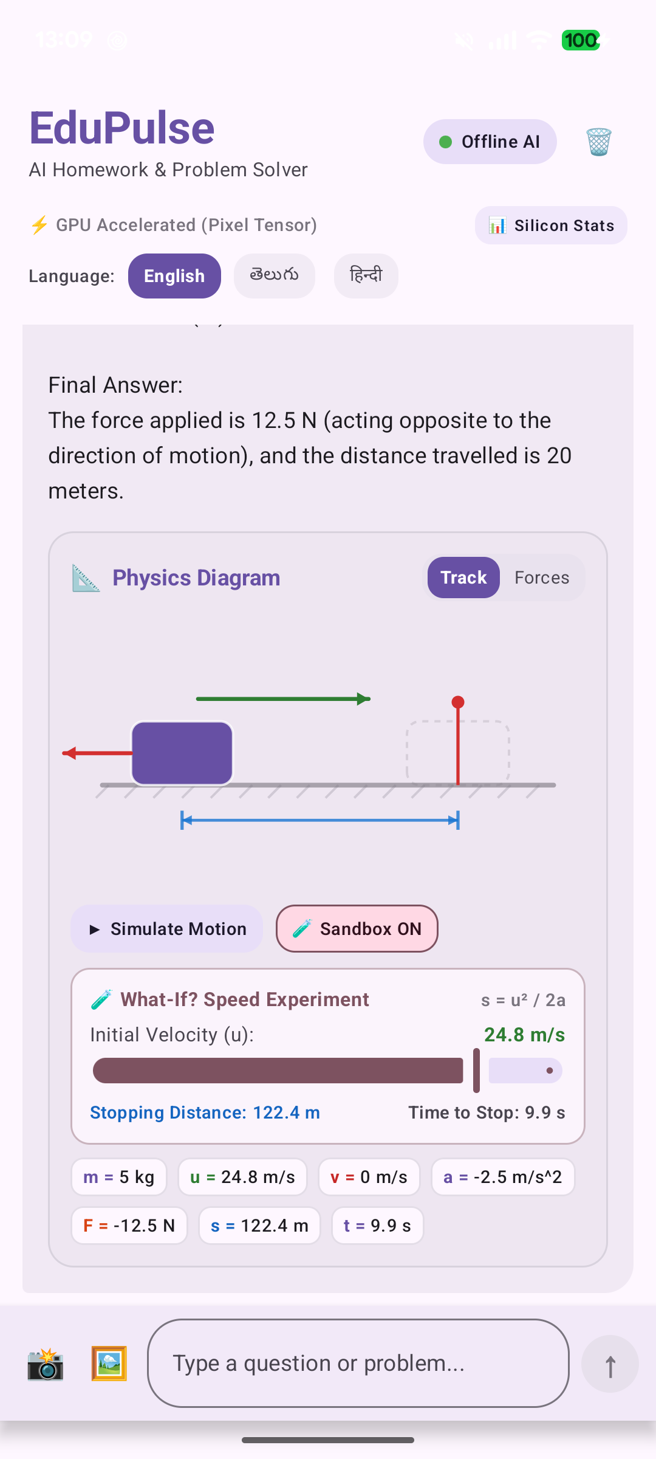
EDUPULSE • ON-DEVICE AI TUTOR
Innovation 1: Doubt-to-Diagram & 'What-If?' Sandbox
Active Physical Experimentation in Real-Time
• Motion Track & Force Equilibrium: Visualizes the mass block moving along a friction track, with green velocity vector (→ u) and opposing red retarding force (← F) until rest.
• The 'What-If?' Speed Slider: Students drag initial velocity u from 2.0 to 30.0 m/s. The app instantly recalculates stopping distance s = u² / 2a and stopping time t in real-time.
• Dynamic Vector Scaling: The velocity arrow on top of the block expands and contracts smoothly on the Jetpack Compose Canvas.
• Pedagogical Impact: Proves Newtonian kinematics visually: Doubling speed from 10 m/s (s = 20m) to 20 m/s (s = 80m) quadruples braking distance!

Slide 6
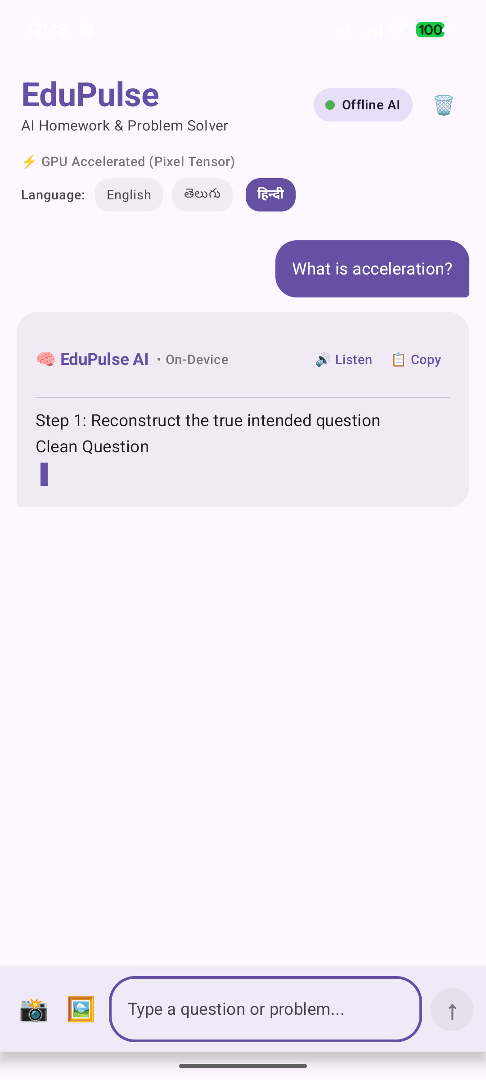
EDUPULSE • ON-DEVICE AI TUTOR
Innovation 2: Hyper-Local Vernacular & Offline Voice
Breaking the English STEM Language Barrier
• Tri-Lingual Engine (Telugu, Hindi, English): Instant 1-tap switching between languages. Over 70% of state-board students in Tier-2/3 study STEM in regional native languages.
• Zero English Bleed-Through: Engineered prompt construction guarantees 100% fluent native script generation (Devanagari & Telugu) with step-by-step math reasoning.
• Offline Android Text-to-Speech (TTS): Tap 'Listen' for voice narration powered purely by local Android TTS engines. Pre-cleans Markdown syntax for natural speech.
• Accessibility for All Learners: Empowers students with dyslexia, visual challenges, or early literacy barriers to learn science through sound and touch.

Slide 7
EDUPULSE • ON-DEVICE AI TUTOR
Technical Architecture: The On-Device Silicon Pipeline
[L1: INPUT]
CameraX / Photo Picker
Contrast Filter
Grayscale Normalize
[L2: VISION OCR]
PaddleOCR v5 DBNet
CRNN Recognition
ONNX Runtime v1.20
[L3: REPAIR]
Phase 1: Regex Fix
Phase 2: Gemma Fix
Zero Cloud Telemetry
[L4: LOCAL LLM]
Google LiteRT-LM C++
Gemma 2B INT4
OpenCL GPU Shader
[L5: REACTIVE UI]
Jetpack Compose
Kinematics Schema
Offline Native TTS

Slide 8
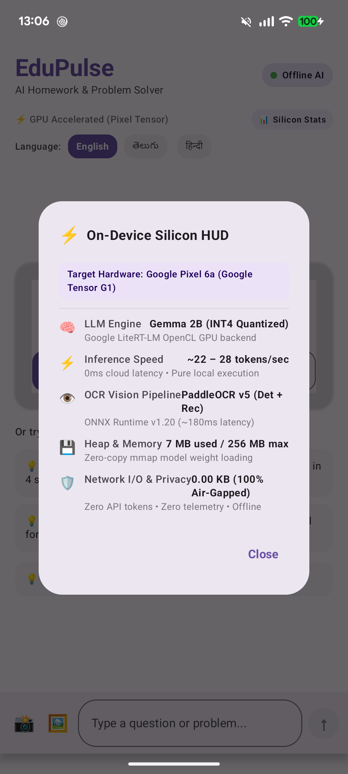
EDUPULSE • ON-DEVICE AI TUTOR
Live Hardware Benchmarks & Zero-Cloud Proof
Google Pixel 6a (Google Tensor G1 Silicon) Validation
• Network Transmission: 0.00 KB (100% Air-Gapped / Works in Airplane Mode)
• GPU Inference Throughput: ~22 – 28 tokens / second (LiteRT-LM OpenCL GPU)
• Vision OCR Latency: ~160 – 240 ms (PaddleOCR v5 on ONNX Runtime Mobile)
• Active JVM Heap Memory: 7 MB used / 256 MB max (1.4 GB weights mmap zero-copy)
• Zero Cloud API Cost: $0.00 recurring fees • Zero user telemetry • 100% Private

Slide 9
EDUPULSE • ON-DEVICE AI TUTOR
Target Audience, NEP 2020 Alignment & Scalability
[AUDIENCE]
Target Users
• 250M+ K-12 students in emerging markets across India.
• Competitive exam aspirants (JEE Foundation, NEET Foundation).
• Rural schools with computer labs lacking active internet.
[POLICY]
NEP 2020 Alignment
• Mother-tongue STEM: Boosts foundational numeracy & literacy.
• Experiential learning: Replaces rote formula memorization.
• Zero privacy risks: 100% offline, FERPA/COPPA compliant.
[GROWTH]
Roadmap & Scale
• Phase 1 (MVP): High School Kinematics (Validated on Pixel 6a).
• Phase 2: Ray Optics, Chemical Equilibrium & Geometric proofs.
• Phase 3: OEM device pre-installation & State Board bundles.

Slide 10
EDUPULSE • ON-DEVICE AI TUTOR
Why EduPulse Wins the iQOO Hackathon
[CATEGORY 1] Beyond Cloud Wrappers — A true edge-silicon build utilizing OpenCL GPU shaders, ONNX Runtime Mobile v1.20, and zero-copy mmap weight execution.
[CATEGORY 2] Groundbreaking Innovation — Doubt-to-Diagram transforms passive homework text into interactive 60fps vector physics simulations and What-If sandboxes.
[CATEGORY 3] Genuine Social Impact — Air-gapped, zero-cost, tri-lingual STEM tutoring for millions of underserved students left behind by the cloud divide.
"EduPulse turns any budget smartphone into an interactive, offline STEM laboratory."

