Slide 1
Introduction to Python for Data Science AIMLCPFDS/DSECLPFDS
Parthasarathy

Slide 2
Agenda for CS #6
Visualizations using Matplotlib
Visualizations using Seaborn
Introduction to Scikit-learn
Summary
Way ahead Q&A
Feedback

Slide 3
Matplotlib Pyplot
Matplotlib is a low level graph plotting library in python that serves as a visualization utility.
Most of the Matplotlib utilities lies under the pyplot
https://matplotlib.org/stable/api/_as_gen/matplotlib.pyplot.plot.html
Let’s try some small plots
Tomorrow we shall use the bike dataset and plot some more plots ..

Slide 4
Seaborn
Seaborn is a Python data visualization library based on matplotlib. It provides a high-level interface for drawing attractive and informative statistical graphics.
https://seaborn.pydata.org/

Slide 5
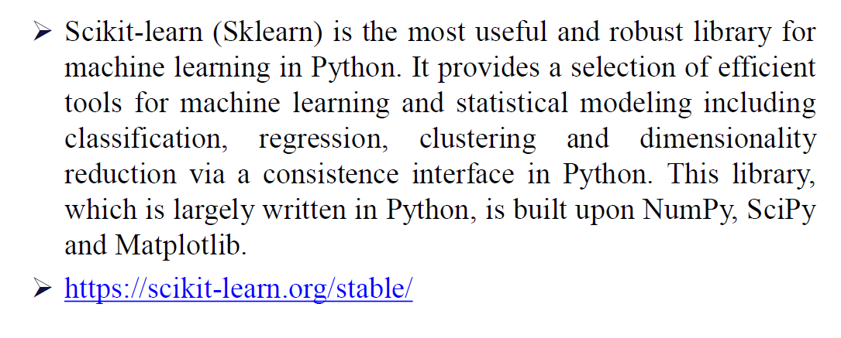
Scikit-learn

Slide 6
Summary
1) Python Basics
2) Python Data Structures
3) Python Programming Constructs
4) Functions and Files
5) NumPy
6) Pandas
7) Data Exploration –Bike dataset
9) Matplotlib
10) Seaborn

Slide 7
Journey Ahead …
1. Mentally Prepare Yourself
2. Research Exclusively On Significant Topics
3. Develop Self-Confidence in Solving Tasks
4. Spend Time Analyzing Complex Problem Statements
5. Work On Improving Specific Math And Programming Skills
6. Try Numerous Visualization Techniques
7. Dedication And Persistence
8. Ask For Help When Required
9. Read Research Papers
10. Take Breaks
11. Stay Updated
12. Understand The Purpose Of Your Codes
13. Try Various Architectures, Models, Optimizers, etc.
14. Just Explore And Have Fun
15. Keep Up The Practice!

Slide 8

Post your queries in the Discussion Forum!!
All the best for your upcoming semesters ☺

Slide 9






Feedback
: 5
: 3
Thank You for your time & attention !
: 1
Contact : parthasarathypd@wilp.bits-pilani.ac.in

