Slide 1

IBM Cousera Capstone
Alex Li

Slide 2
Overview: 1- Introduction 2- Data Collection 3-Methodology 4-Result 5-Conclusion

Slide 3
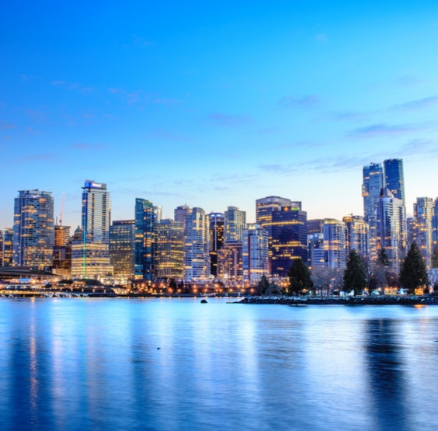
Introduction
Vancouver is a vibrant city with a constant increase in population
It is also ranked as one of the best cities to do business.
Vancouver is the fastest growing economy in Canada

Slide 4
Business Problem:
This project tackles a hypothetical data analysis problem to determines the best neighborhood to open a business, whether it is a coffee shop or a restaurant. Vancouver has over 21 neighborhoods and each neighborhood has restaurants, coffee shops and bakeries. The project will perform basic data analysis.

Slide 5




Data Resources
List of neighborhoods from Wikipedia
API Foursquare
Vancouver population from 2016 from website of City of Vancouver
Python Libraries
GitHub Vancouver Geojson file

Slide 6
Methodology
Exploratory Data Analysis
Data Wrangling
Cluster Group
K Means Clustering
Folium Map with Clustering and Geo Coordinates

Slide 7
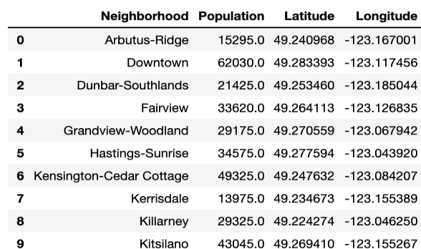
Exploratory Data Analysis:
Population and Geo Coordinates Data are extracted and grouped into a Table

Slide 8
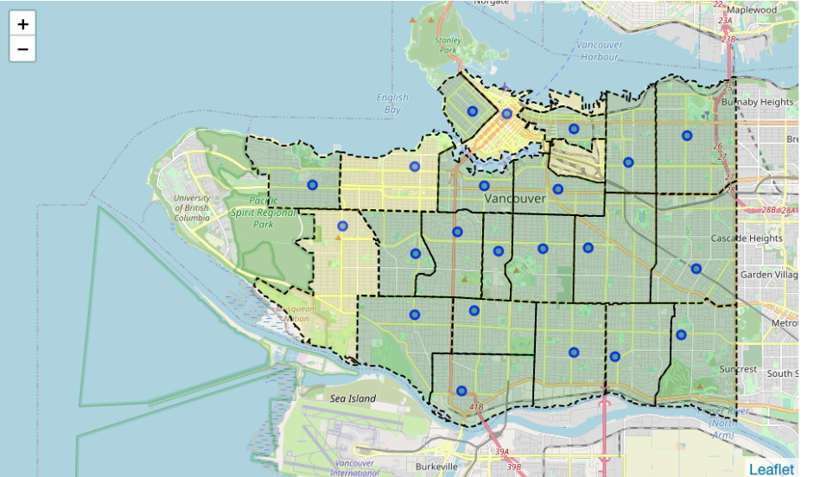
Folium Map of Vancouver
Folium Map of Vancouver with geo coordinates and Geo Json of Vancouver

Slide 9
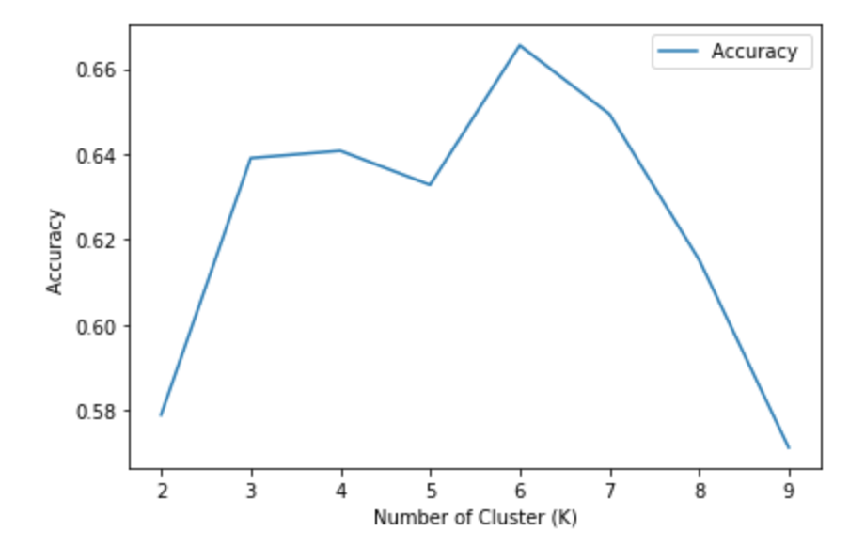
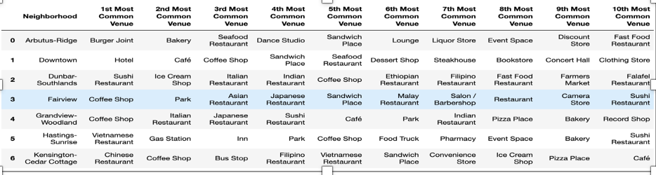
K Means Clustering
K Means Clustering requires tuning
One group encoding is used along with clustering algorithm on the venue categories and population of each neighborhood to determine the best number of clusters .

Slide 10
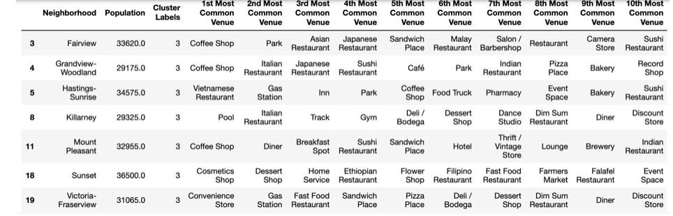
Results and Discussion
There are total of 6 clusters in total organized based on common venues and the population of the neighborhood.

Slide 11
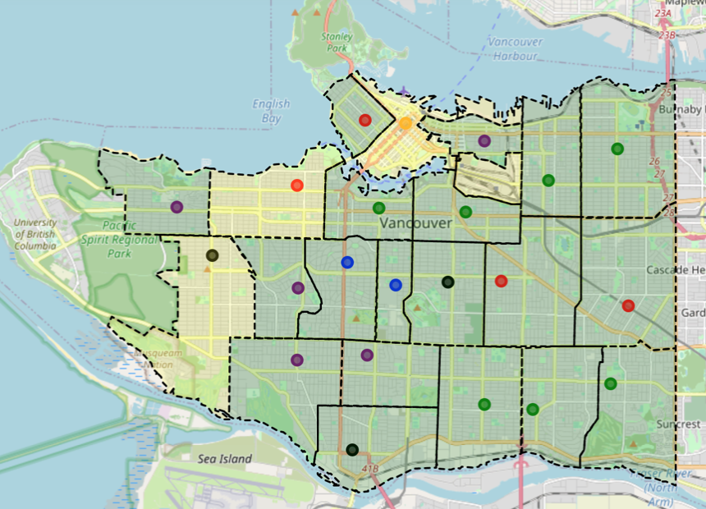
Results and Discussion
Map has cluster labels and geo coordinates of the neighborhoods

Slide 12
Conclusion
Location and competition are two of the important factors before starting a business
This project analysis clusters neighborhood based on population and types of businesses.
This analysis allow investors to understand the types of business in an area and potential customers (population) as well as potential competitions.

