Slide 1



Explainable AI for Rare Retinal Disease Classification
Using CNNs with SHAP and LIME for Interpretability
Presented By:
Anand Kumar Dubey
23122005
Mission
Christ University is a nurturing ground for an individual’s holistic development to make effective contribution to the society in a dynamic environment
Vision
Excellence and Service
Core Values
Faith in God | Moral Uprightness
Love of Fellow Beings | Social Responsibility | Pursuit of Excellence
Notes:
1.7.2013
‹#›

Slide 2

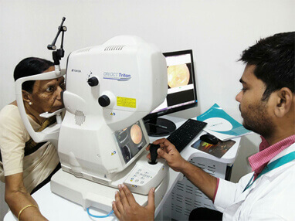
CHRIST
(Deemed to be University)
Introduction:
  Optical Coherence Tomography (OCT) is a key imaging technique for diagnosing retinal diseases.
  Deep Learning models, especially CNNs, can automate classification tasks but lack interpretability.
  This project aims to classify OCT images and explain predictions using SHAP and LIME.
Excellence and Service
Notes:
1.7.2013
‹#›

Slide 3
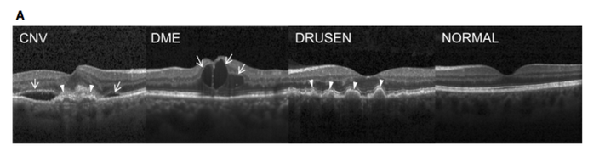
CHRIST
(Deemed to be University)
CHRIST
(Deemed to be University)
Dataset
Source: Kermany et al. 2018 (Kaggle)
  Categories:
  CNV (Choroidal Neovascularization)
  DME (Diabetic Macular Edema)
  DRUSEN
  NORMAL
Dataset Split:
  Train: 80%
  Validation: 20%
  Preprocessing:
  Resized images to 128x128
  Data augmentation: Rotation, zoom, flip
Excellence and Service
Excellence and Service
Excellence and Service
Notes:
1.7.2013
‹#›

Slide 4
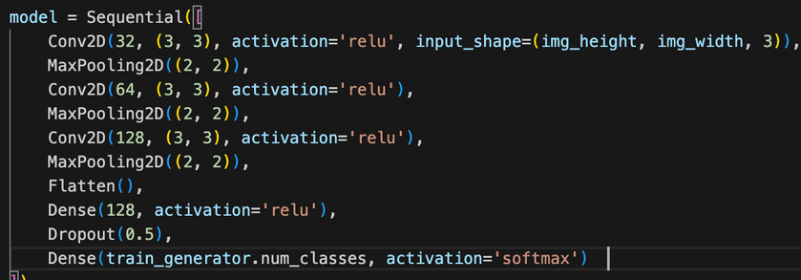
CHRIST
(Deemed to be University)
CHRIST
(Deemed to be University)
Model Architecture
  CNN with 3 Convolutional Blocks
Layers:
    Conv2D + ReLU + MaxPooling (32, 64, 128 filters)
    Flatten + Dense (128 neurons)
    Dropout (50%)
    Output Layer: Softmax activation for multi-class classification
  Optimizer: Adam (learning rate: 0.001)
  Loss Function: Categorical Cross-Entropy
  Metrics: Accuracy
Excellence and Service
Excellence and Service
Excellence and Service
Notes:
1.7.2013
‹#›

Slide 5
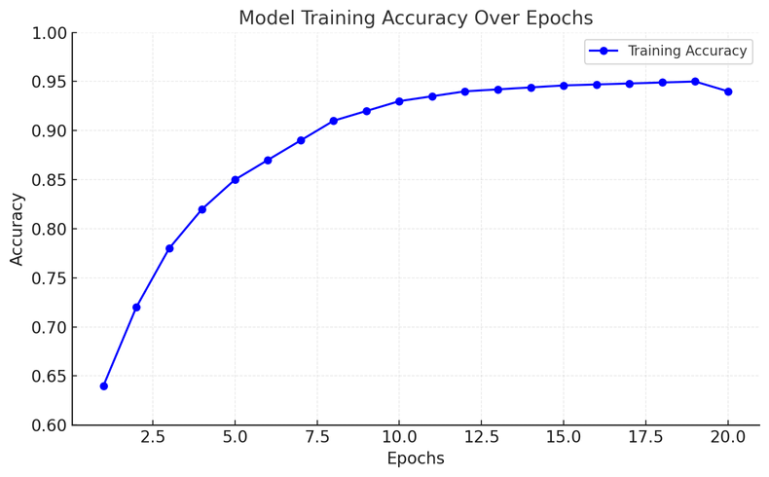
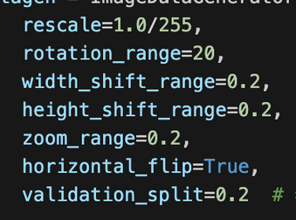
CHRIST
(Deemed to be University)
CHRIST
(Deemed to be University)
Training Process
  Data Augmentation Applied:
  Rotation: 20°
  Width & Height Shifts: 20%
  Zoom: 20%
  Horizontal Flip
  Training Details:
  Epochs: 20
  Batch Size: 32
  Validation Split: 20%
Excellence and Service
Excellence and Service
Excellence and Service
Notes:
1.7.2013
‹#›

Slide 6
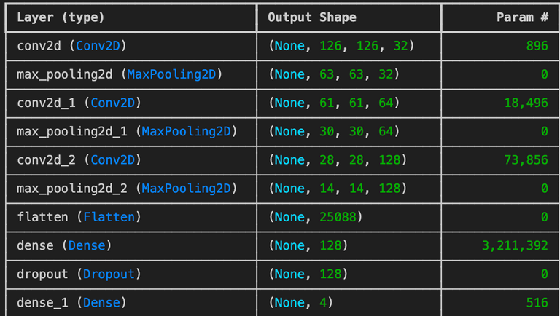
CHRIST
(Deemed to be University)
CHRIST
(Deemed to be University)
Model Evaluation
Training: 90.34%
Training Loss: 0.2741
Validation Accuracy: 90.71%
Validation Loss: 0.2701
Your paragraph text
Excellence and Service
Excellence and Service
Excellence and Service
Notes:
1.7.2013
‹#›

Slide 7
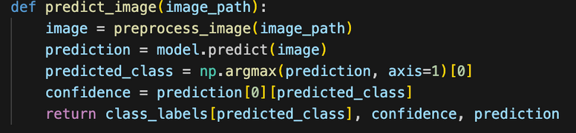
CHRIST
(Deemed to be University)
CHRIST
(Deemed to be University)
Prediction Pipeline
  Steps:
  Load image
  Preprocess (resize, normalize)
  Predict using the trained model
  Get class with highest probability
1/1 ━━━━━━━━━━━━━━━━━━━━ 0s 49ms/step
Predicted Class: DME, Confidence: 99.91%
Model Prediction Distribution: [[7.8054040e-04 9.9913651e-01 6.0557413e-05 2.2508448e-05]]
Excellence and Service
Excellence and Service
Excellence and Service
Notes:
1.7.2013
‹#›

Slide 8
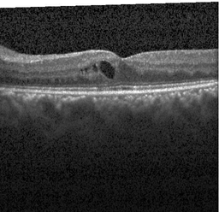
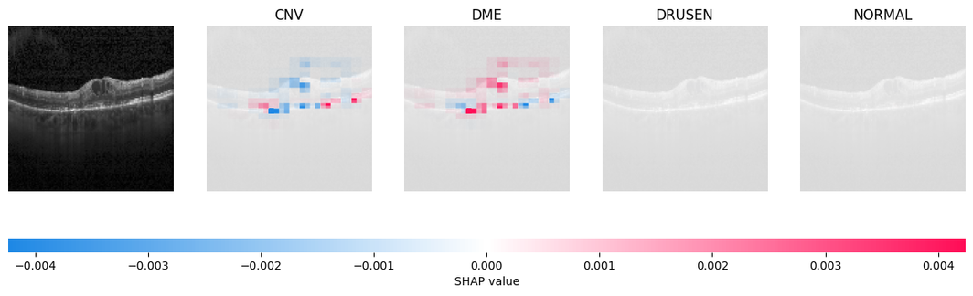
CHRIST
(Deemed to be University)
CHRIST
(Deemed to be University)
Explainability with SHAP
SHAP (SHapley Additive exPlanations)
Explains model decisions by calculating feature importance
Input Image
Uses a blur mask to generate importance maps
SHAP Visualization:
Shows which parts of an image contributed most to the prediction
Excellence and Service
Excellence and Service
Excellence and Service
Notes:
1.7.2013
‹#›

Slide 9
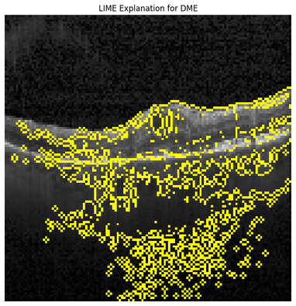
CHRIST
(Deemed to be University)
CHRIST
(Deemed to be University)
Explainability with LIME
Input Image
LIME (Local Interpretable Model-agnostic Explanations)
  Generates perturbed images & analyzes changes in predictions
  Highlights most important image regions for classification
LIME Visualization:
  Displays superpixel regions that impact model predictions
Excellence and Service
Excellence and Service
Excellence and Service
Notes:
1.7.2013
‹#›

Slide 10
CHRIST
(Deemed to be University)
CHRIST
(Deemed to be University)
Key Findings
1. Model Performance
  Validation Accuracy: 92.56%
  Validation Loss: 0.227
2. Evaluation Metrics
  The model shows high accuracy and low loss on the validation set, indicating effective training.
  Minimal overfitting observed.
3. Performance Insights
  Consistent improvement in accuracy and loss throughout training.
  Confusion Matrix reveals some misclassifications in specific classes (e.g., DRUSEN).
  Possible Improvements:
    Further hyperparameter tuning.
    Experiment with more data augmentation techniques.
Excellence and Service
Excellence and Service
Excellence and Service
Notes:
1.7.2013
‹#›

Slide 11
CHRIST
(Deemed to be University)
CHRIST
(Deemed to be University)
Thank You!
T
Excellence and Service
Excellence and Service
Excellence and Service
Notes:
1.7.2013
‹#›

