Slide 1
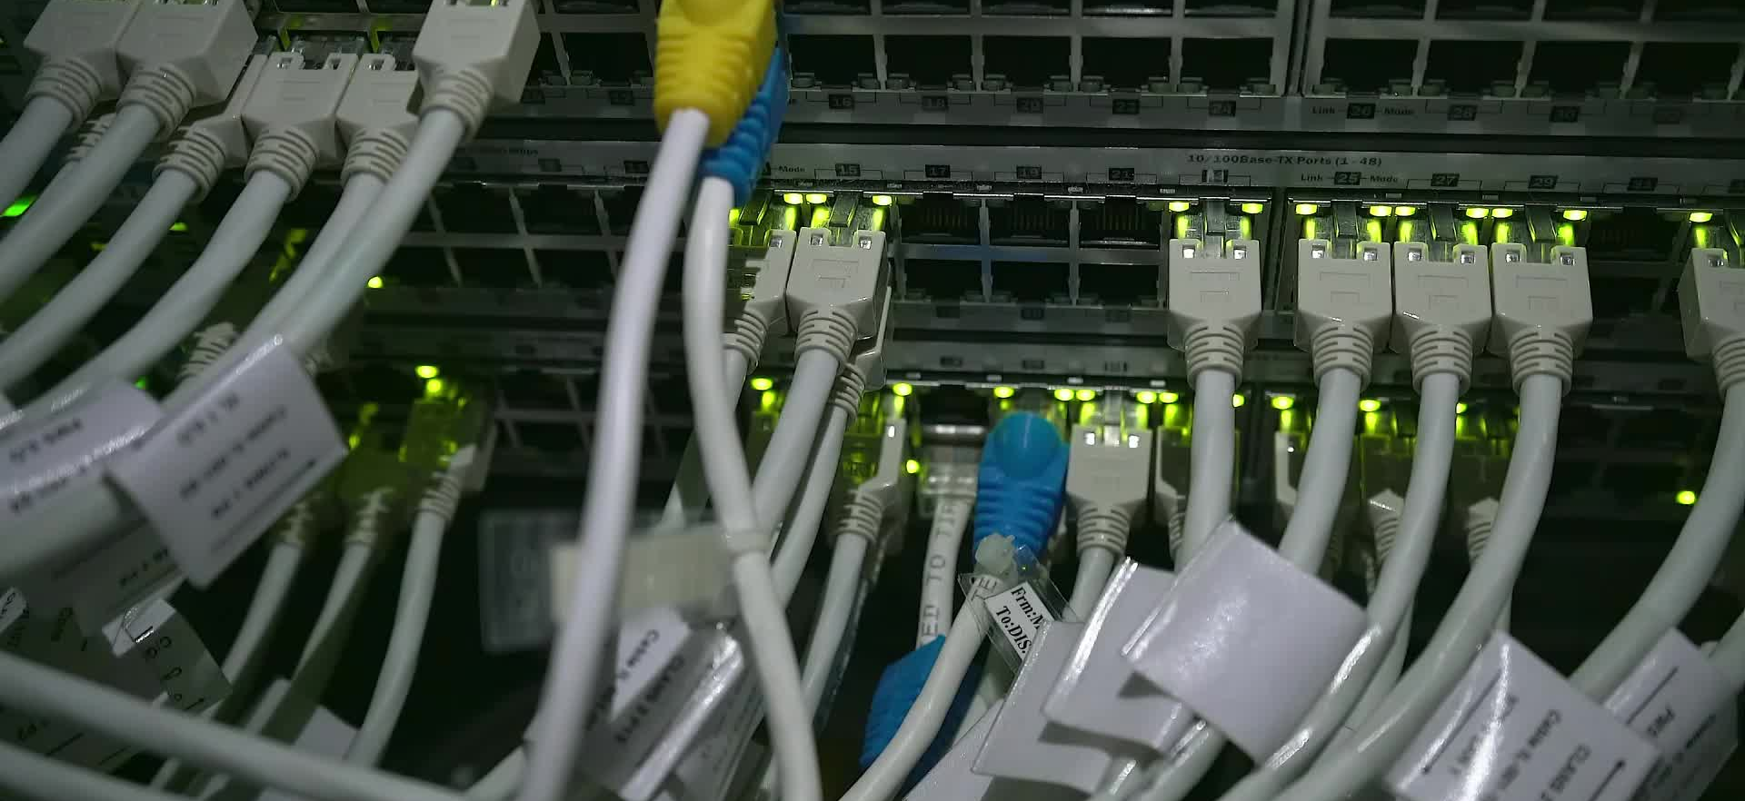
Telecom Customer Churn Prediction
Abdullrahman AbuTaleb 2100610

Slide 2

Project Goal
• Develop an ML system to predict customer churn
• Include training, deployment, and monitoring
• Ensure reliability, interpretability, and automation
This system addresses customer churn in the telecom industry.

Slide 3
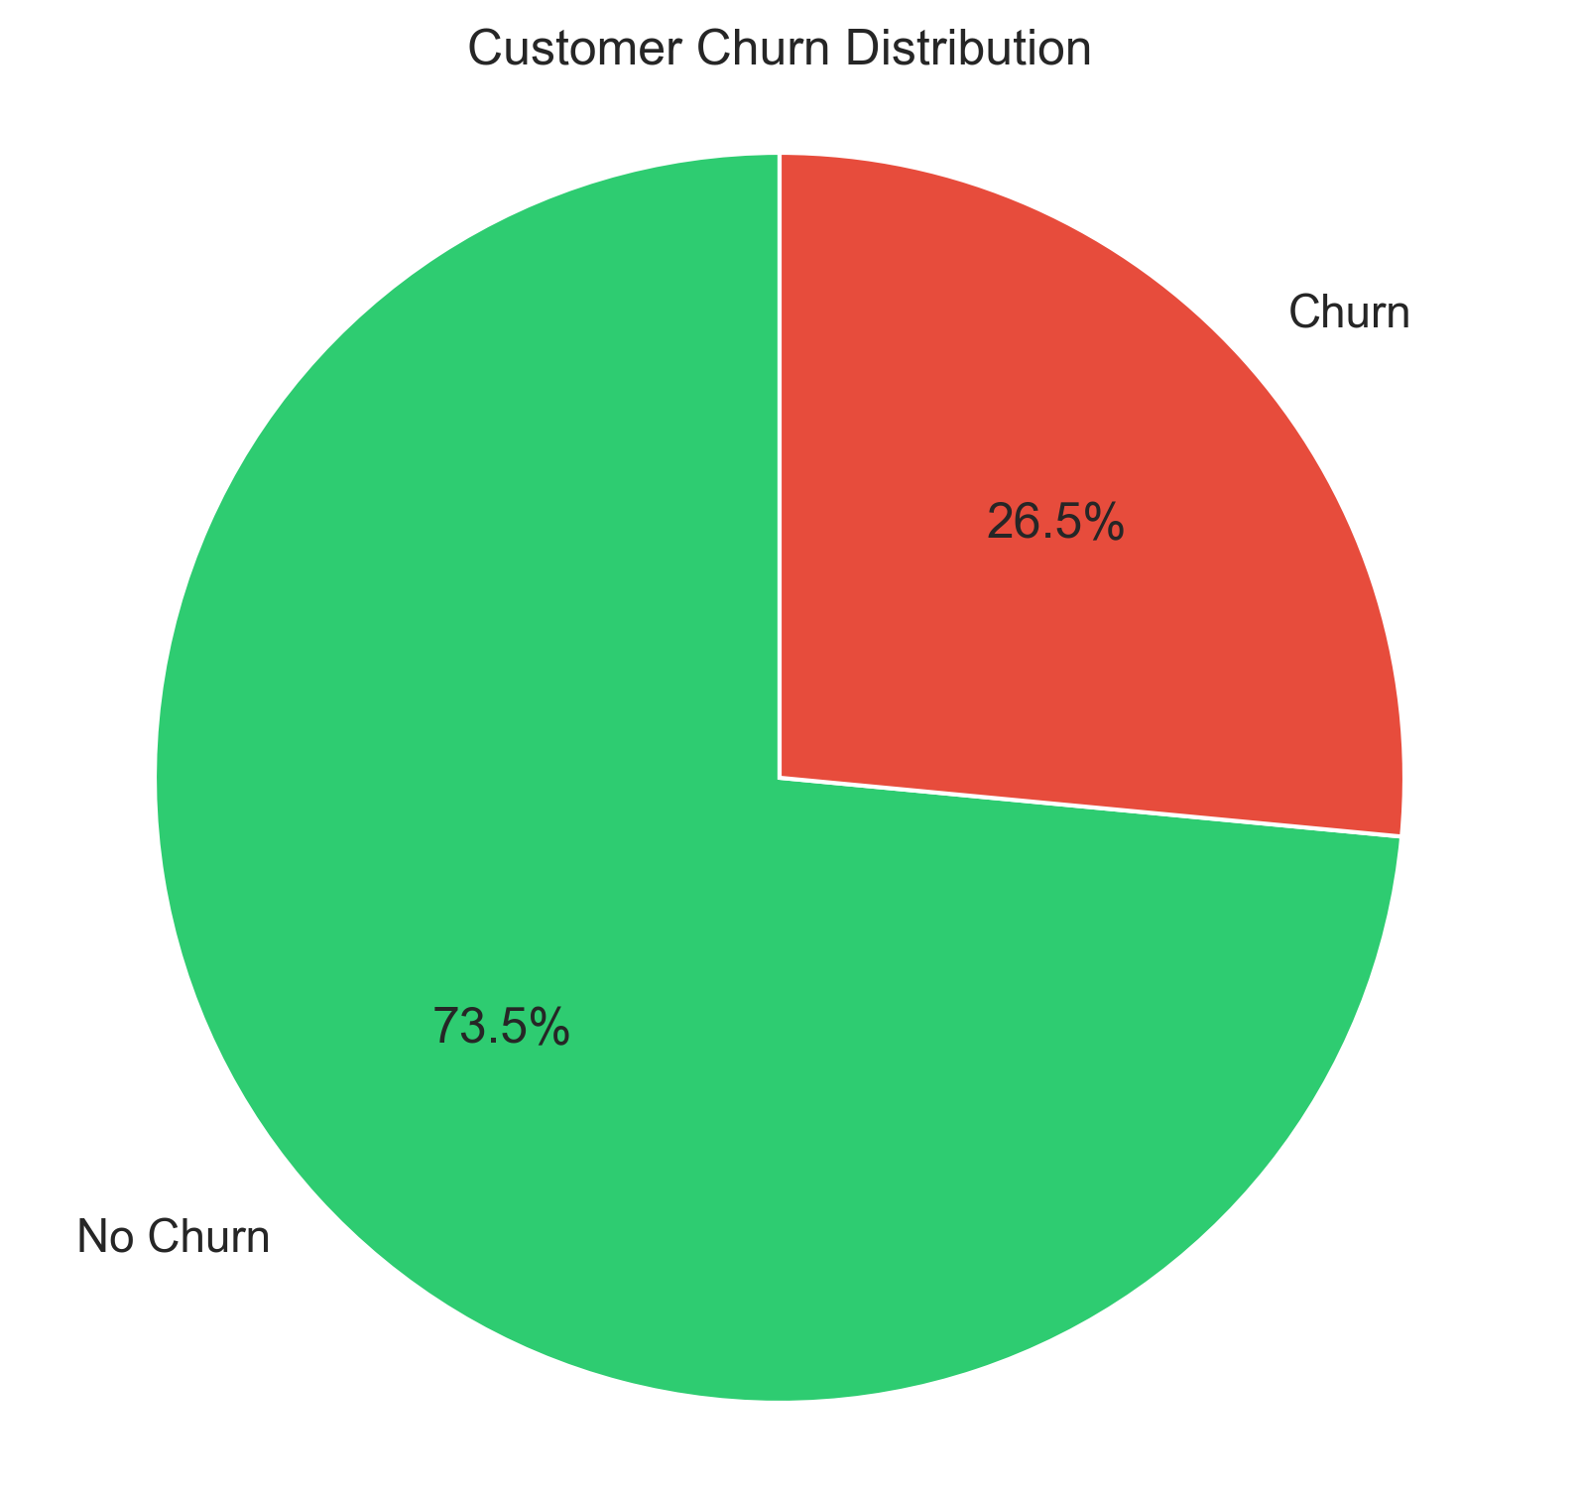
Dataset Overview
Source: Telco Customer Churn Dataset (Kaggle, by blastchar) Size: 7,043 rows × 21 columns Features: Demographics: gender, senior citizen, etc. Services: internet, phone, streaming, etc. Account info: contract type, tenure, monthly charges Imbalance addressed using SMOTE.

Slide 4
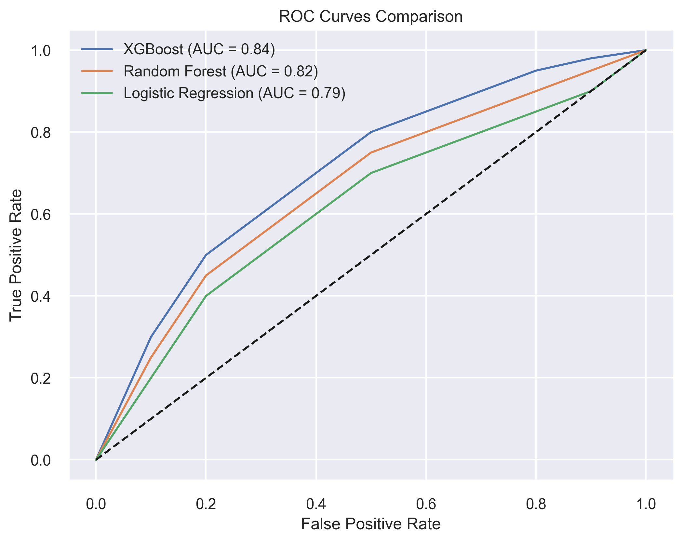
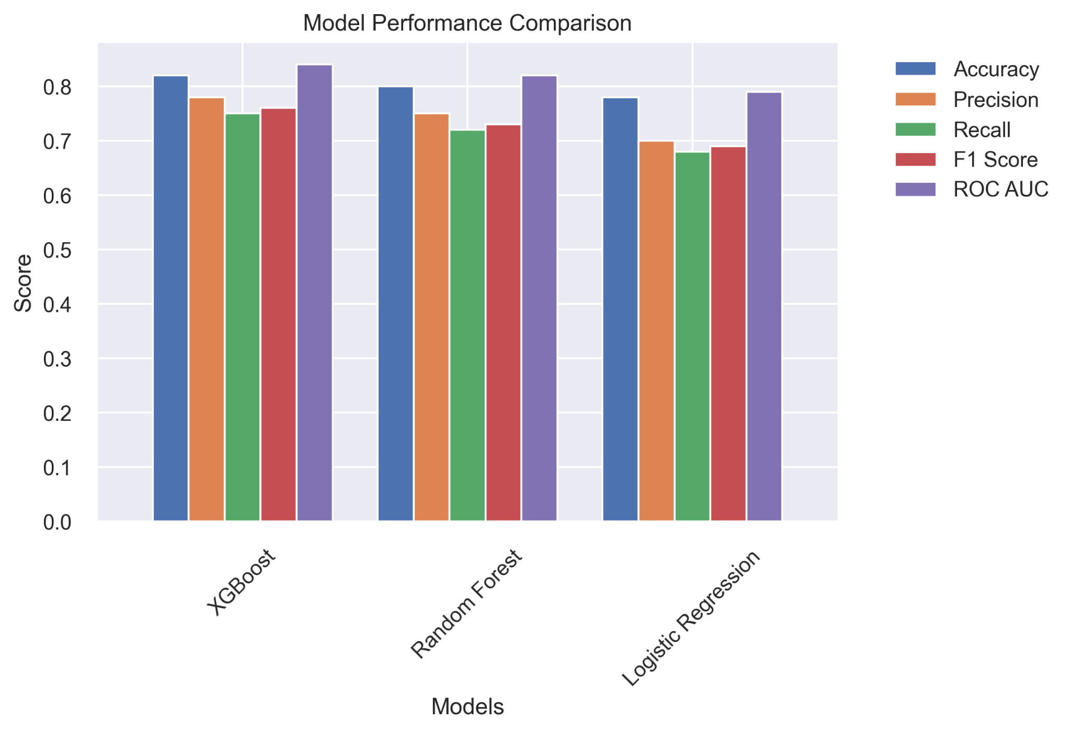
Models Trained

Slide 5
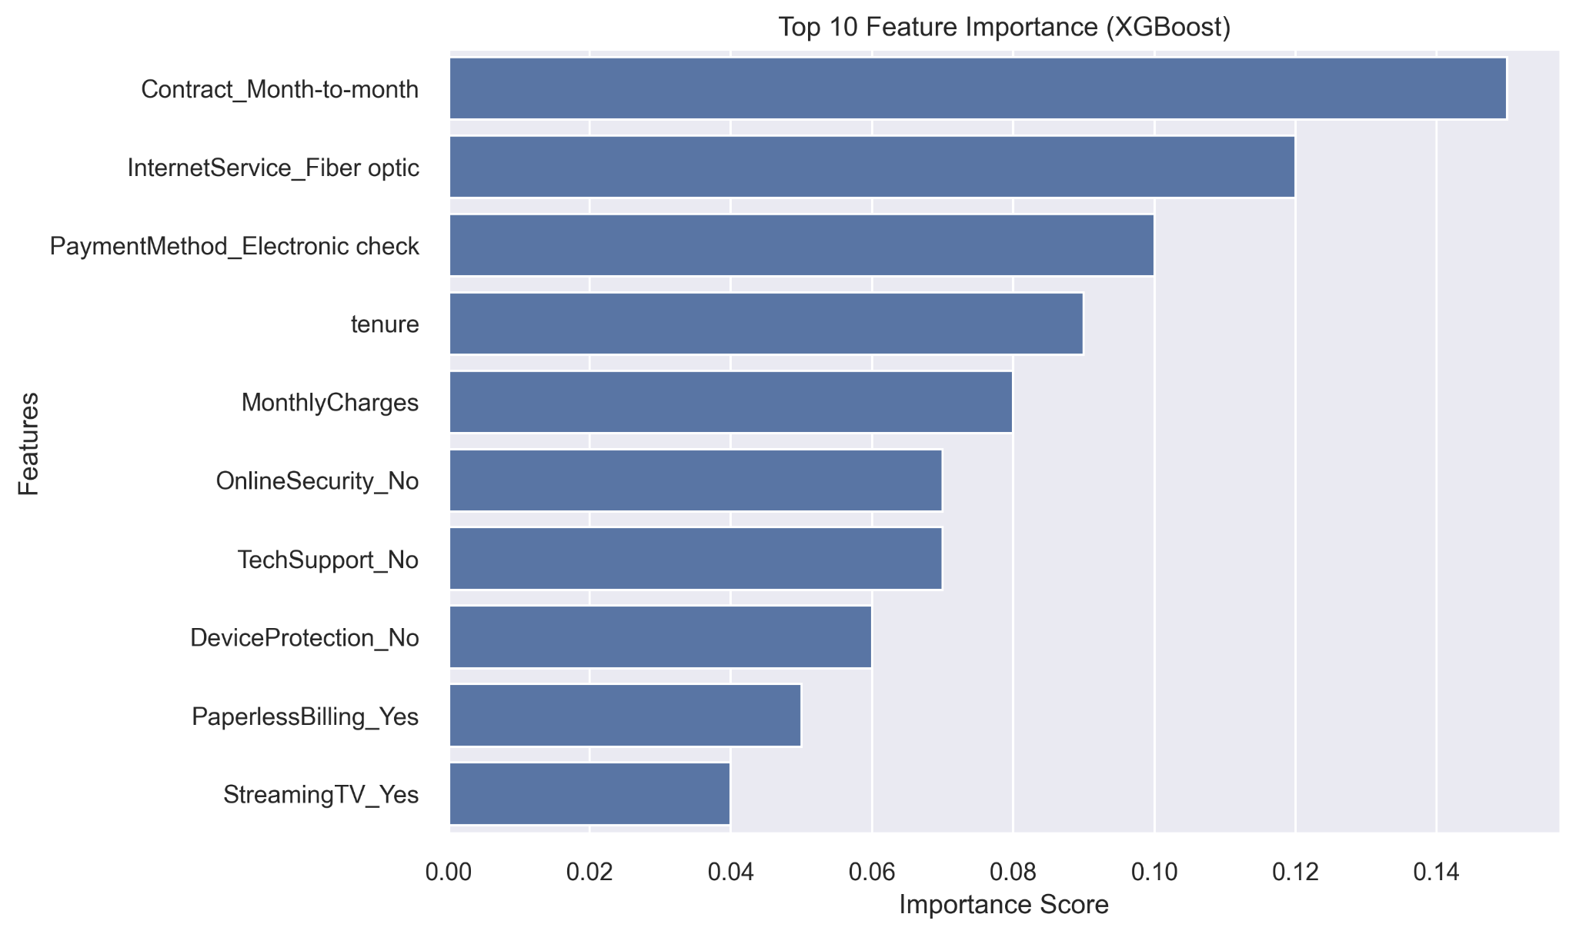
XGBoost model revealed the most influential features: 1. Month-to-month contracts – 15% 2. Fiber optic internet – 12% 3. Electronic check payments – 10% 4. Tenure (customer loyalty) – 9% 5. Monthly charges – 8% Helps target retention efforts more effectively.

Slide 6
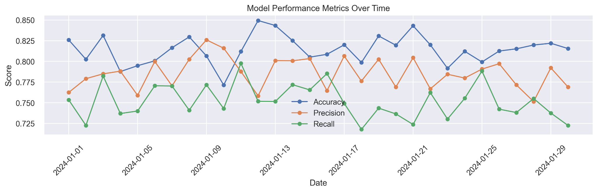
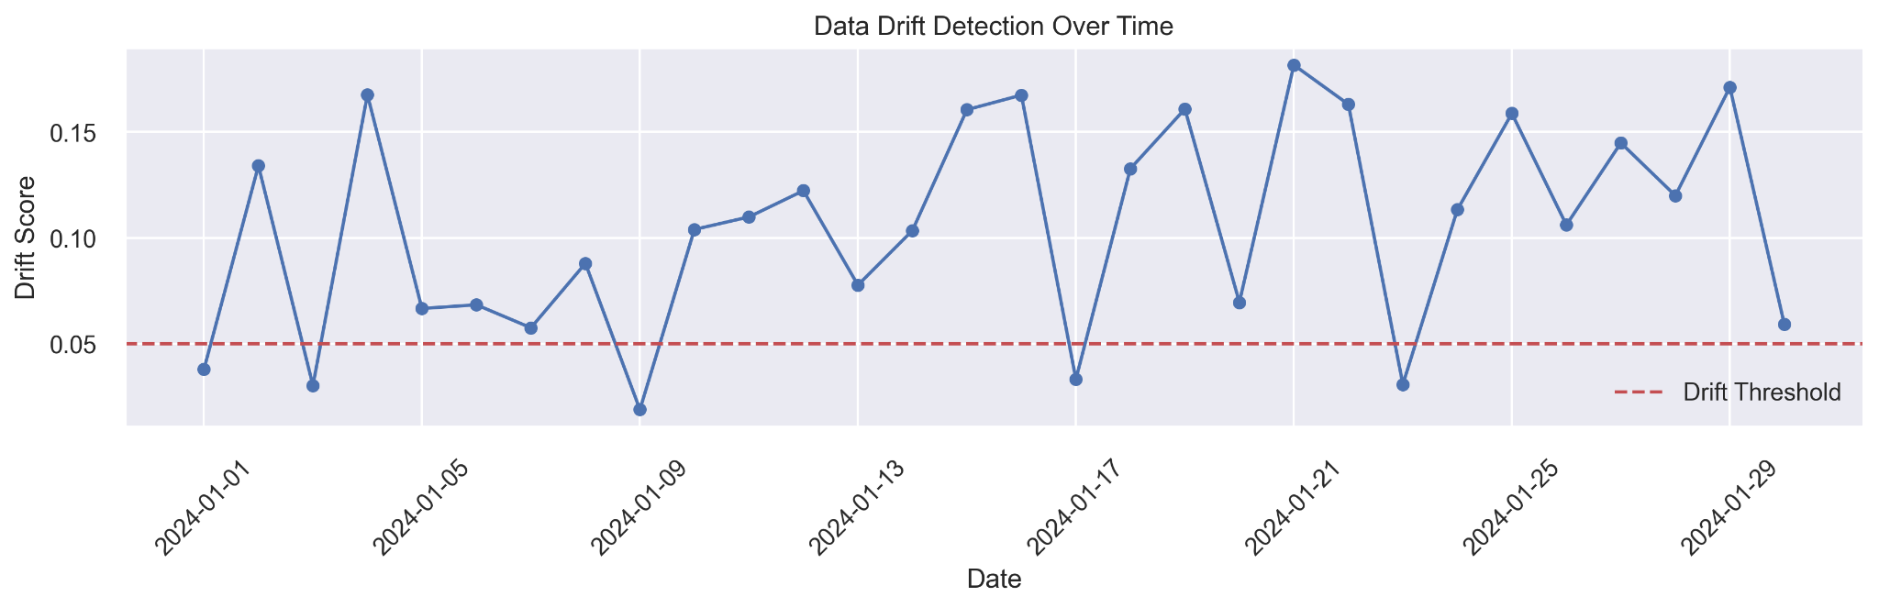
System implementation

Slide 7
conclusion
• XGBoost selected for robustness and top metrics as it has highest performance (AUC 0.84) System includes training, API deployment, and real-time monitoring.
Enables: - Early churn detection - Data-driven retention strategies - Scalable deployment - Real-time insights
-
Flask-based REST API - Endpoints: - /health: System health check - /metadata: Model information - /predict: Churn predictions

