Slide 1
HR
BRAND PLACEHOLDER
HR Handbook & Orientation Program
A clear starting point for people, policies, and belonging.
PEOPLE OPERATIONS
[Organization Name] · [Year]
ORG
WELCOME
01
BRAND / COVER IMAGE
Insert approved organization mark or workplace image
[Department]
Internal orientation resource
Designed to make the first days clear, consistent, and connected.

Slide 2




HR HANDBOOK SYSTEM
Project Overview
A polished orientation tool built for clarity, consistency, and confident navigation.
THE PROPOSAL AT A GLANCE
From handbook
to experience.
Purpose
Elevate the HR handbook into a polished orientation tool.
Audience
General employees, new hires, and internal stakeholders.
Outcome
A consistent, branded, easy-to-navigate handbook system.
DESIGN DIRECTION
Corporate, clean, and compliance-friendly.
Structured content. Branded navigation. Clear employee guidance.

Slide 3



DESIGN CONCEPT DIRECTION
A formal visual system that feels clear, modern, and unmistakably institutional.
Structure with a human edge
Branded anchor
Readable hierarchy
Ordered polish
Deep blue establishes a confident left-panel identity and guides the page.
White space and dark typography make essential information easier to scan and trust.
Vertical lines and blocks reinforce institutional order, softened by subtle organic shapes.
Strong visual recognition
Clarity before decoration
Formal, never rigid
A STRUCTURED CORPORATE HANDBOOK, MADE APPROACHABLE

Slide 4



CORPORATE HANDBOOK SYSTEM
Cover Page Mockup
A formal opening spread built around a confident blue anchor.
DESIGN DIRECTION
A strong first impression, without visual noise.
NORTHSTAR GROUP
N
Corporate
Handbook
Blue anchor panel
Deep blue establishes authority and gives the title immediate presence.
Policies, principles & practice
Clear institutional hierarchy
Bold white typography makes the cover legible, direct, and memorable.
Practical footer zone
Company identity, address, and contacts stay visible but visually quiet.
COMPANY NAME
contact@company.com
+00 000 000 000
Address line · City, Country
Structured grid · Restrained accents · Timeless finish

Slide 5
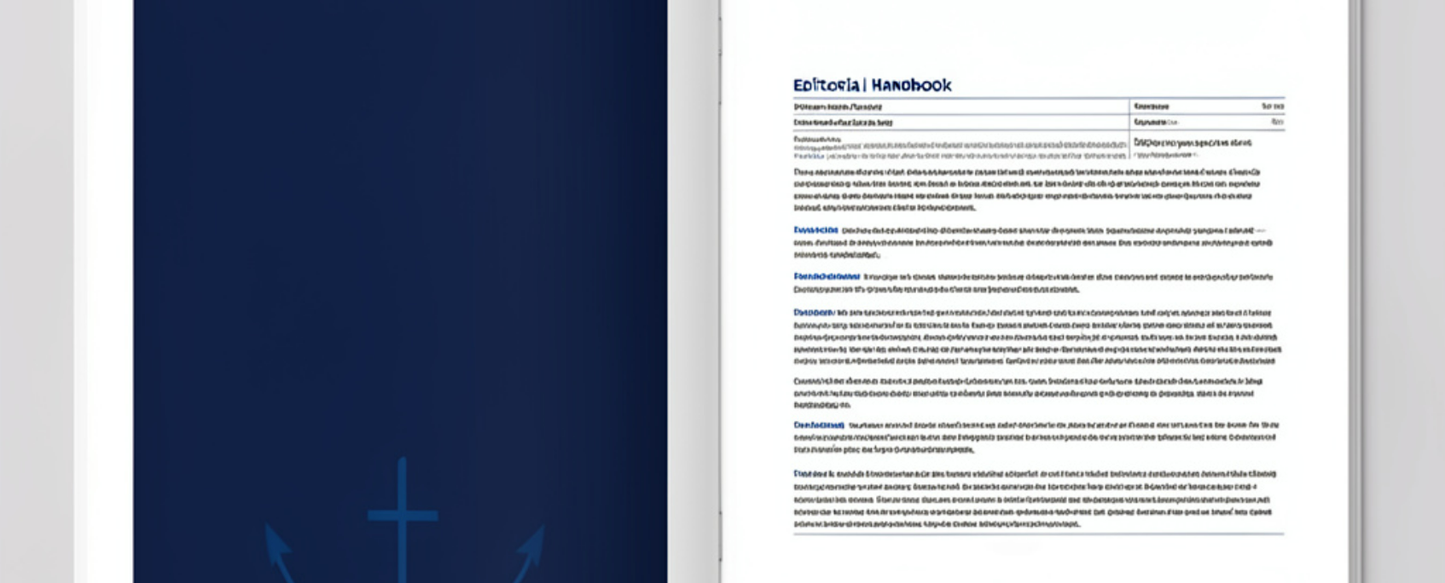
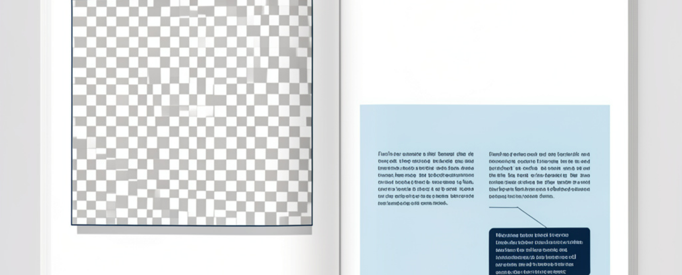


INTERIOR SYSTEM · 04
FORMAT
Interior Spread System
Double-page spread
A repeatable editorial rhythm for clear, confident handbook reading.
SECTION OPENER
PROCESS PAGE
READING FLOW
NAVIGATION LANGUAGE
Structure makes the handbook feel navigable.
Blue blocks signal what matters next.
Grid-based alignment
Keeps sections consistent from page to page.
Use the accent consistently to separate topics, orient the reader, and frame callout content.
Functional image zones
Make room for policy, culture, and process visuals.
CLEAR HIERARCHY · REPEATABLE PATTERN

Slide 6

TYPOGRAPHY + GRID SYSTEM
Typography and Grid Standards
A clear system makes every page easier to navigate.
SYSTEM PRINCIPLE
Structure should disappear into clarity.
Heading hierarchy turns content into a visible path: readers can scan sections, understand emphasis, and move through the handbook with confidence. Sans-serif typography reinforces clarity and modern professionalism.
Hierarchy guides attention.
A disciplined grid creates a repeatable rhythm.
Columns protect rhythm.
Fixed column widths keep alignment consistent across pages, while deliberate spacing prevents dense, overwhelming layouts. The result is a visual language that feels ordered, calm, and dependable.
Spacing protects focus.
CONSISTENT RULES · CONFIDENT READING

Slide 7




TEMPLATE SYSTEM / ONBOARDING
Section Divider and Spread Variants
Two page types, one structured onboarding experience.
Section dividers
Content spreads
Introduce each onboarding topic with strong visual hierarchy.
Balance policy text with supporting imagery and structure.
Create a clear pause between major content chapters.
Use callouts for key employee actions and reminders.
Best for: orientation, navigation, and topic resets
Best for: compliance guidance, training, and reference

Slide 8





HANDBOOK STRUCTURE
Content Modules for the Handbook
EDITORIAL PRINCIPLE
Make every answer easy to find.
A clear path from welcome to readiness
Welcome and company overview
Start with the organization, mission, and employee context.
The handbook moves employees from orientation to confident action.
Policies, conduct, and workplace expectations
Make standards, responsibilities, and everyday behaviors explicit.
Benefits, support, and orientation checkpoints
Guide employees to procedures, contacts, resources, and training milestones.
Structured for clarity and use

Slide 9




Executive summary
Business Value and User Experience
A structured design system turns every HR touchpoint into a clearer, more confident experience.
CONSISTENCY
COMPLIANCE
EMPLOYEE EXPERIENCE
Aligned
Clearer
Confident
HR communications and onboarding materials feel like one system.
Standardized structure makes important information easier to follow.
Readable navigation helps employees know where to look and what to do.
Recommendation
Adopt the design system as the shared standard for every employee-facing HR touchpoint.

Slide 10





IMPLEMENTATION ROADMAP
From rules to a ready-to-use handbook
A clear sequence for building, applying, and maintaining the design system.
01
02
03
Set the foundation
Build the system
Activate and maintain
Finalize brand rules and content architecture.
Build master cover and spread templates.
Apply the system across sections and prepare editable HR files.
Rules first. Consistency follows.
A repeatable grid for every page.
Designed to stay useful over time.
HANDBOOK IMPLEMENTATION STRUCTURE → SYSTEM → SUSTAINABILITY

Slide 11




HR HANDBOOK SYSTEM
Conclusion
A clearer system makes every update easier to use.
Built to evolve with HR
THE TAKEAWAY
Structure turns policy into experience.
Employee experience
A refined handbook makes guidance easier to find, understand, and trust.
Clarity and compliance
A consistent layout system keeps information clear, aligned, and dependable.
Ready for what comes next
The system scales cleanly as HR guidance grows and changes.
Clear today. Consistent tomorrow.

