Slide 1
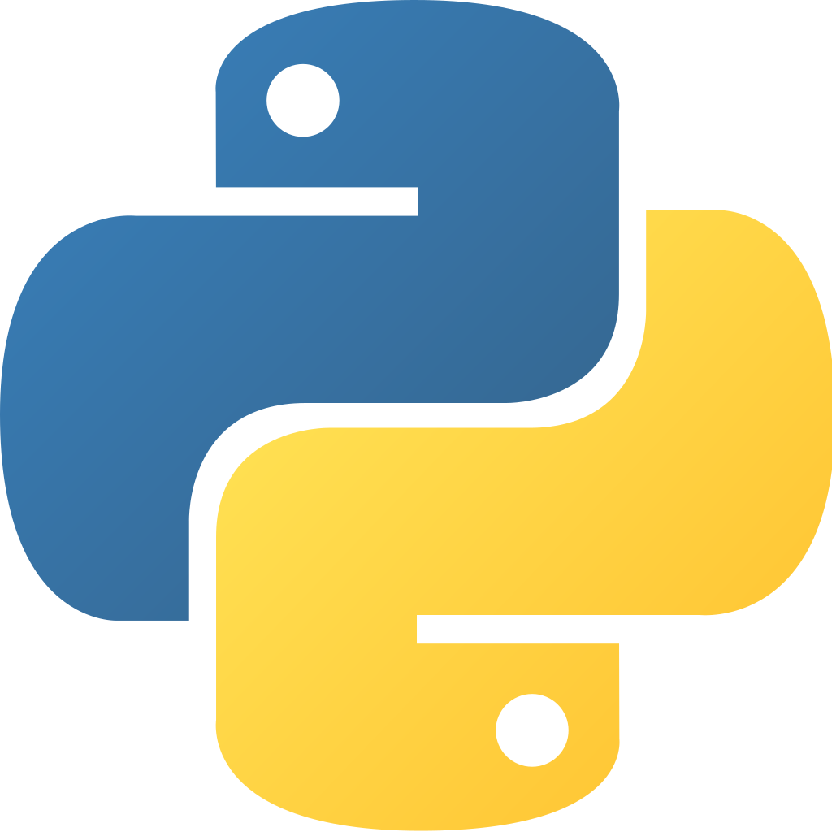
Python – Day 3
ANis Boudih
Nazli Ander

Slide 2

outline
Object Oriented Python
Demo: creating a simple class together
Exercise: creating your own bank account class
Unit testing

Slide 3
Object oriented approach in python

Slide 4

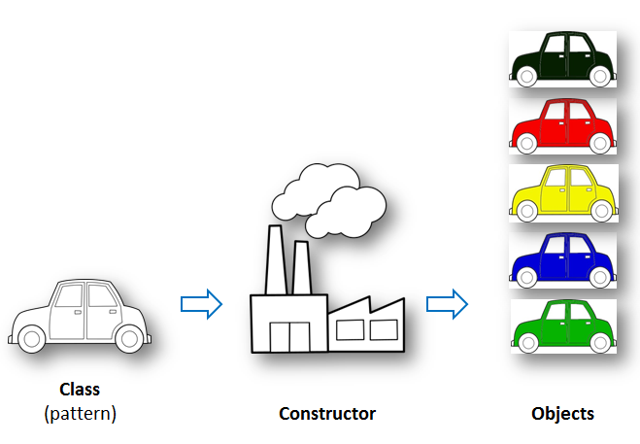
Class in Python
Group our data and functions together in a way that's easy to reuse and easy to build upon if need be
In the context of classes, we refer a lot to attributes and methods, these are equivalent to data and functions

Slide 5
Class vs instance
Class | Instance
blueprint for creating its instances | An object created from this blueprint
Class variables are the same for all instances: WHEELS = 4 | Instance variables can be unique for each instance: Name = "Ferrari"
Class Car(): #statements | Car1 = Car()
By convention we call the class cls | By convention we call the instance self

Slide 6

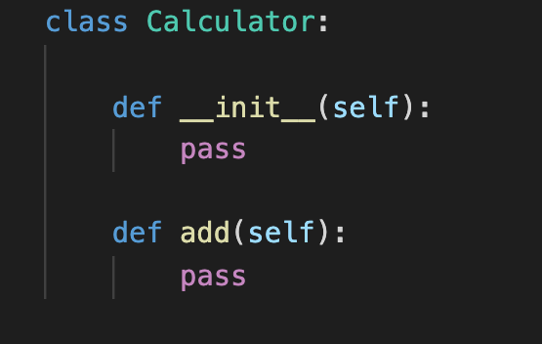
Defining a CLASS

Slide 7

Instance
In order to use the class, we must create an instance of the class
Instances are objects that are created using the class definition

Slide 8
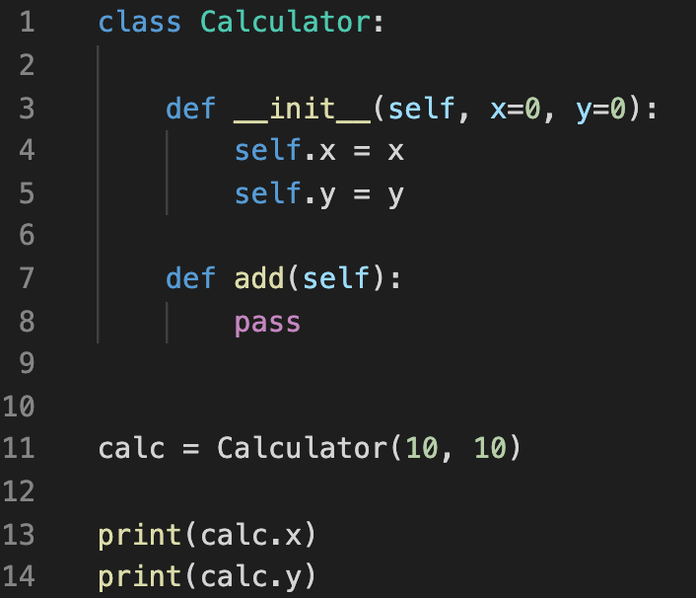
__init__() method
With the special __init__() method we can create instances of a class.
Think of it as 'initialized' or as a constructor
The init method runs automatically every time when we create a new instance of a class
Output:
10
10

Slide 9
SELF keyword
The first argument of every method is a reference to the current instance of the class
By convention, we name this argument self
In __init__, self refers to the object currently being created
In other class methods, it refers to the instance whose method was called
Similar to the keyword this in Java or C++

Slide 10
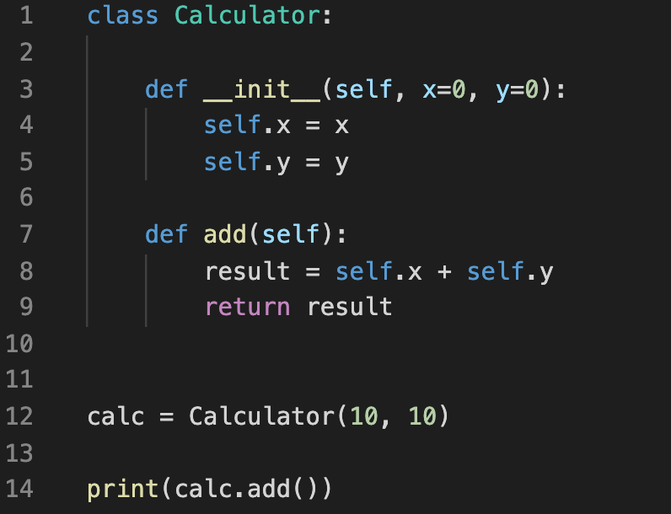
Instance methods
When we create a method in a class, it will always receive the ‘instance’ as the first argument automatically!
By convention we should call the instance self
Although you must specify self explicitly when defining the method, you don’t include it when calling the method
Python passes it for you automatically
Output:
20

Slide 11
Class variables vs instance variables
Class variables are shared among all instances
All class instances share the same value for this attribute
Most used for class-wide constants or building a counter that tracks the amount of instances that has been made
Instance variables/attributes are owned by a particular instance
Each instance has its own value for it
Most common used attribute/variable

Slide 12
Class methods and static methods
In contrary to regular methods, class methods take the class as the first argument
Class methods can also be used as alternative constructors.
@classmethod
Def method_name(cls,*args):
Static methods do not take the instance or the class as the first argument.
They behave just like normal functions, yet they should have some logical connection to our class.
@staticmethod
Def method_name(*args):

Slide 13

Inheritance
Inheritance allows us to inherit attributes and methods from a parent class
This is useful, because we can overwrite or add completely new functionality without affecting the parent class
It is as easy as:
class Child(Parent):

Slide 14
Special (dunder/magic) methods
Special methods are a set of predefined methods you can use to enrich your classes
We can easily recognize these methods, because they start and end with double underscores
For example: __init__, __str__ or __add__
With these methods we can implement operator overloading

Slide 15
Exercise: creating your own bank account class
In this exercise you're going to create a bank account class with some typical functionality.
Your bank account class should have/be able to:
The class declaration
Data about the customer such as their first name, last name, account number, and balance.
The ability to make a deposit.
The ability to make a withdrawal. (With a limit of 500)
The ability to see the most recent transaction.

Slide 16

Unit testing

Slide 17
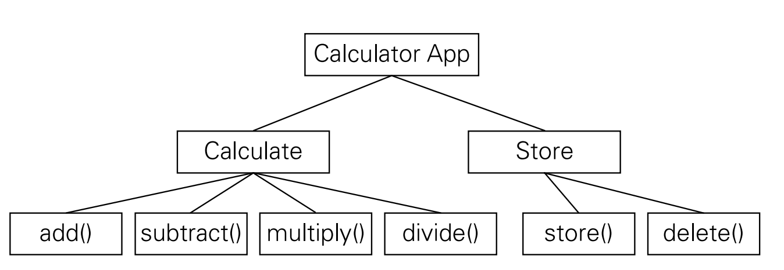
Unit testing?
Testing the separate parts (units) of an application.
Think of the functions in a calculator app:

Slide 18
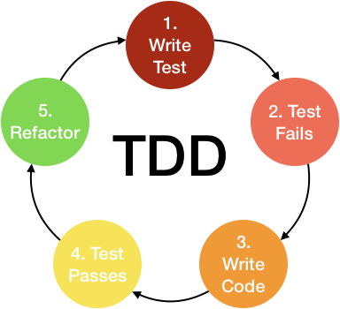
Tdd, integration and unit tests
Unit test: Test only one unit
Integration Test: Testing more than only one unit – and their integration
TDD (Test Driven Development): Writing the test first then the implementation...

Slide 19
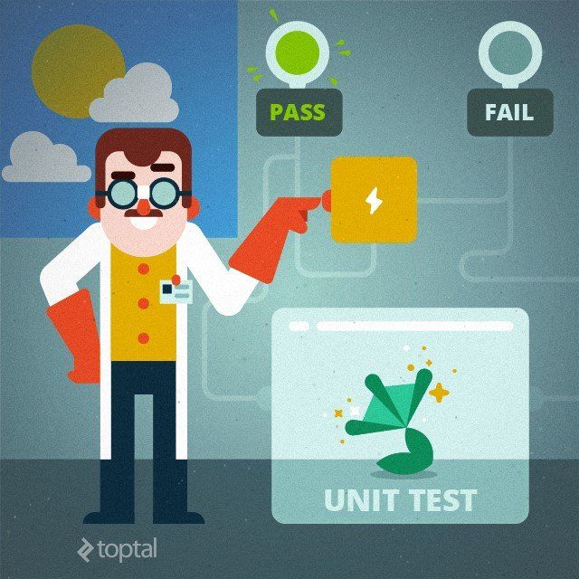
benefits
Easier refactoring
Fine grained responsibilities for methods
Simpler functions
Smaller pieces - less bugs
Better interpretation for units

Slide 20
Python – unit tests
There are a few frameworks for unit tests: PyTest, Behave, UnitTest
How do we structure the tests:
example_app/
example_app/
__init__.py
static/
templates/
app.py
test/
__init__.py
test_app.py

Slide 21
Python – unit tests: how to
import unittest
class TestExampleCase(unittest.TestCase):
def test_some_fnc(self):
self.assertEqual(X, Y)

Slide 22
Writing a simple unit-test Hands-on exercise
Here is an example of a Calculator.
We should subclass the unittest.TestCase to create a unit test case.
The examples will lead you to test a Calculator using Python...
assertEqual
assertAlmostEqual
assertTrue

Slide 23
Organizing test code: - Setup and teardown
We sometimes need to:
Create object instances
Initialize db
Prepare rules
Then there is a method in Test class: setUp
To revert the setUp changes: tearDown

Slide 24
Setup and teardown: how to instance method override
import unittest
class TestExampleCase(unittest.TestCase):
def setUp(self):
self.db_conn = ConnectSomeDB()
def tearDown(self):
self.db_conn.close()
def test_some_fnc(self):
pass

Slide 25
Setup and teardown: how to class method override
import unittest
class TestExampleCase(unittest.TestCase):
@classmethod
def setUpClass(cls):
cls.db_conn = ConnectSomeDB()
@classmethod
def tearDownClass(cls):
cls.db_conn.close()
def test_some_fnc(self):
pass

Slide 26
Setup and teardown hands on exercise
Write test cases for smart_calculator.py
You have - this time - an absolute option within a Calculator object.
You need to setUp absolute for both True and False values.
You can tearDown for both cases to be False.
Try also with override for classmethods.

Slide 27
mocking
Mock objects used for replacing code dependencies,
Testing while being reliant upon dependencies.
A mock object will know how to respond.
Can improve the performance of the unit tests.

Slide 28
Mocking in python
Mocks objects are callable
Accessing the same attribute will always return the same mock.
Mocks record how you use them, allowing you to make assertions about what your code has done to them.
Side effects
Return values

Slide 29
Mocking in python: how to

Slide 30
Mocking in pyton - hands-on exercise – data processor

Slide 31
Mocking in pyton - hands-on exercise – employee patch

