Slide 1
LF21 Lab induction
Louise Dennis – A&V Group Leader, Academic responsible for LF21, louise.dennis@manchester.ac.uk

Slide 2
Requirements to use lab
Completion of University Health and Safety and Computer Science Department Health and Safety training
Lab induction – this one
Read and understand the General Risk Assessment (RA)
Read and understand the specific RA(s) for your activities e.g drone use, robot use.
There is a folder of RAs in the lab. Sign these as you read them.

Slide 3
Useful Resources
All documents (this induction, RAs, etc.,) are stored in the RobotLab folder of the group Dropbox. Email Louise to request access. This also includes a spreadsheet listing who owns/is responsible for various pieces of equipment.
There is a lab email list - CS-AANDV-ROBOT-LAB@listserv.manchester.ac.uk. Email Louise to request access.
Use the wall planner in the lab to coordinate lab usage.
There is a ring binder in the lab containing all risk assessments.

Slide 4
Risk Assessment Structure All Risk Assessments can be found a Ring Binder in the Lab
The general area RA.
Everyone must read and follow
Specific activities not on general RA (e.g. using a robot).
We have specific RAs for using most of the lab equipment which you should read and follow.
If you want to do something not covered by an existing RA (e.g., bringing in the general public to interact with the equipment) then you need to complete an RA for that activity, get it approved by Louise Dennis and then signed off by Haroon Haladh.
If you think one of the general RAs should be extended to include your activity (e.g., if you imagine it will be a regular part of usage) then liaise with Louise about getting this done.

Slide 5
Lab rules
At the end of each day your area should be clean and clear
All tools put away, any rubbish should be removed to the recycling bins.
This is a shared space - a tidy lab is efficient and safe.
Batteries can be disposed of in a dedicated bin outside CSOps.
Please don't let anyone in to work who is not inducted
Showing people around is fine, so long as you supervise them and they do not use any of the lab equipment.
Do not use, move or repurpose other people’s equipment.
Ask the person responsible for a piece of equipment if you do wish to use something.
We have a spreadsheet listing who is responsible for all large items in the Robot Lab folder in the Group Dropbox.

Slide 6
If you break the rules
If you are caught breaking rules this is the process
Verbal warning
One day ban
One week ban
Disciplinary action
If you are caught in the lab while banned: Disciplinary action

Slide 7
Responsible people
There are people responsible for specific things
e.g. battery charging, specific pieces of equipment
List can be found in the Robot Lab folder
If you find a problem, find the responsible person and report the problem. Don't leave it and hope someone else will sort it out
Helpdesk - Directorate of Estates
Infrastructure & Facilities Team Request Form

Slide 8
Charging and Storage of Lithium batteries
Store all Lithium batteries in safe bag in the storage room unless otherwise specified in RA for that specific piece of equipment.
Do not leave any Lithium battery unattended and charging for more than 20 minutes.
Read and follow Lithium battery RA.

Slide 9
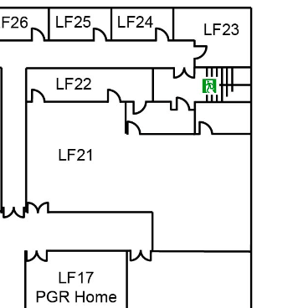
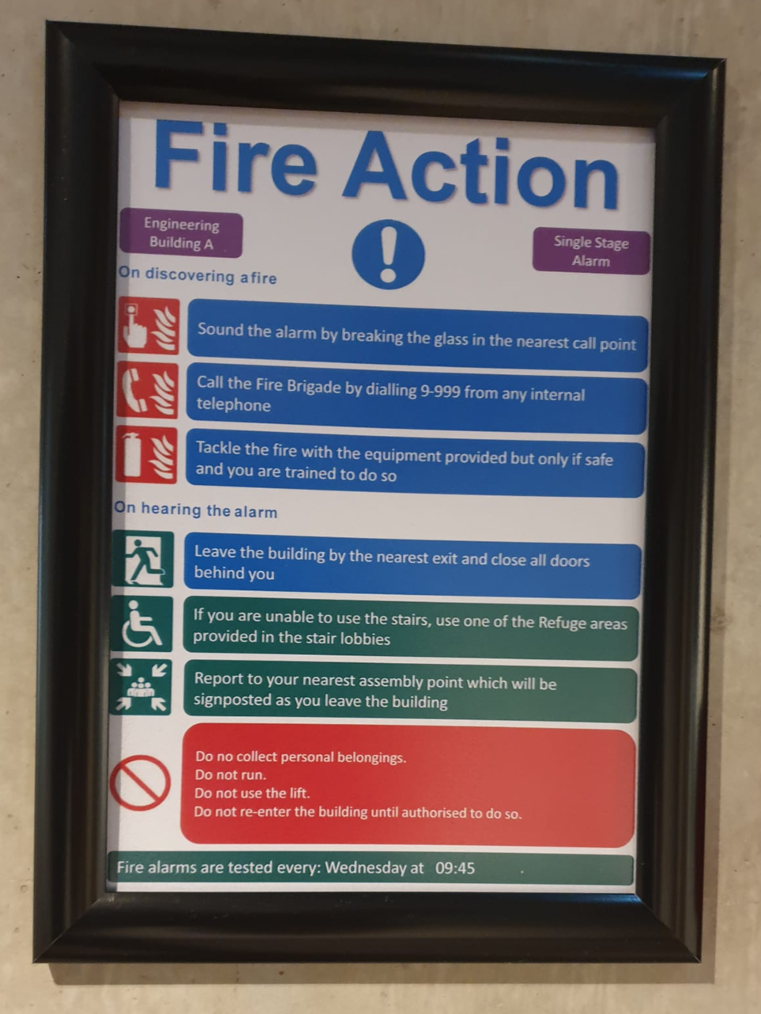
FIRE
Fire extinguisher (appropriate for electric fires).
Exit route
Two stage alarm (intermittent (no action required but prepare to move if necessary) – constant - evacuate) 1:45pm Wednesday test
Call Security – number on back of ID card

Slide 10
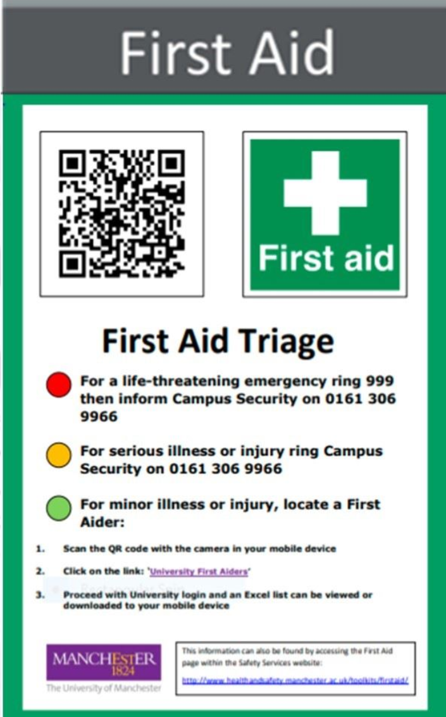
First Aid
QR code on signs leads to list of First Aiders.
If there is an incident that requires first aid inform Louise Dennis and Haroon Haladh
First aiders:
For life-threatening emergencies, call 999 and then inform Security on 0161 306 9966
For serious injuries and illnesses (and out of hours first aid), call Security on 0161 306 9966
For minor injuries and illnesses 9am-5pm, locate first aider using QR code on First aid notice

Slide 11
Out of hours
Currently we have no lab use out of core hours - 8am-6pm Mon-Fri
If you want to work outside core hours, then complete a specific activity RA and get it approved

