Slide 1
QueueFlow
QoS-Aware Traffic Prioritization in Software-Defined Networks
SDN Networking Project

Slide 2



Problem Statement
Unmanaged networks treat every packet identically — first in, first out. A bandwidth-greedy bulk transfer can crowd out a latency-sensitive flow sharing the same link, not by consuming bandwidth it needs, but by forcing it to wait in queue behind bulk traffic.
Shared 10 Mbps link
TCP blocking high-priority UDP packets
Bulk download packets flood the pipe
Bulk Buffer Flooding
Movie DL
(Bulk Transfer)
VoIP
BULK
Data 3
BULK
Data 2
BULK
Data 1
Result:
Video call packet stuck behind them
Increased jitter
Exit
→ Jitter, delay, and dropped packets on the call
Packet loss on real-time traffic
Degraded call/video quality
Starved Packet
Waiting behind queue
Video Call
(VoIP/Jitter-Sens.)
FIFO Scheme: No Prioritization or QoS Rules Applied
QueueFlow | 02

Slide 3

The Solution: SDN-Based QoS
Our framework dynamically classifies network traffic and prioritizes latency-sensitive UDP flows over bandwidth-intensive TCP transfers.
1
2
3
Traffic Classification
Dedicated Queuing
Forwarding & Limits
Using a RYU controller, programmatic OpenFlow rules inspect headers to dynamically distinguish between real-time and bulk transfers.
Traffic is mapped to separated, dedicated egress queues configured directly on the bottleneck link, bypassing global FIFO queues.
Forward UDP on a high-priority queue with guaranteed bandwidth, while bulk TCP transfers are placed in a rate-limited, lower-priority queue.
This prevents TCP traffic from monopolizing the shared link, reducing queueing delay and jitter for UDP packets.
QueueFlow | 03

Slide 4
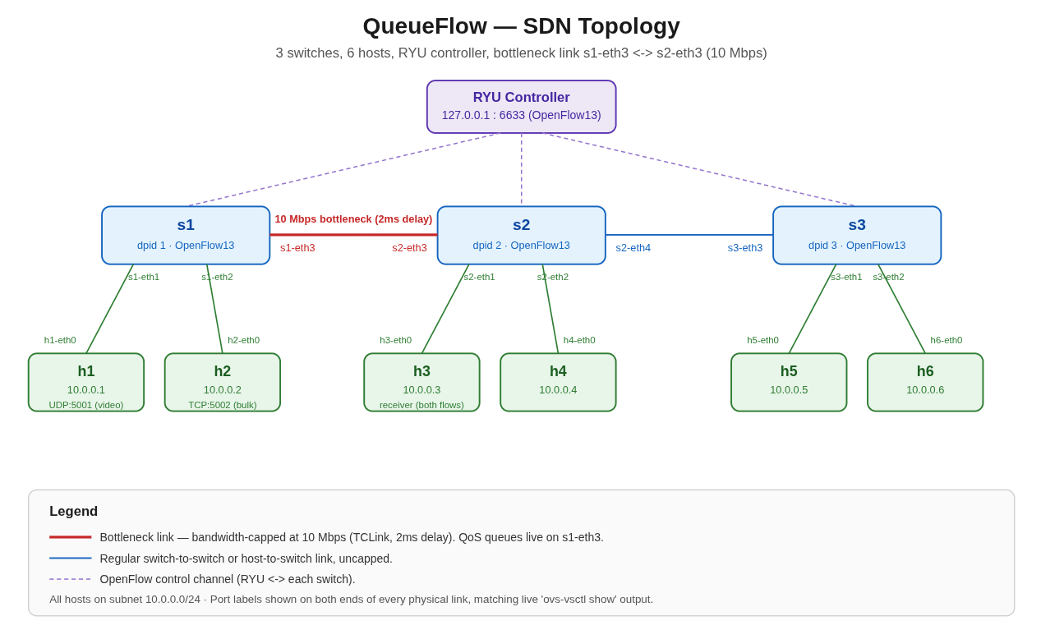
System Architecture & Topology
RYU Controller
10 Mbps bottleneck — QoS queues live here
s1
s2
s3
s1-eth3
s2-eth3
s2-eth4
s3-eth3
h1
h2
h3
h4
h5
h6
10.0.0.1
10.0.0.2
10.0.0.3
10.0.0.4
10.0.0.5
10.0.0.6
s1-eth1
s1-eth2
s2-eth1
s2-eth2
s3-eth1
s3-eth2
UDP 5001 — video
TCP 5002 — bulk
receiver
Bandwidth-capped bottleneck link (10 Mbps)
OpenFlow control channel
All hosts on 10.0.0.0/24 · OpenFlow 1.3
QueueFlow | 05

Slide 5
Flow Rule Implementation
1. Automatic (via RYU controller code, qos_controller.py)
Table-miss Rule
Installed automatically when each switch connects to establish the default pipeline.
qos_controller.py
# Define action list for matched QoS flow
actions = [
OFPActionSetQueue(queue_id),
OFPActionOutput(out_port)
]
QoS Classification Rules
Matches traffic on key ports to separate flows:
Matches on udp_dst=5001 or tcp_dst=5002
Applies SET_QUEUE and output actions dynamically as traffic arrives
QueueFlow | 06

Slide 6
QoS Policy Configuration
Two-layer queue mechanism
Layer 1 — OVS / kernel (setup_queues.sh)
Design rationale: reserve generous headroom above the video call's actual 3 Mbps need, then deliberately squeeze bulk traffic well below the raw link capacity so the enforcement effect is clearly measurable.
Creates HTB queues on the bottleneck port s1-eth3, with real rate limits enforced by Linux tc.
Layer 2 — Controller (qos_controller.py)
A flow rule's SET_QUEUE action routes matched packets into the correct queue at runtime.
Configured queue rates (10 Mbps link)
ovs-vsctl set port s1-eth3 qos=@newqos \
-- --id=@newqos create qos type=linux-htb \
other-config:max-rate=10000000 \
queues=0=@q0,1=@q1 \
-- --id=@q0 create queue \
other-config:max-rate=9000000 \
-- --id=@q1 create queue \
other-config:max-rate=2000000
Queue 0 — priority (video)
6–9 Mbps
Queue 1 — capped (bulk)
0.5–2 Mbps
QueueFlow | 07

Slide 7
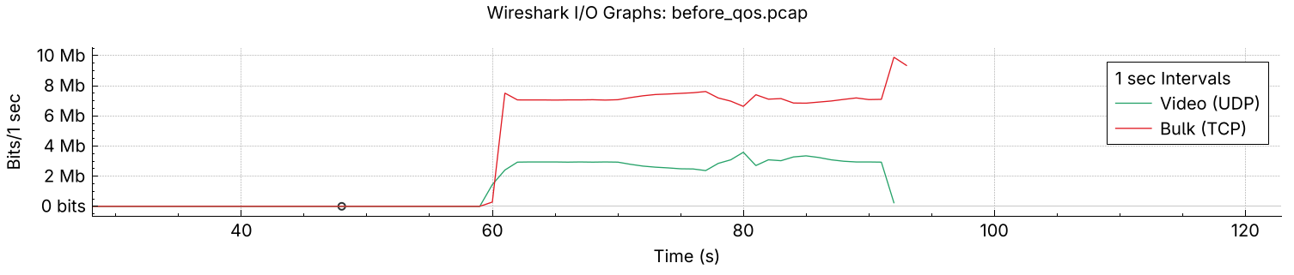
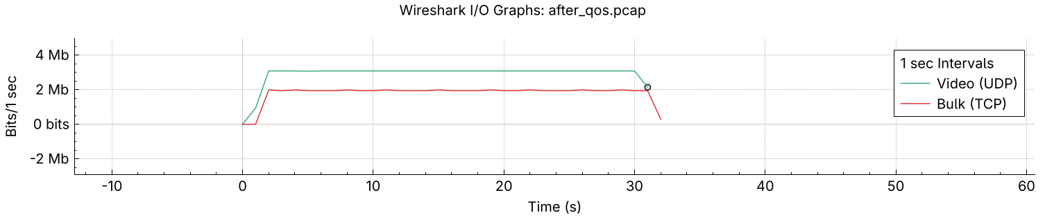
Traffic Monitoring
Before queue setup :
After queue setup :

Slide 8
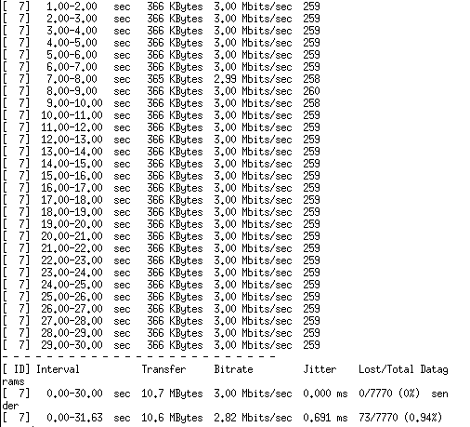
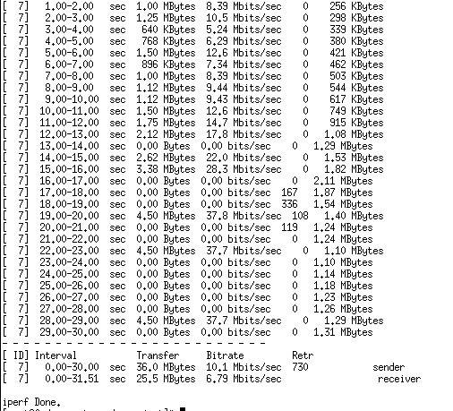
Performance Analysis — Raw Traffic Data (Before Qos)
UDP Data Stream (iperf3 client)
TCP Data Stream (iperf3 client)
QueueFlow | 08

Slide 9
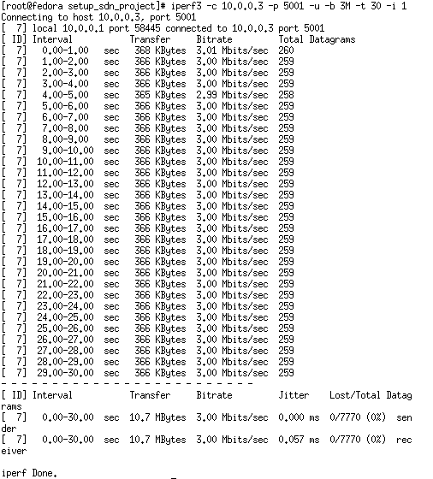
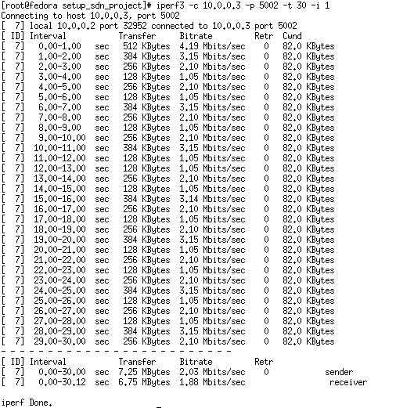
Performance Analysis — Raw Traffic Data (After QoS)
UDP Data Stream (iperf3 client)
TCP Data Stream (iperf3 client)
QueueFlow | 10

Slide 10
Performance Analysis — Before vs. After QoS
Metric | Before QoS | After QoS
UDP jitter (video) | 0.691 ms | 0.057 ms
UDP packet loss | 73 / 7770 (1.1%) | 0 / 7770 (0%)
TCP throughput (bulk) | ~10.1 Mbps | ~1.9 Mbps (capped)
TCP retransmissions | 730 | 0
Every metric moved in the expected direction, and the after-QoS values land almost exactly on the configured queue rates — strong evidence the mechanism works as designed.
Validated with two independent tools
iperf3 — endpoint throughput / jitter / loss statistics
Wireshark — on-the-wire packet capture and I/O graphs
QueueFlow | 09

Slide 11
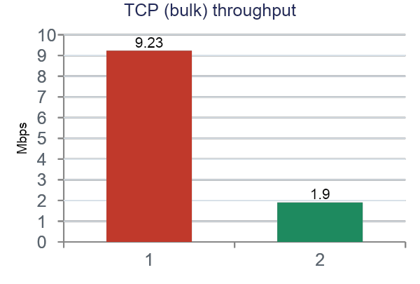
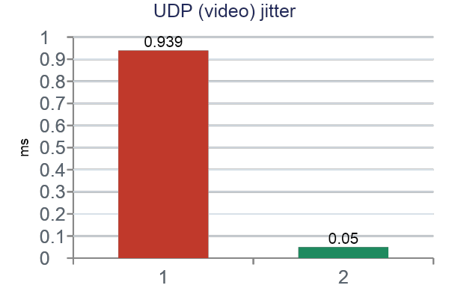
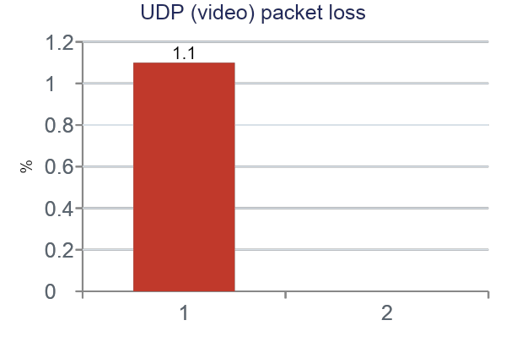
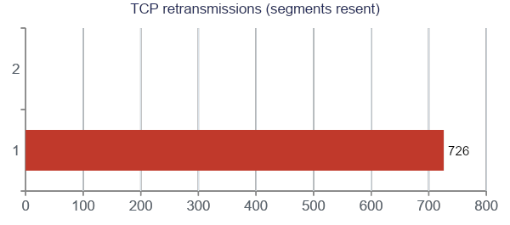
Performance Analysis — Charts
QueueFlow | 10

Slide 12
Conclusion
SDN-based QoS enforcement successfully protected latency-sensitive traffic from being degraded by competing bulk traffic — validated through two independent measurement methods, both showing consistent results.
Centralized control (RYU) enabled consistent, instantly-updatable policy across the network
Two-layer queue mechanism (OVS/HTB + OpenFlow SET_QUEUE) enforced both priority and rate limits
Real-time flow: jitter dropped from 0.691 ms → 0.057 ms, loss from 1.1% → 0%
Bulk flow: reliably capped at the configured ~2 Mbps ceiling, retransmissions eliminated
QueueFlow | 11

Slide 13
Thank You
Questions?

