Slide 1
By
A. ARUN
211521243022
B.Tech - A.I&D.S
PANIMALAR INSTITUTE OF TECHNOLOGY
Capstone Project

Slide 2
PROJECT TITLE
Deep Convolutional Generative Adversarial Network (DCGAN) for Handwritten Digit Generation

Slide 3


AGENDA
PROBLEM STATEMENT
PROJECT OVERVIEW
WHO ARE THE END USERS?
SOLUTION AND ITS VALUE PROPOSITION
THE WOW IN THE SOLUTION
MODELLING
RESULTS
OUTPUTS
CONCLUSION
3/21/2024 Annual Review

Slide 4

PROBLEM STATEMENT
Generating realistic handwritten digits is challenging due to variations in style and shape. Existing datasets may lack diversity or fail to cover all possible scenarios, leading to limitations in training digit recognition models.

Slide 5

PROJECT OVERVIEW
Project Objective:
Develop a GAN-based system capable of generating diverse and realistic handwritten digits.
Approach:
Utilize the adversarial training paradigm to train a Generator and Discriminator network simultaneously.
Implement Convolutional Neural Networks (CNNs) for both Generator and Discriminator architectures.

Slide 6

WHO ARE THE END USERS?
Digit recognition system developers.
Researchers in machine learning and computer vision.
Educational institutions for creating digit datasets and resources.

Slide 7

THE SOLUTION AND ITS VALUE PROPOSITION
Solution:
Implementation of GANs, a state-of-the-art deep learning technique, for generating handwritten digits.
Incorporation of data preprocessing techniques such as normalization and resizing to enhance model performance.
Value Proposition:
Provides an automated and scalable solution for generating large quantities of diverse handwritten digits.
Enables the creation of custom datasets tailored to specific requirements.

Slide 8

THE WOW IN THE SOLUTION
Adoption of Convolutional Transpose layers in the Generator to upscale latent vectors into high-resolution images.
Introduction of LeakyReLU activation function in the Discriminator to prevent sparse gradients and improve training stability.
3/21/2024 Annual Review

Slide 9
MODELLING
Generator Architecture:
Sequential arrangement of Convolutional Transpose layers, Batch Normalization, and ReLU activation functions.
Transformation of random noise vectors into realistic images resembling handwritten digits.
Discriminator Architecture:
Stacked Convolutional layers with LeakyReLU activation for discriminating between real and fake images.
Utilization of Batch Normalization to improve convergence and training speed.

Slide 10
RESULTS
Training Progress:
Graphical representation of Generator and Discriminator losses over training epochs.
Demonstration of convergence and stability of the GAN training process.
Generated Images:
Visual comparison between real and generated handwritten digits.
Evaluation metrics such as Frechet Inception Distance (FID) to quantify image quality and diversity.
Github Link

Slide 11
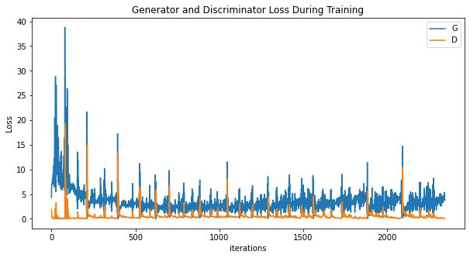
OUTPUTS

Slide 12
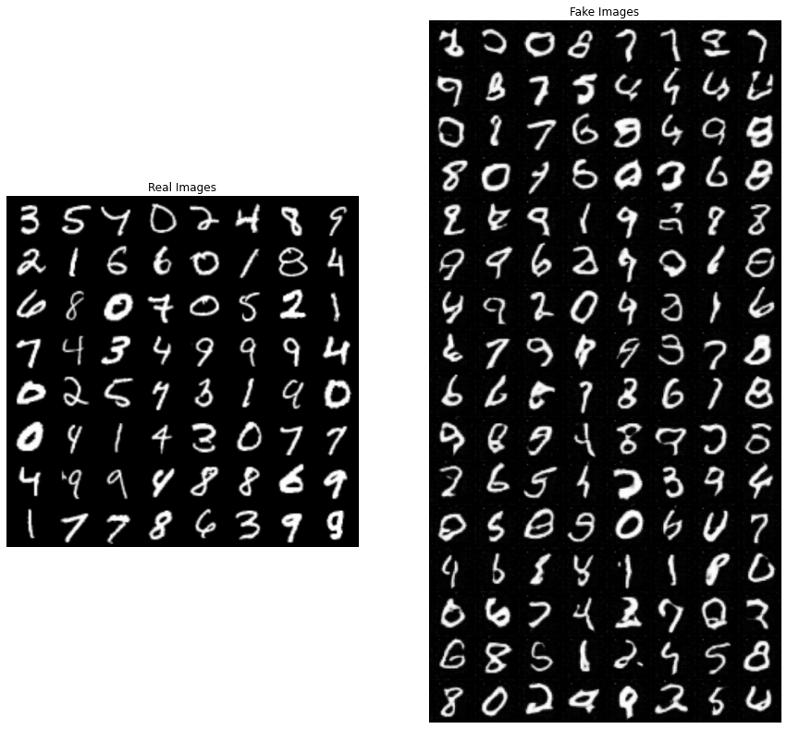
Comparison - Real Vs Fake Images

Slide 13
CONCLUSION
Summary:
Successful development of a GAN-based system for generating high-quality handwritten digits.
Discussion on challenges faced during model training and optimization.
Future Directions:
Exploration of advanced GAN variants such as Wasserstein GANs or Progressive GANs for further improving image quality.
Integration of domain-specific knowledge to enhance digit generation for specific applications (e.g., medical imaging or forensic analysis).

Slide 14
THANK YOU!!

