Slide 1
By
A. ARUN
211521243022
Final Project

Slide 2
PROJECT TITLE
Deep Convolutional Generative Adversarial Network (DCGAN) for Handwritten Digit Generation

Slide 3


AGENDA
PROBLEM STATEMENT
PROJECT OVERVIEW
WHO ARE THE END USERS?
SOLUTION AND ITS VALUE PROPOSITION
THE WOW IN THE SOLUTION
MODELLING
RESULTS
OUTPUTS
CONCLUSION
3/21/2024 Annual Review

Slide 4

PROBLEM STATEMENT
Generating realistic handwritten digits is challenging due to variations in style and shape.

Slide 5

PROJECT OVERVIEW
Project Objective:
Develop a GAN-based system capable of generating diverse and realistic handwritten digits.
Approach:
Utilize the adversarial training paradigm to train a Generator and Discriminator network simultaneously.
Implement Convolutional Neural Networks (CNNs) for both Generator and Discriminator architectures.

Slide 6

WHO ARE THE END USERS?
Digit recognition system developers.
Researchers in machine learning and computer vision.
Educational institutions for creating digit datasets and resources.

Slide 7

THE SOLUTION AND ITS VALUE PROPOSITION
Solution:
Implementation of GANs, a state-of-the-art deep learning technique, for generating handwritten digits.
Incorporation of data preprocessing techniques such as normalization and resizing to enhance model performance.
Value Proposition:
Provides an automated and scalable solution for generating large quantities of diverse handwritten digits.
Enables the creation of custom datasets tailored to specific requirements.

Slide 8

THE WOW IN THE SOLUTION
Adoption of Convolutional Transpose layers in the Generator to upscale latent vectors into high-resolution images.
Introduction of LeakyReLU activation function in the Discriminator to prevent sparse gradients and improve training stability.
3/21/2024 Annual Review

Slide 9
MODELLING
Generator Architecture:
Sequential arrangement of Convolutional Transpose layers, Batch Normalization, and ReLU activation functions.
Transformation of random noise vectors into realistic images resembling handwritten digits.
Discriminator Architecture:
Stacked Convolutional layers with LeakyReLU activation for discriminating between real and fake images.
Utilization of Batch Normalization to improve convergence and training speed.

Slide 10
RESULTS
Training Progress:
Graphical representation of Generator and Discriminator losses over training epochs.
Demonstration of convergence and stability of the GAN training process.
Generated Images:
Visual comparison between real and generated handwritten digits.
Evaluation metrics such as Frechet Inception Distance (FID) to quantify image quality and diversity.
Github Link

Slide 11
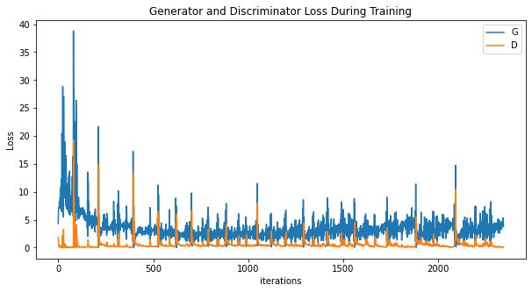
OUTPUTS

Slide 12
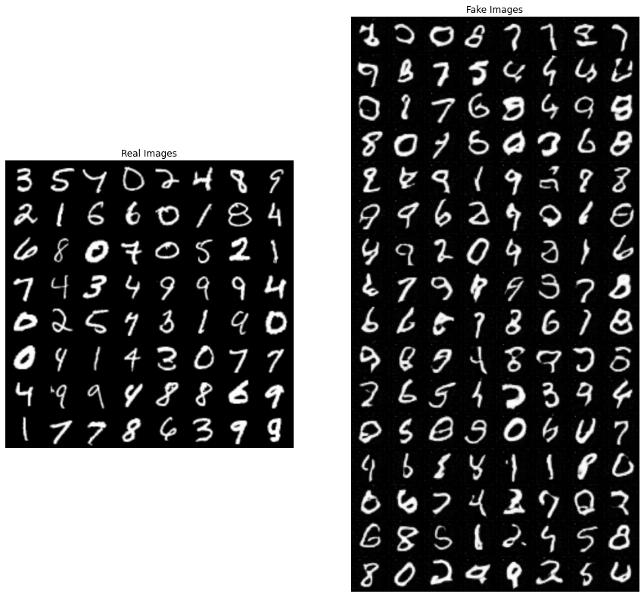
Comparison - Real Vs Fake Images

Slide 13
CONCLUSION
Summary:
Successful development of a GAN-based system for generating high-quality handwritten digits.
Discussion on challenges faced during model training and optimization.
Future Directions:
Exploration of advanced GAN variants such as Wasserstein GANs or Progressive GANs for further improving image quality.
Integration of domain-specific knowledge to enhance digit generation for specific applications (e.g., medical imaging or forensic analysis).

Slide 14
THANK YOU!!

