Slide 1
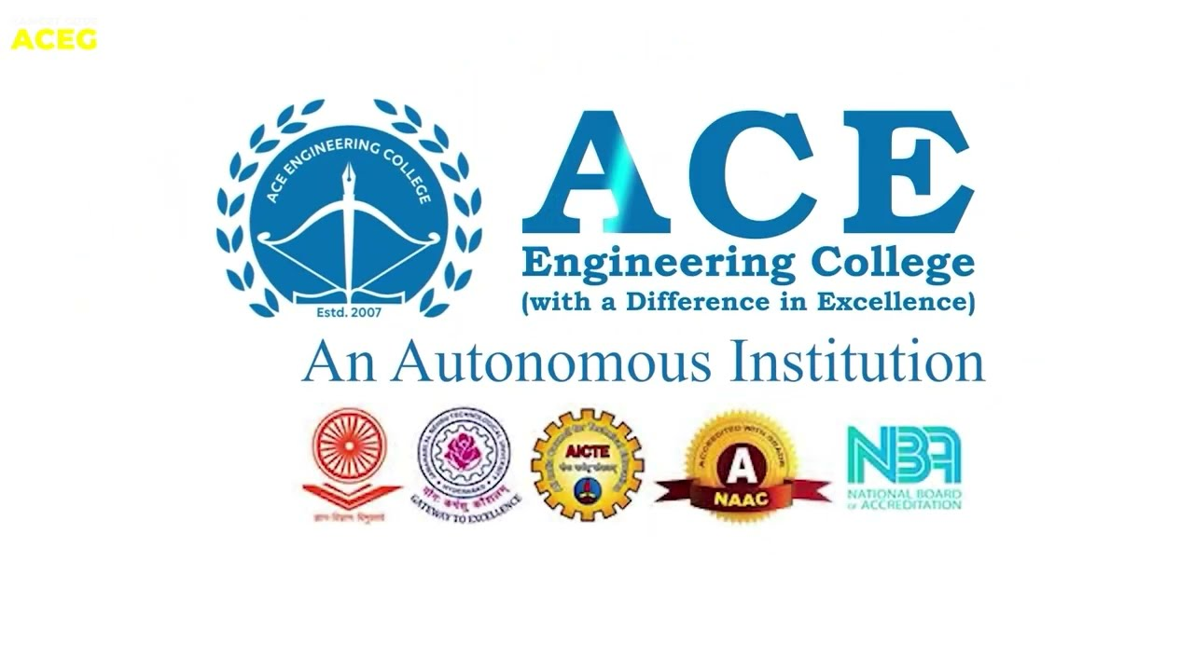
VISION-BASED GESTURE CONTROL SYSTEM
Presented by: Guide name: Coordinator name: Head Of Department(CSM):
24AG1A66D2(A. Praveen Kumar) Mr. S. Venkatesh Dr. Ch. Kishore Kumar Dr. S. Kavitha
24AG1A66E8(D. Tharun)
24AG1A66G9(MD. Hussain)

Slide 2
Abstract
we are always looking for smarter and easier ways to interact with computers. The Handle Cursor Controller is a system that allows users to control the computer cursor using simple hand gestures instead of a traditional mouse. By using a webcam and computer vision technology, the system detects hand movements and converts them into actions like moving the cursor, clicking, and scrolling. This project focuses on creating a touch-free, innovative, and user-friendly solution that makes computer interaction more natural and modern.
This project proposes a Vision-Based Cursor Control System that allows users to interact with a computer using hand gestures instead of a physical mouse. By leveraging a standard webcam and the MediaPipe framework, the system tracks the user's hand landmarks in real-time.

Slide 3
Introduction
The Handle Cursor Controller is a gesture recognition system that uses a webcam to capture live video. The system detects the user’s hand and tracks finger movement. Based on different gestures, the system performs actions such as:*Moving the cursor, Drag and drop
Scroll It works using computer vision, image processing, and machine learning techniques. The goal is to make interaction with computers more natural and easy.
The evolution of HCI is moving toward more natural, "touchless" Interfaces. This project utilizes Python, OpenCV (for video processing), and MediaPipe (for high-fidelity hand tracking) to map hand coordinates to screen coordinates.

Slide 4
Literature Survey
Foundational Frameworks & Core Logic
Goal: Identifying the technical pillars and architectural origins of gesture control.
Google Research (2020) – MediaPipe Hands:
Introduced the core two-stage pipeline: Palm Detector and Landmark Model.
Extracts 21 3D landmarks from a single RGB camera frame.
Provides the high-fidelity data necessary for finger-curl analysis and wrist-relative mapping.
Kotti et al. (2024) – AI Virtual Mouse & Keyboard:
Explored the elimination of physical hardware using OpenCV and MediaPipe.
Focused on touchless interaction efficiency, particularly for public/educational settings.
Emphasized advanced Python integration to reduce human intervention.

Slide 5
Enhancing Stability & Multimodal Interaction Goal: Solving technical bottlenecks like jitter, background noise, and user cognitive load.
Sandhya et al. (2023) – Addressing Environmental Noise:
Identified lighting and background noise as primary failure points for responsiveness.
Project v4.0 Improvement: Adopts their focus on EMA Smoothing and Gesture History Buffers to eliminate cursor "flicker.“
Divate et al. (2024) – Robustness Against Backgrounds:
Researched stabilization techniques for "noisy" or non-standard backgrounds.
Utilizes confidence buffering to ensure accuracy during high-speed movements.
Osman (2024) – Multimodal & Human-Centric Design:
Introduced combining hand gestures with voice assistants for total hands-free control.
Highlighted the need for personalized gesture patterns to minimize the user's learning curve and cognitive load.

Slide 6
Problem Statement
Traditional mouse devices have some limitations:
They require physical contact
They may not be hygienic in shared environments
They are not convenient for physically challenged people
Hardware devices can get damaged*
Limited innovation in interaction methods
There is a need for a touchless, cost-effective, and innovative solution for cursor control

Slide 7
HARDWARE REQUIREMENTS
Processor: Intel Core i5 or above (Recommended for real-time Computer Vision processing).
RAM: 8 GB or higher to handle concurrent MediaPipe landmark detection and frame rendering.
Storage: 256 GB SSD or higher for efficient library management and data logs.
Camera: Integrated HD Webcam or external USB Camera (720p/60fps recommended for optimal gesture stability).
Monitor: Standard resolution display for cursor mapping and Smartboard visualization.

Slide 8
SOFTWARE REQUIREMENTS
Operating System: 64-bit Windows 10/11, Linux (Ubuntu/CentOS), or macOS.
Languages: Python 3.8 or higher.
Computer Vision Libraries: OpenCV-Python (cv2) and MediaPipe.
Automation Libraries: PyAutoGUI (for system-level mouse and keyboard control).
Utility Libraries: NumPy, Subprocess (for OS-level commands), and Collections (for temporal buffering).
Tools: Visual Studio Code, Jupyter Notebook or Eclipse

Slide 9
Solutions
1. Core Technical Architecture
MediaPipe Integration: High-fidelity extraction of 21 3D hand landmarks for pinpoint accuracy.
Intelligent Signal Processing: * EMA Smoothing: Eliminates cursor jitter for pixel-perfect navigation.
Temporal Filtering: Ensures gesture stability even during rapid movement.
Coordinate Mapping: Wrist-relative positioning to maintain control regardless of hand distance from the camera.
2. Feature Ecosystem
Virtual Navigation: Smooth, "zero-lag" cursor movement and clicking.
Smartboard Mode: Intuitive "air-drawing" functionality for presentations and education.
Media & System Control: Dynamic gestures for volume adjustment (pinch-to-slide) and screenshot capture.

Slide 10
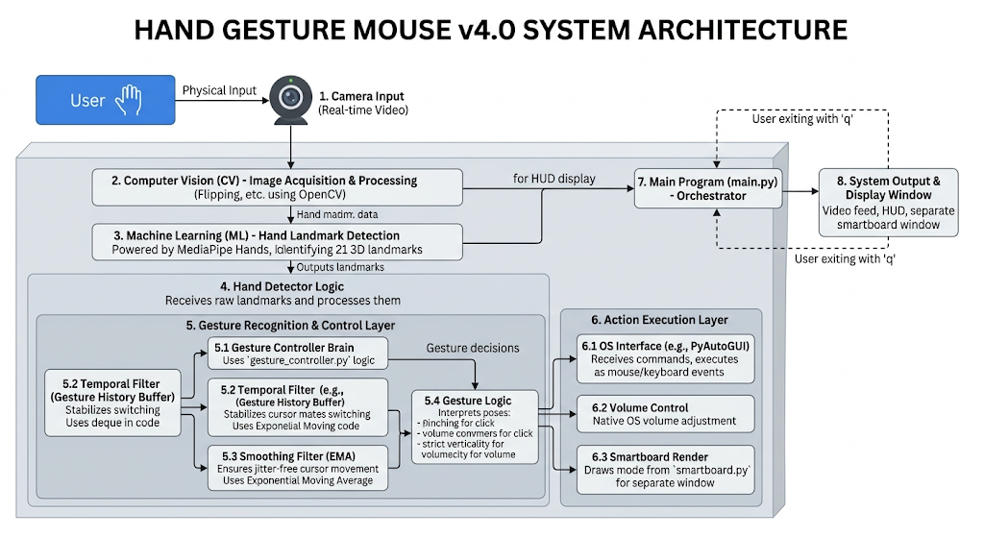
System Architecture

Slide 11
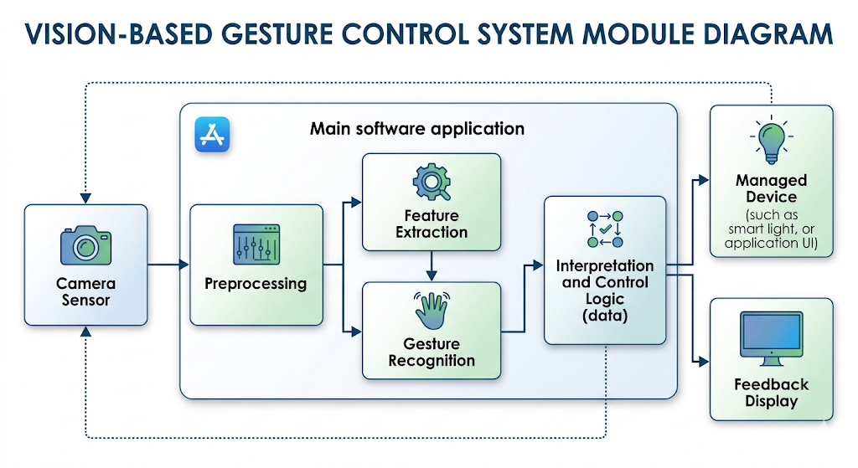
System Module

Slide 12
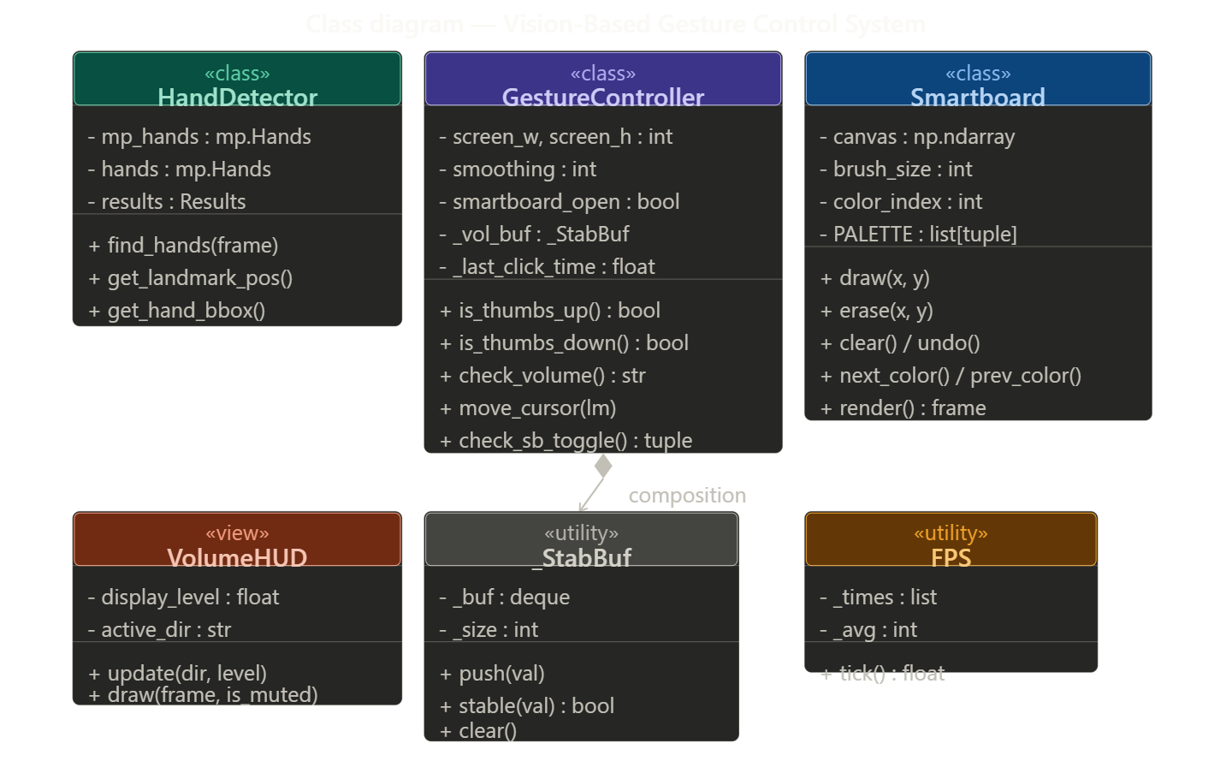
CLASS DIAGRAM

Slide 13
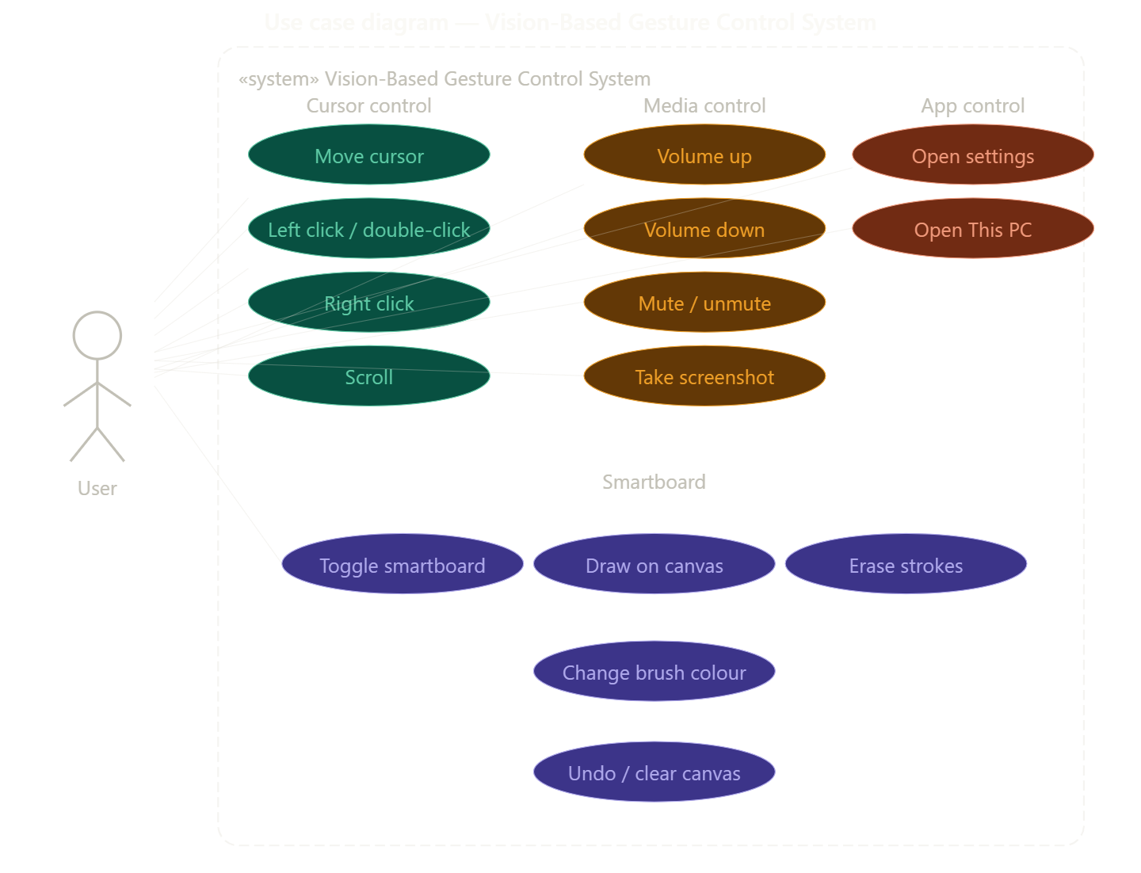
USE CASE DIAGRAM

Slide 14
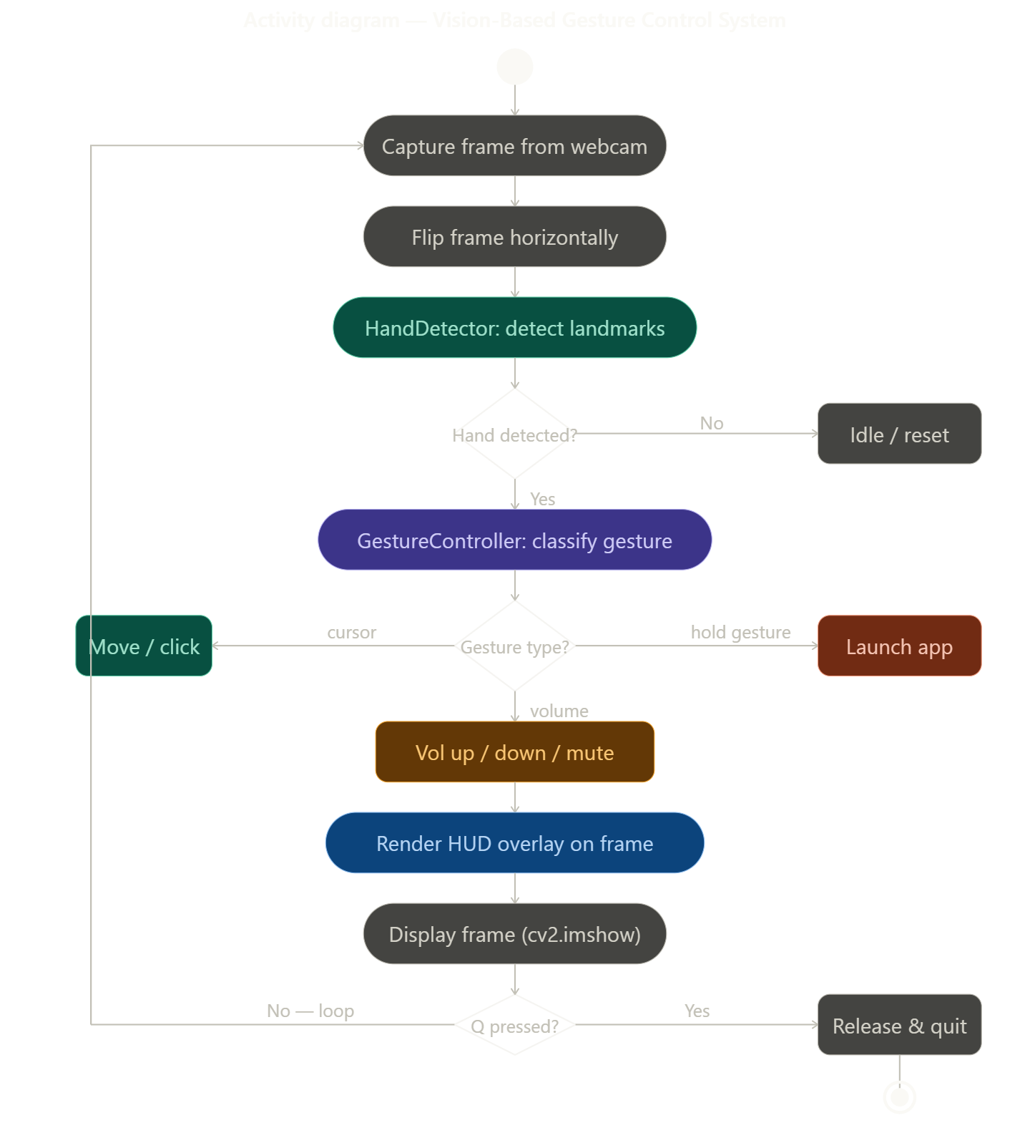
ACTIVITY DIAGRAM

Slide 15
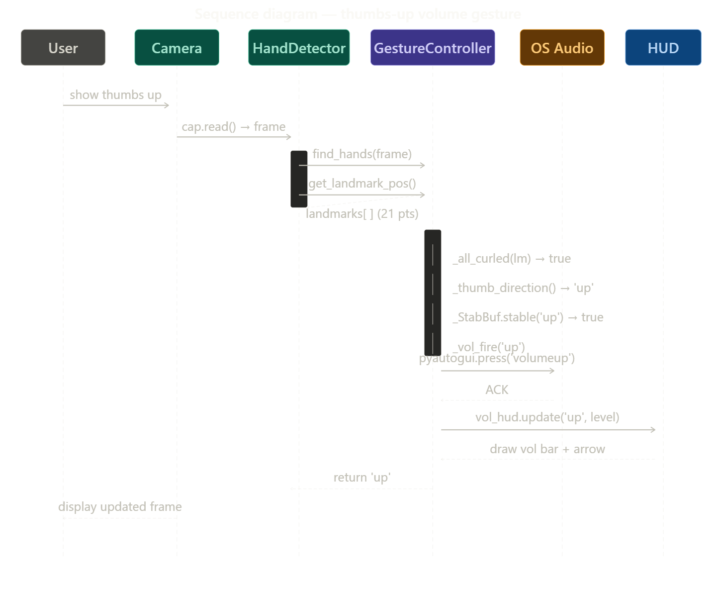
SEQUENCE DIAGRAM

Slide 16
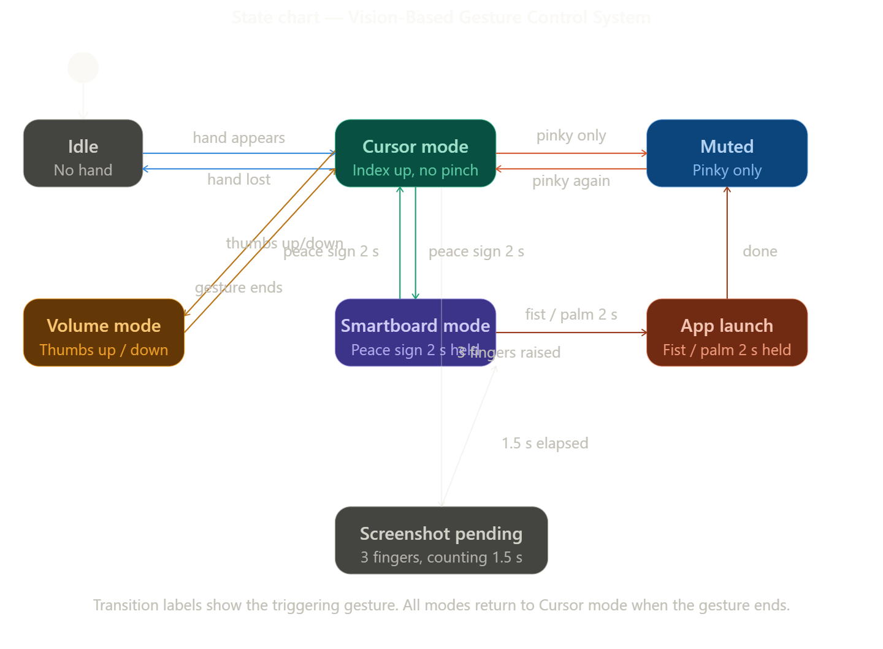
STATE CHART DIAGRAM

Slide 17
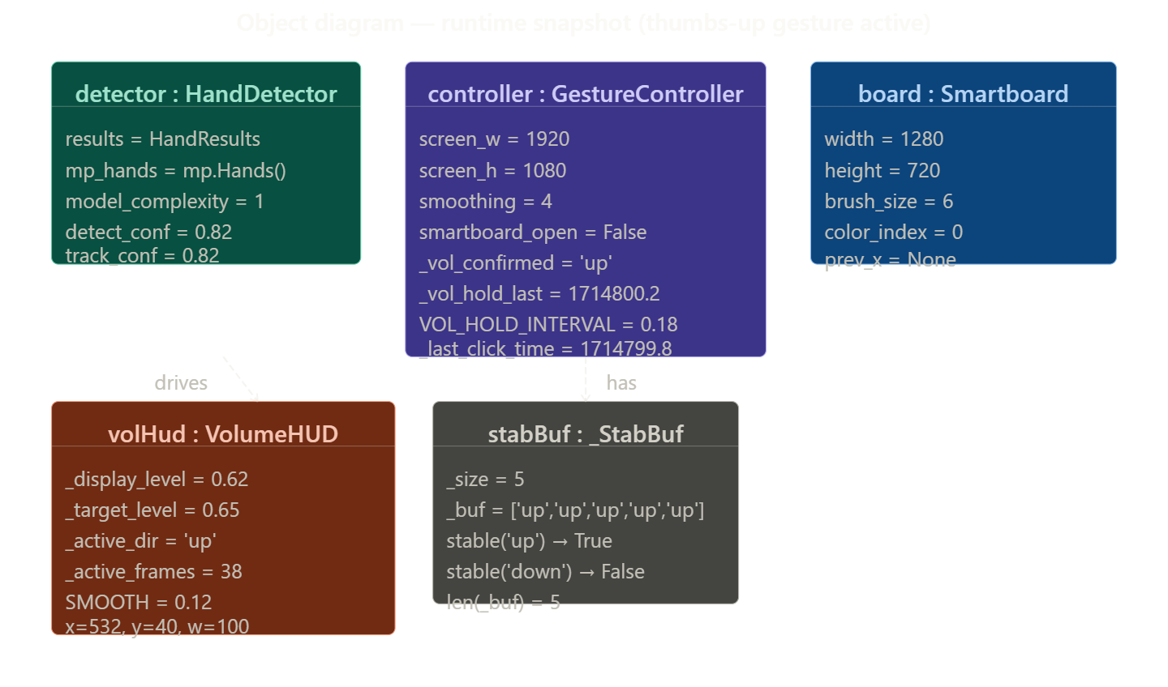
OBJECT DIAGRAM

Slide 18
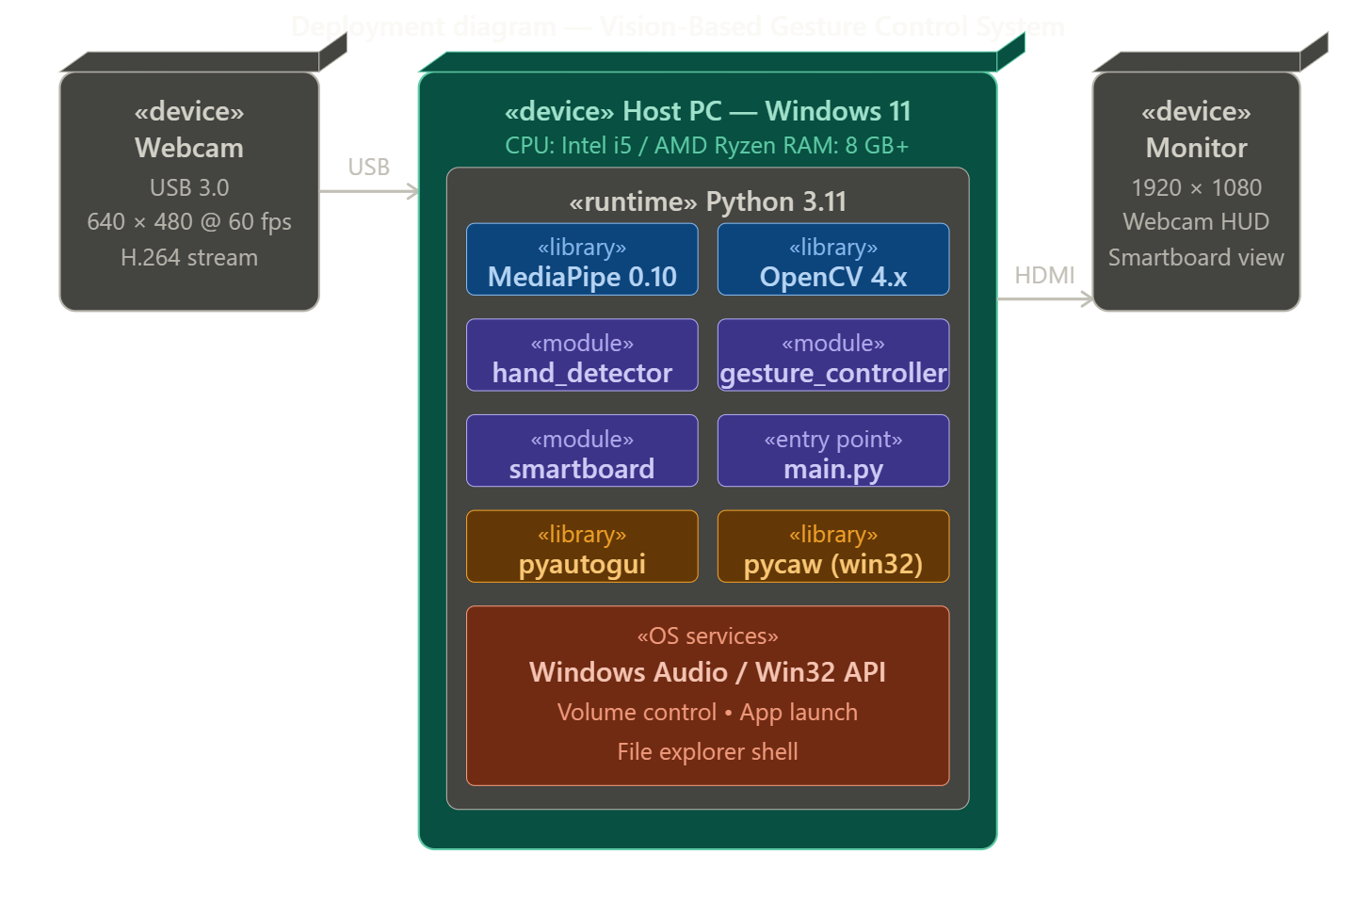
DEPLOYMENT DIAGRAM

Slide 19
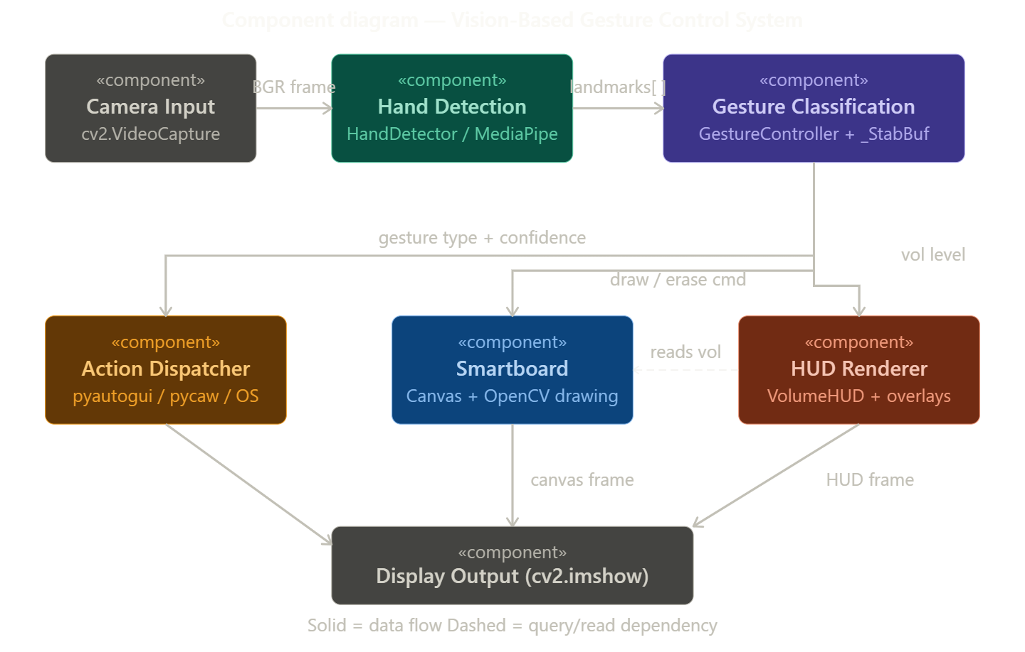
COMPONENET DIAGRAM

Slide 20
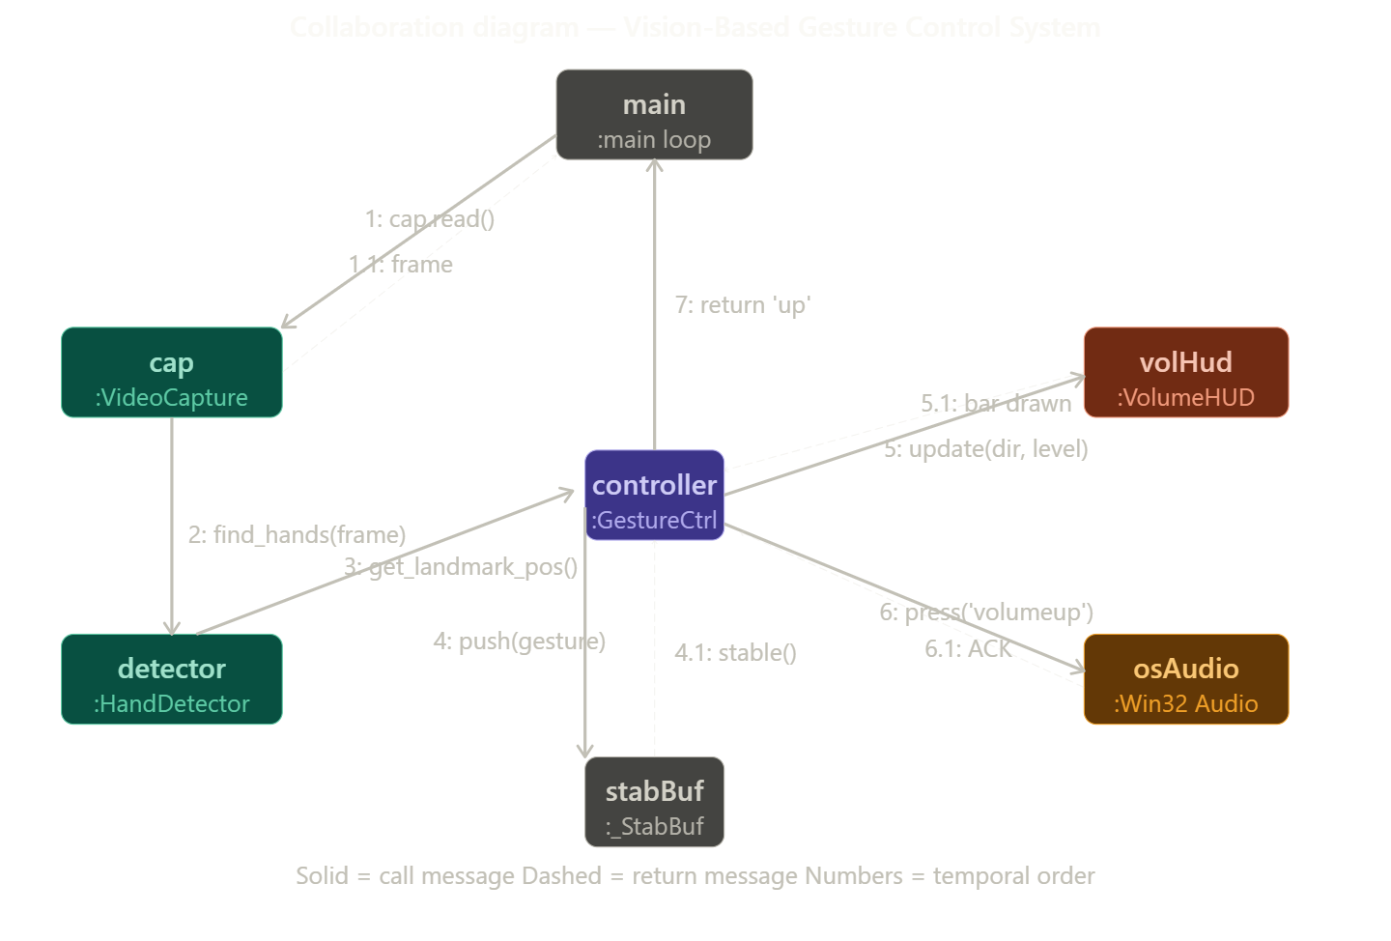
COLLABORATION DIAGRAM

Slide 21
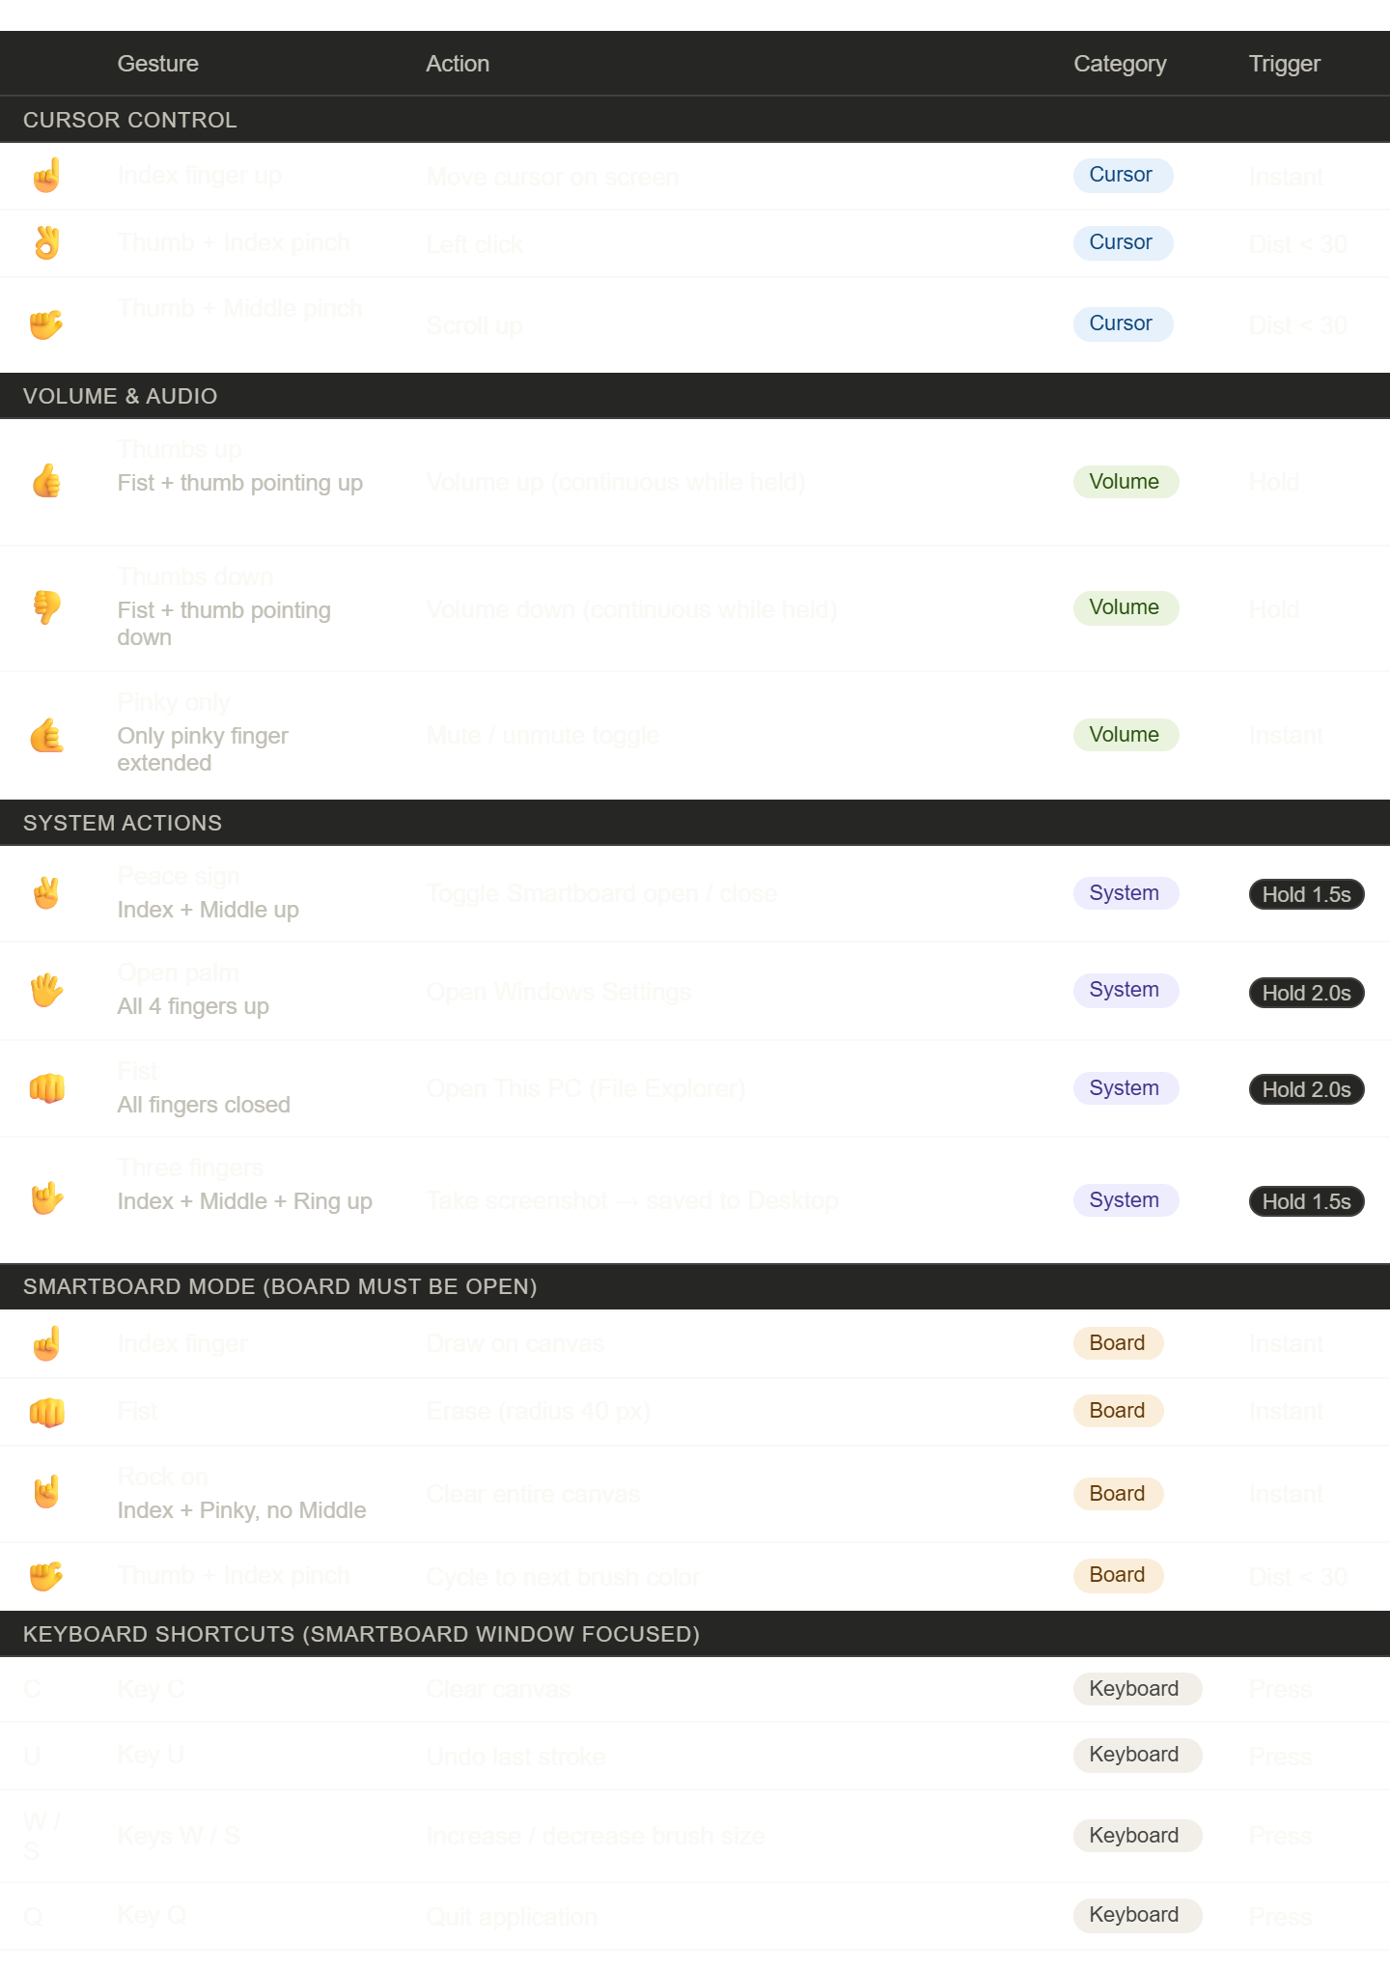
Gestures

Slide 22
Testing
Testing for the Hand Gesture Mouse project aims to ensure the software meets the specified Human-Computer Interaction (HCI) requirements, performs with high precision, and delivers a stable user experience. It involves a systematic process of evaluating the system to identify defects, such as landmark jitter, gesture misclassification, or system-level command latency. Through various testing methods, including unit testing, integration testing, system testing, and acceptance testing, the developer can validate the software's gesture accuracy, real-time performance, and cross-platform usability. By identifying and addressing issues like "cursor flickering" early in the development lifecycle, testing helps improve software stability and increase user satisfaction for touchless computing.

Slide 23
Types of Testing
Unit Testing
Focus: Individual logic components (e.g., Euclidean math, landmark extraction).
Goal: Catch bugs in gesture logic early by isolating mathematical units.
Integration Testing
Focus: Module handovers (e.g., MediaPipe data to Gesture Controller).
Goal: Ensure seamless data flow between image processing and OS execution.
System Testing
Focus: End-to-end workflow (Webcam $\rightarrow$ AI Model $\rightarrow$ Mouse Movement).
Goal: Verify total system stability and accuracy during live operation.
Acceptance Testing
Focus: End-user experience (e.g., sensitivity for presenters/accessibility).
Goal: Validate real-world usability and performance across various lighting conditions.
Performance Testing
Focus: Hardware workload and Frame Rate (FPS) stability.
Goal: Eliminate lag, "coordinate jumping," and high CPU crashes during 3D processing.

Slide 24
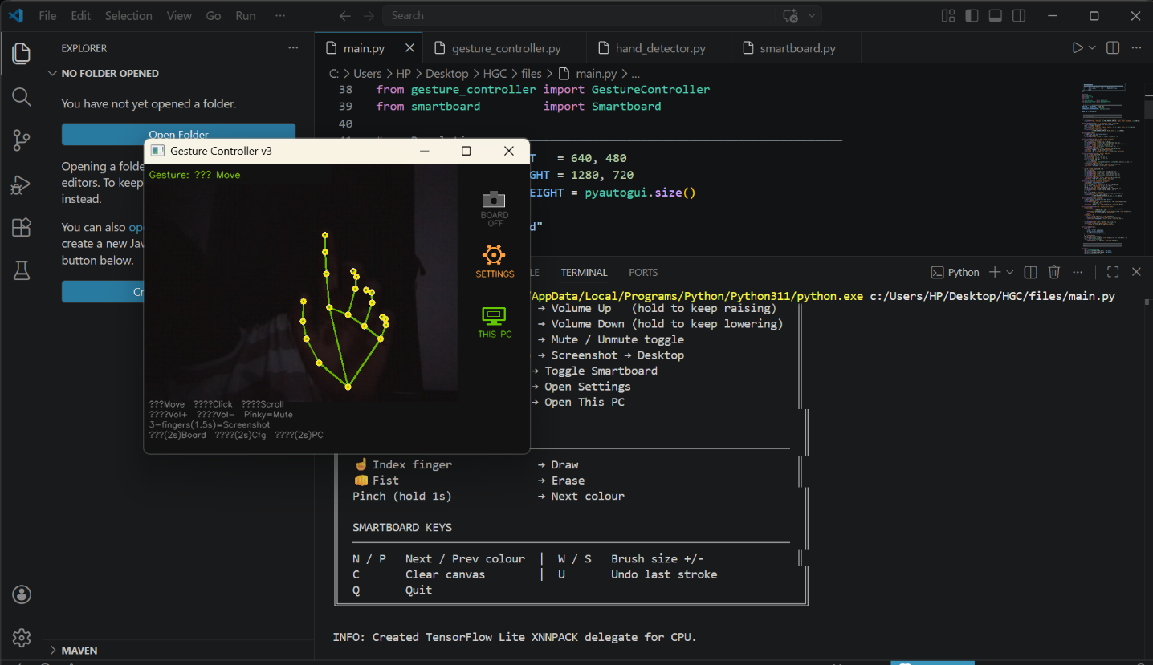
TESTING OUTPUTS: ---

Slide 25
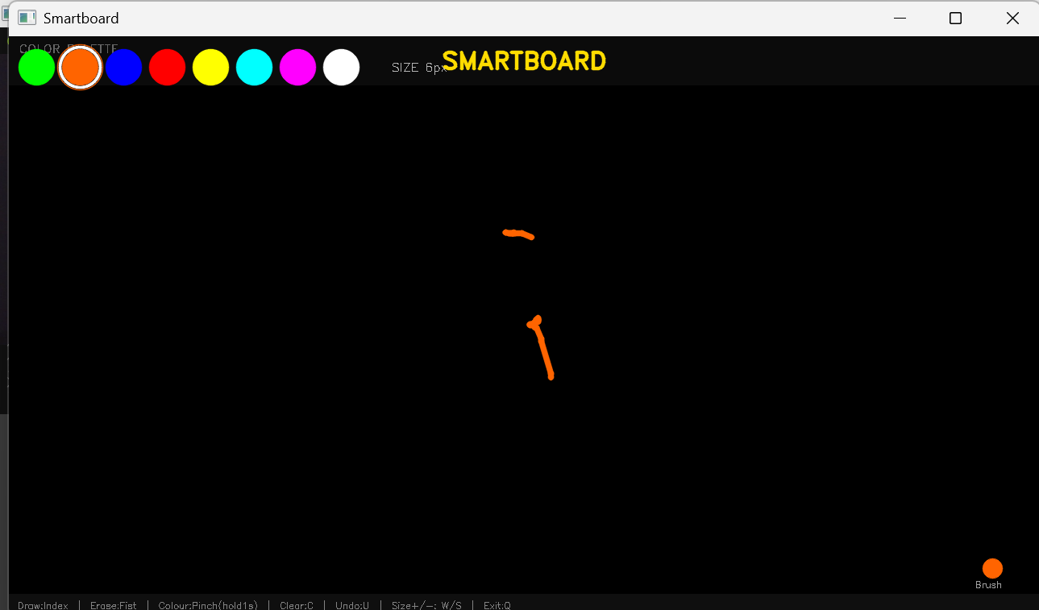

Slide 26
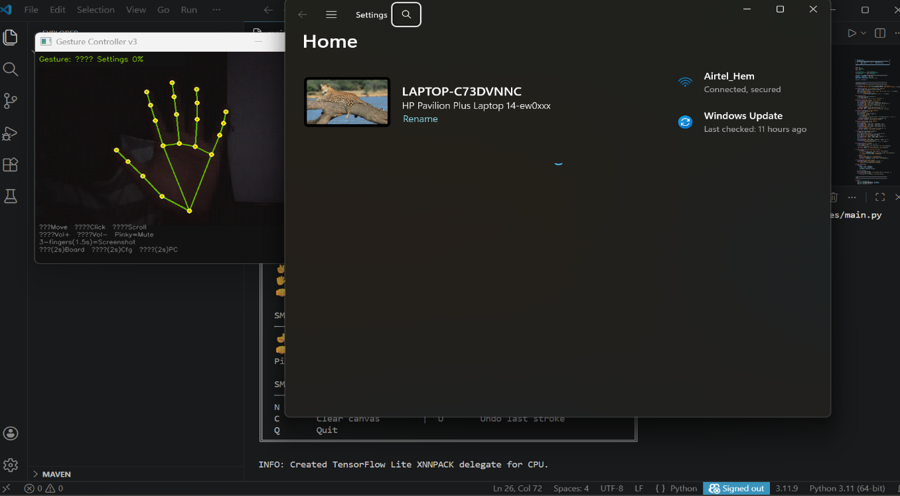

Slide 27
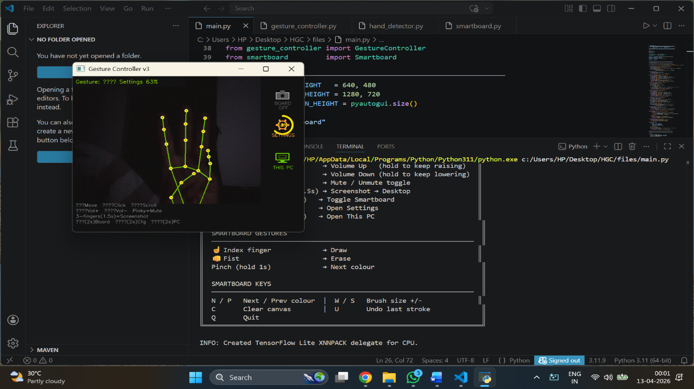

Slide 28
Future Enhancements: The Path Toward Intuitive Interaction
The next phase of the Hand Gesture Mouse system focuses on evolving from simple coordinate tracking to a deeper, more human-like understanding of intent.
Advanced Dynamic Recognition: Implementing RNN and LSTM models to interpret motion sequences (like "air-writing") rather than just static hand shapes.
Contextual Intelligence: Using Vision-Language Models (VLMs) to let the system understand what app is being used (e.g., CAD software vs. medical tools) and predict the user's next logical step.
Transparency & Privacy: * Explainable AI (XAI): Real-time feedback explaining errors (e.g., "lighting too low").
Edge Computing: Processing all video data locally on the device to ensure total user privacy.
Multimodal & Tactile Feedback: Integrating voice commands, eye-tracking, and mid-air haptic feedback to simulate the physical "click" feel.

Slide 29
Conclusion
The Handle Cursor Controller is a simple yet powerful system that replaces the traditional mouse with hand gestures. It promotes touchless technology and improves accessibility for users. This project shows how computer vision can be used to create more natural and intelligent interaction systems. In the future, this system can be enhanced with better accuracy, AI integration, and advanced gesture recognition features. Overall, it represents a step toward smarter and more user-friendly technology.

Slide 30
References
MediaPipe Documentation: Google Open Source - Hand Tracking
OpenCV Library: Official OpenCV Docs for image manipulation and frame handling.
PyAutoGUI Documentation: PyAutoGUI GitHub for cross-platform mouse and keyboard control.
Research Paper: Zhengyou Zhang, "Microsoft Kinect Sensor and Its Effect," IEEE Multimedia, 2012 (For foundational concepts on depth and gesture sensing).

Slide 31
THANK YOU

