Slide 1


OR
CS109 Final project
Stephen Albro | Alpkaan Celik | Jason Dong | Jessica Li

Slide 2
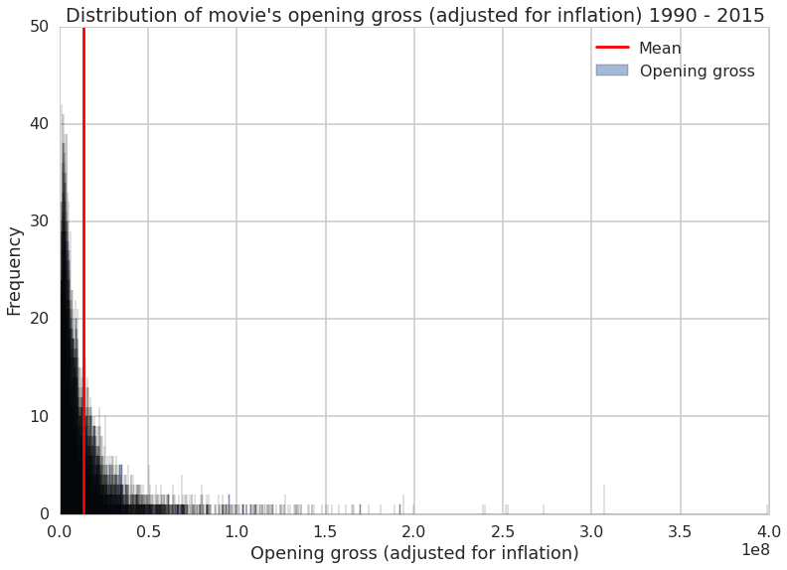
Histogram with mean line

Slide 3
Histogram with mean line

Slide 4
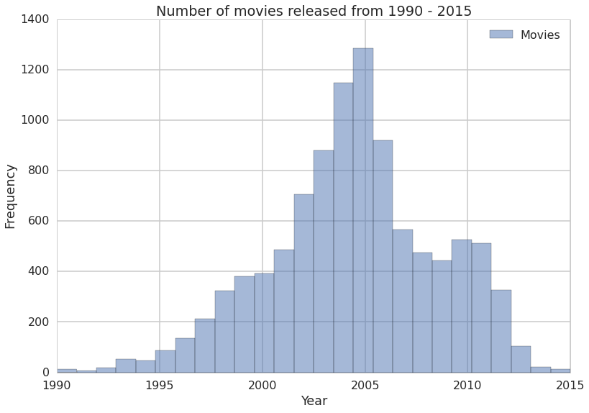
Years vs. movies

Slide 5
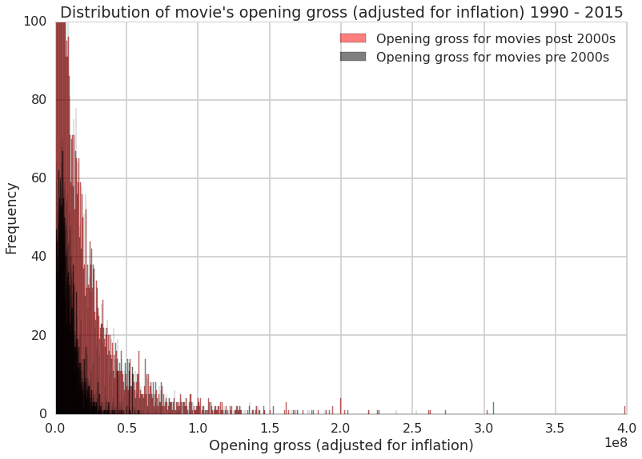
Histogram by years

Slide 6
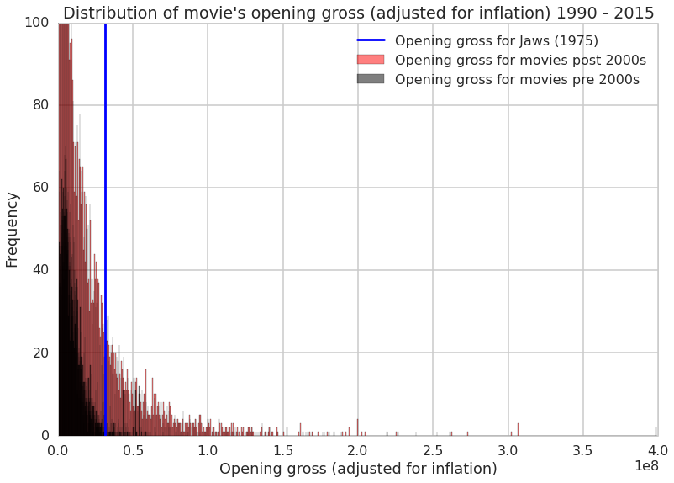
Histogram by years with jaws

Slide 7
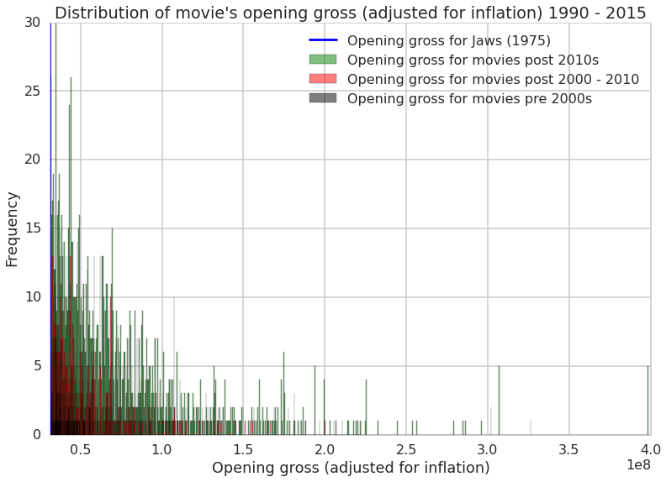

Slide 8
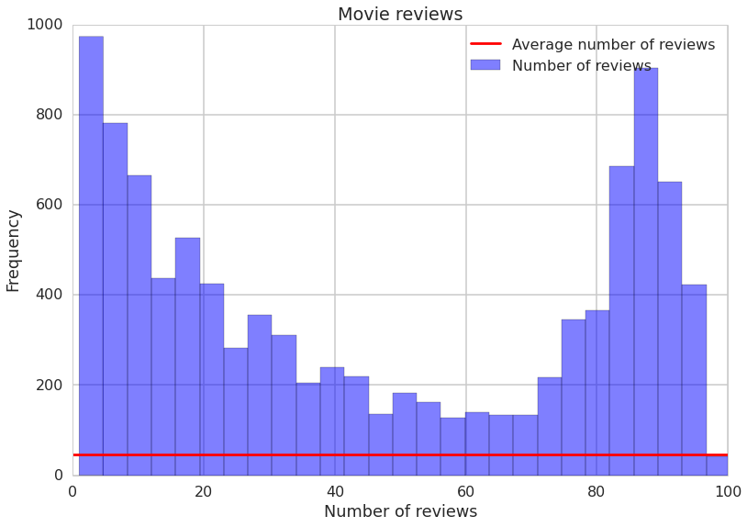

Slide 9
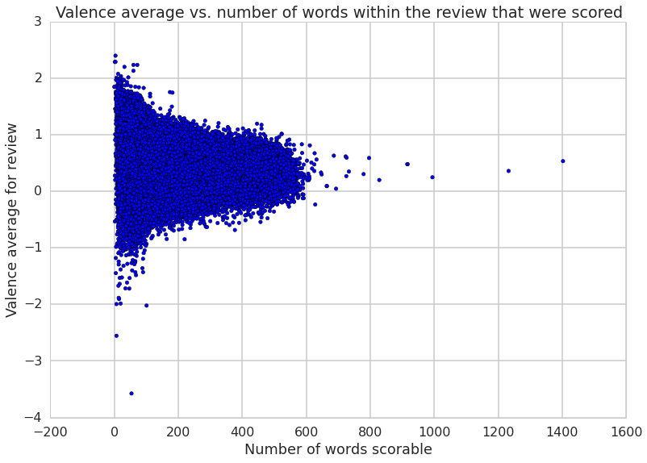

Slide 10
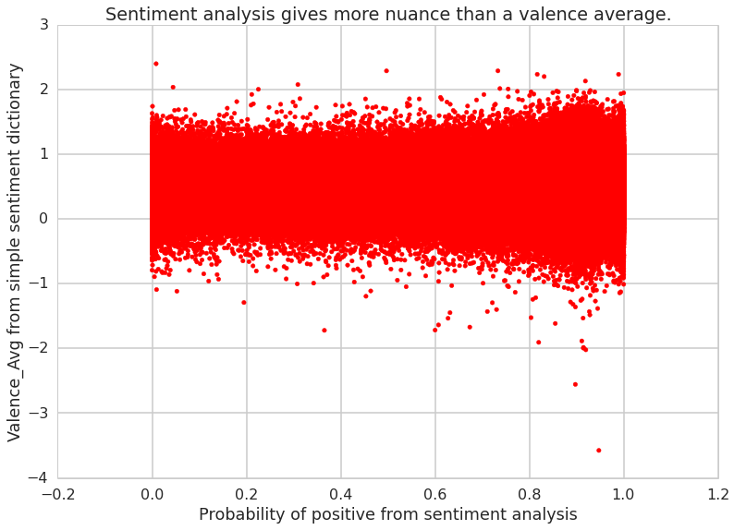

Slide 11
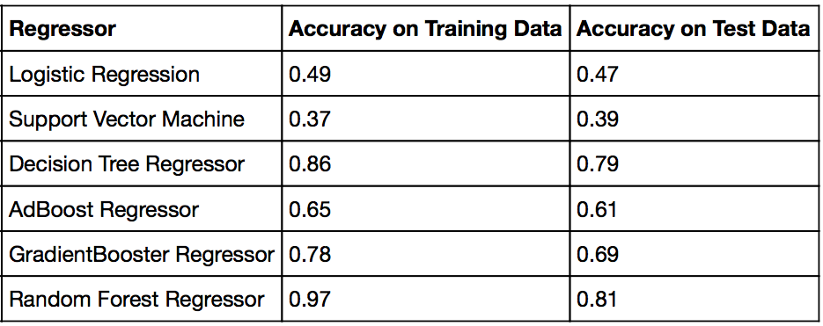
Regression Results

Slide 12
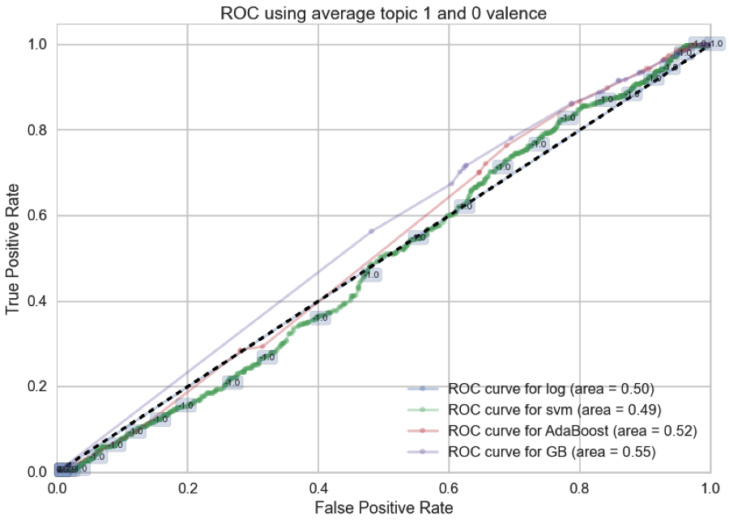

Slide 13
