Slide 1
IM-Analytics Qualification Test
Ariel Ceron G
14/04/24

Slide 2

The problem
some diamonds seem to have been stolen from the bank.

Slide 3
Results

Slide 4
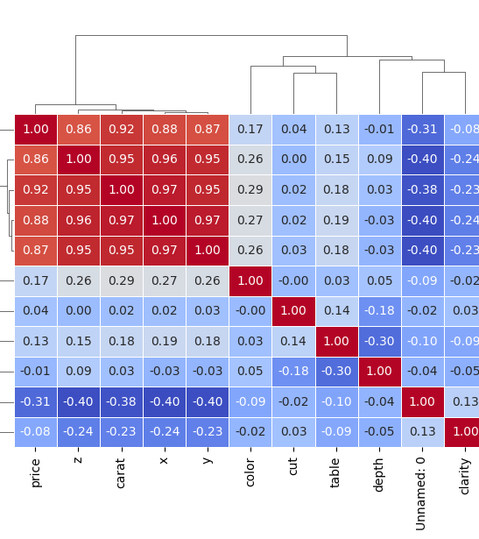
Linear Model
We applied a spearman correlation test, by this we use x,y,z,carat as the principal component to use linear regression model

Slide 5
how much the stolen diamonds are worth.
Diamont | 1 | 2 | 3 | 4 | 5 | 6 | 7 | 8 | 9 | 10
Cost ($) | 3058.91 | 3953.28 | 1577.08 | 895.63 | 407.89 | 4504.02 | 1630.98 | 6244.8 | 907.77 | 662.37
Acumulated cost: $23842.71
Mean error: $ 2,280,766.81

Slide 6
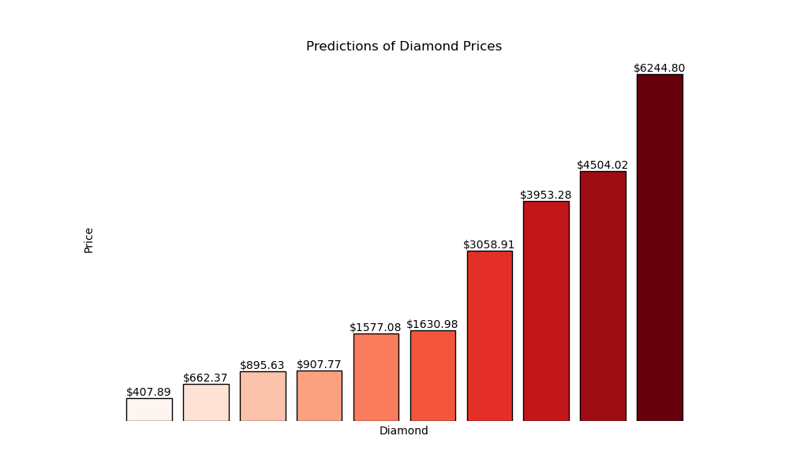
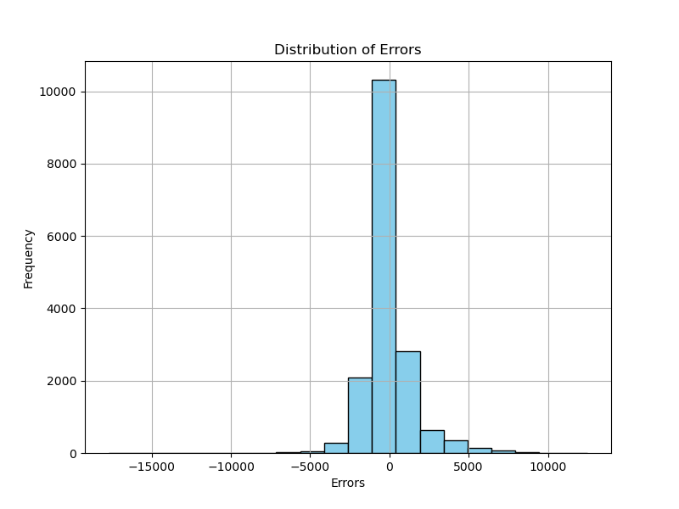

Slide 7
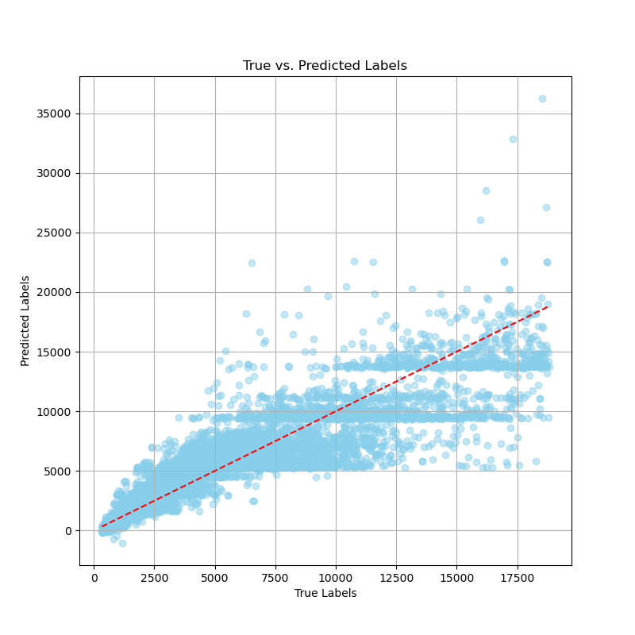
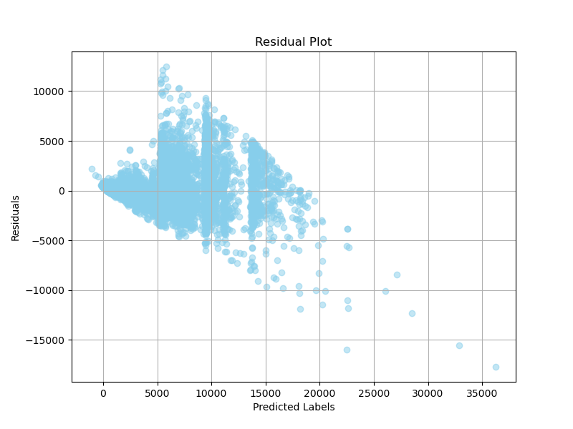

Slide 8
KNN Predictions
how much the stolen diamonds are worth.
Diamont | 1 | 2 | 3 | 4 | 5 | 6 | 7 | 8 | 9 | 10
Cost ($) | 3133.6 | 3214.2 | 2980.2 | 511.8 | 559.8 | 3390.0 | 3137.8 | 6689.0 | 2391.2 | 522.4
Acumulated cost: $26530.0
Mean error: $435 163.22

Slide 9
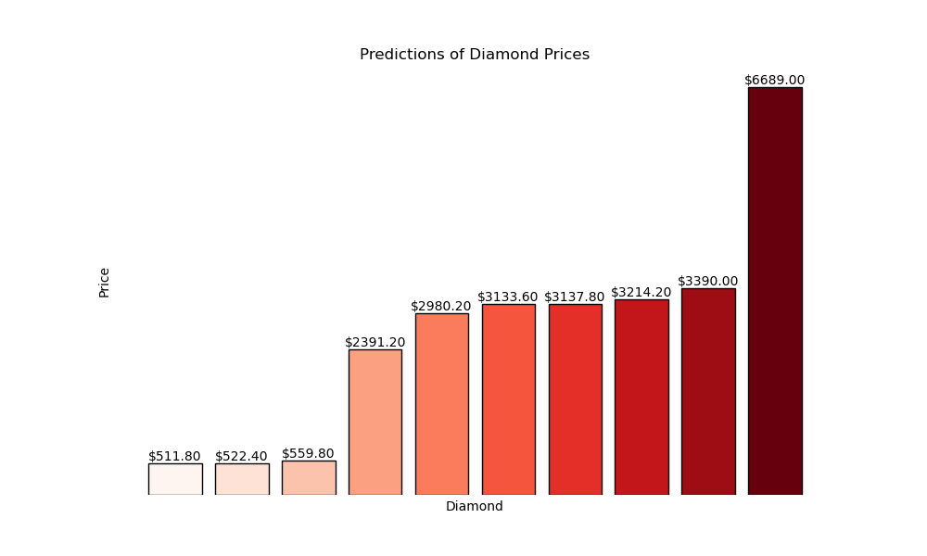
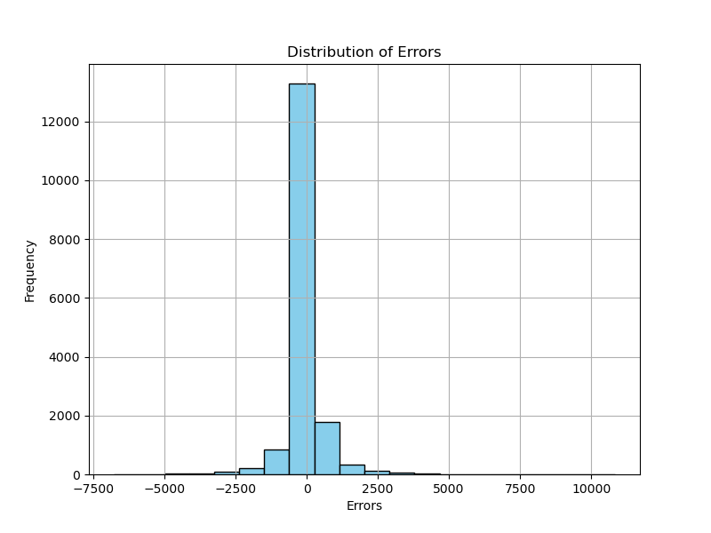

Slide 10
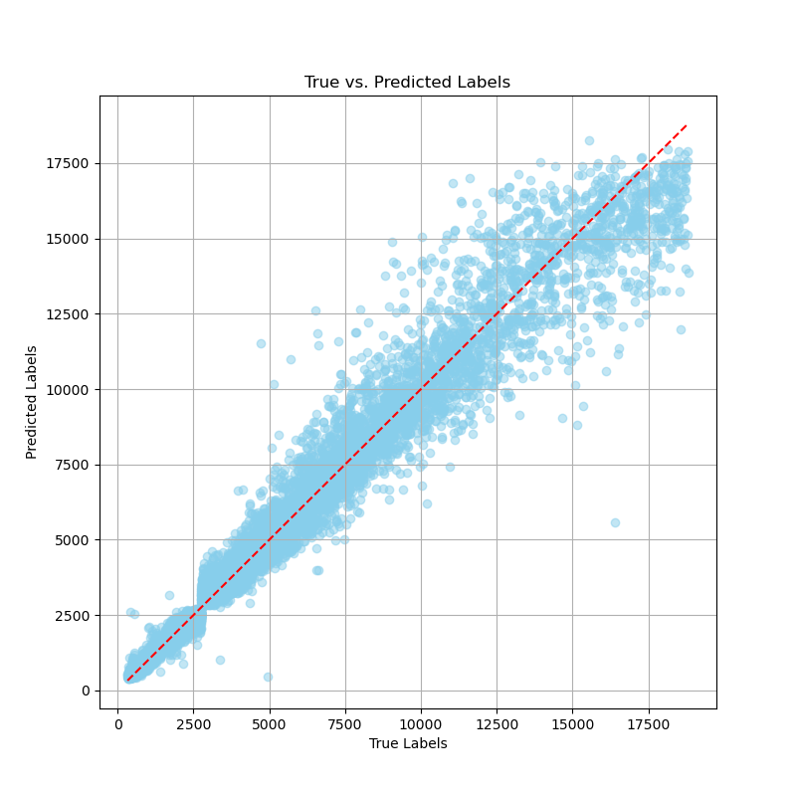
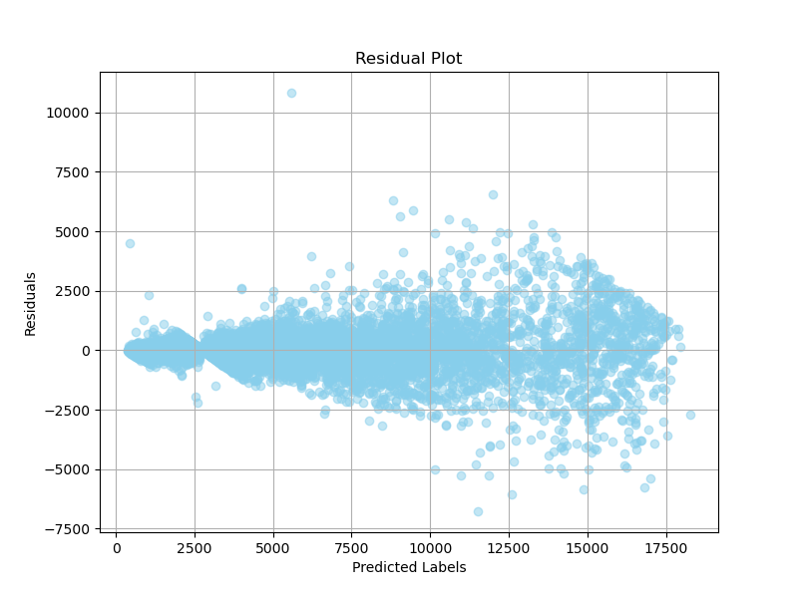

Slide 11
Conclusions
KNN regression is the preferred choice for prediction based on the True vs. Predict results.
While KNN outperforms linear regression, both models exhibit losses above the $20,000 threshold.

