Slide 1
NOVA QA ENGINEERING · CASE STUDY
The Handoff That
Needs No One Awake
The QA → Production Handoff Dashboard
AMANDA CHAN · POWER DIGITAL MARKETING
10+ : 2
~1 hr
2 × day
60 sec
engineers pushing work vs. QA engineers clearing it
of manual triage at every shift start — removed
07:00 & 19:00 UTC, zero manual steps
to read the whole state of the pipeline
Current state, what replaced it, and the one decision that closes the last gap.
01 / 12
Notes:
Open in the audience's world, not the tool's. The ratio — 10+ engineers into 2 QA — is the whole 'what is' in one line. Leave the four stat cards unexplained for now; they pay off at the close.

Slide 2
OVERVIEW
The Thesis and What Is at Stake
THE THESIS
WHAT IS AT STAKE
Cross-time-zone handoff was never a communication problem. It is a delivery problem — and once it is treated as one, coordination stops costing anyone a shared working hour.
Release velocity and regression escapes in every multi-shift team we run. QA is only where it showed first.
CURRENT STATE
TARGET STATE
1
2
3
Constraint
Change
Outcome
why earlier fixes failed
what replaced them, with proof
impact and the one decision
Each section that follows is one step from current state to target state.
02 / 12
Notes:
The line is the shape of the argument: it moves between current and target state, and each move adds pressure. Say the thesis out loud here and again at the close — one idea, stated as a point of view with the stakes attached.

Slide 3
THE CONSTRAINT · CURRENT STATE
A Pipeline Fed Faster Than It Can Be Cleared
VOLUME
NO CONTEXT
10+
→
2
Jira says a ticket is In QA. It does not say what changed, what to test, or how long it has waited.
engineers push work into one QA column
QA engineers clear it, never at the same time
NO MEMORY
Tickets arrive faster than two people can clear them, so In QA floods.
Each shift rebuilt that picture by hand, and it went stale the moment they logged off.
≈ 10 engineer-hours a week
spent reconstructing a state that already existed in the system.
Derived from the case study: ~1 hour of manual triage × 2 shifts × 5 days.
03 / 12
Notes:
Establish what is, plainly and with no fix in sight. The ratio does the emotional work; the 10 engineer-hours does the analytical work. Resist offering the solution on this slide.

Slide 4
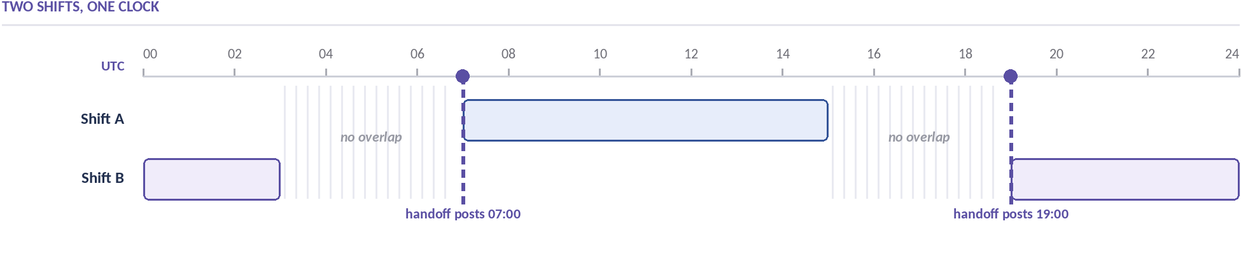
THE CONSTRAINT · WHY EARLIER FIXES FAILED
No Shared Hour Was Ever Available
12 h
Every proposed fix asked for the same thing.
A standing sync, a forced overlap, someone's evening. A shared working hour the schedule would not give up — so none of them held.
is how long anything one engineer learns at the end of a shift must survive before it reaches the other.
The constraint is structural, not behavioural — which is why every process fix lapsed.
04 / 12
Notes:
The point of this slide: the room has to accept that the obvious fixes are already exhausted. Pause after 'none of them held' — this is the moment they should want an answer.

Slide 5
APPROACH · THE REFRAME
Stop solving it as a
communication problem.
Solve it as a delivery problem.
The two shifts never needed to be awake together. They needed an artifact that is already current the moment each of them logs on.
COMMUNICATION FIX
DELIVERY FIX
Asks for a shared hour the schedule will not give up. Lapses within a month.
Asks nothing of anyone. Runs whether or not we remember it exists.
05 / 12
Notes:
The pivot of the deck: one reframe, in a sentence the room can repeat afterwards. Everything after this slide is consequence, not argument.

Slide 6
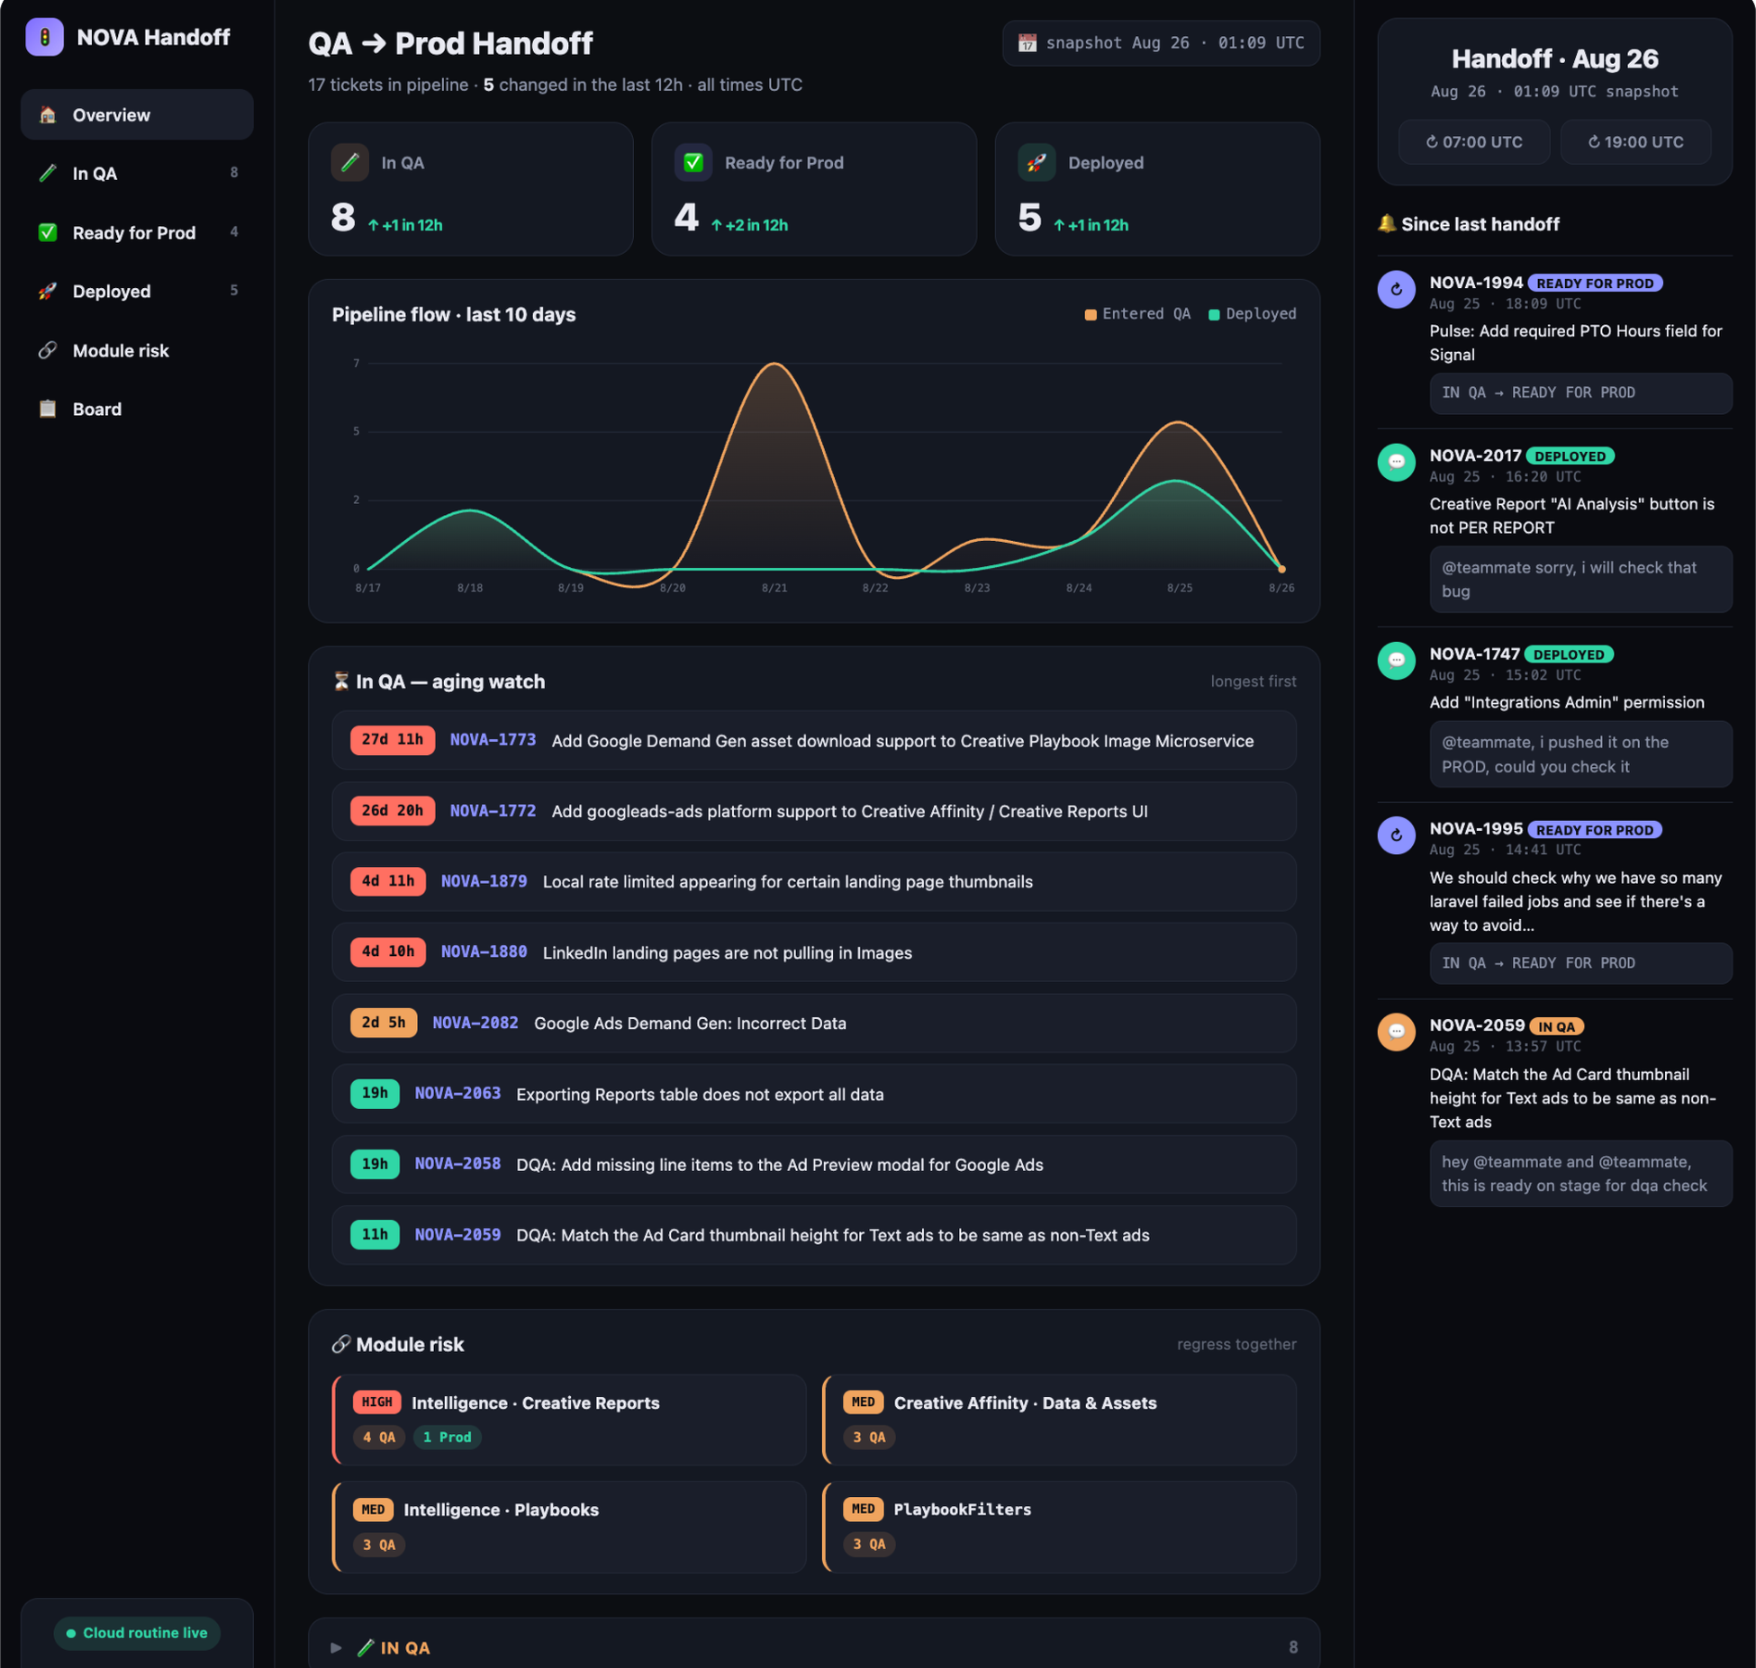
THE SOLUTION · WHAT THE SHIFT RECEIVES
What the Incoming Shift Now Opens
Four questions the shift used to answer by hand — answered on arrival:
1
What moved in the last twelve hours.
2
Which tickets are stuck, and for how long.
3
Which tickets share a module and must be regression-tested together.
4
What each ticket actually requires to test — the developer's Problem / Fix / How to verify, lifted out of the comment thread.
ORDERING IS A DESIGN DECISION
Tickets rank by time in QA, because a ticket sitting on Staging accumulates merge-conflict risk the longer it sits. Triaging by age is how builds get finished instead of reworked.
One screen at 07:00 — changes, aging watch, module risk, test notes. Every item links back to Jira.
06 / 12
Notes:
The first look at the target state. Show the artifact, then go straight to the ordering rule — a CTO reads ranking logic as risk management, not UI.

Slide 7
BEFORE AND AFTER · FIVE GAPS CLOSED
Before and After, Gap by Gap
BEFORE
AFTER
A write-up sits six comments deep (NOVA-1747).
→
It arrives on the ticket. Testing starts in minutes, not after a triage pass.
An end-of-day question waits a full lap. NOVA-1710 cycled In QA ↔ Back to Development for days — mostly clock, not effort.
→
Open questions lead the handoff and get answered on the next shift instead of the next loop.
Nothing tracked time in QA. One ticket held ~10 days on a request for testing details — a two-minute answer.
→
The aging watch names the oldest tickets every 12 hours and flags them at two and three days.
One shift ships a module while the other still holds related tickets. Nobody sees the overlap; regressions ship.
→
Shared-module tickets are flagged when they span stages. That flag is the regression test plan.
The report existed only if someone awake ran it.
→
It posts at 07:00 and 19:00 UTC whether anyone is awake or not.
Each gap above cost the team a full shift cycle. One artifact closes all five.
07 / 12
Notes:
Contrast is the mechanism. Read each pair as a beat — what is, then what could be — and do not linger. The five passes are the engine of the middle act.

Slide 8
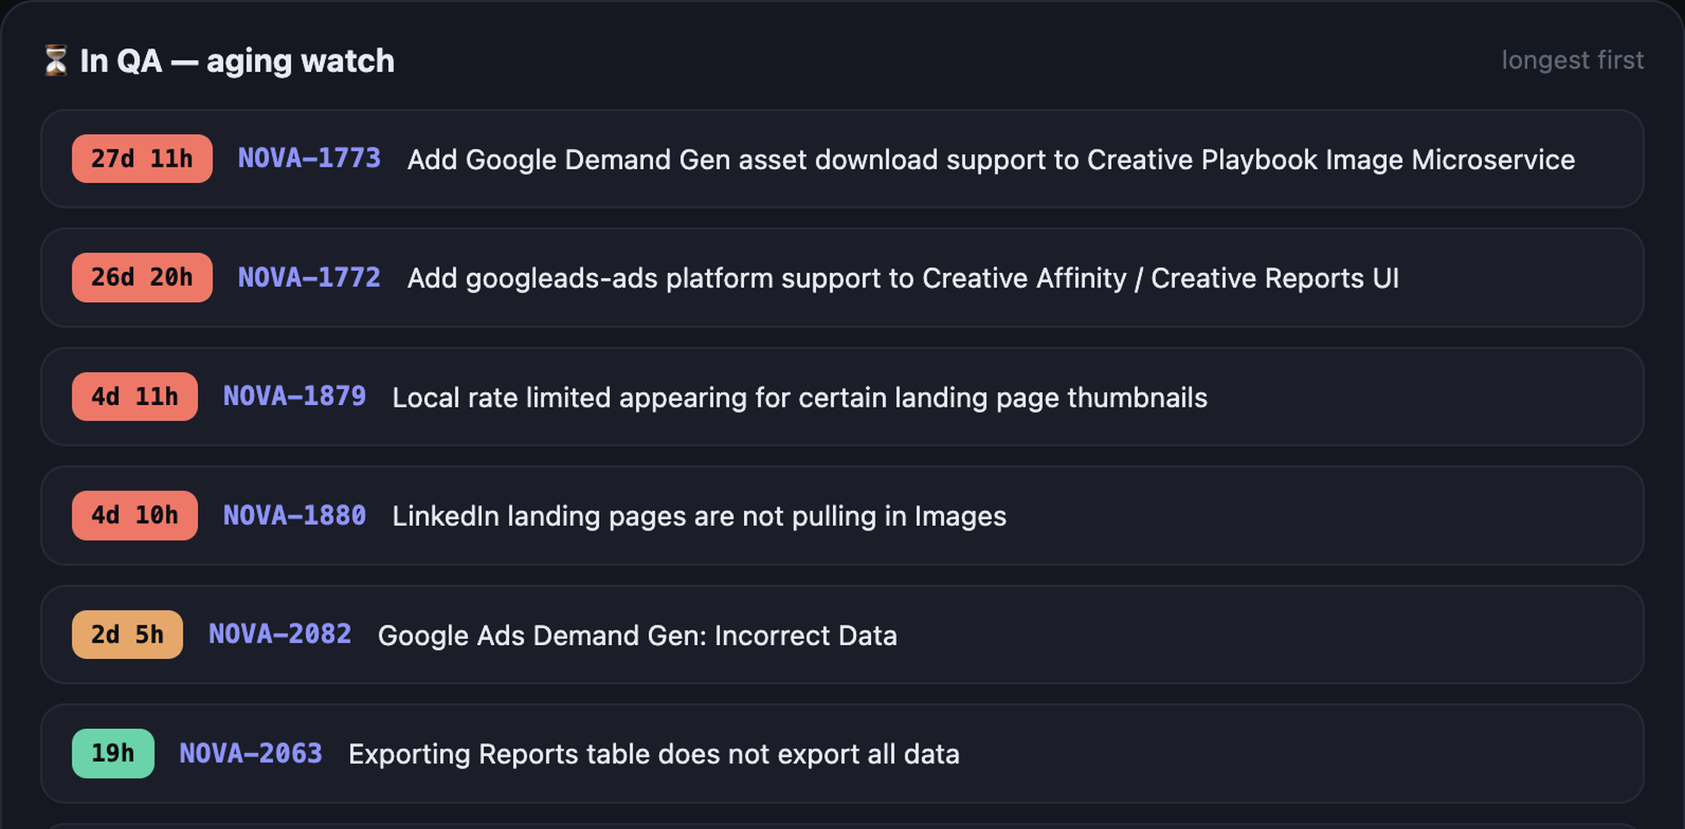
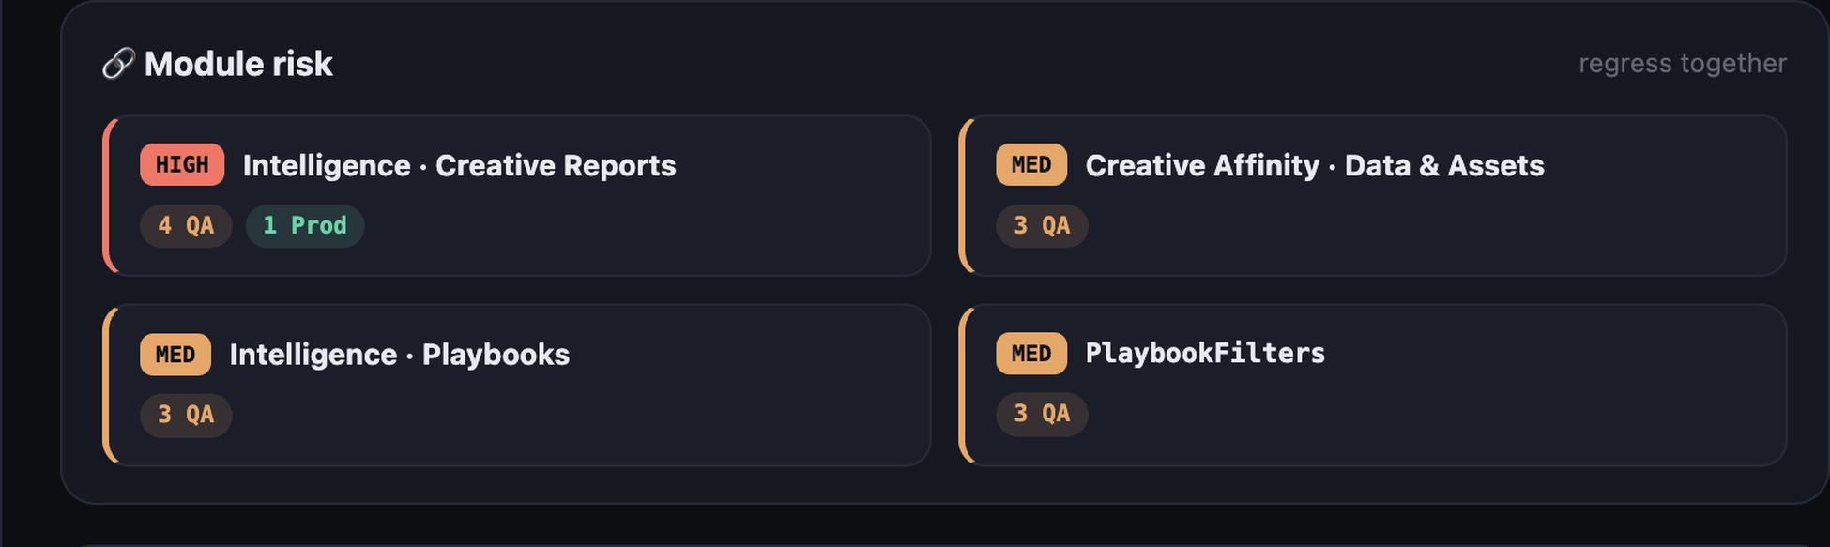
EVIDENCE · RELEASE RISK MADE VISIBLE
Stalls and Regression Risk, Named Every Twelve Hours
27d 11h
oldest ticket in QA — surfaced without anyone asking
HIGH RISK MODULE
Intelligence · Creative Reports
4 in QA · 1 Ready · 2 in Prod, at the same time. One module carrying tickets across three stages is where a regression escapes.
For a VP of Product: the tickets most likely to slip a release surface themselves before anyone goes looking for them.
08 / 12
Notes:
Analytical proof, placed immediately after the emotional turn. Both exhibits are unedited product screenshots — for a technical audience the artifact is the argument.

Slide 9
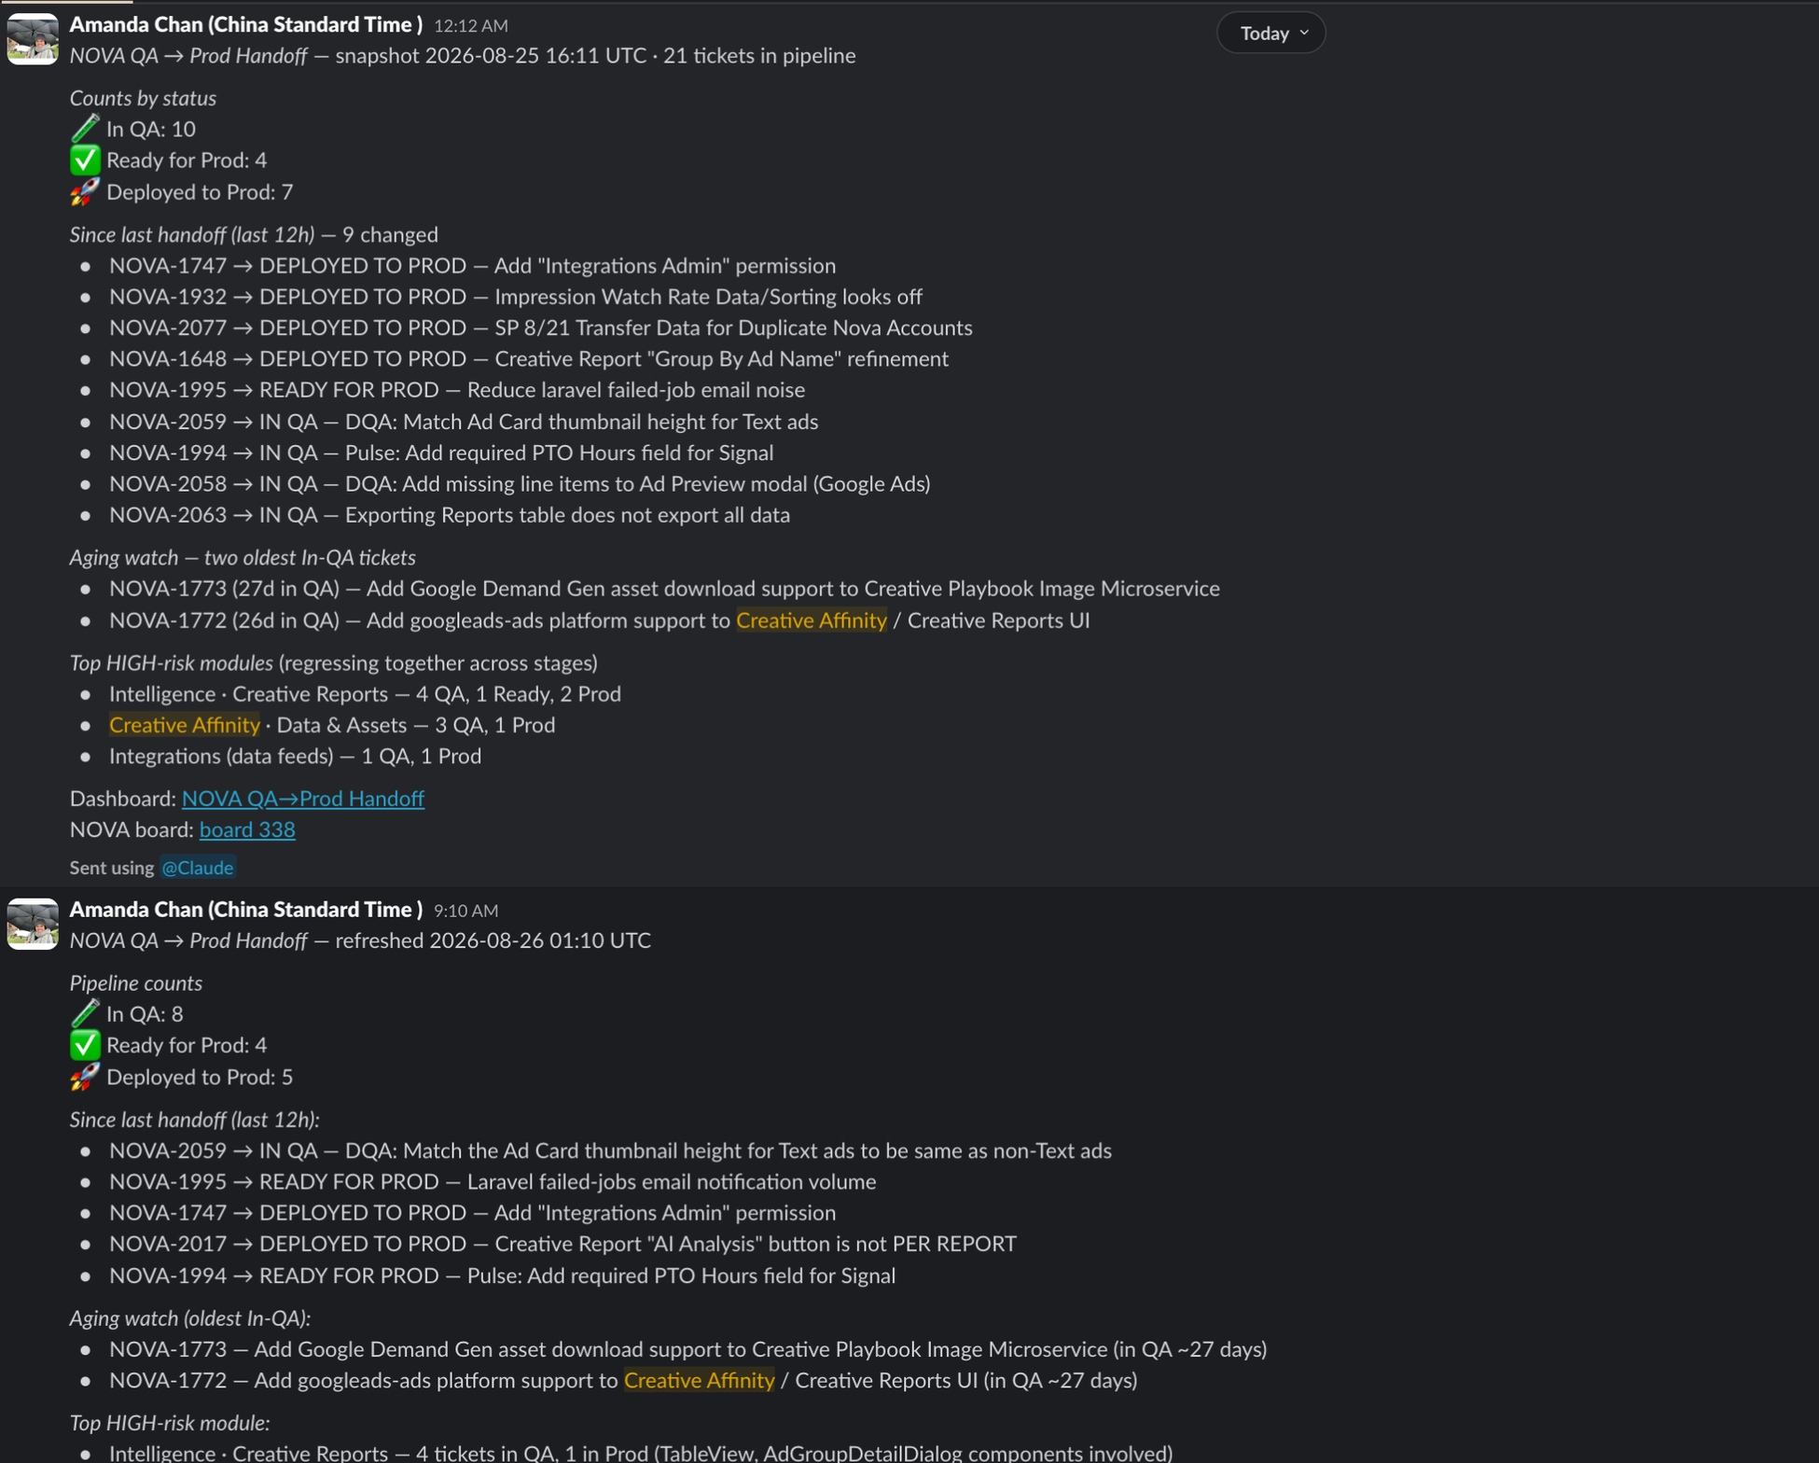
AUTONOMOUS DELIVERY · PROOF IN PRODUCTION
Neither of These Was Sent by a Person
Two consecutive handoffs in #qa-daily-reports, twelve hours apart. No one triggered either one, and no machine involved was awake.
WHY AUTONOMY IS THE LOAD-BEARING PART
Autonomy is what makes the other four gains count. A lens that works only sometimes is a lens the shift stops opening.
0
0
2
manual steps per cycle
machines awake
posts a day
#qa-daily-reports — 25 Aug 16:11 UTC and 26 Aug 01:10 UTC, unattended.
09 / 12
Notes:
This is the one image the room repeats afterwards. Say the line — 'no one triggered either one, and no machine involved was awake' — then stop talking for a beat and let it land.

Slide 10
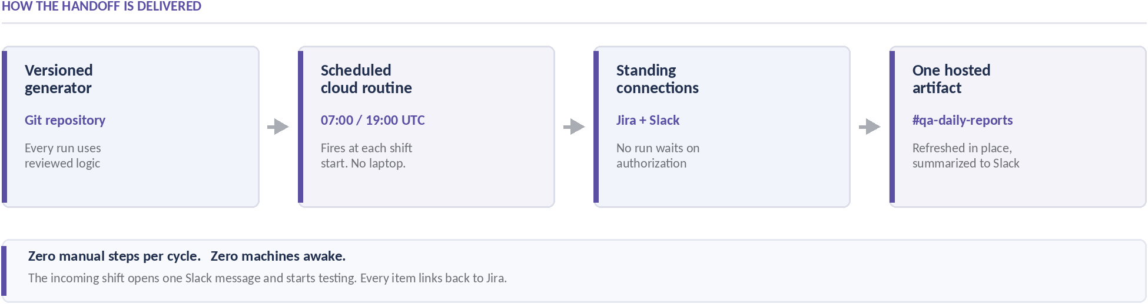
ARCHITECTURE · FOUR PARTS, ZERO MANUAL STEPS
The Part That Generalizes
THE THREE REUSABLE PIECES
THE REPORT CANNOT SHOW THE WRONG TICKET
A versioned generator, a scheduled cloud routine, and standing connections to the systems of record. Nothing here is QA-specific.
Jira's API occasionally returns a mismatched issue, so the generator cross-checks every ticket key and re-fetches on mismatch.
Any recurring cross-shift task can become an unattended service.
10 / 12
Notes:
For the CTO this is the slide that matters: the architecture is boring on purpose and reusable by design. Keep it to 60 seconds — the pattern, not the plumbing.

Slide 11
BUSINESS IMPACT
What This Buys Product and Engineering
01
02
The same 60-second read
Status-chasing becomes a link
What is moving down the pipeline, what has been sitting long enough to warrant attention, and where a module carries regression risk across stages. No status meeting required.
Long-standing tickets surface themselves instead of waiting to be asked about, and the tickets most likely to slip a release are flagged before anyone looks.
03
04
Ramp without adding a meeting
The pattern, not the tool
As QA grows, the same view is where a new member picks up work and sees what happened while they were away.
A multi-shift organisation lives or stalls on the quality of its async handoffs. This is the template for the rest of them.
The value accrues to the teams reading the handoff, not to the tool that writes it.
11 / 12
Notes:
Describe the end state in their terms — their release risk, their ramp time, their meetings — never the builder's. Hand the win to the room.

Slide 12
RECOMMENDATION · THE ONE OPEN DEPENDENCY
One Decision Closes the Last Gap
THE GAP
ALREADY CONTROLLED
The generator runs from a personal GitHub repository — not SOC 2 compliant. The interim mitigation is to omit all PII, and it holds — but it costs the one field the handoff most needs: which developer owns a stall. The incoming shift still returns to the board for it, which is the exact lookup this exists to remove.
Data integrity — every ticket key cross-checked, re-fetched on mismatch
Connection drift — standing Jira and Slack auth — administrative, owned with IT
Scope creep — changes-first by design; a 60-second read gets opened
THE ASK
Land the GitHub Enterprise migration (owned by Anton). Attribution goes back in and the last manual lookup disappears.
Ownership — start-of-shift ownership convention ships with the rollout
Handoff stopped being a communication problem the moment it became a delivery one.
AMANDA CHAN · POWER DIGITAL MARKETING · 2026
12 / 12
Notes:
End on one action, stated as a decision someone in this room can actually make. Repeat the thesis as the last sentence, then stop — no summary slide after this one.

