Slide 1

String Search 2: Boyer-Moore and Knuth-Morris-Pratt
By Arlen dumas and Max Johnson

Slide 2
Itinerary
What string searching is and when to use the right algorithm
Overview of Boyer-Moore
Overview of KMP (Knuth-Morris-Pratt)
Comparison between sorting algorithms
Live demo

Slide 3
What string searching is and when to use the right algorithm
String searching is simply looking for a word/pattern in a string.
What do string searching algorithms look like?
Notes:
What string searching is and when to use the right algorithm [[[enter]]] String searching is simply looking for a word/pattern in a string. Pressing control f on a webpage is a perfect example of that. Two good string search algorithms are BM and KMP. [[[enter]]] There are a wide variety of string searching algorithms available, but KMP and BM are two that rely heavily on preprocessing the pattern being searched for in order to gain information and make skips along the string. <end>

Slide 4
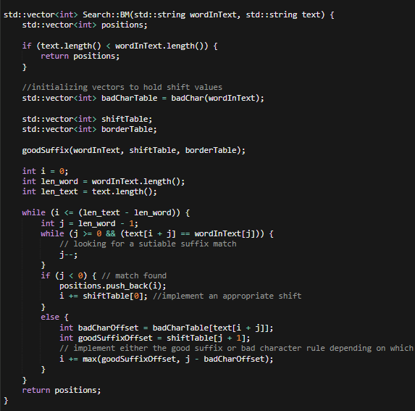
Boyer Moore
P: A B C
T: A B A B A B C
A B C
A B C
skip!
A B C
skip!
A B C
skip!
A B C
Notes:
Boyer Moore is considered the benchmark for practical string-searching. It implements two heuristics, or methods, to preprocess the string being searched for in order to skip portions of the text where there is no possible match. [[enter]] Boyer-Moore works backwards to compare two strings, with the logic being that if the end of the pattern is compared to the string instead of the front, then jumps can more easily be made along the text instead of cross-checking each character.
[[enter]] Here’s a quick example. If we began checking from the front, we’d have to complete two comparisons before realizing that there wasn’t a match. By checking from the back, we can skip a portion of the string [[enter]] And see that there was a match later down the line. This Makes Boyer Moore pretty efficient. It has a worse-case time complexity of O(mn), where m is the length of the pattern and n is the length of the string.

Slide 5
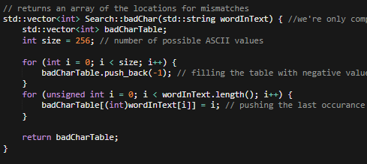
Bad Character Heuristic
Case 1:
P: T A T G T G T: G C A A T G C T A T G T G A
T A T G T G--------
T A T G T G
skip!
T A T G T G
Notes:
The first of these heuristics is called the bad character heuristic. This is a pretty simple method that will propose one of two shifts once a mismatch occurs in the comparison process. By using a lookup table to find the last occurrence of a particular character, we’re able to tell how far we should shift the pattern through the text.
[[enter]]
The first case is when the mismatched character in the text appears at some other position within the pattern. By using the lookup table to locate the location of the next instance of the mismatched character in the string, we can determine how many times we’ll need to shift the pattern for this mismatched character to become a match. In this example, we hit a mismatch between G and A [[enter]]
but once we reference the lookup table we can see that there’s another A to the left of the current pattern position.
[[enter]]
This allows us to safely make one shift of the pattern along the text [[enter]]
Until we create a match between the mismatched character and the pattern.

Slide 6
Bad Character Heuristic cont.
Case 2:
P: T A T G T G T: G C A A T G C T A T G T G A
T A T G T G -------------
T A T G T G
skip!
T A T G T G
skip!
ECT….
T A T G T G
Notes:
Working with the same pattern and text as before, we come across the second case for shifting using the bad character heuristic.
[[enter]]
This case will happen if the mismatched letter in the text does not appear anywhere else within the pattern. In this case we compare the mismatched character C to the rest of our pattern [[enter]]
and our lookup table returns -1, meaning that it does not exist. This means we can completely shift our pattern past C, because we know that we will not produce a valid match. [[enter]]
In this case, once we completely shift our pattern past the mismatched character in the string, we produce a match.
[[enter]]

Slide 7
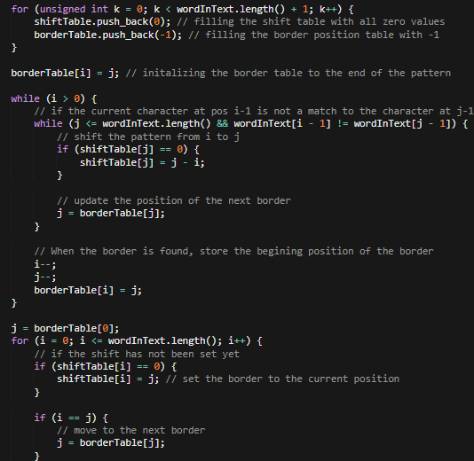
Good suffix heuristic
P: C T T A C T T A C T: C G T G C C T A C T T A C T T A C
C T T A C T T A C
skip!
C T T A C T T A C
ECT…
C T T A C T T A C
C T T A C T T A C
skip!
ECT…
C T T A C T T A C
Notes:
The good Character heuristic focuses on a matched substring within the text as opposed to one mismatched character to propose shift values.
[[enter]]
In this example we see that we have a substring, T A C, that matches our pattern. What the good suffix heuristic aims to do is to keep our matches as matches, so we’ll look to see if there is another substring in our pattern that matches the substring in the text
[[enter]] And we see that there is another instance of T A C within our pattern [[enter]]
so we’ll shift by 5 so that we match the substring in our pattern to the substring in our text
[[enter]]
Now we’ll look to see if we have any more substrings within our pattern that match the substring in our text. This is a little harder to see, but now that we’ve shifted our pattern to create a longer substring, we actually have a prefix in our pattern that will match the suffix in our substring. [[enter]]
So we’ll shift by a total of six to create another match.

Slide 8
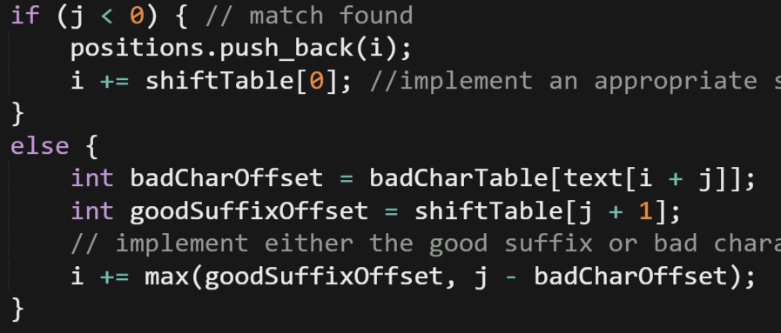
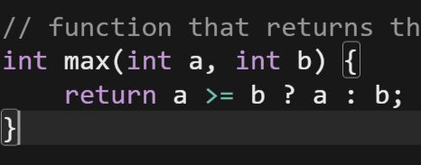
How Heuristics Work Together
Notes:
These heuristics are useful because when working together, they tell us the maximum shift value we can safely move. By using a function to determine if the bad character or good suffix rule would produce a larger shift value, we’re able to determine which heuristic to apply.

Slide 9
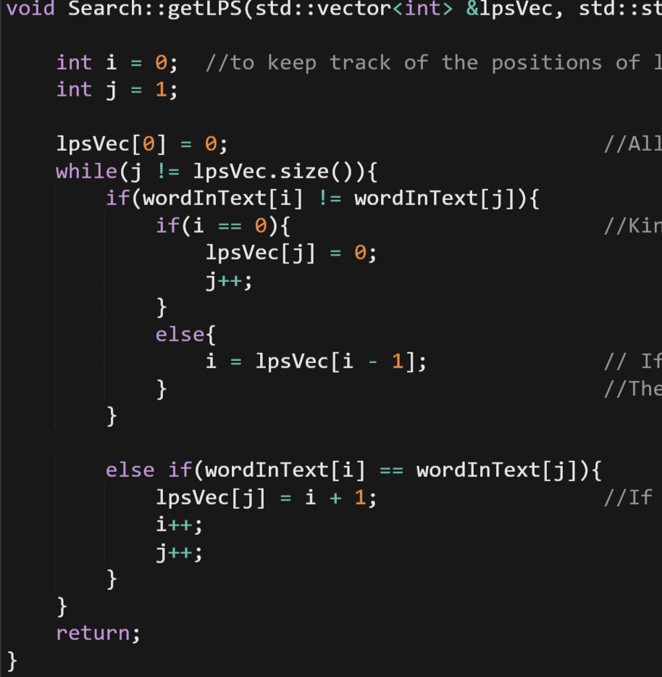
Overview of KMP
LPS (Longest proper Prefix).
0 1 2 3 4 5 6
bbxbbbx
I J
0 1
0
1
0
1
2
2
3
1 2
0 2
0 3
1 4
2 5
1 5
2 6
3 7
Notes:
A big portion of why KMP is so effective is because it finds sub patterns in the word being used.
[[[enter]]]
This is called LPS (Longest proper Prefix). The point of this is to not match any character that we know already matches. To get an in-depth example, we will use the word [[[enter]]]
bbxbbbx. Im sure you’ve heard of it. So following the code here. [[[enter]]]
We see that the first index is set to zero regardless.
[[[enter]]]
This is because there is nothing to compare it too yet. Now comparing character at index ‘i’ and ‘j’, we see that they do match. This means we set lpsVec at position j to ‘i’ + 1 and increment ‘I’ and ‘J’
[[[enter]]]
Looping, we see that ‘I’ and ‘j’ don’t match and since ‘I’ isn’t zero, we set ‘I’ to lpsVec[i-1].
[[[enter]]]
Looping again, ‘I’ is zero this time so we set lpsVec at position ‘j’ to 0 and increment ‘j’
[[[enter]]]
Looping again we see that ‘I’ and ‘j’ match so we set the next position to ‘I’ + 1 and increment ‘I’ and ‘j’
[[[enter]]]
Looping again, the same thing happens
[[[enter]]]
Looping again, ‘I’ and ‘j’ don’t match so ‘I’ is set to one position back in lpsVec
[[[enter]]]
Looping again, and this is important, you’ll notice that ‘I’ and ‘j’ match again. Which means we set the next position to 2 again. And of course, we increment
[[[enter]]]
Looping for the final time, ‘I’ and ‘j’ match so we set the next position to ‘I’ + 1 and increment.
[[[enter]]] This preprocessing gives KMP a time complexity of O(m+n)

Slide 10
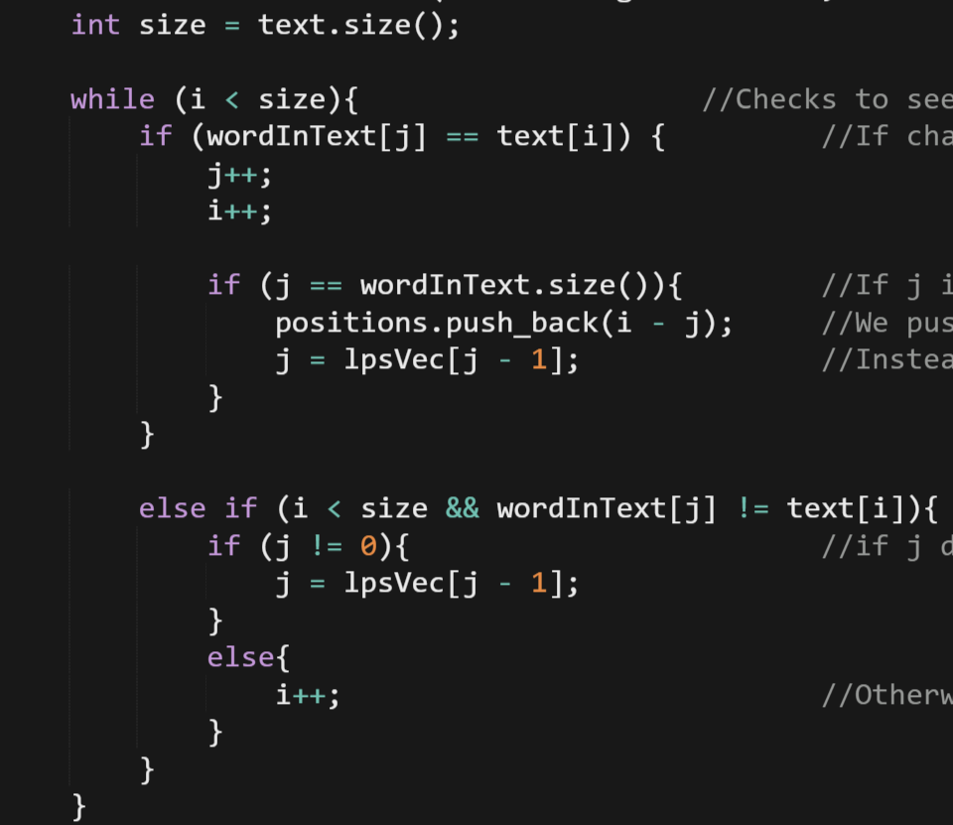
Overview of KMP Cont.
Notes:
So now that we have our LPS, which I consider the most important part, we now do the actual string searching. (while using lazer pointer) you got your pretty basic stuff. If characters match, increment ‘I’ and ‘j’ by one. If j managed to equal word size, it means the algorithm found a match so it adds the position to a vector labeled positions. Heres the important part though, instead of setting ‘j’ to 0, we set ‘j’ to lpsVec[j-1]. This allows us to save time by not checking the characters we don’t have to. If j hits zero he increment ‘I’ by one and loop again.

Slide 11
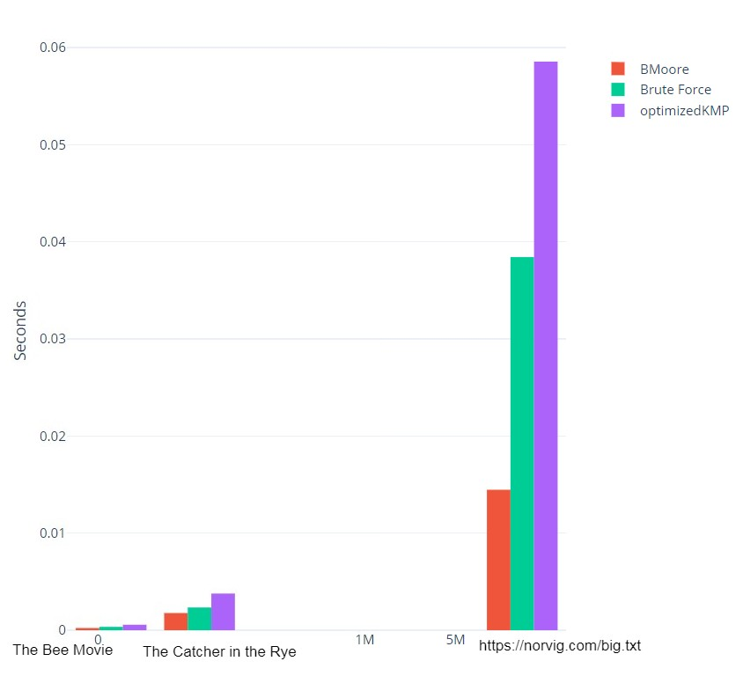
Comparison Between the Two
Seconds
Character Amount
Notes:
Now that we know how these two algorithms work, we can compare their runtimes. Using a control of a standard Brute Force algorithm, we can see how the time complexity of these algorithms grow given a larger data set. We can see that while Boyer-Moore is consistently faster due to its preprocessing, KMP is actually slower than Brute Force. This is because KMP aims to gain a sufficient amount of information from it’s preprocessing, meaning that it works best when given a limited alphabet to work from, such as a DNA sequence.

Slide 12
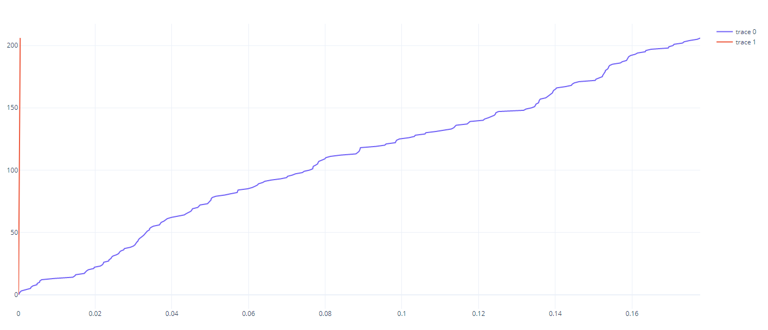
So I Made a Mistake
KMP Iterative VS KMP Recursive
Words Found
Seconds
Notes:
So when I first researched KMP, I came to the conclusion that a recursive implementation may be faster due to the function doing repetitive work. Upon implementation, it turns out that a recursive KMP implementation is actually significantly slower than an iterative solution. This is probably because KMP functionality can be costly and probably takes up too much memory, and slows the program down. In fact, after an 18,000 character limit, the program is killed by linux from too much memory usage. This is probably why we don’t see too many recursive KMP algorithms.

Slide 13
Time For The Epic Demo

