Slide 2
Python for AI Using GitHub Codespaces
Anas Abuelhaag

Slide 3
Why Python?
Easy to learn and read
Versatile: web development, data science, AI, etc.
Strong community and libraries

Slide 4
Python and AI
Popular for AI and machine learning
Libraries: TensorFlow, Keras, PyTorch

Slide 5
Tools We'll Use
GitHub Codespaces: Cloud-based, collaborative
VS Code: Intuitive, extensible
Visual Studio: Full-featured IDE
GitHub: Code sharing and collaboration

Slide 6
Fun Facts
Hobby Project: Started by Guido van Rossum in 1989 to create an easy-to-use scripting language.
Comedy Show Name: Named after "Monty Python's Flying Circus"
Educational Impact: More popular than French in UK schools
Battery included
One of the nine languages influencing JavaScript design

Slide 7
Fun Project
Hands-on introduction to Python
Create a rule-based chatbot

Slide 8
Alright folks, time to kick Python into gear! Let's dive in and get this party started!

Slide 9
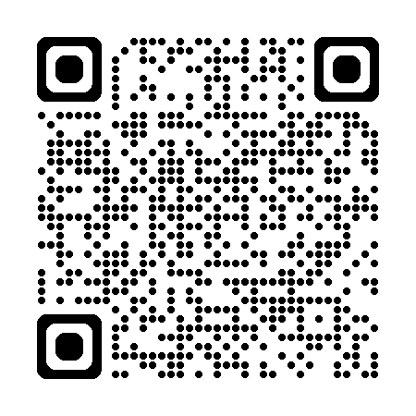
Take our two-question survey

