Slide 1
SPA-GAN: Spatial Attention GAN for Image-to-Image Translation

Slide 2
Image-to-image translation
Is the task of transferring styles and characteristics from one image domain to another. The source domain is the domain of the starting image. The target domain is the desired domain after translation.
You can perform image-to-image translation using deep learning generative adversarial networks (GANs).

Slide 3
In the paper, they introduce the attention mechanism directly to the generative adversarial network (GAN) architecture and propose a novel spatial attention GAN model (SPA-GAN) for image-to-image translation tasks.
They mainly Use Cycle GAN in addition to attention learning to computes the attention in discriminator and use it to help the generator focus more on the most discriminative regions between the source and target domains.

Slide 4
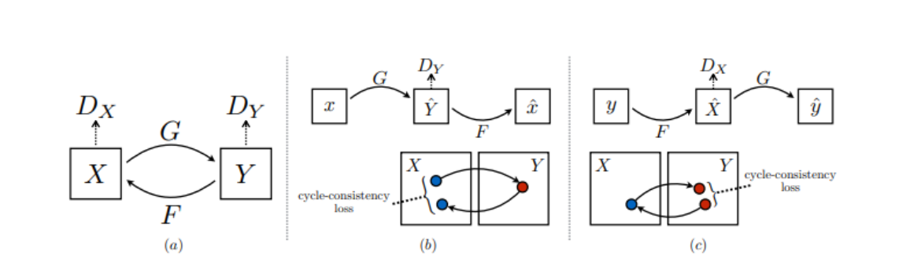
Cycle-GAN
In Cycle-GAN we treat the problem as an image reconstruction problem. We first take an image input (x) and using the generator G to convert into the reconstructed image. Then we reverse this process from reconstructed image to original image using a generator F. Then we calculate the mean squared error loss between real and reconstructed image.

Slide 5
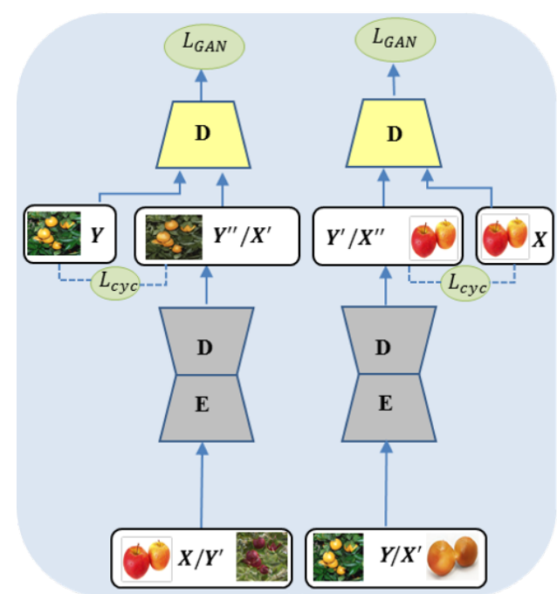
Cycle-GAN architecture
Is composed of 2 GANs, making it a total of 2 generators and 2 discriminators.
Given 2 sets of different images, oranges and apples for example
Generator: transforms apples into oranges and the other transform oranges into apples.
Discriminators: check if images computed by generators seem real or fake.

Slide 6
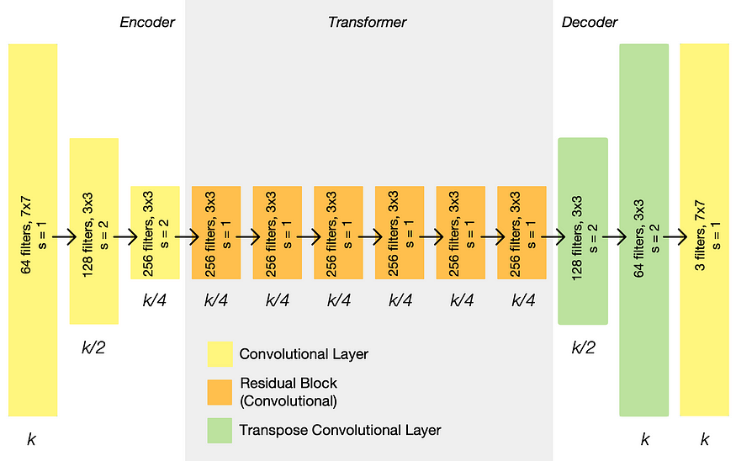
Generator architecture
The generator model uses deep convolutional GAN which is implemented using multiple residual blocks from the ResNet architecture and is based on the approach described in the paper Perceptual Losses for Real-Time Style Transfer and Super-Resolution. The model uses a number of down-sampling convolutional blocks to encode the input image, a number of ResNet convolutional blocks to transform the image and a number of up-sampling convolutional blocks to generate the output image.
C7s1–64,d128,d256,R256,R256,R256,R256,R256,R256,u128,u64,C7s1–3.
Each Resnet block(R256) has two 3x3 convolutional neural network layers

Slide 7
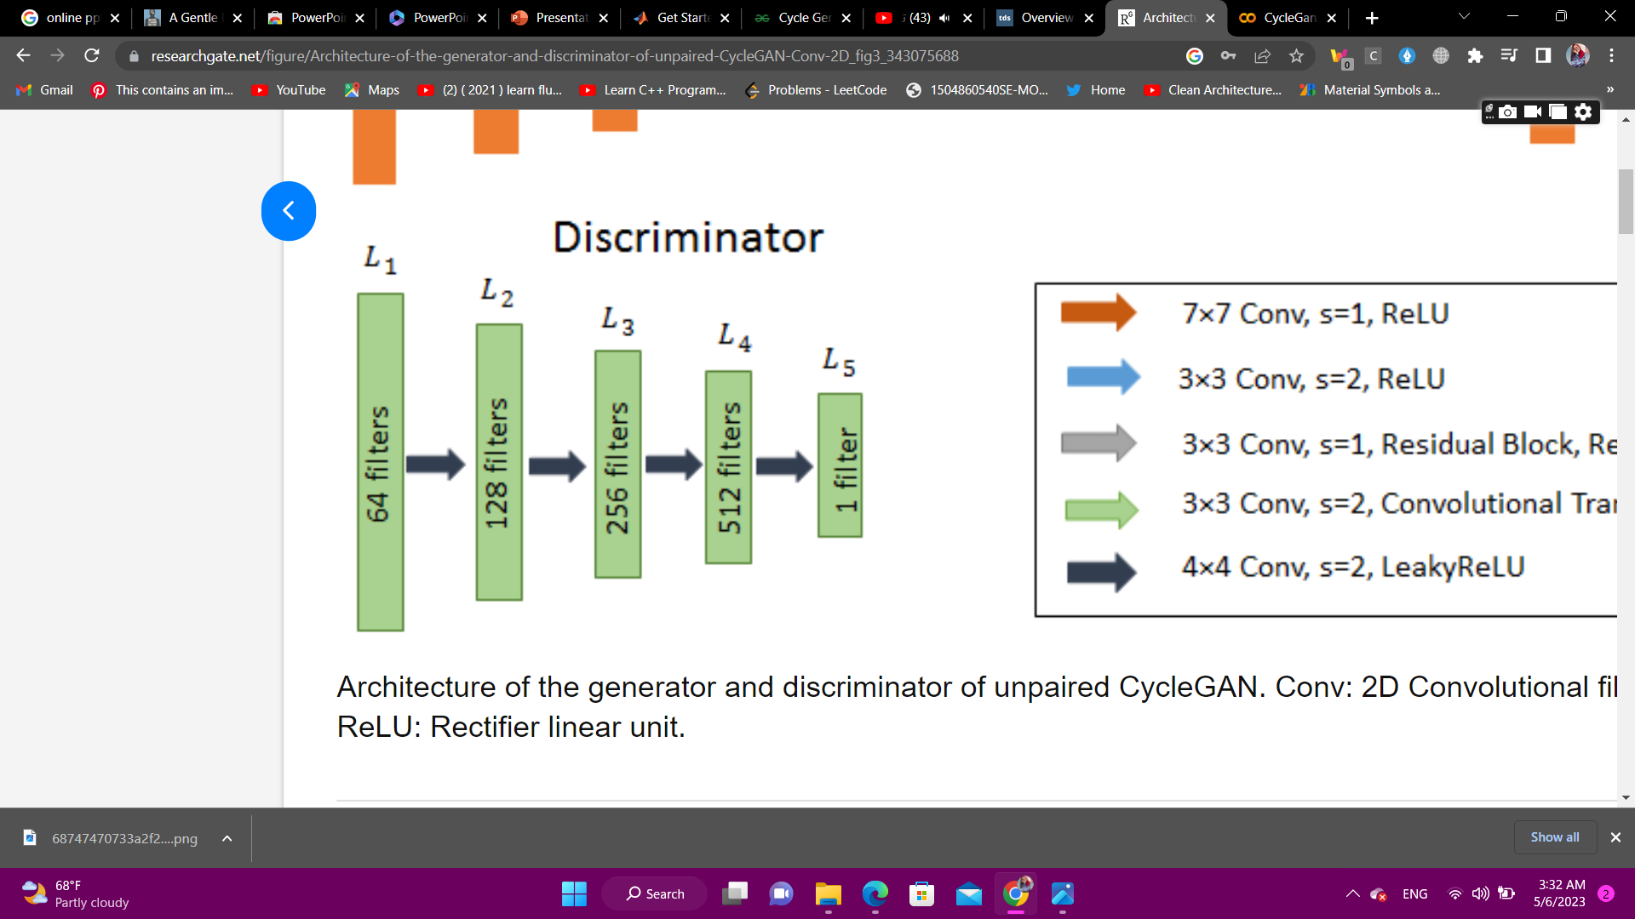
Discriminator architecture
The discriminator model described in the paper uses blocks of Conv2D-InstanceNorm-LeakyReLU layers with 4x4 filters and 2x2 strides. The architecture is C64-C128-C256-C512. After the last layer a convolution is applied to produce a 1D output

Slide 8
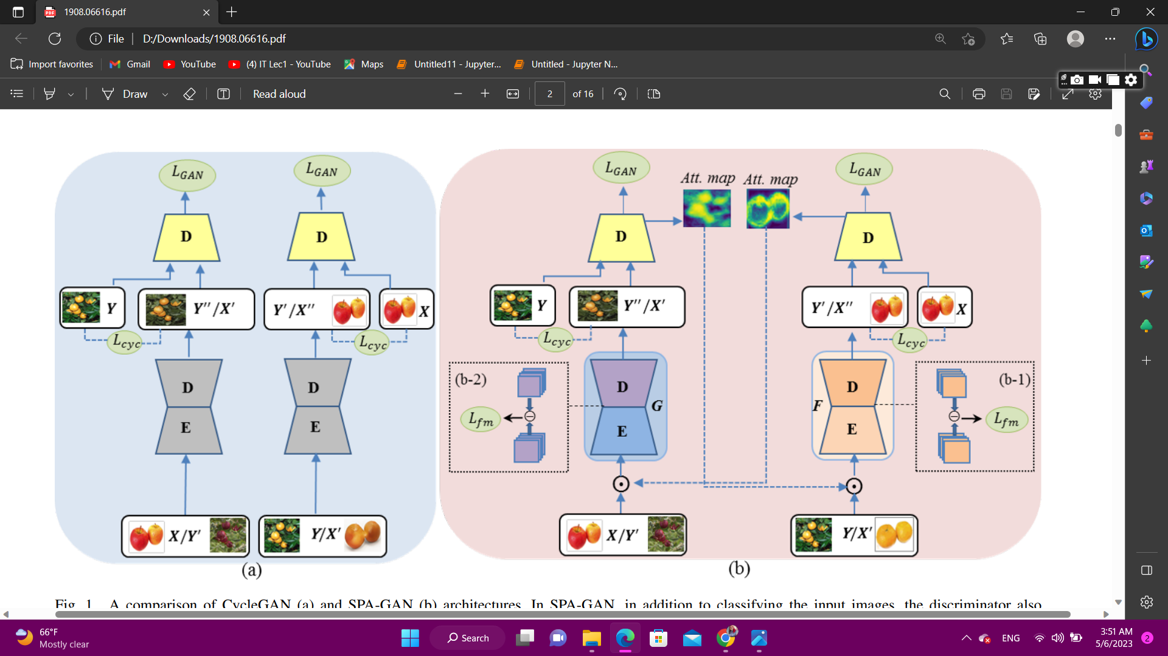
SPA-GAN architecture
In SPA-GAN, in addition to classifying the input images, the discriminator also generates spatial attention maps, which are fed to the generator and help it focus on the most discriminative object parts.
In addition, the feature map loss is shown in the dashed blocks (b-1) and (b-2), which is the difference between the feature maps of the (attended) real and generated images computed in the first layer of the decoder. The feature map loss is used to preserve domain specific features in image translation.

Slide 9
Dataset

Slide 10
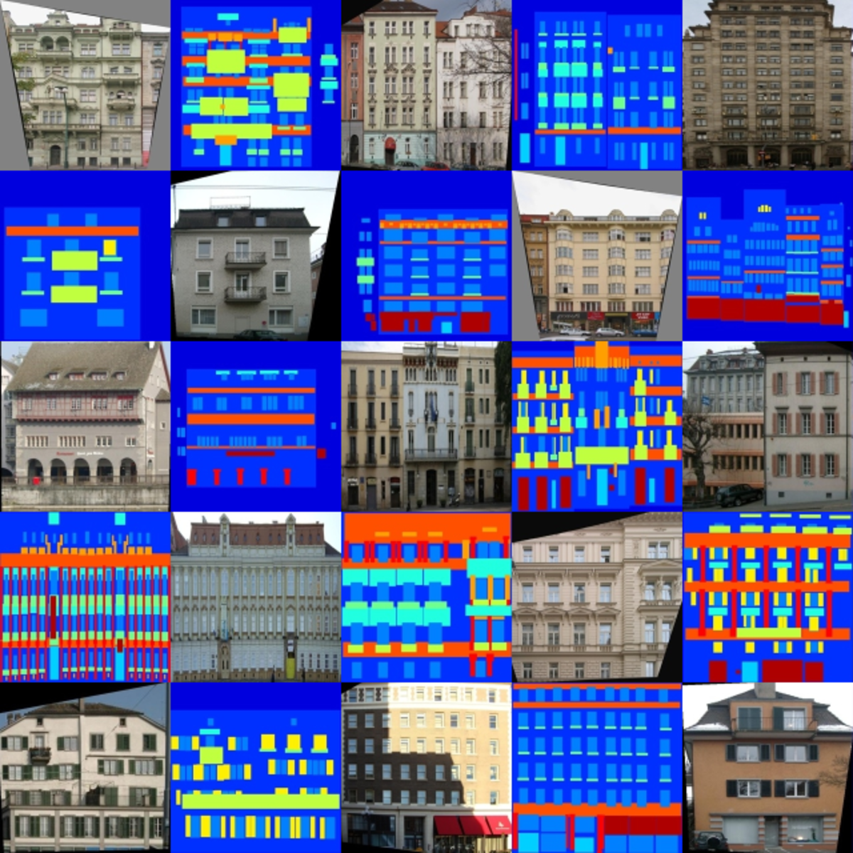
Step 1: Data
We changed the dataset that are used in the paper.
We used Facades Dataset
Facades dataset consists of 506 Building Facades & corresponding Segmentations with split into train and test subsets.
Image Size 256x256

Slide 11

Step 1: Data
1-The length and width must be fixed so we made them equal to 256.
2-Download dataset if it isn't downloaded yet.
3-Image processing by
Resize it.
Crop it to the fixed size.
Make it horizontial.
Normalize it.
4-The dataset is divided into four files Train_A, Train_B and Test_A,Test_B we load the file by it's mode.

Slide 12
Model

Slide 13
Step 2:Model
1- convolutional Custom
2-deconvolutional
Custom convolutional layer with optional batch normalization.
Take (No input channels, No output channels, Kernal size, Stride, Padding, Bais with false value) as arguments and make convolutional layer with them after that check if bn is true then normalize and pass the output to LeakeyRelu.
Return layer
Custom deconvolutional layer with optional batch normalization.
Take (No input channels, No output channels, Kernal size, Stride, Padding, apply dropout with false value) as arguments and make convolutional layer and up sampling with them after that check if bn is true then normalize , if dropout is true then dropout with (0.5) dropout percentage and pass the output to LeakeyRelu.
Return layer.

Slide 14
Generator
-Starts with convolutional dimension equals 64.
-Encoding (Down Sampling): Takes features and convert it to latent space, by using 2 convolutional layers , using 6 convolutional networks with increasing the dimensions by factor 2 in the first three layers and then stay constant and the kernel size is 4.
Decoding (Up sampling): using 7 de-convolutional networks with constant dimensions and applying dropout for the first three layers, then reducing the dimensions for the next three layers and apply normal distribution for the last layer.

Slide 15
Discriminator
-Starts with convolutional dimension equals 64.
Consists of 4 convolutional networks with increasing the dimensions by factor 2.
The last layer is the classification layer.

Slide 16
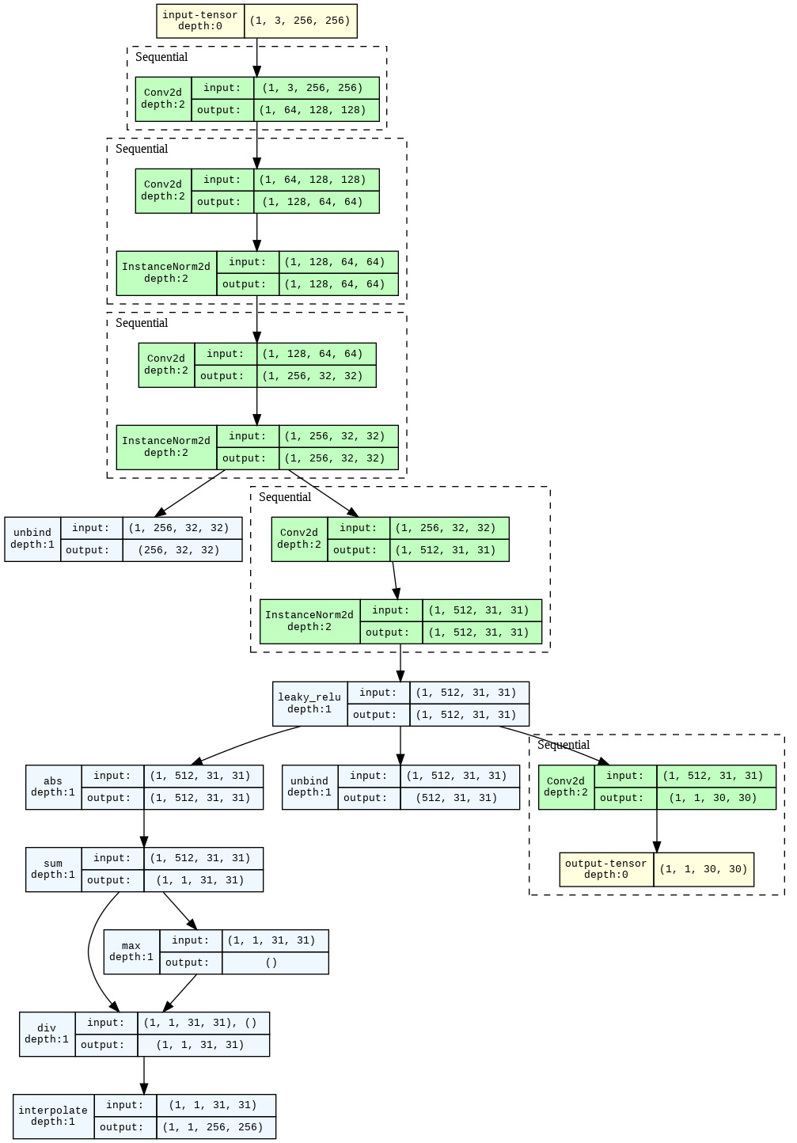

Slide 17
Loss functions
Adversarial loss:
The adversarial loss is defined as the binary cross-entropy loss between the discriminator's output and a vector of ones, indicating that the discriminator should output a high probability for real samples, and a vector of zeros, indicating that the discriminator should output a low probability for synthetic samples..
Identity loss:
if the input x and the output y are the same, the identity loss function should produce a small value, indicating that the model has successfully learned to preserve the identity of the input.
Cycle consistency:
The cycle consistency loss is based on the idea that if an image A can be translated to an image B, and then translated back to the original image A', then A and A' should be similar. In other words, the mapping from A to B and then from B back to A' should be consistent, or form a cycle.
Feature map loss:
The feature map loss is typically defined as the mean squared error (MSE) between the feature maps of the synthesized image and the content image at a certain layer.
Total loss = sum of all the four losses

Slide 18
Training

Slide 19
Starting with setting the optimizers for both the two generators and discriminators.
We use 'Adam' optimizer with learning rate 0.002 and betas of 0.5 and 0.999
Using checkpoints to save the training process.

Slide 20
Training Step
In each training step, we take the original images x and y and set the gradients of generators and discriminators to zero.
Take the feature map from the discriminator and apply it to the real image.
Feed them to the generator to generate the fake images.
Feed the fake images to the discriminator.
Calculate the losses (GAN, feature map , and cycle) and then compute the total loss.
Perform the backpropagation and update the weights.

Slide 21
Training Process
Repeat the training step over the number of epochs.
Printing the loss values in each epoch.

Slide 22
Testing
Use function generate_image that takes a given image and pass it to the generator
Clean KID = 0.345

Slide 23
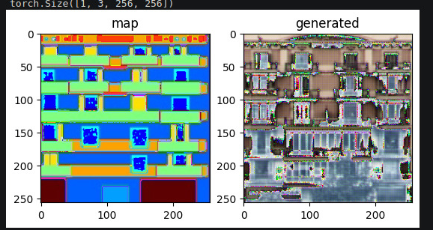
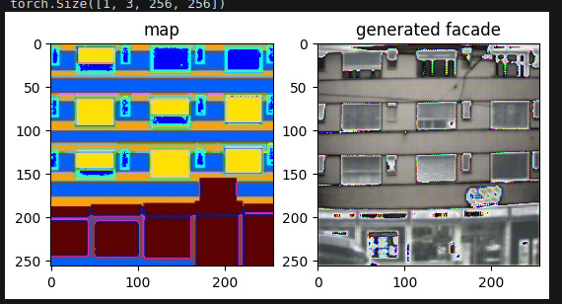
While training
After training

