Slide 1






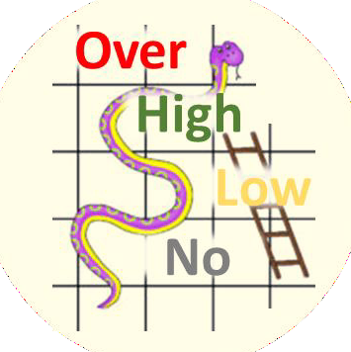

Tournament | A series of games to measure rank of teams
Teamwork | Group of interdependent individuals working together towards a common goal
Win | Leading at end of final whistle blow
Leading | More points than opponent while game is still at play
Game | Start of whistle …. Period of play …. final whistle blow
Routine | A sequence of actions regularly followed.
Tactics | Action or strategy carefully planned to achieve a specific end.
2 | 3
1 | 4
Definition
Game Plan
Competent Phases
INCOMPETENT
COMPETENT
Tournament Rules
Strategy & Tactics
Mistake
vs Weakness
Standard Rules
Skills & Tactics
Game Rules
Referee / Umpire
Competent
& Conscious
In the Zone
Individual Skills
Catching
Shooting
Passing
Footwork
Marking
Dodging
Confidence Level
Positive mindset
Memorize | Understand | Alert / Aware

Slide 2


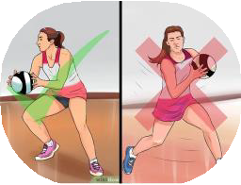
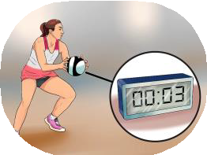
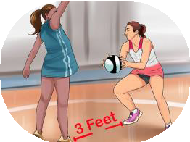
Standard Netball Rules
100ft
5
✓
✓
✗
₁st Quarter | Interval | ₂nd Quarter | Interval | ₃rd Quarter | Interval | ₄th Quarter
15 min | 4 min | 15 min | 12 / 8 min | 15 min | 4 min | 15 min
Tournament rules may change standard timings
50ft
A
E
32ft
B
C
D
Extra time, tie score | 1st Quarter | Interval | 2nd Quarter
 | 7 min | 1 min | 7 min
1/3
1/3
1/3
4
P l a y i n g A r e a s
GS | A | B | o f f s i d e | o f f s i d e | o f f s i d e
GA | A | B | C | o f f s i d e | o f f s i d e
WA | o f f s i d e | B | C | o f f s i d e | o f f s i d e
C | o f f s i d e | B | C | D | o f f s i d e
WD | o f f s i d e | o f f s i d e | C | D | o f f s i d e
GD | o f f s i d e | o f f s i d e | C | D | E
GK | o f f s i d e | o f f s i d e | o f f s i d e | D | E
1
2
3
 | ✓ | ✗
Hands | Short Nails | Jewellery | Penalty
Score | GS or GA | All other positions | Free pass | Penalty Throw | Penalty Throw
Ball Handling ❶ | Only pivot with the foot you land on first | Travel with ball | Opponent gets free pass
Ball Holding ❷ | 3 seconds max | More than 3 seconds | Opponent gets free pass
Defending distance ❸ | 3 feet minimum | Less than 3 feet/1meter | Opponent gets free pass
Playing Area ❹ | In designated playing area according to position | Offside and outside court | Opponent gets free pass
Passing or throwing the ball ❺ | ED to C or C to AB | Over 1/3 of the court Ie. ED to AB | Opponent gets free pass
Major Rule | No contact (accidental or deliberate) | Obstructing play, or intimidating your opponents | Opponent gets free pass and you can be sent off | Opponent gets free throw | Opponent gets free throw

