Slide 1
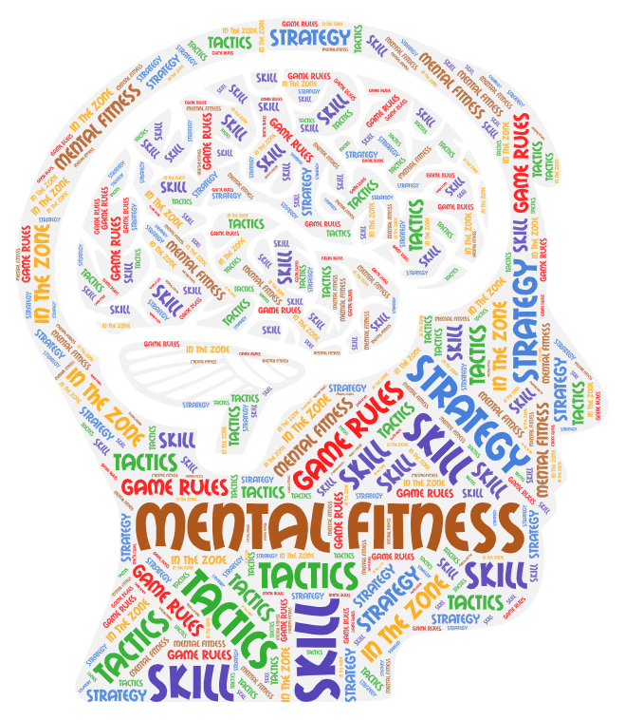
…. having and maintaining a state of well-being and cultivating awareness of how we think, behave and feel.

Slide 2
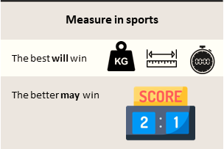



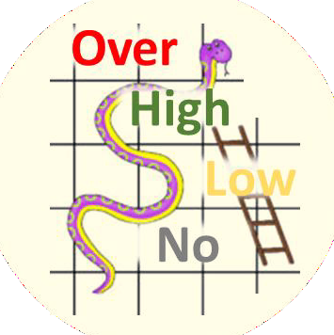
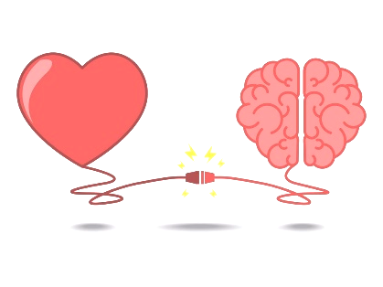
Tournament | A series of games to measure rank of teams
Teamwork | Group of interdependent individuals working together towards a common goal
Win | Leading at end of final whistle blow
Leading | More points than opponent while game is still at play
Game | Start of whistle …. Period of play …. final whistle blow
Routine | A sequence of actions regularly followed.
Tactics | Action or strategy carefully planned to achieve a specific end.
2 | 3
1 | 4
Definition
Game Plan
Competent Phases
M
A
Tournament Rules
INCOMPETENT
COMPETENT
Strategy & Tactics
A
U
Mistake
vs Weakness
Standard Rules
Game Rules
M
Skills & Tactics
U
Referee / Umpire
A
In the Zone
Individual Skills
U
Catching
Shooting
Passing
Footwork
Marking
Dodging
Confidence Level
U
Positive mindset
Alert / Aware | Understand | Memorize | …. free your mind ….. more brain time for game
A
U
M

Slide 3
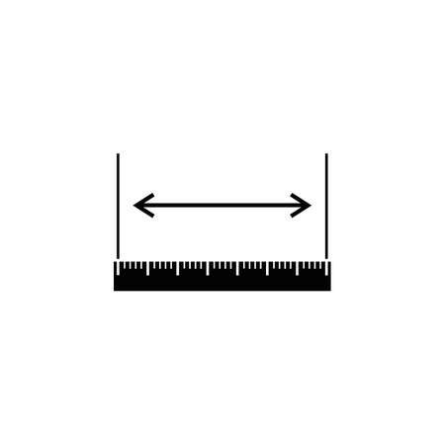

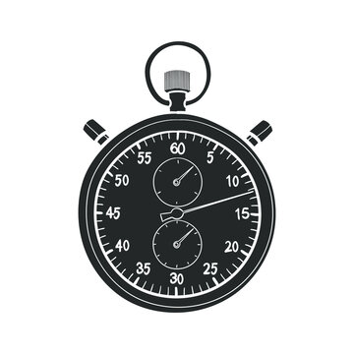
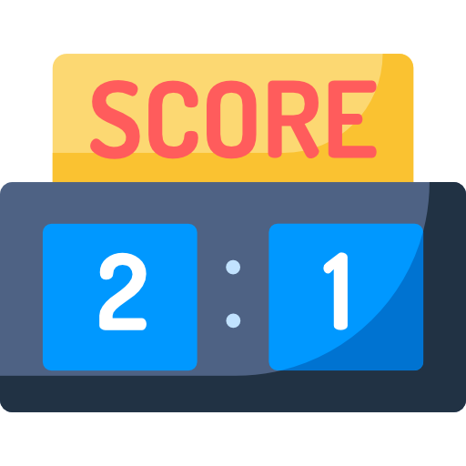
Measure in sports
The best will win
The better may win
Elements for a win
Strategy & Tactics
Skills & Tactics
In the Zone
Game Rules
Notes:
Measure for weight, length or time, most often are about the individual skill. Therefore the best will be the winner.
Measure of scoreboard on the other hand, is the competition between 2, where the better will win if based on individual skills alone. There are a number of other elements (which makes it very interesting) that makes it challenging, making the better one MAY win. The weaker team still stand a chance to win with being better at the other elements.
Other elements are described in next slides;
Strategy and Tactics
Skill and Tactics
In the Zone
Game Rules

Slide 4
Strategy & Tactics
Skills & Tactics
In the Zone
Game Rules
Game Plan
Definition
Strategy decided by leader to implement in game
Tournament - A series of games to measure rank of teams
Teamwork - Group of interdependent individuals working together towards a common goal
Win - Leading at end of final whistle blow
Leading - More points than opponent while game is still at play
Game - Start of whistle …. Period of play …. final whistle blow
Routine - A sequence of actions regularly followed.
Tactics - Action or strategy carefully planned to achieve a specific end.
Notes:
Strategy and Tactics
Skill and Tactics
In the Zone
Game Rules
Game Plan – These are the strategies decided to be used in the game/tournament with the goal to win by capitalizing on our strength and also exploiting on opponent’s weaknesses
Definition – Audience to fully understand each definition.
Common misconception to be corrected;
for Teamwork
Each team member do different functions (not same function) working together to achieve common goal.
Perfect teamwork is when each team member can work as 1 single mind. Like as though, each have telepathic powers.
Imagine how each every part of our body function when we perform a simple task.
for Leading and Win
Leading is not winning
Win is leading at end of final whistle.

Slide 5
Strategy & Tactics
Skills & Tactics
In the Zone
Game Rules
Competency Phases
Unconscious Incompetent – Phase 1
You don’t know what you don’t know
Conscious Incompetent – Phase 2
You start to know what you don’t know
Conscious Competent – Phase 3
You know and start practicing to make it blend with you
Unconscious Competent – Phase 4
You no longer realize but you automatically react and do it
Mistakes vs. Weakness
Capable to do but had a flaw = MISTAKE
Incapable to do = WEAKNESS
Individual Skills
Practice to achieve
Phase 3 to be competent
Phase 4 to free your mind
2 | 3
1 | 4
INCOMPETENT
COMPETENT
Notes:
Strategy and Tactics
Skill and Tactics
In the Zone
Game Rules
Competency Phases – Audience to understand how every skill they plan to practice for; goes thru a lifecycle.
Unconscious Incompetent - You don’t know what you don’t know
We see a skill being performed, we think we can do it too.
See person riding a bicycle. We think we can ride just like them
Conscious Incompetent – You start to know what you don’t know
We try to perform the skill, we realize it is not as easy, we thought it was.
First try on riding a bicycle. Realized we need to balance and coordinate legs and steer handlebar.
Conscious Competent – You know and start practicing to make it blend with you
We practice the skill, improving what we are weak at to be better and better.
Practice Practice Practice on cycling. Body start to coordinate together.
Unconscious Competent – You no longer realize but you automatically react and do it
We start to be able to do other stuff while performing the skill.
Our body start to works automaticall, and react based on reflects most often.
Reaching this phase usually takes 10,000 practice reps.
Able to cycle while our mind is look at scenery or talking with another cyclist etc.
Mistake vs. Weakness
Capability and ability have similar meanings, but
Capability is often associated with a particular competence or efficiency at a specific task.
Ability is more basic, and often means the capacity to do something, regardless of quality.
So when you are able and capable to do something, but did not achieve it at a particular attempt, that was a mistake made.
When you are able to perform something but not capable to reach a particular quality/standard/benchmark. That is a weakness.
Mistakes can be repaired, you just need to quickly know what caused the mistake and do corrections.
Weakness need to be improved, not a repair. Weakness need time and practice.
If mistakes get repeated much too often, it is not a mistake but is actually a weakness.
Never ever reveal your weakness in a tournament/game!
Individual Skills
Practice the skill to improve your weakness to be no longer a weakness; meet a certain capability (particular quality/standard/benchmark)
Practice the skill to improve your capability to meet a higher capability (higher quality/standard/benchmark)
Practice to achieve
Phase 3 to be competent
Phase 4 to free your mind

Slide 6

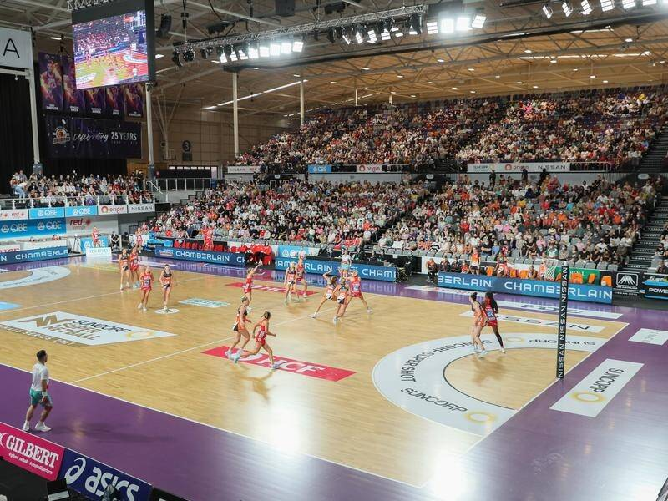
Strategy & Tactics
Skills & Tactics
In the Zone
Game Rules
Confidence Level
Over confidence. - feel like nothing can go wrong (nothing can beat you)
High confidence - feel like there is a high chance you can win.
Low confidence - feel like there is a high chance you can loose.
No confidence - feel like you cannot overcome it. (give-up)
Positive Mindset
Predictable outcome is when heart and mind agree the same
Unpredictable is when heart and mind disagree
Both your heart and mind must feel and know it is can be.
Notes:
Strategy and Tactics
Skill and Tactics
In the Zone
Game Rules
Confidence Levels
No confidence –see the external factors, a feel/know you cannot overcome it. (as good as give-up)
Low confidence - see the external factors, a feel/know there is a high chance you can loose.
High confidence - see the external factors, a feel/know there is a high chance you can win.
Over confidence. - see the external factors, a feel/know nothing can go wrong (nothing can beat you)
Confidence level changes with every event that happens at that time. It happens to you, it also happens to the opponent.
You tend to not hide and try your weakness during game because you are over confident.
“Butterfly in stomach” the best feeling to have at start of game.
Happens when you feel there is a chance and you do not know what will the result be. (surprise)
This get you to start at range of high confidence spectrum.
You have to be fully aware of your (and opponents) confidence levels from just before the start of a game, during the game, and at end of game.
Goal is to maintain at high confidence and higher than opponent.
Positive Mindset
Heart feels - Mind knows
Unpredictable results.
If you feel it can go wrong, but your mind knows how to get it right. Your body can be influenced by it.
If you feel it can go right, but your mind knows it can go wrong. Your body can be influence by it.
Predictable results.
If you feel it can go wrong, and your mind knows it can go wrong. Your body will be influenced and produce the fail result.
If you feel it can go right, and your mind knows it can go right. Your body will be influenced and produce the success result.
Eliminate negative thoughts
If you have a routine, and a next routine is needed if 1st routine produce a fail result. Combined next routine to be part of 1st routine.

Slide 7
Strategy & Tactics
Skills & Tactics
In the Zone
Game Rules
Game Rules
Referee are humans too
Judgement we expect is fair
Always give respect to referee
Challenge(decision) if needed, but never argue (personal)
Never show disrespect to referee
Tournament Rules
Be fully aware, remember what changes onto the standard rule
Standard Rules
Memorize the standard rules of the game
Notes:
Strategy and Tactics
Skill and Tactics
In the Zone
Game Rules
Referee are humans too. Judgement we expect is fair (without realizing, even favor to us.)
Always give respect to referee.
Goal is to make us play and enjoy our game.
Close 1 eye, for mistakes we may make.
Challenge(decision) if needed, but never argue (personal). Never show disrespect to referee.
Purposes of rules is to establish a level playing field for all players. By defining the parameters of the game, rules help to ensure that everyone is playing by the same set of rules.
Standard Rules
Audience need to be aware, understand and memorize the standard rules of the game
Most often players, love the game so much because of the fun and play. Rules are not known, made aware and sometimes misinformed or misunderstood.
Make sure it is done! Not just lectured about but see that it gets done.
Tournament Rules
Audience need to be aware, remember especially what change to the standard rule game

Slide 8
Tournament | A series of games to measure rank of teams
Teamwork | Group of interdependent individuals working together towards a common goal
Win | Leading at end of final whistle blow
Leading | More points than opponent while game is still at play
Game | Start of whistle …. Period of play …. final whistle blow
Routine | A sequence of actions regularly followed.
Tactics | Action or strategy carefully planned to achieve a specific end.
2 | 3
1 | 4
Definition
Game Plan
Competent Phases
M
A
Tournament Rules
INCOMPETENT
COMPETENT
Strategy & Tactics
A
U
Mistake
vs Weakness
Standard Rules
Game Rules
M
Skills & Tactics
U
Referee / Umpire
A
In the Zone
Individual Skills
U
Catching
Shooting
Passing
Footwork
Marking
Dodging
Confidence Level
U
Positive mindset
Alert / Aware | Understand | Memorize | …. free your mind ….. more brain time for game
A
U
M
Notes:
Key takeaways :
Games involving scoreboard, result are always unpredictable. No matter how strong or weak a team is, results can be different.
True, winning against a stronger team not impossible, but harder.
How? Your team game plans, teamwork and your mastery of “In the zone”.
False, winning against a weaker team as easy as you may think.
Why? Surprising game plans and confidence levels.
Maintain your focus on the game for a win at the final whistle.
Leading is not a win yet. Identify how ways to stay and extend lead before the final whistle.
Trailing is not a lost yet. Identify how ways to get into lead before the final whistle.
Mistakes can be repaired, you just need to quickly know what caused the mistake and do corrections.
Weakness need to be improved during practice, not during game.
Have a session in team to identify what to say/do among team members to:
Makes teams’ confidence level to go up.
Makes the opponent confidence level to go down.
Never ever reveal your weakness in a tournament/game!
The more skills you have at Phase 4 competent level, the more free time you have for your mind. You have more time to think and execute your next plan.
If you have a routine, and a next routine is needed if; 1st routine produce a fail result. Combined next routine to be part of 1st routine.
Goal is to maintain at high confidence and higher than opponent.
Always give respect to referee.
Rules affect us and opponent. So when we memorize that, we can ensure we don’t break the rule, and also find ways to get opponent to break the rule to our benefit.

Slide 9


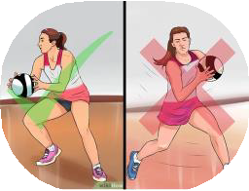
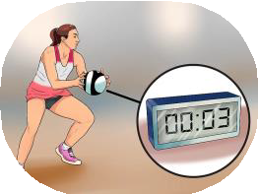
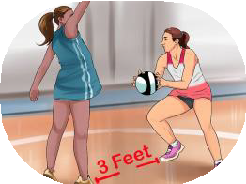
Standard Netball Rules
100ft
5
✓
✓
✓
✗
✗
₁st Quarter | Interval | ₂nd Quarter | Interval | ₃rd Quarter | Interval | ₄th Quarter
15 min | 4 min | 15 min | 12 / 8 min | 15 min | 4 min | 15 min
Tournament rules may change standard timings
50ft
A
E
32ft
B
C
D
Extra time, tie score | 1st Quarter | Interval | 2nd Quarter
 | 7 min | 1 min | 7 min
1/3
1/3
1/3
4
P l a y i n g A r e a s
GS | A | B | o f f s i d e | o f f s i d e | o f f s i d e
GA | A | B | C | o f f s i d e | o f f s i d e
WA | o f f s i d e | B | C | o f f s i d e | o f f s i d e
C | o f f s i d e | B | C | D | o f f s i d e
WD | o f f s i d e | o f f s i d e | C | D | o f f s i d e
GD | o f f s i d e | o f f s i d e | C | D | E
GK | o f f s i d e | o f f s i d e | o f f s i d e | D | E
1
2
3
 | ✓ | ✗
Hands | Short Nails | Jewellery | Penalty
Score | GS or GA | All other positions | Free pass | Penalty Throw | Penalty Throw
Ball Handling ❶ | Only pivot with the foot you land on first | Travel with ball | Opponent gets free pass
Ball Holding ❷ | 3 seconds max | More than 3 seconds | Opponent gets free pass
Defending distance ❸ | 3 feet minimum | Less than 3 feet/1meter | Opponent gets free pass
Playing Area ❹ | In designated playing area according to position | Offside and outside court | Opponent gets free pass
Passing or throwing the ball ❺ | ED to C or C to AB | Over 1/3 of the court Ie. ED to AB or Backline to C | Opponent gets free pass
Major Rule | No contact (accidental or deliberate) | Obstructing play, or intimidating your opponents | Opponent gets free pass and you can be sent off | Opponent gets free throw | Opponent gets free throw

Slide 10
…. free your mind ….. more brain time for game
Notes:
Brain does not have to over process ….
when you have memorize as much ….
when you have practice your tactics as routines to phase 4 as much ….

