Slide 1
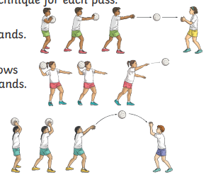

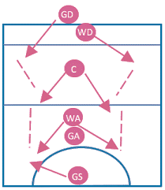

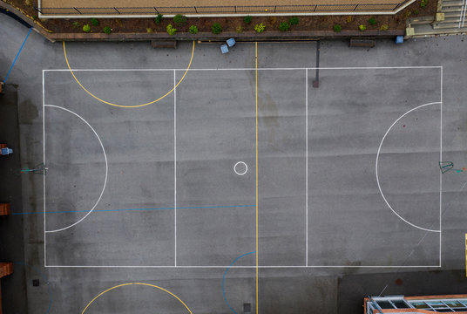

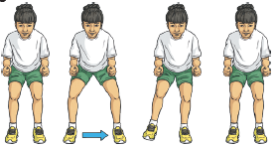
Passing

Slide 2


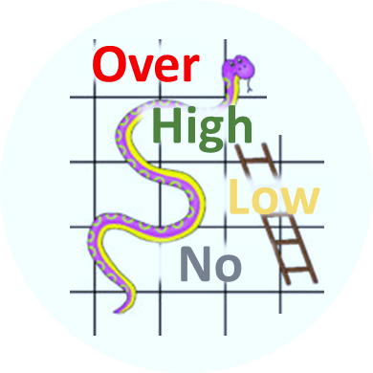
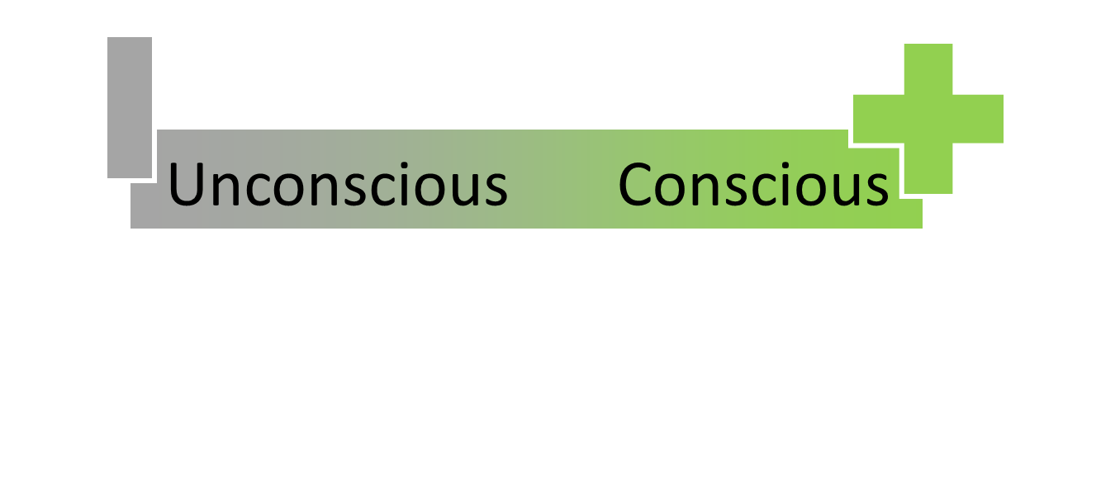
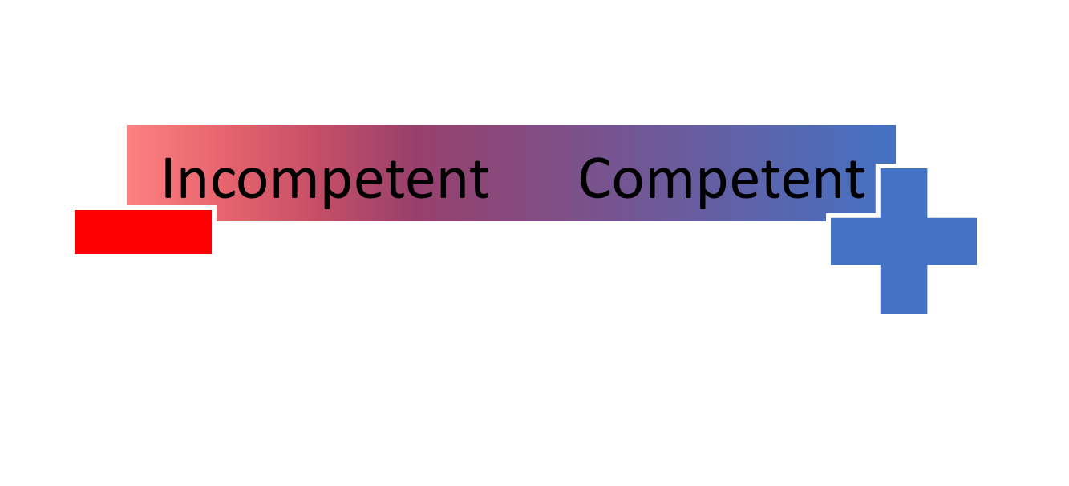
Tournament | A series of games to measure rank of teams
Teamwork | Group of interdependent individuals working together towards a common goal
Win | Leading at end of final whistle blow
Leading | More points than opponent while game is still at play
Game | Start of whistle …. Period of play …. final whistle blow
Routine | A sequence of actions regularly followed.
Tactics | Action or strategy carefully planned to achieve a specific end.
Definition
Game Plan
 | Catching
 | Shooting
 | Passing
 | Footwork
 | Marking
 | Dodging
Individual Skills
Standard Rules
Strategy & Tactics
Tournament Rules
Game Rules
Skills & Tactics
Mistake
vs Weakness
Referee
In the Zone
Positive mindset
2 | 3
1 | 4
Competent & Conscious
Confidence Level

Slide 3









