Slide 1


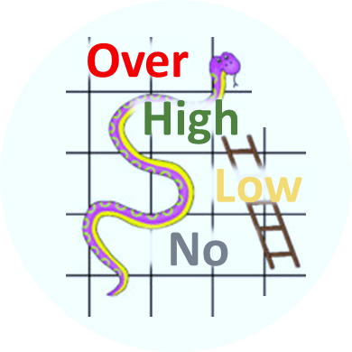

Tournament
Teamwork
Leading
Win
Game
2 | 3
1 | 4
Definition
Game Plan
Competent & Conscious
COMPETENT
INCOMPETENT
Tournament Rules
Strategy & Tactics
Mistake
vs Weakness
Standard Rules
Game Rules
Skills & Tactics
Referee / Umpire
In the Zone
Individual Skills
 | Catching
 | Shooting
 | Passing
 | Footwork
 | Marking
 | Dodging
Confidence Level
Positive mindset
Low

Slide 2
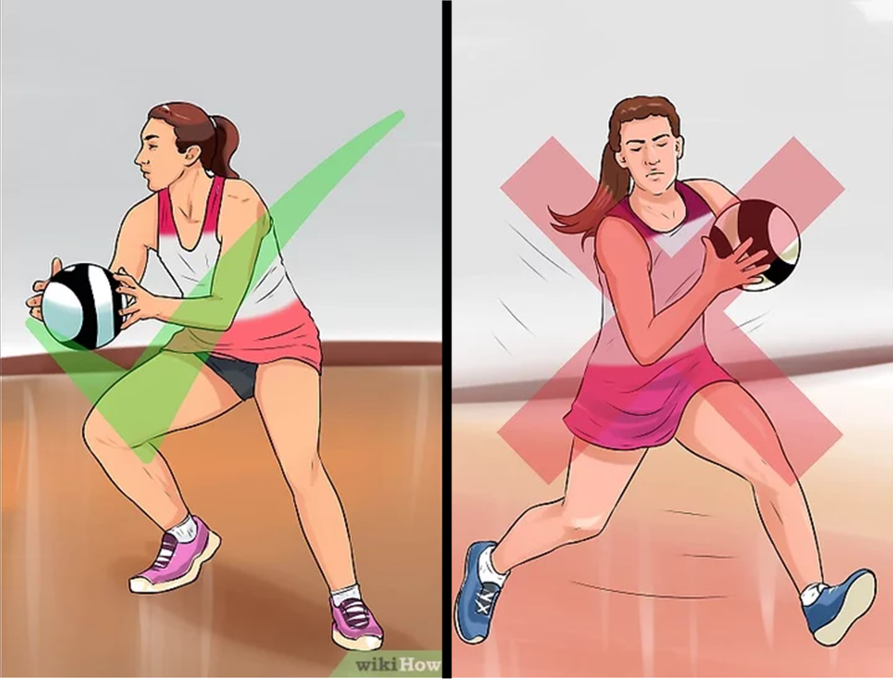
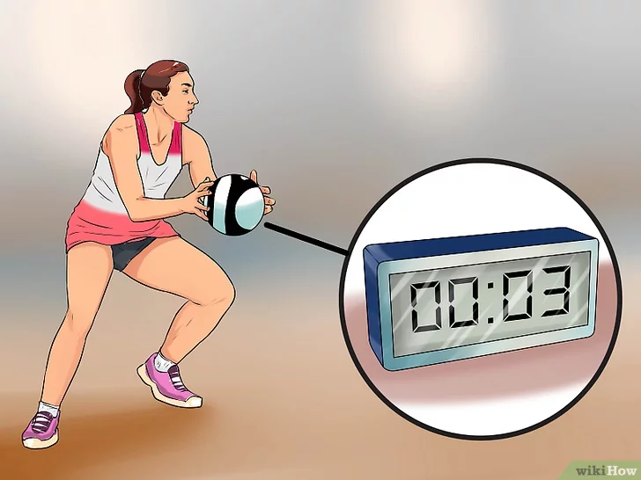
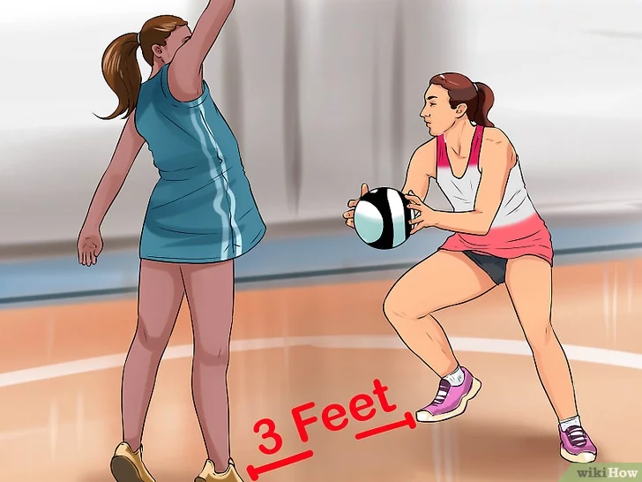
Standard Netball Rules
100ft
A |  |  |  | E
 | B | C | D
1st Quarter | Interval | 2nd Quarter | Interval | 3rd Quarter | Interval | 4th Quarter
15 min | 4 min | 15 min | 12 / 8 min | 15 min | 4 min | 15 min
Tournament rules may change standard timings
50ft
32ft
Extra time, tie score | 1st Quarter | Interval | 2nd Quarter
 | 7 min | 1 min | 7 min
1/3
1/3
1/3
 | Playing Areas
GS | A | B | offside | offside | offside
GA | A | B | C | offside | offside
WA | offside | B | C | offside | offside
C | offside | B | C | D | offside
WD | offside | offside | C | D | offside
GD | offside | offside | C | D | E
GK | offside | offside | offside | D | E
1
2
3
 | ✓ | ✗
Hands | Short Nails | Jewellery | Penalty
Score | GS or GA | All other positions | Free pass | Penalty Throw
Ball Handling ❶ | Only pivot with the foot you land on first | Travel with ball | Opponent gets free pass
Ball Holding ❷ | 3 seconds max | More than 3 seconds | Opponent gets free pass
Defending distance ❸ | 3 feet minimum | Less than 3 feet/1meter | Opponent gets free pass
Playing Area | In designated playing area according to position | Offside and outside court | Opponent gets free pass
Passing or throwing the ball | ED to C or C to AB | Over 1/3 of the court Ie. ED to AB | Opponent gets free pass
Major Rule | No contact (accidental or deliberate) | Obstructing play, or intimidating your opponents | Opponent gets free pass and you can be sent off | Opponent gets free throw

