Slide 1
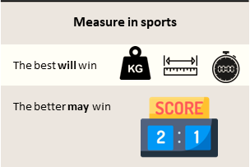



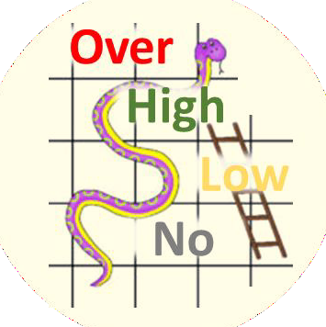

Tournament | A series of games to measure rank of teams
Teamwork | Group of interdependent individuals working together towards a common goal
Win | Leading at end of final whistle blow
Leading | More points than opponent while game is still at play
Game | Start of whistle …. Period of play …. final whistle blow
Routine | A sequence of actions regularly followed.
Tactics | Action or strategy carefully planned to achieve a specific end.
2 | 3
1 | 4
Definition
Game Plan
Competent Phases
M
A
Tournament Rules
INCOMPETENT
COMPETENT
Strategy & Tactics
A
U
Mistake
vs Weakness
Standard Rules
Skills & Tactics
M
Game Rules
U
Referee / Umpire
A
In the Zone
Individual Skills
U
Catching
Shooting
Passing
Footwork
Marking
Dodging
Confidence Level
U
Positive mindset
Alert / Aware | Understand | Memorize | …. free your mind ….. more brain time for game
A
U
M

