Slide 1
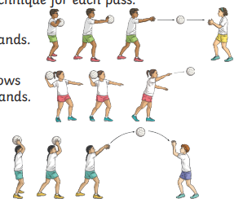

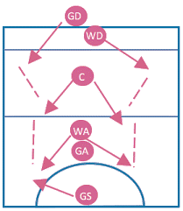

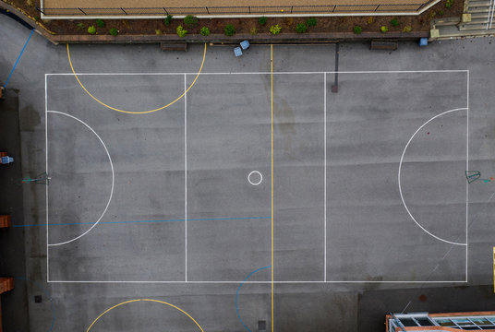

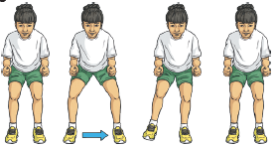
Passing

Slide 2

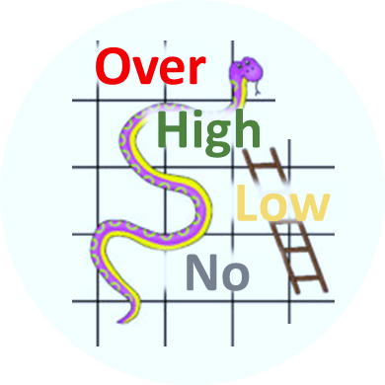

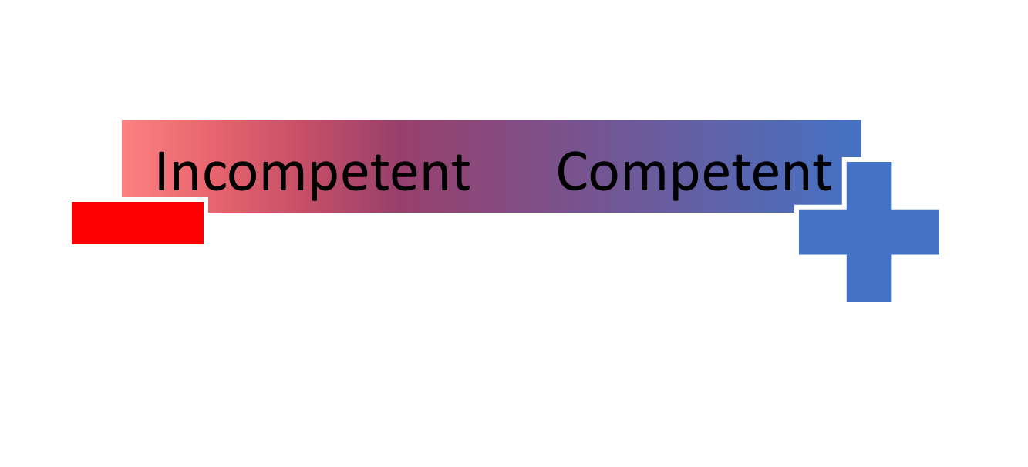
Tournament
Teamwork
Win
Leading
Game
Definition
Game Plan
 | Catching
 | Shooting
 | Passing
 | Footwork
 | Marking
 | Dodging
Individual Skills
Standard Rules
Strategy & Tactics
Tournament Rules
Game Rules
Skills & Tactics
Mistake
vs Weakness
Referee
In the Zone
Positive mindset
2 | 3
1 | 4
Competent & Conscious
Confidence Level

