Slide 1
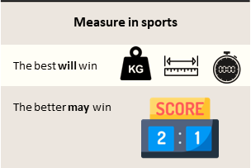



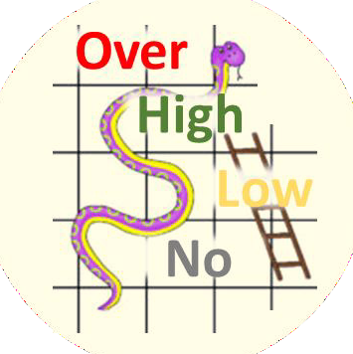

Tournament | A series of games to measure rank of teams
Teamwork | Group of interdependent individuals working together towards a common goal
Win | Leading at end of final whistle blow
Leading | More points than opponent while game is still at play
Game | Start of whistle …. Period of play …. final whistle blow
Routine | A sequence of actions regularly followed.
Tactics | Action or strategy carefully planned to achieve a specific end.
2 | 3
1 | 4
Definition
Game Plan
Competent Phases
M
A
Tournament Rules
INCOMPETENT
COMPETENT
Strategy & Tactics
A
U
Mistake
vs Weakness
Standard Rules
Skills & Tactics
M
Game Rules
U
Referee / Umpire
A
In the Zone
Individual Skills
U
Catching
Shooting
Passing
Footwork
Marking
Dodging
Confidence Level
U
Positive mindset
Alert / Aware | Understand | Memorize | …. free your mind ….. more brain time for game
A
U
M

Slide 2
Measure in Sports
The best will win
The better may win
Weight
Length
Time
Scoreboard

Slide 3
Strategy & Tactics
Skills & Tactics
In the Zone
Game Rules
Game Plan
Definition
Strategy decided by leader to implement in game
Tournament - A series of games to measure rank of teams
Teamwork - Group of interdependent individuals working together towards a common goal
Win - Leading at end of final whistle blow
Leading - More points than opponent while game is still at play
Game - Start of whistle …. Period of play …. final whistle blow
Routine - A sequence of actions regularly followed.
Tactics - Action or strategy carefully planned to achieve a specific end.

Slide 4
Strategy & Tactics
Skills & Tactics
In the Zone
Game Rules
Competency Phases
Mistakes vs. Weakness
Individual Skills
Unconscious Incompetent – Phase 1
Conscious Incompetent – Phase 2
Conscious Competent – Phase 3
Unconscious Competent – Phase 4
You don’t know what you don’t know
You start to know what you don’t know
You know and start practicing to make it blend with you
You no longer realize but you automatically react and do it
Incapable to do
Capable to do but had a flaw
Practice to achieve
Phase 3 to be competent
Phase 4 to free your mind

Slide 5
Strategy & Tactics
Skills & Tactics
In the Zone
Game Rules
Confidence Level
Positive Mindset

Slide 6
Strategy & Tactics
Skills & Tactics
In the Zone
Game Rules
Standard Rules
Tournament Rules
Referee / Umpire

