Slide 1
Lecture 10:
Web Services

Slide 2
Outline
Overview of Web Services
SOAP (messaging)
WSDL (service description)
UDDI (registry)

Slide 3
A bit of buzz (1)
“By 2006, Web services will take hold as a competitive differentiator in business relationships and product innovation. Enterprises that want to remain competitive will need to use Web services to provide commonly requested data to their partners. It is imperative that enterprises develop a strategy for how to use Web services to develop products, including hard goods, digital goods and services.”
Gartner Research, November 2003

Slide 4
A bit of buzz (2)
Yankee Group, Nov. 2004 survey (437 entreprises)
  48% have already deployed Web Services
  39% will deploy Web Services within one year
  71% will increase spending on Web Services in 2005
Jeff Bezos (CEO Amazon), Tech. Review 01/2005
  “Web 1.0 was making the Internet for people; Web 2.0 is making the Internet better for computers”

Slide 5
What is a Web Service?
A web service is a network accessible interface to application programs, built using standard Internet technologies.
Clients of web services do NOT need to know how it is implemented.
Network
Web
Service
Application
client
Application
program

Slide 6
Web Services: Some Definitions
A Web Service is a URL-addressable software resource that performs functions (or a function).
"Web services are a new breed of Web application. They are self-contained, self-describing, modular applications that can be published, located, and invoked across the Web. Web services perform functions, which can be anything from simple requests to complicated business processes. … Once a Web service is deployed, other applications (and other Web services) can discover and invoke the deployed service.” IBM web service tutorial
Notes:
The notion of web services captures a recent technological development that aims at the possibility to access services (i.e. applications) through the Internet infrastructure (i.e. Web standards). Technologically they represent only a small change as compared to earlier distributed computing standards, but the impact of this new technology is considered as being very high as it facilitates automated distributed computing and information access by taking advantage of the ubiquitously available Web infrastructure. In particular on-demand use of software is considered as one of the important developments Web service technology is going to support.

Slide 7
Web Evolution
Technology | TCP/IP | HTML | XML
Purpose | Connectivity | Presentation | Programmability
Applications | E-Mail, FTP… | Web Pages | Web Services
Outcome | Create the Web | Browse the Web | Program the Web

Slide 8
Web Service Architecture
"server"
Service provider
publish
(WSDL)
bind
(SOAP)
Service broker
Service requestor
find
(UDDI)
"naming service"
"client"
Notes:
The Web architecture consists of three components
The service providers that publish available services and offer bindings for services
The service brokers that allow service providers to publish their services (register and categorize). They provide also mechanisms to locate services and their providers
The service requestor that uses the service broker to find a service and then invokes (or binds) the service offered by a service provider.
Note that this architecture corresponds 1:1 to the CORBA model of server-naming service-client.
For each of the three activities the Web services architecture provides specific standards, namely SOAP, WSDL, and UDDI. SOAP and WSDL are W3C standards, whereas UDDI is an OASIS standard.

Slide 9
Web Service Stack
A set of standards for implementing web services
Publication and Discovery: UDDI
extends URI
Service Description: WSDL
extends HTML
Messaging: SOAP
extends HTTP
Transport: HTTP, SMTP, FTTP, …
Notes:
The different standards of the web services architecture establish a communication infrastructure that can be viewed as a high-level protocol stack, where each higher level protocol builds on the lower level protocol:
The web service transport layer is responsible for the basic communication between web services and builds on existing Internet (application) protocol standards
The messaging layer uses the XML-based Simple Object access Protocol for exchanging messages in a request/reply fashion in a distributed environment
The description layer allows describing interfaces of web services – including operations and their parameters. The descriptions are based on the XML-based WSDL standard (Web Service Description Language)
The publication and discovery layer provides the mechanisms for the service brokers. This layer is based on the Universal Description, Discovery and Integration (UDDI) standard, a standard that defines XML-based service AND business descriptions, and a SOAP-based standard API to interact with the service broker.
On can view each of the three higher layers of this protocol stack as an extension of existing WWW protocols for supporting services instead of simple document access. SOAP extends HTTP allowing not only document requests but also service requests. WSDL extends HTML by allowing to describe services instead of the structure of documents. UDDI extends URI by allowing to locate services instead of documents only.

Slide 10
Basic Web Service Usage Scenario
2 http get
Web Service
Repository
(UDDI)
(manual) web
service lookup
3 WSDL file
write client
application
1 register
WSDL file
(manually)
publish web
service
deploy client
application
4 SOAP request
Web Service
Provider
5 SOAP response
Notes:
This figure illustrates a (possible) basic Web service usage scenario. A Web service provider registers it's web service at a UDDI repository. This could be done manually through a Web interface or through a UDDI API. He registers the description of the web service which is given in WSDL. A potential user may, for example, manually look up in the UDDI repository the Web service through http and obtain the WSDL file. This file contains all the information needed in order to access the Web service. Based on this information he/she implements a client application that makes use of the web service. When the client application is executed it accesses the web service by using the SOAP protocol for service invocation.

Slide 11
Web Services Implementation
Web Service Provider
(endpoint)
HTTP
server
SOAP
server
application
server
Requestor
(SOAP client)
SOAP
messages
(http transport)
Application Server (web service-enabled)
  provides implementation of services and exposes it through WSDL/SOAP
  implementation in Java, as EJB, as .NET (C#) etc.
SOAP server
  implements the SOAP protocol
HTTP server
  standard Web server
SOAP client
  implements the SOAP protocol on the client site
Notes:
The implementation of web services (in runtime) requires in particular the support of the SOAP protocol on the server and the client site. At the server this support is provided by a SOAP server that uses the HTTP server for transporting SOAP messages. The applications implementing the service can be implemented in any implementation platform, ranging from simple programming languages to application services, that support a web service front-end. It is irrelevant what exactly the interface between the SOAP server and application server is and to which degree exposing applications as web services is automated (e.g. whether web services can be automatically generated from application server components such as EJBs). These solutions are vendor-specific.

Slide 12
Down to earth example:
Amazon Web Services
www.amazon.com/gp/aws/landing.html
Exposes world’s largest product database through Web Services
  Counterintuitive strategy? (cf. Google)
Idea: let others figure out how to sell products for us
  Associates program enables Web sites to link to Amazon.com and earn referral fees
By November 2004: 65000 developers
Some interesting examples:
  www.grokker.com
  www.monsoonretail.com

Slide 13
2. SOAP –
Simple Object Access Protocol
Lightweight messaging framework based on XML
Supports simple messaging and RPC
SOAP consists of
  Envelope construct: defines the overall structure of messages
  Encoding rules: define the serialization of application data types
  SOAP RPC: defines representation of remote procedure calls and responses
  Binding framework: binding to protocols such as HTTP, SMTP
  Fault handling
Soap supports advanced message processing:
  forwarding intermediaries: route messages based on the semantics of message
  active intermediaries: do additional processing before forwarding messages, may modify message
Notes:
SOAP defines the protocol by which web services can be invoked. It supports both simple messaging (as in message queuing approaches) and RPC-style communication. It can be used over any transport protocol layer (such as HTTP, SMTP). SOAP defines the basic structure of messages and encoding rules for data types (used as parameters in procedure/method calls) and the encoding of procedure calls and responses. SOAP also defines bindings to specific transport protocols most notably to HTTP and SMTP.
SOAP is designed to also allow the implementation of advanced message processing models, in particular the use of intermediaries. Intermediaries both can just route messages, based on the content of the message, or do some additional processing before routing the message.

Slide 14
SOAP Message
SOAP messages consist of
  Envelope: top element of XML message (required)
  Header: general information on message such as security (optional)
  Body: data exchanged (required)
Header
  elements are application-specific
  may be processed and changed
  by intermediaries or recipient
Body
  elements are application-specific
  processed by recipient only
envelope
header
body
Notes:
The basic structure of a SOAP message consists of a header and a body, both of which the contents are application specific, i.e. not defined by SOAP. The differentiation is made to distinguish information that is to be processed by all intermediaries (Header) and information that is to be processed at the final destination (Body).

Slide 15
Skeleton SOAP Message
<?xml version="1.0"?>
<soap:Envelope
xmlns:soap="http://www.w3.org/2001/12/soap-envelope"
soap:encodingStyle="http://www.w3.org/2001/12/soap-encoding">
<soap:Header>
...
...
</soap:Header>
<soap:Body>
...
...
<soap:Fault>
...
...
</soap:Fault>
</soap:Body>
</soap:Envelope>

Slide 16
Example: SOAP Message
Envelope
<?xml version='1.0' ?>
<env:Envelope xmlns:env="http://www.w3.org/2002/12/soap-envelope">
<env:Header>
<m:reservation xmlns:m=http://travelcompany.example.org/reservation
env:role=http://www.w3.org/2002/12/soap-envelope/role/next
env:mustUnderstand="true">
<m:dateAndTime>2001-11-29T13:20:00.000-05:00</m:dateAndTime>
</m:reservation>
<n:passenger xmlns:n=http://mycompany.example.com/employees
env:role=http://www.w3.org/2002/12/soap-envelope/role/next
env:mustUnderstand="true">
<n:name>Åke Jógvan Øyvind</n:name>
</n:passenger>
</env:Header>
<env:Body>
<p:itinerary xmlns:p="http://travelcompany.example.org/reservation/travel">
<p:departure>
<p:departing>New York</p:departing>
<p:arriving>Los Angeles</p:arriving>
<p:departureDate>2001-12-14</p:departureDate>
</p:departure>
<p:return>
<p:departing>Los Angeles</p:departing>
<p:arriving>New York</p:arriving>
<p:departureDate>2001-12-20</p:departureDate>
</p:return>
</p:itinerary>
</env:Body>
</env:Envelope>
SOAP attributes
Header
SOAP attributes
Body
Notes:
We highlight some specificities of the SOAP message model for this example. The envelope is the mandatory top-level element of any SOAP message.
The header relates to information on authentication, transaction management, payment etc. needed for processing the message and during transport. Elements in the header contain SOAP-specific attributes (recognizable as belonging to the env namespace) which are used to determine which type of processing is expected by intermediaries and endpoints. This example shows of how the header is used in order transmit certain transactional properties that are required for the service invocation.
The body contains the request, which consists of a travel itinerary in this case. That is, this message is not corresponding to a method invocation but to a simple message transfer.

Slide 17
Conversational Message Exchanges in SOAP
travel agency
customer
proposed
itinerary
alternatives
choice
Notes:
Having simple informational messages as in the previous example, using SOAP, one can implement conversational message exchanges such as illustrated in this example. Such exchanges can for example be used to model a negotiation process between a seller and a customer.

Slide 18
SOAP RPC
Encapsulate RPC into SOAP messages
  procedure name and arguments
  response (return value)
  processing instructions (transactional RPC!)
Example: Request message
<?xml version='1.0' ?>
<env:Envelope xmlns:env="http://www.w3.org/2002/12/soap-envelope" >
<env:Header>
<t:transaction xmlns:t="http://thirdparty.example.org/transaction"
env:encodingStyle="http://example.com/encoding"
env:mustUnderstand="true" >5</t:transaction>
</env:Header>
<env:Body>
<m:chargeReservation env:encodingStyle="http://www.w3.org/2002/12/soap-encoding"
xmlns:m="http://travelcompany.example.org/">
<m:reservation xmlns:m="http://travelcompany.example.org/reservation">
<m:code>FT35ZBQ</m:code>
</m:reservation>
<o:creditCard xmlns:o="http://mycompany.example.com/financial">
<n:name xmlns:n="http://mycompany.example.com/employees">
Åke Jógvan Øyvind </n:name>
<o:number>123456789099999</o:number>
<o:expiration>2005-02</o:expiration>
</o:creditCard>
</m:chargeReservation>
</env:Body>
</env:Envelope>
transaction information
TID
method invocation
parameter 1
parameter 2
Notes:
SOAP also standardizes the way of how request/response interactions are to be represented within a SOAP message. The example shows of how a request is represented: the (application-specific) method name (chargeReservations) occurs as top element in the message Body. The (application-specific) parameters are then to be included as subelements of the method element. SOAP also specifies of how to encode various data types. The Header of the message can be used to include information that is necessary to properly process the request: in this example it is used to state that the message is to be performed as part of a transaction, with a given TID. Note that also the encoding of this processing information is not standardized by SOAP but by the applications, resp. systems, using the SOAP message format.

Slide 19
SOAP RPC
Example cntd.: Response message
<?xml version='1.0' ?>
<env:Envelope xmlns:env="http://www.w3.org/2002/12/soap-envelope" >
<env:Header>
<t:transaction xmlns:t=http://thirdparty.example.org/transaction
env:encodingStyle=http://example.com/encoding
env:mustUnderstand="true">5</t:transaction>
</env:Header>
<env:Body>
<m:chargeReservationResponse
env:encodingStyle=http://www.w3.org/2002/12/soap-encoding
xmlns:m="http://travelcompany.example.org/">
<m:code>FT35ZBQ</m:code>
<m:viewAt> http://travelcompany.example.org/reservations?code=FT35ZBQ
</m:viewAt>
</m:chargeReservationResponse>
</env:Body>
</env:Envelope>
method result
output parameters
Notes:
Similarly as the request also the response is encoded. In the response the method result is represented by an application specific top element in the message Body, which again includes one or more output parameters as sub-elements. In order to model functions SOAP provides an alternative representation of response messages allowing to distinguish a function result value as a special element.

Slide 20
SOAP Processing Model (1)
Elements in the Header may carry SOAP-specific attributes controlling the message processing
  attributes from namespace
  http://www.w3.org/2002/12/soap-envelope
  role, mustUnderstand, relay, encodingStyle
"role" attribute
  if processing node matches role in header it must process the header
  special role "next": receiving node must be capable of processing header
  special role "ultimateRceiver: receiving node must be capable of processing body
"mustUnderstand" attribute
  processing of header information is mandatory
Notes:
We now explain in more detail the meaning of the SOAP-specific attributes that are used in the elements occurring in the Header element. The role attribute is considered by the receiver of the message and concerns the capability of the receiver to process the (application-specific) information in the SOAP message. If its value is set to "next" this implies that every receiving node must be capable of processing the header, whereas the value "ultimateReceiver" implies the capability to also process the message body.
The "mustUnderstand" attributes can be used to control the processing of the header. Note that being capable of processing the header does not necessarily imply that the header will be processed.

Slide 21
SOAP Processing Model (2)
"relay" attribute
  header block must be relayed if it is not processed
" encodingStyle" attribute
  Indicates the encoding rules used to serialize parts of a SOAP messages
    "http://www.w3.org/2003/05/soap-encoding"
      Base64
      date
      hexBinary …
    "http://example.org/encoding/"
    "http://www.w3.org/2003/05/soap-envelope/encoding/none"
Notes:
The "relay" attribute can in the case processing is not done, require to forward the message to another SOAP node.
The encodingStyle attribute information item indicates the encoding rules used to serialize parts of a SOAP message.

Slide 22
The Fault element
Carries an error message
If present, must appear as a child of <Body>
Must only appear once
Has the following sub-elements:
Sub Element | Description
<faultcode> | A code for identifying the fault (VersionMismatch, MustUnderstand, Client, Server)
<faultstring> | A human readable explanation of the fault
<faultactor> | Information about who caused the fault to happen
<detail> | Holds application specific error information related to the Body element
Notes:
A SOAP fault is used to carry error information within a SOAP message.

Slide 23
Protocol Binding
Bindings to different protocols possible: HTTP, SMTP
Different HTTP bindings: HTTP POST, HTTP GET
  standard HTPP POST for request-response
POST /Reservations?code=FT35ZBQ HTTP/1.1
Host: travelcompany.example.org
Content-Type: application/soap+xml; charset="utf-8"
Content-Length: nnnn
<?xml version='1.0' ?>
<env:Envelope xmlns:env="http://www.w3.org/2002/12/soap-envelope">
…SOAP request message…
</env:Envelope>
HTTP/1.1 200 OK
Content-Type: application/soap+xml; charset="utf-8"
Content-Length: nnnn
<?xml version='1.0' ?>
<env:Envelope xmlns:env="http://www.w3.org/2002/12/soap-envelope">
… SOAP response message …
</env:Envelope>
HTTP POST
request
HTTP response
Notes:
SOAP also standardizes the binding of SOAP messages to specific transport protocols, in particular to HTTP. Essentially it prescribes of how the transport protocols are to be used to perform SOAP message exchanges. A possible way of how such a binding looks like for HTTP is given in the example. Specifically this type of binding requires the use of HTTP POST to transmit a request and to use the corresponding HTTP response to transmit the response associated with the request.

Slide 24
3. WSDL – Web Service Description Language
Description of Web services in XML format
  abstract description of operations and their parameters (messages)
  binding to a concrete network protocol (e.g. SOAP)
  specification of endpoints for accessing the service
Structure of a WSDL document
Types: structure
of messages
Messages: used
by operations
abstract
(abstract)
Operations
PortType: operations
supported by service
(protocol)
Operations
Binding:
concrete protocol
concrete
Port: Binding and
a network address
Service: collection
of related ports
Notes:
WSDL describes web services in terms of the services offered and the endpoints that offer the services. Using the WSDL specification of a web service a client is able to construct the necessary SOAP messages in order to access the service, to send the message to the required network location, as well as to correctly interpret the responses.
WSDL distinguishes the abstract and concrete specification of a service. The abstract part specifies the type of data used in the parameters, the types of messages exchanged during an operation, and the operations themselves, which might require the exchange of multiple messages. Since a Web service might consists of a set of operations supported (e.g. a travel reservation service might offer operations to check itineraries, book flights and payment) multiple operations can be bundled in so-called portTypes.
The concrete specification of the service concerns the transport protocol used and the necessary binding (e.g. to SOAP) and the network addresses where the service is offered (called ports). Again the same service may be offered at multiple physical sites, therefore a set of ports can be specified to define the service.
This organization is also reflected in the structure of a WSDL document. The vertical arrows in the figure correspond to references made within a WSDL document through a "name" attribute (thus they are "refersTo" relationship) whereas the horizontal arrows correspond to sub-element relationships in the WSDL document.

Slide 25
Overview of Defining WSDL Services
Define in XML Schema the message types used when invoking the service: MT1, MT2 etc.
Define (named) messages by using these types, e.g.
  message m1 has type MT1
  message m2 has type MT2 etc.
Define Services that consist of one or more operations; each operation is implemented by the exchange of messages
  service S offers operation O1; for executing O1 first send a request message m1, then a response message m2 is returned
Define a Binding B to a specific protocol, e.g. SOAP
  service S is implemented in SOAP; the SOAP messages are constructed from the abstract messages m1 and m2 by, e.g. inlining the message as body of SOAP messages
Service S is provided with binding B at the following URI's (called ports)
Notes:
To better understand the role of the different parts of a WSDL document, we sketch here the typical steps that would be taken in completely defining a Web service using WSDL.

Slide 26
Example: Overall Document Structure
<?xml version="1.0">
<definitions name="StockQuote>
<types>
<schema>
definition of types in XML Schema …………
</schema>
</types>
<message name="GetTradePriceInput">
definition of a message....
</message>
<portType name="StockQuotePortType">
<operation name="GetLastTradePrice">
definition of an operation ………
</operation>
</portType>
<binding name="StockQuoteSoapBinding">
definition of a binding ………
</binding>
<service name="StockQuoteService">
<port name="StockQuotePort">
definition of a port ………
</port>
</service>
</definitions>
Notes:
This is an overview of the syntactical representation of a service in WSDL. For each of the main parts (data, messages, portTypes, Service) a separate top element is used (outer boxes). Within this subelements represent collections of specifications, such as the set of operations belonging to a portType. These are indicated by the inner boxes.

Slide 27
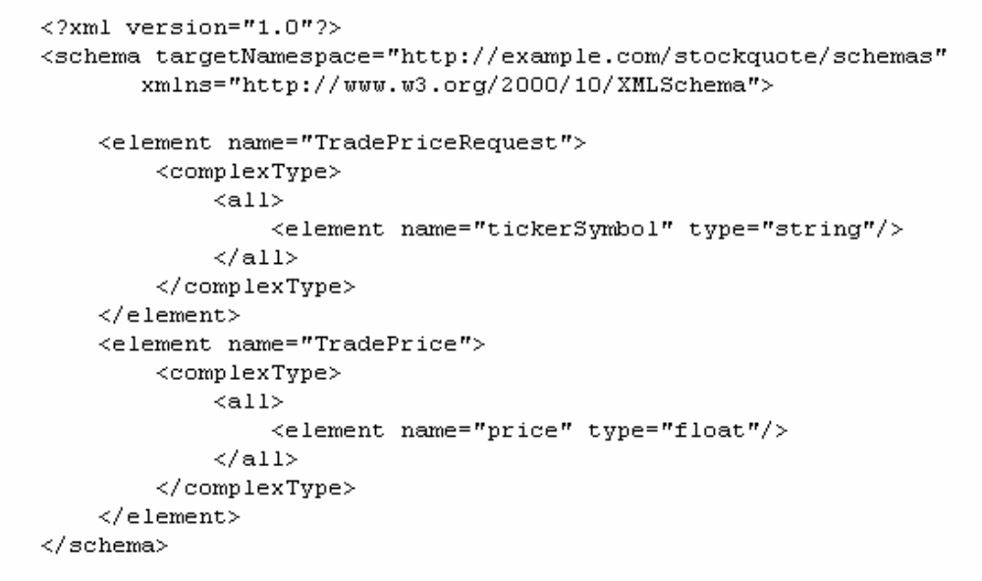
Example: Definition of Types
Notes:
This example shows the type definition of a WSDL specification. The types are defined using the XML Schema language. In this example two data types are defined as complex types. XML document (fragments) corresponding to these types will be used as parameters of the web service.

Slide 28
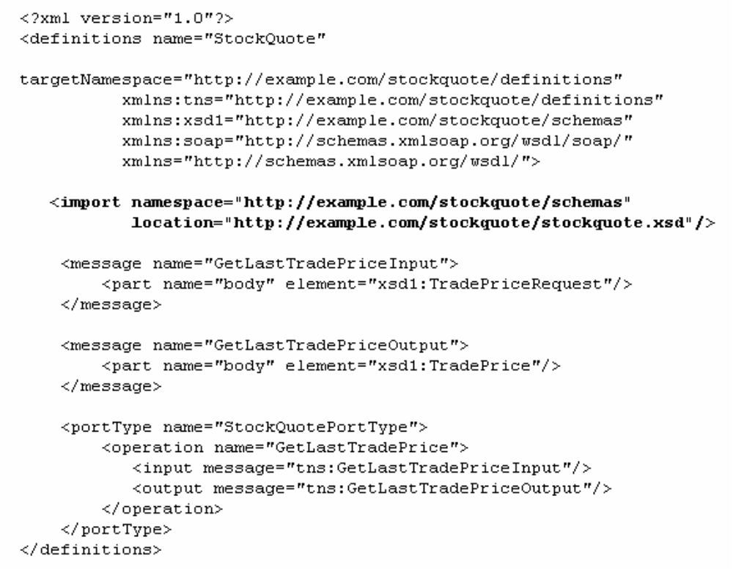
Example: Definition of Messages and PortType
Operation uses these messages
Notes:
This (fragment of a) WSDL specification refers to the type definitions before. Two messages are defined. The elements of a message allow to associate with the message one or more types that have been defined before in the type specification. Each part obtains an individual name and refers to a type.
A portType consists of one or more operations. Each operation requires two messages, one for the request (input) and one for the response. The messages are referred to by their names.
This example illustrates of how a WSDL definition can be decomposed into multiple documents: the type definitions from the previous slides are imported into the document using the import element (rather than directly inlined into the document, which also would be possible).
Note that all element and attribute names in this example are WSDL-specific, i.e. defined in the WSDL schema (which is given as an XML Schema)

Slide 29
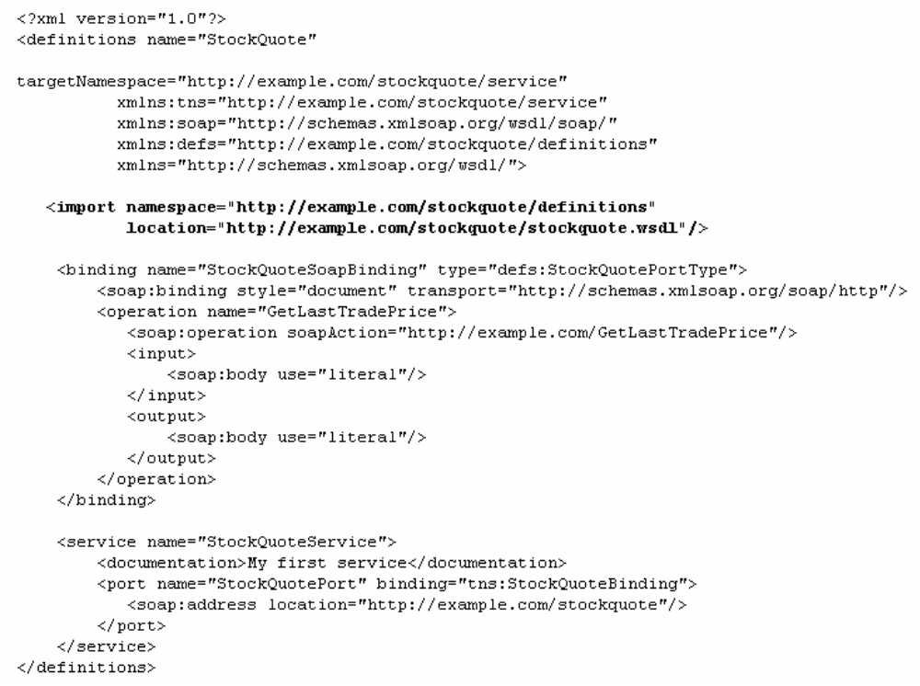
Example: Definition of Binding and Service
abstract operation GetLastTradePrice
of portType StockQuotePortType
implemented by these SOAP messages
Binding provided at this URI
Notes:
This WSDL specification completes the example. It refers to the specification on the previous slide. In the binding element it binds the port type GetLastTradePrice (which is the abstract service) to a concrete protocol, namely the SOAP protocol and thus defines the message format. In the service part the binding StockQuoteBinding (which is the abstract service definition together with a concrete transport protocol) is bound to a specific access point, given as URL, resulting in a port. This single port then constitutes the concrete service.
We do not detail the rules of how the binding between the abstract operation specification and its corresponding SOAP operations is established. Essentially using the syntax given above the input/output messages are mapped to SOAP request/response messages, and the SOAP message body is derived from the XML types associated with the messages in the abstract specification.

Slide 30
PortTypes
WSDL supports 4 message patterns that an endpoint (=service provider!) can support for an operation
  one-way: message is sent to service provider without expecting response
  request-response: request is sent to service provider expecting response
  solicit-response: provider sends a message and expects response
  notification: message is sent by service provider
Message patterns are distinguished by the use of input/output elements
  one way:
  <wsdl:definitions .... > <wsdl:portType .... > *
  <wsdl:operation name="nmtoken">
  <wsdl:input name="nmtoken"? message="qname"/>
  </wsdl:operation>
  </wsdl:portType >
  </wsdl:definitions>
  request/response:
  <wsdl:definitions .... >
  <wsdl:portType .... > *
  <wsdl:operation name="nmtoken" parameterOrder="nmtokens">
  <wsdl:input name="nmtoken"? message="qname"/>
  <wsdl:output name="nmtoken"? message="qname"/>
  <wsdl:fault name="nmtoken" message="qname"/>*
  </wsdl:operation
  </wsdl:portType >
  </wsdl:definitions>
Notes:
WSDL foresees four different types of operations, corresponding to different message exchange patterns. These patterns are considered as being the most frequently used in practice. These different patterns are distinguished in the specification of the operation by the different use of the input/output elements, as illustrated in the example.

Slide 31
4. UDDI – Universal Description Discovery and Integration
Standard for describing, publishing and finding web services
  Still evolving
  Use XML-based description files for services
Main components
  White pages: basic contact information about an organization
  Yellow pages: classification of organization based on industrial categorization
  Green pages: technical description of services offered by registered organizations
Access to UDDI Registry
  Standard UDDI API (accessible via SOAP)
  Web browser
Data Structures (XML)
  Business entity: general information + business services
  Business services: business level description + binding templates
  Binding templates: access point + tModel (service types)
  tModel: abstract definition of a web service
Notes:
The UDDI standard contains a number of different components for describing organizations, classifying them according to their general activities and allowing them to offer registered web services. UDDI also standardizes an access protocol for accessing a UDDI repository. First UDDI repositories are being made publicly or commercially available. These can also be accessed through Web interfaces.
A business is described in UDDI by an XML document. UDDI introduces an abstract model to specify web services, the tModel. This seems to be redundant with WSDL, but the purpose is different: UDDI foresees that different abstract service description mechanisms might be used in future. The tModel provides a common framework to include these into UDDI registry entries.

Slide 32
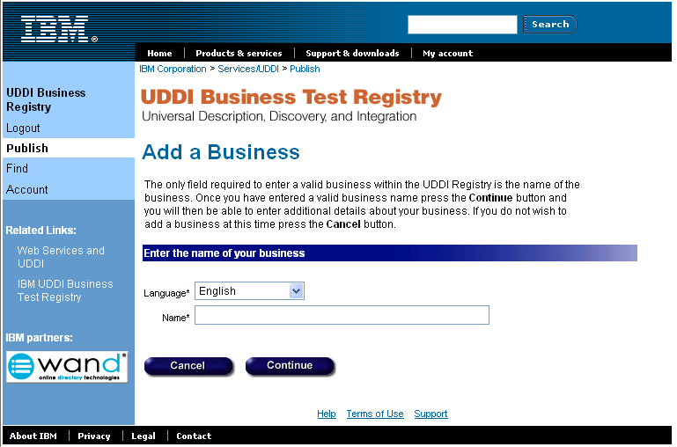
Registering a WSDL Service in UDDI
Register a business
Register the abstract service definition (tModel)
Register the service implementation definition (BusinessService)
Step 1: Register a business
(see demo at https://uddi.ibm.com/testregistry/registry.html/)
Notes:
Registration of service can be performed interactively at UDDI repositories. The registration of a business requires to capture basic information (like address, areas of activity).

Slide 33
Step 2: Registering an Abstract WSDL Service Definition
<?xml version="1.0">
<definitions name="StockQuote>
<types>
<schema>
definition of types
</schema>
</types>
<message name="GetTradePriceInput">
definition of a message
</message>
<portType name="StockQuotePortType">
<operation name="GetLastTradePrice">
definition of an operation ………
</operation>
</portType>
<binding name="StockQuoteSoapBinding">
definition of a binding ………
</binding>
<service name="StockQuoteService">
<port name="StockQuotePort">
definition of a port ………
</port>
</service>
</definitions>
<?xml version="1.0">
<tModel tModelKey="…">
<name>StockQuote</name>
…
<overviewDoc>
<overviewURL>
http//…
</overviewURL>
<categoryBag>
<keyedReference tmodelKey="…"
keyName="uddi-org:types"
keyValue="wsdlSpec">
</categoryBag>
</tModel>
service specified in WSDL
Notes:
Registering a service requires two steps: the registration of the abstract description and the registration of the service implementation-related information. The abstract definition is captured by the so-called tModel (another XML document type). It allows to provide the UDDI registry with the information on the service name (i.e. it's identification) and it's abstract specification, by referring to a WSDL document. The figure illustrates of how this association is syntactically represented in XML. UDDI provides for every service representation standard a model for registering the description, though WSDL is apparently the only relevant one at the given time.

Slide 34
Step 3: Registering a Service Implementation
<?xml version="1.0">
<definitions name="StockQuote>
<binding name="StockQuoteSoapBinding"
type="tns:StockQuotePortType">
<soap:binding style="document"
transport="http://schemas.xmlsoap.org/soap/http"/>
<operation name="GetLastTradePrice">
<soap:operation
soapAction=
"http://example.com/GetLastTradePrice"/>
<input>
<soap:body use="literal"/>
</input>
<output>
<soap:body use="literal"/>
</output>
</operation>
</binding>
<service name="StockQuoteService">
<documentation>My first service</documentation>
<port name="StockQuotePort"
binding="tns:StockQuoteBinding">
<soap:address
location="http://example.com/stockquote"/>
</port>
</service>
</definitions>
<?xml version="1.0">
<businessEntity businessKey="…">
…
<businessService serviceKey"…"
<name>StockQuote</name>
…
<bindingTemplates>
<bindingTemplate>
<accessPoint urlType="http">
http://example.com/stockquote
</accessPoint>
<tModelInstanceDetails>
…
<overviewDoc>
<overviewURL>
http://...
</overviewURL>
</overviewDoc>
…
</tModelInstanceDetails>
</bindingTemplate>
</bindingTemplates>
</businessService>
</businessEntity>
Notes:
Similarly, the concrete implementation of the service is registered (as part of the business service description) by referring to a WSDL document. For the registration of the implementation, in particular the physical address at which the service is accessed, which is found in the port definition in the WSDL specification, is included in the UDDI service description as shown in the example. Again the UDDI service description then refers for the details of the service binding to the WSDL document.

Slide 35
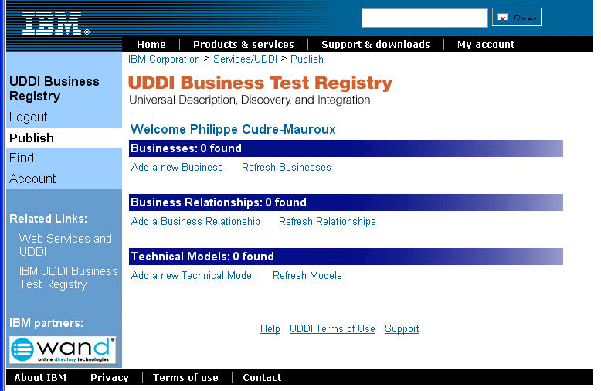
Interface Example (1)

Slide 36
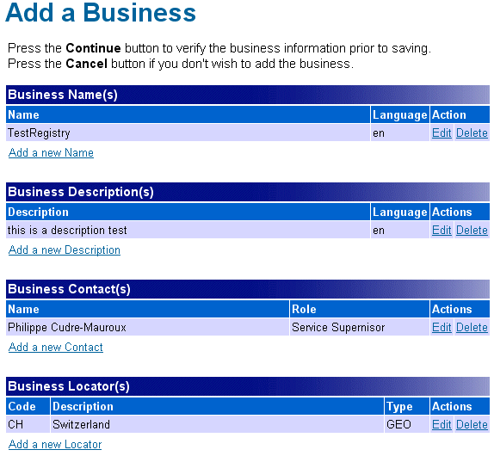
Interface Example (2)

Slide 37
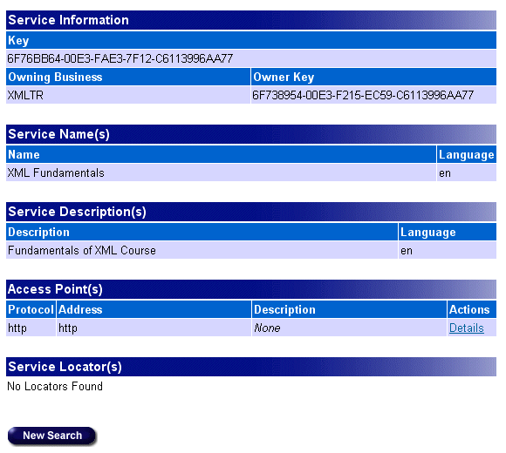
Interface Example (3)

Slide 38
References
Standard documents
  http://www.w3.org/2002/ws/
  http://www.w3.org/TR/2002/CR-soap12-part0-20021219/ (SOAP primer)
  http://www.w3.org/TR/SOAP/
  http://www.w3.org/TR/wsdl
  http://www.uddi.org

