Slide 1
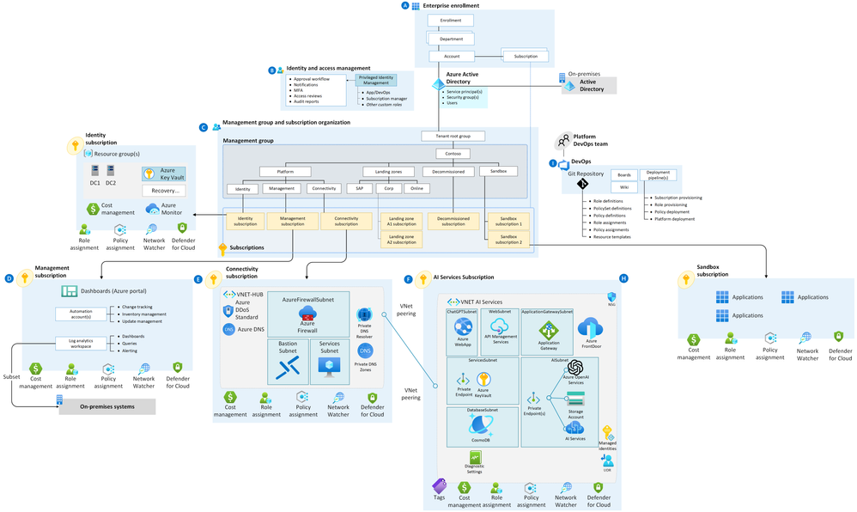

Slide 2
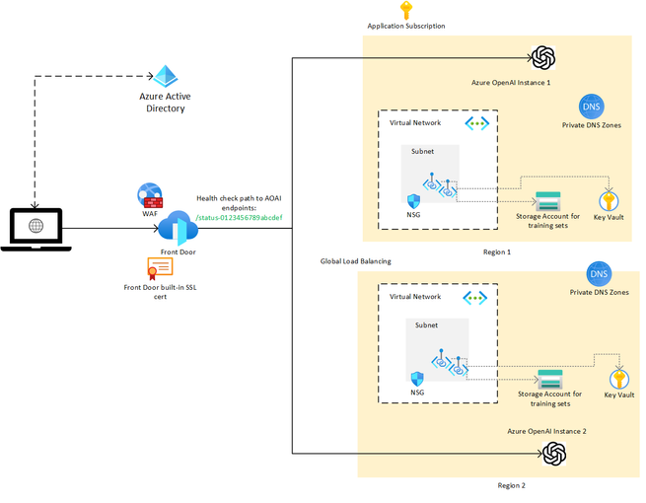
Notes:
With load balancing

Slide 3
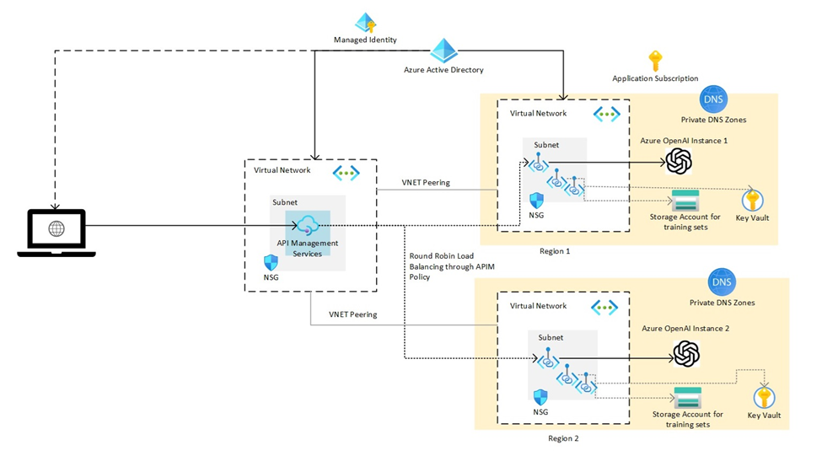
Notes:
With API Management

Slide 4
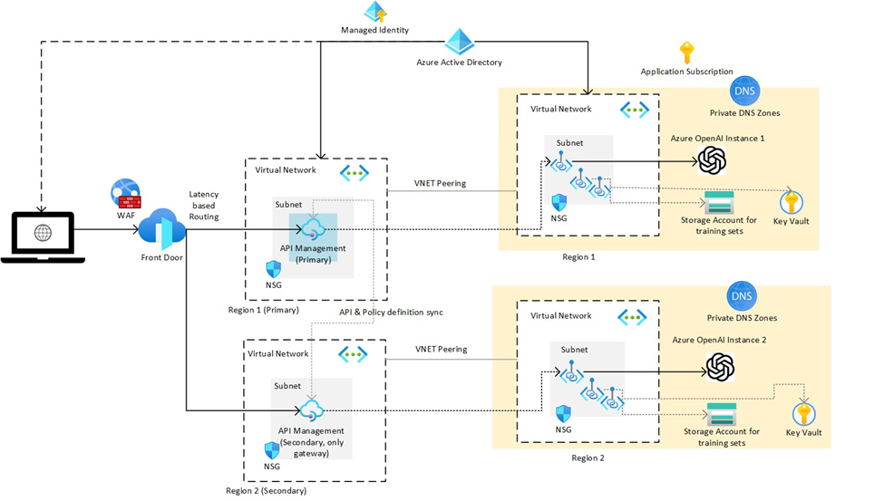
Notes:
Multi-region availability

Slide 5
Introduction to LangChain
LangChain is a framework designed to simplify the development of applications that rely on language models.
It provides tools and abstractions to build complex applications by chaining together different components in a flexible and modular way.

Slide 6
Key Concepts of LangChain
Chains: Combine multiple components to form a single pipeline.
Nodes: Individual components that perform specific tasks within a chain.
Flows: Directed graphs of nodes, representing complex workflows.

Slide 7
Simple Chains
Create a chain that takes a user's input, processes it with a language model, and performs a specific action based on the output.
Example: User query -> Language model -> Response generation.

Slide 8
Advanced Chains
Chains can include branching, looping, and conditional logic.
Example: User query -> Language model -> Conditional logic -> Different responses.

Slide 9
Nodes in LangChain
Nodes are modular components that perform specific tasks.
Examples: Input nodes, processing nodes, output nodes.

Slide 10
Flows in LangChain
Flows are directed graphs of nodes, representing complex workflows.
Flows can be nested and reused across different applications.

Slide 11
Modularity in LangChain
Easily combine different components to build complex applications.
Encourages reuse and modular design.

Slide 12
Flexibility in LangChain
Build complex workflows with minimal effort.
Support for various language models and processing tasks.

Slide 13
Scalability in LangChain
Handle large-scale language model applications.
Efficient processing and resource management.

Slide 14
Reference Architecture
Overview of a typical LangChain architecture.
Components: Input interfaces, processing nodes, output interfaces, storage, and orchestration.

Slide 15
Reference Architecture Diagram
Diagram illustrating the reference architecture.
Shows the flow of data and interactions between components.

Slide 16
Input Interfaces
Components that accept user inputs.
Examples: Web forms, chat interfaces, APIs.

Slide 17
Processing Nodes
Components that process data using language models.
Examples: Text analysis, sentiment analysis, summarization.

Slide 18
Output Interfaces
Components that present results to users.
Examples: Dashboards, reports, notifications.

Slide 19
Storage
Components for storing data and intermediate results.
Examples: Databases, data lakes, file storage.

Slide 20
Orchestration
Components that manage the workflow and execution of nodes.
Examples: Workflow engines, schedulers, message brokers.

Slide 21
Deployment Considerations
Scalability: Ensuring the system can handle large volumes of data and users.
Reliability: Ensuring high availability and fault tolerance.

Slide 22
Security Considerations
Data privacy: Ensuring user data is protected and processed securely.
Access control: Managing permissions and access to different components.

Slide 23
Performance Optimization
Strategies for optimizing the performance of LangChain applications.
Examples: Caching, parallel processing, efficient data handling.

Slide 24
Monitoring and Logging
Monitoring: Tracking the performance and health of the system.
Logging: Capturing detailed logs for debugging and analysis.

Slide 25
Integration with Other Systems
Integrating LangChain applications with other enterprise systems.
Examples: CRM, ERP, data warehouses.

Slide 26
Case Study: Chatbot Development
Building a conversational agent using LangChain.
Steps: Input handling, processing with language model, response generation.

Slide 27
Case Study: Text Analysis
Performing sentiment analysis on customer feedback.
Steps: Input handling, text processing, sentiment analysis, reporting.

Slide 28
Case Study: Automation
Automating business processes with LangChain.
Steps: Input handling, process automation, output generation.

Slide 29
Best Practices for Architects
Designing modular and reusable components.
Ensuring scalability and performance.

Slide 30
Getting Started with LangChain
Installation: pip install langchain
Basic Usage: Import and create chains to process language model outputs.
Examples: Explore LangChain documentation for sample projects.

Slide 31
Community and Support
Join the LangChain community for support and collaboration.
Resources: Documentation, forums, tutorials.

Slide 32
Future of LangChain
Upcoming features and enhancements.
Expanding the ecosystem and community.

Slide 33
Conclusion
LangChain simplifies the development of language model applications.
Provides modularity, flexibility, and scalability for a wide range of use cases.
Start exploring LangChain today to enhance your language model projects.

